Slide 1
Swappo
Filip Turk
Kristjan Volk

Slide 2
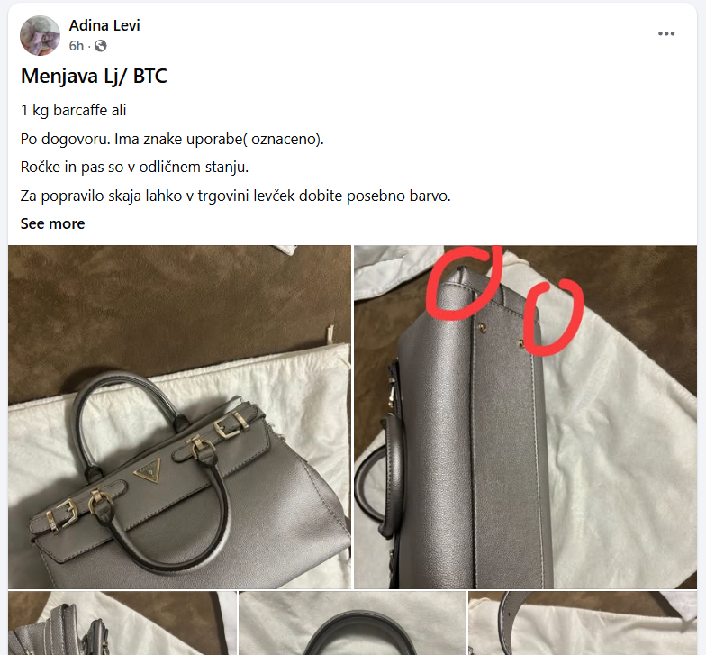
Ideja
Izmenjava predmetov
Facebook skupina kosovci
Podoben pristop kot vinted/tinder

Slide 3
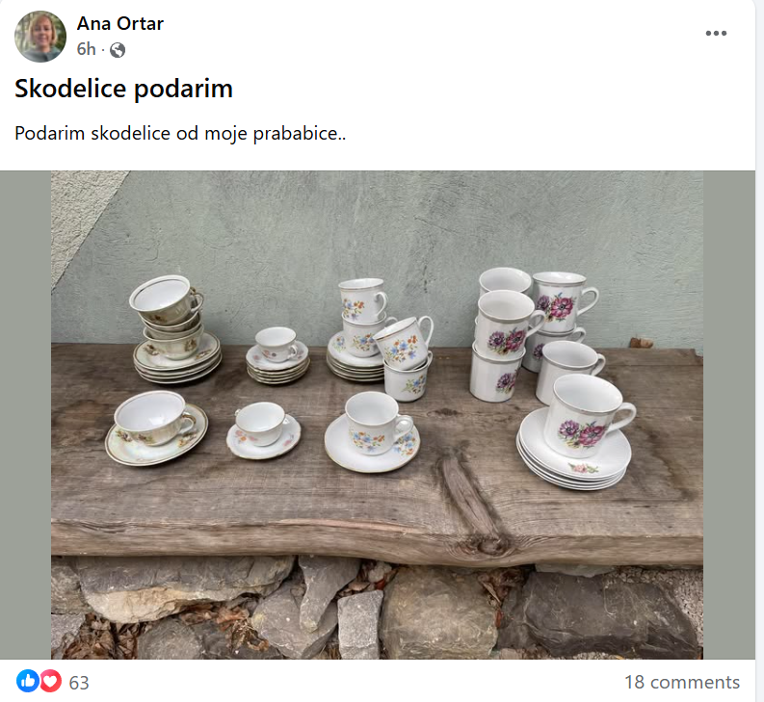

Slide 4


Slide 5
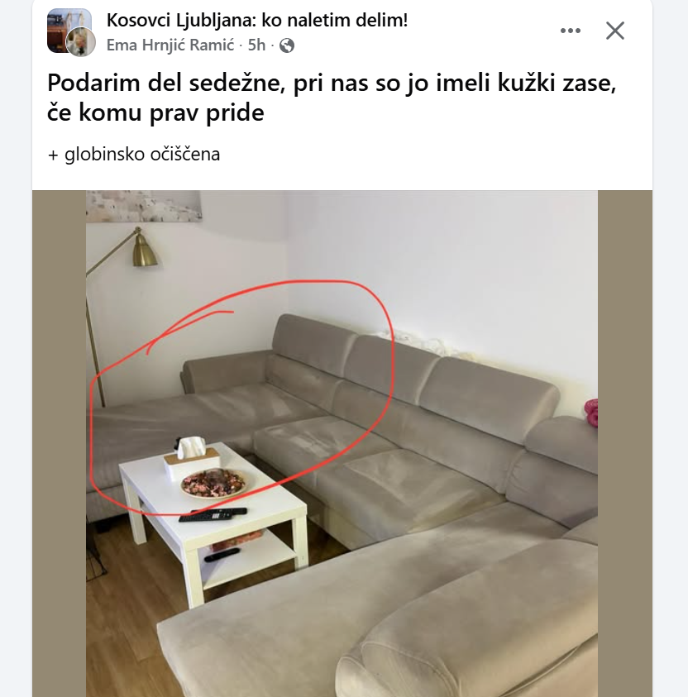

Slide 6
Architecture
Auth Service - JWT-based authentication & user management
Catalog Service - Item listings with location-based smart feed
Matchmaking Service - Trade offers and swap matching
Chat Service - Real-time messaging between users
Notifications Service - User notifications system

Slide 7
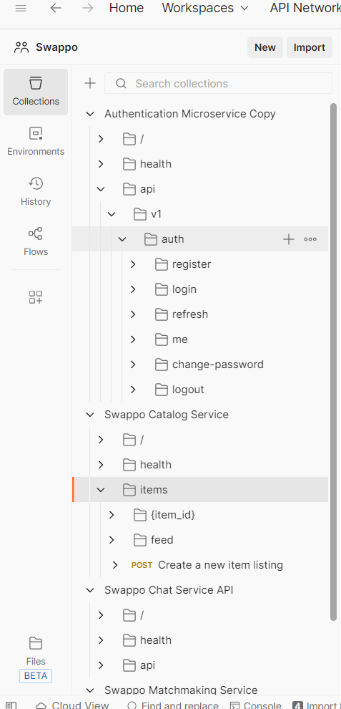
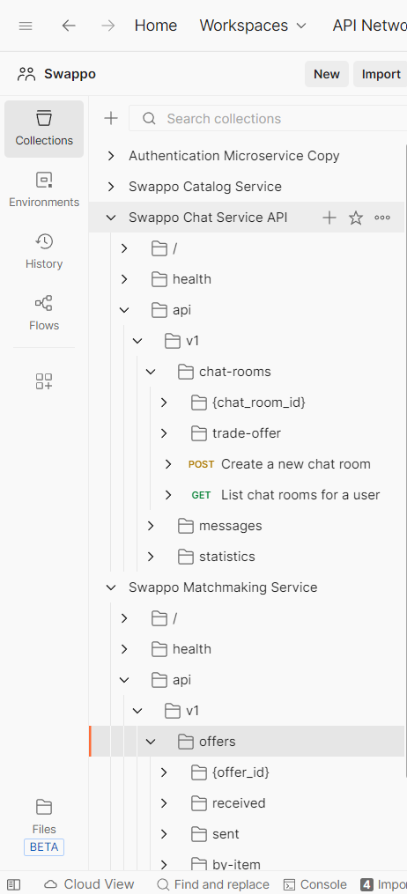

Slide 8
Technology
5 Independent Backend Services
FastAPI + PostgreSQL
Docker Compose - for local development
Docker kuberenetes cluster – for production (local for now)

Slide 9
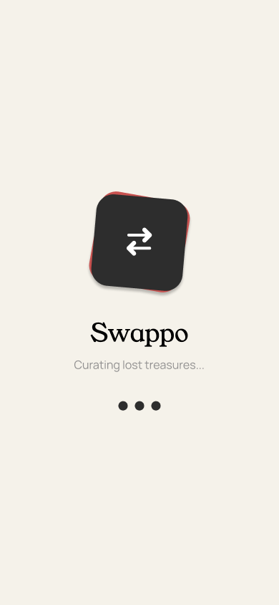
FRONTEND
React Native/Expo app
Tailwind
Figma design

Slide 10
https://www.figma.com/proto/IoHvJDOKj8Rm5ykUbsik5v/Swappo-2025-design?page-id=65%3A715&node-id=65-717&viewport=360%2C551%2C0.17&t=f3EHmpoiuALoSWhc-1&scaling=scale-down&content-scaling=fixed&starting-point-node-id=68%3A913

Slide 11
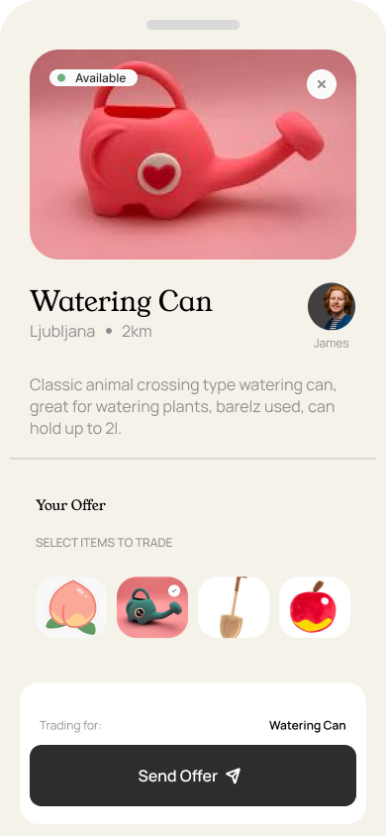
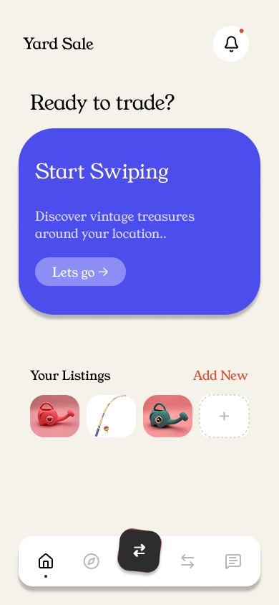
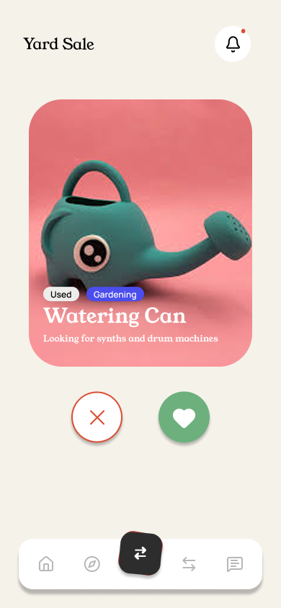


Slide 12
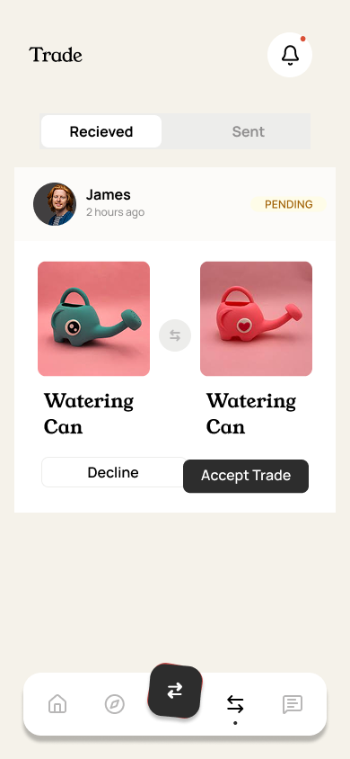
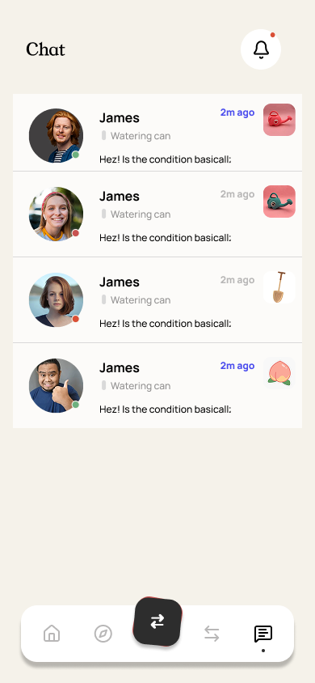
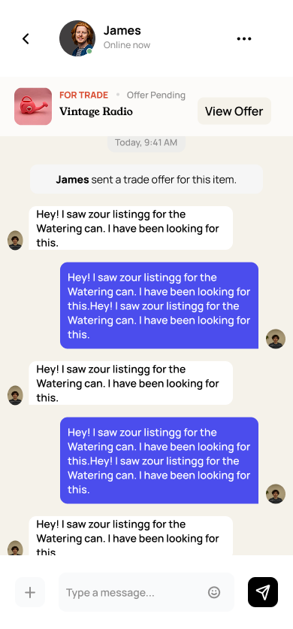

Slide 13
Development Progress
Full microservices architecture with isolated databases
RESTful APIs with OpenAPI documentation (/docs for each service)
Docker containerization for all services
Kubernetes deployment configuration
Frontend screens: Login, Register, Swipe, Explore, Chat, Matches, Items, Notifications
Authentication flow with secure token storage

Slide 14
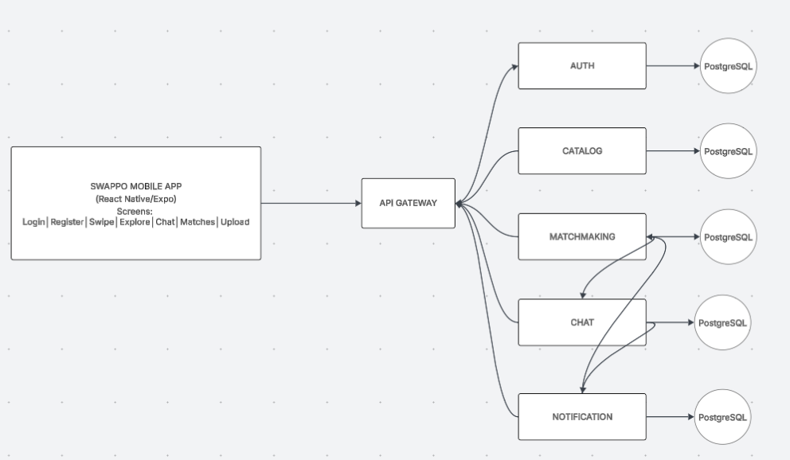

Slide 15
Current Focus
CI/CD
Matchmaking logic/bartering 1→1 / x→y
Frontend-backend integration
Real-time chat implementation
Notification system completion
Image upload infrastructure - Migrate to Azure Blob Storage or AWS S3

Slide 16
Github
https://github.com/orgs/Swapppo/repositories

