Slide 1

A Internship Project
On
Book Shop
Represented By,
Swapnil Jadhav

Slide 2
Introduction
This is my portfolio project which demonstrates my abilities in building a completely based on JDBC i.e Java Database Connectivity. Using Mysql and Java Eclipse ide i Create Database Connection and Create Database i.e the Namely “ Book-Shop” In these Database User stores Many No of Books information like Book name its Edition and its Price He Display all Data. And Also User Make Many Operations On it He can Save Book Data , Update Book Data , Delete Book Data and Clear Book Data .

Slide 3
JDBC What is JDBC ? JDBC stands for Java Database Connectivity. JDBC is a Java API to connect and execute the query with the database. It is a part of JavaSE (Java Standard Edition). JDBC API uses JDBC drivers to connect with the database. We can use JDBC API to access tabular data stored in any relational database. By the help of JDBC API, we can save, update, delete and fetch data from the database. What is API ? API (Application programming interface) is a document that contains a description of all the features of a product or software. It represents classes and interfaces that software programs can follow to communicate with each other. An API can be created for applications, libraries, operating systems, etc. There are 4 types of Driver Softwares: Type1 Driver : JDBC-ODBC Bridge Type2 Driver : Native API Driver Type3 Driver : Network Protocol Driver Type4 Driver : Pure Java Driver/ Thin Driver

Slide 4
When we are interacting with the database we must following the following steps:
1. load the driver
mysql 5.1 → Class.forName("com.mysql.jdbc.Driver");//adding the jar
2. establish connection
con = DriverManager.getConnection(url, user, password);
url = "jdbc:mysql://localhost:3306/bookshopcrud";
jdbc → API
mysql → database
localhost → Network
3306 → Port for mysql
bookshopcrud → database name
name = root
pwd = system
3. prepare the query
4. run the query and get the results
5. close all the open connections

Slide 5
Software Tools
Java Eclipse
MySQL
Windows Builder
MySQL Connector jar
rs2xml.jar
Xampp

Slide 6
Steps For Create the Project :
Steps For Create the Project :
We Create New Java Project File and Give name as JavaCrud then Creat class name JavaCrud.java .
Download Windows builder Using Eclipse Marketplace and then Going to Design Application Windows For Our project file that is steps , Firstly Right Click on project → New → Others → Windows Builder → Swing Designer → Application Window . This Application Window Shows below pic then

Slide 7
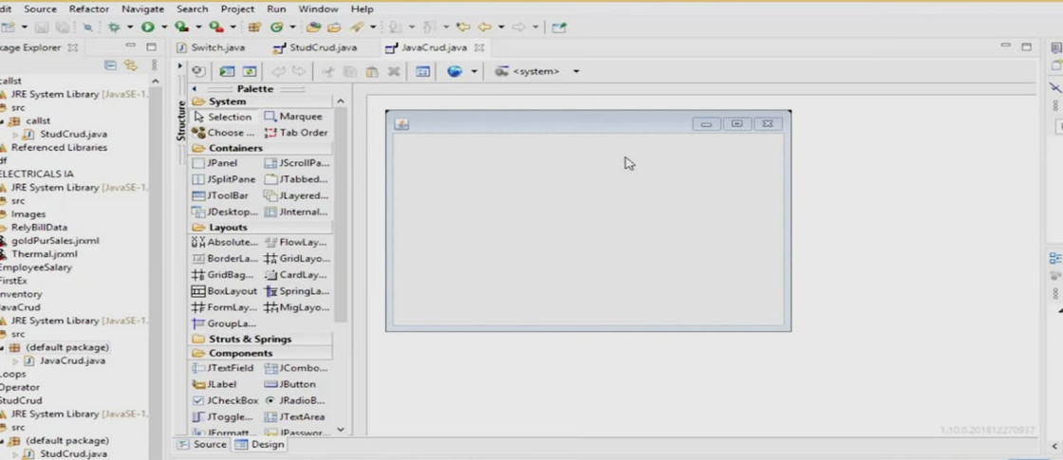

Slide 8
Design Application Window :-
From the Using Palette i.e Left Side Palette from application window There are many tools We want to used in our project Design that are Section wise i.e System, Containers, Layouts, Struct & Springs , Components etc.
From The Palette Firstly Going to Components , Select and Drag JLabel as New Label for our Application window and Going to properties Change the Name Or Rename as a “Book Shop” and Using Properties also change Font and Bold it.
Then , We Need to Design Registeration Panel For that Select and Drag JPanel from Containers Going to properties of the panel then select border then Select TitledBorder Give Title as Registeration. In Registeration Panel Using Jlabel Create Three Labels Rename it as Book Name , Edition , Price then Drag JTextField For all of these in front of each labels and Design Registeration Panel. And Also Rename JTextField name as txtbname , txtedition and txtprice .
After that We need to Create Buttons Save , Exit , Clear is in below the Registeration Panel For that Select and Drag JButton From Components Rename it From Properties as Save , Exit and Clear

Slide 9
Design Search Panel Select and Drag JPanel from Containers Going to properties of the panel then select border then Select TitledBorder Give Title as Search.
After that Select and Design Scroll Pane in Application Windows i.e Right Side of Registeration Panel Go to pallete Select and DragJScrollPane From Containers.
Finally Design Update and Delete Buttons Select and Drag JButton From Components Rename it From Properties as Update and Delete .

Slide 10
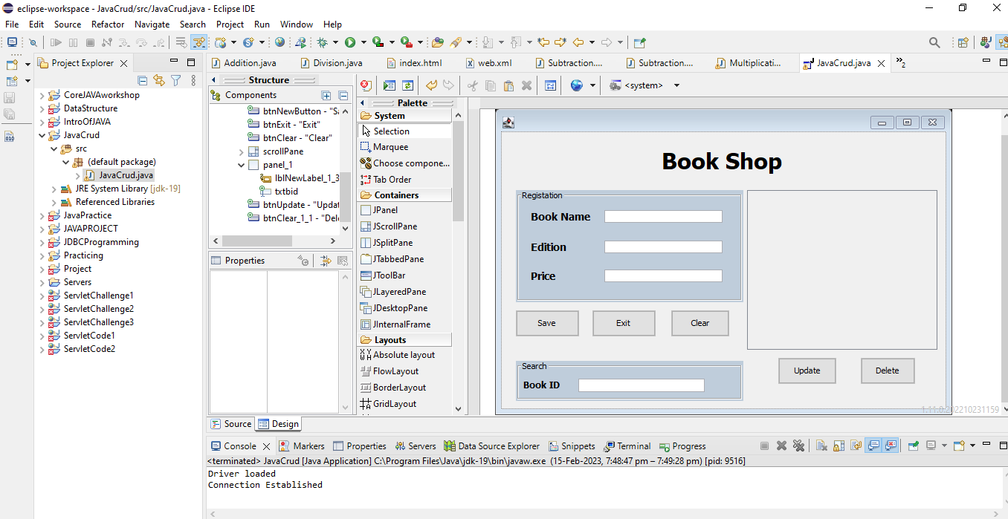
Application Windows Design

Slide 11
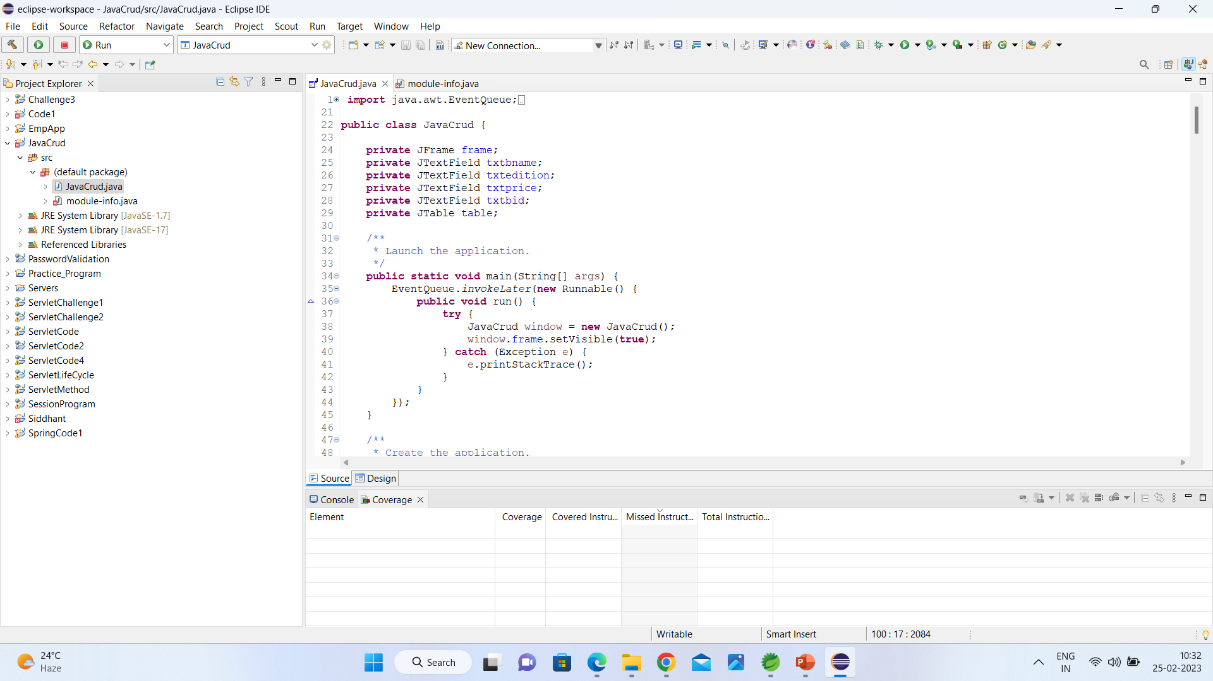
JDBC Source Code

Slide 12
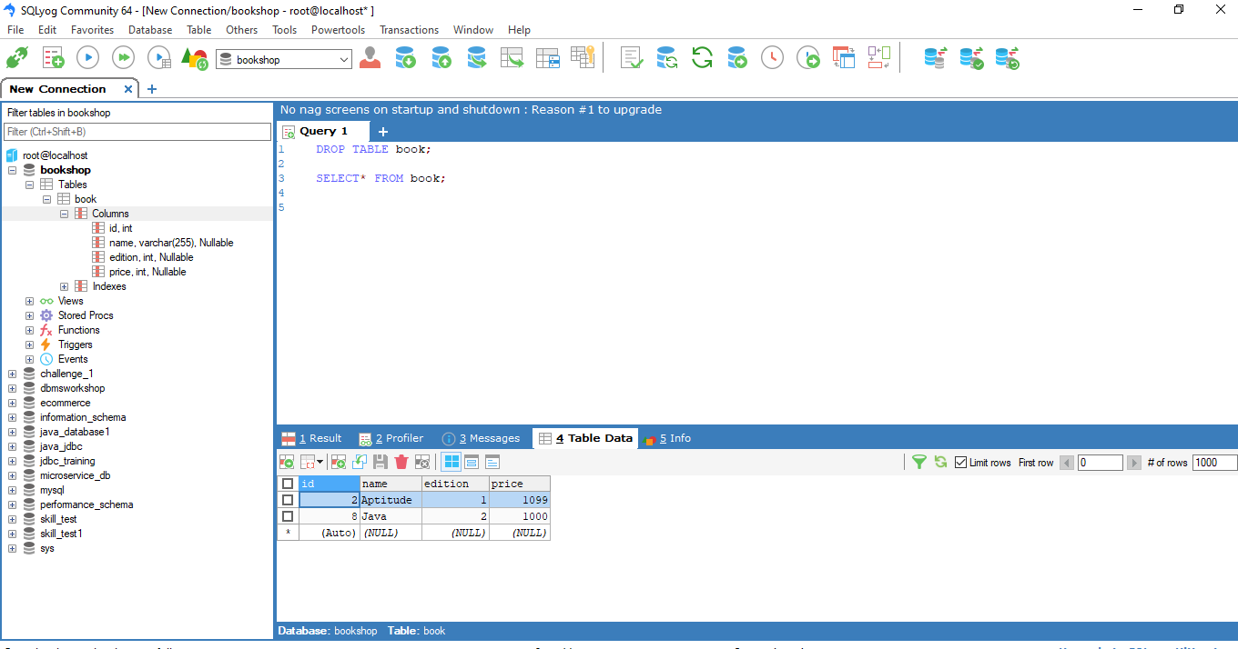
MySQL Window

Slide 13
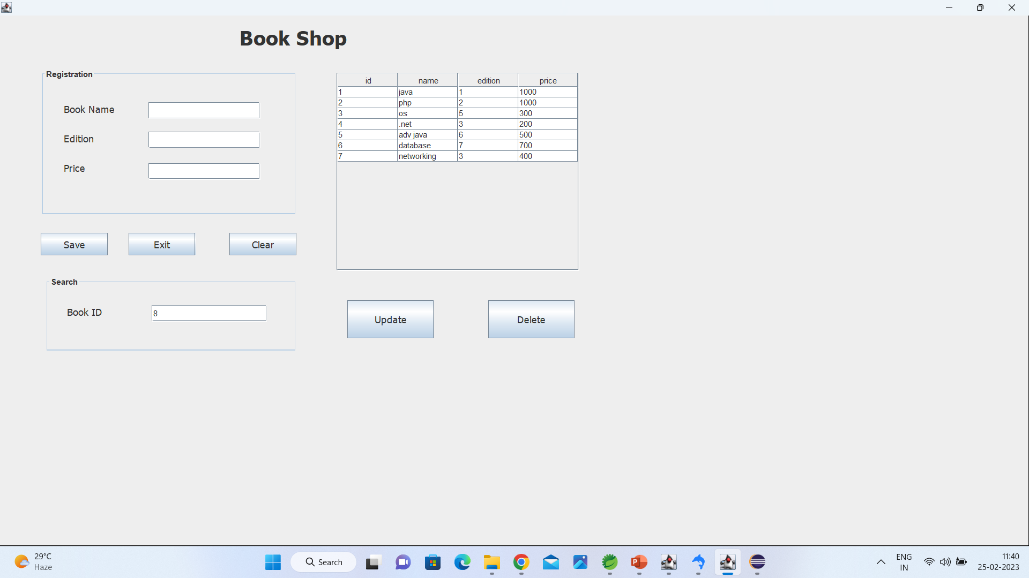
Output Windows

Slide 14
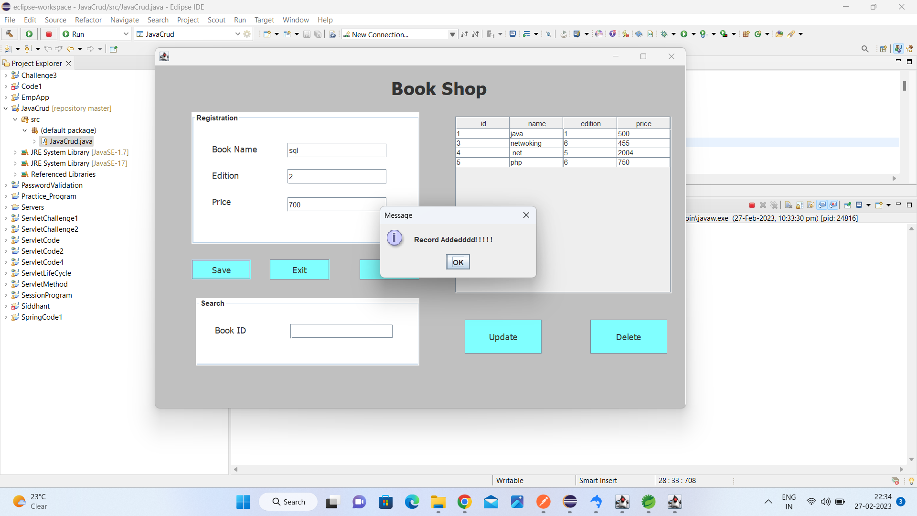
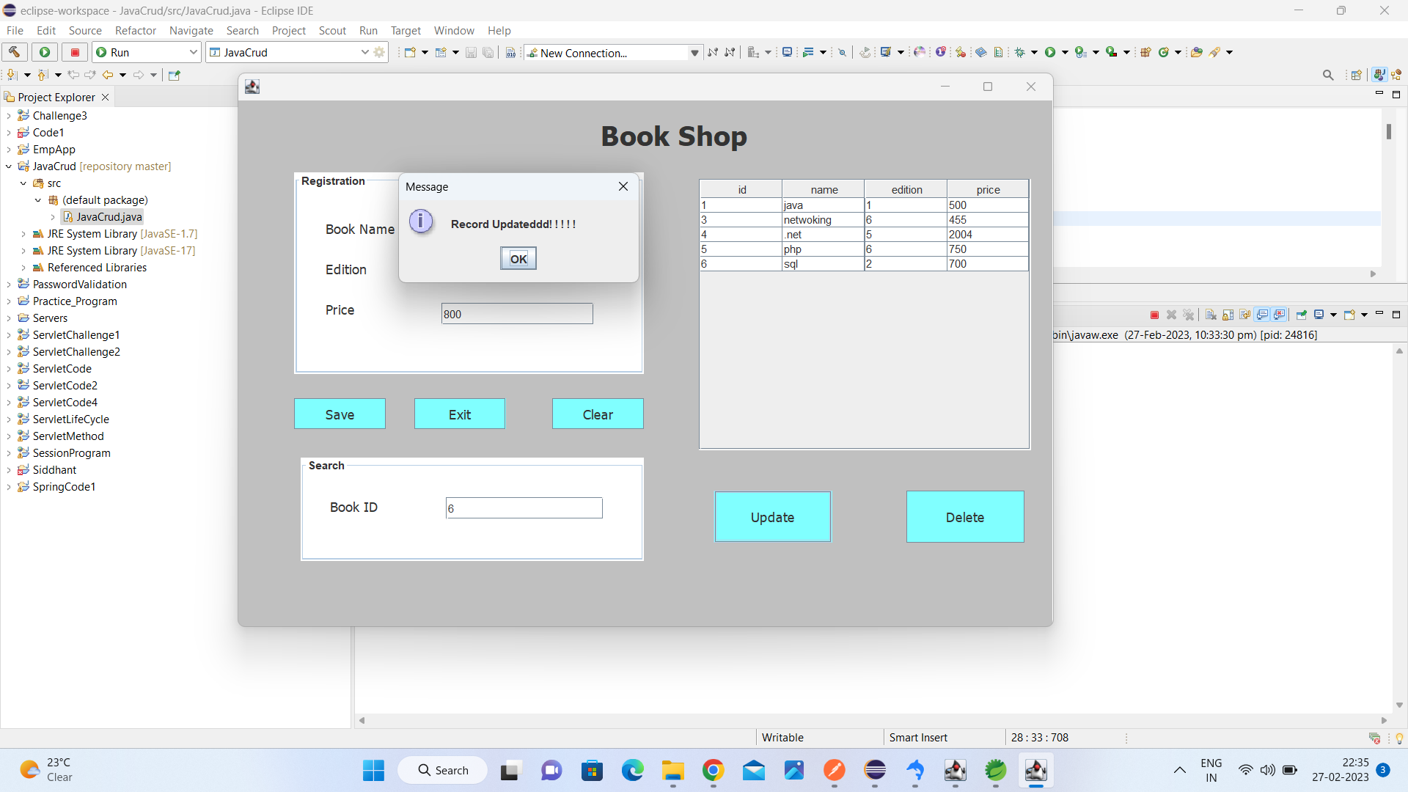

JDBC Operations
Record Added
Record Updated
Record Deleted

Slide 15
Thank you..

