Slide 1
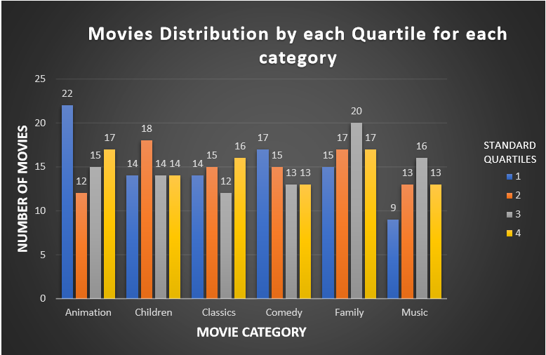
If we sort all movies according to the rental duration in ascending order of duration?How can we compare the number of movies in each quartile for each category of family movies?
This graph shows the distribution of movies by each quartile for each category of family movies when within the database all movies were sorted according to the rental duration in ascending order of duration.

Slide 2
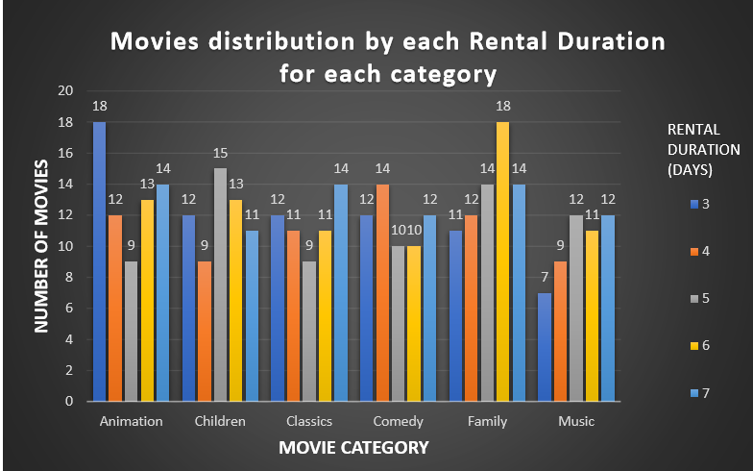
How the length of rental duration of specifically ‘Family’ category movies compares to the duration that all family movies are rented for?
<visualization>
The plot here shows the distribution of movies by each rental duration for each category of the family movies

Slide 3
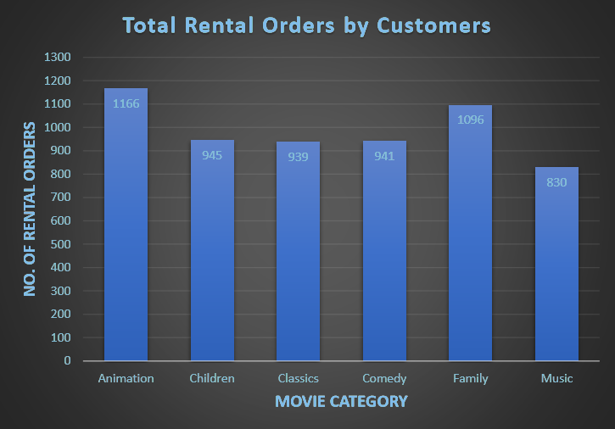
What is the trend in the number of total rental orders till now for each category of family movies ?
This graph shows the rental orders for each category of family movies till now.

Slide 4
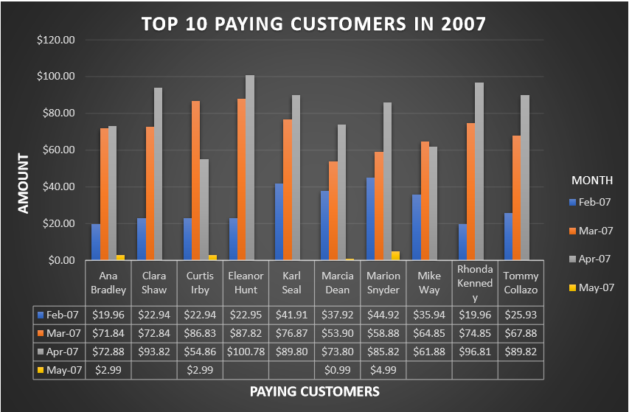
What was the amount of the monthly payments they made in 2007 and Who were the top 10 paying customers ?
<visualization>
This graph is showing top 10 paying customers in 2007 and the amount of the monthly payments which they made in 2007.

