Slide 1


Detecting Bias in Indian News Articles Using Natural Language Processing
Team Members :
Dyuti Kole (2023CSB105)
Abhirup Saha (2023CSB108)
Swarnava Banerjee (2023CSB109)
Truth Tuner - 2025
Team Name: 3rr0r404_n07F0und

Slide 2
Introduction
Bias in this context refers to the tendency of some news content to favor one political ideology over another.
It is typically categorized as left-leaning, right-leaning or neutral.
Objective: To automate the detection of bias in Indian news. Classify news articles into political bias categories:
Left-leaning
Centrist
Right-leaning
Need: Biased news can influence readers subconsciously, skewing their perception of reality.
So it is an important area of study in today’s context.
Combat misinformation, media polarization, and understand content framing.

Slide 3
Dataset Collection
01
02
03
04
05
Source of dataset
Article collection from GoogleNews API which in turn lists articles from multiple sources around the world which was refined to contain articles of only Indian publishers e.g Times of India, India Today, Hindustan Times, etc.
Requirements
pygooglenews (GoogleNews), pandas, re, requests, bs4 (BeautifulSoup), Selenium, webdriver (headless browsing), Proxy service, json, time, pandas, random, concurrent (for Threading or, Parallel Processing), os
BeautifulSoup (parses HTML), Selenium (automates scrape process, collect JS content in <script> tags), Parallel Processing or Threading (concurrent connections for faster article collection), Proxies (proxy rotation) & Random Timeouts & User Agents (Header change helps in avoiding 403 error, bans), Headless Browsing (using webdriver, hides GUI of loaded article websites, does process in background)
Methods/Modules used
Dataset attributes
title, published, source, news_url, final_url, content
Initial article collection using google news = 12613
Articles after keeping only selected Indian sources = 3886
After adding final_url in df.csv = 2702
After saving content into final_df.csv = 1576 (Final Dataset Size)
Dataset size

Slide 4
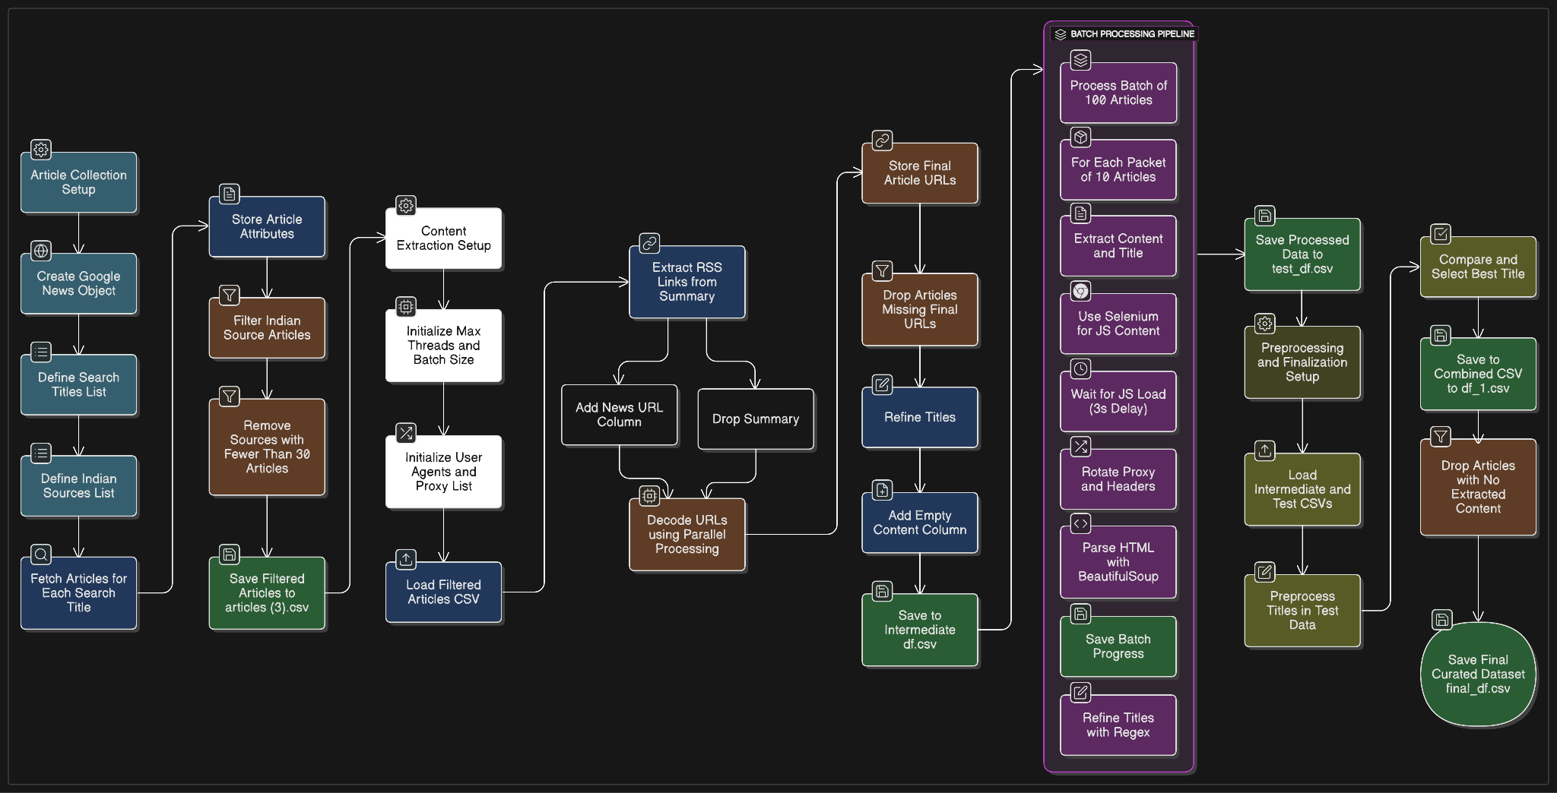
Dataset Collection Methodology

Slide 5
Model's Design
Main model for classification: AutoModelForSequenceClassification from Hugging Face
Parameters:
num_labels(number of labels) = 3
id2label & label2id used for interpretability
id2label = { 0: Left-leaning, 1: Centrist, 2: Right-leaning}
Output: Softmax over 3 classes
Base Model Used: google/bigbird-roberta-base
Why is BigBird-RoBERTa chosen?
Handles long documents (4096 tokens)
Efficient use of memory via sparse attention
Robust language understanding (pretrained)

Slide 6
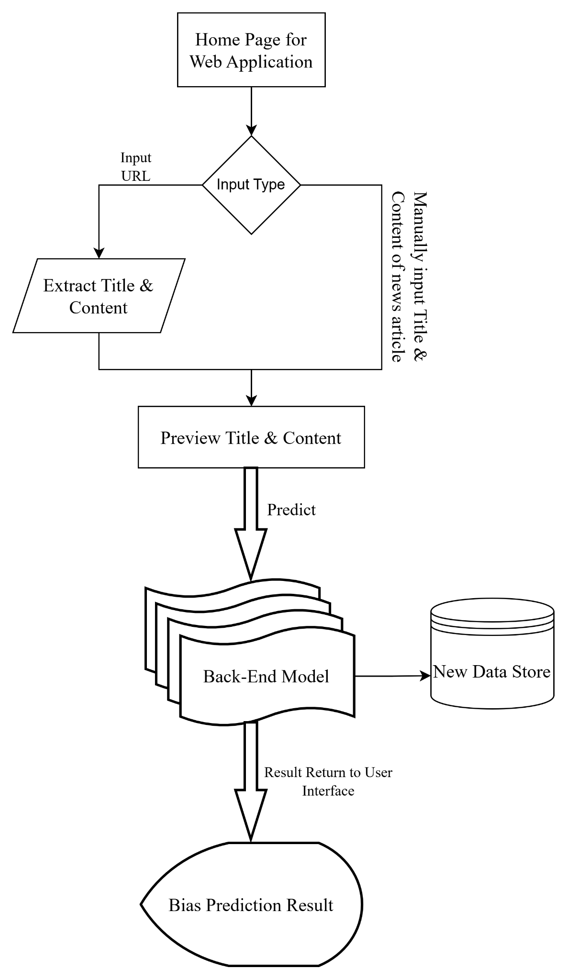
Overall Workflow

Slide 7
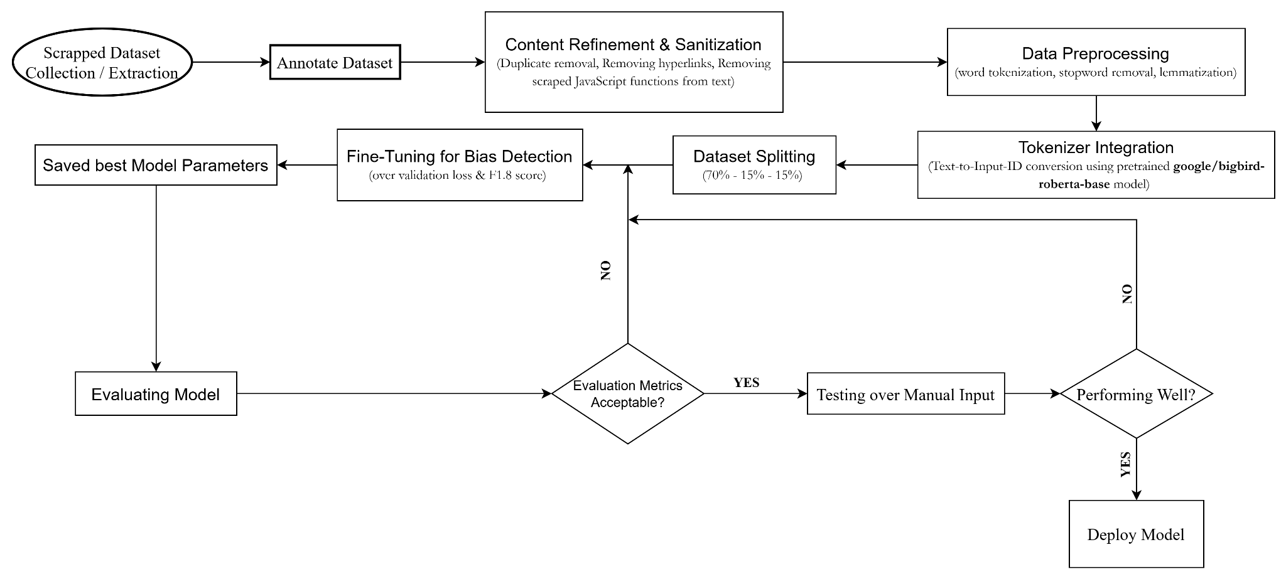
Model's Architecture

Slide 8
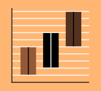
Preprocessing steps
Removed Duplicate Entries
Trimmed whitespaces
Final dataset size: 1329 [Right-leaning: 888, Left-leaning: 412, Centrist: 29]
Sanitized the data by removing HTML links, tags, Promotional content, Disclaimers and embedded JavaScript functions collected along with content during scraping
Using Natural Language Toolkit(nltk) word tokenization, stopword removal and POS-wise lemmatization is done
label2id = {"Left-leaning": 0, "Centrist": 1, "Right-leaning": 2} map and it’s vice-versa map both are used.

Slide 9
Preprocessing Steps
Label Encoding
Converted bias categories to numerical IDs: Left-leaning: 0, Centrist: 1, Right-leaning: 2
Data Splitting
Used train_test_split from sklearn with stratification to maintain class balance with 70% Training, 15% Validation and 15% Test
Tokenization:
Combined processed_title and processed_content
Used Hugging Face AutoTokenizer for:
Tokenization
Padding
Truncation (to max 4096 tokens)
Dataset Conversion:
Converted pandas DataFrame → HuggingFace Dataset
Removed raw text columns after tokenization
Set format to "torch" for use with PyTorch models.

Slide 10
Choice of Algorithms
BigBird-RoBERTa is designed to handle long documents (up to 4096 tokens)
Selecting RoBERTa, a strong, performance-tuned variant of BERT. It employs dynamic masking and longer pretraining to enhance downstream performance, particularly text classification.
BigBird uses Sparse Attention = Faster + Scalable
Pretrained knowledge transfer and fine-tuning on domain-specific data makes it better.
The model has adaptive classification heads, so it can scale up to 3-class (Left, Center, Right) tasks very easily without altering the architecture.
Unlike LSTM-based or TF-IDF + SVM approaches, BigBird-RoBERTa does not require human feature engineering and can learn non-local dependencies, which are the key to bias detection between paragraphs.

Slide 11
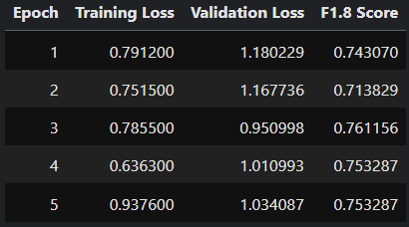
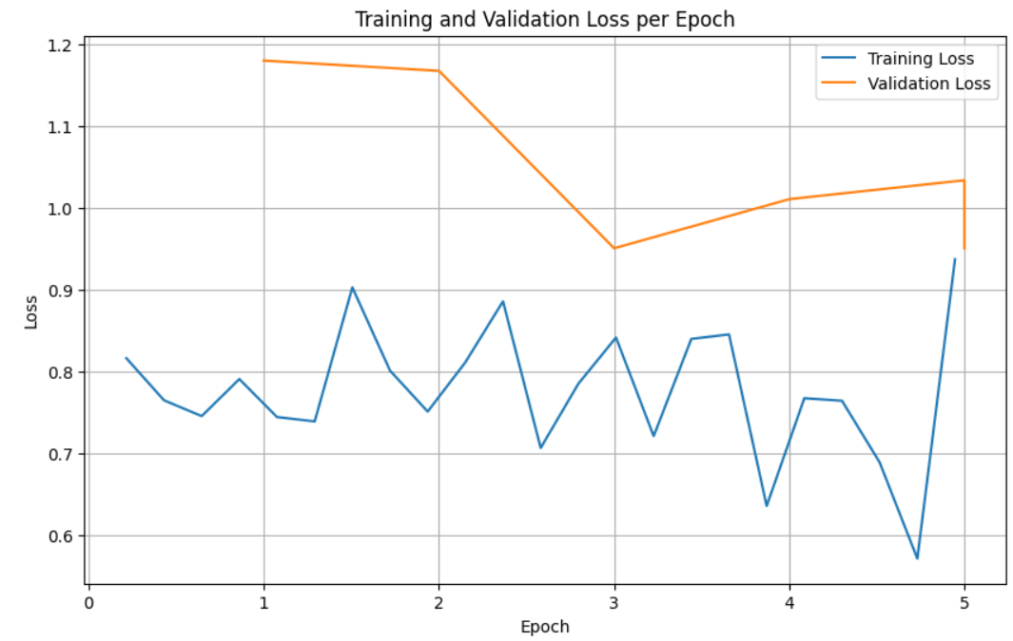
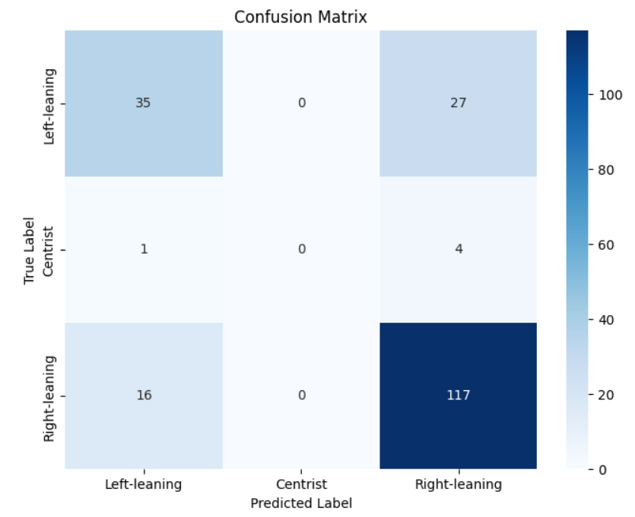
Evaluation Results
Weighted F-beta Score:
Tunable emphasis on precision and recall
Beta value: 1.8 [given imbalanced data, we slightly prioritize recall]
Training Loss vs. Epoch
Validation Loss vs. Epoch
Confusion Matrix

Slide 12
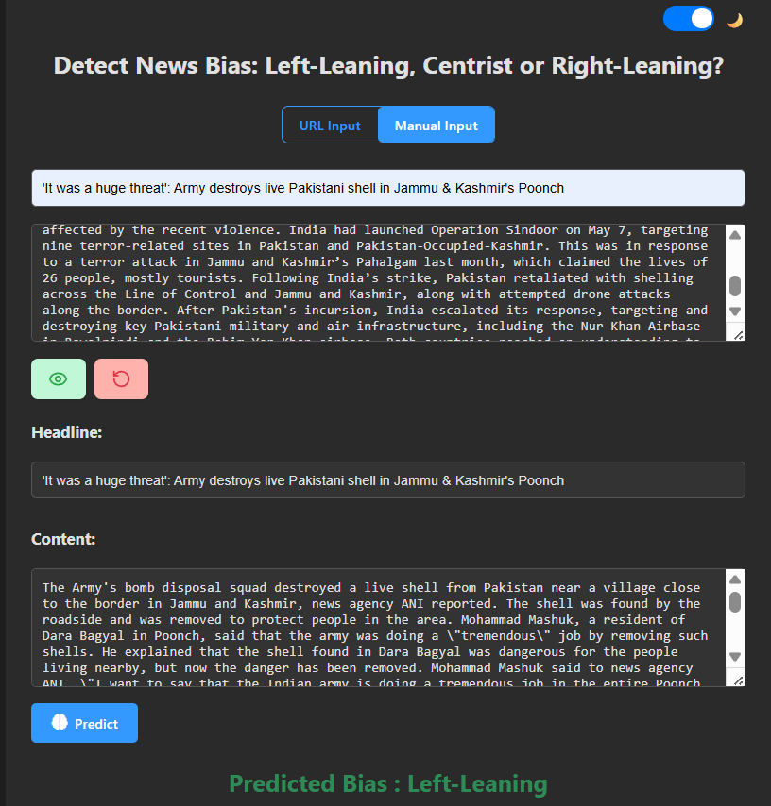
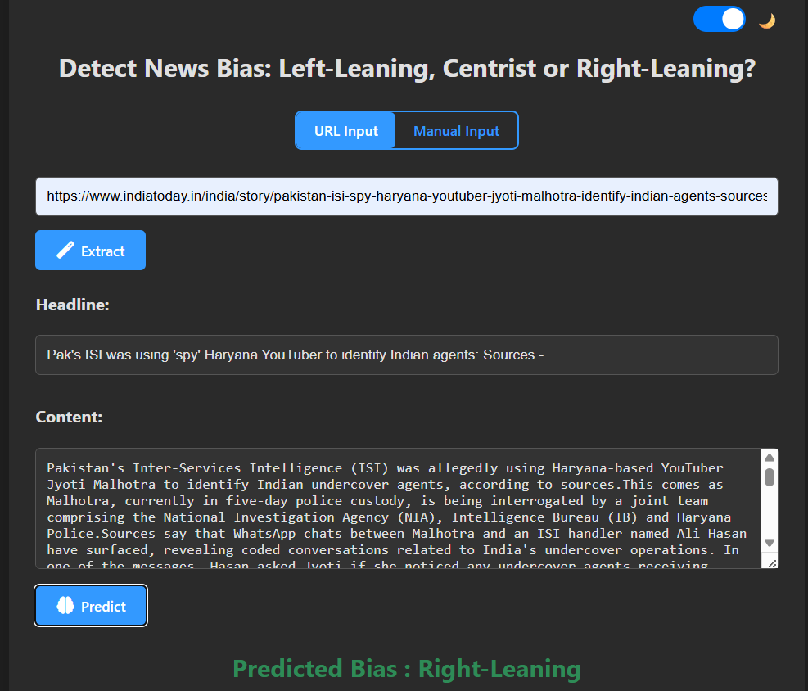
Model Deployment
Created an interface that takes inputs in either of the two formats:
URL
Headline and Content of the news
Upon clicking on the predict button, the user gets the desired result based on our model.
Languages: Python, JavaScript, HTML, CSS
Frameworks/Libraries: FastAPI, PyTorch, Transformers, Selenium, BeautifulSoup, NLTK, Pydantic
Tools: Uvicorn (Server for FastAPI)

Slide 13
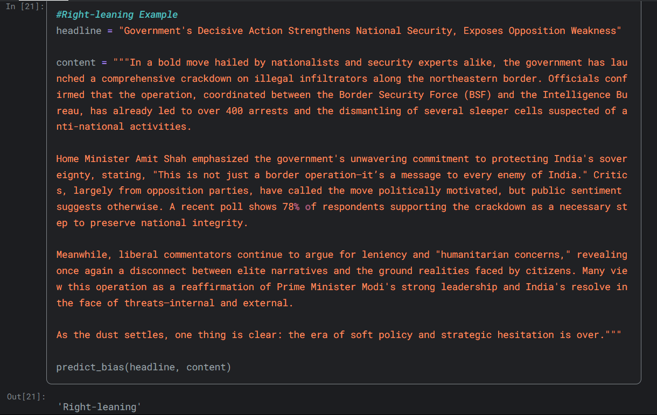
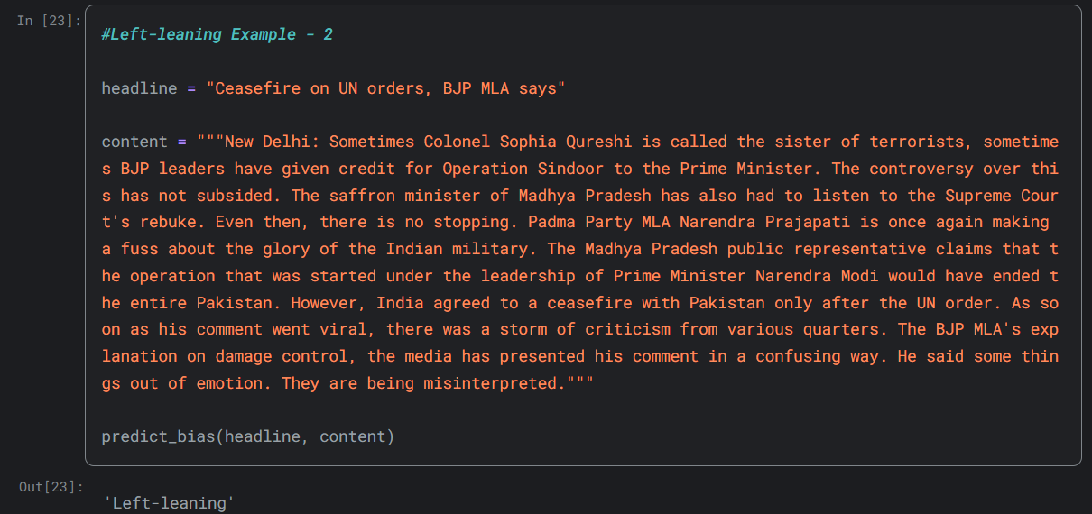
Test on some inputs

Slide 14
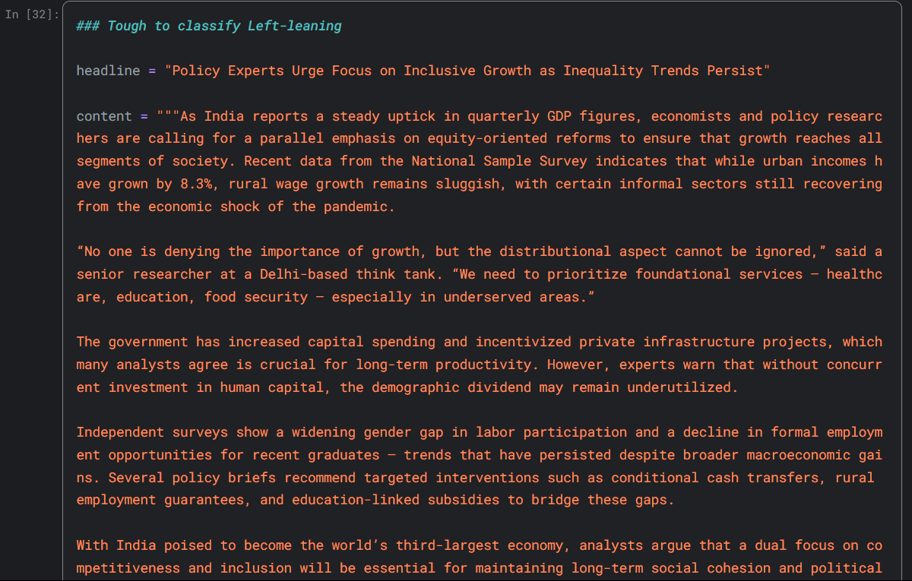
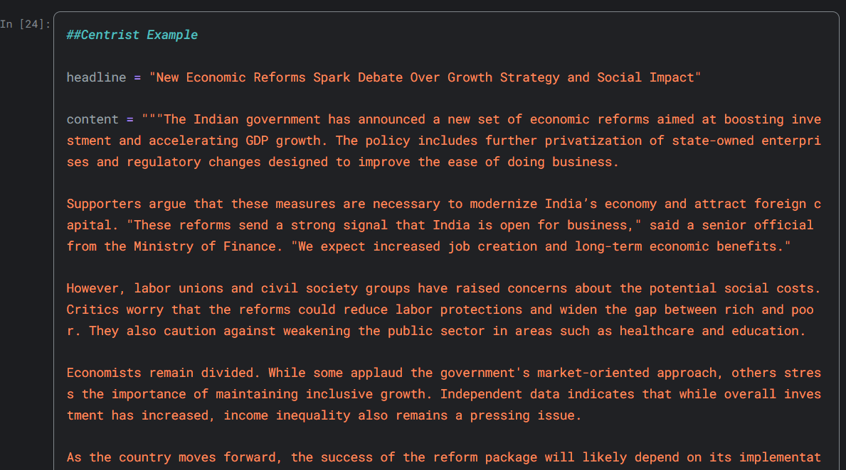
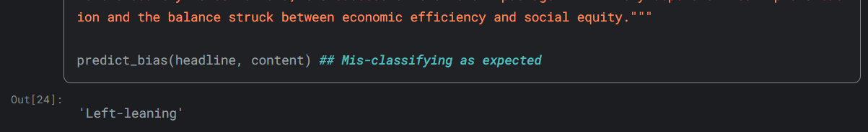
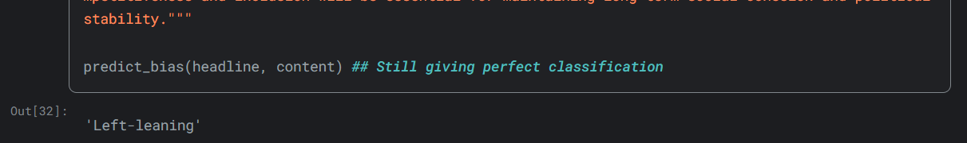
Test on some inputs

Slide 15
Challenges Faced
Significant bottleneck of proxy availability. With only 100 premium, reliable proxies having a limit of 10 concurrent connections, the content extraction time was much higher.
Some websites took too long to respond, thus returning empty title and content cells. Also, some websites have content within other <p> tags, that are located in the body of the web pages, nested within multiple <div> tags.Thus, their content extraction was not possible as it requires specific code for each publisher.
We had difficulty to find centrist data. These class labelled data were fewer compared to the others. This lead to class imbalanced data. To overcome this, we used F-beta score with beta value=1.8

Slide 16
Improvements
An improved method has been utilized for dataset collection. It targets the news organization website archives to retrieve links to articles rather than GoogleNews, and scrapes the content from there.
As of now, only Times of India articles have been processed. More organizations might be added later on.
https://drive.google.com/drive/u/3/folders/1Y3jMgRonE-HRdEPkj0VEBh0kpLtUND0J
This would enable to build a more balanced dataset, when targeting multiple publisher archives.
Having a premium proxy service with at least 1000 concurrent connections, will reduce the content extraction time by a great margin.

Slide 17
Conclusion
This system offers an easy and end-user-focused method of identifying bias in news articles.
By supporting both manual input of article content and extraction based on URLs, it offers flexibility to users in different contexts.
The extracted or input content is then analyzed by a back-end AI/ML engine that gives a prediction of potential bias and sends the output back to the user interface. New input is also stored in a centralized data repository so that the system is tunable and can learn continuously.
Built a bias classification model to detect political orientations (Left, Right, Centrist) in news headlines.
Used pre-trained transformer model – BigBird-RoBERTa – to handle long-length text data.
Google drive link of Dataset, Model, Web Implementation along with the data :
https://drive.google.com/drive/folders/1Sz7sfGleHndchUXsiPrfI2dHaQ83AsIf?usp=sharing

Slide 18
REFERENCES
Nadeem, M.U. and Raza, S., 2021. Detecting Bias in News Articles using NLP Models
Raza, S., Reji, D.J. and Ding, C., 2024. Dbias: detecting biases and ensuring fairness in news articles. International Journal of Data Science and Analytics, 17(1), pp.39-59
Chen, W.F., Al-Khatib, K., Stein, B. and Wachsmuth, H., 2020. Detecting media bias in news articles using gaussian bias distributions. arXiv preprint arXiv:2010.10649
Gangula, R.R.R., Duggenpudi, S.R. and Mamidi, R., 2019, August. Detecting political bias in news articles using headline attention. In Proceedings of the 2019 ACL workshop BlackboxNLP: analyzing and interpreting neural networks for NLP (pp. 77-84)
Rodrigo-Ginés, F.J., Carrillo-de-Albornoz, J. and Plaza, L., 2024. A systematic review on media bias detection: What is media bias, how it is expressed, and how to detect it. Expert Systems with Applications, 237, p.121641
https://gist.github.com/huksley/bc3cb046157a99cd9d1517b32f91a99e?permalink_comment_id=5184759#gistcomment-5184759
coderishabh11/Media-Bias-Analysis-in-Indian-News-Articles

