Slide 1
Welcome

Slide 2

TATYASAHEB KORE INSTITUTE OF ENGINEERING AND TECHNOLOGY, WARANANAGAR
DEPARTMENT OF COMPUTER SCIENCE & ENGINEERING
2021-2022
Presentation of Domain Specific Mini Project on
“Gesture recognition for Human Computer Interaction”

Slide 3
Group No : 18
Members :
Name | Roll No.
Mr. Gaikwad Nilesh Chandrakant | 37
Mr. Ghule Pranav Arjun | 44
Mr. Gurav Jayash Uday | 47
Mr. Parit Swaroop Kiran | 67
Mr. Ganesh Ananda Khot | 69

Slide 4
Content :
RELEVANT OBJECTIVES
PROBLEM STATEMENT
REQUIREMENT ANALYSIS
METHODOLOGY TO SOLVE THE PROBLEM
LAYOUT OF SYSTEM ARCHITECTURE
REFERENCES

Slide 5
RELEVANT OBJECTIVES:
Designing a system for hand gesture recognition is one of the goal of achieving the objectives of this project.
The task of recognizing hand gestures is one of the main and important issues in computer vision. With the latest advances in information and media technology, human computer interaction (HCI) systems that involve hand processing tasks such as hand detection and hand gesture recognition.

Slide 6
Problem statement
“Hand Gesture Recognition Using Camera ” is based on concept of Image processing.
This project is focus on reduce cost and improve robustness of the proposed system using simple web camera .

Slide 7
Requirement Analysis
a) Software Requirement
Python Compiler
Python Libraries like mediapipe,OpeanCV.
b) Hardware Requirement
Laptop or PC with Webcam

Slide 8
Some Important Libraries :
1.OpenCV :
OpenCV is a great tool for image processing and performing computer vision tasks. It is an open-source library that can be used to perform tasks like face detection, objection tracking, landmark detection, and much more. It supports multiple languages including python, java C++
2.Mediapipe:
Mediapipe is a cross-platform library developed by Google that provides amazing ready-to-use ML solutions for computer vision tasks. OpenCV library in python is a computer vision library that is widely used for image analysis, image processing, detection, recognition, etc.
3.Autopy:
AutoPy is a simple, cross-platform GUI automation library for Python. It includes functions for controlling the keyboard and mouse, finding colors and bitmaps on-screen, and displaying alerts.
4.PyautoGui:
This python library is used for controlling the movement of Mouse and Keyboard . We Can control movements using set of code.

Slide 9
Methodology to Solve the Problem
Camera :Capturing the Video and Processing. The AI virtual mouse system uses the webcam where each frame is captured till the termination of the program. The video frames are processed from BGR to RGB colour space to find the hand movement
Rectangular Region for Moving through the Window. The AI virtual mouse system makes use of the transformational algorithm, and it converts the coordinates of fingertip from the webcam screen to the computer window full screen for controlling the mouse. When the hands are detected and when we find which finger is up for performing the specific mouse function, a rectangular box is drawn with respect to the computer window in the webcam region where we move throughout the window using the mouse cursor.
Detecting Which Finger Is Up and Performing the Particular Mouse Function. In this stage, we are detecting which finger is up using the tip Id of the respective finger that we found using the MediaPipe and the respective co-ordinates of the fingers that are up , and according to that, the particular mouse function is performed.

Slide 10
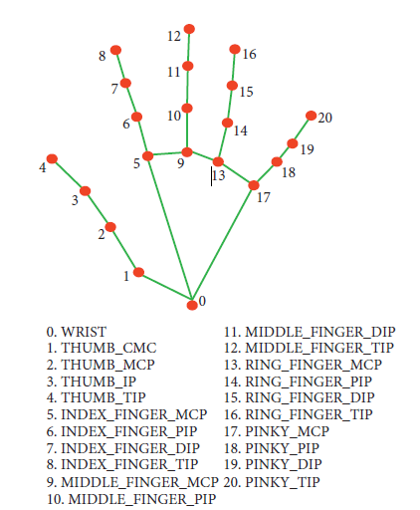

Slide 11
try: # pyautogui.moveTo(indexfingertip_x,indexfingertip_y) Distance_x = sqrt((indexfingertip_x - thumbfingertip_x) ** 2 + (indexfingertip_x - thumbfingertip_x) ** 2) Distance_y = sqrt((indexfingertip_y - thumbfingertip_y) ** 2 + (indexfingertip_y - thumbfingertip_y) ** 2) if (Distance_x < 5 or Distance_x < -5) and (Distance_y < 5 or Distance_y < -5): click = click + 1 if click % 5 == 0: print("double click") pyautogui.doubleclick()

Slide 12
LAYOUT OF SYSTEM ARCHITECTURE
Camera live feed
Detection of Landmarks
Image Processing
Using OpenCV and Mediapipe
Virtual Movement of Mouse
Landmarks
Programmed code

Slide 13
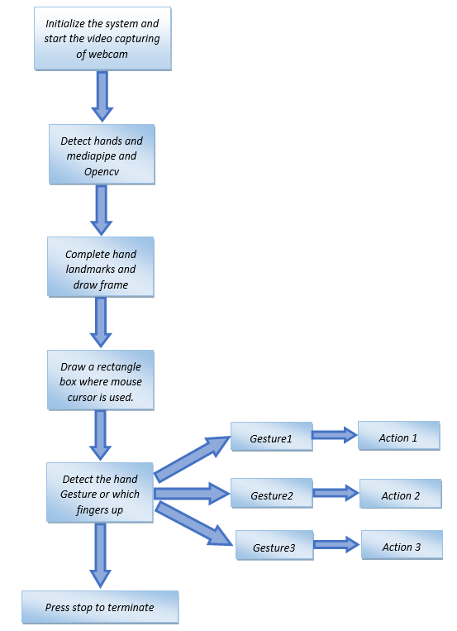
Flow chart :

Slide 14
References
OpenCV Website – www.opencv.org
2)Murtaza workshop –murtazahassan.com
3)Advanced Computer Vision (Free code camp ) - https://www.youtube.com/watch?v=01sAkU_NvOY

Slide 15
Conclusion and Future Scope
There are several features and improvements needed in order for the program to be more user friendly, accurate, and flexible in various environments. The following describes the improvements and the features required:
a) Smart Movement
b) Better Accuracy & Performance
c) Mobile Application

Slide 16
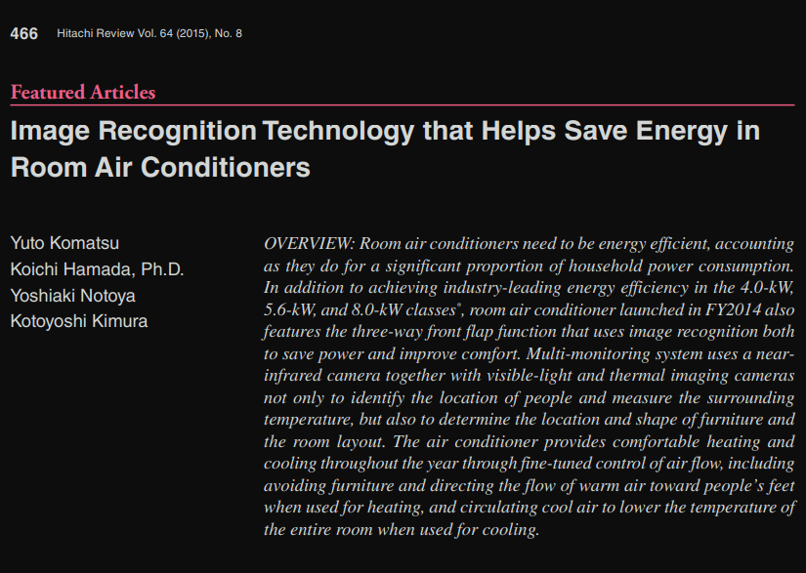
HITACHI TECHNICAL MAGAZINE REVIEW :

Slide 17
Thank You

