Slide 1
Data Visualisation Lab 3
Spring 2024

Slide 2
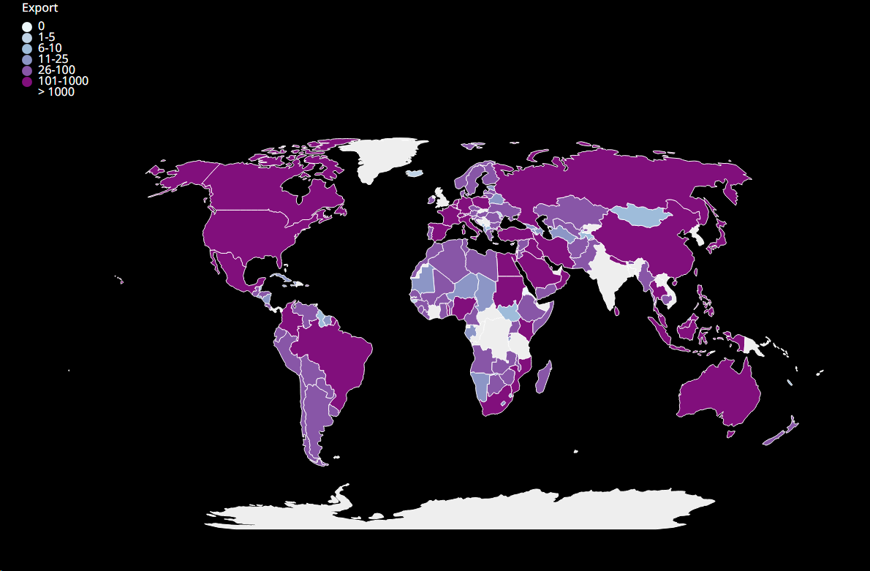
Q1
Choropleth chart :
Data: data.csv (shows total export and import with India over the years)
Create a world choropleth graph for the 2019-2020 fiscal year .
Allow the user to choose between export and import using a slider/radio button , and display the data chosen.
(Bonus) highlight the country on hovering

