Slide 1
EXAM CENTER ASSIGNMENT
TEAM MEMBERS
Koduri Bhavitha
Sai bhargavi Yaramuddaiah Gari Nalamala
Byalla Sunitha
Swarachita Acharya
Sowjanya K N

Slide 2
CONTENTS
Introduction
Daily Activity
Software Requirements
Software Resources
About Project
UseCase Diagram
Sequence Diagram
Conclusion

Slide 3

INTRODUCTION
It assigns exam center to candidates based on exam id and candidate id.
These information are stored in text files.
Exam center allocation is the process of allocating places for the candidate to write the exam.

Slide 4

DAILY ACTIVITY
DAY 1
Received the project document and spent time understanding the functional and non functional requirement of our project.
Discussed over the working of the program by deciding which data structure to use and the functions we will need to make.
Divided tasks among team members and started working on them.
Created the RTM document and updated progress in it.
Started working on the SRS document file for the project.
Created input files for our application viz. examcentres.txt, candidate1.txt, candidate2.txt.

Slide 5
Discussed about the current progress of the application and jotted down changes.
Spent time analyzing the working of our program and updating the flow.
Next, created the final flow diagram document.
Finally, created the pseudocode file which has the basic working of the application in layman terms for easy understanding.
DAY 2

Slide 6
DAY 3
Started the coding part for the application.
Finally decided to use the data structure linked list to implement the program.
Created structures for the exam centers data and the candidates data.
Finalized the functions and started creating them.
Made functions that conform to the standard coding guidelines.
Adhered to use dynamic memory allocation and multithreading concepts.

Slide 7
Day 4
Started unit testing and Integration testing.
Used valgrind tool to detect memory leaks.
Finalizing the RTM, SRS doc, IT_UT file and uploading their PDF format on GitHub.
Uploading the final version of the code on GitHub and ensuring all files are present.

Slide 8
SOFTWARE REQUIREMENTS
Linux
Cloud Machine

Slide 9
SOFTWARE RESOURCES
Cpp
Valgrind
Oops(Inheritance,exception handling…)

Slide 10
ABOUT PROJECT
Exam center assignment is the process of allocating the candidate who are going to apply for any particular exam.
He/She will get exam center allocated based on the exam he/she applied.
The admin who is going to allot the exam center based on the exam,the admin will first checks before allocating the centers count and checks the availability and assigns the exam center.

Slide 11
InsertExamData
It parses the exam center data from the text file for details like exam centre , exam id, college and address.
It uses the suitable STL to manage candidates data and exam center allocations.

Slide 12
InsertCandidateData
It will enters the candidate data and checks whether the entry is valid or not for a valid condition.
We have inheritance to store the candidates data and run-time polymorphism using virtual functions.
We have used exception file handling to store the invalid entries in a file called "invalidcandidates.txt“.

Slide 13
WriteToFile
It checks the values which store only valid entries and then allocates the students their exam center.
We create a file for each exam center that saves the candidate details of that exam center in the particular file.
This will help the exam admin controller and the exam candidates to search for their required information easily.

Slide 14
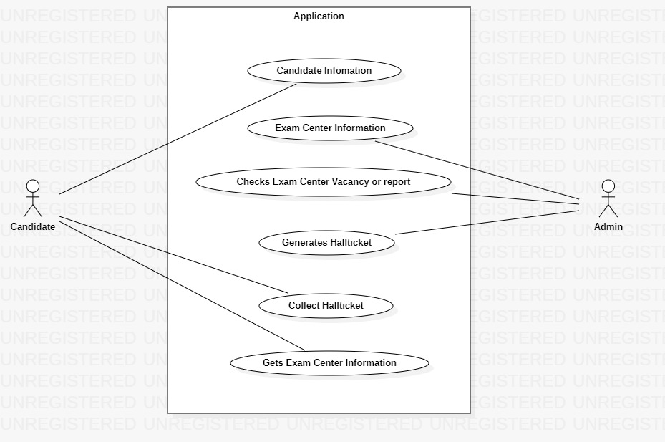
UseCase Diagram

Slide 15
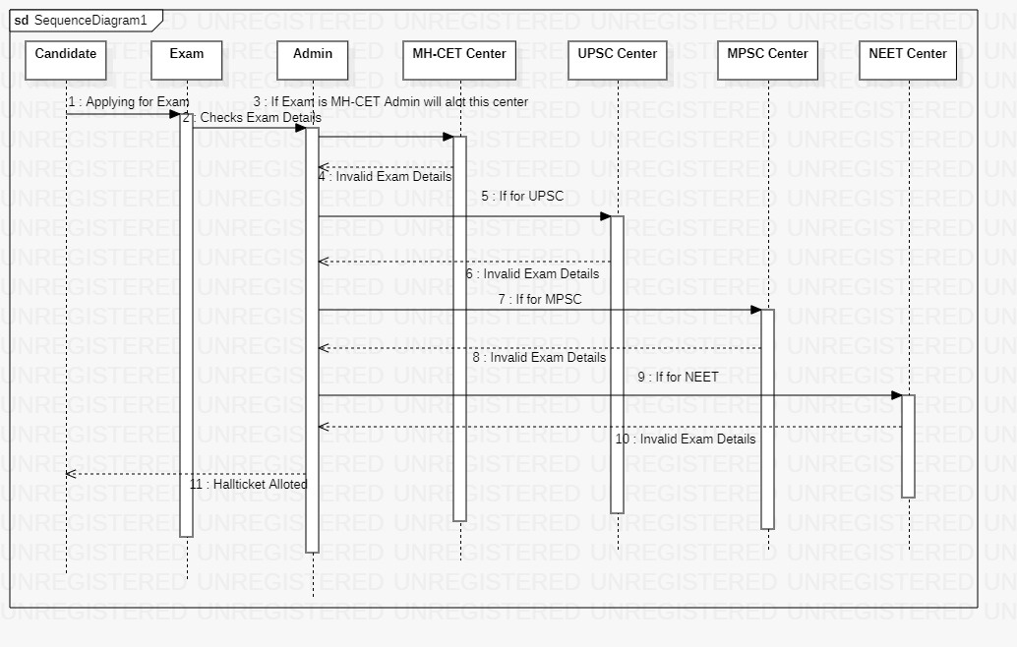
Sequence Diagram

Slide 16
Conclusion
In this project we have designed and application which allocates exam centers for respective exams.
We have implemented it using inheritance multithreading and other concepts.
We have used to step compilation process and makefile to built this application.

Slide 17
Thank you

