Slide 1

Project Title -Seasonal Agriculture Performance Analysis
Name: Swaranjali Baburao Harkare
College Name- Dr.J.J.Magdum College Of Engineering Jaysingpur.
AICTE STU ID : STU6719efaf344861729753007

Slide 2

PROBLEM STATEMENT
Core Context: Agricultural activities are highly susceptible to seasonal changes in environmental conditions, farming practices, resource availability, and marketplace trends. Consequently, crop yields and economic performance differ sharply from one macro season to another.
The Analytical Challenge: Raw agricultural datasets do not inherently explain how multi-variable agricultural outputs change across growing horizons, leaving critical trends completely hidden.
Project Mission: This study cleans, pre-processes, and thoroughly analyzes a localized agricultural dataset to investigate cross-seasonal differences. By executing univariate, bivariate, and multivariate analysis, we identify meaningful patterns, linear relationships, and key anomalies within the dataset.

Slide 3
Project Description
Workbook Strategy: This project sets up an iterative Exploratory Data Analysis (EDA) pipeline utilizing Python's core analytics libraries (pandas, numpy, matplotlib, seaborn) to evaluate 4,000 multi-regional farm records.
Core Methodology:
  Data Integrity Audit: Cleans duplicate entries and handles data gaps via programmatic median imputation strategies.
  Feature Engineering: Creates business KPIs, including Net Profit Margin (%), Cost-to-Revenue Ratio, and a Water Efficiency Index (Tonnes per 1000m³).
  Visual Mapping Layout: Plots variance profiles using specialized histograms, single-variable density estimate lines, categorical bar charts, and dual-axis heatmaps.

Slide 4

WHO ARE THE END USERS?
1. Regional Agricultural Planners & Policymakers:
  Use data-backed insights to design regional crop rotation schedules and manage regional water resources.
2. Farmers & Agricultural Cooperatives:
  Gain deep visibility into fertilizer saturation risks and seasonal cash crop returns to optimize farm-level profit margins.
3. Agribusiness Supply-Chain Managers:
  Rely on production and harvest volume summaries to optimize logistics, grain storage logistics, and target market drops.
4. Rural Micro-Finance & Insurance Institutions:
  Utilize seasonal crop failure risk spreads and environmental profiles to establish fair credit baselines and evaluate policy parameters.

Slide 5

Technology Used
Core Language Runtime: Python 3.14 (Optimized for robust data computing tasks).
Data Ingestion & Structural Manipulation:
  Pandas: Used for categorical grouping operations, variable sorting, data index cleaning, and building pivot summary matrices.
  NumPy: Handles high-performance multi-dimensional array operations and calculates localized mathematical parameters.
Exploratory Visualizations & Heat Mapping:
  Matplotlib: Coordinates global canvas properties, subplots layout grids, and axis ranges.
  Seaborn: Renders multi-variable bar charts, outlier box plots, and continuous feature density graphs.

Slide 6
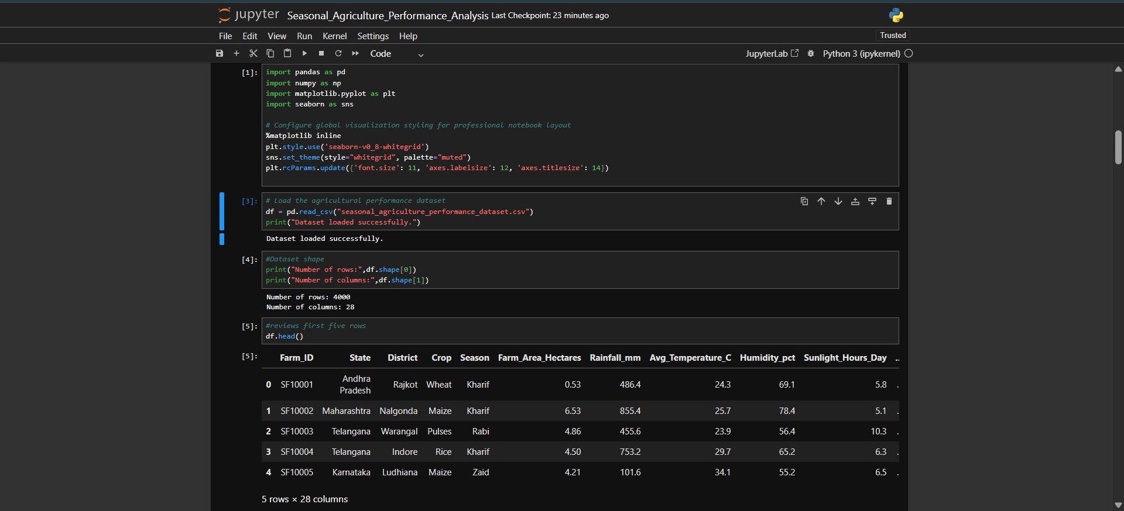
RESULTS

Slide 7
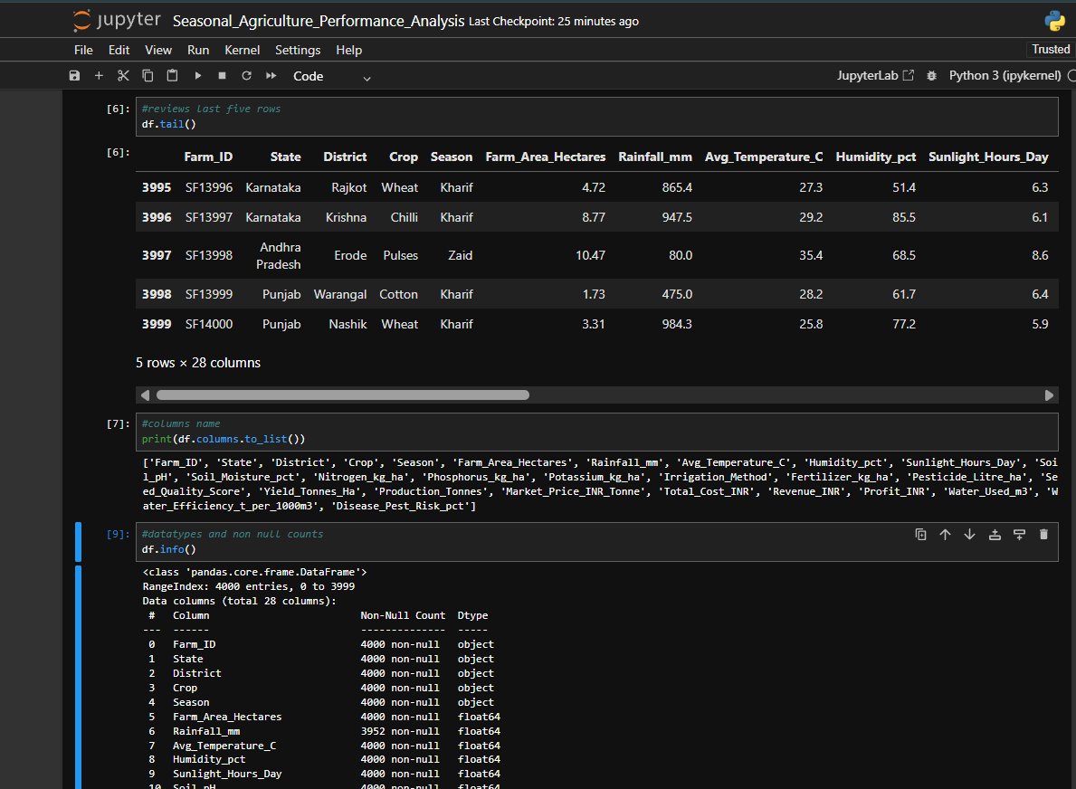
RESULTS

Slide 8
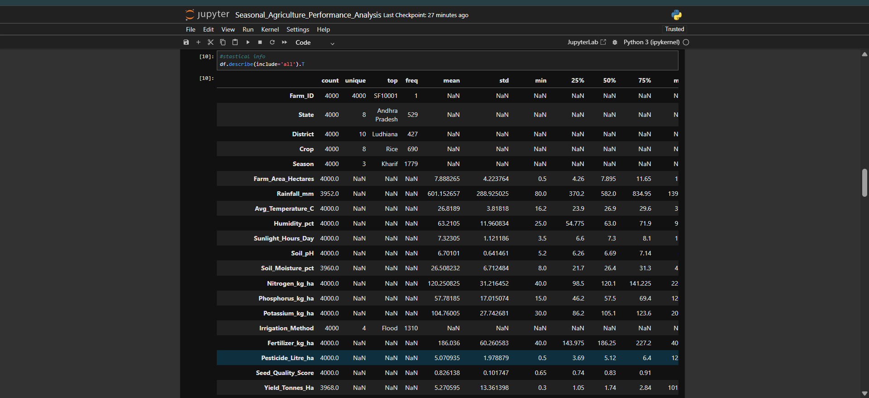
RESULTS
[Add screen shots of your code ]

Slide 9
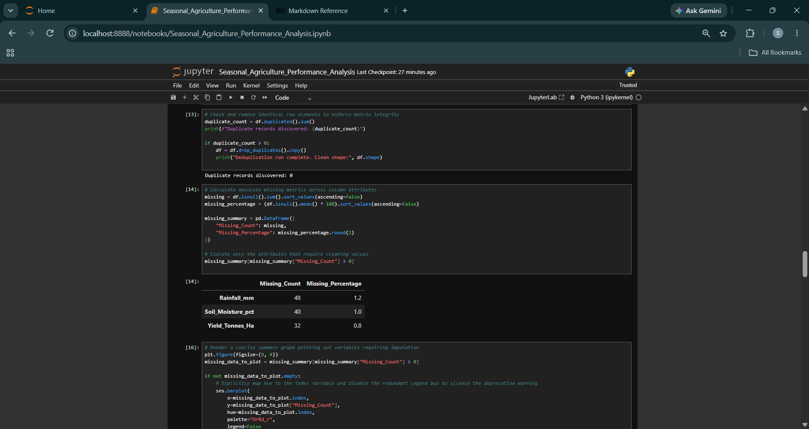
RESULTS

Slide 10
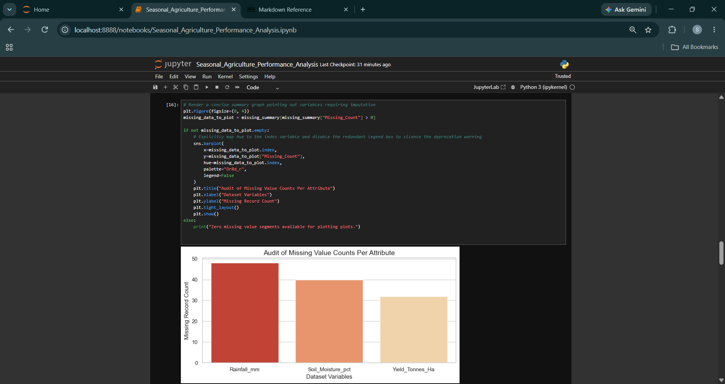
RESULTS

Slide 11
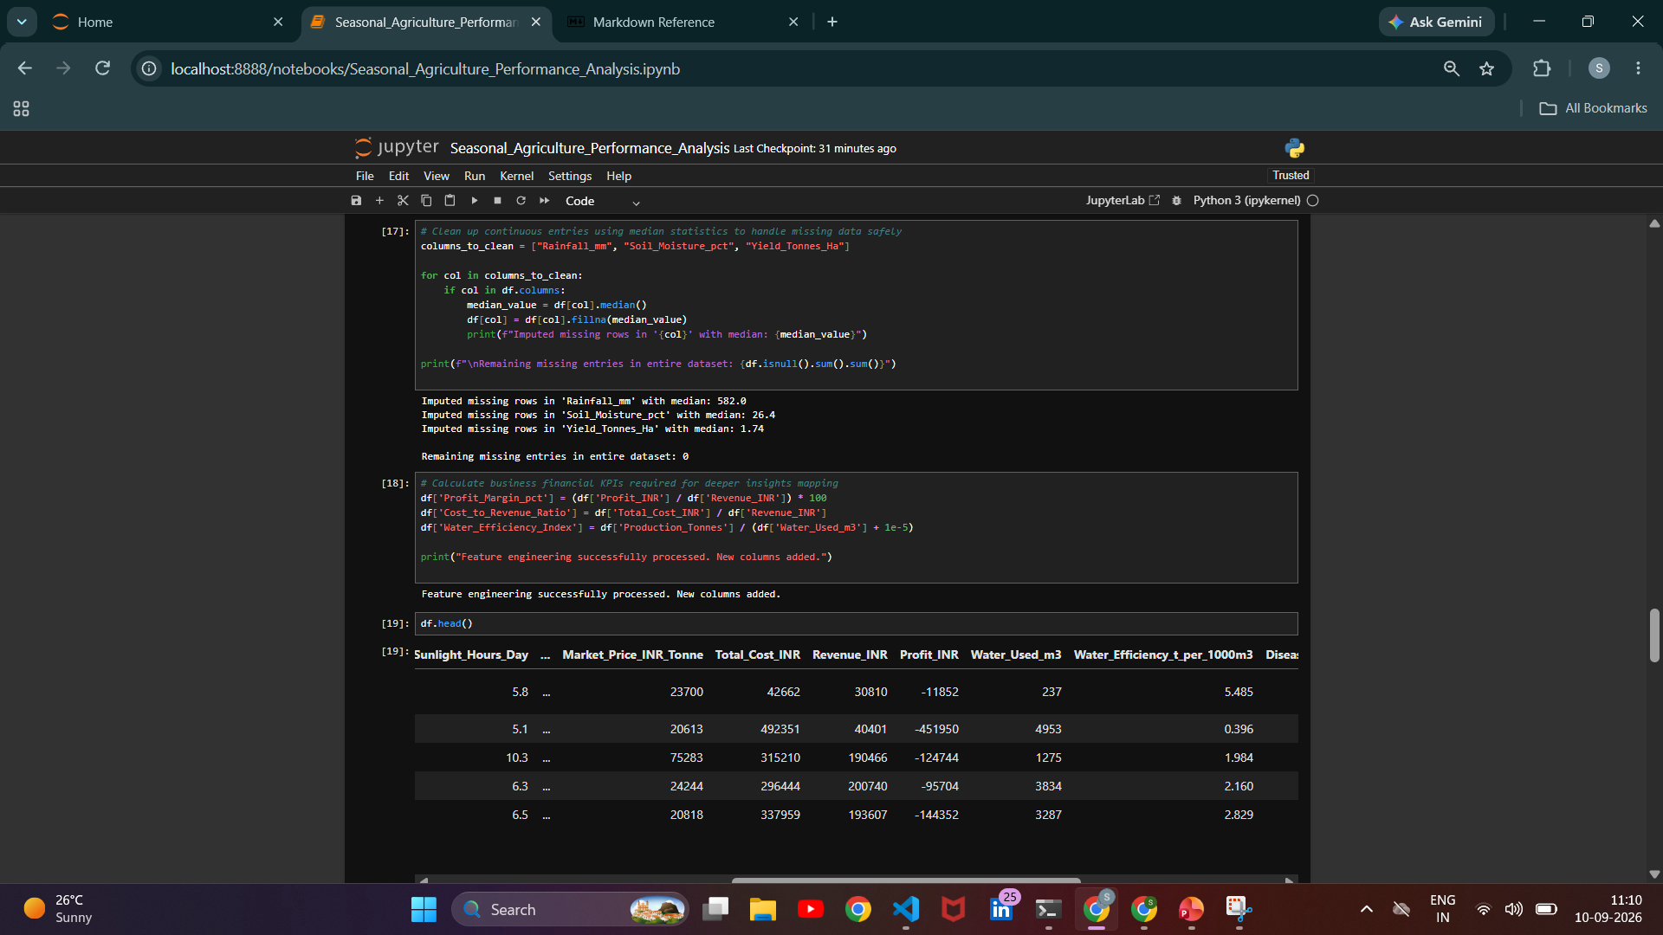

Slide 12
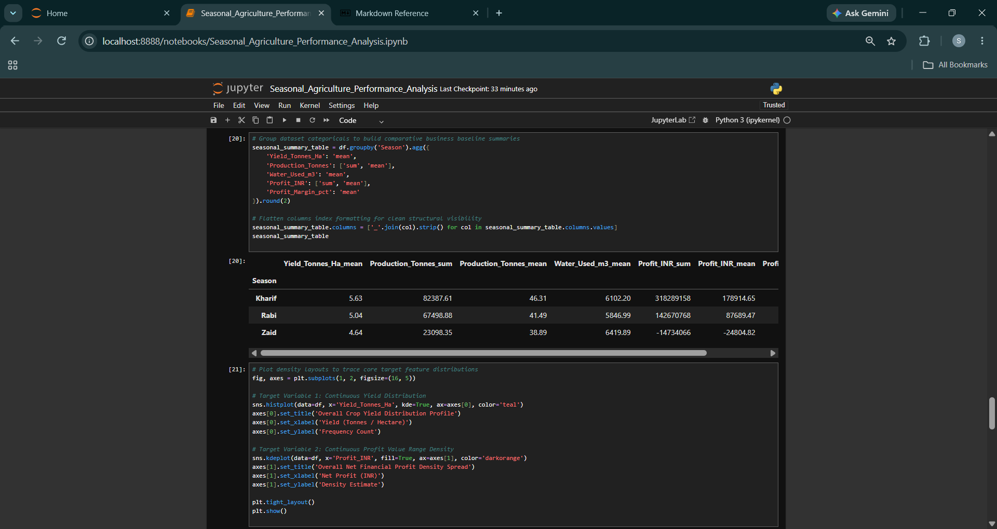

Slide 13
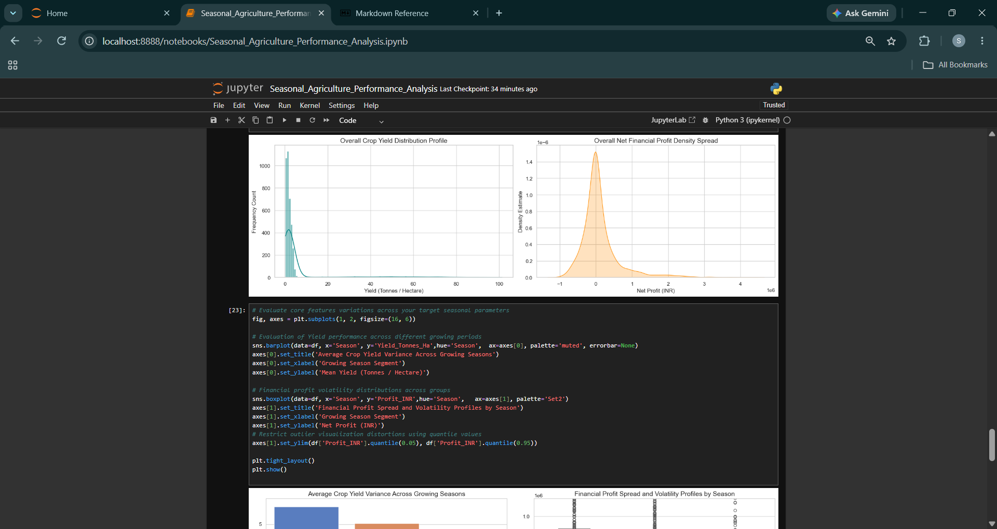

Slide 14
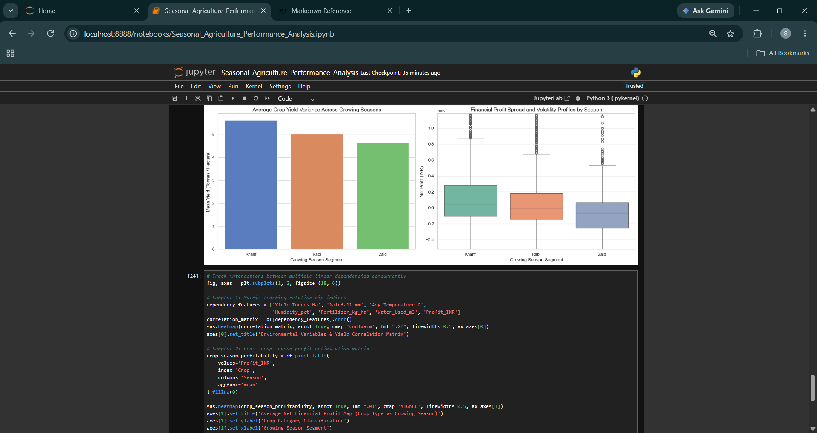

Slide 15
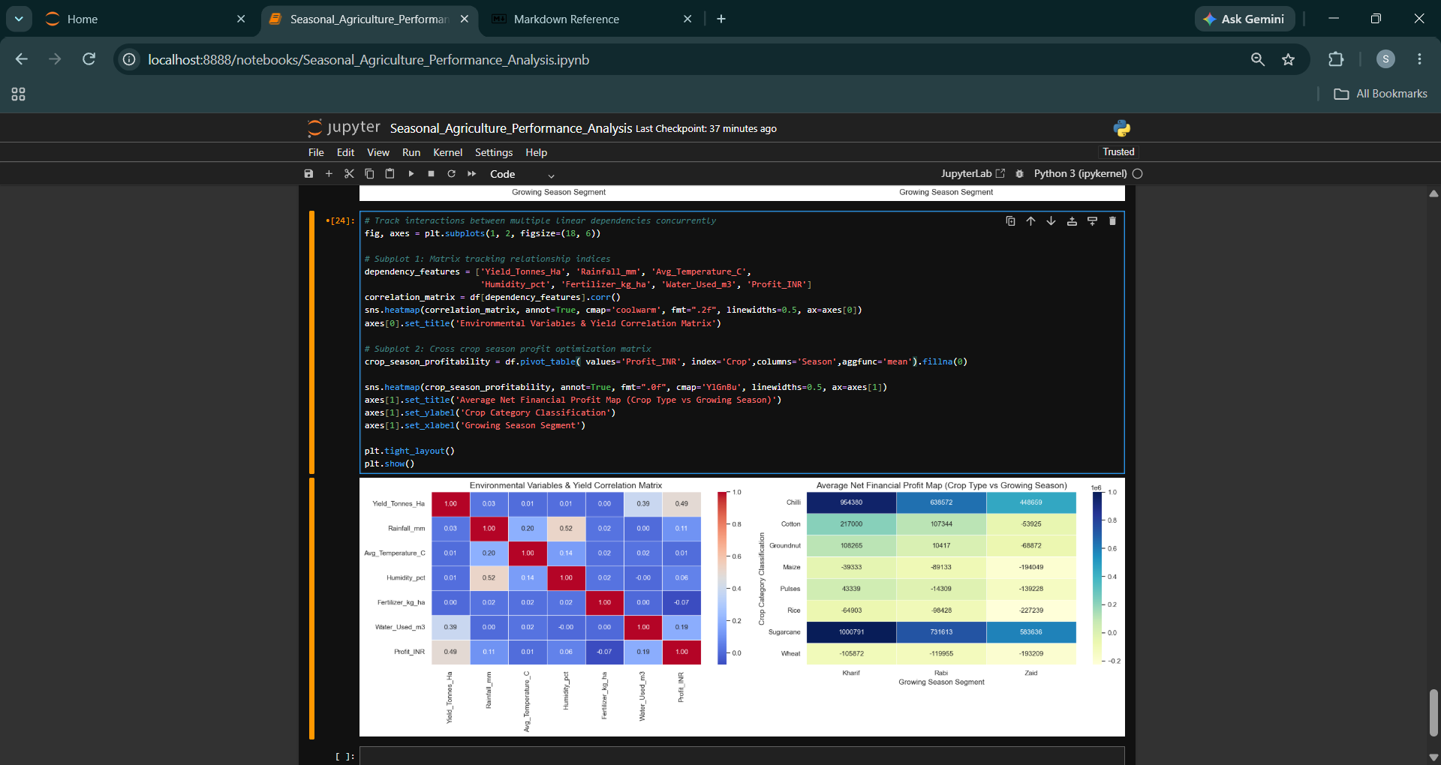

Slide 16
Future scope
1. Predictive Predictive Analytics Implementation:
  Add advanced Machine Learning modules (e.g., Random Forest Regressors or XGBoost models) to predict yield directly based on real-time weather readings.
2. Geospatial Mapping & GIS Integration:
  Connect GIS and longitude coordinate records with Geopandas to build live geographic risk and production maps.
3. Interactive Executive Dashboards:
  Port the core Python analytical functions into a live Streamlit or Plotly Dash interface for executive decision-making.
4. Cost Optimization Engine:
  Build a mathematical solver script to recommend the exact minimum amount of fertilizer needed to maximize profit margins without harming soil health.

Slide 17
GitHub Link
https://github.com/AswiniKumar55/-Seasonal-Agriculture-Performance-Analysis-.git

Slide 18

VOIS Course completion certificate -
Course name- Data Visualization

Slide 19
Thank you
.
.

