Slide 1
SEPTEMBER REVENUE · SAHYADRI STORES
Rs 24,03,00,20
Our AI agent said this, with full confidence.
The real answer is Rs 2,40,300
No error. No warning. Just a wrong number, a hundred times too big.
QueryMend · Group 17 · AIA_05
1
Notes:
Pause for two seconds on the number. Ask the room: would you have caught that? The tool returned prices in paise instead of rupees. Nothing crashed, so a normal agent just reports it. QueryMend is about catching exactly this kind of failure.

Slide 2
THE PROBLEM
AI agents fail in three ways. Only one makes noise.
Loud
Quiet
Spreading
The tool throws an error
The number is just wrong
The next answer builds on it
no such column: amount
prices read in paise, a missing GROUP BY
turn 2 reuses turn 1's number
Easy to catch, easy to retry.
The query runs fine. Nobody notices.
One mistake becomes many.
PBA 1 catches the loud ones. PBA 2 catches all three.
QueryMend · Group 17 · AIA_05
2
Notes:
Most demos only show loud failures, where the tool throws an error. The dangerous ones are quiet: the SQL runs, the number is wrong. And in a multi-turn chat, a wrong number gets reused, so the error spreads. PBA 2 targets all three.

Slide 3
QueryMend
Ask your shop database a question in plain English. If the answer is wrong, it notices, fixes it, or tells you it can't.
Executor
Monitor
Recovery
A person
writes the SQL
checks everything
fixes or stops
approves personal data
qwen2.5:3b · LangGraph · SQLite · Chroma · fully offline · free
Swaraj Mandre · Saumya Joshi · Siddhant Pawar Topic 17: an agent that detects and recovers from its own tool failures
QueryMend · Group 17 · AIA_05
3
Notes:
One line: ask in plain English, and if the answer is wrong, it notices, fixes it, or tells you it can't. Three agents plus one human checkpoint. Everything runs on a laptop GPU with a 3B model, no paid API.

Slide 4
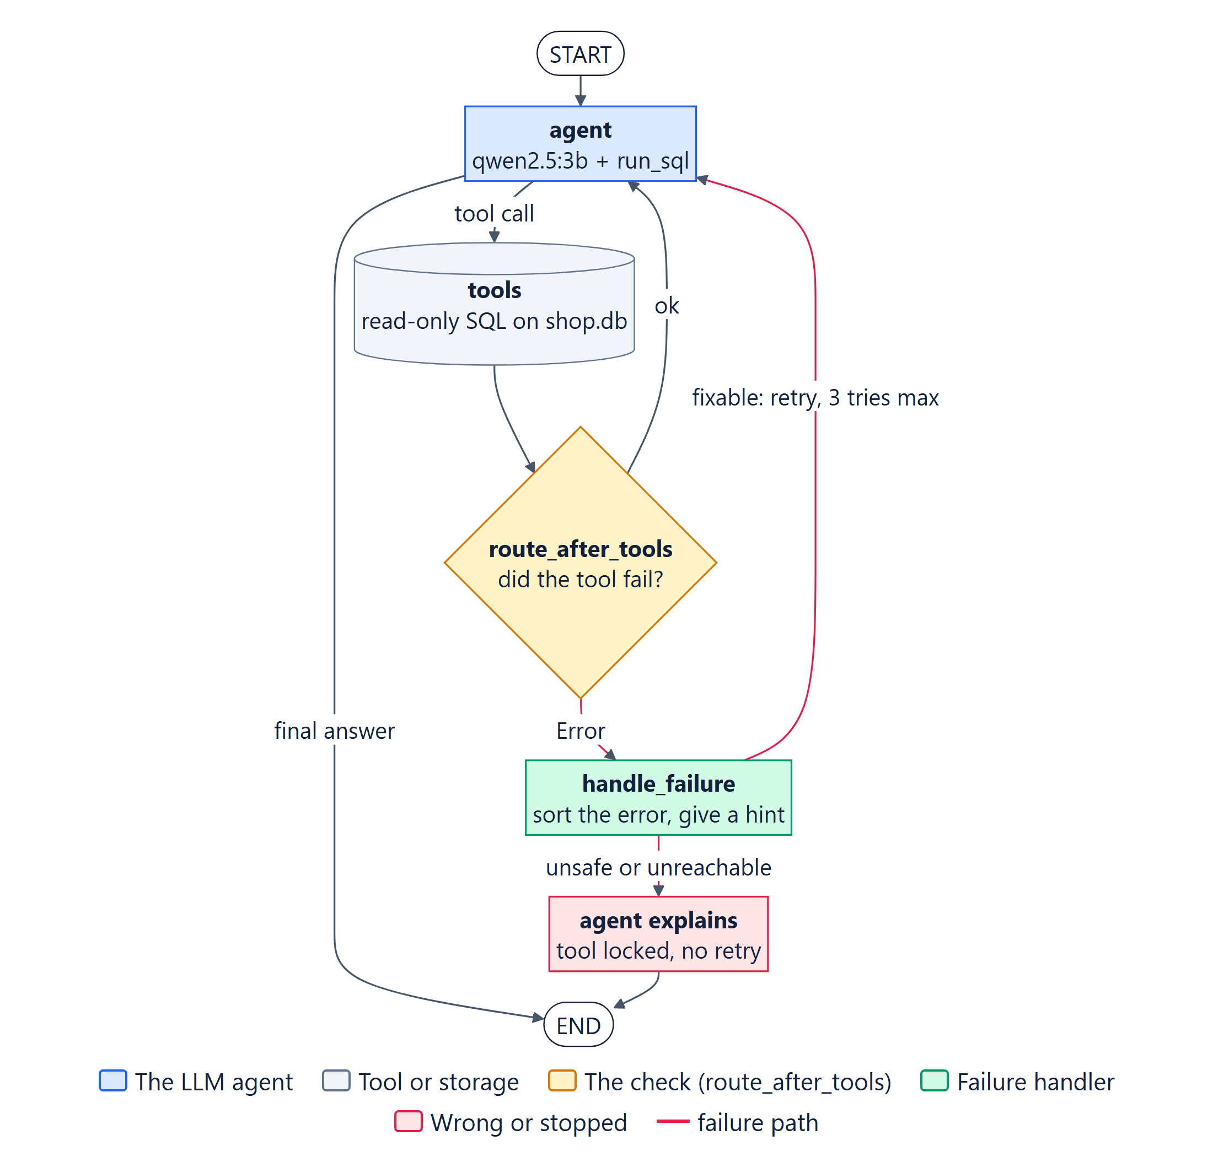
PBA 1 · UNITS 1 AND 2
One agent that notices when its tool fails
THE SLIDE VERSION
One generic message for every error
Sent the same broken query 7 times. Told a user to run a DELETE by hand.
OUR REFINEMENT
Sort the error, then act on it
A specific hint, at most 3 tries, and the tool is locked when retrying can't help.
Blind spot: wrong data that raises no error goes straight to the user.
QueryMend · Group 17 · AIA_05
4
Notes:
route_after_tools checks every tool result for our Error prefix or an error status, and sends failures to handle_failure. The slide version treated every error the same, so the agent looped and even told a user to run DELETE. Our version classifies the error, caps retries at 3 and locks the tool for unsafe or unreachable cases. What it still cannot see: a wrong number with no error. That is why PBA 2 exists.

Slide 5
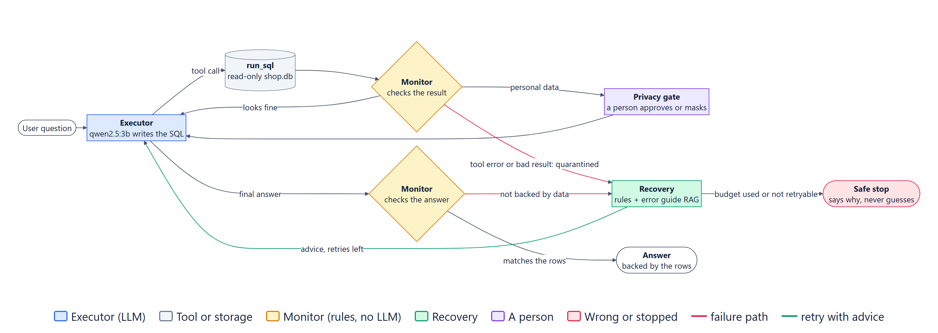
PBA 2 · UNITS 3 AND 4
Three agents, one job each
Executor
Monitor
Recovery
Writes and runs the SQL. The only agent that touches the data.
Plain rules, no LLM. Checks every result and every answer.
Advice from our error guide, or a safe stop after 3 retries.
QueryMend · Group 17 · AIA_05
5
Notes:
The Executor is the only agent with database access. The Monitor has no model on purpose: a 3B model checking another 3B model shares its blind spots, so it uses rules from the shop's real limits. Recovery decides: retry with advice, or stop. The retry budget of 3 is the hop limit.

Slide 6
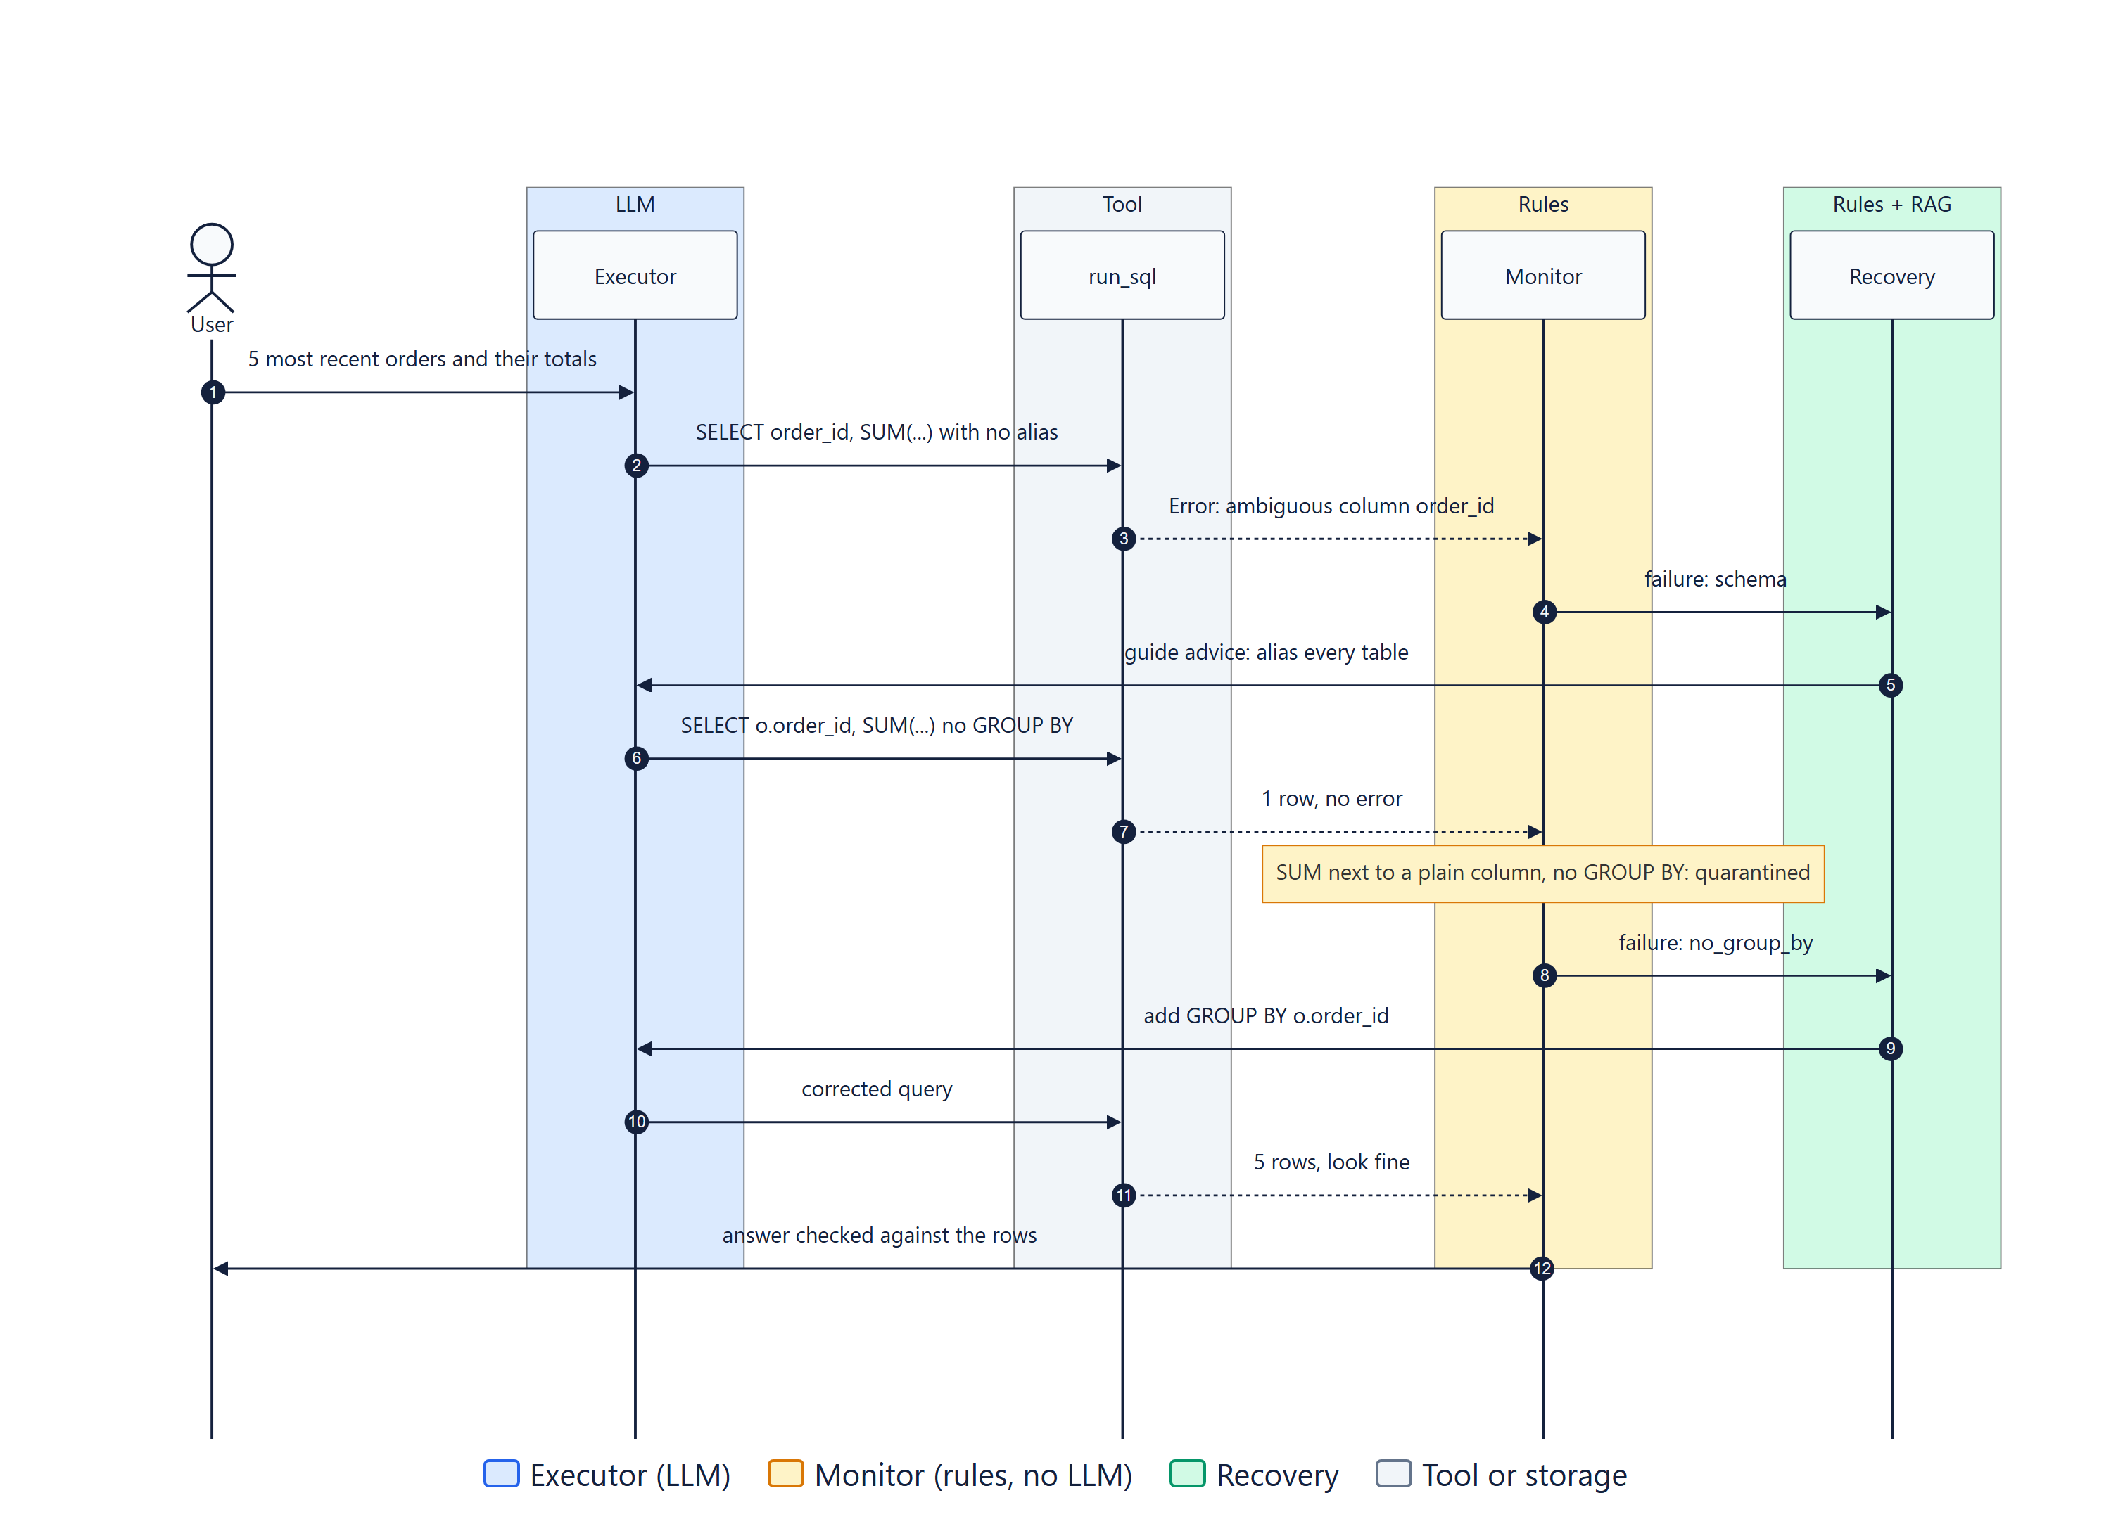
A REAL RUN
One question, two silent mistakes, both caught
1
Ambiguous column
The tool errors. Recovery pulls advice from the guide.
2
Missing GROUP BY
No error at all. The Monitor reads the SQL and quarantines it.
3
Corrected query
5 rows. The answer matches the data.
traces/ta2/failures.txt
QueryMend · Group 17 · AIA_05
6
Notes:
This is a real run from our failure demo. The first mistake is loud: an ambiguous column. The second is quiet: SUM next to order_id with no GROUP BY. SQLite returns one row without any error. Our number checks could not see it, so the Monitor now reads the SQL itself. Third try is correct.

Slide 7
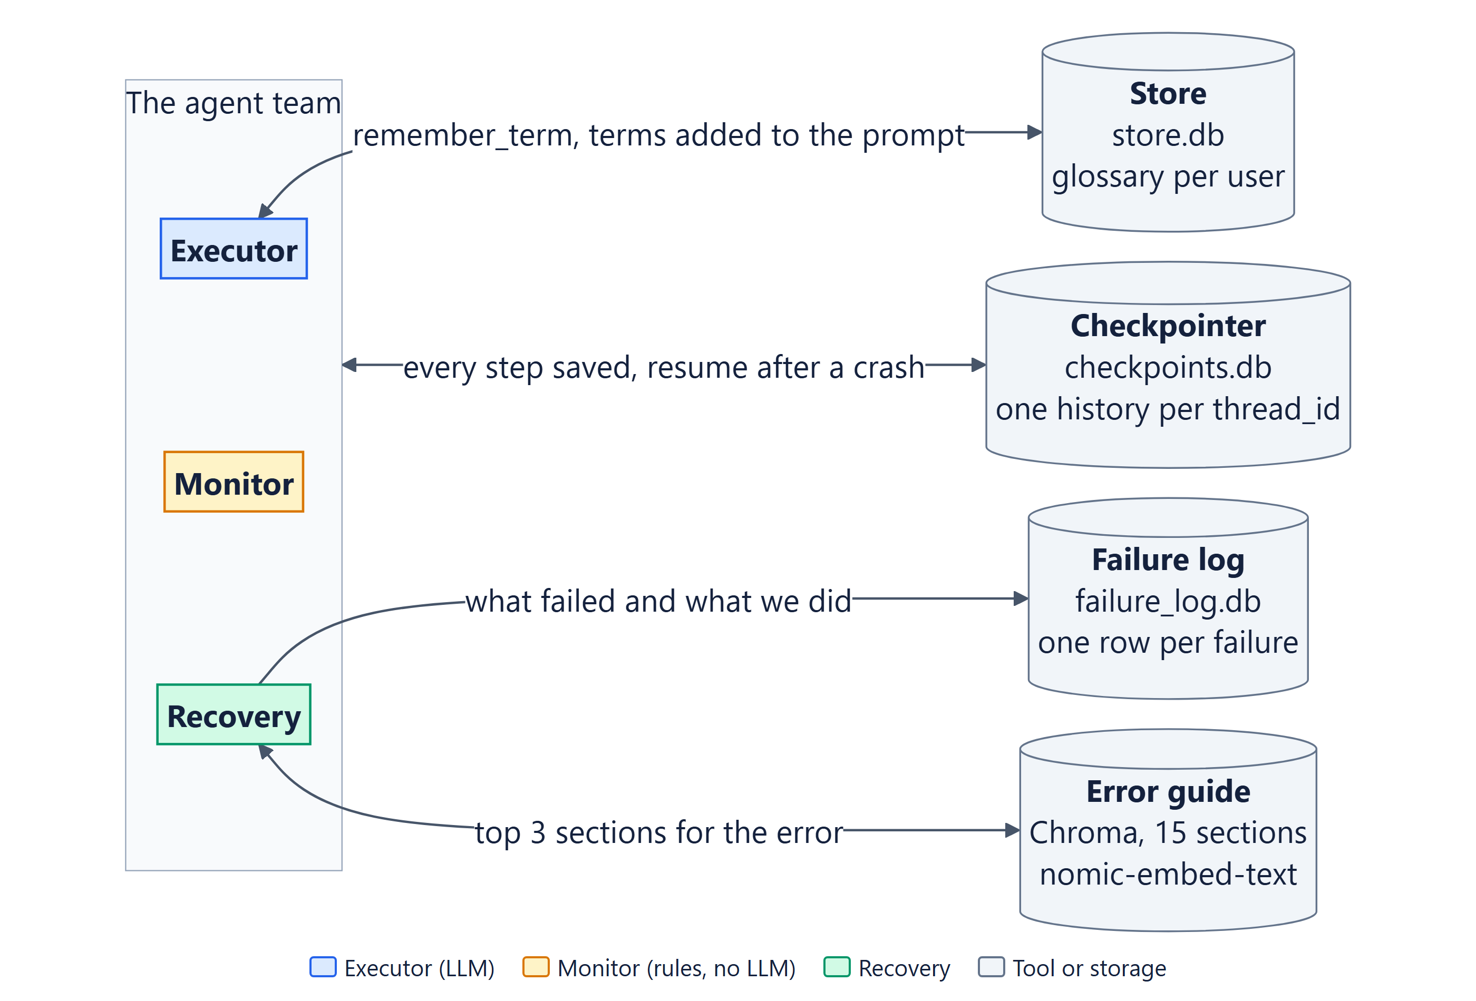
UNIT 3 · MEMORY AND RAG
It remembers, it resumes, it reads its own guide
55 → 63
"And in September?" works with a checkpointer, and fails without one.
Restart
"Premium product = above Rs 1500" is recalled in a brand-new process.
k = 3
A two-part question gets both parts. "Connect to MySQL?" gets "I don't know".
Logged
Every failure, its SQL and what Recovery decided, in SQLite.
QueryMend · Group 17 · AIA_05
7
Notes:
Short-term memory is a SQLite checkpointer per thread_id, so follow-ups work and a crashed run resumes. Long-term memory is a SQLite store with a glossary per user. RAG is Chroma over our own 15-section error guide; it answers only from the guide and says I don't know otherwise.

Slide 8
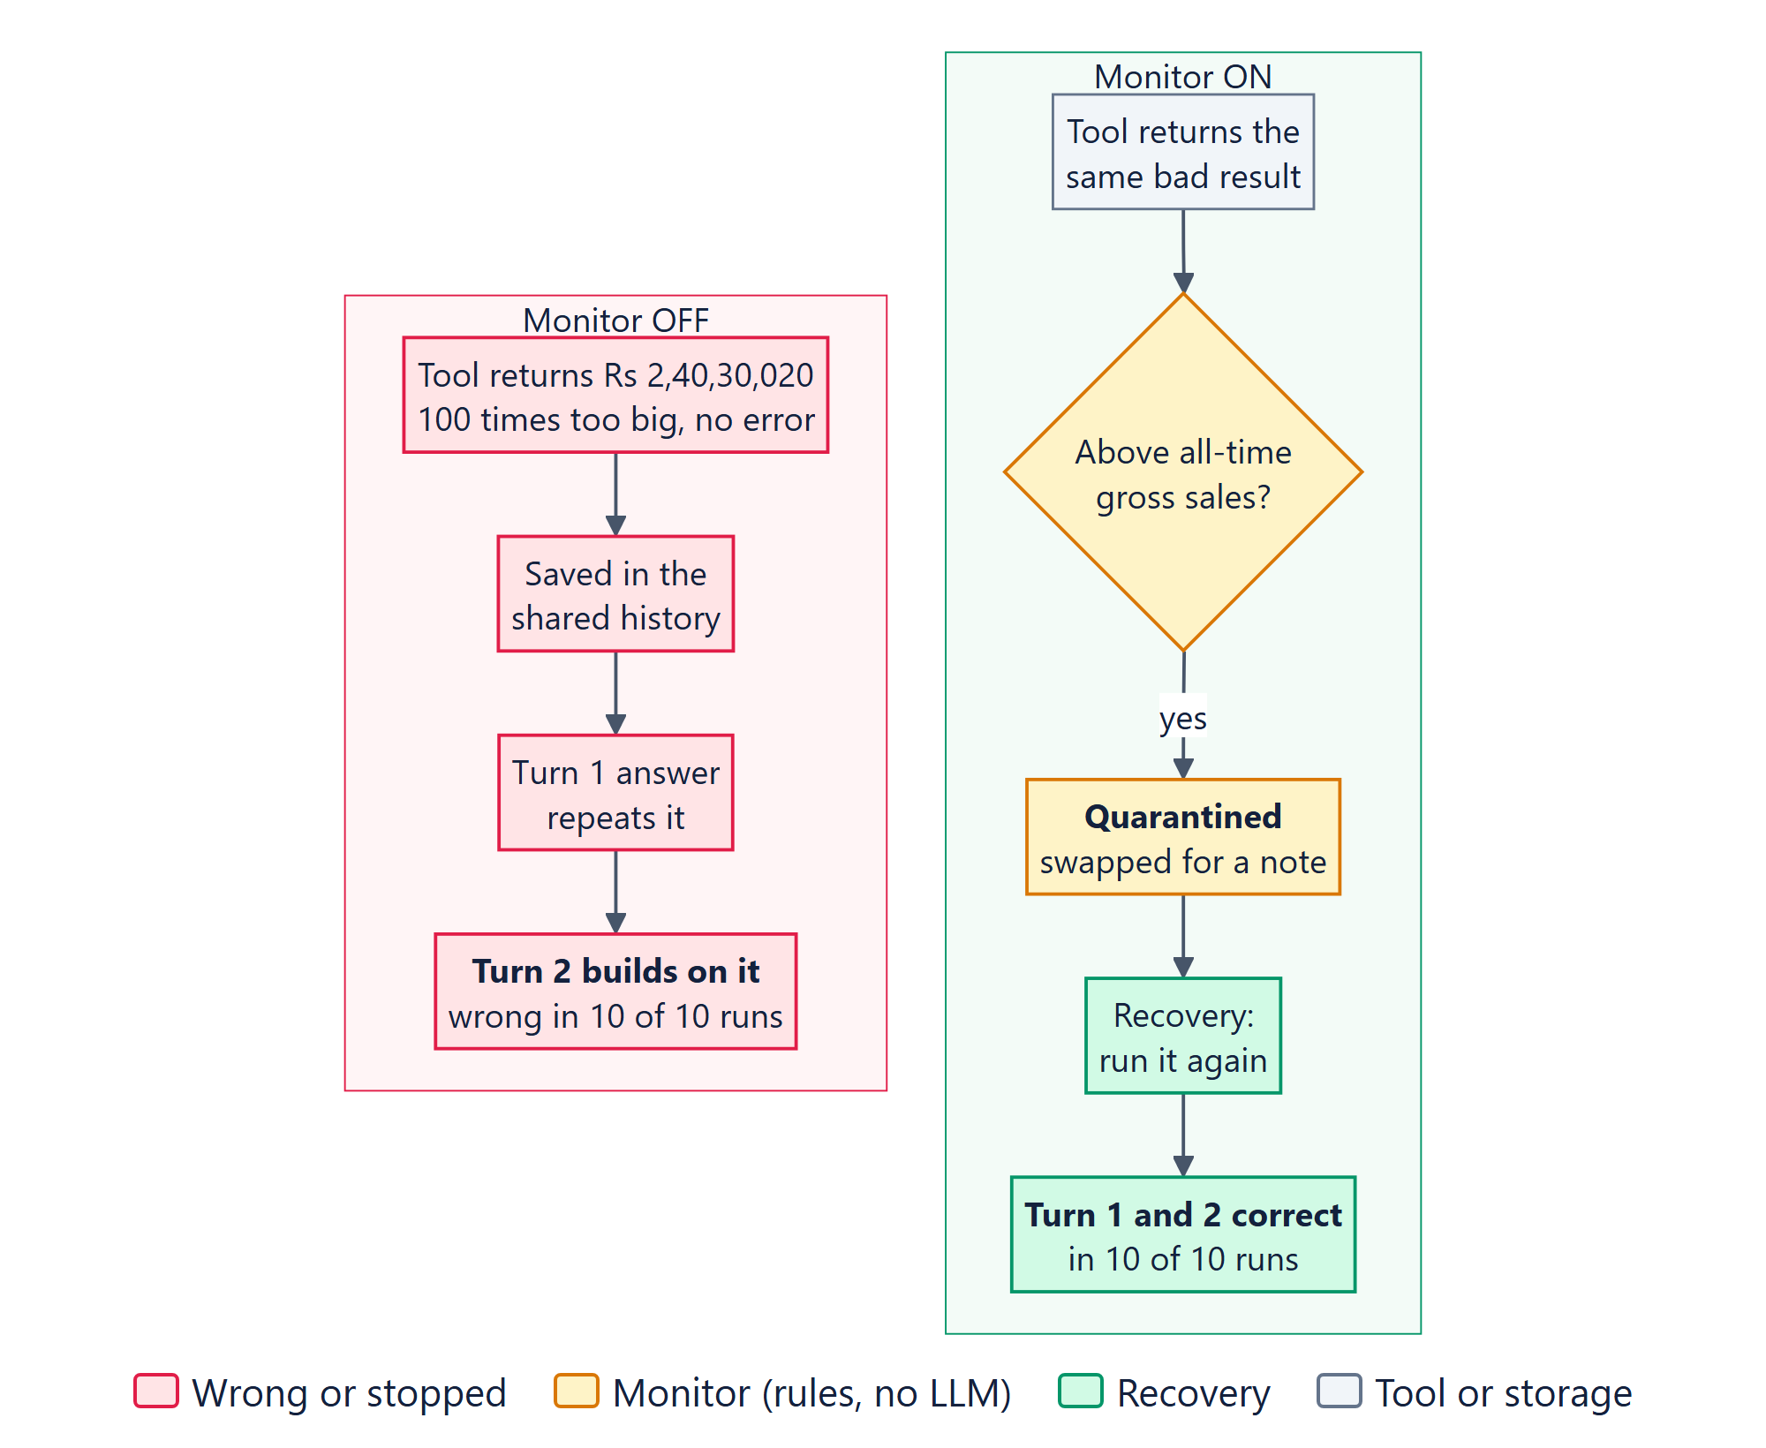
ERROR PROPAGATION · 10 RUNS EACH
With the Monitor on, a bad number stops spreading
10 / 10
Monitor off: the wrong number was carried into the follow-up answer.
0 / 10
Monitor on: quarantined before any agent could read it.
Cost: 2 extra model calls, about 2 seconds.
QueryMend · Group 17 · AIA_05
8
Notes:
One corrupted result in turn 1, then the follow-up: how does that compare with August? Monitor off: the bad value sits in the shared history, and 10 out of 10 follow-ups repeat it. Monitor on: it swaps the bad message for a quarantine note with the same message id, so no agent ever sees it. 0 out of 10.

Slide 9
SAME 5 CASES · PBA 1 VS PBA 2 · 3 RUNS EACH
Fewer wrong answers, more model calls. Both are true.
4 → 0
0 → 3
2 → 6
+1
wrong answers given to the user, out of 15 runs
silent corruptions caught, out of 3
model calls when the data is corrupt
model call even on a clean question
GOOD NEWS
THE PRICE
FOUND BY OUR OWN TESTS
A missing GROUP BY slipped past every number check. The Monitor now reads the SQL too. Clean question: 3/3 wrong became 3/3 correct.
QueryMend · Group 17 · AIA_05
9
Notes:
Numbers, not opinions. PBA 1 gave a wrong number in 4 of 15 runs, PBA 2 in none. The price is real: up to three times the model calls when something needs fixing, and one extra call on the clean question. The evaluation also found a bug in our own Monitor, and we fixed the checks, not the test.

Slide 10
LIVE DEMO
Four runs, about three minutes
1
One corrupted result, Monitor off, then on
python ta2/run.py containment
2
Five injected failure types and the evidence table
python ta2/run.py failures
3
Personal data paused for a person: approve, then reject
python ta2/run.py privacy
4
Your question, or your edge case
every run is also saved in traces/ as a backup
QueryMend · Group 17 · AIA_05
10
Notes:
Warm the model first (about 45 seconds cold). Run containment, then failures, then privacy. Then hand over to the jury for their own question or edge case. If anything misbehaves, open the saved trace.

Slide 11
WHAT'S NEXT
From a class project to a tool a shop owner can trust
Owners set their own limits
"An order is never above Rs 50,000"
Real databases, read-only
Postgres or MySQL through a read-only user, same checks
Show the work
The answer, the SQL behind it, and a note whenever the Monitor stepped in
Thank you. Questions?
github.com/Swaraj-Mandre/FailureDetectionAgent
QueryMend · Group 17 · AIA_05
11
Notes:
Close on the product idea: owner-defined limits, real databases through a read-only user, and an interface that shows the SQL and every time the Monitor stepped in. Then invite questions.

