Slide 1
Chatbot with Long-Term Memory
A memory layer that lets a language model remember a user between conversations
Topic 192 | Model Making | Jury 1
Swaraj Mandre
Memory design and retrieval
Saumya Joshi
Language model integration
Siddhant Pawar
Evaluation and interface
Guided by
Prof. Dr. Snehalata Funde
MIT School of Computing
MIT Art, Design and Technology University
Notes:
Introduce the topic and the team. Topic 192 is a Model Making topic, so the same project continues into Jury 2 and the end semester jury.

Slide 2
THE PROBLEM
A language model forgets everything
A transformer answers using only the text placed inside its context window, and that window is a fixed size. The model keeps no state of its own between calls. When a conversation ends, every detail the user shared is gone.
Without a memory layer
SESSION 1
I live in Pune and I study AI.
The user is left repeating themselves. The assistant never builds up any picture of who it is talking to, so it cannot give advice that depends on what it was told last week.
SESSION 2
Where do I live?
What we were asked to build
ASSISTANT
I have no record of that.
A chatbot that stores past turns and facts in a memory store, retrieves the relevant ones, and uses them to answer new questions across sessions.
The detail was never stored anywhere, so there is nothing to look up.
Notes:
Make the point that this is an architectural limit of the transformer, not a bug. The context window is finite and the model is stateless between calls.

Slide 3
GROUNDING AND SCOPE
Where this problem already shows up
Shipped products and published research have both had to solve it.
What our system had to do
1
ChatGPT Memory
Store the raw messages and the facts inside them
Carries user details between separate conversations instead of starting blank.
OpenAI, February 2024
Retrieve by meaning rather than by matching words
2
MemGPT
Recall details after the program has been closed
Moves information between a small context and a larger store, the way an operating system moves pages between memory and disk.
Packer et al., arXiv:2310.08560, 2023
Replace a fact as soon as it is contradicted
3
Mem0
Strip personal details before anything is written
An open source memory layer that keeps user facts between sessions.
github.com/mem0ai/mem0
Notes:
Keep this short. Name the three systems, then read the five requirements down the right hand side.

Slide 4
ARCHITECTURE
How one message travels through the system
User message
Fact extraction
Memory store
Retrieval
Prompt assembly
Reply
Typed in the browser
DeepSeek v4 Flash
ChromaDB on disk
Cosine and recency
Memories in system text
DeepSeek v4 Flash
Every message follows the same six stages.
Embeddings never leave this machine
The model that turns text into numbers runs locally, so stored memories are never sent to an API. Only the current message and the few memories retrieved for it are sent.
The store is asked to filter, not just to search
Replaced facts are excluded by the database during the search, so they are never candidates in the first place.
The database can be swapped
ChromaDB sits behind a small interface, so moving to another vector database later means adding one file.
Notes:
If asked why not FAISS: FAISS has no metadata filtering, so replaced facts could only be removed after the search, which silently shrinks the result set.

Slide 5
MEMORY DESIGN
Three layers, each with a different job
1
Working memory
2
Episodic memory
3
Semantic memory
The last six messages, kept word for word.
The raw messages the user typed.
Short facts such as city: Mumbai.
Lives in the running program only. Cleared when a new session starts, which is what proves later recall came from the database.
Stored and searchable. Useful for questions about the conversation itself. Trimmed when the store grows too large.
Each fact is dated and versioned. A newer fact replaces an older one instead of sitting beside it. This is the layer that resolves contradictions.
The split matters. Raw messages are bulky and repetitive, so they are capped and trimmed. Facts are small and already condensed, so they are kept for good.
Notes:
Naming the three layers clearly is worth doing slowly. Most questions about the design start here.

Slide 6
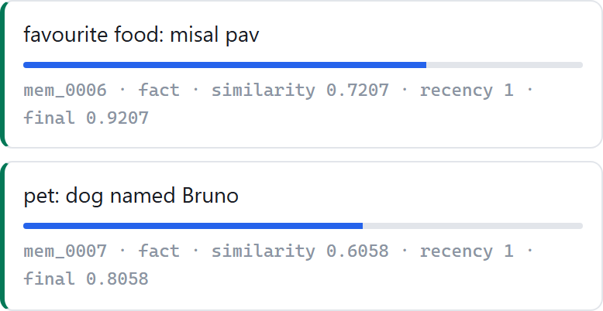
STEP 2, RETRIEVAL
Searching by meaning instead of by words
Every memory is turned into a list of 384 numbers by a model that runs on this machine. Sentences with a similar meaning end up with similar numbers, so we can compare meaning by measuring the angle between two lists.
Measured on our own system
I live in Pune and My home city is Pune
score 0.821
The same sentence against I enjoy playing cricket
score 0.351
Live from the running system. Every retrieved memory shows its similarity, its recency and the final score.
Similarity alone is not enough, because it has no sense of time. Two memories can match a question equally well while one of them is months out of date. So the final score adds a small bonus for being recent, and a small bonus for being a tidy fact rather than a raw sentence.
Notes:
This slide answers the first likely jury question, how do you retrieve the right memory.

Slide 7
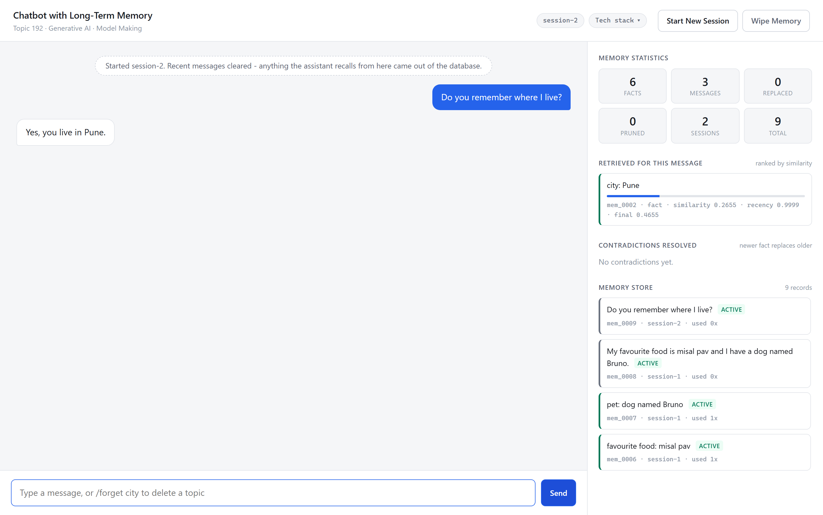
STEP 3, ACROSS SESSIONS
Remembering after the program restarts
Chat history alone is not memory. To show the difference, the demo starts a new session, which empties the list of recent messages completely.
From that point there is nothing in the running program to answer from. Anything the assistant recalls has to come out of the database on disk.
What the screenshot shows
Working memory is empty
The question is asked fresh
The answer still names Pune
Session 2, started with recent messages cleared.
Notes:
Offer to close the program entirely and restart it. The memory survives because it is written to disk, not held in the process.

Slide 8
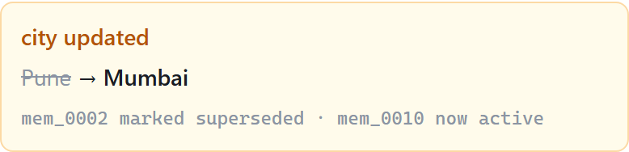
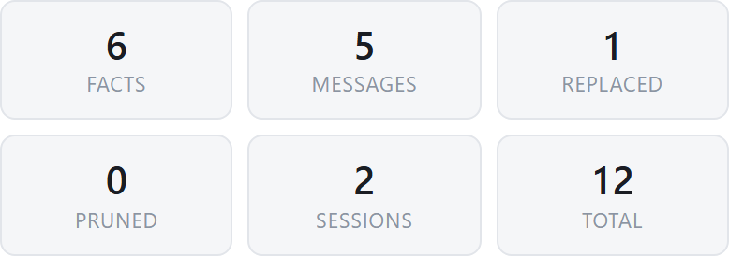
STEP 4, CONFLICTING FACTS
A newer fact retires the older one
When the user says something that contradicts a stored fact, the old record is not deleted and the two are not kept as equals. The old one is marked as replaced and stays in the database as history. Searches only look at current records, so the outdated value can never be returned again.
BEFORE
city: Pune
current
The panel names both records, so the change is auditable during the demo.
AFTER
city: Pune
replaced
city: Mumbai
current
Keeping the old record rather than overwriting it means the history of a fact can still be read back, which matters if anyone ever needs to check why the assistant believes something.
Replaced facts are counted separately from current ones.
Notes:
This answers the second likely jury question, how do you handle outdated or conflicting memories.

Slide 9
EVIDENCE
Why similarity on its own gets this wrong
We tested this rather than assuming it. The same four questions were asked twice, once with replaced facts filtered out and once with them left in.
QUESTION ASKED
OUTDATED FACT RETURNED
SIMILARITY SCORE
Which city am I living in?
Pune
0.424
Who do I work for?
Infosys
0.416
What sport do I like most?
football
0.651
What do I eat?
vegetarian
0.381
Filter switched off
Filter switched on
4 of 4 questions were given an outdated fact as though it were true.
0 of 4. The correct current fact was returned every time.
Notes:
Point out the football row. The outdated fact scored 0.651, which is higher than most correct answers score. Similarity is confident and wrong.

Slide 10
STEP 4, MEMORY GROWTH
Keeping the store from growing without limit
Facts are kept
Raw messages are capped
Bigger is not better
Extracted facts are small and already condensed, so they are never removed by trimming. They are the useful part of everything that was said.
Once the store holds more than one hundred raw messages, the least useful are dropped first: least often retrieved, then oldest.
Every extra memory is another candidate competing for the same few slots in the results, so an oversized store retrieves less accurately, not more.
Replacing is not the same as deleting
When a fact changes, the old version is marked as replaced and stays in the database so the history can be read. When the user asks the assistant to forget a topic, those records are removed from the database completely. The two are deliberately different operations, because a request to delete personal data has to actually delete it.
Notes:
Trimming only touches raw messages. If asked what happens to a pruned message, the facts extracted from it were already saved separately, so the information is not lost.

Slide 11
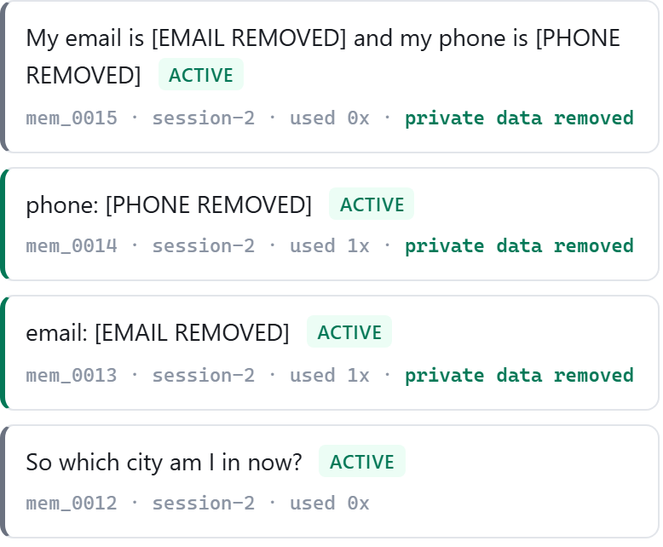
STEP 5, PRIVACY
Personal details are removed before saving
Redaction happens on the way in, not on the way out. Email addresses, phone numbers and identity numbers are replaced with a label before the record is written, so the real value never reaches the database file at all.
Nothing is sent away to be indexed
The model that creates the vectors runs on this machine, so stored memories never travel to an API.
The user can ask for deletion
A forget command removes every record about a topic from the database permanently.
An honest boundary
Redaction protects what is stored. The message the user has just typed is still sent so the assistant can reply to it.
The stored records, with the email and phone number already replaced.
Notes:
Be ready for the follow up about the live turn. The answer is that redaction is applied at the storage boundary and redacting the live message is listed in future scope.

Slide 12
EVALUATION
Results
Twenty two questions, with the correct answer for each decided before any test was run. Twelve are worded plainly and ten the way people actually talk. Accuracy is not reported, because almost every stored memory is irrelevant to any one question, so a system that returned nothing at all would still score well on it.
MEASURE
RESULT
WHAT IT MEANS
Recall at 4
1.000
Every question found its memory
MRR
1.000
The correct memory was always first
Correct at rank 1
22 of 22
No question was answered from the wrong memory
Contradictions
4 of 4
New value returned, old value never
Conversational
0.900 to 1.000
After padding is stripped from the question
Precision at 4
0.694
Capped by design, see the note below
Each question has one correct memory and we return four, which caps precision at 0.25 by definition. Rank one accuracy and MRR are the measures that fit this task.
Notes:
Read one row, not all six. Say that precision is capped by design before anyone asks why it is the lowest number here.

Slide 13
LIMITATIONS
What this system does not do well
Wording changes the score
One user at a time
The same question phrased politely scores lower, because the extra words dilute the sentence vector. Stripping the padding recovers most of it, but the underlying weakness remains.
There is a single memory store. Separating memory per user is designed for but not yet built.
Extraction depends on consistent naming
A small test set
If the model records a detail as location one time and city the next, the two are never compared and a contradiction goes unnoticed.
Twenty two questions is enough to find real faults but too few to claim a precise figure. The numbers show behaviour, not a benchmark.
Redaction covers storage only
The message the user has just typed is still sent to the model, because the assistant has to read it in order to reply.
Notes:
Stating limitations plainly is worth marks. Do not hide the failure cases.

Slide 14
FOUNDATIONS
What this project is built on
CONCEPT
WHERE IT IS USED
Fixed context window of a transformer
The reason the project exists. The model keeps no state between calls, so memory has to be built around it.
Text embeddings and vector space
A local model turns each memory into 384 numbers so that meaning can be compared instead of words.
Cosine similarity search
Retrieval ranks memories by the angle between vectors. Values are normalised, so the comparison is a dot product.
Retrieval augmented generation
Retrieved memories are placed in the prompt before the model generates. The corpus searched is the user's own history.
Prompt design and system messages
Memories go in the system message, kept separate from what the user actually said, so the two are never confused.
Decoding controls
Temperature is zero when extracting facts so the result is repeatable, and higher when writing a reply.
All six come from Unit 2, Transformers and Large Language Models.
Notes:
Be ready to be questioned on any row here.

