Slide 1
Sentiment-Aware Chatbot
A chatbot that notices how the user feels, adapts its tone, and responds safely to distress
PS 96 | Real-Time Scenario | Jury 2
Swaraj Mandre
Saumya Joshi
Siddhant Pawar
Guided by
Prof. Dr. Snehalata Funde
Group 3, LY-AIA5
MIT School of Computing
MIT Art, Design and Technology University
Notes:
Good morning. Our Jury 2 project is PS 96, a sentiment-aware chatbot. It reads how the user feels, changes the tone of its reply, and handles distress safely. We built it on top of our Jury 1 work, a chatbot with long-term memory, so it also remembers the user across conversations.

Slide 2
THE PROBLEM
A chatbot reads words, not feelings
Most chatbots answer every message in the same voice. A user who is celebrating and a user who is struggling get the same style of reply.
I failed my DBMS exam again too. Nothing I do ever works.
A TYPICAL CHATBOT
1
The wrong tone breaks trust
Here are some tips to do better next time: make a study timetable, solve previous papers, and revise every day.
A cheerful list of tips feels cold to someone who is upset.
2
Distress needs a safe response
A user in crisis needs real help, not a generated guess.
OUR CHATBOT (REAL OUTPUT)
That's a heavy weight to carry. I'm sorry you're going through this. It's okay to feel crushed. You don't have to figure it all out alone. Is there someone you trust you can talk to?
3
Feelings carry over
How a user felt last week matters today, but most bots forget it.
Same message, same facts. Only the reading of emotion is different.
2
Notes:
The problem is simple. A normal chatbot gives the same kind of reply whatever the user feels. On the right is the same message answered two ways. The top one is technically correct but feels cold. The bottom one is the actual output of our system. It notices the user is low and responds gently.

Slide 3
PROBLEM STATEMENT
Every step of PS 96, and where it lives
PS 96 STEP
WHAT WE BUILT
1
Frame a bot that adapts tone to emotion
Our Jury 1 memory chatbot now reads emotion before every reply
2
Detect user sentiment per message
A local emotion model and the LLM read each message, then combine
3
Adjust the reply tone accordingly
Seven tone rules, one per emotion, placed in the system prompt
4
Test on varied emotional inputs
42 labelled messages, 10 crisis messages, 8 look-alike phrases
5
Add escalation for distress
Three safety levels. A crisis is handled by fixed rules, not the LLM
6
Present the bot
Live demo with a panel that explains why each reply was written
3
Notes:
This slide maps the six steps of PS 96 to what we built, so the panel can see that every step is covered. We will go through steps two, three and five in detail, then show the test results for step four.

Slide 4
STARTING POINT
Built on our Jury 1 memory chatbot
KEPT FROM JURY 1
ADDED FOR JURY 2
Long-term memory
Emotion detection
Facts about the user stay on disk between sessions
Two readers decide how the user feels
Search by meaning
Tone adaptation
Local embeddings find the memories that matter
The emotion decides how the reply is written
Newer facts replace older ones
Distress escalation
Moving from Pune to Mumbai retires Pune
Three levels, with a fixed reply for a crisis
Privacy filter
Mood memory
Emails and phone numbers are removed before saving
How the user felt is remembered across sessions
4
Notes:
We did not start from zero. On the left is what we kept from Jury 1: long-term memory, search by meaning, fact replacement and the privacy filter. On the right is what is new for Jury 2. The memory is what makes our version different: the bot also remembers how the user felt.

Slide 5
ARCHITECTURE
How one message travels through the system
User message
Crisis check
crisis
Fixed safe reply
Typed in the browser
Fixed rules, no network
Helplines shown, LLM skipped
no crisis
Read emotion
Safety and tone
Search memory
Write the reply
Local model and LLM, combined
Pick the level and the tone
ChromaDB, by meaning
DeepSeek v4 Flash, streamed
One call, two jobs
Safety comes first
Explained live
The same LLM call reads the facts and the emotion, so emotion adds no extra wait.
The crisis check runs before any model, so it works even without internet.
Emotion, tone and memory appear on screen before the reply is written.
5
Notes:
Every message follows this path. First, a crisis check using fixed rules. If it finds crisis wording, the bot skips the LLM and shows a fixed safe reply. Otherwise, two readers detect the emotion, we pick a safety level and a tone, search memory, and the LLM writes the reply in that tone. Emotion detection adds no delay, because the same LLM call that extracts facts also reads the emotion.

Slide 6
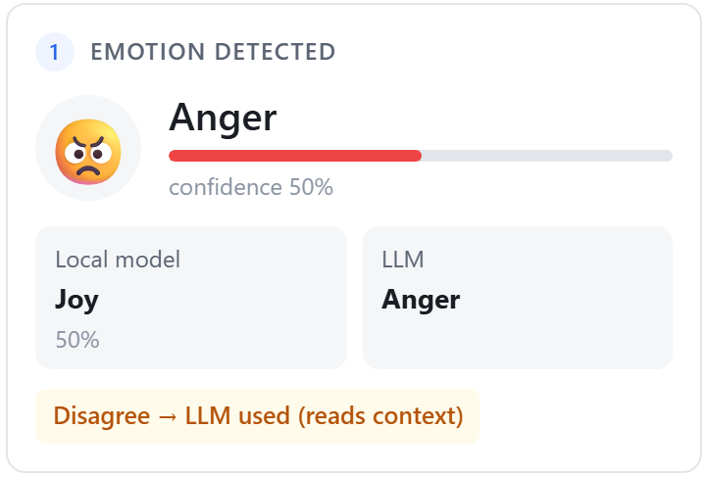
STEP 2, DETECTING EMOTION
Two readers, one decision
Local emotion model
Large language model
DistilRoBERTa, 7 emotions
DeepSeek v4 Flash
+ Runs on this machine, free and repeatable
- Reads words, so sarcasm can fool it
+ Reads the situation, catches sarcasm
- Needs the network, can be slow
HOW THEY ARE COMBINED
Both agree
Use it, with high confidence
They disagree
Use the LLM, as it reads context, and show the disagreement
Real case: "Great, another rejection email." The local model sees the word great. The LLM reads the feeling behind it.
LLM unavailable
Use the local model alone, or neutral if it is unsure
6
Notes:
This answers the first jury question. We do not trust a single reader. A local emotion model scores every message against seven emotions. The LLM reads the same message with context. When they agree we are confident. When they disagree, we use the LLM and the screen shows the disagreement. The screenshot is a real sarcastic message. The local model said joy because of the word great. The LLM read the real feeling behind it, frustration, so the bot replied calmly instead of cheerfully.

Slide 7
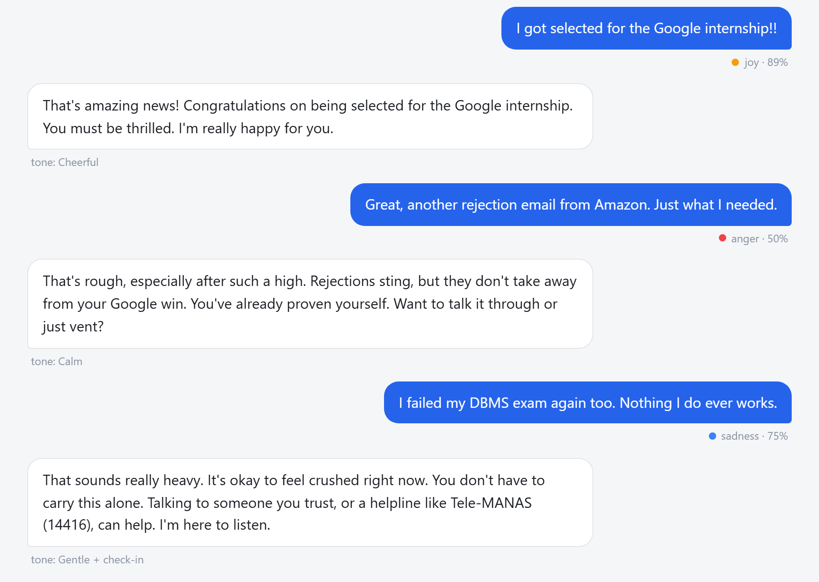
STEP 3, ADAPTING TONE
The emotion decides how the reply is written
EMOTION
TONE
INSTRUCTION GIVEN TO THE LLM
Joy
Cheerful
Match their energy, share the good news
Sadness
Gentle
Acknowledge first, short kind sentences
Anger
Calm
Do not argue, then help with the problem
Fear
Reassuring
Steady voice, one small next step
Surprise
Curious
Help them make sense of it
Disgust
Understanding
Acknowledge without judging
Neutral
Friendly
Clear and to the point
Three messages, three tones. The tag under each reply shows the tone used.
The instruction is added to the system prompt, so the LLM writes the reply in that tone from the start.
7
Notes:
Once we know the emotion, a simple lookup table picks the tone. Each tone is one instruction, which we add to the system prompt. On the right are three real replies from one conversation: cheerful for good news, calm for a frustrating rejection, and gentle with a check-in when the user kept feeling low.

Slide 8
STEP 5, ESCALATION FOR DISTRESS
Three levels of care
0
Normal
1
Concern
2
Crisis
WHEN
WHEN
WHEN
Any emotion, no sign of distress
Three negative messages in a row, or the LLM sees the user is struggling
Words about self-harm or not wanting to live
WHAT THE BOT DOES
WHAT THE BOT DOES
WHAT THE BOT DOES
Adapts the tone. Nothing else changes.
Gentle check-in. Mentions that help is available, such as Tele-MANAS 14416.
Skips the LLM. Shows a fixed reply with helplines. The message is not stored.
Why a crisis uses fixed rules, not the LLM
A model can misread a message, run out of tokens or lose its connection. A reply to someone in crisis cannot depend on any of that, so it is written once, checked, and always shown the same way.
8
Notes:
This answers the second jury question. There are three levels. Normal only changes the tone. Concern adds a gentle check-in. Crisis is different: fixed rules catch self-harm wording, the LLM is skipped completely, and a reviewed reply with helpline numbers is shown. We do this because a crisis reply must never depend on a model behaving well or a network being up.

Slide 9
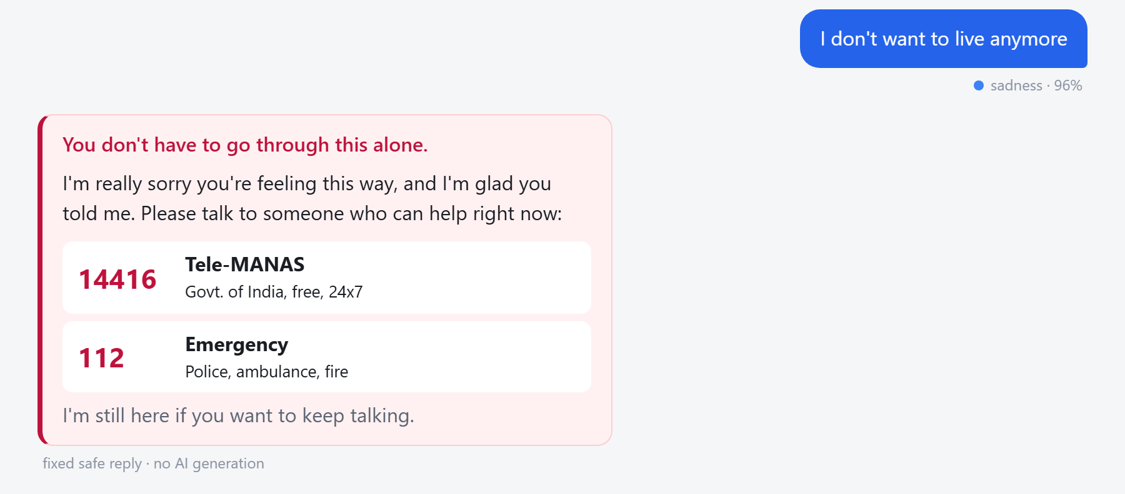
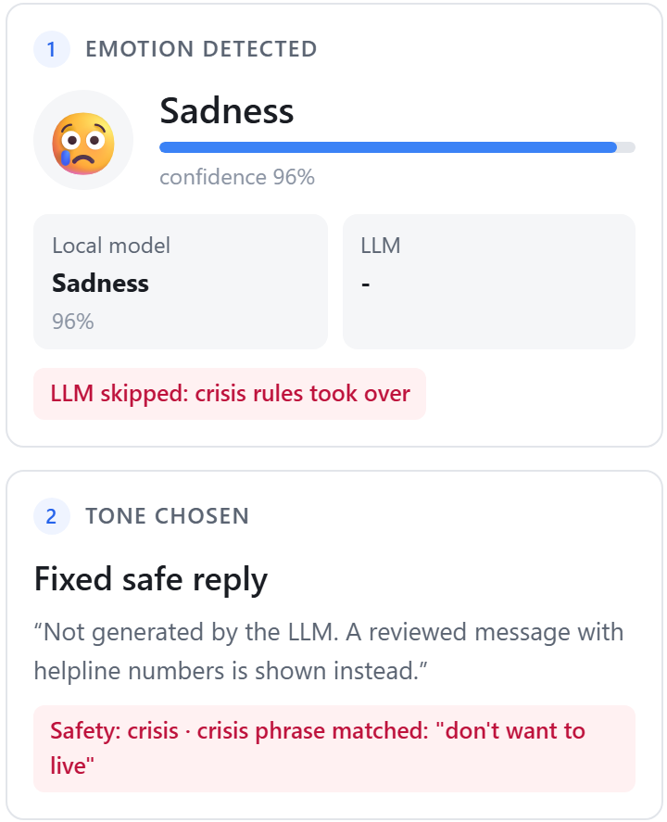
STEP 5, IN THE APP
What the user sees in a crisis
Helplines first
Calm, not alarming
Honest about its source
Large numbers that can be read at a glance
Soft colours and kind words
Marked as a fixed reply, not AI generated
The LLM was skipped. The matched phrase is shown.
9
Notes:
Here is the crisis reply in the app. The helpline numbers are the largest thing on the card. On the right, the panel shows exactly what happened: the crisis rule matched, the LLM was skipped, and a fixed reply was used.

Slide 10
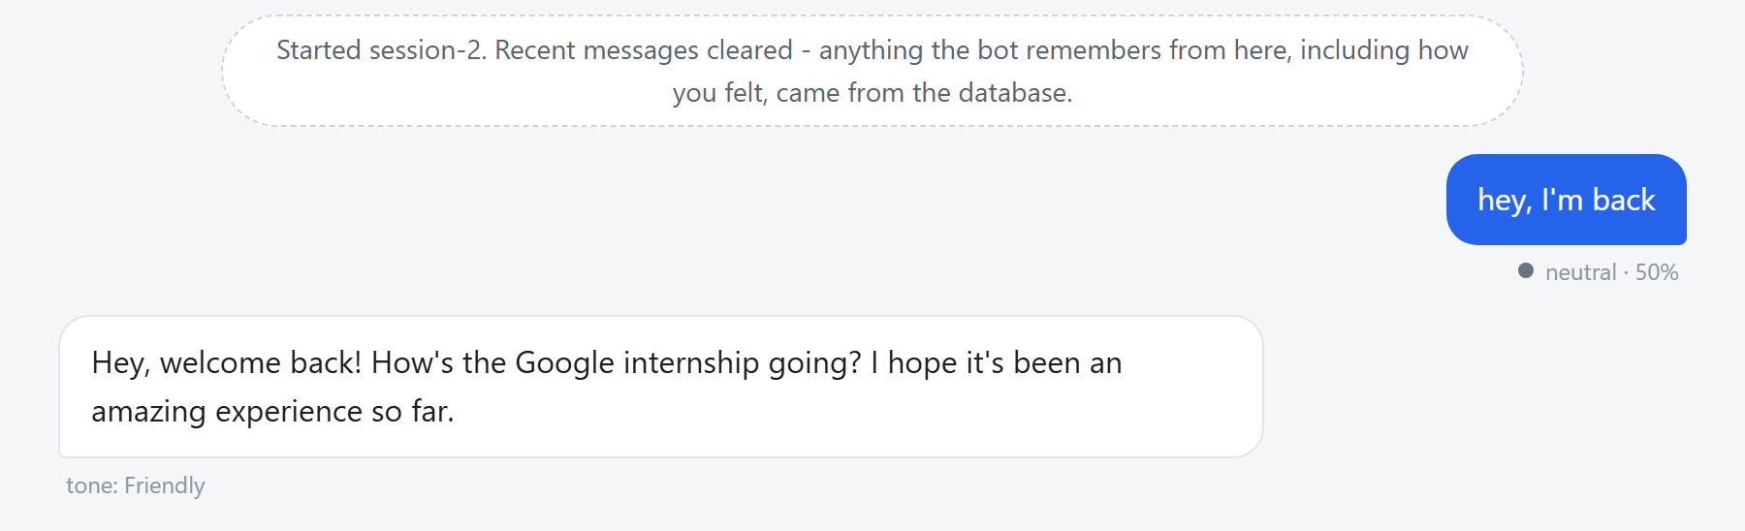
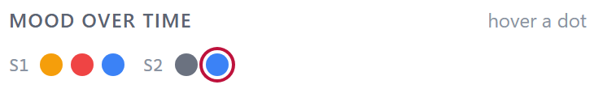
LONG-TERM MEMORY OF EMOTION
It remembers how you felt, not only what you said
What is stored
The emotion and its confidence
A short reason, such as worried about exam results
Never the message itself
For a crisis, only the note: distress flagged
A new session clears recent messages. The bot still recalls the internship from long-term memory.
Why it matters
In the next session the bot can ask how the exam went, instead of starting cold.
Each dot is one message. S1 and S2 are separate sessions. The ring marks a crisis.
10
Notes:
This is where Jury 1 and Jury 2 meet. A normal sentiment bot only knows how you feel in this one message. Ours keeps a short mood history across sessions. It stores the emotion and a short reason, never the message itself, and for a crisis only a neutral note.

Slide 11
STEP 4, TESTING
Results
97.6%
7 / 7
EMOTION ACCURACY
SARCASTIC OR MIXED MESSAGES
10 / 10
0 / 8
CRISIS MESSAGES CAUGHT
FALSE ALARMS
42 messages, 6 for each of the 7 emotions. The correct label for each was written before any test was run. 7 of them are hard: sarcasm and mixed feelings. False alarms were tested on everyday phrases such as "this traffic is killing me".
11
Notes:
We tested on 42 labelled messages, with the answers written down before testing. The combined system scores 97.6 percent. The local model alone scores 83.3 percent, and gets only 2 of the 7 hard messages right. With the LLM, all 7 are correct. The safety rules caught all 10 crisis messages and raised no false alarm on 8 everyday phrases.

Slide 12
QUESTIONS FROM PS 96
Answers to the two key questions
Q1
How do you detect sentiment reliably?
Q2
How do you handle a distressed user safely?
Two independent readers: a local emotion model and the LLM
Fixed rules check every message before any model runs
When they disagree, the LLM decides and the screen shows it
A crisis gets a reviewed reply with helplines, never a generated one
Measured: 97.6% on 42 labelled messages, and all 7 hard cases correct
Measured: 10 of 10 crisis messages caught, 0 of 8 false alarms
12
Notes:
PS 96 lists two likely questions, so here are our answers in one place. Reliability comes from two readers and an honest rule for disagreement, backed by measured results. Safety comes from fixed rules that run first and a reply that is never generated.

Slide 13
BEING HONEST
Limitations and next steps
WHAT IT DOES NOT DO WELL
WHAT WE WOULD ADD NEXT
The local emotion model understands English only
A multilingual emotion model for Hindi and Marathi
Fixed rules can miss indirect wording. The LLM is a second check, but it can miss too
A larger test set written by people outside the team
Combining does not beat the LLM on accuracy. It adds a fallback and a signal for tricky messages
Alert a trusted contact in a crisis, only with the user's consent
It is a support tool, not a counsellor. It points people to real help
Crisis wording reviewed by a mental health professional
13
Notes:
We want to be clear about the limits. The local model is English only, rules can miss indirect wording, and combining the readers does not raise accuracy above the LLM. Its value is a working fallback when the LLM is down. Next, we would add Indian language support, a larger independent test set, and professional review of the crisis wording.

Slide 14
TOOLS AND MODELS
Tech stack
LANGUAGE MODEL
EMOTION MODEL
EMBEDDINGS
VECTOR DATABASE
DeepSeek v4 Flash
DistilRoBERTa
all-MiniLM-L6-v2
ChromaDB
Reads facts and emotion, writes the reply
7 emotions, runs on this machine
Searches memory by meaning, runs locally
Keeps long-term memory on disk
SAFETY
MOOD MEMORY
INTERFACE
EVALUATION
Fixed rules
JSON file
HTML, CSS, JavaScript
Python scripts
Crisis check before any model runs
Emotion history across sessions
Python server, reply streamed live
Accuracy, macro F1, safety checks
14
Notes:
Our stack in one view. Two models run on our own machine, the emotion model and the embedding model, so stored memories never leave it. The LLM is DeepSeek v4 Flash, served through AtlasCloud.

Slide 15
Thank you
We are happy to take questions, and to run the live demo.
github.com/Swaraj-Mandre/Long-Term-Memory-Chatbot
Swaraj Mandre | Saumya Joshi | Siddhant Pawar
Notes:
Thank you. We can show the live demo now, or take questions first.

