Slide 1
COST VOLUME PROFIT ANALYSIS

Slide 2
What is cost?
Cost refers to the monetary value of resources sacrificed or spent to achieve a specific objective, produce goods or services, or acquire something.
In simple terms, it’s the amount paid or payable to obtain a benefit.
In accounting, cost represents the expenditure incurred to acquire or manufacture a product or service.
In economics, cost can also include opportunity cost — the value of the next best alternative forgone.
Examples of Cost
Buying raw materials for production.
Paying wages to workers.
Depreciation on machinery used to produce goods.

Slide 3
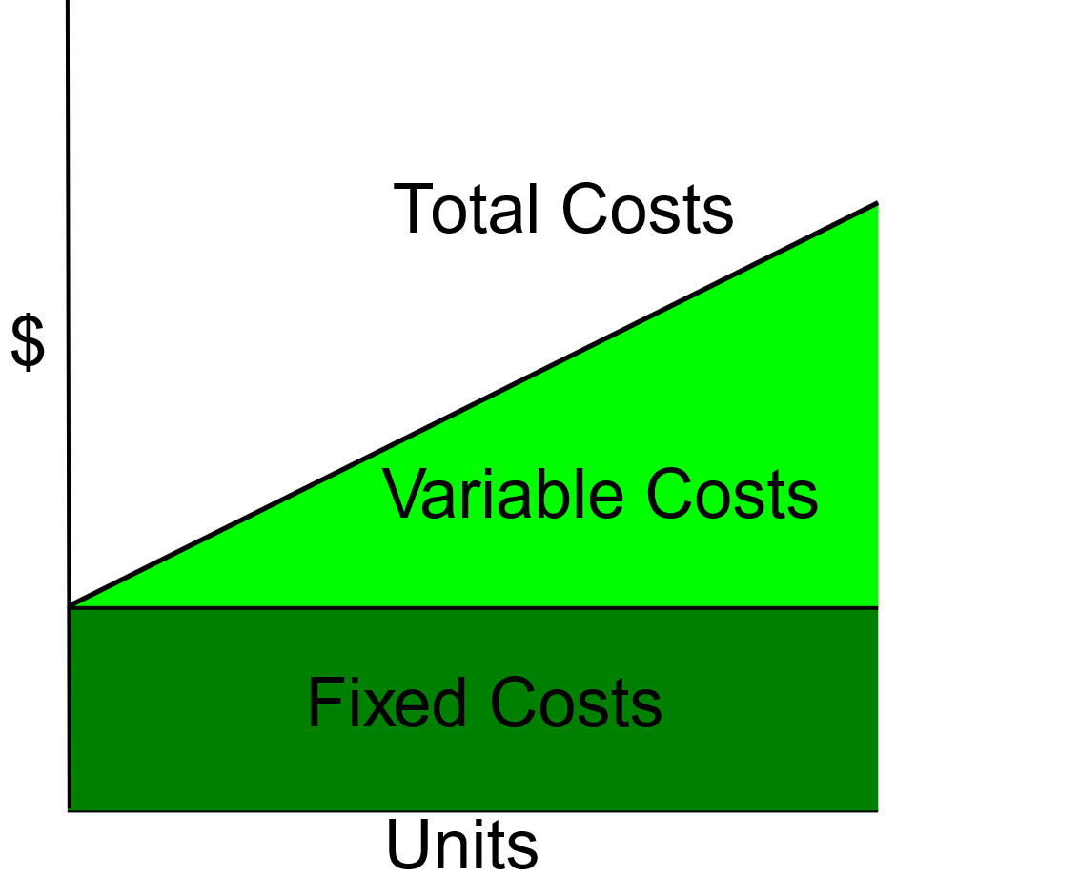
TYPES OF COST

Slide 4
1. By Nature / Behavior
Fixed Costs: Remain constant regardless of production volume.
Example: Factory rent, managerial salaries.
Variable Costs: Change in proportion to production volume.
Example: Raw materials, direct labor.
Semi-Variable (Mixed) Costs: Have both fixed and variable components.
Example: Telephone bills with a fixed line rent plus usage charge.

Slide 5
2. By Traceability
Direct Costs: Can be directly identified with a specific product, job, or process.
Example: Direct materials, direct labor.
Indirect Costs (Overheads): Cannot be directly traced to one product; shared costs.
Example: Factory lighting, supervisor salary.

Slide 6
3. By Decision-making Purpose
Opportunity Cost: Value of the next best alternative forgone.
Relevant Cost: Costs directly affected by a specific decision.
Sunk Cost: Costs already incurred and cannot be recovered.
Controllable / Uncontrollable Costs: Costs managers can or cannot influence.

Slide 7
4. By Time
Historical Costs: Actual costs incurred in the past.
Pre-determined Costs: Estimated or budgeted costs set in advance.

Slide 8
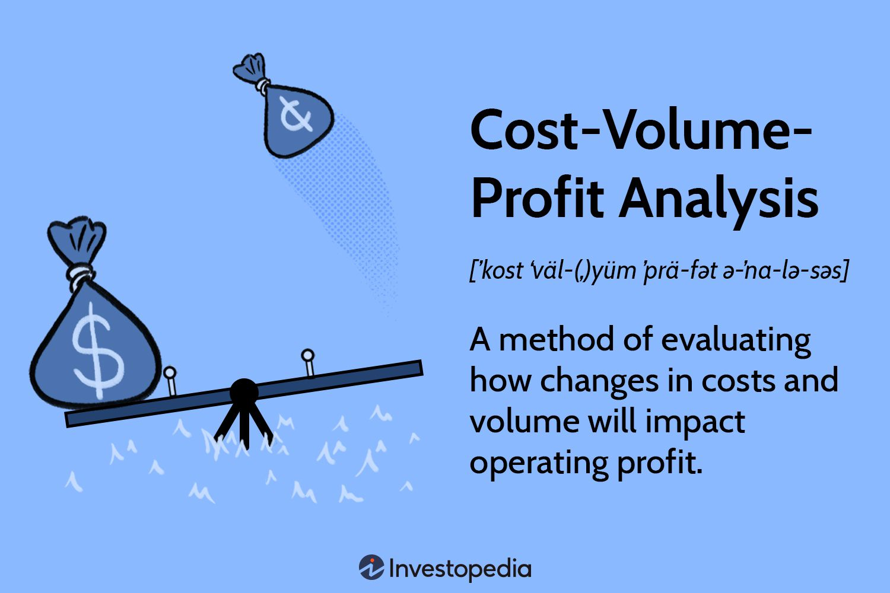

Slide 9
MEANING
The Cost -Volume-Profit (CVP) analysis is an attempt to measure the effect of changes in volume, cost, price and products-mix on profits.
These variables are inter-related, each one of them, in turn, is affected by a number of internal and external factors.
For instance, costs vary due to choice of plant, scale of operations, technology, efficiency of work-force and management efficiency. Etc

Slide 10
ASSUMPTIONS OF CVP
All costs can be resolved into fixed and variable elements.
Semi-variable cost can be segregated into both the variable and its fixed components.
Selling price per unit is constant.
Variable cost per unit is constant.
Total fixed cost remain unchanged regardless of output.
Only one product is involved and in case of a multi-product organization, there is a constant sales mix.
The only factor affecting costs and revenues is volume
Over the activity range being considered costs and revenues behave in a linear fashion
Risk and uncertainty are non-existent
There is a relevant range.

Slide 11
BASIC TERMINOLOGIES
Break-even: Break even explains a situation where a company is making neither profit nor loss. A company that makes neither profit nor loss is said to be breaking even.
Contribution: this is the difference between sales revenue and variable cost.
Contribution margin ratio (CMR): This is also known as contribution to sales ratio (C/S ratio) or Profit volume ratio. It is designed to measure the level of contribution derivable from a specified amount.
Margin of Safety: This indicates the extent to which sales may decrease before loss begin to set in.

Slide 12
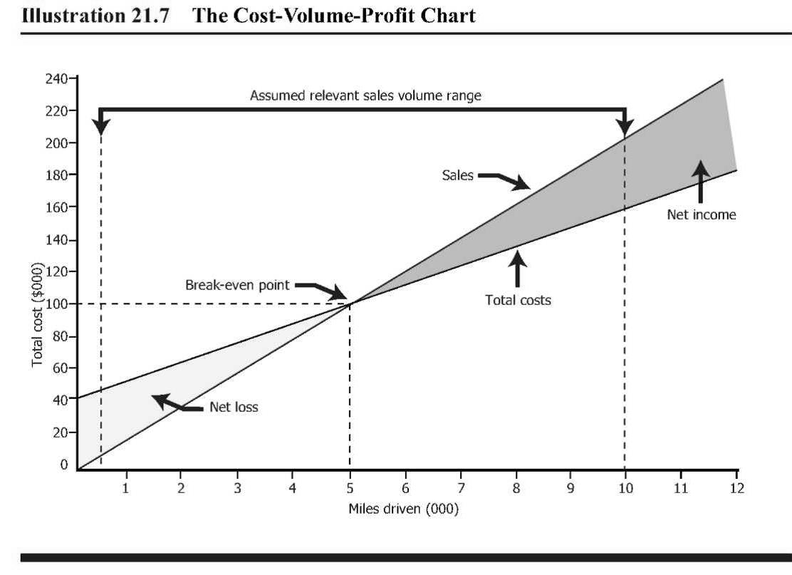

Slide 13
Contribution =
Sales price per unit – Variable cost per unit
Break even =
Fixed cost/Contribution per unit
Break even (Rs.) =
BEP (Units)*Sales price
P/V Ratio =
(Contribution /Sales revenue)*100
Margin of safety=
Actual sales-break even sales

Slide 14
PRACTICE QUESTIONS
Assume that as an investor, you are planning to enter the construction industry as a panel formwork supplier. The potential number of forthcoming projects, you forecasted that within two years, your fixed cost for producing formworks is Rs. 300,000. The variable unit cost for making one panel is Rs. 15. The sale price for each panel will be Rs. 25. If you charge Rs. 25 for each panel, how many panels you need to sell in total, in order to start making money?
Answer: 30,000 panels

Slide 15
Suppose you intend to open a franchise business to
supply a nationally-known line of women’s shoes. You’ve
found a good location in Abbottabad to open your shop,
and have determined that the average prices and costs of
operating the store are:
Price = Rs. 50 per pair
Cost = Rs. 30 per pair
Rent=Rs.2,500per month
Insurance = Rs. 500 per month
Fixed Utilities & Telephone = Rs. 300 per month
In addition, you plan to hire two sales ladies on a commission basis of 10% in order to provide them with incentive to sell shoes. You are required determine the breakeven point in Rupees?
Answer: Rs. 11,000

Slide 16
A manufacturing company supplies its products to construction job sites. The average monthly fixed cost per site is Rs. 4,500, while each unit cost Rs. 35 to produce and selling price is Rs. 50 per unit. Determine the monthly breakeven volume.
Answer: 300 Units

Slide 17
A store sells t-shirts. The average selling price is Rs. 15 and the average variable cost (cost price) is Rs. 9. Thus, every time the store sells a shirt it has Rs. 6 remaining after it pays the manufacturer. This Rs. 6 is referred to as the unit contribution.
Suppose the fixed costs of operating the store (its operating expenses) are Rs. 100,000 per year. Find Break-even in units?
Answer: 16,667 t-shirts

Slide 18
R Kumar provides you with the following information.
Calculate PV ratio based on this information.
YEAR | SALES | PROFIT
1990 | 10,000 | 2,000
2010 | 15,000 | 4,000

Slide 19
Units (Q) | Total Cost (TC) | Total Revenue (TR)
0 | 100 | 0
1 | 120 | 40
2 | 140 | 80
3 | 160 | 120
4 | 180 | 160
5 | 200 | 200
6 | 220 | 240
7 | 240 | 280
8 | 260 | 320
9 | 280 | 360
10 | 300 | 400

