Slide 1

ANALYSIS OF THE MARKET

Slide 2
WHAT IS MARKET ANALYSIS?
A market analysis studies the attractiveness and the dynamics of a special market within a special industry. It is part of the industry analysis and thus in turn of the global environmental analysis.
Through all of these analyses the strengths, weaknesses, opportunities and threats (SWOT) of a company can be identified. Finally, with the help of a SWOT analysis, adequate business strategies of a company will be defined.
The market analysis is also known as a documented investigation of a market that is used to inform a firm's planning activities, particularly around decisions of inventory, purchase, work force expansion/contraction, facility expansion, purchases of capital equipment, promotional activities, and many other aspects of a company.

Slide 3
WHAT DOES MARKET ANALYSIS INCLUDE?
In a market analysis, we study the dynamics of the market, such as volume and value, potential customer segments, buying patterns, competition, and other important factors. A thorough marketing analysis should answer the following questions:
Who are my potential customers?
What are my customers’ buying habits?
How large is my target market?
How much are customers willing to pay for my product?
Who are my main competitors?
What are my competitors’ strengths and weaknesses?

Slide 4
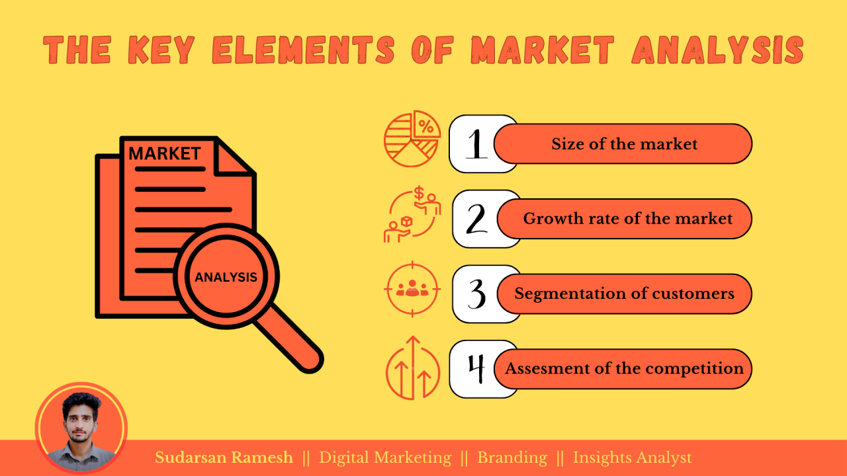

Slide 5
Size of the Market:
Understanding the size of the market is fundamental for businesses aiming to identify their potential customer base and estimate the revenue opportunities. By determining the total addressable market (TAM), businesses can evaluate the potential demand for their products or services. This involves assessing factors such as the population size, demographics, geographic distribution etc. Accurate market sizing provides a foundation for strategic planning, resource allocation, and setting realistic business goals.
Growth Rate of the Market:
Assessing the growth rate of the market helps businesses gauge the future potential and viability of their products or services. This element focuses on analyzing the market trends, and external factors that can influence market expansion. Understanding the growth rate enables businesses to identify emerging opportunities, anticipate shifts in demand, and align their strategies accordingly. Additionally, it aids in evaluating the market saturation level and potential barriers to entry.

Slide 6
Segmentation of Customers:
Customer segmentation is a vital aspect of market analysis that involves dividing the target market into distinct groups based on shared characteristics and behaviors. By segmenting customers, businesses can gain a deeper understanding of their diverse needs, preferences, and buying behaviors. This facilitates the development of tailored marketing strategies, product positioning, and effective communication strategies. Customer segmentation allows businesses to prioritize their efforts, personalize offerings, and maximize customer satisfaction, ultimately leading to increased market share and customer loyalty.
Assessment of Competition:
A comprehensive analysis of the competitive landscape is crucial to navigate the market successfully. This element involves identifying and evaluating direct and indirect competitors, analyzing their strengths, weaknesses, market share, and strategies. Understanding competitor positioning, pricing, distribution channels, and marketing tactics enables businesses to identify their unique selling proposition (USP) and develop effective differentiation strategies. Furthermore, assessing competition fosters market intelligence, helps identify market gaps, and allows businesses to stay agile and responsive to market changes.

Slide 7
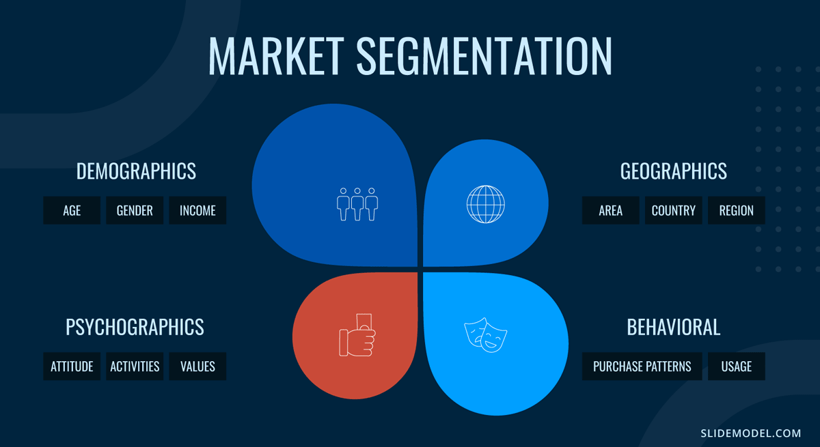

Slide 8
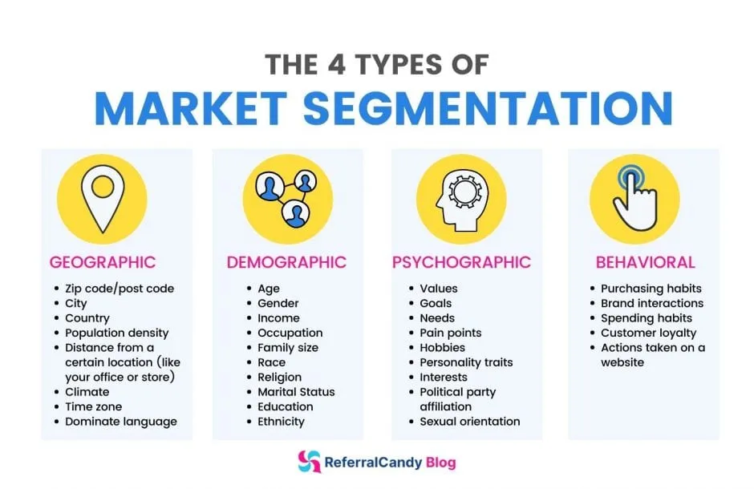

Slide 9
Benefits of market analysis
Risk reduction: Knowing your market can reduce risks in your business, since you’ll have an understanding of major market trends, the main players in your industry, and what it takes to be successful, all of which will inform your business decisions. To help you further protect your business, you can also conduct a SWOT analysis, which identifies the strengths, weaknesses, opportunities and threats for your business.
Targeted products or services: You are in a much better position to serve your customers when you have a firm grasp on what they are looking for from you. When you know who your customers are, you can use that information to tailor your business’s offerings to your customers’ needs.
Emerging trends: Staying ahead in business is often about being the first to spot a new opportunity or trend, and using a marketing analysis to stay on top of industry trends is a great way to position yourself to take advantage of this information.
Revenue projections: A market forecast is a key component of most marketing analyses, as it projects the future numbers, characteristics and trends in your target market. This gives you an idea of the profits you can expect, allowing you to adjust your business plan and budget accordingly.
Evaluation benchmarks: It can be difficult to gauge your business’s success outside of pure numbers. A market analysis provides benchmarks or key performance indicators (KPIs) against which you can judge your company and how well you are doing compared to others in your industry.
Context for past mistakes: Marketing analytics can explain your business’s past mistakes or industry anomalies. For example, in-depth analytics can explain what impacted the sale of a specific product, or why a certain metric performed the way it did. This can help you avoid making those mistakes again or experiencing similar anomalies, because you’ll be able to analyze and describe what went wrong and why.
Marketing optimization: This is where an annual marketing analysis comes in handy – regular analysis can inform your ongoing marketing efforts and show you which aspects of your marketing need work, and which are performing well in comparison to the other companies in your industry.

Slide 10
1 | Risk reduction | Before expanding to a new city, a restaurant analyzes local food preferences to avoid menu failure
2 | Targeted products or services | A fashion brand learns that its target customers prefer sustainable fabrics and starts an eco-friendly clothing line.
3 | Emerging trends | Through market analysis, a food company discovers an emerging trend—a significant rise in consumer interest in plant-based and vegan diets due to health concerns and environmental awareness.
4 | Revenue projections | E-commerce Business Expansion An online fashion retailer conducts market analysis and discovers that demand for athleisure wear is growing at 15% annually in Tier-2 cities. Based on this data, they estimate: Target audience size: 1 lac potential customers Average purchase value: ₹150 Revenue 1,00,000 × ₹150 = ₹1,50,00,000 expected revenue in the first year.
5 | Evaluation benchmarks | Restaurant Chain Expansion A restaurant brand wants to open outlets in new cities. They conduct market analysis to identify industry benchmarks like: Average revenue per outlet in similar restaurants: ₹10 lakhs/month Customer footfall benchmark: 200 customers/day Average spend per customer: ₹500 Application: If their pilot outlet in City A is generating only ₹7 lakhs/month and 150 customers/day, they know they are below the industry benchmark. This insight helps them improve pricing strategy, marketing efforts, or menu offerings to reach the benchmark.
6 | Context for past mistakes | Tata Motors
7 | Marketing optimization | E-commerce Clothing Brand An online clothing brand runs ads on Facebook, Instagram, and Google Ads but notices inconsistent returns. Through market analysis, they find: Instagram Ads have a 10% conversion rate, highest among all platforms. Facebook Ads attract older demographics, but their core buyers are 18–30 years old. Customers respond better to ads featuring eco-friendly fabrics.

Slide 11

CASE STUDY

Slide 12
AMAZON
1. Introduction
Amazon is a global e-commerce leader that caters to a wide range of customers by using effective market segmentation strategies. Its ability to personalize experiences has contributed to its dominance in multiple markets.
2. Segmentation Strategy
Amazon uses multiple segmentation bases:
a) Demographic Segmentation
Age: Targets tech-savvy millennials, working professionals, families, and senior citizens.
Income: Offers products for both budget-conscious and premium buyers (Amazon Basics vs. Amazon Luxury Stores).
b) Geographic Segmentation
Global presence in over 100 countries, with localized websites (e.g., Amazon.in, Amazon.co.uk).
Adapts delivery models and product availability as per region.
c) Behavioral Segmentation
Purchase behavior: Recommends products based on browsing and buying history.
Prime Membership: Targets frequent buyers with free delivery, exclusive deals, and streaming services.
d) Psychographic Segmentation
Lifestyle & interests: Fitness enthusiasts (Amazon Fit), gamers (Amazon Gaming), eco-conscious buyers (Amazon Eco products).

Slide 13
Case Study: Coca-Cola – Market Segmentation Strategy
Background
Coca-Cola is one of the world’s largest beverage companies. It sells billions of servings daily across different countries. To cater to its diverse customer base, Coca-Cola uses market segmentation effectively.
Segmentation Approach
Coca-Cola segments its market based on 4 main bases:
Demographic Segmentation
  Age: Teens, adults, and seniors.
  Income: Different products for various price ranges (Coca-Cola, Diet Coke, Coke Zero).
Geographic Segmentation
  Different flavors for different countries (e.g., fruity flavors in Asia).
  Availability in rural and urban markets.
Psychographic Segmentation
  Lifestyle: Health-conscious consumers get Coke Zero / Diet Coke.
  Personality: Fun-loving and social customers targeted through campaigns.
Behavioral Segmentation
  Occasions: Festivals, parties, and sports events.
  Loyalty: Discounts and promotional offers for regular buyers.

Slide 14
END OF SWOT & MARKET ANALYSIS

