Slide 1
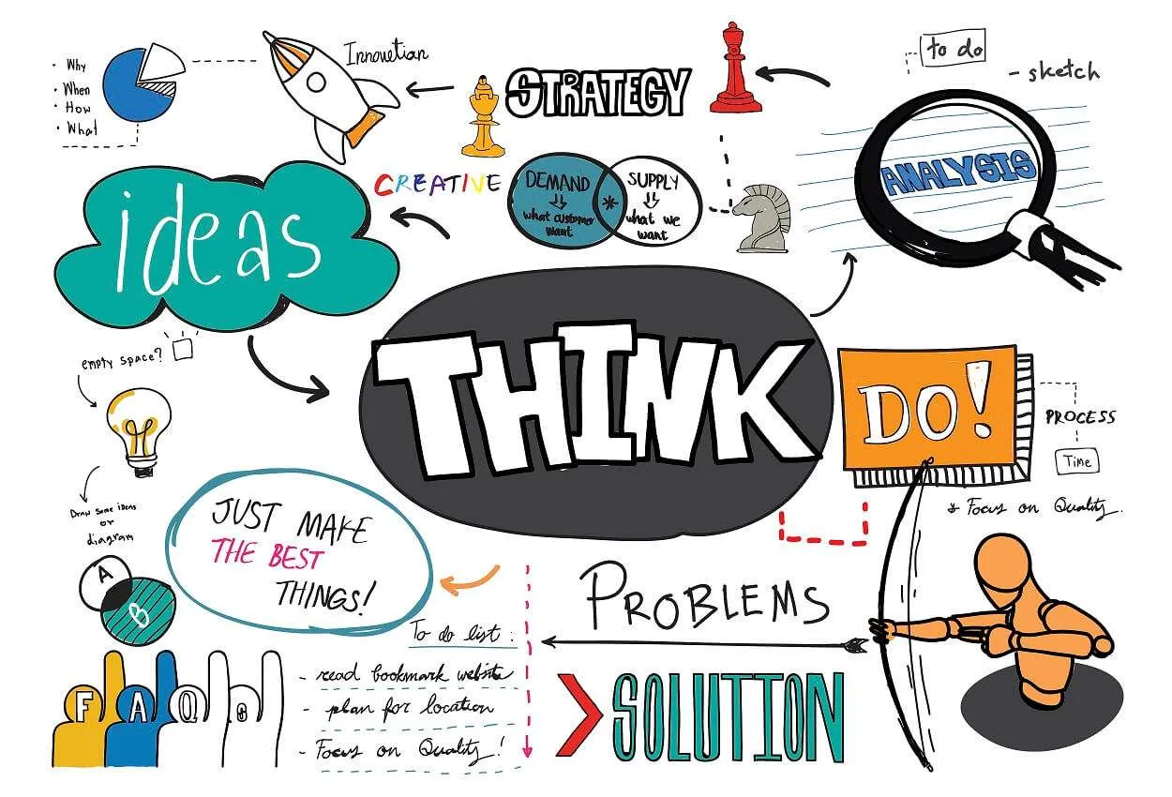
IDEA GENERATION

Slide 2
What is Idea Generation?
Idea generation is the process of creating, developing, and communicating new concepts, solutions, or innovations.
It's a crucial initial step in problem-solving, product development, and innovation, often involving techniques like brainstorming, mind mapping, and other methods to stimulate creative thinking.
Effective idea generation can lead to new opportunities, improved processes, and overall advancement in various fields.
Idea generation is described as the process of creating, developing and communicating abstract, concrete or visual ideas.
It’s the front end part of the idea management funnel and it focuses on coming up with possible solutions to perceived or actual problems and opportunities.

Slide 3
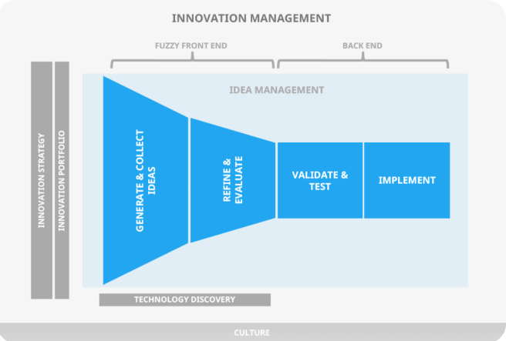

Slide 4
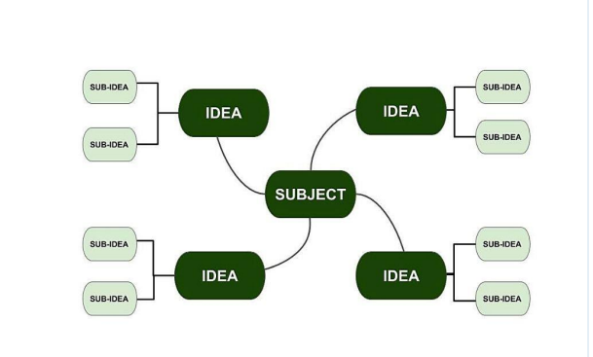

Slide 5
IDEA GENERATION PROCESS
The process may be different for different organizations and different people. But there are three main steps in the process.
It starts with the identification of the question or the problem we need to solve.
After which we need to come up with ideas and probable solutions.
Finally, in the third stage, we select the most suitable idea and execute it.
For example, let’s suppose you are opening up a restaurant. So firstly, you need to identify what question you need to answer. Let’s assume you want to decide upon a name for the restaurant. Now you will use different techniques (brainstorming, mind mapping, etc) to come up with ideas for names. In the last step, you will choose the most appropriate name from the different names you came up with within the second step.

Slide 6
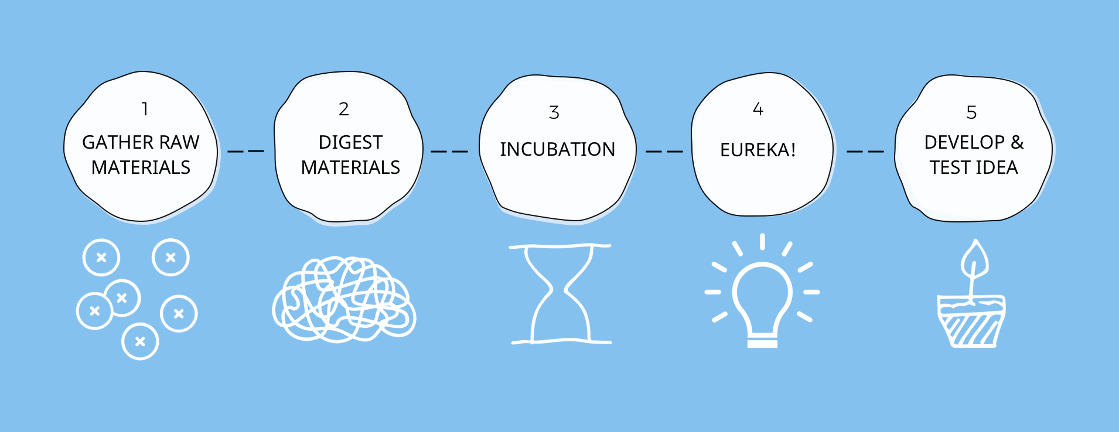

Slide 7
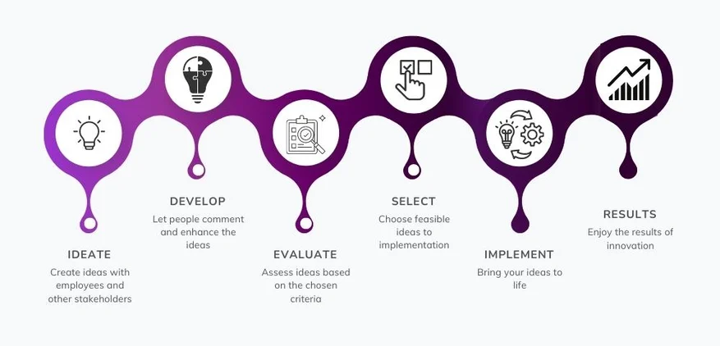

Slide 8

TECHNIQUES FOR IDEA GENERATION
Several effective techniques can be used for idea generation. Some popular methods include brainstorming, mind mapping, SCAMPER, and reverse brainstorming. These techniques help individuals and teams explore a problem, generate a wide range of potential solutions, and organize thoughts for further development.

Slide 9


Slide 10
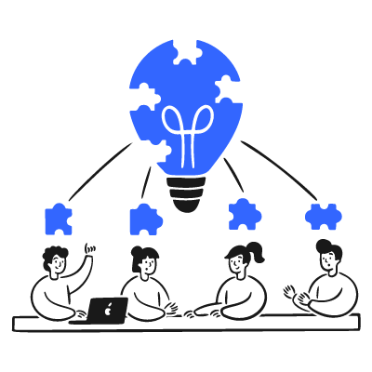

Slide 11
Brainstorming:
This involves generating ideas in a group setting without immediate criticism or judgment. The goal is to produce a large quantity of ideas, even seemingly outlandish ones, which can then be evaluated later for documenting and executing ideas smoothly.
Blue sky thinking, or brainstorming, encourages unrestrained creativity. When developing a new project, team members throw out specific details or constraints and voice any and every idea, no matter how unconventional.
While the approach might sound chaotic, focusing on quantity rather than the quality lets groundbreaking concepts emerge. Once brainstorming concludes, you scrap unrealistic suggestions and turn viable ones into actionable strategies aligned with your product vision board.

Slide 12
Brainwriting
Like brainstorming, brainwriting focuses on amassing different perspectives. But rather than shouting out ideas, team members jot everything down on paper. They then pass their papers around in a circle, and receiving teammates build on each other’s ideas by adding new perspectives or pointing out pain points. The cycle continues until everyone has their original paper back — now fleshed out with team reactions and elaborations.
This technique diversifies ideas and stimulates inclusivity, which is useful for large groups where some team members might be more comfortable verbally sharing ideas than others.

Slide 13
Activity: Brainwriting – “6-3-5 Method”
Objective:
To generate a large number of business ideas or solutions silently and collaboratively in a short time.
Instructions (6-3-5 Method):
6 Participants (can be in groups of 6)
3 Ideas per person
5 Rounds of idea sharing
🔄 Step-by-Step:
Topic:
Provide a challenge or prompt.
👉 Example: "How can we reduce plastic use in daily life?" or "Business ideas using AI for students."
Round 1 (5 minutes):
Each participant writes 3 ideas silently on a sheet of paper (no talking).
Pass & Build (5 rounds):
After 5 minutes, everyone passes their sheet to the next person. Each participant then:
  Reads the previous ideas
  Builds on or adds 3 new ideas inspired by what’s already written
Repeat for 5 rounds until the original sheet returns to its owner.

Slide 14
Mind Mapping
Mind mapping is more than just a visual outlining method. It’s a structured approach to organizing complex information and concepts.
Imagine you’re launching a new product. To create a mind map, you’d write the product's name in the center of your outline. From there, you’d draw branches representing major categories, such as marketing, product design, and distribution. Next, you’d add sub-branches that detail specific actions or elements.
This visual representation focuses on organizing every project detail, highlighting interdependencies, and ensuring teams see the big picture so they can collaborate effectively. It’s a useful way to plan complex projects while keeping sight of overarching objectives.

Slide 15
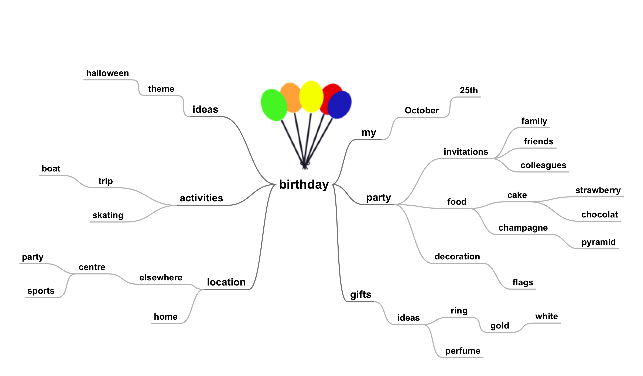

Slide 16
Mind Mapping Activity: “Start-Up Storm”
Objective:
To help students explore and organize ideas around a business concept using mind mapping.
📝 Instructions:
Topic at the Center:
  Each student (or group) to write a central idea in the middle of a blank page or chart paper.
  👉 Example: "Healthy Food Startup"
Main Branches (First Layer):
  From the center, draw 4–6 main branches representing key areas such as:
    Target Market
    Products/Services
    Marketing Strategies
    Revenue Model
    Distribution Channels
    Technology Use
Sub-branches (Second Layer):
  Expand each main branch with sub-ideas.
  👉 For example, under Target Market, sub-branches could be:
    Office goers
    Gym enthusiasts
    Students
Use Color & Visuals:
  Encourage use of colors, icons, or doodles to make the map more memorable and engaging.
Presentation & Discussion:
  Have individuals or groups present their mind maps to the class.
  Discuss the diversity of approaches and highlight creative angles.

Slide 17
SCAMPER
SCAMPER stands for substitute, combine, adapt, modify, put to another use, eliminate, and reverse. It’s a technique to reimagine existing ideas, services, and products. For teams aiming to refresh their offerings, SCAMPER is a structured way to dream up enhancements and new directions.
Imagine a product development team brainstorming ways to revitalize an old product to meet current consumer trends. Using the SCAMPER method, they explore multiple options for reinvention. The “substitute” prompt might lead to swapping a material for another with a lower cost, while “adapt” might stimulate ideas for tweaking the product to cater to a new audience.

Slide 18
Activity: Innovate with SCAMPER
Objective:
To help students think creatively and improve an existing product, service, or idea using the SCAMPER technique.
SCAMPER Prompt | Guiding Question Example
S – Substitute | What can we replace? (materials, parts, people?)
C – Combine | What can we combine with this product?
A – Adapt | What can we adapt from something else?
M – Modify | What can we change in shape, size, appearance?
P – Put to Other Use | Can it be used for something else entirely?
E – Eliminate | What can we remove or simplify?
R – Reverse/Rearrange | What happens if we flip or rearrange parts?

Slide 19
Role-playing
Sometimes, it’s helpful to step out of your role as a designer, developer, or project manager and think from your consumer's perspective. Role-playing requires you to simulate the users you aim to serve.
Role-playing in idea generation is a creative technique where participants adopt different perspectives, personas, or stakeholder roles to explore new ideas and solutions.
By stepping into someone else’s shoes, participants can break free from habitual thinking and discover innovative possibilities.
Think about building a mobile app. Instead of relying on market data alone, role-playing would have you consider the app from the perspective of your target audience. You might think of how busy parents and teenagers uniquely navigate the app, providing real-time feedback to generate potential refinements and spotlight user concerns.

Slide 20
How it works
Choose a scenario or problem
  Example: Launching a new product, improving customer service, or designing a marketing campaign.
Assign roles
  These can be realistic (e.g., customer, competitor, investor) or imaginative (e.g., a famous entrepreneur, a child, a time traveler).
Act out the roles
  Each participant shares ideas as if they were in that role.
Capture ideas
  All suggestions are recorded without criticism.
Discuss and refine
  Evaluate the collected ideas for feasibility and originality.

Slide 21
Example
Problem: How can we make our café more attractive to customers?
Role 1 (Customer): “I want free Wi-Fi and a cozy corner to read.”
Role 2 (Competitor): “We should offer something they don’t, like live music nights.”
Role 3 (Environmentalist): “Let’s use only biodegradable packaging and promote it.”

Slide 22
TO DO:-
“How can we make our campus more eco-friendly?”.
Give each participant (or group) a role. Example roles:
  Customer/Student (wants convenience and fun)
  Competitor (wants to outshine you)
  Investor (cares about ROI)
  Environmentalist (cares about sustainability)
  Technologist (loves innovation and automation)
  Celebrity Influencer (wants publicity and image boost)

Slide 23
Storyboarding
Storyboarding is a visual planning tool where you arrange a sequence of drawings, sketches, or images to represent the flow of an idea, process, or story.
It helps in organizing thoughts, visualizing solutions, and identifying gaps or improvements.
Like frames in a comic strip, storyboarding sequences your idea's journey from concept to final product. Using images, quotes, and other graphics brings procedural or product management to life. Storyboarding transforms abstract ideas into clear visual narratives, pointing out potential areas for enhancement and friction points in a way that suits visual learners.

Slide 24
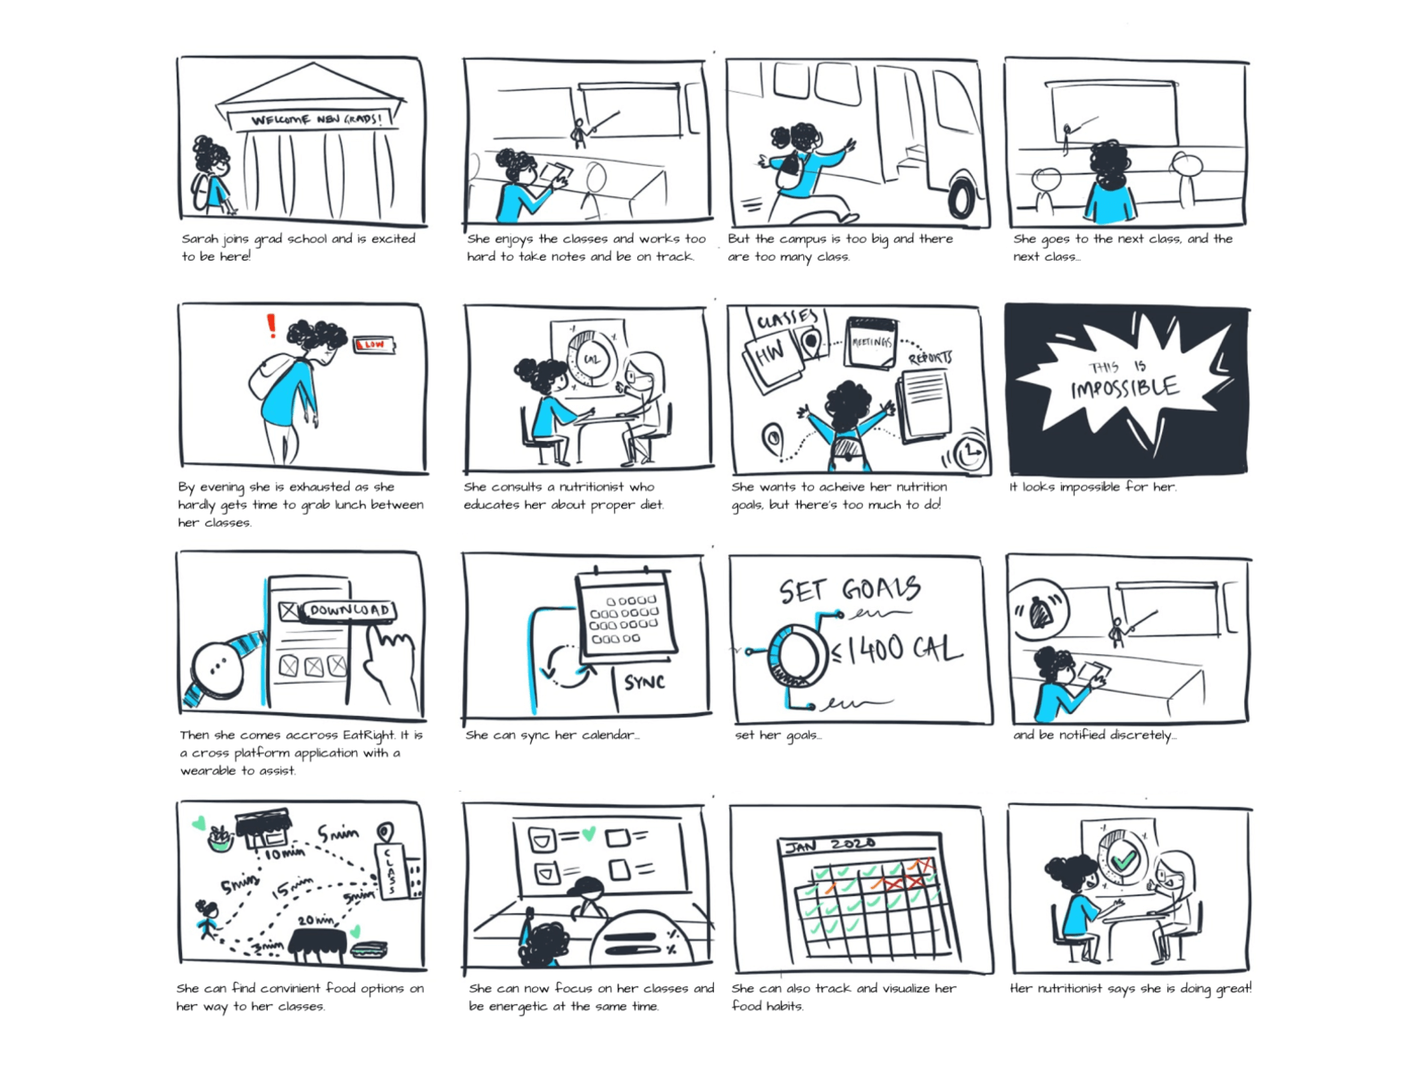

Slide 25
HOW TO ACE IDEA GENERATION?
WHO
WHAT
WHERE
WHEN
WHY
For example, suppose you want to create a new product or a service. You can do so by asking questions like, who would use the product, why would people buy it, what would it do, etc.

Slide 26
3 tips for successful idea generation
1. Clearly define the problem or opportunity
Ideas that successfully tackle a problem or seize an opportunity need clear frameworks. Start by giving a detailed definition of what ideation seeks to accomplish. When team members understand the core issue, it directs brainstorming efforts and ensures targeted and relevant suggestions.
2. Involve the right people
Idea generation benefits from diversity of thought, experience, and expertise. To enrich your solutions pool, welcome insights from team members across various departments and roles. Incorporating varied viewpoints helps you anticipate cross-departmental challenges, identify overlooked opportunities, and craft well-rounded solutions.
3. Consider execution
Throwing out ideas is just the beginning of successful ideation. It’s just as essential to develop a clear plan for evaluating, refining, and implementing new initiatives. Tools like Notion’s idea-to-execution template help nurture suggestions from start to finish.

Slide 27
Conclusion
Idea generation is the lifeblood of innovation, problem-solving, and creativity in all aspects of life and industry. It’s a dynamic process that thrives on diversity of thought, conducive environments, and the ability to overcome creative blocks. Individuals and organizations can tap into their creative potential with the right techniques and mindset. It continuously produces fresh, valuable ideas that drive progress and transformation. In an ever-evolving world, the power of idea generation remains a vital force for shaping the future.

