Slide 1
BLOCK CIPHERS AND THE DATA
ENCRYPTION STANDARD

Slide 2
      The way in which the plaintext is processed.
      A block cipher processes the input one block of elements at a time, producing an output block for each input block.
A stream cipher processes the input elements continuously, producing output one element at a time,
The basic scheme of a block cipher is depicted as follows −
A block cipher takes a block of plaintext bits and generates a block of cipher text bits, generally of same size. The size of block is fixed in the given scheme. The choice of block size does not directly affect to the strength of encryption scheme. The strength of cipher depends up on the key length.

Slide 3
Block Size
Though any size of block is acceptable, following aspects are borne in mind while selecting a size of a block.
Avoid very small block size − Say a block size is m bits. Then the possible plaintext bits combinations are then 2^{m}. If the attacker discovers the plain text blocks corresponding to some previously sent ciphertext blocks, then the attacker can launch a type of ‘dictionary attack’ by building up a dictionary of plaintext/ciphertext pairs sent using that encryption key. A larger block size makes attack harder as the dictionary needs to be larger.
Do not have very large block size − With very large block size, the cipher becomes inefficient to operate. Such plaintexts will need to be padded before being encrypted.
Multiples of 8 bit − A preferred block size is a multiple of 8 as it is easy for implementation as most computer processor handle data in multiple of 8 bits.

Slide 4
Block ciphers process blocks of fixed sizes (say 64 bits). The length of plaintexts is mostly not a multiple of the block size. For example, a 150-bit plaintext provides two blocks of 64 bits each with third block of balance 22 bits. The last block of bits needs to be padded up with redundant information so that the length of the final block equal to block size of the scheme. In our example, the remaining 22 bits need to have additional 42 redundant bits added to provide a complete block. The process of adding bits to the last block is referred to as padding.
Too much padding makes the system inefficient. Also, padding may render the system insecure at times, if the padding is done with same bits always.

Slide 5
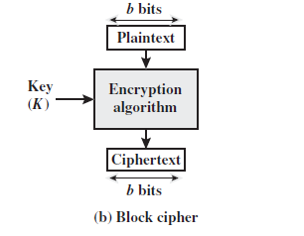

Slide 6
Feistel Block Cipher
Feistel Cipher is not a specific scheme of block cipher. It is a design model from which many different block ciphers are derived. DES is just one example of a Feistel Cipher. A cryptographic system based on Feistel cipher structure uses the same algorithm for both encryption and decryption.
FEISTEL CIPHER DESIGN ELEMENTS
block size
key size
number of rounds
subkey generation algorithm
round function
fast software en/decryption
ease of analysis

Slide 7
Substitution: Each plaintext element or group of elements is uniquely replaced by a corresponding ciphertext element or group of elements.
Permutation: A sequence of plaintext elements are replaced by a permutation of that sequence. That is, no elements are added or deleted or replaced in the sequence, rather the order in which the elements appear in the sequence is changed.

Slide 8
In fact, Feistel’s is a practical application of a proposal by Claude Shannon to develop a product cipher that alternates confusion and diffusion functions [SHAN49]. The Feistel cipher structure, which dates back over a quarter century and which, in turn, is based on Shannon’s proposal of 1945, is the structure used by many significant symmetric block ciphers currently in use.

Slide 9
In diffusion, the statistical structure of the plaintext is degenerate into long-range statistics of the ciphertext. This is achieved by having each plaintext digit affect the value of many ciphertext digits; generally, this is equivalent to having each ciphertext digit be affected by many plaintext digits.

Slide 10
The confusion seeks to make the relationship between the statistics of the ciphertext and the value of the encryption key as complex as possible . It should be as complex as attacker must be confused to deduce the key. This is achieved by the use of complex substitution algorithm.

Slide 11
DES (History)
IBM developed Lucifer cipher – by team led by Feistel in late 60’s – used 64‐bit data blocks with 128‐bit key • then redeveloped as a commercial cipher with input from NSA and others • in 1973 NBS issued request for proposals for a national cipher standard • IBM submitted their revised Lucifer which was eventually accepted as the DES

Slide 12
Data Encryption Standard
The Data Encryption Standard (DES) is a symmetric-key block cipher published by the National Institute of Standards and Technology (NIST).
DES is an implementation of a Feistel Cipher. It uses 16 round Feistel structure. The block size is 64-bit. Though, key length is 64-bit, DES has an effective key length of 56 bits, since 8 of the 64 bits of the key are not used by the encryption algorithm (function as check bits only). General Structure of DES is depicted in the following illustration −

Slide 13
Encryption Process-----
The encryption process uses the Feistel structure consisting multiple rounds of processing of the plaintext, each round consisting of a “substitution” step followed by a permutation step.
Feistel Structure is shown in the following illustration −

Slide 14
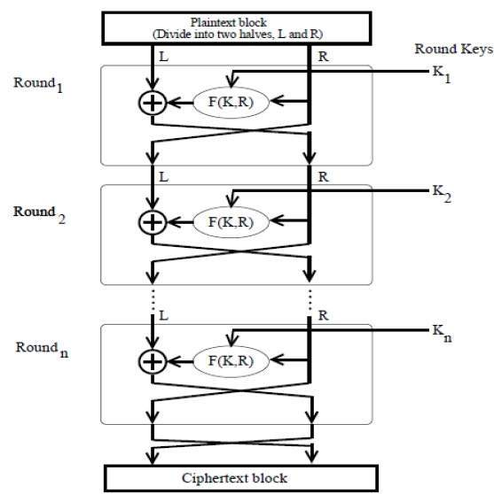

Slide 15
STEPS
The input block to each round is divided into two halves that can be denoted as L and R for the left half and the right half.
In each round, the right half of the block, R, goes through unchanged. But the left half, L, goes through an operation that depends on R and the encryption key. First, we apply an encrypting function ‘f’ that takes two input − the key K and R. The function produces the output f(R,K). Then, we XOR the output of the mathematical function with L.
In real implementation of the Feistel Cipher, such as DES, instead of using the whole encryption key during each round, a round-dependent key (a subkey) is derived from the encryption key. This means that each round uses a different key, although all these subkeys are related to the original key.

Slide 16
The permutation step at the end of each round swaps the modified L and unmodified R. Therefore, the L for the next round would be R of the current round. And R for the next round be the output L of the current round.
Above substitution and permutation steps form a ‘round’. The number of rounds are specified by the algorithm design.
Once the last round is completed then the two sub blocks, ‘R’ and ‘L’ are concatenated in this order to form the ciphertext block.
The difficult part of designing a Feistel Cipher is selection of round function ‘f’. In order to be unbreakable scheme, this function needs to have several important properties that are beyond the scope of our discussion.

Slide 17
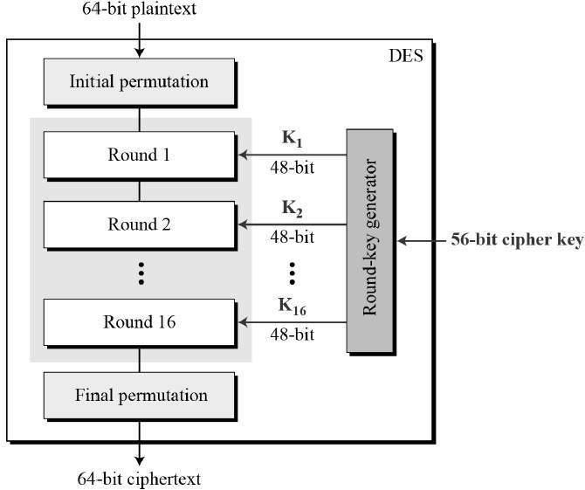

Slide 18
Decryption Process
The process of decryption in Feistel cipher is almost similar. Instead of starting with a block of plaintext, the ciphertext block is fed into the start of the Feistel structure and then the process thereafter is exactly the same as described in the given illustration.
The process is said to be almost similar and not exactly same. In the case of decryption, the only difference is that the subkeys used in encryption are used in the reverse order.
The final swapping of ‘L’ and ‘R’ in last step of the Feistel Cipher is essential. If these are not swapped then the resulting ciphertext could not be decrypted using the same algorithm.

Slide 19
Number of Rounds
The number of rounds used in a Feistel Cipher depends on desired security from the system. More number of rounds provide more secure system. But at the same time, more rounds mean the inefficient slow encryption and decryption processes. Number of rounds in the systems thus depend upon efficiency–security tradeoff.

Slide 20
128 bit
64 bit 64 bit R(56 bits key)K1
(F(K, k1)
L (64 bit)+56 bit (XOR)
Output-→ R

Slide 21
Since DES is based on the Feistel Cipher, all that is required to specify DES is −
Round function
Key schedule
Any additional processing − Initial and final permutation

Slide 22
Initial and Final Permutation
The initial and final permutations are straight Permutation boxes (P-boxes) that are inverses of each other. They have no cryptography significance in DES. The initial and final permutations are shown as follows −

Slide 23
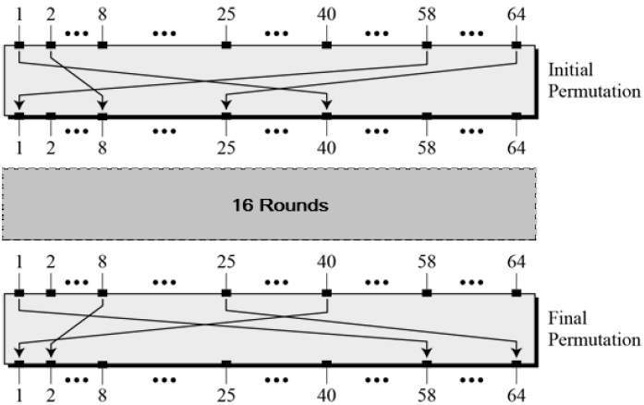

Slide 24
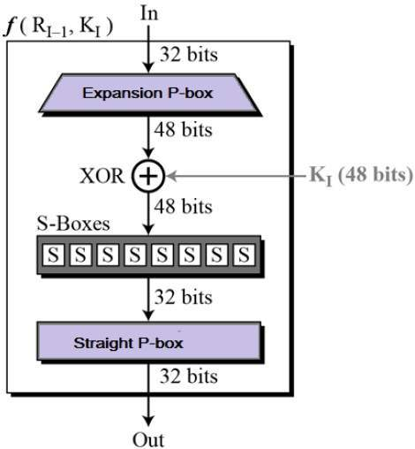
Round Function
The heart of this cipher is the DES function, f. The DES function applies a 48-bit key to the rightmost 32 bits to produce a 32-bit output. 64 bits key-56bit-k1(48bit)

Slide 25
64 bits PT
Initial permutation
L(32) R(32)
Key Length-K 64bit (56 bits)-→K1(Sub-key)48 bit
K1(48 bits) R(32)
K1(48 bit) R(48 bit) (expand) and,or,nor,xor,xand
F(K,R)—XOR=output(48) xor Left hand side(32)
Output –shift Right
Right(32)-shift Left
16 round
Final permutation
Cipher text

Slide 26
DES Analysis
The DES satisfies both the desired properties of block cipher. These two properties make cipher very strong.
A small change in plaintext results in the very great change in the ciphertext.
Completeness − Each bit of ciphertext depends on many bits of plaintext. During the last few years, cryptanalysis have found some weaknesses in DES when key selected are weak keys. These keys shall be avoided.
DES has proved to be a very well designed block cipher. There have been no significant cryptanalytic attacks on DES other than exhaustive key search.

Slide 27
STRENGTH OF DES – KEY SIZE
56‐bit keys have 256 = 7.2 x 1016 values
• brute force search looks hard

Slide 28
Strength of DES – Analytic Attack
• generally these are statistical attacks
• include – differential cryptanalysis – linear cryptanalysis – related key attacks

Slide 29
Strength of DES – Timing attack
attacks actual implementation of cipher
• use knowledge of consequences of implementation to derive information about some/all subkey bits
• specifically use fact that calculations can take varying times depending on the value of the inputs to it

Slide 30
DOUBLE DES
The simplest form of multiple encryption has two encryption stages and two keys ‐Double‐DES.could use 2 DES encrypts on each block
C = EK2(EK1(P))
Encrypt (K1,P)=E(C,K2)=final cipher
•issue of reduction to single stage (might have a single key that is equivalent to using 2 keys as above)
•“meet‐in‐the‐middle” attackworks whenever use a cipher twice
known plaintext attack
since X = EK1(P) = DK2(C)
takes O(256)search steps

Slide 31
TRIPLE‐DES WITH TWO‐KEYS
Triple‐DES with two keys is a popular alternative to single‐DES
•Encryption & decryption stages are equivalent, but the chosen structure allows for compatibility with single‐DES implementations
  •hence must use 3 encryptionswould seem to need 3 distinct keys
  •but can use 2 keys with E‐D‐E sequenceC = EK1(DK2(EK1(P)))
  encrypt & decrypt equivalent in security
  if K1=K2then can work as single DES

Slide 32
TRIPLE‐DES WITH THREE‐KEYS
Although are no practical attacks on two‐key Triple‐DES have some indications
  •We can use Triple‐DES with Three‐Keys to avoid even theseC = EK3(DK2(EK1(P)))
•It has been adopted by some Internet applications, egPGP, S/MIME

