Slide 1



Introduction
Content
Sign Out
1
Tork
AI
Transforming Information Into Decision

Slide 2
Home
Content
Sign Out
2
Team Composition
Hrishikesh Nerkar
Btech(CT)
23103900034
Parth Khairnar
Btech(CT)
23103900043
Sumit Dhivar
Bvoc(CT)
23103900049
Swaraj Kadam
Btech(CT)
23104800011
Swarupa Deshpande
Btech(CT)
23103900050

Slide 3
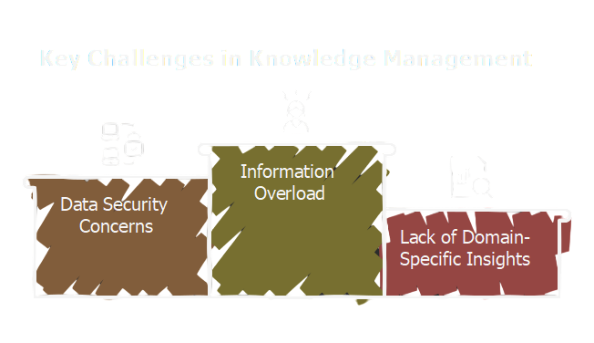
Home
Content
Sign Out
3
Problem Statement
Information Overload
Lack of Domain-Specific Insights
In today’s information-heavy world, organizations across various sectors are struggling with managing large volumes of data.
Data Security Concerns

Slide 4
Home
Content
Sign Out
4
Proposed Solution
Tork Ai
Tork AI is a Simple, domain-specific knowledge management platform that combines AI powered information retrieval with generative capabilities, providing real-time, actionable insights from an organization’s internal data.

Slide 5

Home
Content
Sign Out
5
Proposed Solution
Domain-Specific Customization
AI-Powered Knowledge Retrieval
Security and Privacy
Scalable and Flexible
Retrieval-Augmented Generation (RAG)

Slide 6
Home
Content
Sign Out
6
Work Flow
Technology
Tork AI Methodology Process
Software Components
⁓ Backend: Python
⁓ Frontend: React.js
⁓ Vector Database: Chroma
⁓ Deployment: Docker
Hardware Requirements
⁓ High-performance computational resources
⁓ Cloud infrastructure
⁓ Scalable computing environment
⁓ Secure data storage systems
Key Technical Design Aspects
⁓ Modular system architecture
⁓ Microservices design
⁓ Containerized deployment
⁓ Continuous Integration
Document Upload
Phase
Document Processing
Phase
Knowledge Base
Creation
Query Processing
Retrieval-Augmented
Generation
Solution Generation

Slide 7


Home
Content
Sign Out
7
Competitive Analysis
Data security risks
Limited integration capabilities
Lack of domain-specific customization

Slide 8
Home
Content
Sign Out
8
Competitve analysis
The knowledge management and AI solutions market is growing rapidly. However, existing tools, such as general-purpose AI models like ChatGPT, Google Gemini, and traditional knowledge management systems, have several limitations
Competetion

Slide 9
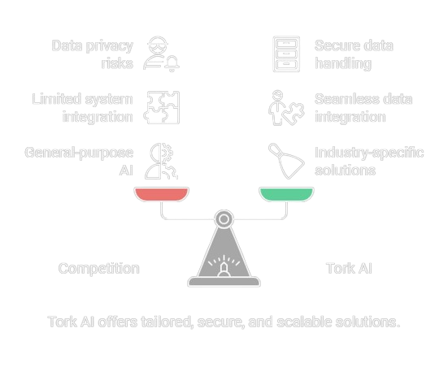
Home
Content
Sign Out
9
Competitve analysis

Slide 10
Home
Content
Sign Out
10
Thank You!

