Slide 1

G H Raisoni College of Engineering & Management
An Empowered Autonomous Institute, Affiliated to Savitribai Phule Pune University Approved by AICTE, New Delhi and Recognized by Govt. of Maharashtra, NAAC Accredited "A+" Grade Navin Gat No.1200, Domkhel Road, Wagholi, Pune - 412 207 (India)
T: +91-9604787185/186 | E: ghrcem.pune@raisoni.net | W: www.ghrcemp.raisoni.net
EmoTrack – Strengthening Mental Health
Guide:
Prof.Shubhangi Ingale
Name of Project Members
Ashwin Bahekar(BCOB75) Santosh Vishwakarma(BCOB73)
Rishikesh Durnale(BCOA55) Swaraj Singh(BCOB102)

Slide 2
Contents
Introduction
Justifications for Selecting the Title
Problem Statement
Benefits to the surrounding/society:
Disadvantages
Challenges
Literature Survey
Block Diagram
Output
Work plan
References

Slide 3
Introduction
Mental health challenges are rising among children, but identification and intervention can be difficult.
Develop a system to track and assess children's mental well-being.
Benefits:
l. Early identification of potential issues
ll. Improved access to appropriate support
lll. Better tracking of treatment progress.

Slide 4
Justification For Selecting The Title
EmoTrack is a student assessment program that uses multiple methods to measure student health.
It raises awareness about mental well-being by encouraging users to actively monitor their emotions, moods, and behaviors.
By regularly tracking their mental health, users can detect early signs of distress or decline.
EmoTrack offer a convenient and accessible platform for monitoring mental well-being anytime, anywhere.

Slide 5
Problem Statement
EmoTrack: Developing a comprehensive and effective mental health and well-being surveillance, assessment, and tracking solution among children to address the growing concern of mental health issues in this demographic.

Slide 6
Benefits to the surrounding/society:
Reduced Healthcare Burden: By promoting proactive mental health management and early intervention, EmoTrack helps alleviate the burden on healthcare systems.
Enhanced Productivity and Well-being in the Workplace: A mentally healthy workforce is more productive, engaged, and resilient.
Educational institutions: Emotrack can help educational institutions to Better understand the mental health needs of their students. Develop more effective student support programs and policies.

Slide 7
Disadvantages
Over-reliance on technology: Users may depend too much on the app, potentially neglecting other important aspects of mental health management.
Privacy concerns: There's worry about sensitive data being compromised or misused, leading to hesitancy in using these apps.
Lack of human interaction: These apps may lack the empathy and connection provided by traditional therapy or support groups, leaving users feeling isolated during times of distress.

Slide 8
Literature Survey
Sr. No. | Title | Author | Year | Findings
1 | “Mental health monitoring apps for depression and anxiety in children and young people: A scoping review and critical ecological analysis” | Jessy E. Williams , Jessica Pykett | 2022 | These findings underscore the necessity for further research and diverse perspectives in developing mental health apps for children and young people.
2 | "The role of technology in mental healthcare” | Dr Becky Inkster, Dr Christopher Burr | 2022 | Benefits and challenges associated with integrating technology into mental healthcare, emphasizing the importance of evidence-based practices and ethical considerations in this rapidly evolving field.
3 | “Mental health monitoring with multimodal sensing and machine learning: A survey” | Michael Riegler, Tine Nordgreen | 2019 | The potential of leveraging sensor data and machine learning techniques for automatic mental health monitoring, showcasing the diverse applications and challenges in this emerging field.

Slide 9
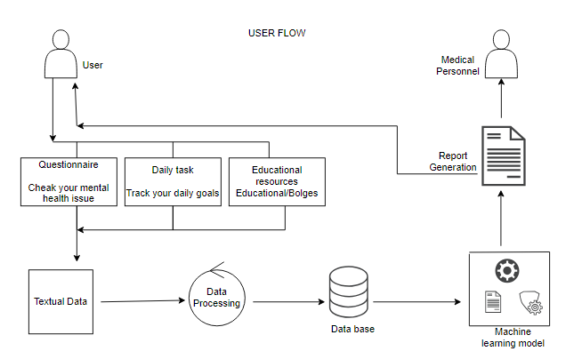
Block Diagram

Slide 10
Output
Insightful Reports: The ML-powered reports provide valuable insights into the mental health status of children. These reports highlight areas of concern, identify triggers for stress, and suggest potential interventions.
Data-informed decisions: Users make more informed decisions regarding their mental health, leveraging insights from tracked data to optimize their self-care routines and treatment plans.
Link For Datasets: /kaggle/input/mental-health-data/mental health dummy data.csv

Slide 11
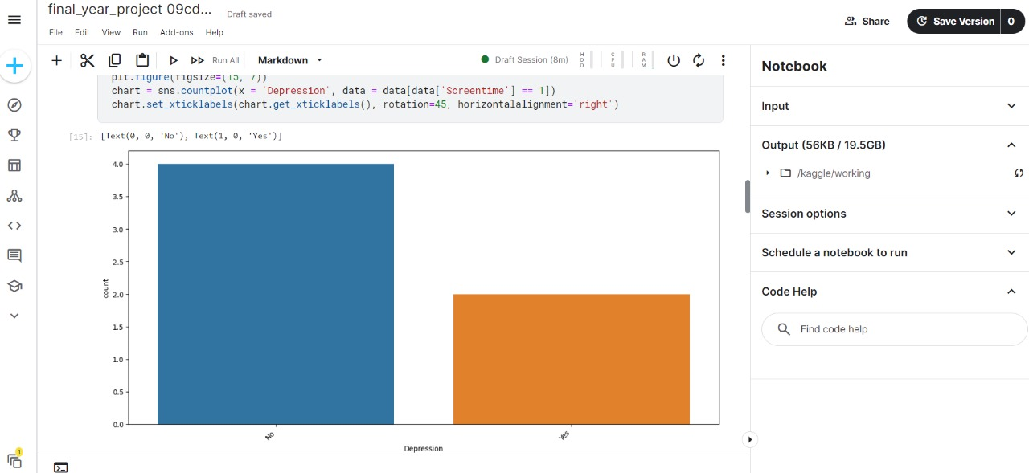
Output

Slide 12
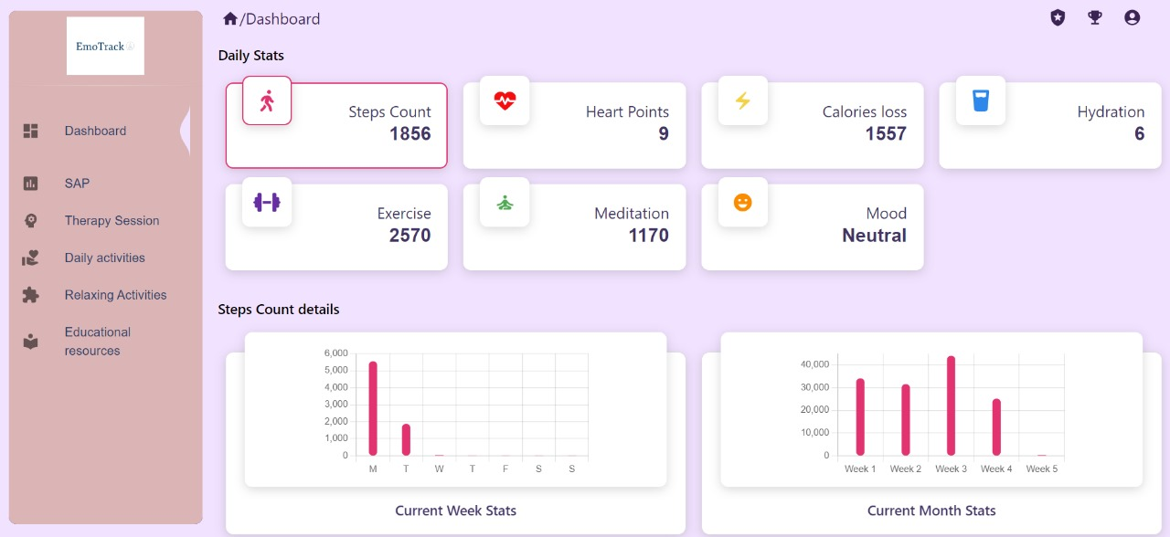
Output

Slide 13
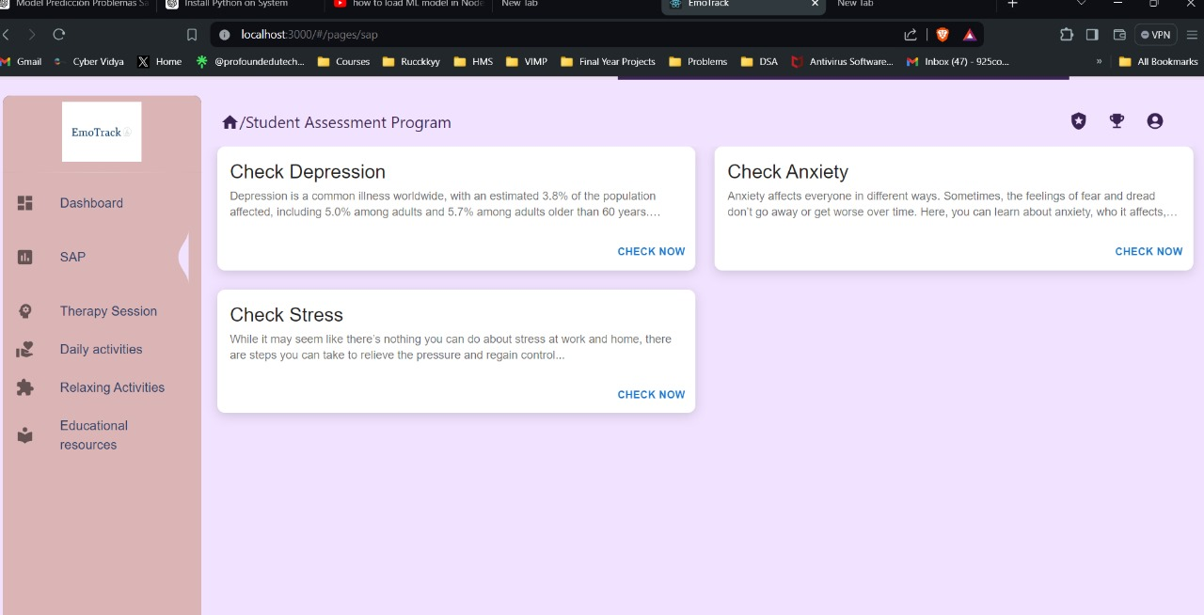
Output

Slide 14
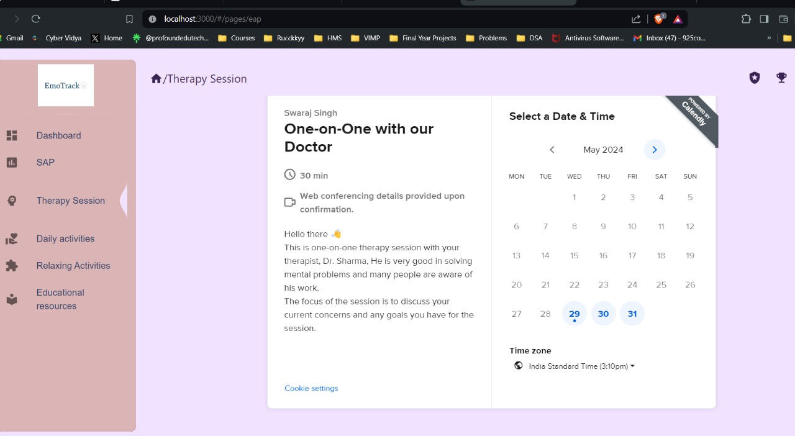
Output

Slide 15
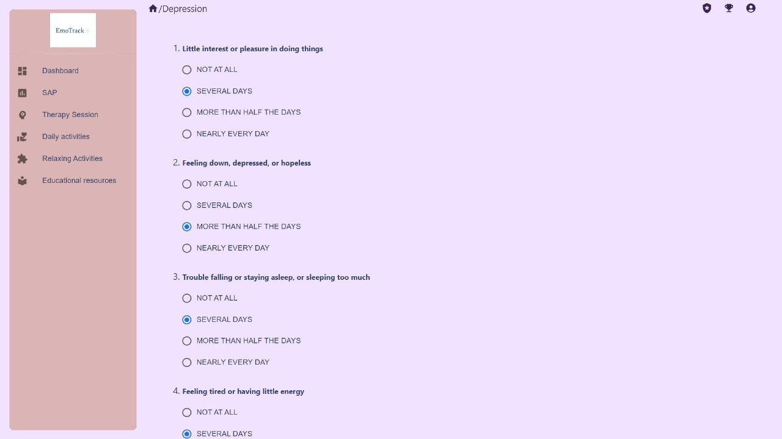
Output

Slide 16
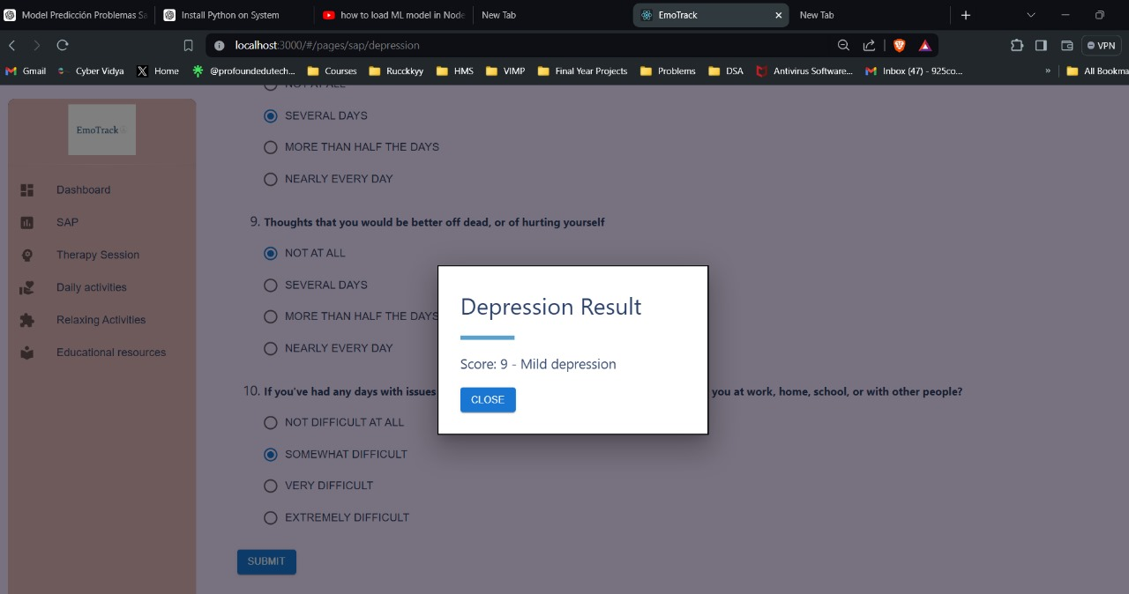
Output

Slide 17
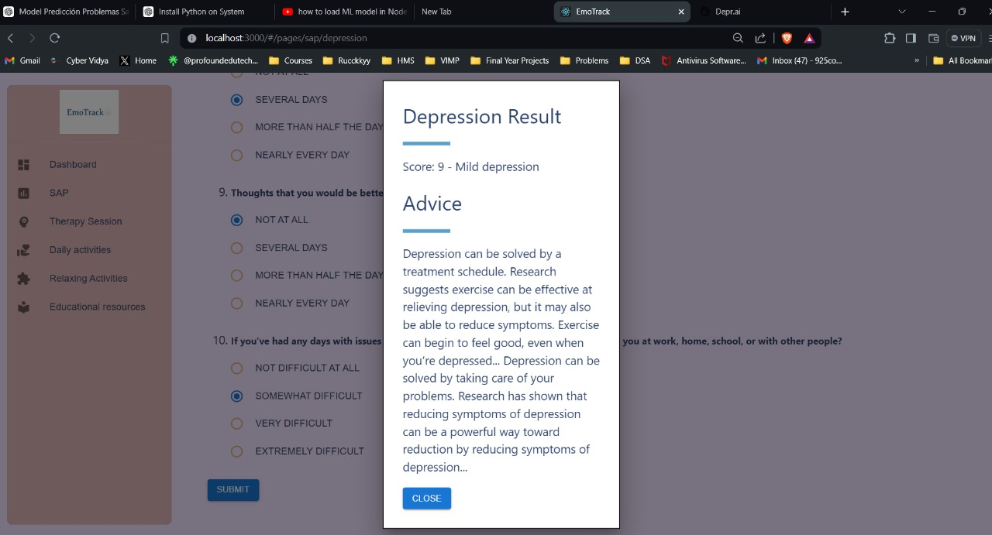
Output

Slide 18
Work – Plan
Months Activities | Jan’24 | Feb’24 | Mar’24 | April’24 | May’24 | June’24 | July’24
Literature Reviews | √ | √ | √ | √ | √
Component Identification & Selection |  | √ | √ | √ | √
Designing |  |  | √ | √ | √
Experimental Analysis |  |  | √ | √ | √
Fabrication |  |  |  | √ | √
Testing and Debugging |  |  |  | √ | √
Preparation of Project Report |  |  |  |  | √

Slide 19
References
https://www.aimprosoft.com/blog/how-to-make-a-mental-health-app/
https://www.hindawi.com/journals/acisc/2022/9970363/
https://mental.jmir.org/2020/10/e17453/
https://www.ncbi.nlm.nih.gov/pmc/articles/PMC8787665/
/kaggle/input/mental-health-data/mental health dummy data.csv

Slide 20
Thank you !

