Slide 1

Enabling flexible financing solutions through fully digital journeys for learners pursuing education programs at partner institutions.
● Under the Supervision of ●
● Submitted By ●
- Dr. Suchismita Rout
- Department of Computer Science & Engineering
- Swaraj Baral
- SIC: 180310251
01

Slide 2
My Mentors
Mr. Saad Hassan
Lead Developer, Propelld
Mr. Siddhant Raghuvanshi
Senior Backend Developer, Propelld
02

Slide 3
BACKGROUND
Propelld is working towards revolutionizing the way students look at education and financing.
The company is still looking for other modes of expansion so that they can penetrate a larger demographic.
One such largely untouched area was corporations or corporate upskilling to be exact.
Hence the idea of Propelld Learning was born.
03

Slide 4
OBJECTIVE
Main objective of this project was to build a hybrid, corporate Learning Management System.
To provide HRs with an efficient dashboard to manage courses, invite employees, remove courses.
PL also aims to solve all issues of outdated LMSes that are still prevalent to this day.
04

Slide 5
05
Problem Definition
1. Understanding Backend
Core concepts of backend developement.
2. Messaging Queues
Understanding and implementing messaging queues.
3. Propelld Learning
Backend Development of Propelld Learning (A new propelld product).

Slide 6
PROPELLD LEARNING
To create a hybrid corporate learning management system that has the features of course selection, inviting specific employees, changing courses, personalized course recommendation and assigning those courses to the invited employees.
06

Slide 7
Propelld Learning (contd.)
This is a new and upcoming product of propelld aimed at simplifying the process of upskilling its employees.
We are looking to bring in all the resources under one roof.
Concerned managers can then assign the pooled resources to their employees within the platform itself
07

Slide 8
WORK FLOW DIAGRAM
Schema Diagram
Desiging routes
Coding the controller and services
08

Slide 9
CURRENT WORK
Currently I am working on the next phase of PL.
Researching about implementing webhook events with messaging queues.
Along with this, the work on adding financing options are also underway.
For API design and testing, I am using Insomnia client.
09

Slide 10
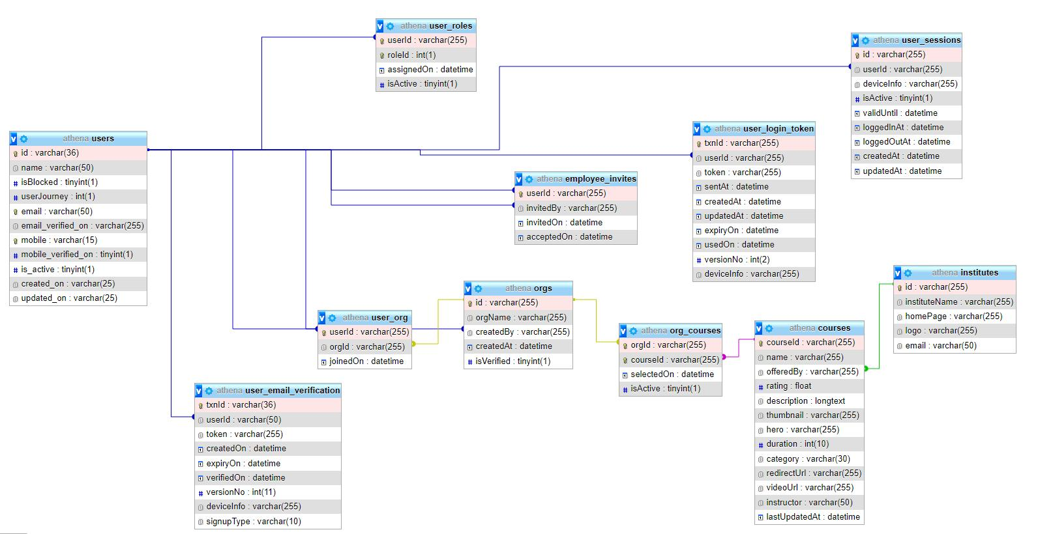
RESULTS OBTAINED
10

Slide 11
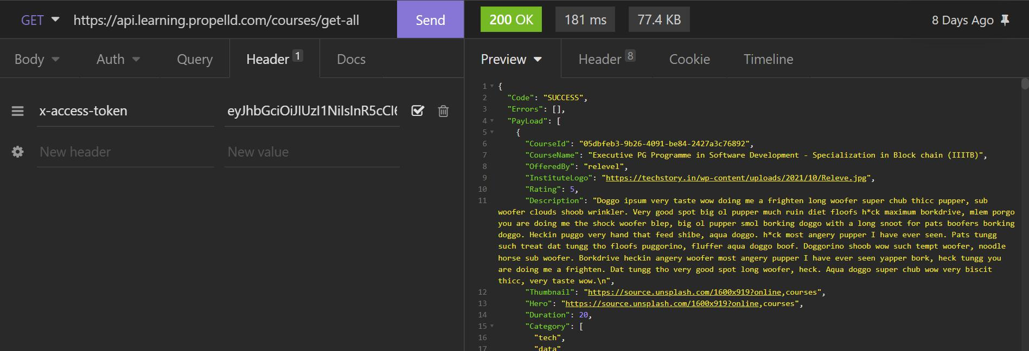
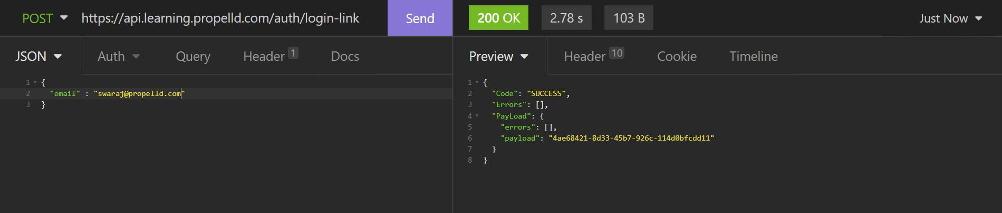
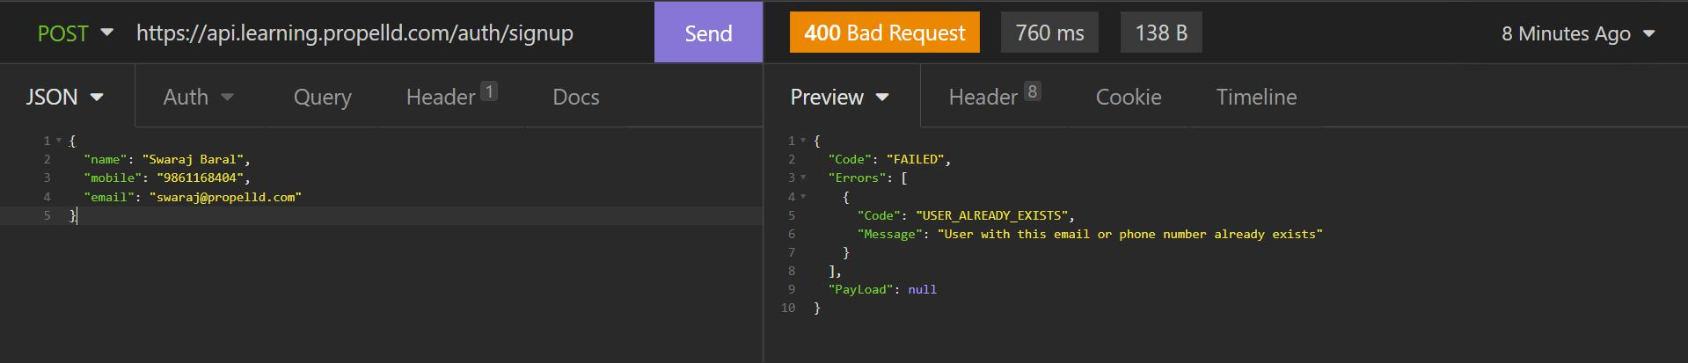
11

Slide 12
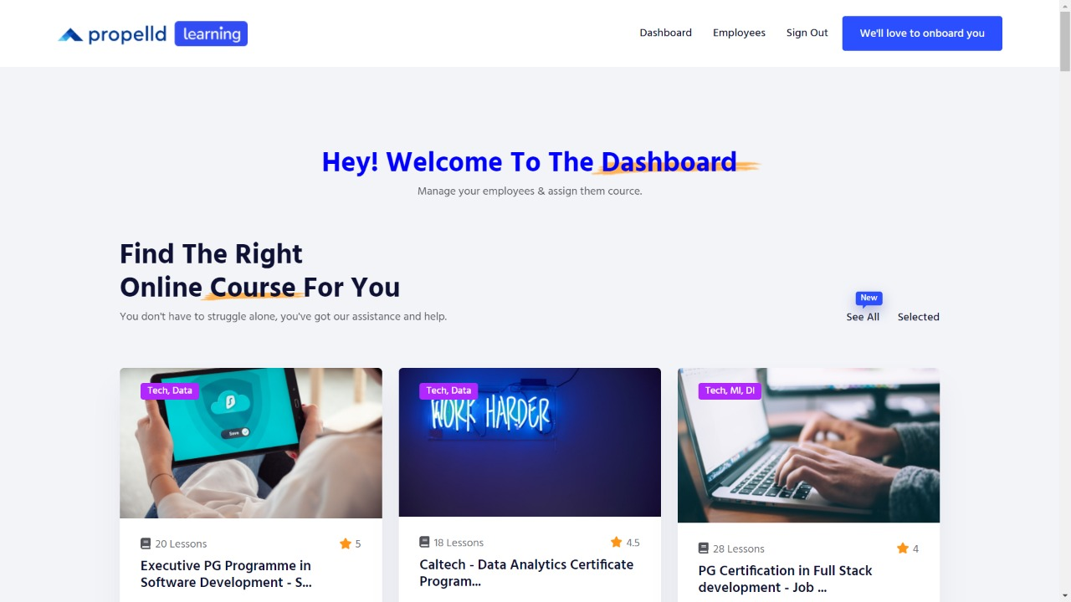
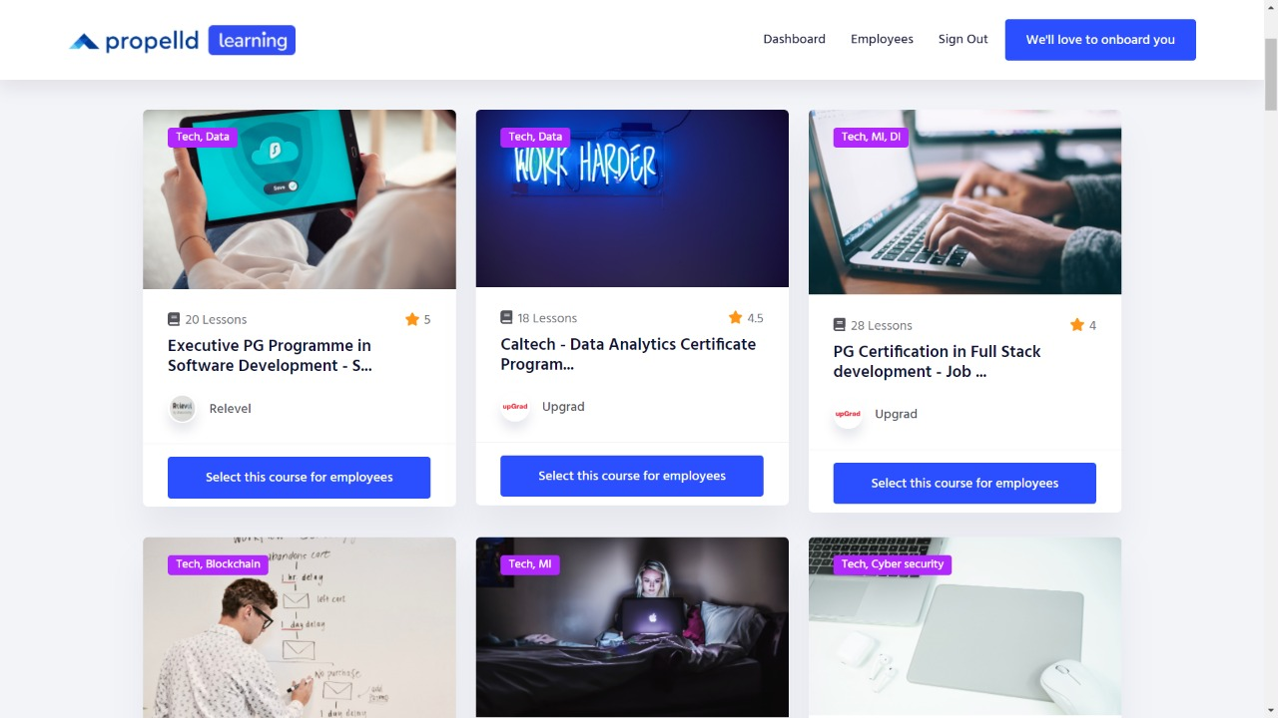
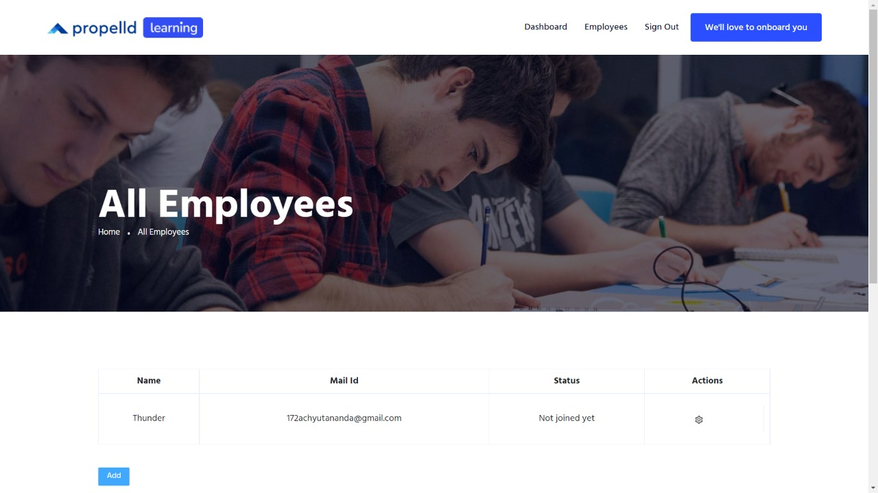

Slide 13
SOCIAL CONTRIBUTION
Hassle free upskilling
Easier User Management
Better resource utilisation
12

Slide 14
13
CONCLUSION
Writing production ready code
This PS program taught me how to differentiate between hobby projects and scalable projects.
Understanding documentations
Utisiling documentations to the fullest was something that I lacked before this internship.
Learning by doing
Every small concept was understood by implementing it in a small task or project.

Slide 15
WORK AHEAD
Easy financing option for paid courses with Propelld Integrated financing.
Courses recommendation with the collaboration of the data team.
Separate dashboard for learning content creators and perks.
14

Slide 16
REFERENCES
NodeJS documentation
https://nodejs.dev/learn/nodejs-with-typescript
Microsoft TypeScript documentation
https://www.typescriptlang.org/docs/handbook/
StackOverflow
Wikipedia
15

Slide 17
THANK YOU

