Slide 1
Density Based AI Traffic Control System

Slide 2
TEAM MEMBERS: SWARAJ KOTAPATI VAMSI MOHAN SASANK MAYUR REDDY
</CODEPHILES/>

Slide 3
PROBLEM
Traffic jam is a huge and complicated problem nowadays.
It causes longer vehicle travel Times, increased energy consumption, and growing environmental pollution.
People traveling to work are the most affected, as it hampers their efficiency at their particular job.

Slide 4
However the traditional systems do not consider
the factor of number of vehicles on the road at the given time.
The disadvantage of such systems is that this system cannot
customize the duration of green signal based on the current
traffic conditions.
This may result in traffic congestion
problems on junctions where the duration of green signal is
not enough to clear the lanes with heavy traffic.

Slide 5
SOLUTION
Given a junction our aim is to determine the best possible
duration of the cycle and each phase in it based on the current
incoming traffic in each of the four lanes.
The duration of each phase should be flexible so that congestion does not occur in any lane.
Even the vehicle density of each road will be
calculated and depending upon the density of each road the
signal will be programmed so that in high density roads the
signal will display green for a greater duration of time and
with this process the traffic can be controlled dynamically.

Slide 6
OBJECTIVES
To develop an artificial intelligence technique in order to solve traffic jam problem.
To design an efficient road system, through setting and using strategically placed observation cameras for collecting an actual traffic data, in order to elaborate an Intelligent Traffic light System

Slide 7
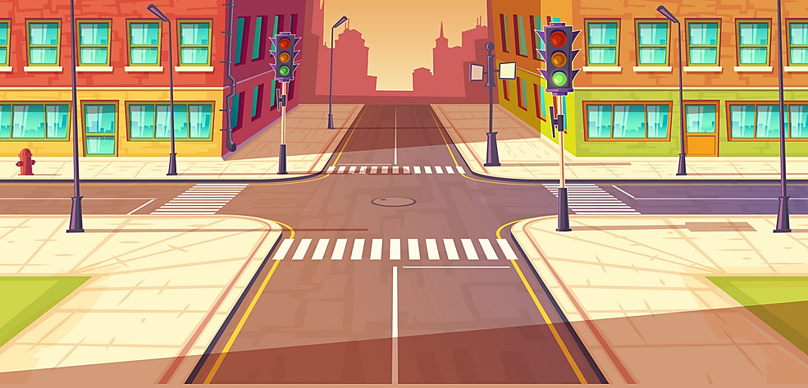
OUR APPROACH
Let us consider a crossroad, which has four traffic signals, as shown in the figure below.

Slide 8
METHODOLOGY:
Traffic light can be controlled by collecting information about the number of passing vehicles, and processing this data. The model computes timing information for the control unit of the traffic lights controller on the basis of the information coming from the cameras.
We have come up with a possible solution to this problem, using a simple machine learning model, which detects the number of vehicles and depending on the density, that is, the number of vehicles in a lane, the green light or red light is shown for required time, until the density decreases.

Slide 9
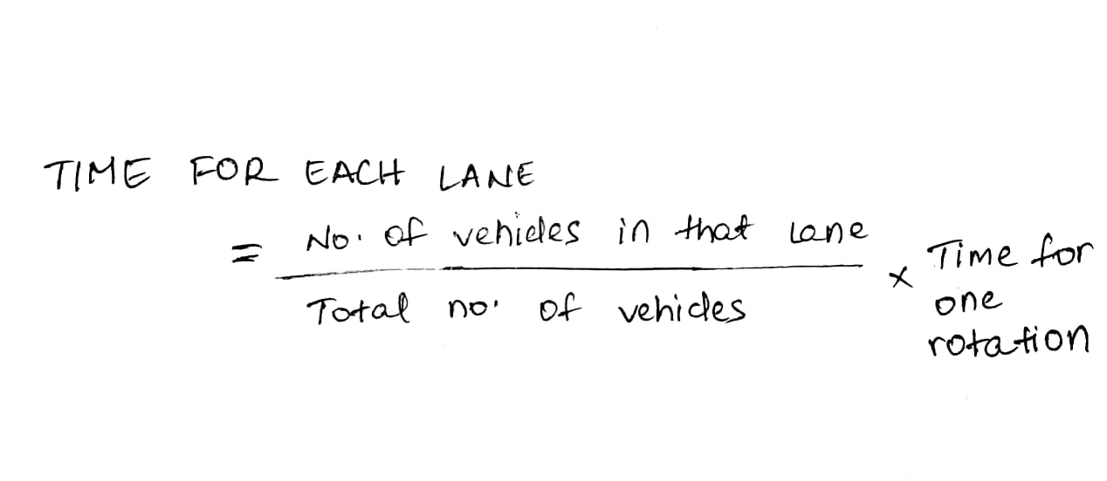
For example, if the cars in lane 1 are more compared to other lanes, then we show the green light for a little longer time, so that the traffic is cleared to some extent. We are going to use an object detection method using the Python library OpenCV, which will detect whether the object on the lane is a vehicle or not. Then, we have a vehicle counter, which keeps the count of number of vehicles

Slide 10
PROCEDURE
The features of this project include
Placement of Cameras : Cameras corresponding to each lane across a junction are placed to detect the total vehicles in each lane these cameras takes footage after each successful rotation.
Model Processing : Each image sent to the model . This model detects the total number of vehicles in each lane and gives the output to time calculating algorithm.
Time Calculating Algorithm : Total number of cars detected at each lane are processed by the algorithm to calculate the time slots for each lane and the order of the green light . The algorithm is as follows:

Slide 11
DEPENDENCY
Our Project is dependent on the following factors:
Superior quality cameras
Permission from RTO department.

Slide 12
LIBRARIES USED
OPEN CV
PANDAS
NUMPY

Slide 13
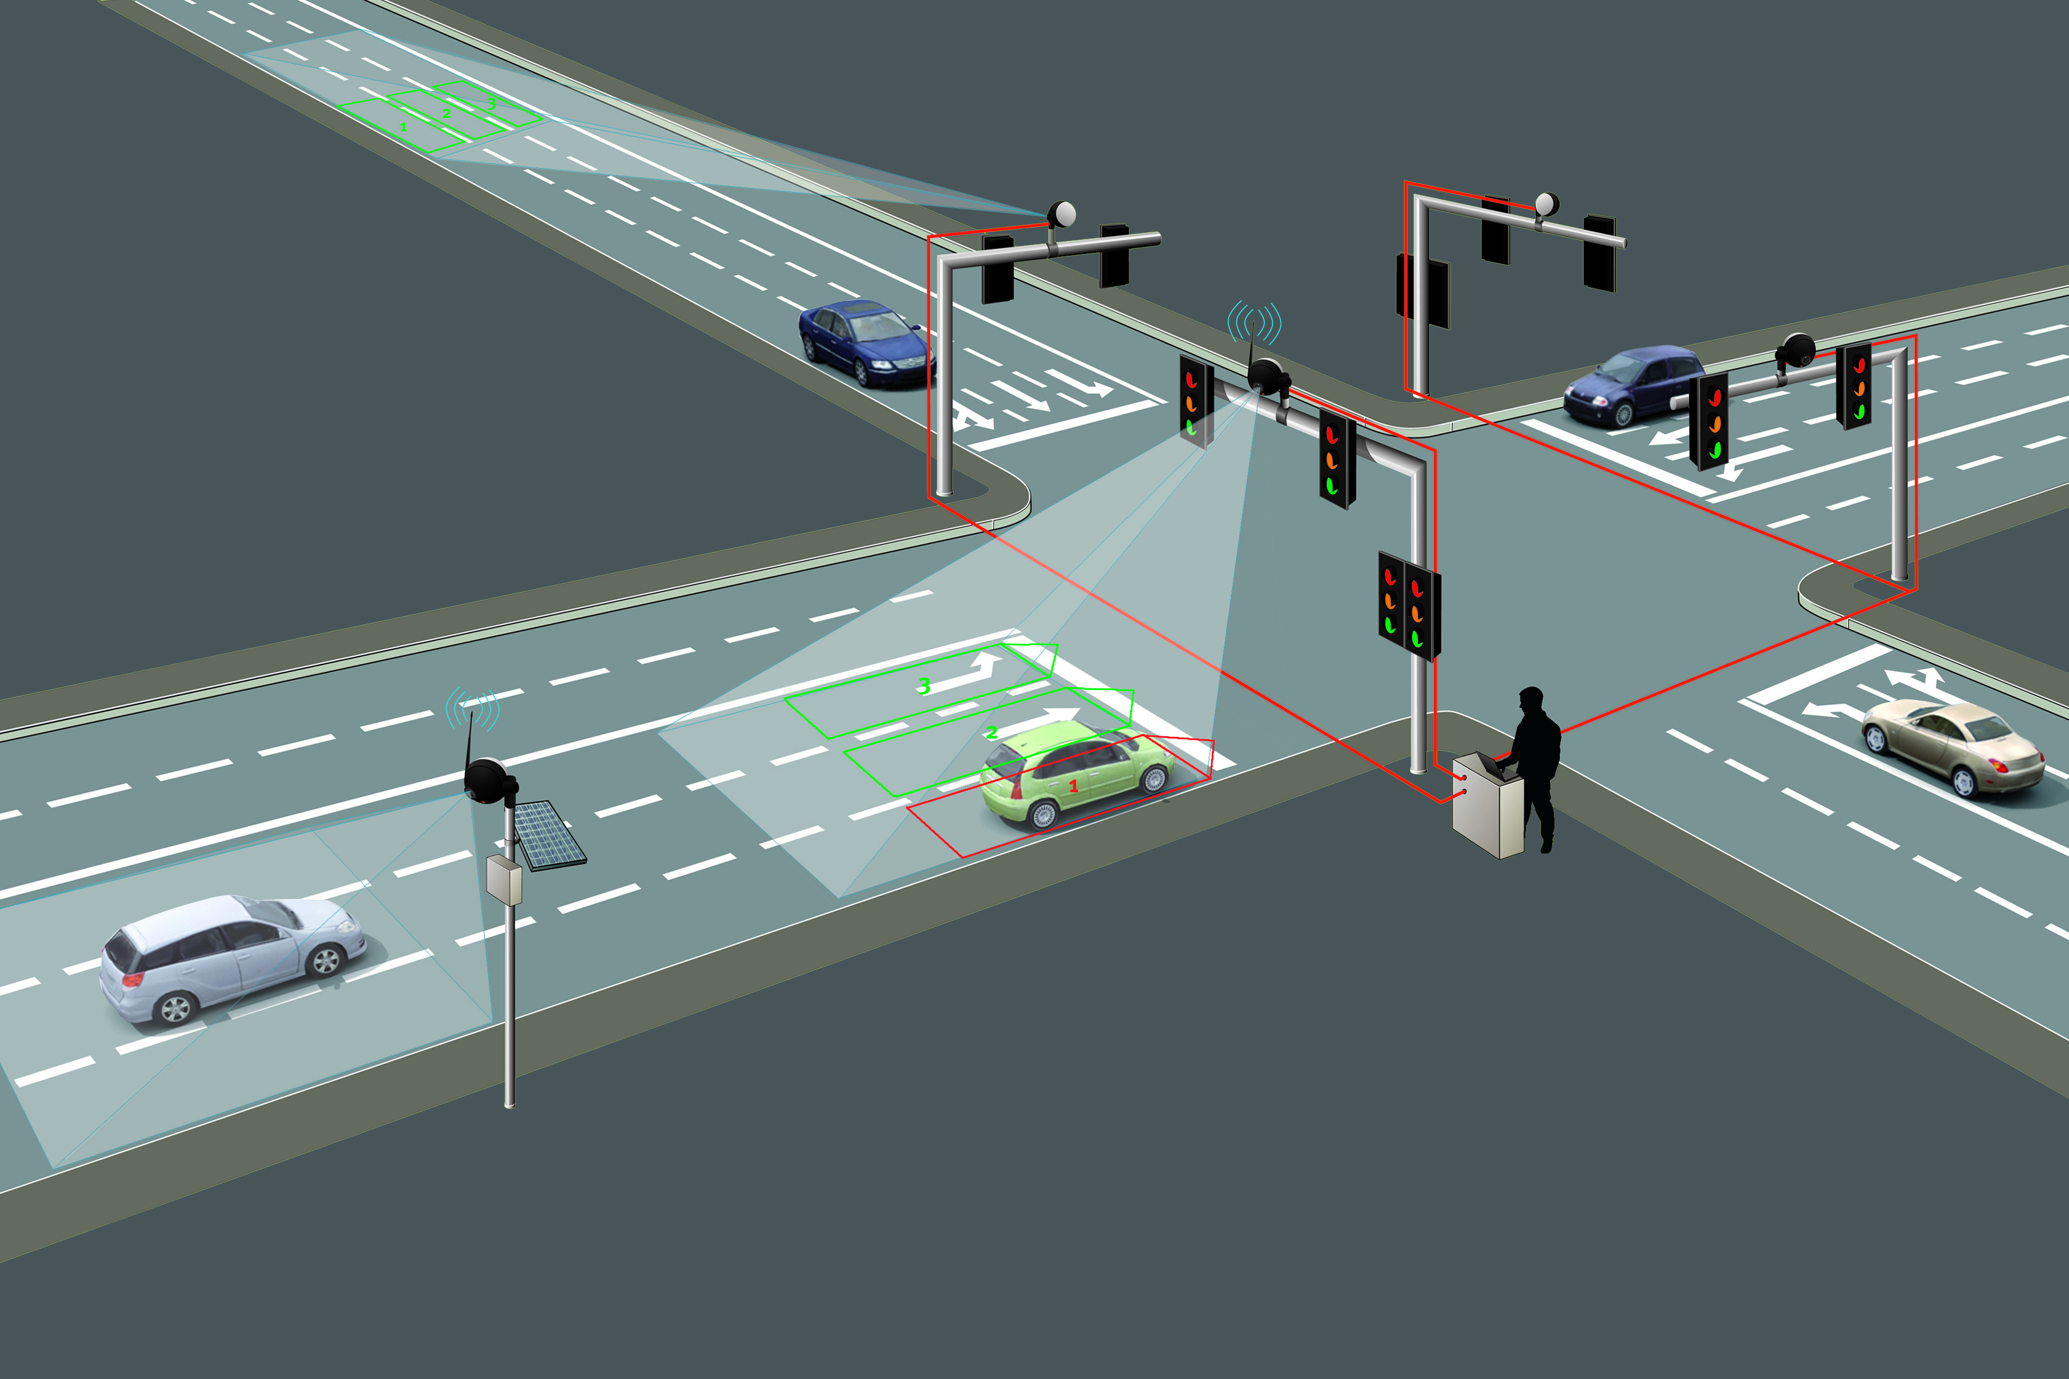
DATA
We are going to use a video camera to shoot the lane
Feed the frames of the video to the model.
These frames will be used to train our model to detect the vehicles.

Slide 14
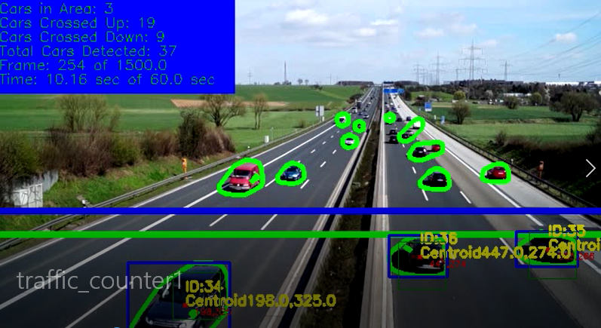

Slide 15
RESULT
• Enhancement in the traffic control system.
• Increased efficiency of the road system.
• Precious time of people is saved.

Slide 16
SUMMARY
The results of this study will be reported and used to suggest and apply more efficient transportation policies with the aim of providing useful insights on traffic congestion problem and to elaborate the best transportation policies.

Slide 17
THANK YOU

