Slide 1

Project
By Team HCL PG

Slide 2

Password Generator

Slide 3

Java console-based project
Introduction

Slide 4
Overview
It’s console-based java application. The purpose of this project is to create an application for Password Generator.
Project will generate password for using uppercase letter, lowercases, number and special characters.

Slide 5
Scope of project
Generate secure password
Provide security

Slide 6

Intended Audience
The person who is searching for the strong password. We use passwords for emails, Instagram, Facebook, internet banking etc.

Slide 7
High Level Use Cases
User will open the application it will generate password for user. and output password will be generated
User
Application
Output(generated password)

Slide 8
User Interface Modules
Its java console-based application.
User
Java console
Output
Interface

Slide 9
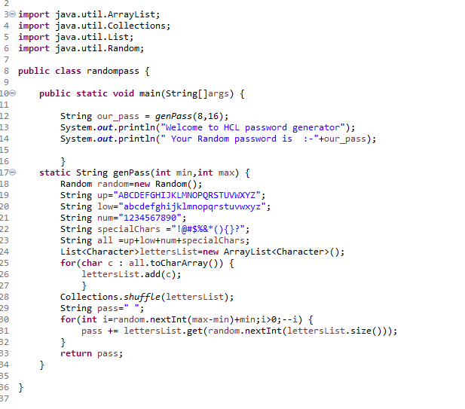
Source code
Code is available on GitHubclickhere

Slide 10
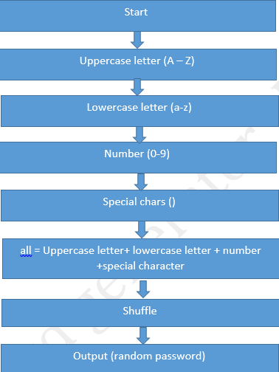
Workflow Diagram

Slide 11


Slide 12
Test objective:
The purpose of this document is to create an application test plan for a password generator.
The purpose of testing this program is to check the correct operations that automatically generate a password.

Slide 13
Scope of Testing:
Within the scope: generate password using lowercase, uppercase and numbers.
Out of scope:
Database logical
Hardware interface

Slide 14

Test Strategies
Levels of testing
Types of testing
Test Design techniqe
Configuration management tool
Terminology
Area Planned for Automation
Full test case document is available on GitHub
For download Click here

Slide 15
Test Case Document

Slide 16
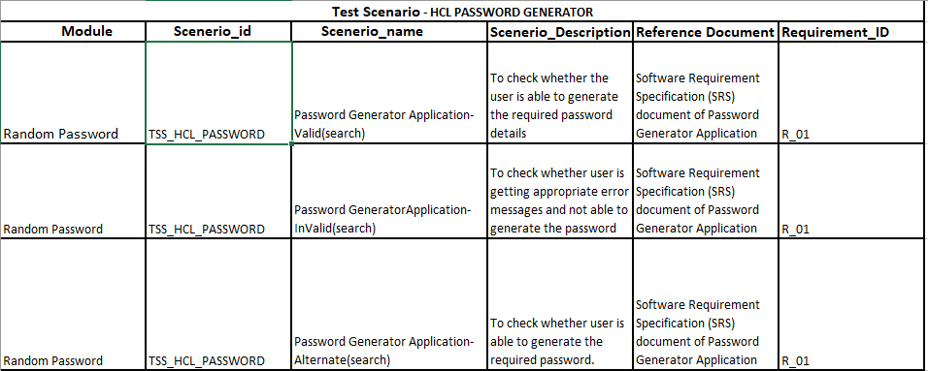
Test Scenario

Slide 17
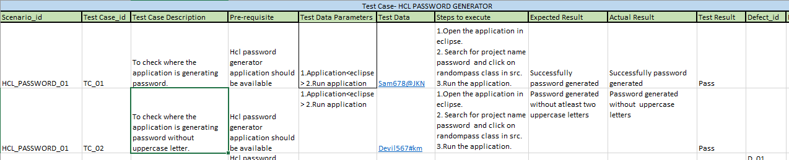
Test cases

Slide 18
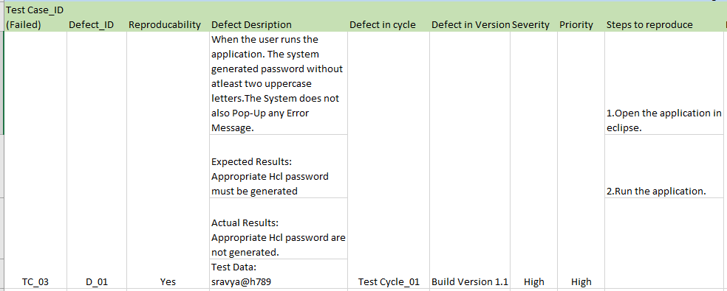
Defect log

Slide 19
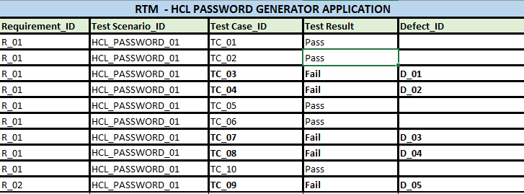
RTM

Slide 20

Automation Testing on OrangeHRM using selenium

Slide 21
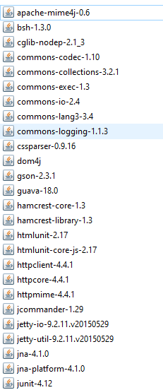
Important jars for automation Testing
For download jars click here.

Slide 22
Data Driven Testing

Slide 23
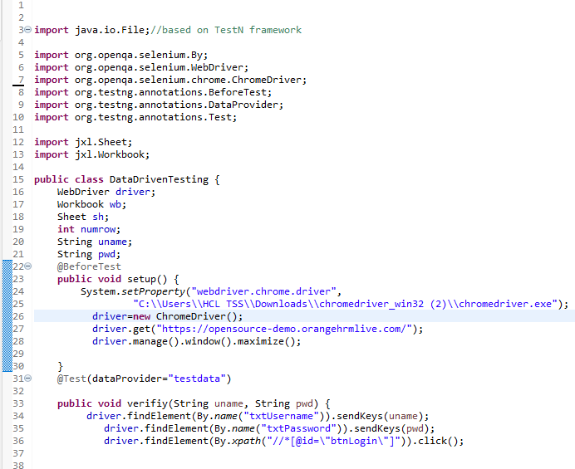

Slide 24
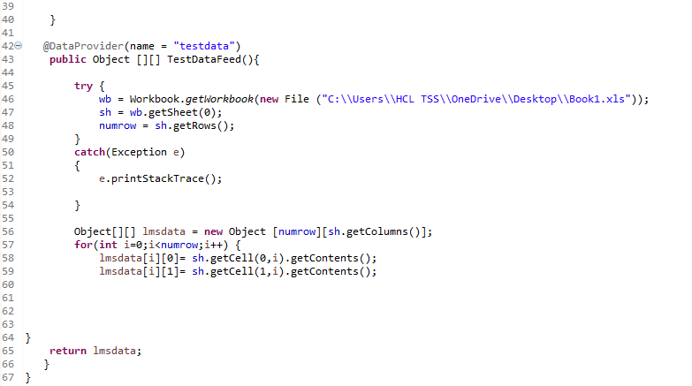
Code is available on GitHub clickhere

Slide 25
Cross-Browser Testing

Slide 26
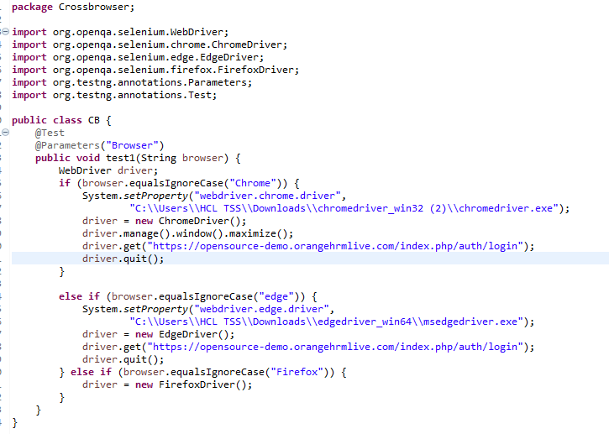
Code is available on GitHub clickhere

Slide 27

Page Object Model
For code click here

Slide 28

Page Object Model without Browser Factory

Slide 29
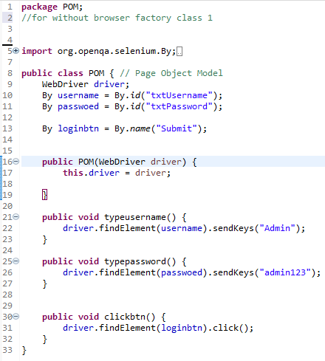
Class 1

Slide 30
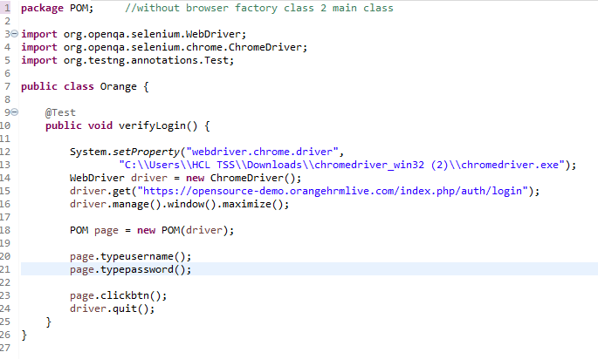
Class 2

Slide 31
Page Object Model with Browser Factory

Slide 32
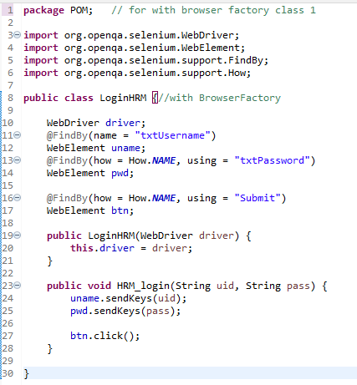
Class 1

Slide 33
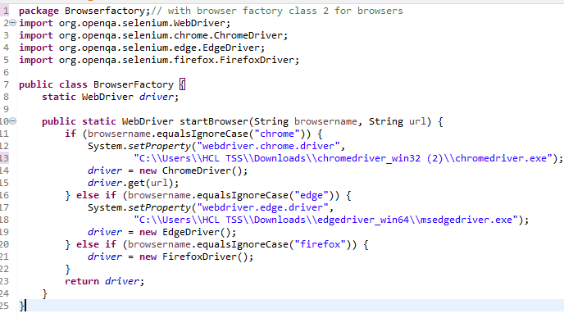
Class 2

Slide 34
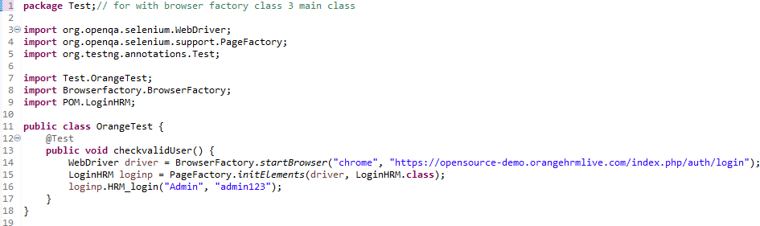
Class 3

Slide 35
Important links
For Java password generator project source code Click here
For all documents of project Click here
For Data driven Testing Click here
For Cross-Browser Testing Click here
For Cross-Browser XML file Click here
For Page object Model Click here

Slide 36

Questions?

Slide 37
Thank you

