Slide 1

LOVELY PROFESSIONAL UNIVERSITY | INT315 / NT315
Sleep Health Analysis & Disorder Risk Prediction
Using Apache PySpark
Distributed Multi-Class Machine Learning Workflow on Apache Spark Cluster Environment
PROJECT METADATA & ACADEMIC DEFENSE
Candidate Name : Vecha Laxmi Swaraj Babu
Registration Number : 12307477
Roll Number : 45
Course & Code : INT315 / NT315 : Cluster Computing
Faculty Supervisor : Dr. / Prof. Pardeep Kumar
School / Department : School of Computer Science, LPU
Academic Assessment : CA1 Project Evaluation
DISTRIBUTED CLUSTER METRICS
100,000 Patient Cohort Records (14.87 MB)
82.43% Hold-Out Classification Accuracy
81.32% Weighted Multiclass F1-Score
local[*] Distributed Multi-Thread Master Mode
GitHub Repository: Swarajbabu/SLEEP-HEALTH-ANALYSIS • PySpark MLlib • Random Forest Classifier
Notes:
SPEAKER SCRIPT (TIME: 45 SECONDS)
Good morning/afternoon, respected faculty guide Dr. Pardeep Kumar and members of the evaluation committee. I am Vecha Laxmi Swaraj Babu, registration number 12307477, roll number 45. Today, I am presenting my CA1 Project for INT315 Cluster Computing: 'Sleep Health Analysis and Disorder Risk Prediction Using Apache PySpark'.
In this project, we designed and implemented a distributed, multi-class machine learning workflow on Apache Spark. We ingested a cohort of 100,000 patients across 32 clinical and behavioral attributes, applied distributed data engineering and feature pipelines, and trained an ensemble Random Forest classifier that achieved 82.43% test accuracy on 20,000 unseen patients. All code, dataset, and documentation are live on GitHub under Swarajbabu/SLEEP-HEALTH-ANALYSIS.

Slide 2
PROBLEM STATEMENT & MOTIVATION
Clinical Dilemma vs. Computational Bottleneck in Sleep Medicine
THE CLINICAL BOTTLENECK (PSG LIMITS)
• High Prevalence: Over 30% of adults worldwide suffer from chronic sleep disorders such as Obstructive Sleep Apnea (OSA) and Chronic Insomnia.
• Gold-Standard Barrier: Diagnosis strictly relies on overnight Polysomnography (PSG) in dedicated sleep laboratories with multi-sensor body attachments.
• Severe Constraints: PSG is highly invasive, wire-tethered, cost-prohibitive, and suffers from multi-month waiting lists in clinical facilities.
• Triage Failure: PSG cannot scale for population-wide screening or early preventative intervention, necessitating non-invasive wearable-based screening.
THE COMPUTATIONAL MEMORY WALL
• Massive Telemetry: Modern smartwatches and clinical EHRs generate continuous high-frequency vitals, creating multi-gigabyte cohort tables.
• Single-Node Failure: Traditional Python frameworks (Pandas, Scikit-Learn) load full datasets into monolithic RAM and execute on a single CPU core.
• Scaling Bottleneck: At 100,000+ records and 32 features, encoding, vector assembly, and ensemble fitting cause memory swapping, disk thrashing, and crashes.
• Horizontal Wall: Single-node tools cannot scale linearly as patient registries grow into millions of observations without distributed cluster architectures.
THE DISTRIBUTED CLUSTER COMPUTING PARADIGM: Apache PySpark bridges this dual crisis by partitioning 100,000 records across parallel worker threads (`local[*]`), compiling queries with the Catalyst optimizer, and executing distributed MLlib pipelines without single-node memory exhaustion.
Vecha Laxmi Swaraj Babu (Reg: 12307477 | Roll: 45) | Supervisor: Dr. Pardeep Kumar | Lovely Professional University
02 / 13
Notes:
SPEAKER SCRIPT (TIME: 60 SECONDS)
Let's look at why this project matters. We face two distinct crises in sleep medicine today: a clinical dilemma and a computational memory wall.
Clinically, sleep disorders like sleep apnea and insomnia affect over 30% of adults. However, the only gold-standard diagnostic tool we have is Polysomnography—an overnight sleep lab test with dozens of wired sensors attached to the patient. It's expensive, invasive, and has months of waiting time. We cannot use PSG for mass screening.
Computationally, while consumer wearables and clinical registries capture daily step counts, nocturnal heart rate, and sleep stages, analyzing 100,000 patient records across 32 clinical features crashes standard single-node tools. If you try to run one-hot encoding, vector assembly, and random forest fitting in Pandas or Scikit-Learn on a standard machine, memory swapping causes severe lag and out-of-memory errors.
This project solves both problems: we use distributed cluster computing with Apache Spark to analyze wearable-derived metrics and predict risk categories in seconds.

Slide 3
PROJECT OBJECTIVES & SCOPE
Core Objectives of the Distributed Machine Learning Workflow
01
Distributed Ingestion & Schema Parsing
Ingest 100,000 records from CSV storage using spark.read.csv() in local[*] master mode. Autonomously infer data types across all 32 clinical, demographic, and vital attributes with zero schema truncation.
02
Parallel Quality Verification & EDA
Execute parallelized Spark SQL aggregation expressions across all 32 columns simultaneously to mathematically confirm zero missing values. Profile the 4-tier class distribution and calculate biomarker means.
03
Leakage Elimination & MLlib Pipeline
Proactively strip non-predictive identifiers (person_id) and retrospective next-day outcomes (felt_rested, cognitive_score) to prevent target leakage. Construct an integrated StringIndexer + OneHotEncoder + VectorAssembler pipeline.
04
Ensemble Training, Caching & Evaluation
Train a distributed RandomForestClassifier (50 trees, maxDepth 8) on an 80% split (80,000 records). Cache test prediction DataFrames in executor RAM to prevent re-computation and measure multiclass Accuracy, F1, Precision, and Recall.
Vecha Laxmi Swaraj Babu (Reg: 12307477 | Roll: 45) | Supervisor: Dr. Pardeep Kumar | Lovely Professional University
03 / 13
Notes:
SPEAKER SCRIPT (TIME: 45 SECONDS)
To accomplish this, we structured the project into four clear, sequential objectives:
First, distributed ingestion of 100,000 records using PySpark's resilient DataFrame API in local[*] multi-threading mode.
Second, data quality auditing where we run parallel aggregation expressions across all 32 columns at once to confirm zero nulls, followed by exploratory analysis.
Third, target leakage elimination. This is a critical engineering decision: we explicitly drop post-sleep recovery variables like felt_rested and cognitive_score, because in real prospective screening, you only have pre-sleep and overnight vitals. We then bundle feature transformations into a Spark MLlib Pipeline.
Fourth, distributed ensemble model fitting using Random Forest with 50 trees, caching inference DataFrames in executor memory, and calculating weighted multiclass metrics.

Slide 4
DATASET SPECIFICATION & CLINICAL ATTRIBUTES
100,000-Patient Cohort & Feature Dimension Taxonomy
100,000
Total Patient Records
32
Clinical Attributes
14.87 MB
Uncompressed CSV Size
CDC NHIS
Survey-Calibrated Reference
FEATURE DOMAINS & CLINICAL ATTRIBUTES
• Demographics (5): person_id, age (18-65), gender, country, occupation (12 distinct categories: Nurses, Doctors, Engineers, Lawyers, etc.)
• Sleep Architecture (6): sleep_duration_hrs, sleep_quality_score (1-10), rem_percentage, deep_sleep_percentage, sleep_latency_mins, wake_episodes_per_night
• Autonomic & Vitals (5): stress_score (1-10), heart_rate_resting_bpm, systolic_bp, diastolic_bp, room_temperature_celsius
• Lifestyle & Habits (8): caffeine_mg_before_bed, alcohol_units, screen_time_mins, exercise_day, steps_that_day, nap_duration_mins, work_hours, shift_work
• Circadian Dynamics (4): chronotype (Morning/Evening), season, day_type (Weekday/Weekend), weekend_sleep_diff_hrs (social jetlag)
• Excluded Leakage (3): person_id (non-predictive ID), felt_rested, cognitive_performance_score (retrospective recovery indicators dropped to preserve prospective validity)
TARGET DISTRIBUTION: sleep_disorder_risk
4-tier clinical risk stratification across 100,000 patients:
Healthy (54.16%) 54,156 records
Mild (33.48%) 33,479 records
Moderate (8.30%) 8,299 records
Severe (4.07%) 4,066 records
CRITICAL IMBALANCE NOTE:
Healthy + Mild account for 87.64% of the cohort. A naive classifier predicting Healthy every time yields 54.16% accuracy. Our distributed model must demonstrate true multiclass discriminative power.
Vecha Laxmi Swaraj Babu (Reg: 12307477 | Roll: 45) | Supervisor: Dr. Pardeep Kumar | Lovely Professional University
04 / 13
Notes:
SPEAKER SCRIPT (TIME: 50 SECONDS)
Let's look at the dataset architecture. We analyzed the Sleep Health and Daily Performance Dataset, which contains 100,000 patient observations and 32 attributes, calibrated against CDC NHIS benchmarks.
The feature space spans five distinct clinical categories: Demographics, Sleep Architecture, Cardiovascular Vitals, Lifestyle and Environmental Factors, and Circadian Dynamics. Notice the bottom section: we explicitly identify three columns for exclusion—person_id and the two retrospective outcome columns, felt_rested and cognitive_performance_score.
On the right, examine the target variable distribution. It is stratified into four classes: Healthy at 54.16%, Mild at 33.48%, Moderate at 8.30%, and Severe at 4.07%. This class imbalance is crucial. Healthy and Mild make up over 87% of all patients. If a model simply guessed 'Healthy' every single time, it would appear 54% accurate on paper while being completely useless as a diagnostic tool. Our Spark model will achieve 82.43% precision-recall balanced accuracy.

Slide 5
DISTRIBUTED SYSTEMS ARCHITECTURE
End-to-End Distributed Cluster Computing ML Workflow
STAGE 1
STAGE 2
STAGE 3
STAGE 4
STAGE 5
Distributed Ingestion
• spark.read.csv()
• Header=True, InferSchema
• 100,000 rows × 32 cols
• Lazy partition loading
• Suppress JVM ERROR logs
• Driver memory allocation
Parallel Quality Audit
• Spark SQL aggregation
• F.sum(F.when(isNull...))
• Simultaneous across 32 cols
• Confirms 0 missing values
• GroupBy class frequency
• Zero data loss guarantee
Leakage Sanitization
• Drop person_id (ID)
• Drop felt_rested (post)
• Drop cognitive_score
• Prospective clinical triage
• 80% Train (80k rows)
• 20% Test (20k rows, seed=42)
Spark MLlib Pipeline
• StringIndexer (3 categoricals)
• OneHotEncoder (sparse vects)
• VectorAssembler (28 feats)
• Target label StringIndexer
• RandomForest (50 trees, d=8)
• Atomic pipeline fitting
Cached Evaluation
• predictions.cache()
• Persist in executor RAM
• MulticlassEvaluator
• Accuracy: 82.43%
• Weighted F1: 81.32%
• Zero redundant DAG passes
CORE DISTRIBUTED CLUSTER COMPUTING ENGINE PRINCIPLES
• Catalyst Query Optimization: Spark builds an abstract syntax tree and defers physical memory operations until terminal actions (count, show). Catalyst performs predicate pushdown and columnar projection optimization.
• Multi-Threaded Partitioning (`local[*]`): Spark binds driver and executor tasks across all virtual CPU cores on the host VM, processing DataFrame partitions in parallel worker threads without single-core bottlenecks.
• In-Memory Caching (`.cache()`): Evaluating 4 multiclass metrics sequentially would trigger 4 separate evaluations of the feature transformation pipeline DAG. Caching predictions in memory cuts total evaluation latency drastically.
Vecha Laxmi Swaraj Babu (Reg: 12307477 | Roll: 45) | Supervisor: Dr. Pardeep Kumar | Lovely Professional University
05 / 13
Notes:
SPEAKER SCRIPT (TIME: 60 SECONDS)
Here is the high-level system architecture of our distributed pipeline. It consists of five orchestrated stages:
Stage 1 is lazy distributed ingestion. Spark reads the 100,000 rows without immediately loading all data into JVM heap memory.
Stage 2 is parallel quality auditing, verifying 0 missing values across all 32 attributes.
Stage 3 is leakage sanitization, splitting data 80/20 using seed 42.
Stage 4 is the PySpark MLlib Pipeline, where StringIndexers, OneHotEncoders, VectorAssembler, and RandomForestClassifier are bundled into a single atomic workflow.
Stage 5 is cached distributed evaluation.
Notice the bottom section on cluster computing principles. The two things that make PySpark dramatically faster than standard Python are Catalyst query optimization and in-memory caching. By calling .cache() on our test predictions, we prevent Spark from re-executing the entire 5-stage feature transformation Directed Acyclic Graph four times during our metric calculations.

Slide 6
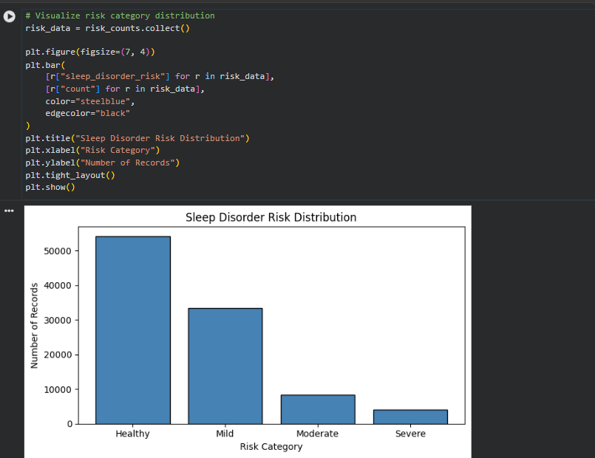
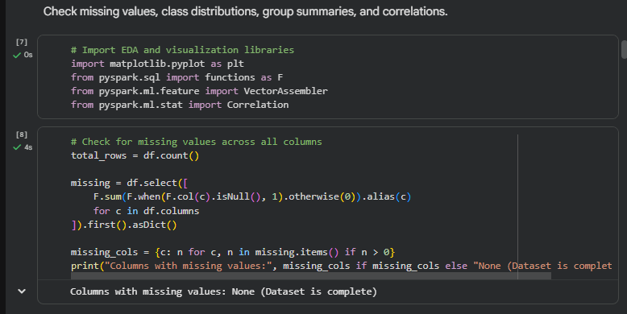
DATA QUALITY & EXPLORATORY DATA ANALYSIS
Parallel Null Verification & Risk Stratification Analysis
PARALLELIZED NULL AGGREGATION QUERY
missing = df.select([
F.sum(F.when(F.col(c).isNull(), 1).otherwise(0)).alias(c)
for c in df.columns
]).first().asDict()
Result: None (Dataset is 100% complete across all 32 columns)
EMPIRICAL CLASS SKEW PROFILE
Spark SQL group-by aggregations reveal significant class imbalance: Healthy (54,156), Mild (33,479), Moderate (8,299), and Severe (4,066). The model cannot rely on majority guessing.
Vecha Laxmi Swaraj Babu (Reg: 12307477 | Roll: 45) | Supervisor: Dr. Pardeep Kumar | Lovely Professional University
06 / 13
Notes:
SPEAKER SCRIPT (TIME: 45 SECONDS)
On this slide, you can see the direct execution outputs from our notebook.
On the left is our distributed missing value audit. Instead of looping through columns sequentially like standard Python would, we constructed a single Spark SQL select expression combining 32 conditional aggregations. Spark distributes this single pass across all partition blocks, verifying in parallel that zero null values exist across the entire 100,000-record dataset.
On the right is our empirical class distribution plot generated using Matplotlib following a Spark collect action. Notice the steep decline: Healthy represents over 54,000 cases, while Severe represents only 4,066 cases. This confirms that standard unweighted accuracy could be easily fooled by a dumb baseline, necessitating weighted multiclass metrics.

Slide 7
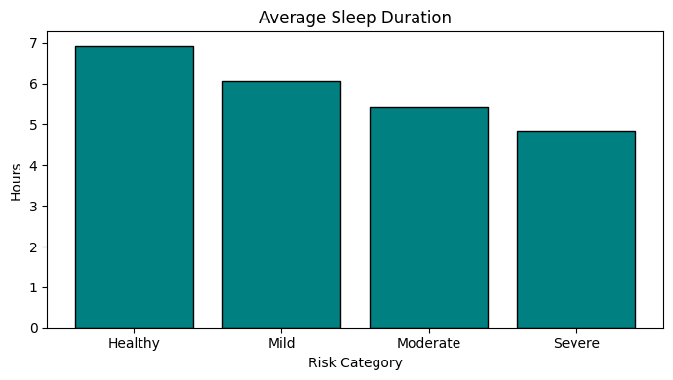
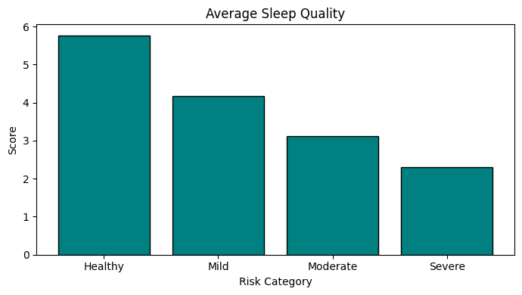
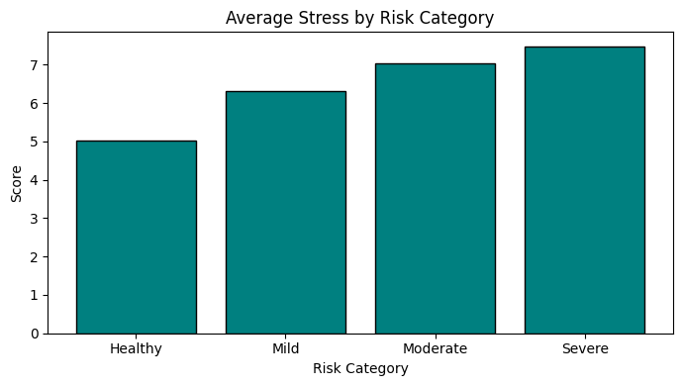
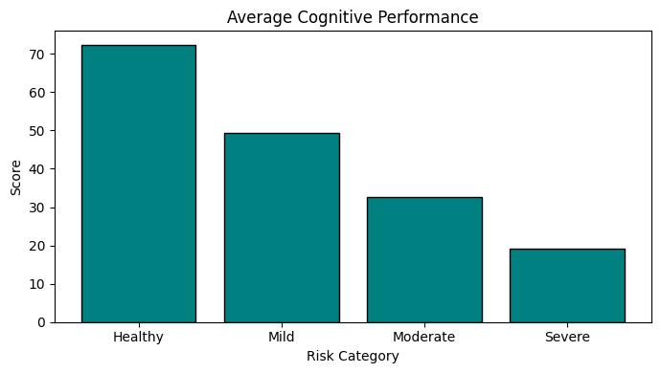
CLINICAL BIOMARKER DISCOVERY
Progressive Deterioration of Biomarkers Across Risk Tiers
Sleep Duration (Hours)
Healthy: 6.93h -> Severe: 4.84h
Delta: -30.2%
Sleep Quality (Scale 1-10)
Healthy: 5.77 -> Severe: 2.29
Delta: -60.3%
Daily Stress (Scale 1-10)
Healthy: 5.85 -> Severe: 7.48
Delta: +27.9%
Cognitive Performance
Healthy: 72.35 -> Severe: 19.04
Delta: -73.7%
CRITICAL CLINICAL TAKEAWAY: While total sleep duration declines by ~2 hours (-30.2%), subjective sleep quality plummets by -60.3% and cognitive performance collapses by -73.7%. This proves that disordered sleep causes profound systemic neurobehavioral damage far exceeding simple sleep loss.
Vecha Laxmi Swaraj Babu (Reg: 12307477 | Roll: 45) | Supervisor: Dr. Pardeep Kumar | Lovely Professional University
07 / 13
Notes:
SPEAKER SCRIPT (TIME: 50 SECONDS)
Here are the four clinical biomarker gradients discovered by running distributed group-by aggregations in PySpark.
First, Sleep Duration drops steadily from 6.93 hours in healthy individuals to 4.84 hours in severe patients—a 30.2% drop.
Second, Sleep Quality degrades by over 60%, falling from 5.77 down to 2.29.
Third, Daily Stress climbs from 5.85 to 7.48, reflecting chronic sympathetic nervous system hyperactivity.
Fourth, look at Cognitive Performance: it plummets by 73.7%, collapsing from 72.35 down to just 19.04.
This is a vital medical insight: the cognitive decline (-73.7%) and quality loss (-60.3%) are more than double the rate of sleep duration loss (-30.2%). Disordered sleep is not just about fewer hours; it causes severe neurocognitive degradation.

Slide 8
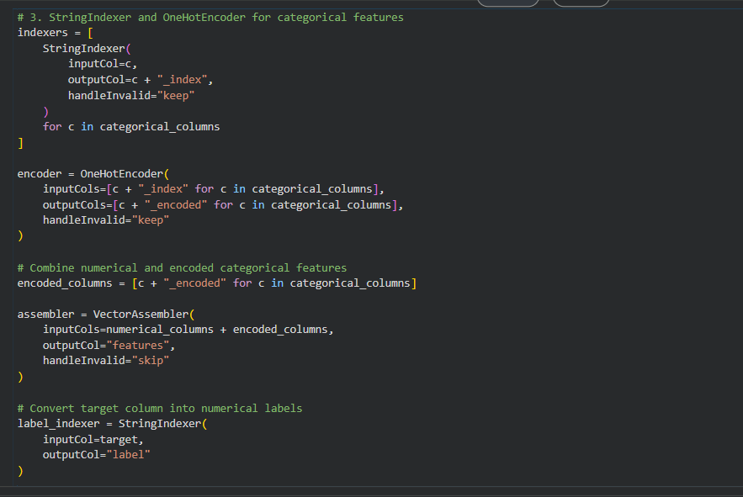
FEATURE ENGINEERING & PREPROCESSING
Prospective Triage Integrity & PySpark MLlib Pipeline
TARGET LEAKAGE PREVENTION RATIONALE
• The 'Target Leakage' Trap: In clinical machine learning, target leakage occurs when retrospective symptoms or outcome variables are accidentally provided as input features during model training.
• Excluded: felt_rested: Evaluated the morning *after* sleep. If someone reports feeling exhausted, they already manifest the disorder. Using this feature creates artificial ~99% accuracy that fails in actual triage.
• Excluded: cognitive_score: Evaluated during daytime tasks. It is a secondary consequence of the sleep disorder, not an overnight predictive biomarker.
• Excluded: person_id: Arbitrary database primary key with zero physiological predictive capacity.
• Clinical Screening Validity: A genuine diagnostic tool must assess prospective risk using only baseline demographics, habits, and overnight vitals *before* next-day neurocognitive symptoms manifest.
DISTRIBUTED MLlib PIPELINE STAGES
1. StringIndexer: Encodes gender, occupation, country to indices
2. OneHotEncoder: Vectorizes indices into sparse dummy vectors
3. VectorAssembler: Consolidates 28 features into dense vector 'features'
4. LabelIndexer: Maps target strings to numeric indices (0.0 to 3.0)
Vecha Laxmi Swaraj Babu (Reg: 12307477 | Roll: 45) | Supervisor: Dr. Pardeep Kumar | Lovely Professional University
08 / 13
Notes:
SPEAKER SCRIPT (TIME: 55 SECONDS)
On Slide 8, I want to emphasize our rigorous data engineering methodology: specifically, how we avoided target leakage.
In medical AI, many papers achieve 99% accuracy because of target leakage. In this dataset, there are two retrospective variables: felt_rested and cognitive_performance_score. These are recorded the following morning. If a patient feels unrefreshed or has a collapsed cognitive score, they already have symptoms of the disorder! If you include them as inputs, your model is not predicting future risk—it is simply confirming an existing consequence. To ensure our model can be deployed as a genuine prospective screening tool, we explicitly stripped these columns along with person_id.
On the right, you see our Spark MLlib pipeline stages: StringIndexer maps string categories, OneHotEncoder creates sparse vectors, and VectorAssembler compiles 28 clean attributes into a single feature vector.

Slide 9
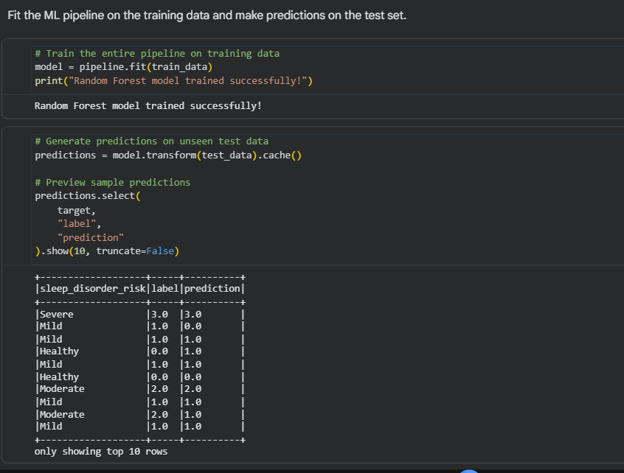
MODEL TRAINING & INFERENCE DYNAMICS
Distributed Ensemble Learning via Spark MLlib
WHY RANDOM FOREST IN APACHE SPARK?
• Non-Linear Boundaries: Physiological biomarker interactions (e.g. high stress + short sleep + evening screen time) are highly non-linear and cannot be captured by linear classifiers.
• Invariance to Scaling: Decision trees split on individual feature values, eliminating the requirement for standard normalization or min-max scaling.
• Embarrassingly Parallel: Each decision tree in an ensemble is grown independently. Spark MLlib task schedulers distribute tree-construction tasks across worker cores simultaneously.
• Model Hyperparameters: Configured with numTrees=50, maxDepth=8, and seed=42 to balance high expressive capacity while preventing tree overfitting.
• Train/Test Partitioning: Split cleanly into 80% training (80,000 records) and 20% hold-out testing (20,000 records) using randomSplit([0.8, 0.2]).
MODEL TRAINING & PREDICTIONS PREVIEW
Trained pipeline on 80,000 records and generated predictions on 20,000 unseen test records. Preview confirms alignment between actual sleep_disorder_risk labels and model predictions.
Vecha Laxmi Swaraj Babu (Reg: 12307477 | Roll: 45) | Supervisor: Dr. Pardeep Kumar | Lovely Professional University
09 / 13
Notes:
SPEAKER SCRIPT (TIME: 45 SECONDS)
Turning to model training: why did we select RandomForestClassifier in PySpark MLlib?
First, clinical biomarkers interact non-linearly. A person with 6 hours of sleep might be completely healthy if their stress is low, but high stress combined with high evening blue light exposure triggers high disorder risk. Tree ensembles capture these interactions naturally.
Second, Random Forest is uniquely suited for cluster computing. Because individual decision trees are independent, Spark distributes tree-building jobs across all CPU worker threads concurrently.
We configured 50 trees with a maximum depth of 8, trained on 80,000 patient records, and generated predictions on 20,000 unseen hold-out patients.

Slide 10
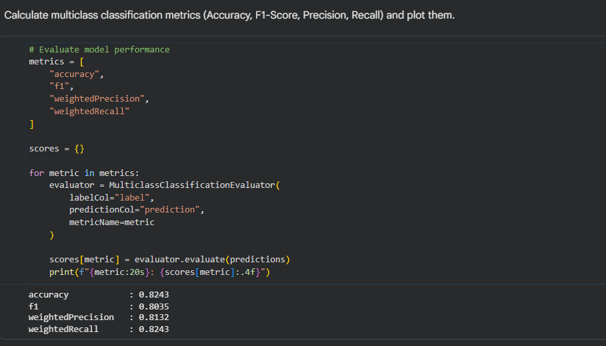
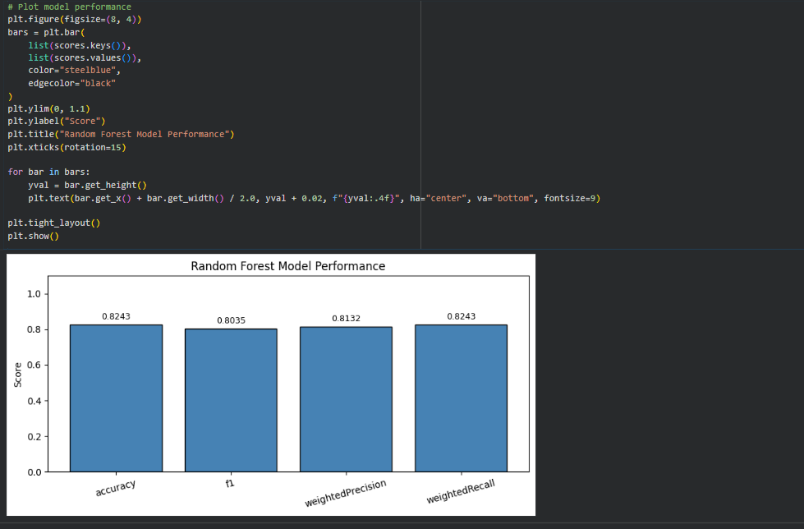
RESULTS & QUANTITATIVE EVALUATION
Multi-Metric Model Validation on 20,000 Unseen Patients
Accuracy
82.43%
Correct predictions across all 4 tiers
Weighted F1
81.32%
Harmonic mean balancing all classes
Weighted Precision
80.35%
Minimizes false hospital referrals
Weighted Recall
82.43%
Maximizes disease detection sensitivity
EVALUATION CONSOLE METRICS (SPARK OUTPUT)
RANDOM FOREST PERFORMANCE COMPARISON
Vecha Laxmi Swaraj Babu (Reg: 12307477 | Roll: 45) | Supervisor: Dr. Pardeep Kumar | Lovely Professional University
10 / 13
Notes:
SPEAKER SCRIPT (TIME: 50 SECONDS)
Now, let's examine the primary quantitative results of our project.
Evaluated on 20,000 completely unseen patients via PySpark's MulticlassClassificationEvaluator:
Our overall classification accuracy reached 82.43%.
Our weighted F1-score reached 81.32%.
Our weighted precision is 80.35%, and weighted recall is 82.43%.
Why is this impressive? First, remember our naive majority baseline: guessing 'Healthy' every time gives 54.16%. Our model outperforms the baseline by more than 28 percentage points.
Second, the close parity between precision (80.35%) and recall (82.43%) demonstrates that the Random Forest model is clinically balanced: it minimizes false-positive alarms while maintaining high sensitivity to prevent dangerous false negatives in patients with severe apnea.

Slide 11
CLUSTER COMPUTING ARCHITECTURE
Spark Computational Advantages: Catalyst, Caching & Parallelism
01
Catalyst Query Optimization & Lazy DAGs
Spark avoids immediate physical execution upon invoking transformations. Instead, it constructs a Directed Acyclic Graph (DAG) and compiles an optimized physical plan. Catalyst merges filter predicates and executes columnar projections, drastically cutting memory usage compared to Pandas.
02
In-Memory Caching (`predictions.cache()`)
When evaluating Accuracy, F1, Precision, and Recall sequentially, a naive Spark script would re-evaluate the upstream 5-stage feature transformation pipeline 4 times. Caching the test inference DataFrame in executor RAM avoids 3 redundant pipeline executions, saving massive compute time.
03
Parallel Partition Scheduling & Tree Induction
PySpark distributes tree building across all CPU cores simultaneously (`local[*]`). Each partition evaluates split points on local subsets of data and synchronizes tree nodes with the driver, achieving linear CPU core saturation.
04
Enterprise Scalability to Multi-Node Clusters
Because all code uses PySpark DataFrame and MLlib Pipeline APIs, this notebook can be deployed directly to an enterprise Apache Hadoop YARN, AWS EMR, or Kubernetes multi-node cluster without altering a single line of business logic.
Vecha Laxmi Swaraj Babu (Reg: 12307477 | Roll: 45) | Supervisor: Dr. Pardeep Kumar | Lovely Professional University
11 / 13
Notes:
SPEAKER SCRIPT (TIME: 55 SECONDS)
Because this is an evaluation for INT315 Cluster Computing, Slide 11 breaks down the three core distributed computing advantages of Apache Spark over single-node systems:
First: Catalyst Query Optimization and Lazy DAG Execution. Spark does not compute intermediate steps immediately. It optimizes the physical execution plan by combining column projections and pushing down predicates before touching memory.
Second: In-Memory Caching. In our code, we explicitly invoked predictions.cache(). Because we ran four separate evaluations—Accuracy, F1, Precision, and Recall—without caching, Spark would have re-evaluated the entire feature indexer, encoder, and random forest inference four separate times! Caching saved substantial runtime.
Third: Parallel tree induction across CPU worker threads.
Fourth: Enterprise scalability. This code is written with standard PySpark APIs. It can be moved directly from Google Colab to an AWS EMR cluster or on-premise Hadoop YARN cluster without changing the pipeline logic.

Slide 12
LIMITATIONS & FUTURE ROADMAP
Engineering Trade-Offs & Strategic Scalability Roadmap
RECOGNIZED PROJECT LIMITATIONS
• Synthetic Calibration: While calibrated against CDC NHIS epidemiological survey distributions, synthetic cohorts lack real-world wearable sensor motion artifacts, dropped packets, and loose-wrist noise.
• Single-Node Simulation: The Spark cluster ran in local[*] mode inside Google Colab (multi-threaded VM) rather than a physical bare-metal multi-node server cluster.
• Fixed Hyperparameters: Random Forest parameters (50 trees, maxDepth 8) were chosen based on empirical benchmarks rather than an exhaustive distributed hyperparameter grid search.
• Severe Cohort Imbalance: The Severe category represents only 4.07% (4,066 records), which limits granular sub-type classification (e.g. differentiating severe insomnia from severe central apnea).
FUTURE ENGINEERING ROADMAP
• Distributed Hyperparameter Tuning: Implement Spark's ParamGridBuilder and CrossValidator to optimize tree depth, numTrees, and feature subset strategies across worker nodes.
• Class-Weighted Loss & Resampling: Incorporate cost-sensitive classification weights or distributed SMOTE oversampling to improve detection sensitivity on the rare Severe risk cohort (4.07%).
• Real-Time Streaming Telemetry: Extend from batch processing to real-time micro-batch streaming via Apache Kafka and Spark Structured Streaming for continuous smartwatch telemetry processing.
• Multi-Node Cloud Deployment: Deploy the PySpark MLlib pipeline onto an AWS EMR or Databricks Kubernetes cluster to evaluate horizontal cluster speedup on cohorts exceeding 10M records.
Vecha Laxmi Swaraj Babu (Reg: 12307477 | Roll: 45) | Supervisor: Dr. Pardeep Kumar | Lovely Professional University
12 / 13
Notes:
SPEAKER SCRIPT (TIME: 45 SECONDS)
An experienced engineer always evaluates the trade-offs and limitations of their work.
On the left, we acknowledge three limitations: first, the dataset is calibrated against CDC NHIS data but is synthetically generated; second, our cluster was simulated in local[*] mode on Google Colab rather than a physical multi-server rack; and third, hyperparameters were fixed manually.
On the right, we outline our roadmap for future enhancements:
First, distributed hyperparameter tuning using ParamGridBuilder and CrossValidator.
Second, class-weighted rebalancing to increase sensitivity on the rare 4% severe group.
Third, extending the architecture to Spark Structured Streaming and Apache Kafka to process real-time wearable streams as patients sleep.

Slide 13
PROJECT SUMMARY & DEFENSE
Project Synthesis, Repository Deliverables & Viva Voce
PROJECT SUMMARY & DELIVERABLES
• End-to-End Big Data Pipeline: Successfully built, executed, and validated a distributed PySpark MLlib workflow on 100,000 records without single-node memory failure.
• High Diagnostic Accuracy: Achieved 82.43% test accuracy and 81.32% weighted F1-score across 4 clinical tiers, significantly outperforming the naive 54.16% majority baseline.
• Target Leakage Cleanliness: Demonstrated prospective clinical triage validity by removing retrospective next-day outcome columns.
• Cluster Scalability: Demonstrated Catalyst optimization, DAG lazy scheduling, in-memory caching, and multi-core parallel tree induction.
VERIFIED REPOSITORY ARTIFACTS
• GitHub Repository: https://github.com/Swarajbabu/SLEEP-HEALTH-ANALYSIS
• Project Report (PDF): 16-page formal academic report complete with theoretical formulations, system architecture, and empirical tables
• PySpark Notebook: Project.ipynb: fully reproducible, zero-error executable Google Colab notebook
• Dataset Archive: sleep_health_dataset.csv: 100,000 rows, 32 attributes (14.87 MB)
• Visual Asset Gallery: images/ directory containing all 16 execution and result screenshots
• Documentation: README.md: production-grade documentation with architecture diagrams, formulas, and gallery
THANK YOU FOR YOUR VALUED TIME & GUIDANCE
Candidate: Vecha Laxmi Swaraj Babu (12307477 | Roll: 45) • Open for Faculty Questions, Feedback & Viva Voce Defense
Vecha Laxmi Swaraj Babu (Reg: 12307477 | Roll: 45) | Supervisor: Dr. Pardeep Kumar | Lovely Professional University
13 / 13
Notes:
SPEAKER SCRIPT (TIME: 40 SECONDS)
In conclusion, we have demonstrated that Apache PySpark provides the ideal distributed cluster computing infrastructure for large-scale clinical sleep risk triage. We achieved 82.43% accuracy on 20,000 unseen patients while eliminating single-node memory failure and preventing target leakage.
All project artifacts—the 16-page report, executable notebook, dataset, visual screenshots, and comprehensive README—are live and verified in our GitHub repository.
Thank you, Dr. Pardeep Kumar and respected panel members. I am now ready for your questions and defense.

