Slide 1

DATA ANALYSIS ON OLYMPICS
INTRODUCTION TO DATA MANAGEMENT
INT 217
EXCEL PROJECT
Submitted By:
Name: Swaraj Senapati
Registration No.: 11902728

Slide 2
ABOUT THE PROJECT
In this project of analysis, I have analyzed the 120 years historical Olympics dataset. First, I have collected the raw data from Kaggle and inspect the data and cleaned the NA values or the unnecessary row or column that is present. Then I have analyzed the data and present in the best form and with proper visualizations with charts, other formatting and styling. I have created 6 dashboard in this project and that dashboards are my 6 objectives too. In 1st objective I have shown the Olympic view of the dataset; Then in 2nd I have analyze the country view which is the most successful country In count of medals etc. Then in 3rd I have analyze the sports view . Then in 4th I have analyze the age view which age group acquire more medals etc. In 5th I have analyze the event view which is mot successful event etc. At last, in 6th I have analyzed India view medals and top athletes of the country. And finally prepare a well-mannered report for the same also and view the main outcomes of the analysis.
Source of Dataset: https://www.kaggle.com/heesoo37/120-years-of-olympic-history-athletes-and-results?select=athlete_events.csv

Slide 3
Scope of analysis
The main objective of this study is to analyze the various factors mentioned above which plays a vital role in the evolution of Olympic Games over the years. The Analysis will include the visualization and explanation of the change in the trends of various factors over the years which help to predict the information of future Olympic Games. As Olympics Games are one of the most important sporting events across the world, each country and each player tries to give their best performance in the event In order to improve their performance, every country should perform such Analysis which would help them in the improvement of their policies and strategies by providing current statistics to them.

Slide 4
COLLECTION OF RAW DATA
DATA PROCESSING
LINE GRAPGH, RADAR GRAPH
DATA CLEANING
DATA
SOURCES
COLUMN GRAPH, BAR GRAPH
EXPLORATORY DATA ANALYSIS
(VISUALIZATION)
PIE CHART, DONUT GRAPH
DATA COLLECTION
DATA PROCESSING
DATA CLEANING
DATA ANALYSIS AND
VISUALIZATION
DATA SOURCE
COLUMN & BAR GRAPHS
LINE & RADAR GRAPH
DONUT & PIE CHARTS
REPORTING
FLOW CHART OF ANALYSIS

Slide 5
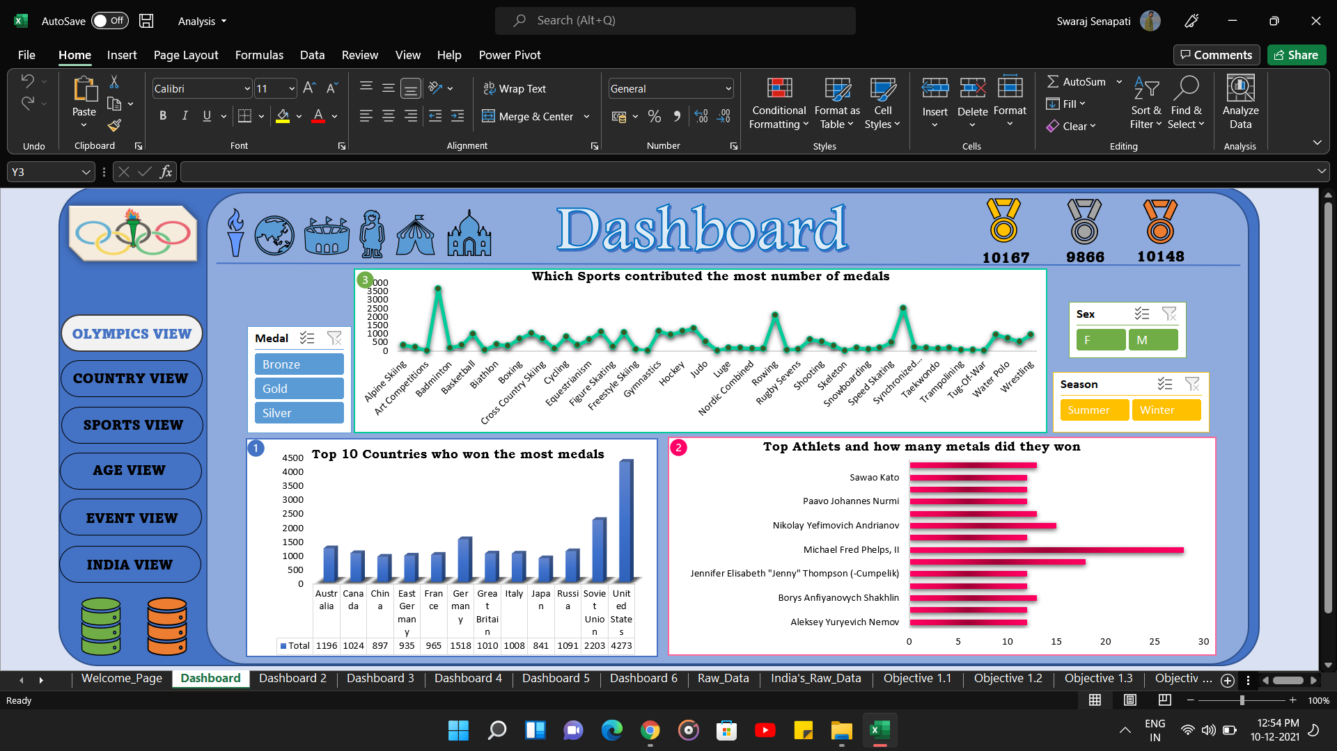
Objective 1
In this part of dashboard, it contain Olympic view of the analysis. Where I have analyzed the Top 10 countries who won the most medals, Top athletes and how many medals did they won & Which sports contributed the greatest number of medals. By using pivot table, I have analyzed the data and by pivot charts and slicers I have visualize the data. And by creating hyperlinks, icon and suitable images I have styled the dashboard.

Slide 6
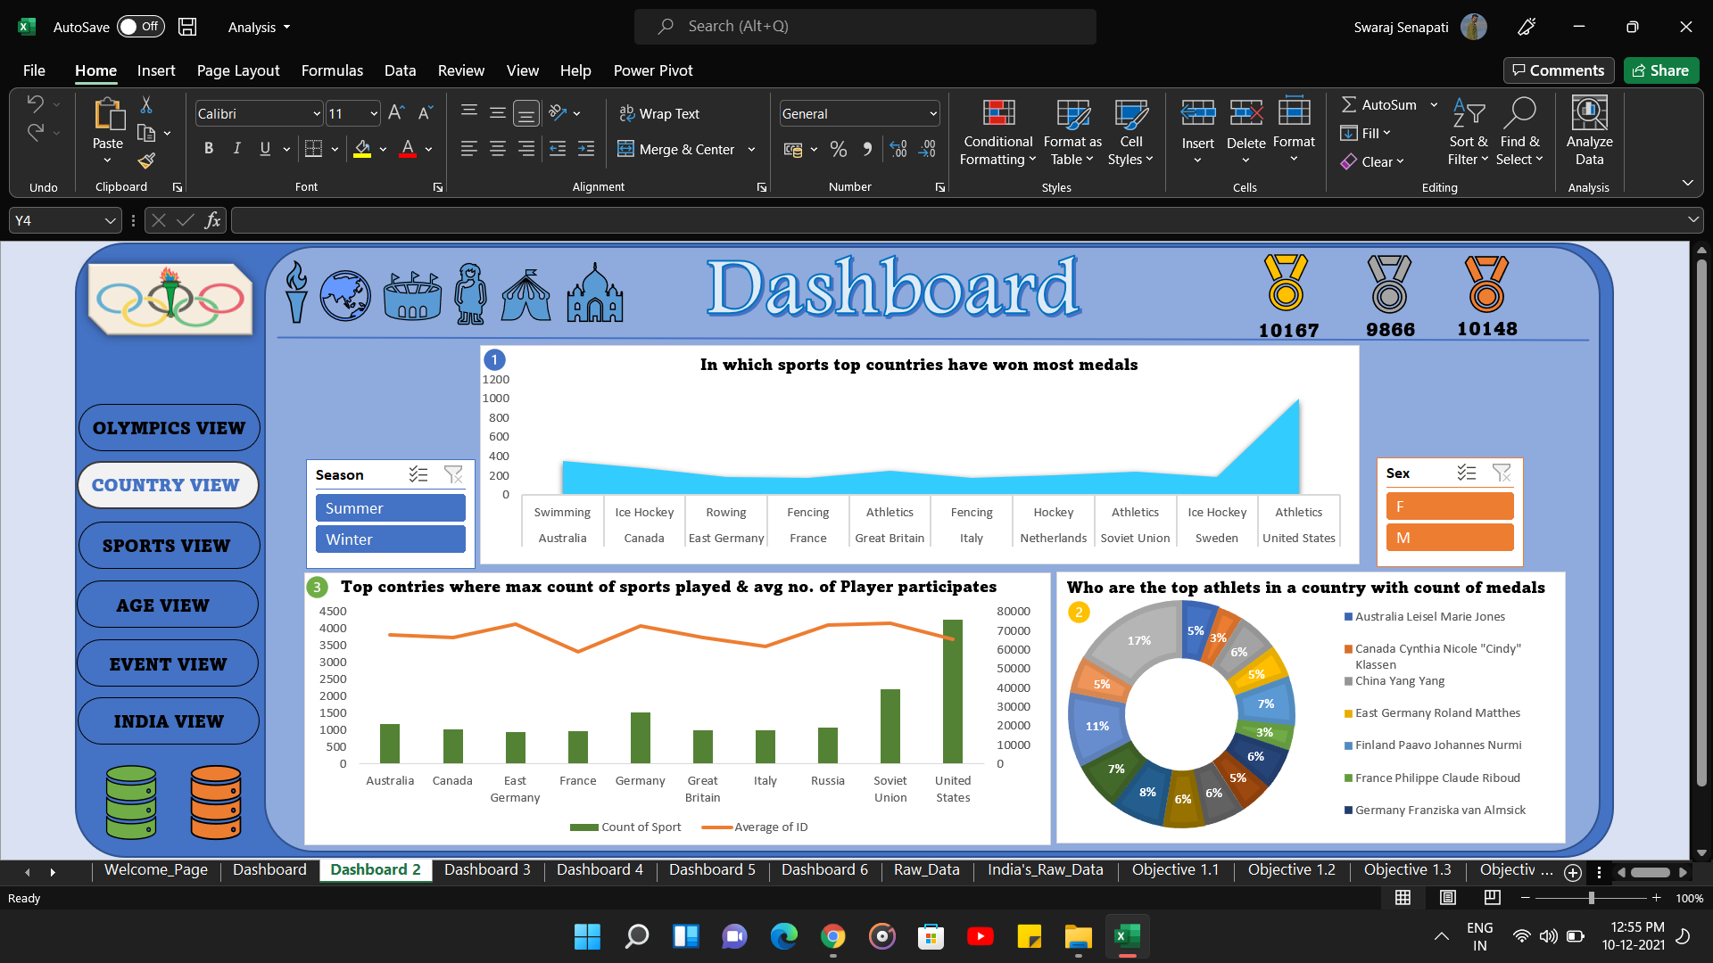
OBJECTIVE 2
In this part of dashboard, it contain Country view of the analysis. Where I have analyzed In which sports top countries have won medals, Who are the top athletes in a country with count of medals & Top countries where max. count of sports played & avg. athletes participated. By using pivot table, I have analyzed the data and by pivot charts and slicers I have visualize the data. And by creating hyperlinks, icon and suitable images I have styled the dashboard.

Slide 7
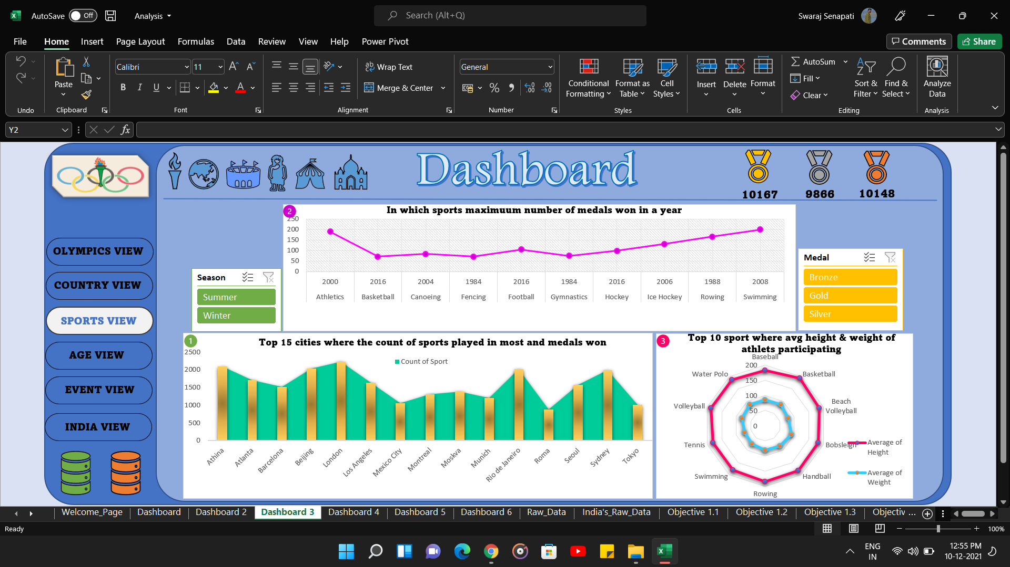
Objective 3
In this part of dashboard, it contain Sports view of the analysis. Where I have analyzed Top 15 cities where the count of sports played and medals win, In which sports max. number of medals won in a year & Top 10 sports where avg. height & weight of athletes participated. By using pivot table, I have analyzed the data and by pivot charts and slicers I have visualize the data. And by creating hyperlinks, icon and suitable images I have styled the dashboard.

Slide 8
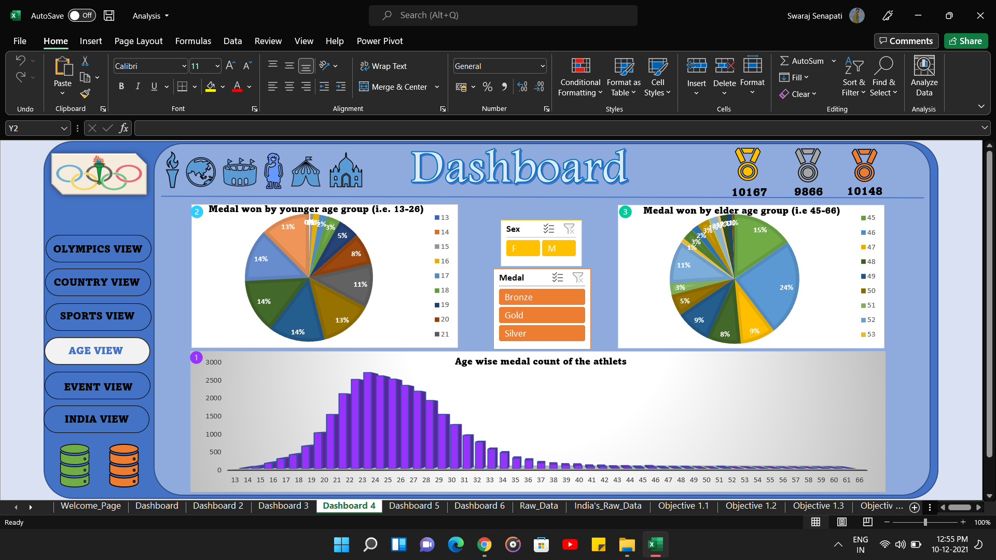
Objective 4
In this part of dashboard, it contain Age view of the analysis. Where I have analyzed the Age wise medals won by the athletes & Medals won by younger grp as compared of elder group .By using pivot table, I have analyzed the data and by pivot charts and slicers I have visualize the data. And by creating hyperlinks, icon and suitable images I have styled the dashboard.

Slide 9
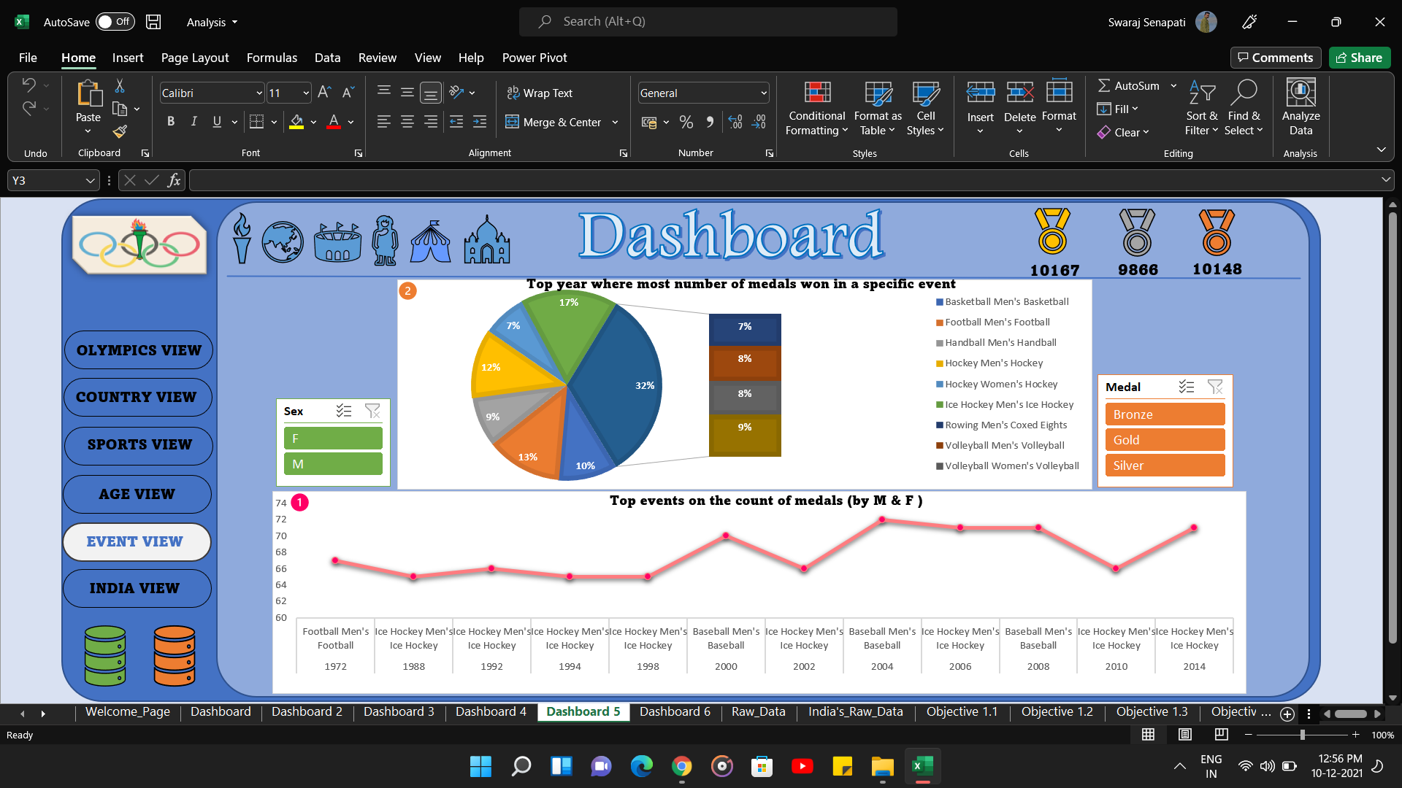
Objective 5
In this part of dashboard, it contain Event view of the analysis. Where I have analyzed the Top events on the count of medals for Male and Female athletes & Top year where most number of medals won in a specific event . By using pivot table, I have analyzed the data and by pivot charts and slicers I have visualize the data. And by creating hyperlinks, icon and suitable images I have styled the dashboard.

Slide 10
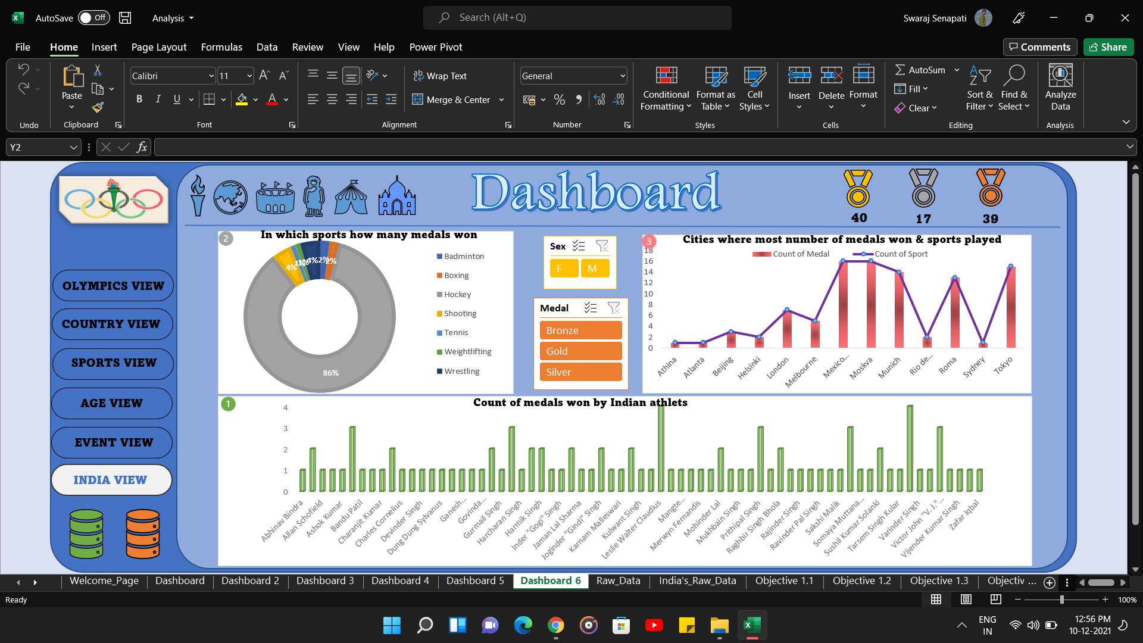
Objective 6
In this part of dashboard, it contain India view of the analysis. Where I have analyzed Count of medals won by Indian athletes, In which sports how many medals won & Cities where most medals won by Indian athletes. By using pivot table, I have analyzed the data and by pivot charts and slicers I have visualize the data. And by creating hyperlinks, icon and suitable images I have styled the dashboard.

Slide 11



