Slide 1


HR EMPLOYEE ATTRITION
BY
SWARANJALI VIJAY KARANJAWANE

Slide 2
ABOUT THE PROJECT
This project involves a descriptive analysis of the HR Employee Attrition dataset which has been taken from kaggle.com.
The dataset includes 1,470 employee records with 35 columns covering factors such as:
  Attrition: Indicates whether the employee has left the company.
  BusinessTravel: Describes the frequency of business travel for the employee.
  Department: The department where the employee works.
  DistanceFromHome: The distance between the employee’s home and workplace.
  EmployeeCount: The count of employees (constant value in this dataset).
  Gender: The gender of the employee.
  JobInvolvement: The level of involvement an employee has in their job.
  JobRole: The specific job role or title of the employe.
  Education: The education level of the employee.
  EducationField: The field of education the employee has studied

Slide 3
  JobSatisfaction: The employee’s satisfaction with their job.
  MaritalStatus: The marital status of the employee.
  MonthlyIncome: The monthly income of the employee.
  NumCompaniesWorked: The number of companies the employee has worked for.
  OverTime: Indicates if the employee is working overtime.
  PercentSalaryHike: The percentage increase in the employee’s salary.
  TotalWorkingYears: The total number of years the employee has worked.
  WorkLifeBalance: The employee’s satisfaction with their work-life balance.
  YearsAtCompany: The number of years the employee has worked at the current company.
  Age: The age of the employee.
This analysis helps us understand how employees behave and using this information we can create better plans so that we can keep employees happy, satisfied with their jobs and manage the workforce more effectively.

Slide 4
Problem Statements:
How does business travel type impact job satisfaction?
Calculate how many employees have left the job from each department
How many married females from All JobRole Had business travel?
Count the number of employee from each job role who have given a Job Satisfaction rating greater than 3 and have worked for more than 5 companies.
Which department has the max no of employees with more than 10 years at the company?
Which gender has the highest count of overtime work?
Calculate the highest age of an employee from each job role who has been with the company for 20 or more than 20 years.

Slide 5
Observations:
Employees who either don't travel at all or travel frequently for business have higher average job satisfaction then those who travel rarely.

Slide 6
Research And Development has highest Attrition → 133
Human Resources has Lowest Attrition →12
Observations:

Slide 7
Observations:
The count of Rarely traveling by married Female is higher in each Job Role

Slide 9
Research & Development has the maximum number of employees with more than 10 years at the company, with a total of 230 employees.
Sales follows with 121 employees.
Human Resources has the least with 15 employees.
Observations:

Slide 12
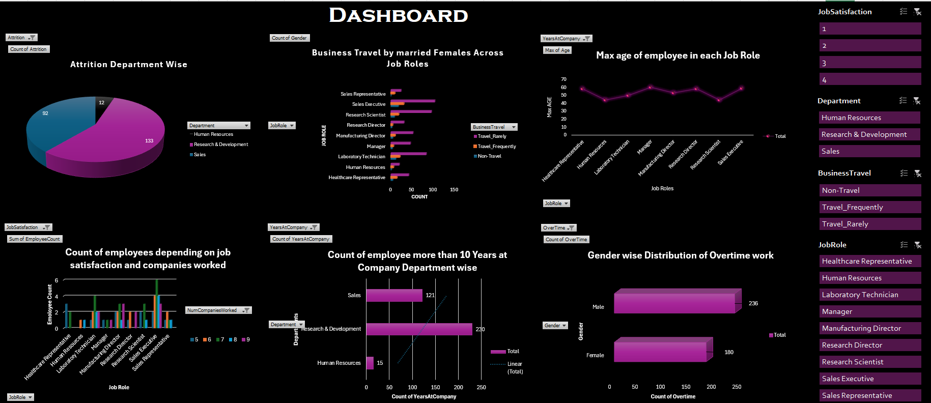

Slide 13
Conclusion:
The HR Employee Attrition analysis has uncovered important trends and areas of concern that can significantly impact the organization's workforce stability and productivity.
Key Findings:
High Attrition in Research & Development: This department has the highest number of employees leaving, despite also having the most long-tenured staff.
Job Satisfaction Disparities: Sales Executives and Laboratory Technicians exhibit high job satisfaction whereas Human Resources and Managers report the lowest satisfaction.
Gender differences in Overtime: Male employees are more likely to work overtime compared to their female counterparts.
Impact of Business Travel: Employees who either do not travel or travel frequently for business tend to be more satisfied with their jobs than those who travel rarely.
Age and Experience: The maximum age recorded is 60 years, highlighting the presence of experienced individuals.

Slide 14
Recommendations for Improvement
Reduce Attrition in Key Departments: The high attrition in Research & Development, suggests possible issues related to work environment, career growth, or workload. A deeper investigation through surveys and one-on-one meetings, improving communication within the department could help retain these valuable employees.
Boost Job Satisfaction in Low-Satisfaction Roles: For Human Resources and Managers, the focus should be on understanding the root causes of dissatisfaction. Regular feedback loops, stress management programs, and leadership training could empower these employees and improve their engagement and satisfaction.
Rebalance Workload to Manage Overtime: The significant overtime work among male employees may lead to burnout if not addressed. Flexible work schedules and better resource allocation can ensure that overtime is minimized and evenly distributed.
Reevaluate Business Travel Policies: Since rare travel correlates with lower job satisfaction, consider offering more autonomy in travel decisions. Providing options such as virtual meetings, flexible travel schedules, or compensatory time off could improve satisfaction for those who find travel challenging.

Slide 15

THANK
YOU

