Slide 1

Data Link Control
_{11.<number>}
Copyright © The McGraw-Hill Companies, Inc. Permission required for reproduction or display.

Slide 2
Data Link Layer Design Issues
❑ Services provided to the Network Layer
❑ Framing
❑ Error Control
❑ Flow Control

Slide 3
Data link Layer Services
❑ Unacknowledged connectionless service
No Acks, no connection
Error recovery up to higher layers
For low error-rate links or voice traffic
❑ Acknowledged connectionless service
Acks improve reliability
For unreliable channels. E.g.: Wireless Systems

Slide 4

Unacknowledged connectionless Service
Acknowledged connectionless Service

Slide 5
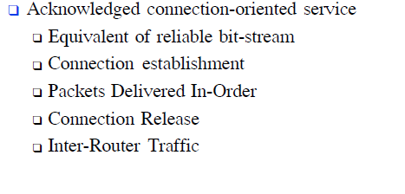
Acknowledged connection oriented service

Slide 6
1.1 FRAMING
The data link layer needs to pack bits into frames, so that each frame is distinguishable from another. Our postal system practices a type of framing. The simple act of inserting a letter into an envelope separates one piece of information from another; the envelope serves as the delimiter.
Topics discussed in this section:
Fixed-Size Framing
Variable-Size Framing
_{11.<number>}

Slide 7

Figure 11.1 A frame in a character-oriented protocol
_{11.<number>}

Slide 8

Figure 11.2 Byte stuffing and unstuffing
_{11.<number>}

Slide 9

Note
Byte stuffing is the process of adding 1 extra byte whenever there is a flag or escape character in the text.
_{11.<number>}

Slide 10

Figure 11.3 A frame in a bit-oriented protocol
_{11.<number>}

Slide 11
Note
Bit stuffing is the process of adding one extra 0 whenever five consecutive 1s follow a 0 in the data, so that the receiver does not mistake
the pattern 0111110 for a flag.
_{11.<number>}

Slide 12

Figure 1 Bit stuffing and unstuffing
_{11.<number>}

Slide 13
1.2 FLOW AND ERROR CONTROL
The most important responsibilities of the data link layer are flow control and error control. Collectively, these functions are known as data link control.
Topics discussed in this section:
Flow Control
Error Control
_{11.<number>}

Slide 14
Note
Flow control refers to a set of procedures used to restrict the amount of data
that the sender can send before
waiting for acknowledgment.
_{11.<number>}

Slide 15
Note
Error control in the data link layer is based on automatic repeat request, which is the retransmission of data.
_{11.<number>}

Slide 16
1-3 PROTOCOLS
Now let us see how the data link layer can combine framing, flow control, and error control to achieve the delivery of data from one node to another. The protocols are normally implemented in software by using one of the common programming languages. To make our discussions language-free, we have written in pseudocode a version of each protocol that concentrates mostly on the procedure instead of delving into the details of language rules.
_{11.<number>}

Slide 17

Figure 1.5 Taxonomy of protocols discussed in this chapter
_{11.<number>}

Slide 18
1.4 NOISELESS CHANNELS
Let us first assume we have an ideal channel in which no frames are lost, duplicated, or corrupted. We introduce two protocols for this type of channel.
Topics discussed in this section:
Simplest Protocol
Stop-and-Wait Protocol
_{11.<number>}

Slide 19

Figure 1.6 The design of the simplest protocol with no flow or error control
_{11.<number>}

Slide 20
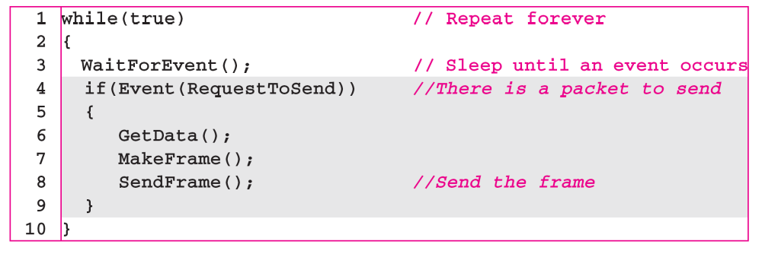
Algorithm 1.1 Sender-site algorithm for the simplest protocol
_{11.<number>}

Slide 21
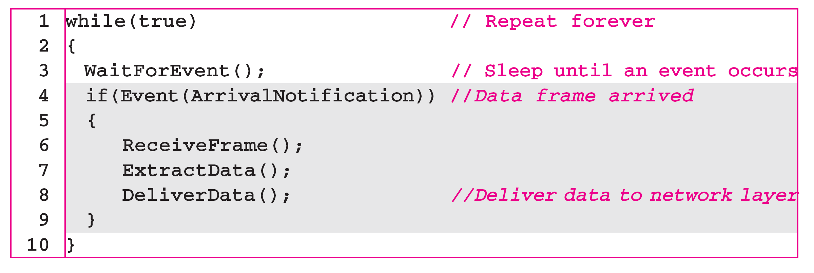
Algorithm 1.2 Receiver-site algorithm for the simplest protocol
_{11.<number>}

Slide 22
Example 1.1
Figure 1.7 shows an example of communication using this protocol. It is very simple. The sender sends a sequence of frames without even thinking about the receiver. To send three frames, three events occur at the sender site and three events at the receiver site. Note that the data frames are shown by tilted boxes; the height of the box defines the transmission time difference between
the first bit and the last bit in the frame.
_{11.<number>}

Slide 23

Figure 1.7 Flow diagram for Example 11.1
_{11.<number>}

Slide 24

Figure 1.8 Design of Stop-and-Wait Protocol
_{11.<number>}

Slide 25
Algorithm 1.3 Sender-site algorithm for Stop-and-Wait Protocol
_{11.<number>}

Slide 26
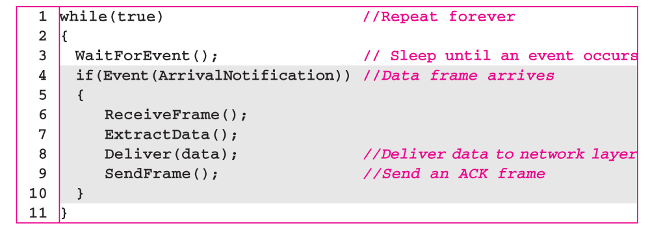
Algorithm 1.4 Receiver-site algorithm for Stop-and-Wait Protocol
_{11.<number>}

Slide 27
Example 1.2
Figure 1.9 shows an example of communication using this protocol. It is still very simple. The sender sends one frame and waits for feedback from the receiver. When the ACK arrives, the sender sends the next frame. Note that sending two frames in the protocol involves the sender in four events and the receiver in two events.
_{11.<number>}

Slide 28

Figure 1.9 Flow diagram for Example 11.2
_{11.<number>}

Slide 29
1-5 NOISY CHANNELS
Although the Stop-and-Wait Protocol gives us an idea of how to add flow control to its predecessor, noiseless channels are nonexistent. We discuss three protocols in this section that use error control.
Topics discussed in this section:
Stop-and-Wait Automatic Repeat Request
Go-Back-N Automatic Repeat Request
Selective Repeat Automatic Repeat Request
_{11.<number>}

Slide 30
Note
Error correction in Stop-and-Wait ARQ is done by keeping a copy of the sent frame and retransmitting of the frame when the timer expires.
_{11.<number>}

Slide 31
Note
In Stop-and-Wait ARQ, we use sequence numbers to number the frames.
The sequence numbers are based on modulo-2 arithmetic.
_{11.<number>}

Slide 32
Note
In Stop-and-Wait ARQ, the acknowledgment number always announces in modulo-2 arithmetic the sequence number of the next frame expected.
_{11.<number>}

Slide 33

Figure 1.10 Design of the Stop-and-Wait ARQ Protocol
_{11.<number>}

Slide 34
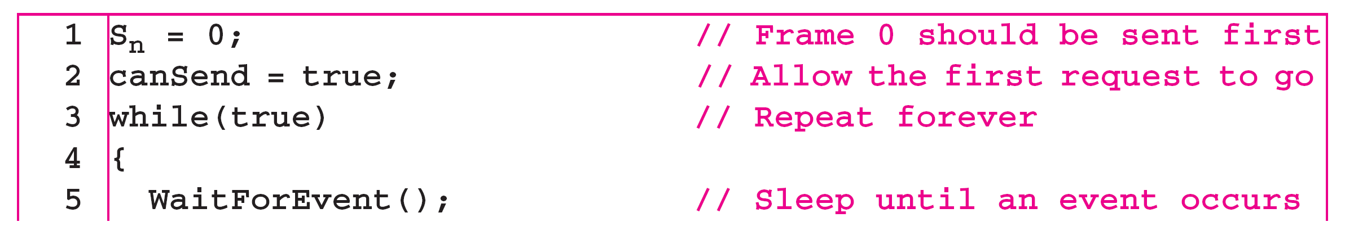
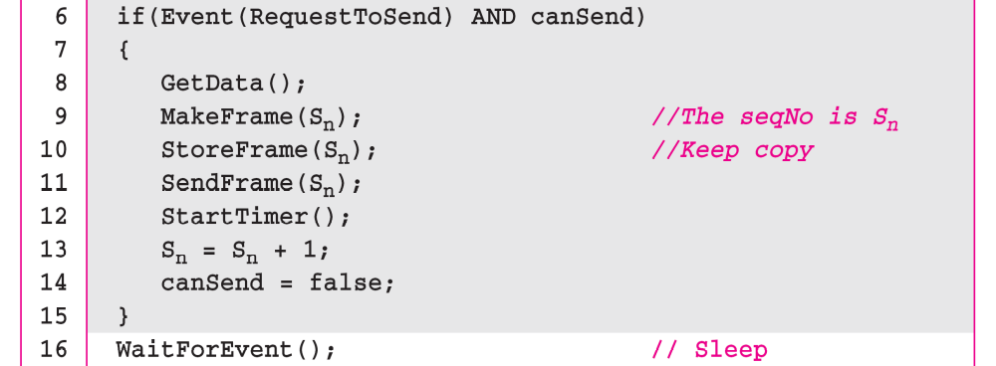
Algorithm 1.5 Sender-site algorithm for Stop-and-Wait ARQ
_{(continued)}
_{11.<number>}

Slide 35
Algorithm 1.5 Sender-site algorithm for Stop-and-Wait ARQ
_{(continued)}
_{11.<number>}

Slide 36
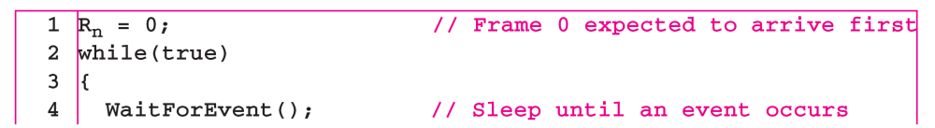
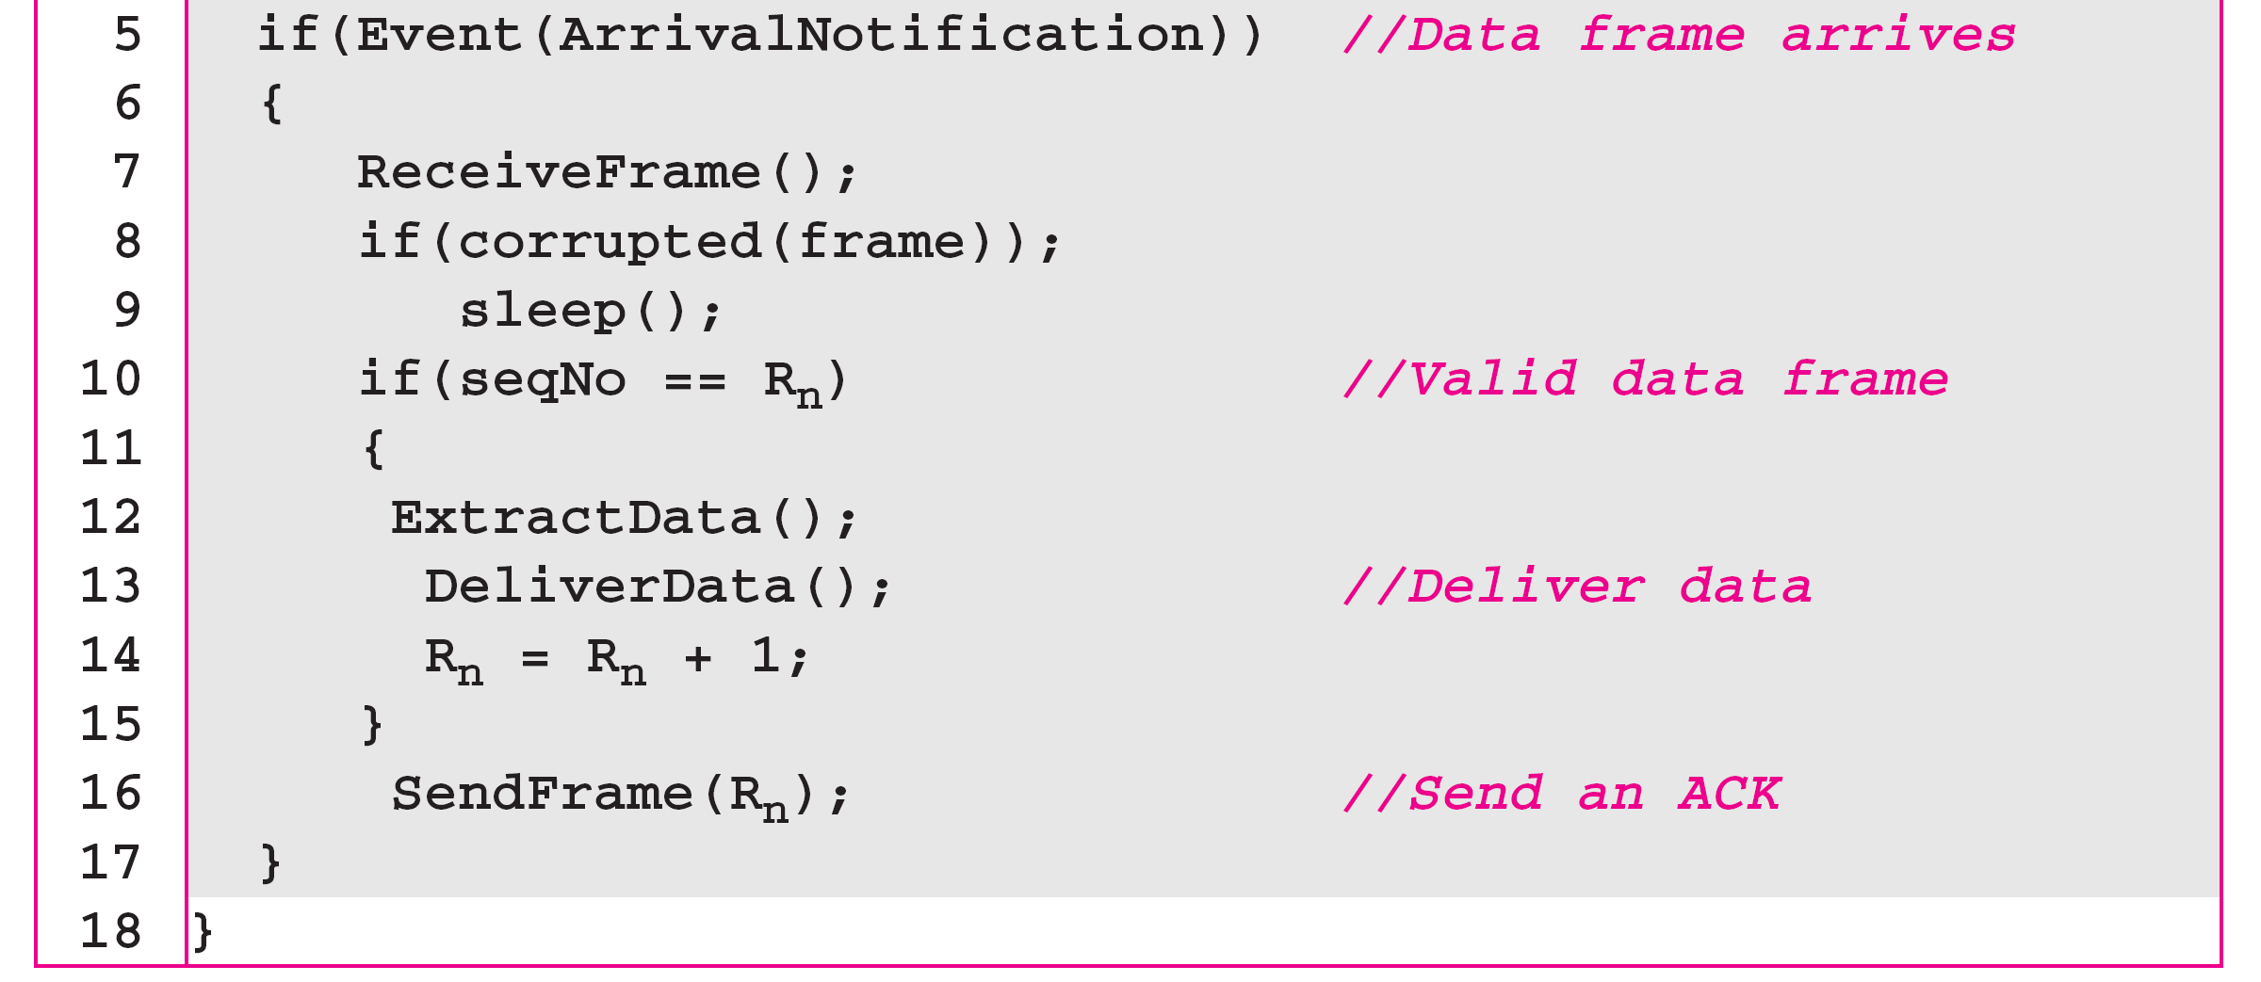
Algorithm 1.6 Receiver-site algorithm for Stop-and-Wait ARQ Protocol
_{11.<number>}

Slide 37
Example 1.3
Figure 1.11 shows an example of Stop-and-Wait ARQ. Frame 0 is sent and acknowledged. Frame 1 is lost and resent after the time-out. The resent frame 1 is acknowledged and the timer stops. Frame 0 is sent and acknowledged, but the acknowledgment is lost. The sender has no idea if the frame or the acknowledgment is lost, so after the time-out, it resends frame 0, which is acknowledged.
_{11.<number>}

Slide 38

Figure 1.11 Flow diagram for Example 1.3
_{11.<number>}

Slide 39
GO back N sliding window Protocol
Note
Introduction of Pipelining:Several frames can be sent before we receive news about the previous frames
In the Go-Back-N Protocol, the sequence numbers are modulo 2^{m},
where m is the size of the sequence number field in bits.
_{11.<number>}

Slide 40
GO back N sliding window Protocol
Sliding window: Abstract concept that defines the range of sequence numbers that is concern of sender and receiver
Sender’s sliding window: the range that is concern of the sender
Receiver’s sliding window: the range that is concern of the receiver
Maximum size of window is 2^{m}-1
If m bit sequence number is allowed(size of sequence no. field in the frame header)
_{11.<number>}

Slide 41

Figure 1.12 Send window for Go-Back-N ARQ (here m=4)
_{11.<number>}

Slide 42
Note
The send window is an abstract concept defining an imaginary box of size 2^{m} − 1 with three variables: S_{f}, S_{n}, and S_{size}.
The send window can slide one
or more slots when a valid acknowledgment arrives.
_{11.<number>}

Slide 43

Figure 1.13 Receive window for Go-Back-N ARQ
_{11.<number>}

Slide 44
Note
The receive window is an abstract concept defining an imaginary box
of size 1 with one single variable R_{n}.
The window slides
when a correct frame has arrived; sliding occurs one slot at a time.
_{11.<number>}

Slide 45
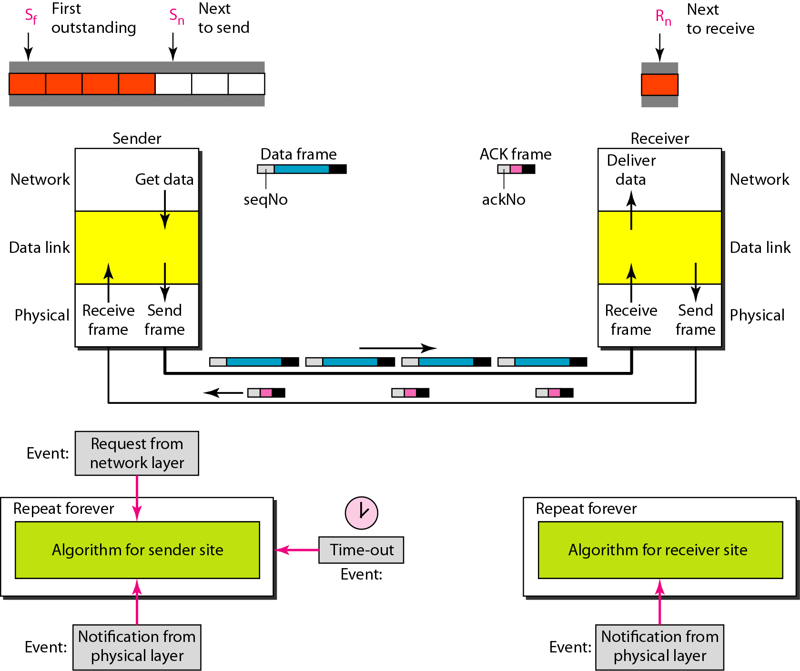
Figure 1.14 Design of Go-Back-N ARQ
_{11.<number>}

Slide 46

Figure 1.15 Window size for Go-Back-N ARQ
_{11.<number>}

Slide 47
Note
In Go-Back-N ARQ, the size of the send window must be less than 2^{m};
the size of the receiver window
is always 1.
_{11.<number>}

Slide 48
Example 1.6
Figure 1.16 shows an example of Go-Back-N. This is an example of a case where the forward channel is reliable, but the reverse is not. No data frames are lost, but some ACKs are delayed and one is lost. The example also shows how cumulative acknowledgments can help if acknowledgments are delayed or lost. After initialization, there are seven sender events. Request events are triggered by data from the network layer; arrival events are triggered by acknowledgments from the physical layer. There is no time-out event here because all outstanding frames are acknowledged before the timer expires. Note that although ACK 2 is lost, ACK 3 serves as both ACK 2 and ACK 3.
_{11.<number>}

Slide 49

Figure 1.16 Flow diagram for Example 11.6
_{11.<number>}

Slide 50
Example 1.7
Figure 1.17 shows what happens when a frame is lost. Frames 0, 1, 2, and 3 are sent. However, frame 1 is lost. The receiver receives frames 2 and 3, but they are discarded because they are received out of order. The sender receives no acknowledgment about frames 1, 2, or 3. Its timer finally expires. The sender sends all outstanding frames (1, 2, and 3) because it does not know what is wrong. Note that the resending of frames 1, 2, and 3 is the response to one single event. When the sender is responding to this event, it cannot accept the triggering of other events. This means that when ACK 2 arrives, the sender is still busy with sending frame 3.
_{11.<number>}

Slide 51
Example 1.7 (continued)
The physical layer must wait until this event is completed and the data link layer goes back to its sleeping state. We have shown a vertical line to indicate the delay. It is the same story with ACK 3; but when ACK 3 arrives, the sender is busy responding to ACK 2. It happens again when ACK 4 arrives. Note that before the second timer expires, all outstanding frames have been sent and the timer is stopped.
_{11.<number>}

Slide 52

Figure 1.17 Flow diagram for Example 11.7
_{11.<number>}

Slide 53
Note
Stop-and-Wait ARQ is a special case of Go-Back-N ARQ in which the size of the send window is 1.
In Selective repeat ARQ window size can be 2^{m-1}
The size of receive window is same as send window
_{11.<number>}

Slide 54

Figure 1.18 Send window for Selective Repeat ARQ
_{11.<number>}

Slide 55

Figure 1.19 Receive window for Selective Repeat ARQ
_{11.<number>}

Slide 56
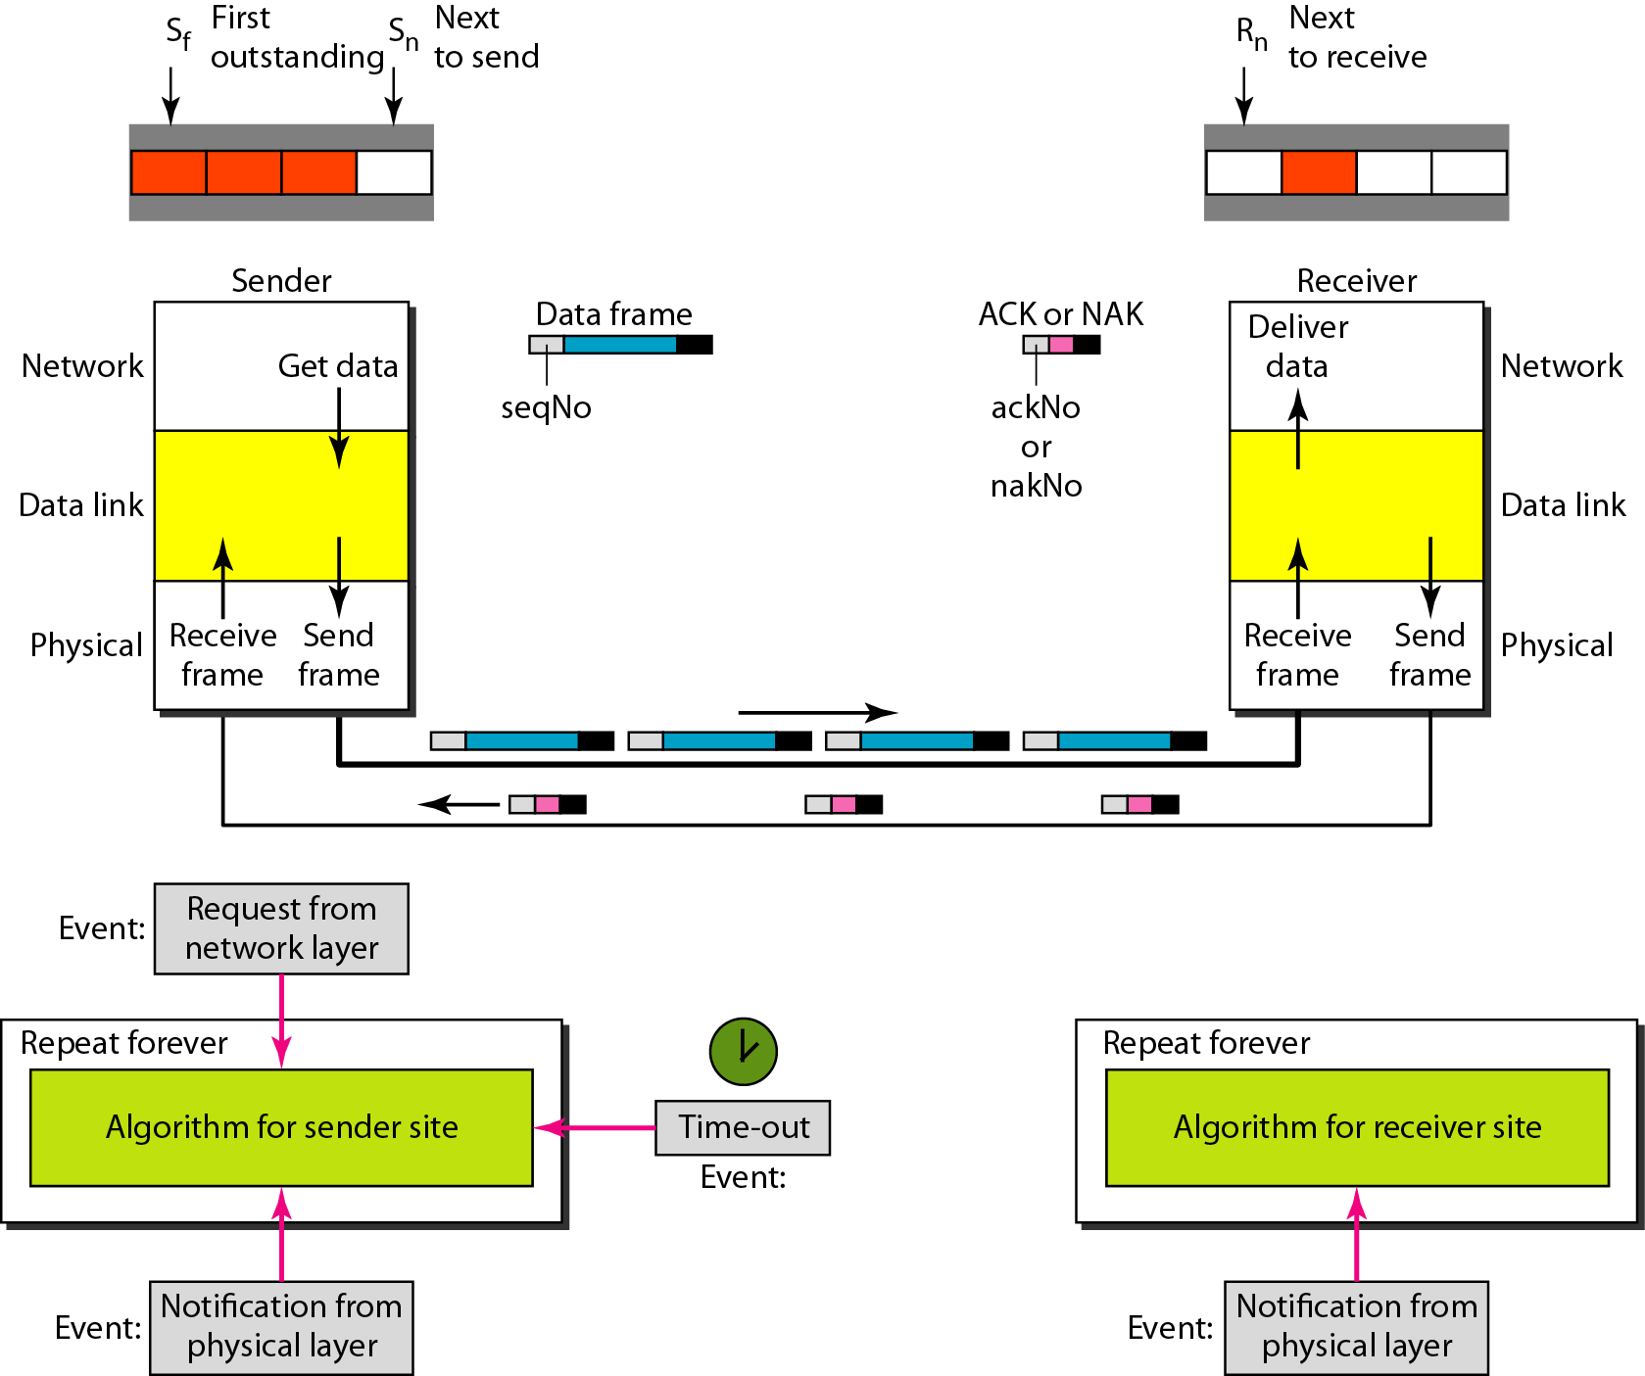
Figure 1.20 Design of Selective Repeat ARQ
_{11.<number>}

Slide 57

Figure 1.21 Selective Repeat ARQ, window size
_{11.<number>}

Slide 58
Note
In Selective Repeat ARQ, the size of the sender and receiver window
must be at most one-half of 2^{m}.
_{11.<number>}

Slide 59

Figure 1.22 Delivery of data in Selective Repeat ARQ
_{11.<number>}

Slide 60
Example 1.8
This example is similar to Example 1.3 in which frame 1 is lost. We show how Selective Repeat behaves in this case. Figure 1.23 shows the situation. One main difference is the number of timers. Here, each frame sent or resent needs a timer, which means that the timers need to be numbered (0, 1, 2, and 3). The timer for frame 0 starts at the first request, but stops when the ACK for this frame arrives. The timer for frame 1 starts at the second request, restarts when a NAK arrives, and finally stops when the last ACK arrives. The other two timers start when the corresponding frames are sent and stop at the last arrival event.
_{11.<number>}

Slide 61
Example 1.8 (continued)
At the receiver site we need to distinguish between the acceptance of a frame and its delivery to the network layer. At the second arrival, frame 2 arrives and is stored and marked, but it cannot be delivered because frame 1 is missing. At the next arrival, frame 3 arrives and is marked and stored, but still none of the frames can be delivered. Only at the last arrival, when finally a copy of frame 1 arrives, can frames 1, 2, and 3 be delivered to the network layer. There are two conditions for the delivery of frames to the network layer: First, a set of consecutive frames must have arrived. Second, the set starts from the beginning of the window.
_{11.<number>}

Slide 62
Example 1.8 (continued)
Another important point is that a NAK is sent after the second arrival, but not after the third, although both situations look the same. The reason is that the protocol does not want to crowd the network with unnecessary NAKs and unnecessary resent frames. The second NAK would still be NAK1 to inform the sender to resend frame 1 again; this has already been done. The first NAK sent is remembered (using the nakSent variable) and is not sent again until the frame slides. A NAK is sent once for each window position and defines the first slot in the window.
_{11.<number>}

Slide 63
Example 1.8 (continued)
The next point is about the ACKs. Notice that only two ACKs are sent here. The first one acknowledges only the first frame; the second one acknowledges three frames. In Selective Repeat, ACKs are sent when data are delivered to the network layer. If the data belonging to n frames are delivered in one shot, only one ACK is sent for all of them.
_{11.<number>}

Slide 64

Figure 1.23 Flow diagram for Example 11.8
_{11.<number>}

Slide 65
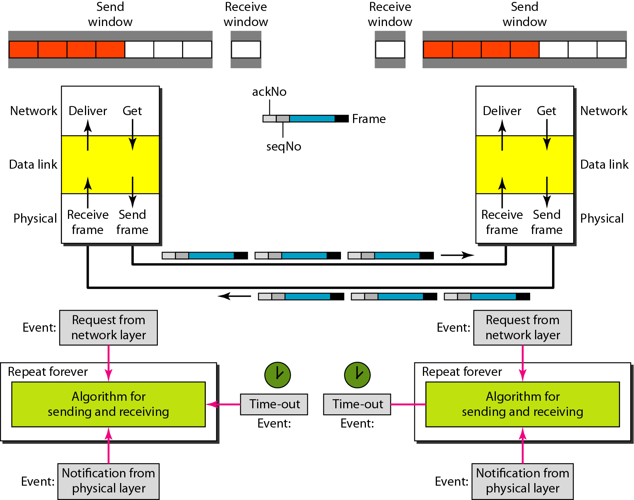
Figure 1.24 Design of piggybacking in Go-Back-N ARQ
_{11.<number>}

Slide 66
1-6 HDLC
High-level Data Link Control (HDLC) is a bit-oriented protocol for communication over point-to-point and multipoint links. It implements the ARQ mechanisms we discussed in this chapter.
Topics discussed in this section:
Configurations and Transfer Modes
Frames
Control Field
_{11.<number>}

Slide 67
Configurations and Transfer modes
1. Normal Response mode
2. Asynchronous balanced mode

Slide 68
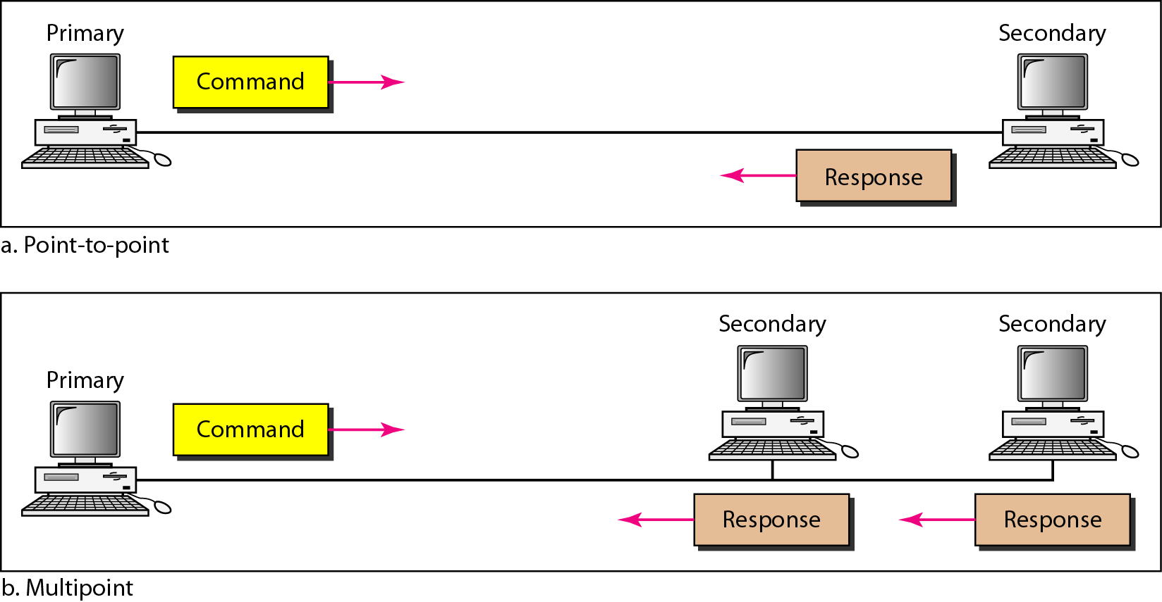
Figure 1.25 Normal response mode
_{11.<number>}

Slide 69
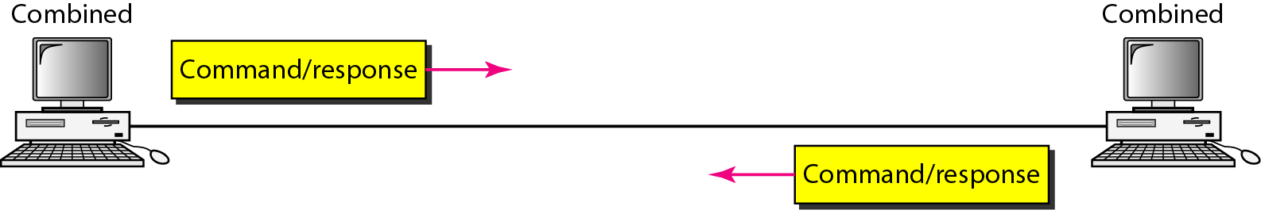
Figure 1.26 Asynchronous balanced mode
_{11.<number>}

Slide 70
Framing
To provide flexibility to support all the options possible in modes and configurations HDLC Defines 3 types of frames.
1. I-Frames:
User data and control info. relating to user data
2. S-Frames:Transports control info.
3. U-Frames:Reserved for system management.

Slide 71
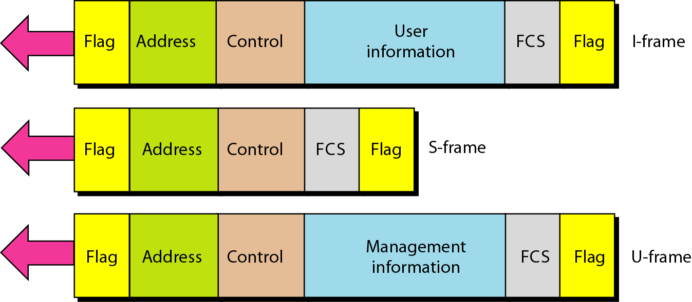
Figure 1.27 HDLC frames
_{11.<number>}

Slide 72
Flag:
Synchronization Pattern 01111110
Address: Address of secondary station. If primary has created the frame it contains toaddress
If secondary has created the frame it contains fromaddress
Control field: for flow and error control
Information field:contains user's data from the network layer.
FCS:Frame check sequence is error detection field it contains 2 or 4 byte CRC

Slide 73
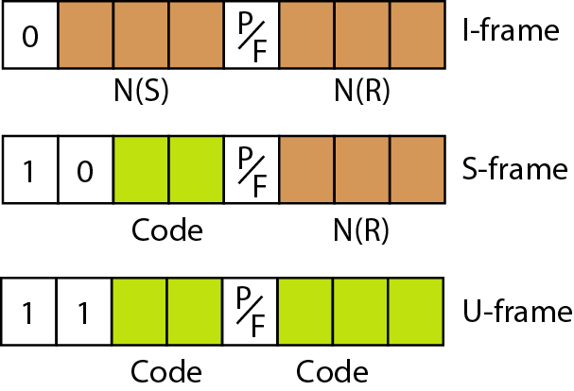
Figure 1.28 Control field format for the different frame types
_{11.<number>}

Slide 74
Control field for I- Frame
The first field defines the type
N(s): sequence number of frame (3-bits)
N(R):Corresponds to Ack number when piggybacking is used
P/F ( Poll or Final): It has meaning only when it is set to 1 and can mean poll or final.
It means poll when the frame has sent by primary to secondary.
It mean final when the frame has send by secondary to primary (when Address fields contains address of the secondary)

Slide 75
Control field for S-Frame
N(R) Currosponds to the Ack number or negative Ack numberdepending on type of S-Frame.
2 bit Code defines type of S-Frame.
RR(Receive Ready): Control field code value -00 .
This kind of frame ACK the recept of safe frames. Value of N(R) defines the ACK number
RNR(Receive not ready)”:Control field code value -10 his kind of frame ACK the recept of safe frames and informs that now it cannot receive more frames.
Reject(REJ): Control field code value -01,NACK frame.
Selective Reject(S-REJ):Control field code value - 11,NACK frame for selective repeat ARQ

Slide 76
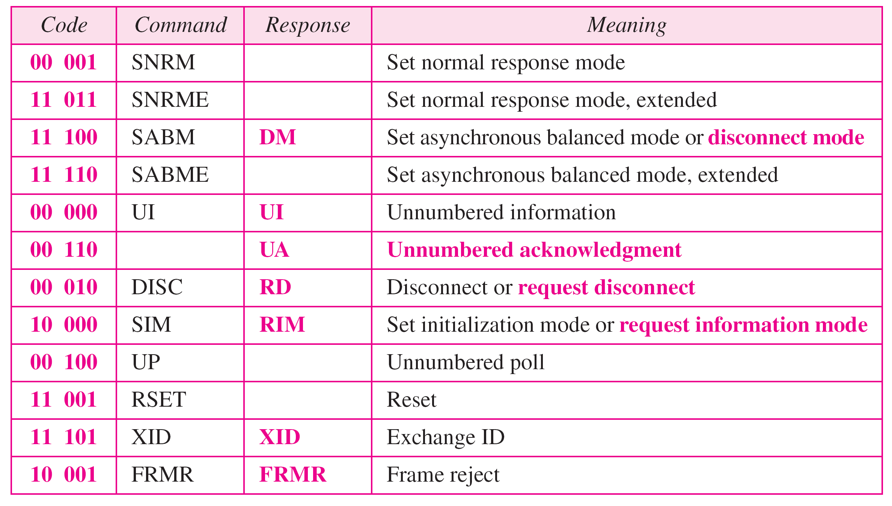
Table 11.1 U-frame control command and response
_{11.<number>}

Slide 77
11-7 POINT-TO-POINT PROTOCOL
Although HDLC is a general protocol that can be used for both point-to-point and multipoint configurations, one of the most common protocols for point-to-point access is the Point-to-Point Protocol (PPP). PPP is a byte-oriented protocol.
Topics discussed in this section:
Framing
Transition Phases
Multiplexing
Multilink PPP
_{11.<number>}

Slide 78
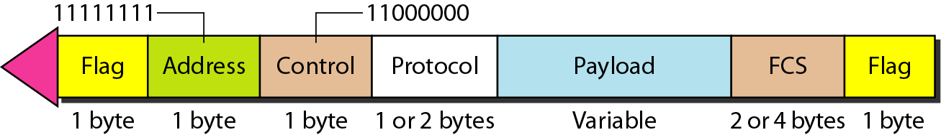
Figure 11.32 PPP frame format
_{11.<number>}

Slide 79
framing
Flag:01111110
Address:broadcast 11111111
Control:00000011
Protocol:what is being carried in the data field
Payload:max 1500 bytes
FCS:2byte or 4 byte standard CRC

Slide 80
Note
PPP is a byte-oriented protocol using byte stuffing with the escape byte 01111101.
_{11.<number>}

