Slide 1
Chapter 7
Transmission Media
Guided Media
Unguided Media
WCB/McGraw-Hill
© The McGraw-Hill Companies, Inc., 1998

Slide 2
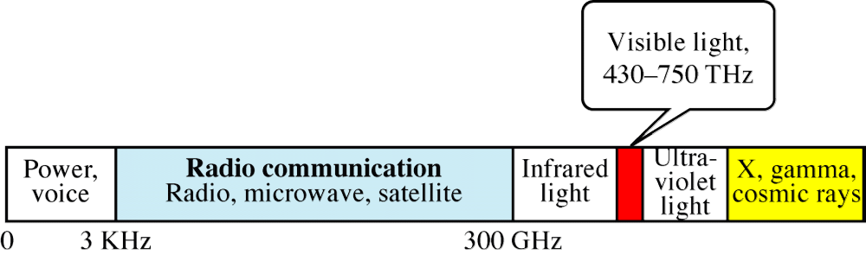
Figure 7-1
Electromagnetic Spectrum
WCB/McGraw-Hill
© The McGraw-Hill Companies, Inc., 1998

Slide 3
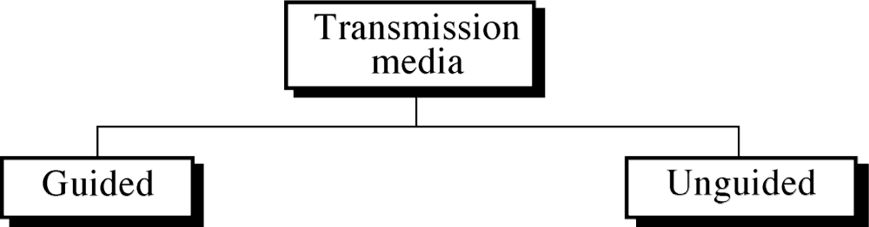
Figure 7-2
WCB/McGraw-Hill
© The McGraw-Hill Companies, Inc., 1998

Slide 4
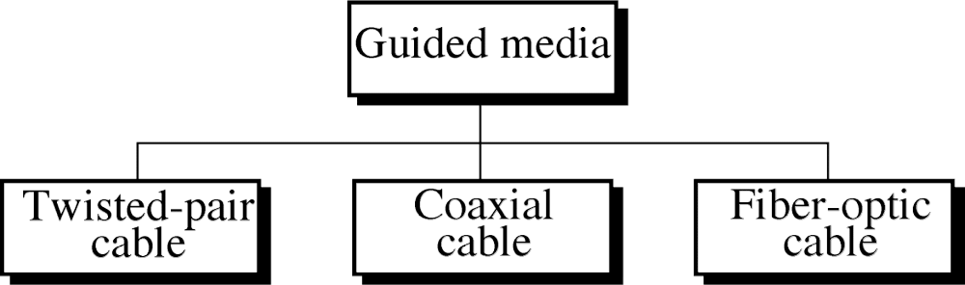
Figure 7-3
WCB/McGraw-Hill
© The McGraw-Hill Companies, Inc., 1998

Slide 5
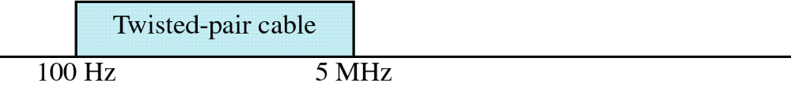
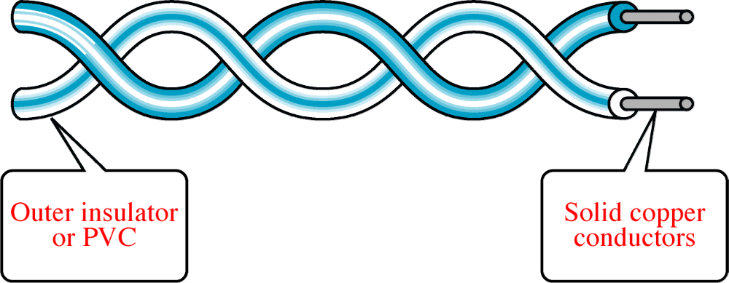
Figure 7-4 and 7-5
Twisted-Pair Cable
WCB/McGraw-Hill
© The McGraw-Hill Companies, Inc., 1998

Slide 6
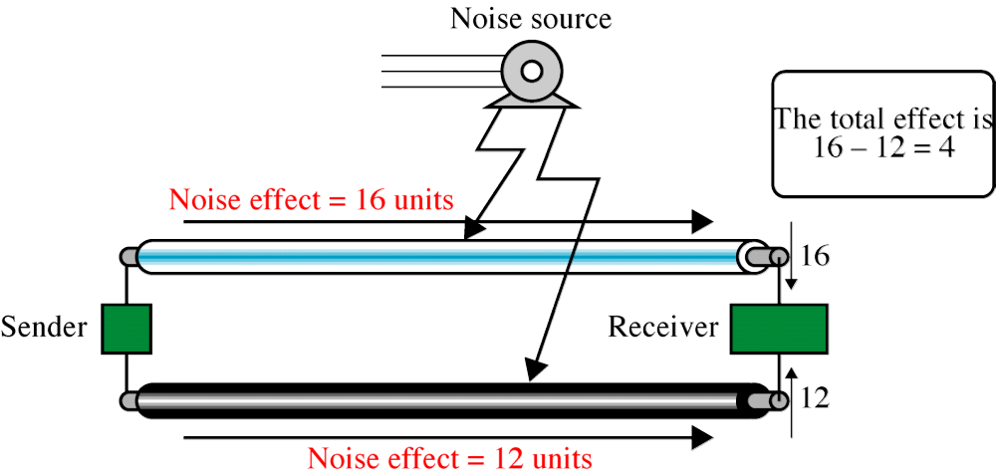
Figure 7-6
Effect of Noise on Parallel Lines
WCB/McGraw-Hill
© The McGraw-Hill Companies, Inc., 1998

Slide 7
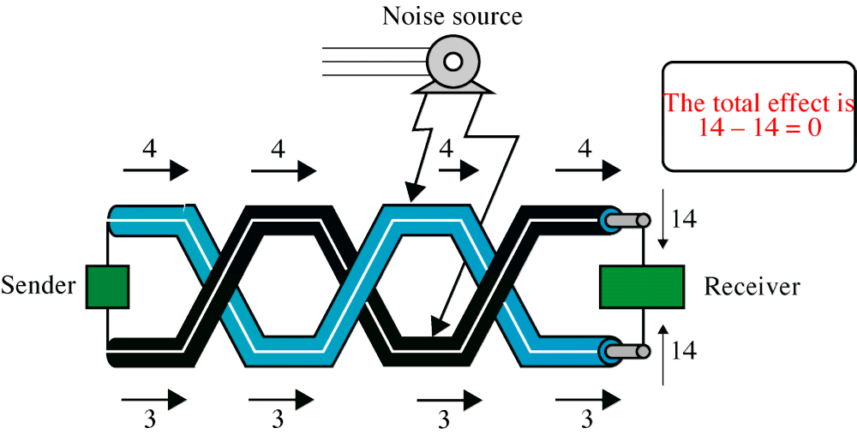
Figure 7-7
Noise on Twisted-Pair Lines
WCB/McGraw-Hill
© The McGraw-Hill Companies, Inc., 1998

Slide 8
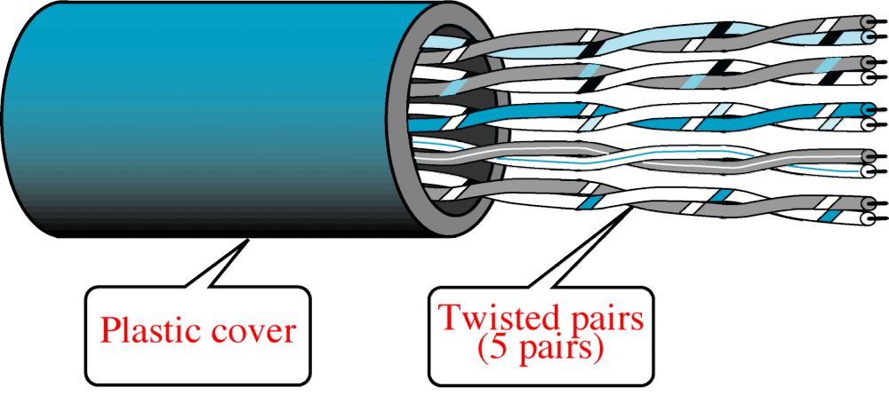
Figure 7-8
Unshielded Twisted-Pair Cable
WCB/McGraw-Hill
© The McGraw-Hill Companies, Inc., 1998

Slide 9
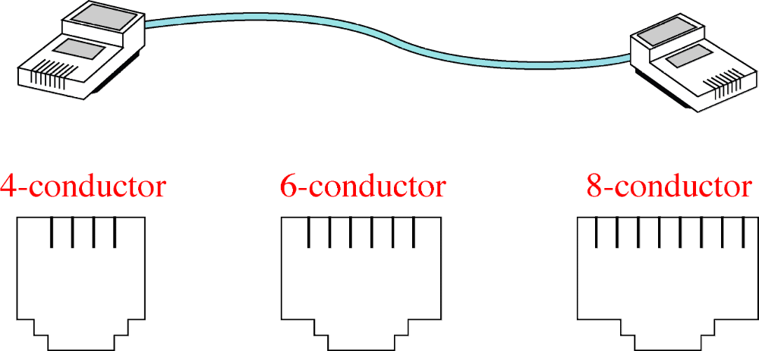
Figure 7-9
UTP Connectors
WCB/McGraw-Hill
© The McGraw-Hill Companies, Inc., 1998

Slide 10
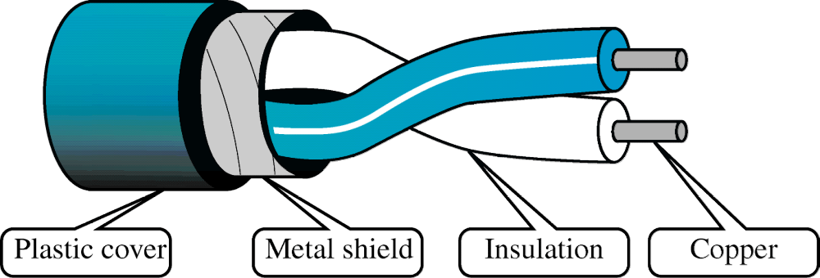
Figure 7-10
Shielded Twisted-Pair Cable
WCB/McGraw-Hill
© The McGraw-Hill Companies, Inc., 1998

Slide 11

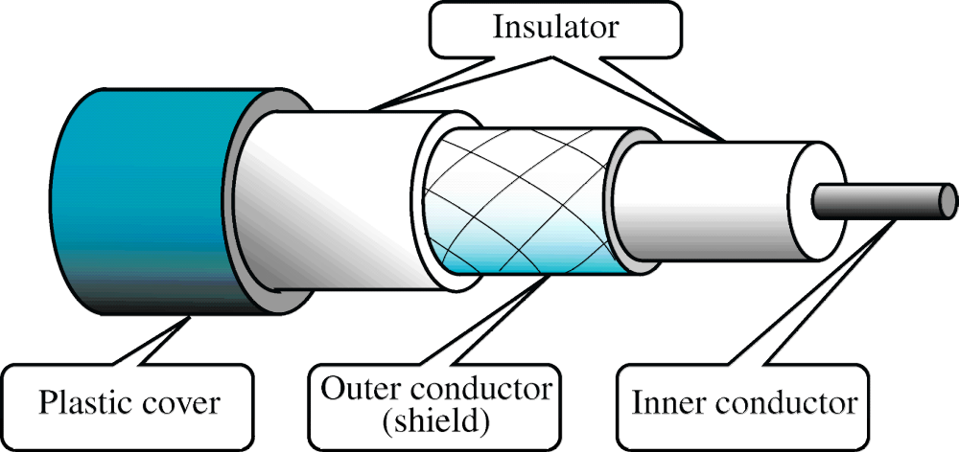
Figure 7-11 and 7-12
Coaxial Cable
WCB/McGraw-Hill
© The McGraw-Hill Companies, Inc., 1998

Slide 12
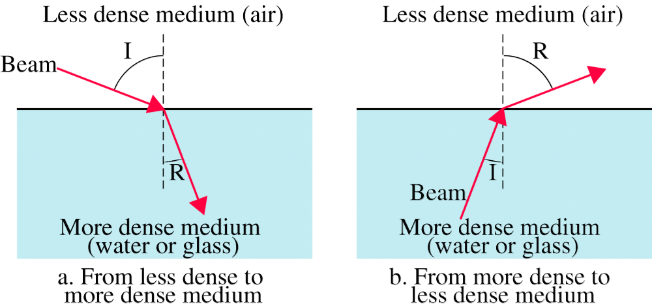
Figure 7-13
Refraction
WCB/McGraw-Hill
© The McGraw-Hill Companies, Inc., 1998

Slide 13
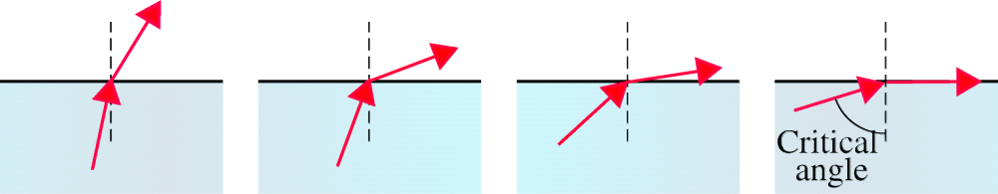
Figure 7-14
Critical Angle
WCB/McGraw-Hill
© The McGraw-Hill Companies, Inc., 1998

Slide 14
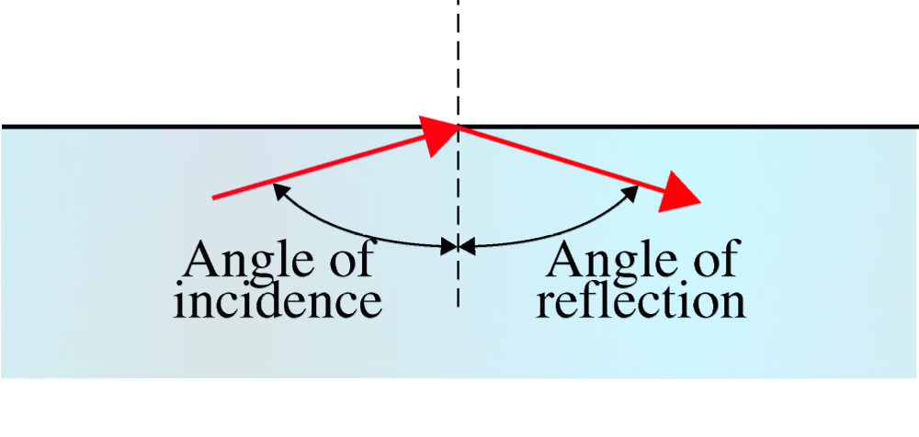
Figure 7-15
Reflection
WCB/McGraw-Hill
© The McGraw-Hill Companies, Inc., 1998

Slide 15
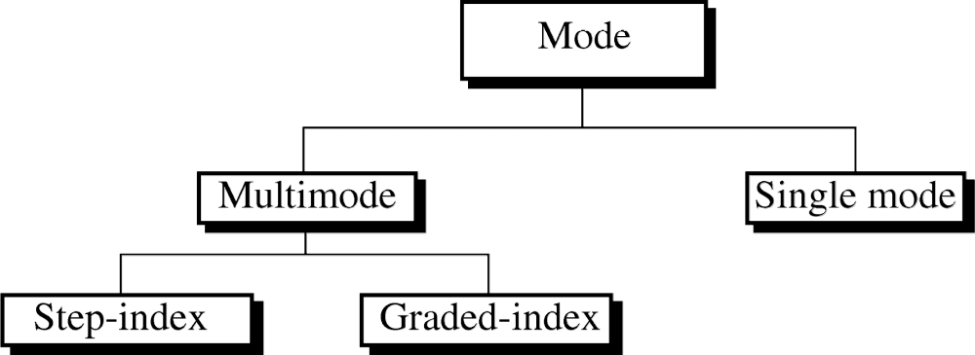
Figure 7-16
WCB/McGraw-Hill
© The McGraw-Hill Companies, Inc., 1998

Slide 16
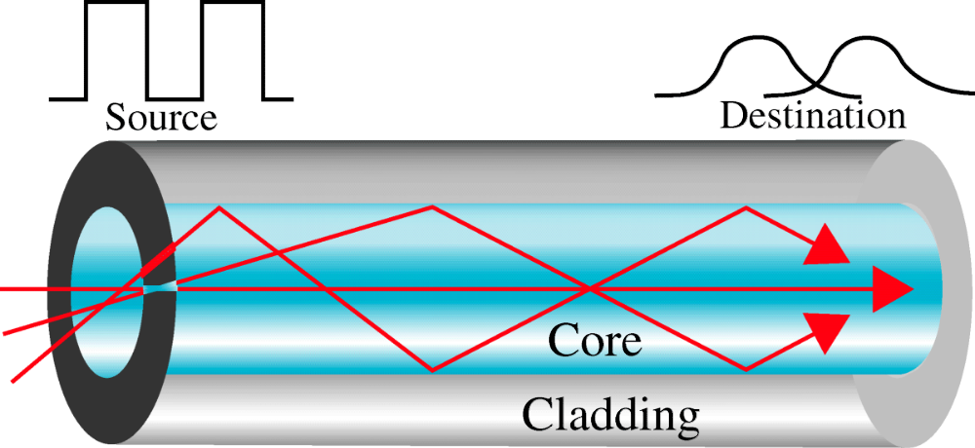
Figure 7-17
Multimode Step-Index
WCB/McGraw-Hill
© The McGraw-Hill Companies, Inc., 1998

Slide 17
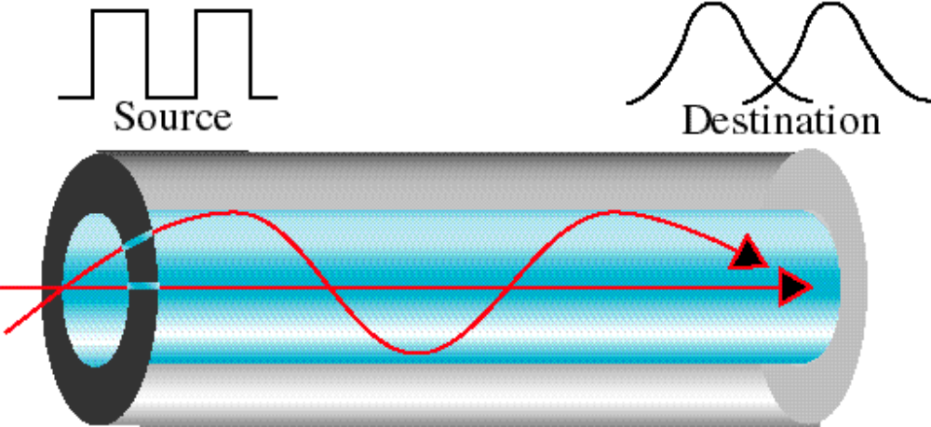
Figure 7-18
Multimode Graded-Index
WCB/McGraw-Hill
© The McGraw-Hill Companies, Inc., 1998

Slide 18
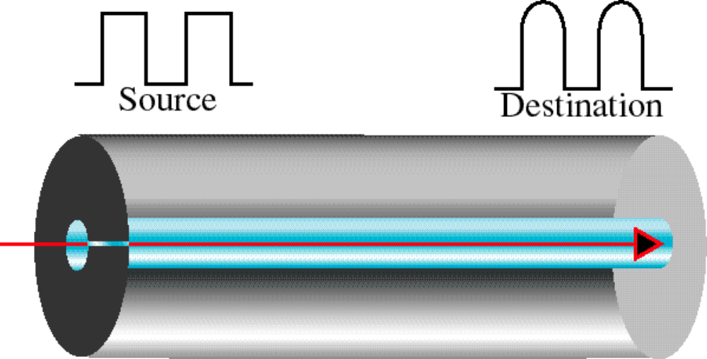
Figure 7-19
Single Mode
WCB/McGraw-Hill
© The McGraw-Hill Companies, Inc., 1998

Slide 19
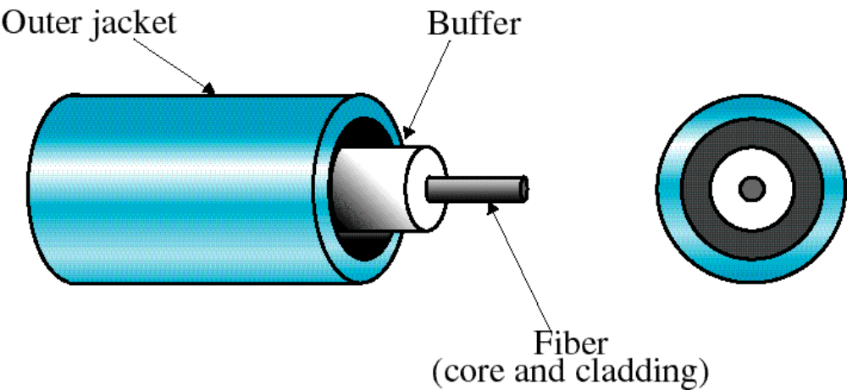
Figure 7-20
Fiber Construction
WCB/McGraw-Hill
© The McGraw-Hill Companies, Inc., 1998

