Slide 1
Diagnosing COVID-19 Using AI-based Medical Image Analysis
Domain : Artificial Intelligence
Name: 1. Swarangi Gaurkar
2. Pranali Bora

Slide 2
Contents
Problem Statement
Introduction
Motivation
Hardware and Software requirements
Dataset Description
Proposed Solution
System Architecture
Deployment Details
Results
Conclusion
References

Slide 3
Problem Statement
The project uses medical image processing to build a AI-based model capable of diagnosing the presence of COVID-19 by analyzing the CT scan images of chest of various patients.

Slide 4
Introduction
According to a recent study, ”Early diagnosis of COVID-19 is crucial for disease treatment and control. Compared to RT-PCR, chest CT imaging may be a more reliable, practical and rapid method to diagnose and assess COVID-19.”
Computed Tomography (CT) scans can be used to gain insights into the nature and extent of the lung damage caused by novel coronavirus (COVID-19).
COVID-19 attacks the epithelial cells that line our respiratory tract.
In the absence of specific therapeutic drugs or vaccines for COVID-19, it is essential to detect the disease at an early stage and immediately isolate an infected patient from the healthy population.
Chest CT scan has a high sensitivity for diagnosis of COVID-19.
We therefore, propose a method to detect the presence of COVID-19 in a human’s body using Chest CT scans.

Slide 5
Motivation
At the moment the total number of people infected with the novel coronavirus is 2,351,163 and many are adding to the number each passing day.
With over 161,275 deaths world wide , and no medication available for the cure, it explains how severe the condition is.
Moreover, the number of doctors and medical facilities in many countries is less considered the population.
It will be helpful if a system is built that can easily detect the presence of Covid-19.
Hence , we propose an approach for the easy diagnosis of Covid-19 using AI based techniques.

Slide 6
Hardware & Software Requirements
Hardware Requirements
Processor : Intel i5/above
OS : Windows/Ubuntu
GPU with a capacity of 12 GB
Software Requirements
Google Colab
APIs/Framework
Keras 2.3.0
Tensorflow 1.8.0
OpenCV 4.2.0
Flask
Programming language
Python3.6+

Slide 7
Dataset Description
The dataset used was formed by merging the data from the following three sources -
https://github.com/ieee8023/covid-chestxray-dataset
https://github.com/agchung/Figure1-COVID-chestxray-dataset
https://www.kaggle.com/praveengovi/coronahack-chest-xraydataset
It contains images of Chest CT scans of patients from different countries.
A total of 6200 images are present in the dataset.
These images are classified as normal, infected with pneumonia or COVID-19.
The images are in the jpeg and jpg format.

Slide 8
The dataset is as follows:-
Chest radiography images distribution
Normal | Pneumonia | COVID-19 | Total
1597 | 4324 | 279 | 6200

Slide 9
Proposed Approach
We have build a system using AI based algorithms for the early diagnosis of the novel coronavirus(COVID-19).
The proposed system is divided into the following stages :-
Image Preprocessing
Increasing Image Contrast
Image Segmentation
Augmentation
Feature Extraction
Classification

Slide 10
Image Preprocessing - The processes involved in this stage are image enhancement, smoothing, segmentation and augmentation.
Image Enhancement - Enhancement techniques are used to make the image better and enhance it from noise or interference. We have used the Gabor filter enhancement technique to increase the quality of the images i.e texture of the CT scan image, and therefore, the accuracy of prediction. The Gabor function is a very useful tool due to its optimal localization properties in both spatial and frequency domain. We are using Gabor filter as it gives highest response at edges and points where texture changes, so that we can get clear boundaries.
Image Segmentation - Segmentation divides an image into its constituent regions or objects. To get a better accuracy we found the ROI(region of interest) using the Rib Suppression approach. In this method, the image of lungs is enhanced by suppressing the chest bones in the image so that the algorithm gets a clear picture of the lungs to predict the respective classes.
Data Augmentation - After enhancement, the data was augmented to increase the number of images. We used augmentation because training a model on larger data always gives better results. Techniques like rotation, and mirroring were used while augmenting. A total of 15000 images were obtained with a total of 5000 per class.

Slide 11
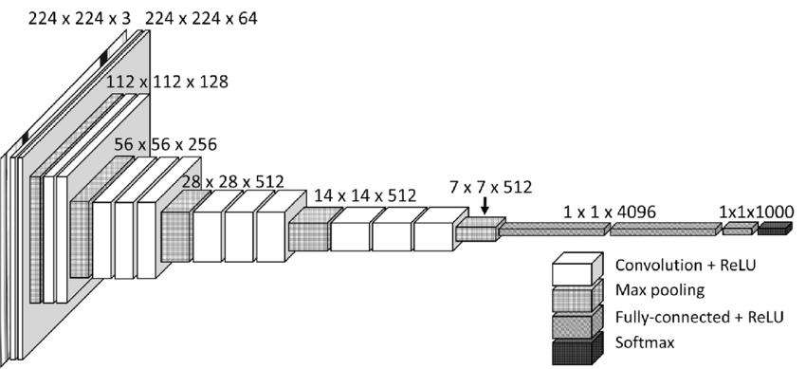
2. Feature Extraction - After image preprocessing, a neural network model was used to train the Chest CT scan images and extract features from it. Feature extraction is an essential stage that represents the final results to determine the normality or abnormality of an image.
We used transfer learning on the pre-trained VGG16 model to extract features from the images. VGG16 has 16 layers consisting of convolutional, max-pool and dense layers. The features extracted from this model will further be classified to detect whether the patient is corona infected or not.
Figure 1. VGG-16 Architecture

Slide 12
3. Classification - Finally, the feature vector extracted from the previous stage is passed to the softmax layer to classify the images to be either normal, infected with pneumonia or COVID-19.
Therefore, the proposed solution can be used to detect the novel coronavirus(COVID-19) using the Chest CT scans.

Slide 13
System Architecture
Image Enhancement
Image Segmentation
Data Augmentation
1. Normal
2.Pneumonia
3. COVID-19
Softmax layer to support Classification
Feature Extraction: VGG -16 model
Image- CT scan of chest
Image Preprocessing
Output labels
Figure 3: System Architecture

Slide 14
Deployment Details
We have developed a web portal which can be provided to various hospitals for their use.
The users(doctors/any concerned person) will have to create an account on the portal.
The portal have a dashboard to keep record of the currently infected coronavirus patients in the hospital.
The portal also have the following functionalities :-
Upload Image -Grayscale image of Chest CT scan of patients has to be uploaded and the probability of whether the patient is infected / not infected with COVID-19 will be displayed.
Adding CT scan image to the database - This results are added to the database only after verification from the doctor. By doing this we aim to increase the number of samples in the dataset, thereby helping the model to learn better and further increase its accuracy.
Therefore, our system will provide an easy way of diagnosing COVID-19 in patients.

Slide 15
Results
Our model when trained on a augmented and preprocessed dataset of 15000 images , gave a striking training accuracy of 99.8% and validation accuracy of 98.3%.
An easy to use web interface has also been developed for users to easily detect the presence of COVID-19 within a few seconds.
A facility to add images to train database is also provided so the model can extract and learn from new images overtime.

Slide 16
Conclusion
Thus , we have proposed a solution for diagnosis of COVID-19 using AI-based Medical Image Analysis.
The solution uses VGG-16 for feature extraction.
Our model is able to distinguish the presence or absence of the novel coronavirus.
With the help of this project we aim to ease the task of diagnosing coronavirus by using the Chest CT scans of patients.

Slide 17
References
[1] Md. Badrul Alam Miah, Mohammad Abu Yousuf , “Detection of Lung Cancer from CT Image Using Image Processing and Neural Network” in Int'l Conf on Electrical Engineering and Information & Communication Technology, 2015.
[2] Anita Choudhary, Sonit Sukhraj Singh, "Lung Cancer Detection on CT Images by using Image Processing," in International Conference of Computing Sciences, 2012.
[3] G. Bhat, V. G. Biradar , H. S. Nalini, "Artificial Neural Network based Cancer Cell Classification (ANN - C3)", Computer Engineering and Intelligent Systems, vol. 3, no. 2, 2012
[4] Diagnosing COVID-19 using AI-based medical image analyses - https://www.quantib.com/blog/diagnosing-covid-19-using-ai-based-medical-image-analyses
[5] Chest CTs of coronavirus patients reveal nature and extent of damage -
https://www.medicaldevice-network.com/news/coronavirus-ct-scans/

