Slide 1
Travel ai agent
IBM AICTE PROJECT
Presented By:
Student name : Swaransh Mishra
College Name & Department :Rajiv Gandhi Institute Of Petroleum Technology ,Amethi ,Uttar Pradesh
Electronics Engineering(2022-26)

Slide 2
OUTLINE
Problem Statement
Technology used
Wow factor
End users
Result
Conclusion
Git-hub Link
Future scope
IBM Certifications

Slide 3
Problem Statement
Planning a trip often becomes overwhelming due to the sheer number of decisions involved—choosing destinations, managing bookings, organizing transportation, adjusting to real-time changes like weather or delays, and staying within budget. Travelers struggle to find trustworthy recommendations, optimize time, and make informed decisions, especially when planning on short notice or across unfamiliar locations. Manual planning is time-consuming, fragmented across multiple platforms, and prone to errors..
Proposed Solution: an AI-powered Travel Planner Agent that automates and personalizes the entire trip planning process. Built using IBM Cloud Lite and IBM Granite, it uses real-time data to suggest destinations, create optimized itineraries, recommend transport and accommodation options, and provide weather updates and local guides. It can also manage bookings, send alerts for changes, and adjust schedules on the go. By understanding user preferences, budget, and constraints, the agent delivers a smooth, efficient, and tailored travel experience—all in one smart platform.

Slide 4
Technology used
IBM cloud lite services
Retrieval Augmented Generation (RAG)
IBM Granite model(granite-3-3-8b instruct)
Framework:LangGraph
Architecture:ReAct
watson.ai Runtime-sp
watson.ai Studio-iq

Slide 5
IBM cloud services used
IBM Cloud Watsonx AI Studio
IBM Cloud Watsonx AI runtime
IBM Cloud Agent Lab
IBM Granite foundation model
IBM Cloud Object Storage

Slide 6
Wow factors
The Travel Planner Agent is an AI-powered assistant that makes trip planning easy, fast, and smart. It personalizes travel suggestions, builds optimized itineraries, and adapts to real-time changes like weather or delays. Powered by IBM Granite and Cloud Lite, it offers a seamless, all-in-one platform for a stress-free travel experience..
Unique features:
Personalized destination and itinerary suggestions.
Real-time weather, traffic, and schedule updates.
AI-powered conversational interface.
One dashboard for bookings and planning.
Location-based tips and local guide integration.
Smart alerts and dynamic itinerary adjustments.

Slide 7
End users
Solo Travelers
Families & Groups
Business Travelers
Travel Enthusiasts & Bloggers
Last-Minute Travelers
Travel Agencies

Slide 8
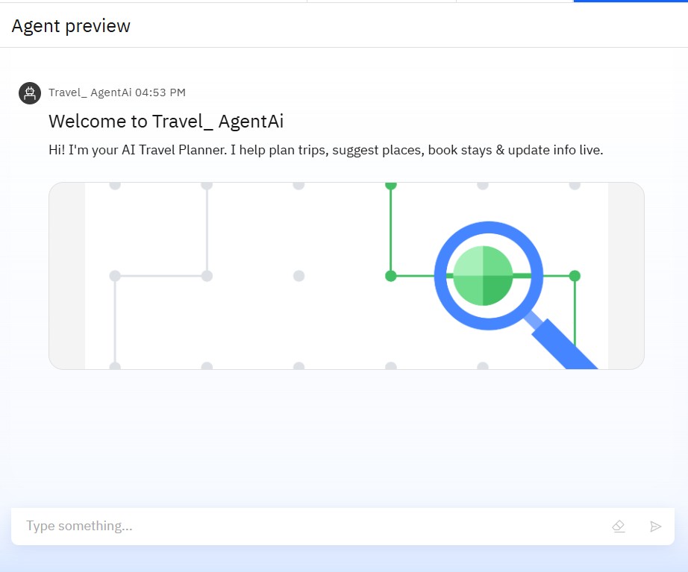
Results

Slide 9
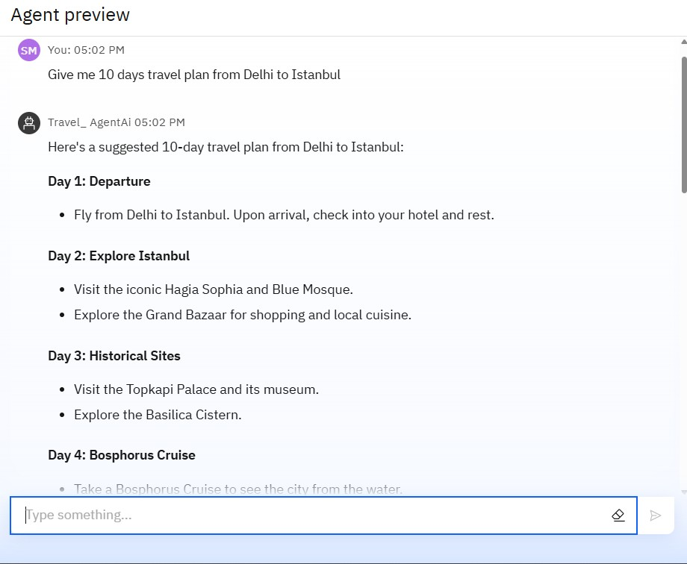
Results

Slide 10
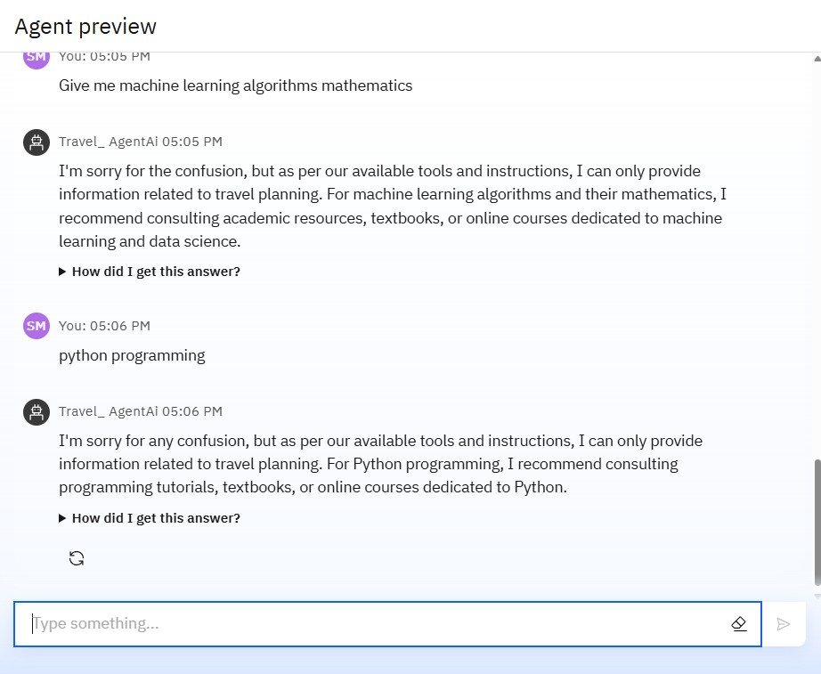
Results

Slide 11
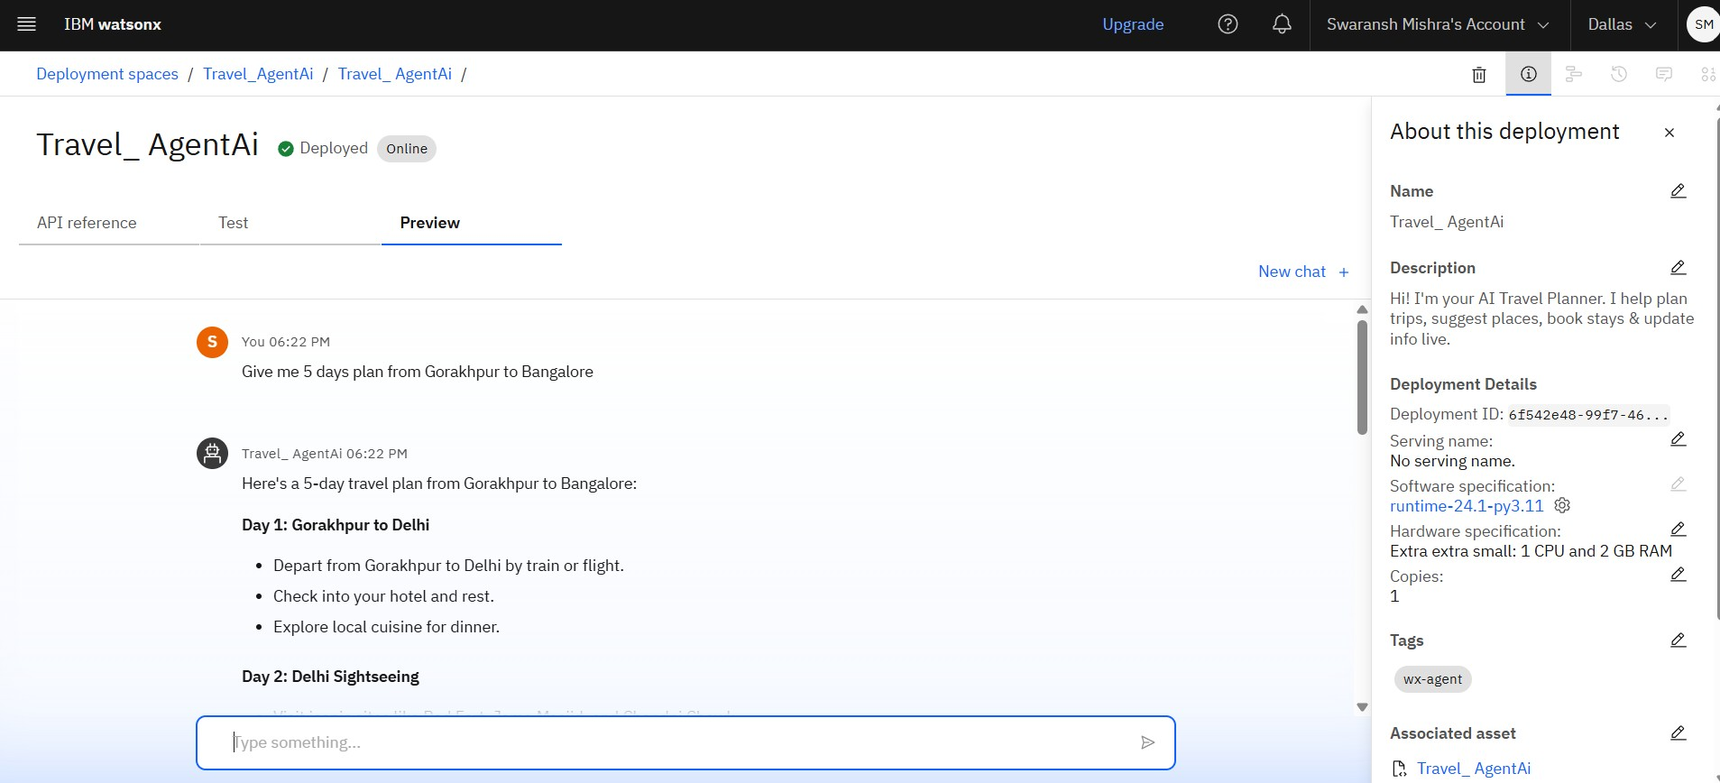
Results
Deployed AI Agent

Slide 12
Conclusion
The Travel Planner Agent provides a smart and personalized solution to simplify complex travel planning tasks.
It uses real-time data and AI to recommend destinations, manage itineraries, and make travel more efficient.
The agent adapts to user preferences and environmental changes like weather or delays, offering dynamic schedule adjustments.
It integrates all essential services—maps, bookings, local guides, and alerts—into one unified platform.
Overall, it enhances the travel experience by saving time, reducing effort, and improving decision-making for all types of users.

Slide 13
GitHub Link
https://github.com/Swaransh-Mishra/Travel_agentAi

Slide 14
Future scope
Voice assistant integration (Alexa, Siri, etc.)
Multi-language support for global users
Budget tracking and expense forecasting
Virtual reality previews of destinations
Learning from user feedback for better suggestions
Direct booking with airlines and hotels
Emergency support features (embassy, medical, live translation)

Slide 15
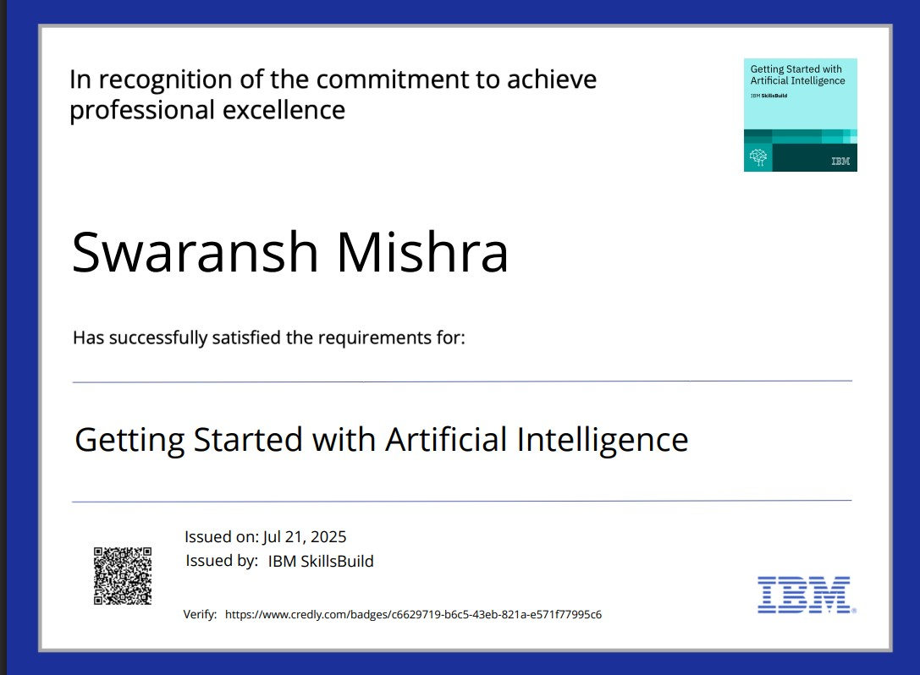
IBM Certifications
Screenshot/ credly certificate( getting started with AI)

Slide 16
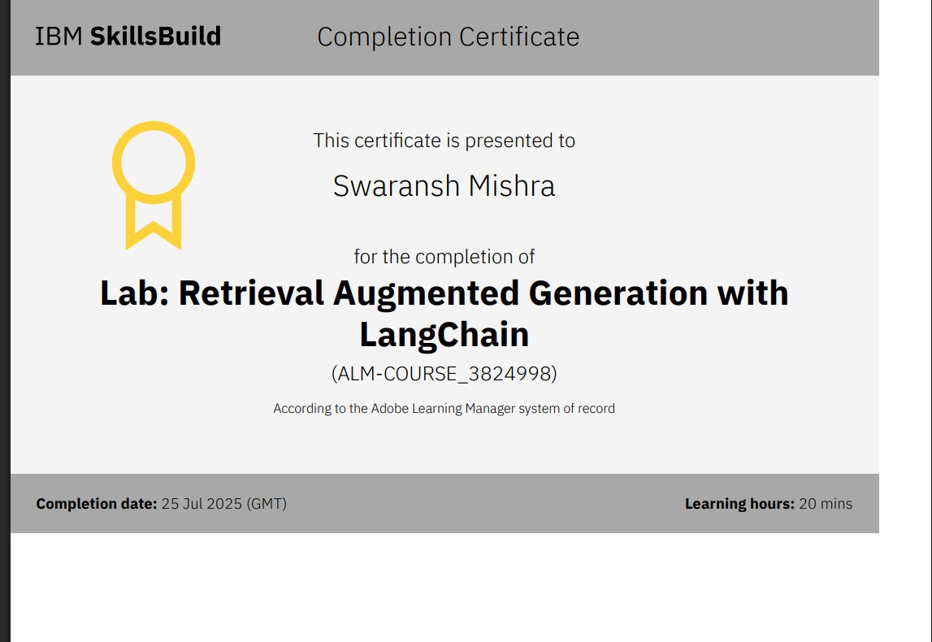
Attach your RAG LAB certificate here

Slide 17
THANK YOU

