Slide 1
RTL for AXI4 (Master & Slave) to PCIe 6 Link
Problem Statement
AXI4 to PCIe link has multiple use cases. For instance,
Network Packet Processing: SmartNICs and networking hardware use AXI-Stream interfaces to process continuous streams of packets (e.g., Ethernet packets). The conversion hardware bridges these streams into PCIe to route them straight into host server memory.
Machine Learning Inference Accelerators: AI acceleration cards (like those based on Xilinx/AMD or Intel FPGAs) take a stream of processed neural network weights or pixel data and send it directly into the host memory buffer.
Objective
Develop a synthesizable RTL Design based on the block diagram shown (next slide)
Deliverables
Complete Synthesized RTL & GDSII (block diagram in the next slide) using OpenRoad/OpenLane (Data Rate may be reduced depending on the tech node)
Exhaustive functional test cases (relevant workloads corresponding to the two use cases)
Bonus: FPGA tested AXI4 to PCIe IP
Tools & Resources
Python, Verilog/SystemVerilog/SVA
Icarus Verilog, Xilinx Vivado (cannot use host controller IPs from Xlinix)
OpenRoad or OpenLane with opensource PDKs

Slide 2
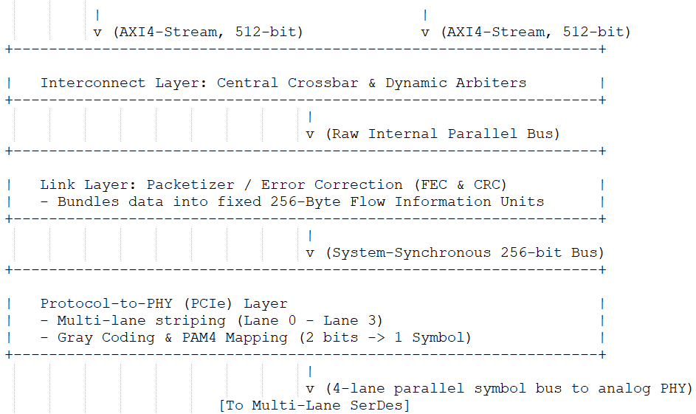
RTL for AXI4 (Master & Slave) to PCIe 6 Link
Block Diagram

