Slide 1
AWS Overview
Notes:
Module 1 describes the history and fundamental elements of Amazon Web Services (AWS), and shows you how to navigate the AWS Management Console. The AWS Management Console is the graphical user interface (GUI) to access AWS. This module discusses the AWS global infrastructure, security measures provided by AWS, and basic principles of deploying on AWS.
By the end of this module you will be able to:
Describe the history of AWS.
Recognize the AWS global infrastructure.
Navigate the AWS Management Console.

Slide 2
Course Contents
Introduction to Amazon Web Services(AWS)
Creating the Free Tier Account on AWS
Navigate the AWS Management Console
Understand the Foundational Services
Amazon Simple Storage Service (S3)
Amazon Elastic Compute Cloud (EC2)
Amazon Relational Database Services (RDS)
Knowledge check
Scenario based case study.

Slide 3








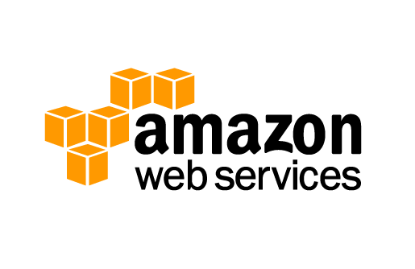


Amazon History
1994: Jeff Bezos Incorporated the Company
1995: Amazon.com Launched Online Bookstore
2005: Amazon Publishing Launched
2006: Amazon Web Services (AWS) Launched
2007: Kindle Launched
2011: Amazon Fresh Launched
2012: Amazon Game Studios Launched
2013: Amazon Art Launched
2014: Amazon Prime Now Launched
2015: Amazon Home Services & Amazon Echo Launched
Notes:
Jeff Bezos incorporated the company in 1994 and Amazon.com was launched in 1995 as an online bookstore. Amazon.com, Inc. is an American multinational e-commerce company with its headquarters in Seattle, Washington. It is the world's largest online retailer. Amazon has continued to grow and officially launched Amazon Web Services (AWS) in 2006. More came after, including Amazon Publishing, the Kindle, Amazon Game Studios, and Amazon Art.
After over a decade of building and running the highly scalable web application, Amazon.com, the company realized that it had developed a core competency in operating massive scale technology infrastructure and data centers, and embarked on a much broader mission of serving a new customer segment—developers and businesses—with a platform of web services they can use to build sophisticated, scalable applications. Today, AWS is the fastest-growing multi-billion dollar enterprise IT vendor in the world.

Slide 4

Amazon Web Services (AWS)
Enable businesses and developers to use web services to build scalable, sophisticated applications.
Storage
Development and Management Tools
Content Delivery
Analytics
Compute
Messaging
Database
App Services
Payments
Mobile
Networking
On-Demand Workforce
VPC
Notes:
Amazon Web Services is 10+ years in the making. Amazon Web Services, also abbreviated to AWS, is a collection of remote computing services called web services. These web services make up a cloud computing platform offered via the Internet. We deliver web-based cloud services for storage, computing, networking, databases, and more.
The AWS mission is to enable businesses and developers to use web services to build scalable, sophisticated applications. Web services is another name for what people now call “the cloud.”

Slide 5
AWS Rapid Pace of Innovation
722
New Features/Services Launched
159
82
48
2009
2011
2013
2015
Notes:
AWS has been continually expanding its services to support virtually any cloud workload. It now has more than 50 services that range from compute, storage, networking, database, analytics, application services, deployment, management and mobile. In 2015, AWS launched 722 new features and services for a total of 1,950 new features and services since its inception in 2006.
Innovation is in our DNA, and our structure and approach to product development and delivery is fundamentally different than other IT vendors. We have decentralized, autonomous development teams who are working directly with customers. They are empowered to develop and launch based on what they learn from interactions with customers. We iterate products continuously, and the latest is instantly available to customers. No need to upgrade, deploy, or migrate. When a feature or enhancement is ready, we “push” it out, and it is instantly available to any customer that uses that service.
This approach also enables us to very rapidly introduce and iterate on new services.

Slide 6


















































AWS Customers
Enterprise Customers
Startup Customers
Public Sector Customers
Notes:
Enterprise Customers: Enterprise cloud computing with AWS can help IT increase innovation, agility, and resiliency; all while reducing cost. With AWS, you can build enterprise cloud solutions quickly and without a big up-front investment. The free tier allows you to prototype virtually any application for free.
Startup Customers: Our innovations free you to scale quickly, go to market faster, control costs, and stay lean. AWS Activate is a free program with resources for startups to get the most out of AWS from day one.
Public Sector Customers: AWS offers scalable, cost-effective cloud services that public sector customers can use to meet mandates, reduce costs, drive efficiencies, and accelerate innovation.

Slide 7

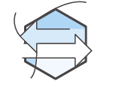




Six Advantages & Benefits of AWS Cloud Computing
Increase speed and agility.
Trade capital expense for variable expense.
Stop spending money on running and maintaining data centers.
Benefit from massive economies of scale.
Go global in minutes.
Stop guessing capacity.
Notes:
Cloud computing provides a simple way to access servers, storage, databases, and a broad set of application services over the Internet. AWS owns and maintains the network-connected hardware required for these application services, while you provision and use what you need via a web application.
Trade capital expense for variable expense: Instead of having to invest heavily in data centers and servers before you know how you’re going to use them, you can pay only when you consume computing resources, and pay only for how much you consume.
Benefit from massive economies of scale: By using cloud computing, you can achieve a lower variable cost than you can get on your own. Because usage from hundreds of thousands of customers is aggregated in the cloud, providers such as Amazon Web Services can achieve higher economies of scale, which translates into benefit for the customer by lower pay as you go prices.
Stop guessing capacity: Eliminate guessing on your infrastructure capacity needs. When you make a capacity decision prior to deploying an application, you often either end up sitting on expensive idle resources or dealing with limited capacity. With cloud computing, these problems go away. You can access as much or as little as you need, and scale up and down as required with only a few minutes’ notice.
Increase speed and agility: In a cloud computing environment, new IT resources are only a click away, which means you reduce the time it takes to make those resources available to your developers from weeks to just minutes. This results in a dramatic increase in agility for the organization, since the cost and time it takes to experiment and develop is significantly lower.
Stop spending money on running and maintaining data centers: Focus on projects that differentiate your business, not the infrastructure. Cloud computing lets you focus on your own customers, rather than on the heavy lifting of racking, stacking and powering servers.
Go global in minutes: Easily deploy your application in multiple regions around the world with just a few clicks. This means you can provide a lower latency and better experience for your customers simply and at minimal cost.

Slide 8
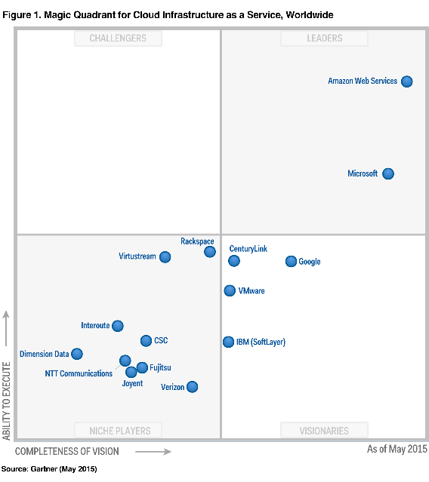
Gartner Magic Quadrant for Cloud Infrastructure as a Service, Worldwide
Gartner “Magic Quadrant for Cloud Infrastructure as a Service, Worldwide,” Lydia Leong, Douglas Toombs, Bob Gill, May 18, 2015. This Magic Quadrant graphic was published by Gartner, Inc. as part of a larger research note and should be evaluated in the context of the entire report. The Gartner report is available at http://aws.amazon.com/resources/analyst-reports/. Gartner does not endorse any vendor, product or service depicted in its research publications, and does not advise technology users to select only those vendors with the highest ratings or other designation. Gartner research publications consist of the opinions of Gartner's research organization and should not be construed as statements of fact. Gartner disclaims all warranties, expressed or implied, with respect to this research, including any warranties of merchantability or fitness for a particular purpose.
Notes:
The Gartner report is available at http://aws.amazon.com/resources/analyst-reports/

Slide 9










AWS Core Infrastructure and Services
Traditional Infrastructure Amazon Web Services
Security
Security
Security
Firewalls
ACLs
Administrators
Security Groups
NACLs
AWS IAM
Security Groups
NACLs
Access Mgmt
Network
Network
Networking
Router
Network Pipeline
Switch
“Public”
VPC
ELB
Provision
EC2 “Classic”
VPC
On-Demand
ELB
VPC
Servers
On-Premises Servers
AMI
Amazon EC2 Instances
Storage and Database
NAS
RDBMS
DAS
SAN
Amazon
RDS
Amazon
EBS
Amazon
EFS
Amazon
S3
Notes:
Many of our services have analogs in the traditional IT space and terminology. This side-by-side comparison shows how AWS products and services relate to a traditional infrastructure
Access Control Lists (ACL): It is a list of permissions attached to an object.
Network Access Control Lists (NACL)
ELB: Elastic Load Balancer
VPC: Virtual Private Cloud
Amazon Machine Image (AMI): An Amazon Machine Image (AMI) is a special type of virtual appliance that is used to create a virtual machine within the Amazon Elastic Compute Cloud ("EC2"). It serves as the basic unit of deployment for services delivered using EC2.
Elastic Compute Cloud(EC2): Amazon Elastic Compute Cloud (EC2) forms a central part of Amazon.com's cloud-computing platform, Amazon Web Services, by allowing users to rent virtual computers on which to run their own computer applications.
Direct Attached Storage (DAS) is digital storage directly attached to the computer accessing it, as opposed to storage accessed over a computer network.
Storage Area Network(SAN) : A storage area network is a Computer network which provides access to consolidated, block level data storage.
Network Attached Storage(NAS) is a file-level computer data storage server connected to a computer network providing data access to a heterogeneous group of clients.
Elastic Load Balancing(ELB): Elastic Load Balancing distributes incoming application or network traffic across multiple targets, such as Amazon EC2 instances, containers, and IP addresses, in multiple Availability Zones. Elastic Load Balancing scales your load balancer as traffic to your application changes over time, and can scale to the vast majority of workloads automatically.
Elastic File System(EFS): Amazon EFS provides a simple, scalable, elastic file system for Linux-based workloads for use with AWS Cloud
Simple Storage Service(S3): It provides object storage through a web service interface. Simply, Amazon S3 provides a web interface to easily store and retrieve data safely, in any amount, at any time, from anywhere, at a low cost.
Relational Database Services (RDS): Amazon Relational Database Service is a distributed relational database service by Amazon Web Services. It is a web service running "in the cloud" designed to simplify the setup, operation, and scaling of a relational database for use in applications.
EBS(Elastic Block Storage)

Slide 10


AWS Cloud Computing
Applications
Virtual Desktops
Collaboration and Sharing
Databases
Analytics
App Services
Deployment and Management
Mobile Services
Cluster Computing
Queuing
Containers
Relational
Identity
Platform Services
Orchestration
Dev/ops Tools
Real-time
Sync
App Streaming
No SQL
Data Warehouse
Resource Templates
Transcoding
Mobile Analytics
Email
Usage Tracking
Caching
Data Workflows
Notifications
Search
Monitoring and Logs
Foundation
Services
Compute
(Virtual, Auto-scaling and Load Balancing)
Networking
Storage
(Object, Block and Archive)
Infrastructure
Regions
Availability Zones
Edge Locations
Notes:
AWS cloud computing provides a simple way to access servers, storage, databases and a broad set of application services over the Internet. AWS owns and maintains the network-connected hardware required for these application services, while you provision and use what you need.

Slide 11






















AWS Foundation Services
Compute
Network
Storage
Security & Identity
Applications
Amazon
EC2
AWS
Lambda
Amazon
VPC
Amazon Route 53
Amazon S3
Amazon
CloudFront
AWS Identity and
Access Management
AWS KMS
Amazon WorkDocs
Amazon WorkSpaces
Amazon EC2 Container Service
AWS
Direct Connect
Amazon Glacier
AWS Directory Service
Amazon WorkMail
Elastic Load Balancing
AWS
Elastic Beanstalk
Amazon Elastic File System
AWS
Storage Gateway
AWS Cloud HSM
AWS WAF
Auto Scaling
AWS Import/Export Snowball
Notes:
AWS Foundation Services are categorized as shown in the slide.

Slide 12


































AWS Platform Services
Databases
Analytics
App Services
Management Tools
Developer Tools
Mobile Services
Internet of Things
Amazon
RDS
Amazon DynamoDB
Amazon
EMR
AWS
Data Pipeline
Amazon
SES
Amazon AppStream
AWS
CloudFormation
AWS
Config
AWS CodeCommit
AWS CodeDeploy
Amazon Cognito
AWS
Device Farm
AWS IoT
Amazon ElastiCache
Amazon Redshift
Amazon Elasticsearch Service
Amazon Machine Learning
Amazon
SWF
Amazon Elastic Transcoder
AWS
CloudTrail
AWS
Service Catalog
AWS CodePipeline
Amazon
Mobile Analytics
Amazon
SNS
AWS Database Migration Service
Amazon Kinesis
Amazon CloudSearch
Amazon
SQS
AWS
OpsWorks
Amazon CloudWatch
Mobile Hub
Amazon
API Gateway
Trusted Advisor
AWS Certificate Manager
Notes:
AWS offers a rich set of platform services that enable you to process a massive number of events from different sources, effectively work with databases, and more.

Slide 13
AWS Global Infrastructure
Regions
Geographic locations
Consists of at least two Availability Zones(AZs)
Availability Zones
Clusters of data centers
Isolated from failures in other Availability Zones
Notes:
AWS Regions are geographic locations that contain multiple Availability Zones (AZs). Availability Zones consist of data centers clustered in a region. Each Availability Zone is engineered to be isolated from failures in other Availability Zones.

Slide 14
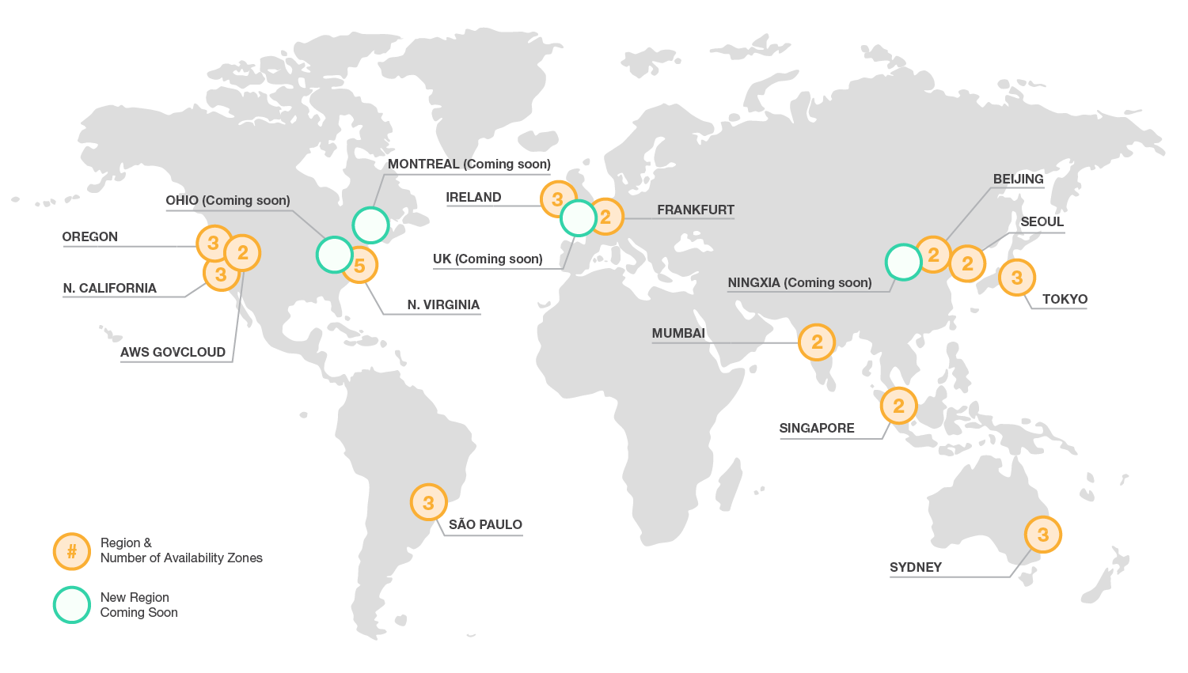
AWS Global Infrastructure
Notes:
AWS is steadily expanding its global infrastructure to help customers achieve lower latency and higher throughput, and to ensure that your data resides only in the region you specify. As you and all customers grow their businesses, AWS will continue to provide infrastructure that meets your global requirements.
AWS has 12 geographic Regions with 32 Availability Zones. The AWS GovCloud (US) Region is an isolated region designed to allow US government agencies and customers to move sensitive workloads into the cloud by addressing their specific regulatory and compliance requirements. AWS products and services are available by region so you may not see all regions available for a given service.
You can run applications and workloads from a region to reduce latency to end-users while avoiding the up-front expenses, long-term commitments, and scaling challenges associated with maintaining and operating a global infrastructure.

Slide 15
AWS Global Infrastructure
At least 2 AZs per region.
Examples:
US East (N. Virginia)
us-east-1a
us-east-1b
us-east-1c
us-east-1d
us-east-1e
Asia Pacific (Tokyo)
ap-northeast-1a
ap-northeast-1b
ap-northeast-1c
US East (VA)
Asia Pacific (Tokyo)
AZ - A
AZ - B
AZ - A
AZ - B
AZ - C
AZ - D
AZ - C
AZ - E
Note: Conceptual drawing only. The number of Availability Zones (AZ) may vary.
Notes:
Each region is a separate geographic area that has multiple locations isolated from each other known as Availability Zones (AZ). Each AZ is isolated, but the AZs in a region are connected through low-latency links. Where natural disasters or fault lines are a consideration, AWS isolates its Availability Zones so that they are not easily affected at the same time. For example, where earthquakes are a problem AWS would not build two AZs on the same fault line. When you launch an instance, you can select an AZ or let AWS choose one for you. If you distribute your instances across multiple AZs and one instance fails, you can design your application so that an instance in another AZ can handle requests.
For more information, see:
http://aws.amazon.com/about-aws/global-infrastructure/regional-product-services/
http://docs.aws.amazon.com/AWSEC2/latest/UserGuide/using-regions-availability-zones.html
https://www.amazonaws.cn/en/

Slide 16

Achieving High Availability Using Multi-AZ
Region
Availability Zone - A
Availability Zone - B
Availability Zone - C
Notes:
AWS highly recommends provisioning your compute resources across multiple Availability Zones. If you have multiple instances, you can run them across more than one AZ and get added redundancy. If a single AZ has a problem, all assets in your second AZ will be unaffected.

Slide 17
AWS Global Infrastructure
50+ AWS Edge Locations:
Local points-of-presence commonly supporting AWS services like:
Amazon Route 53
Amazon CloudFront
Notes:
Edge locations help lower latency and improve performance for end users.

Slide 18



AWS Management Console Demonstration
Notes:
Let’s start by taking a look at the AWS Management Console so you can get familiar with the navigation:
Selecting a region.
Dragging and dropping service icons at the top for quick use.
Verifying what is included in the left navigation menu pane.

