Slide 1
Simple Storage Service - Amazon S3

Slide 2
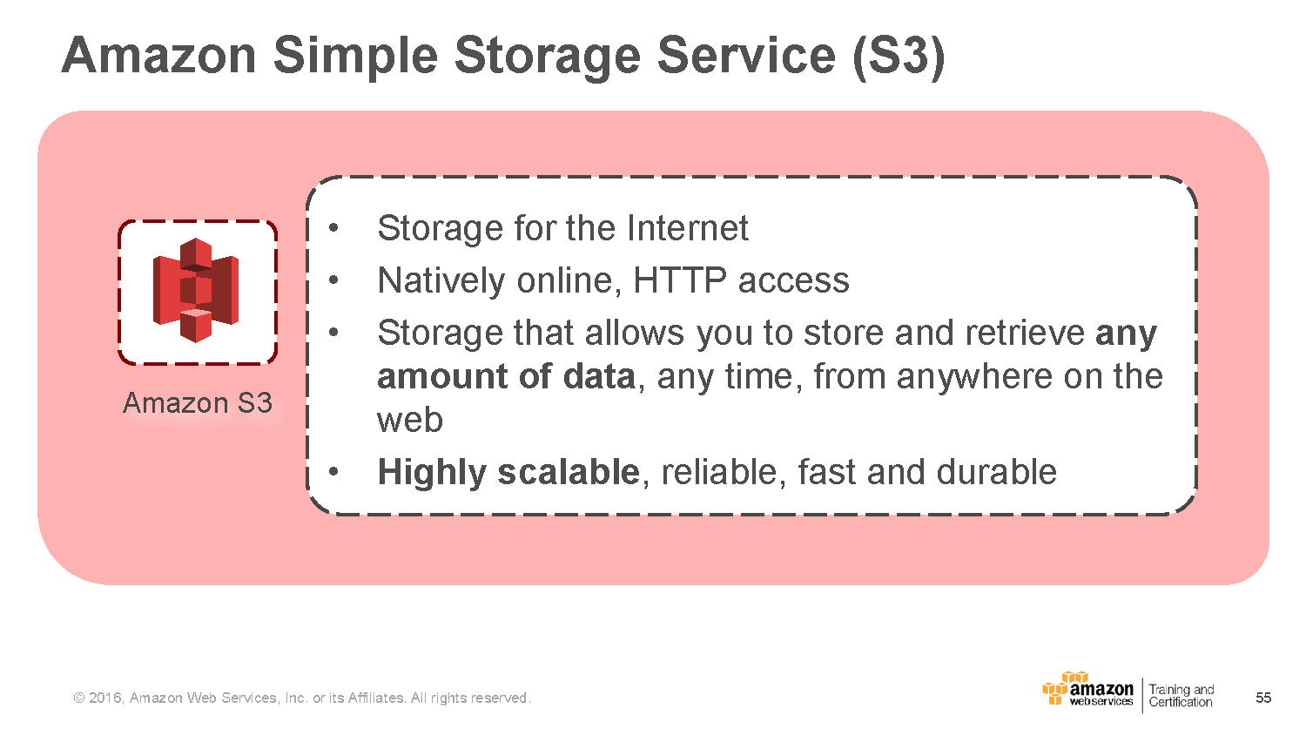

Slide 3
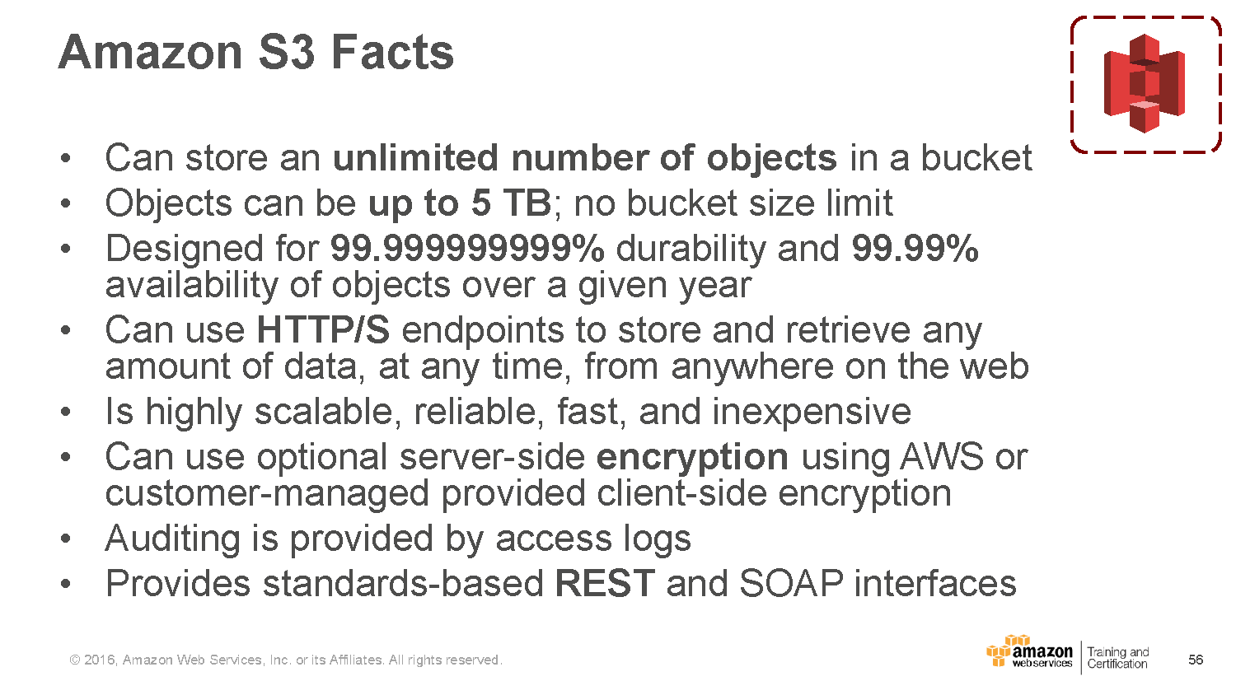
Notes:
There is a 100 bucket limit per account

Slide 4
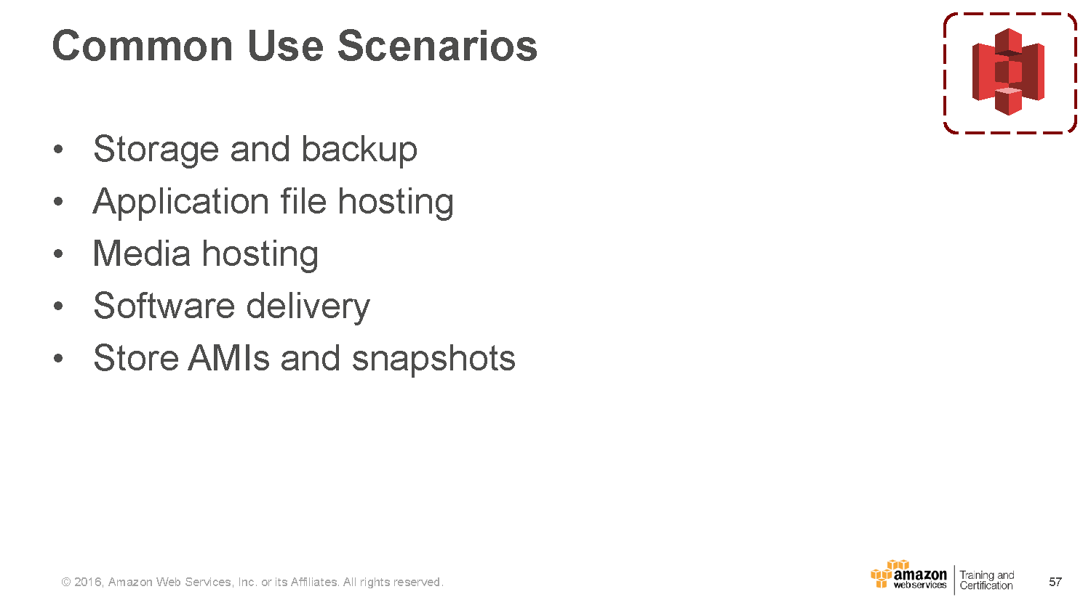

Slide 5
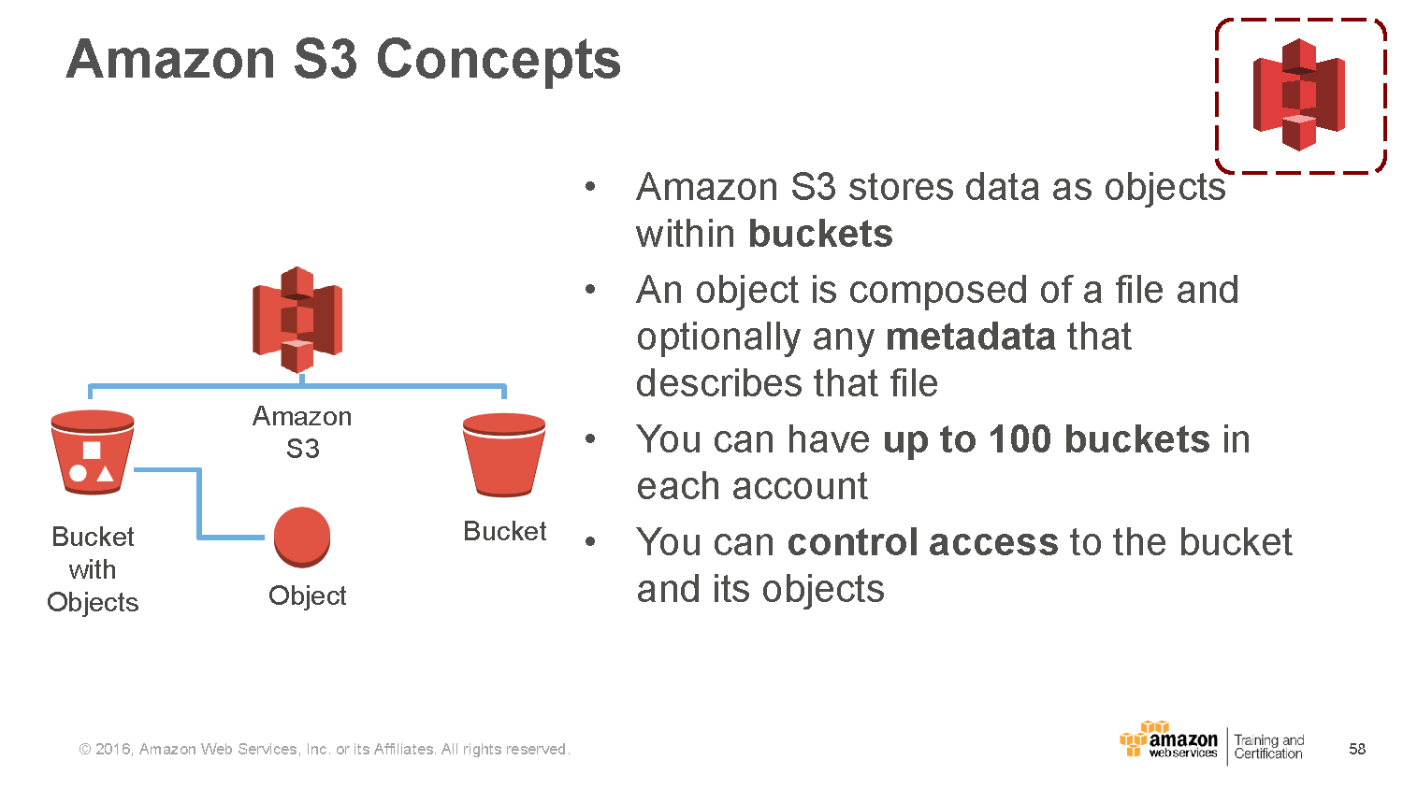

Slide 6
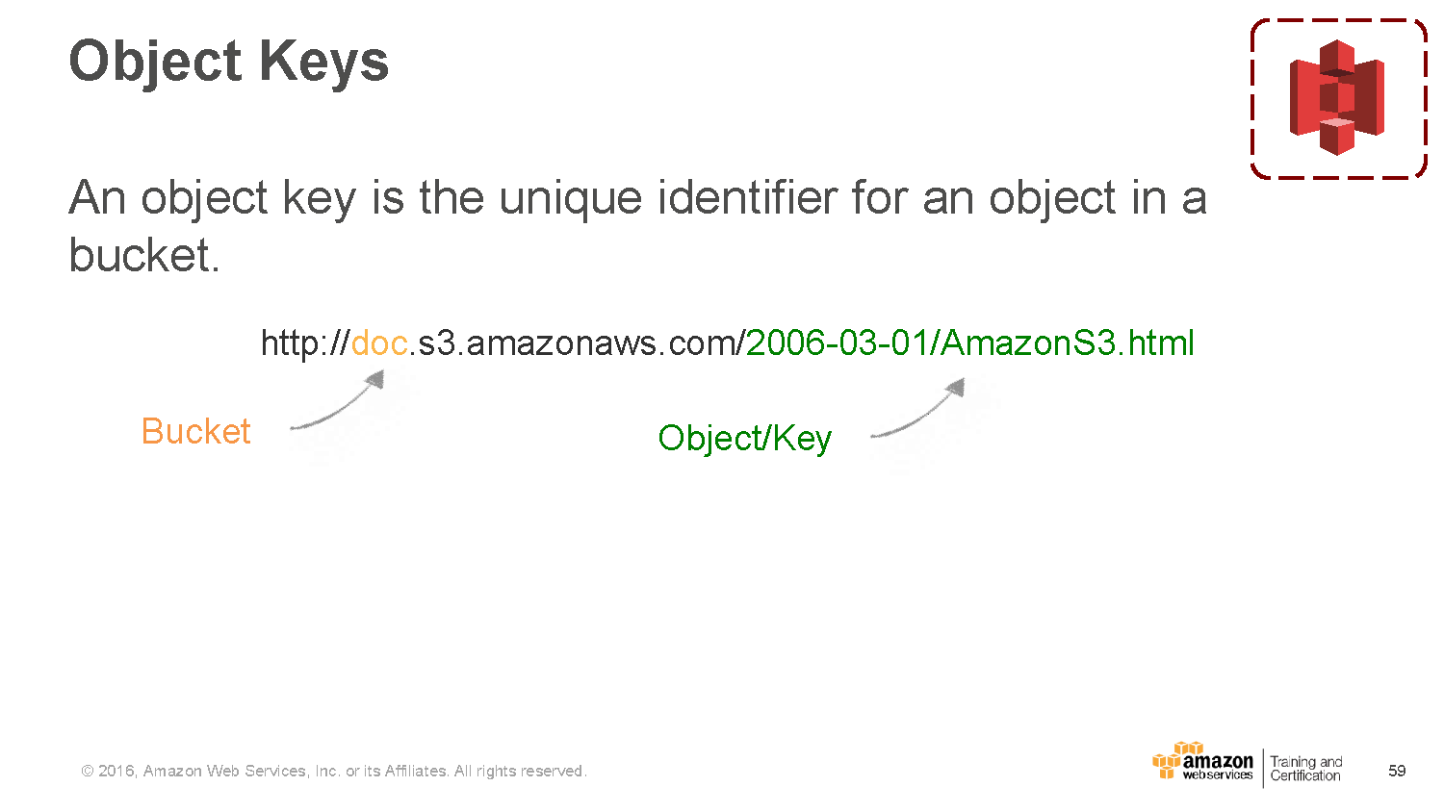
Notes:
Combination of bucket key, Version id uniquely identifies an object
Amazon S3 can be thought of as a basic data map between the bucket key, version and the object itself.

Slide 7
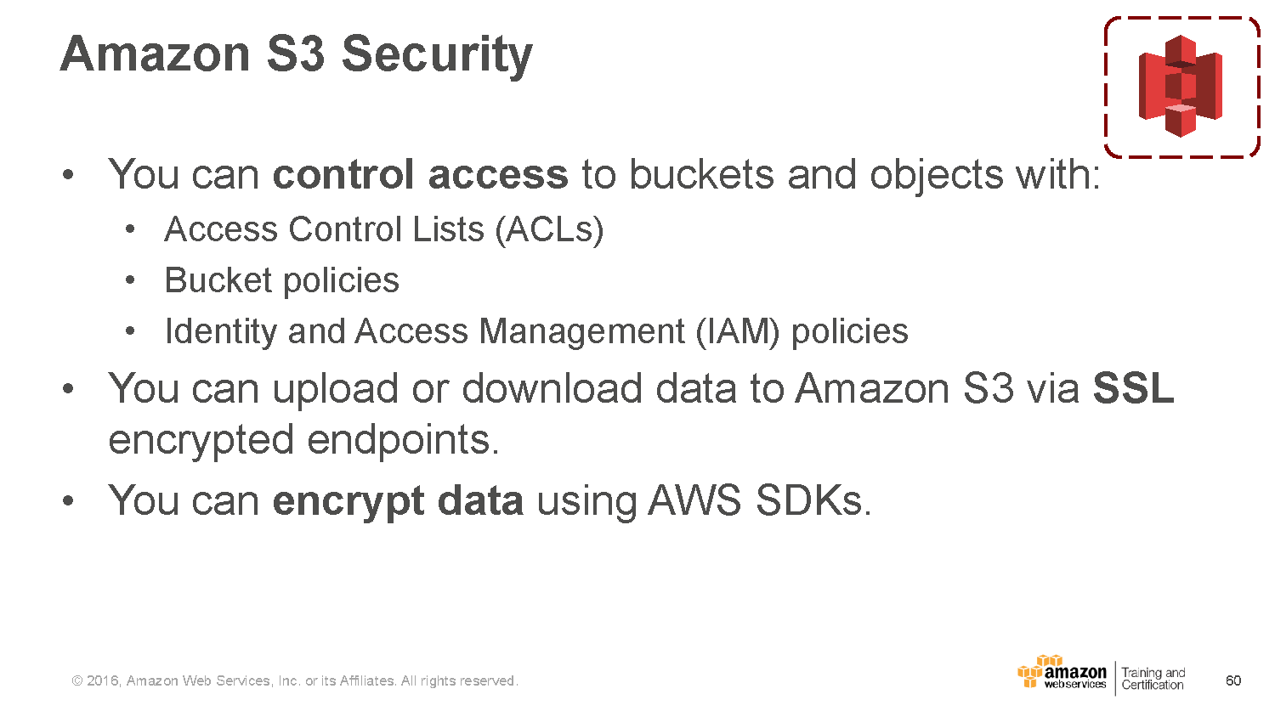

Slide 8
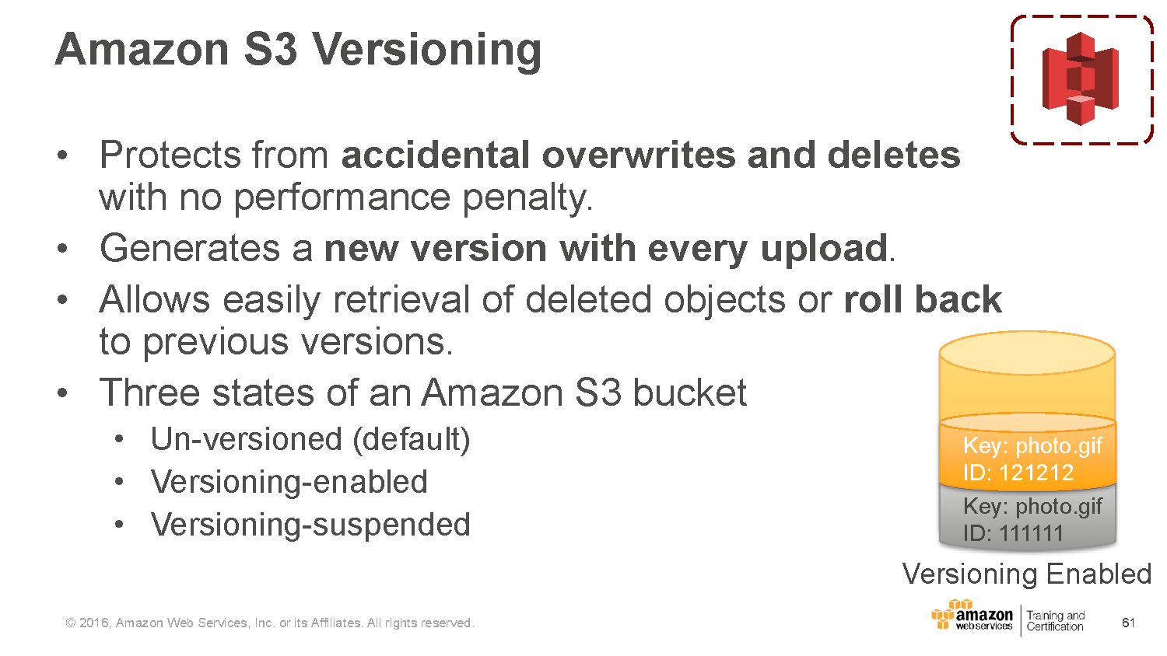

Slide 9
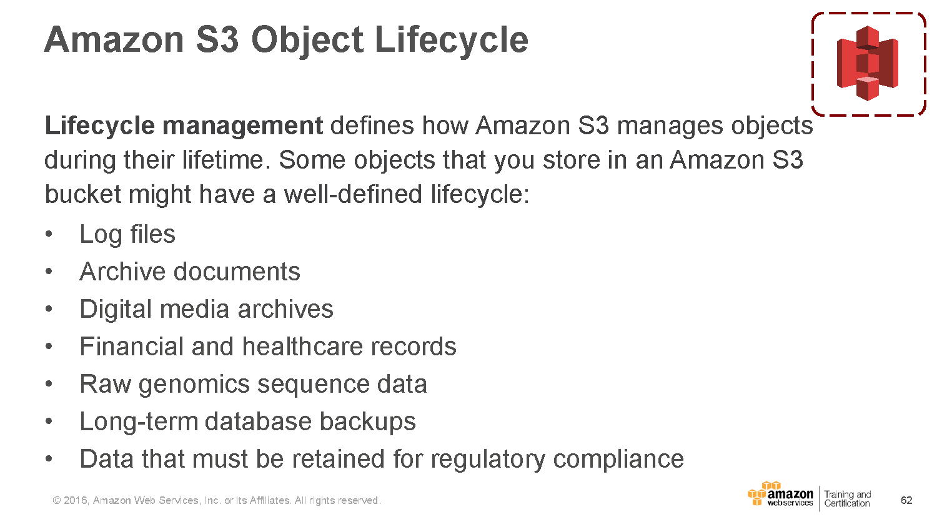

Slide 10
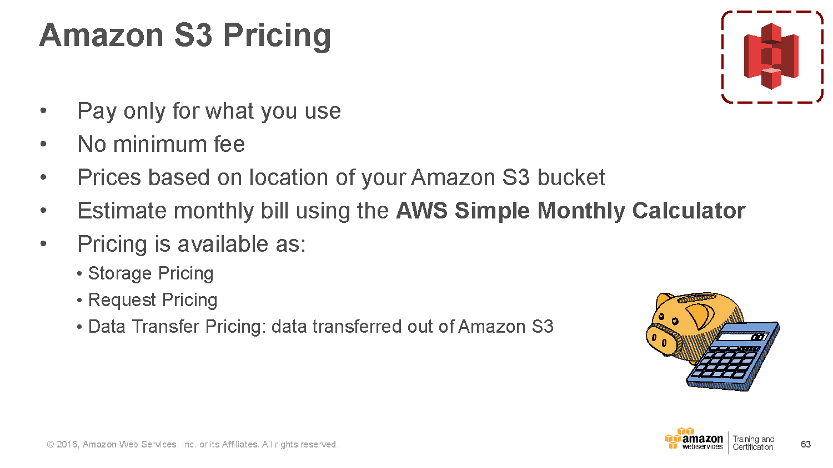

Slide 11
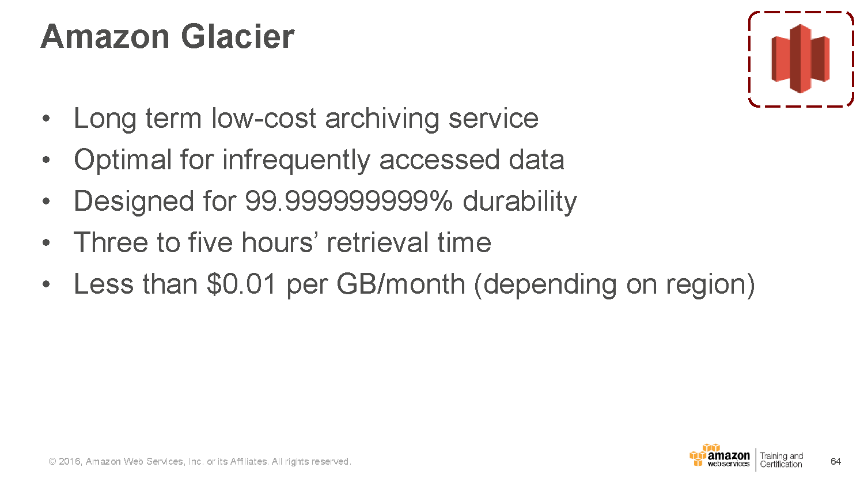

Slide 12
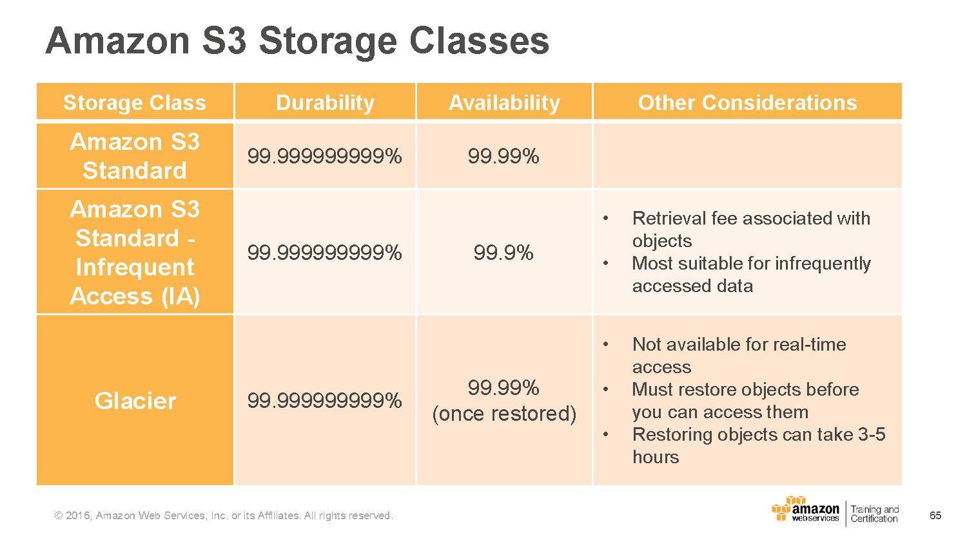

Slide 13
Amazon S3 – Hands on

Slide 14
Exercise 1: Create an Amazon Simple Storage Service (Amazon S3) Bucket
Login to the AWS Management Console
Choose an appropriate region, such as Asia Pacific (Mumbai).
Navigate to the Amazon S3 console. Notice that the region indicator now says Global. Remember that Amazon S3 buckets form a global namespace , even though each bucket is created in a specific region.
Start the create bucket process
Notes:
In this exercise, you will create a new Amazon S3 bucket in your selected region. You will use this bucket in the following exercises.

Slide 15
Exercise 1 continued…
When prompted for Bucket Name, use mybucket
Choose a region, such as Asia Pacific (Mumbai).
Try to create the bucket. You almost surely will get a message that the requested bucket name is not available. Remember that a bucket name must be unique globally.
Try again using your surname followed by hyphen and then today’s date in a six-digit format as the bucket name (a bucket name that is not likely to exist already)
You should now have a new Amazon S3 bucket.
Click on ‘Edit public access settings’. Keep all options unselected, and click save.

Slide 16
Exercise 2: Upload, Make Public, Rename, and Delete Objects in Your Bucket
Upload an Object
Load your new bucket in the Amazon S3 console
Select upload, then Add Files
Locate a file on your PC that you are okay with uploading to Amazon S3 and making public to the internet
Select a suitable file, then Start Upload. You will see the status of Your file in the Transfer section
After your file is uploaded, the status should change to Done.
Notes:
In this exercise, you will upload a new object to your bucket. You will then make this object public and view the object in your browser. You will then rename the object and finally delete it from bucket.
Note: We suggest using non-personal image file for the purpose of this exercise

Slide 17
Exercise 2 continued…
Open the Amazon S3 URL
Now open the properties for the object . The properties should include bucket name and link.
Copy the Amazon S3 URL for the object
Paste the URL in the address bar of new browser window or tab
Notes:
The file you uploaded is now stored as an Amazon S3 object and should be now listed in the contents of your bucket.

Slide 18
Exercise 2 continued…
Open the Amazon S3 URL contd…
You should get a message with an XML error code AccessDenied. Even though the object has a URL, it is private by default, so it cannot be accessed by a web browser

Slide 19
Exercise 2 continued…
Make the Object Public
Go back to the Amazon S3 console and select Make Public
Copy the Amazon S3 URL again and try to open it in a browser or tab.
Your public image file should now display in the browser.

Slide 20
Exercise 2 continued…
Rename the Object
In the Amazon S3 console, select Rename
Rename the object, but keep the same file extension
Copy the new Amazon S3 URL and try to open it in a new browser or tab.
You should see the same image.

Slide 21
Exercise 2 continued…
Delete the Object
In the Amazon S3 console, select Delete.
Select OK when prompted if you want to delete the object
The object has now been deleted.
To verify, try to reload the deleted object’s Amazon S3 URL.
You should again get the XML AccessDenied error message

Slide 22
Exercise 3: Enable Version Control
Enable Versioning
In the Amazon S3 console, load the properties of your bucket.
Enable versioning in the properties and select Ok to verify.
Your bucket now has versioning enabled.
Please note that versioning can be suspended but not turned-off.
Notes:
In this exercise, you will enable version control on your newly created bucket.

Slide 23
Exercise 3: Enable Version Control continued…
Create Multiple Versions of an Object
Create a text file named zensar.txt on your computer and write the word blue in the text file.
Save the text file to a location of your choosing.
Upload the text file to your bucket. This will be version 1.
After you have uploaded the text file to your bucket, open the copy on your local computer and append the word red in the next line after blue. Save the text file with the original filename.
Upload the modified file to your bucket
Select Show Versions on the uploaded object.
Notes:
You will now see two different versions of the object with different Version IDs and possibly different sizes. Note that when you select Show Version, the Amazon S3 URL now includes the Version ID in the query string after the object name.

Slide 24
Exercise 4: Delete an Object and Then Restore It
Delete the Object
Open the bucket containing the text file for which you now have two versions
Select Hide Versions
Select Delete, and then select OK to verify
Your object will now be deleted, and you can no longer see the object.
Select Show Versions
Both versions of the object now show their version IDs
Notes:
In this exercise, you will delete an object from your Amazon S3 bucket and then restore it.

Slide 25
Exercise 4: Delete an Object and Then Restore It contd…
Restore an Object
Open your bucket
Select Show Versions
Select the oldest version and download the object.
Note that the filename is simply zensar.txt with no version indicator.
Upload zensar.txt to the same bucket
Select Hide Versions, and the file zensar.txt should re-appear
Notes:
In this exercise, you will delete an object from your Amazon S3 bucket and then restore it.

Slide 26
Thank You

