Slide 1
DAC-203 · PROJECT NOTES · PART II
A Search-Only Agent for
Perfect-Information Generals.io
Forty-six bots later: what we tried, what failed and why, and how we got to v46.
Same game, same rules, same question: how far does search take you?
Notes:
Part I ended with five papers and three ideas to test. This is what happened when we built them: forty-six versions, most of them failures, and the path to v46.

Slide 2
RECAP
Where part I left off
PART I · 3
PART I · 5
PART II
Five papers
Three ideas to test
This deck
ARA*: an answer at every moment
RTAA*: learn more per unit of search
Depression avoidance: one bit per state
ProbCut: prune what is probably irrelevant
Metareasoning: should I search at all?
The value of computation is measurable
Speculative pre-computation of next tick
The move queue is a compute budget
Every version we built, v1 to v46
What each one tried, and the intuition behind it
Why the failures failed
How v46, the current final.py, works
Part I asked whether these ideas make a strong bot. The short answer: mostly not on their own. What did make it strong came from the rules and from losing to people.
Search-only AI for Generals.io · DAC-203
2
Notes:
Part I: the five papers, the three ideas, and the region-decomposition backbone. The question was whether those ideas make a strong bot.

Slide 3
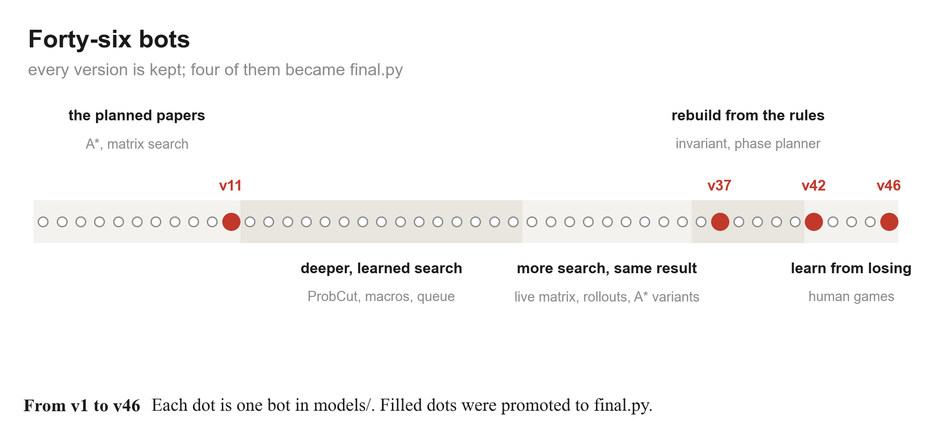
PART II
Forty-six bots, five eras
Search-only AI for Generals.io · DAC-203
3
Notes:
Every bot is kept in models/. Four were promoted to final.py: v11, v37, v42, v46. Most of the deck walks left to right along this line.

Slide 4
METHOD
How we decided what worked
· Every seed is played twice, seats swapped
  - the map favours one seat: v37 against itself goes 8-2 or 2-8 by seat alone
· Captures and tiebreak wins are counted separately
  - early 'wins' against the rusher were land tiebreaks at 220-400 tick caps
· Scripted adversaries for each failure we saw
  - rusher, castle rusher, expander, gather rusher, spread collector
· Recorded human games, replayed move by move
  - every human-vs-bot game is saved and re-run through the bot
8 - 2
2 - 8
v37 vs v37,
same map, by seat
the same ten maps,
seats swapped
2 x seeds
the smallest test we trust:
both seats on every map
A change only counts if it holds across seeds, both seats, and a cap long enough for captures to happen.
Search-only AI for Generals.io · DAC-203
4
Notes:
Small batches lie in this game. Seat and map decide many games between similar bots, and short caps turn tiebreaks into fake wins.

Slide 5
6
Testing the plan
The five papers and three ideas from part I, built and measured.

Slide 6
6. TESTING THE PLAN
What happened to each part of the plan
From part I | Built as | Result | Why
ARA* / weighted A* | v1, v33-v35 | routes fine; A* variants 3/6 vs rusher | route quality was never the bottleneck
RTAA* + depression avoidance | not built | - | full visibility: exact BFS distances each tick are cheap
ProbCut | v12-v21 | fit r = 0.974; no paired win gain | pruned the right branches of the wrong tree
Value of computation | v18 (forecasts) | lost both seed games | the bot was not short of time
Speculative pre-computation | v18 | forecasts kept being invalidated | contact changes the board, not just a few tiles
Queue as compute budget | v5, v18 | safe prefixes work; no strength gain | same: more thinking on wrong decisions
Simultaneous matrix (open question) | v3-v11 | helps only at contact; v11 became final | most ticks have no interaction
Search-only AI for Generals.io · DAC-203
6
Notes:
Walk the table: each idea, which version tested it, the result, and our reading of why.

Slide 7
6. TESTING THE PLAN
Simultaneous moves: the matrix only matters at contact
· Intuition: minimax assumes you move second; here both commit together
  - so solve a small matrix of our moves against theirs at every tick
· v3: the matrix at every state - slow, and weaker than plain A*
· v4-v5: the matrix only when moves can collide, short safe queues otherwise
· v6-v11: siege detection, a response tree, an explicit PASS, launch intercepts
  - v11 stayed final.py until v37
· Why: two stacks interact on few ticks; the rest of the game is economy and timing
v3
matrix everywhere:
slow, weaker
v4
matrix only when
moves can collide
v11
launch intercept:
final.py until v37
Search-only AI for Generals.io · DAC-203
7
Notes:
Part I said a node is a matrix game. True, but almost never relevant.

Slide 8
6. TESTING THE PLAN · PROBCUT
ProbCut worked as statistics, not as strength
· Intuition: part I measured shallow predicting deep; prune with it, go deeper
· The fit was excellent
  - slope 0.955, r = 0.974, residual sigma 2.8 on producer-wait positions
· Deeper search did not convert
  - v16 (1.5 sigma, 4 charge rows) and v17 (4-ply) split with v11, much slower
  - v20 learned ProbCut: error 2.02 -> 1.79, then lost 7 of 8 games
· Why: tactics were already right; games were lost on economy and home safety, over hundreds of ticks
0.974
1-1
shallow-deep correlation
(105 positions)
v17 (4-ply) vs v11,
seed 68000
-11%
7 / 8
learned ProbCut error
(v20, held out)
v20 games lost to v11
(castle-first play)
Search-only AI for Generals.io · DAC-203
8
Notes:
Shallow predicted deep almost perfectly. Deeper search still did not win more games.

Slide 9
6. TESTING THE PLAN · MACROS
Macro scripts: closer, still level
· Intuition: most raw moves are equivalent; search over plans instead
  - hold, take castle, charge general, expand - simulated 96 exact ticks
  - Barriga, Stanescu & Buro, Puppet Search, AIIDE 2015
· v23 split 6-6 with v11 over 12 seat-swapped games
· v24: long waits oscillated - the target was re-chosen every replan
· v26: bucketed raw moves added to the macro set - never got a focused test
· Why: a fixed horizon and nothing that guaranteed the general survives
  - the macro idea itself was right - it returns in v37
96
exact ticks simulated
per script pair
6 - 6
v23 vs v11,
seats swapped
-9%
macro ProbCut error
vs linear (33.3 vs 36.5)
Search-only AI for Generals.io · DAC-203
9
Notes:
Puppet Search idea: search over durative scripts instead of raw moves.

Slide 10
7
More search, same result
v27-v35: live matrices, learned pruning, A* variants, rollouts.

Slide 11
7. MORE SEARCH
Nothing moved the rusher result, until v36
· Each version added depth, a learned cut, or a better route
· v29's second response ply took 0.56 s and still lost
· v30 lost both rusher seats; v31 took 124 s and still lost
· v36 changed what is checked, not how deep
  - 20/20 against the rusher, on a larger held-out suite
Search-only AI for Generals.io · DAC-203
11
Notes:
Win rate against the direct general rusher, the bot that kept beating us.

Slide 12
7. MORE SEARCH
Why none of it worked
FINDING 1
FINDING 2
FINDING 3
We measured wrong
The arithmetic of a rush
So losses were safety holes
Early wins against the rusher were land tiebreaks at short caps.
Seat effects swamped 4-6 game batches.
v32's learned pruner hit 92% precision - and the buckets-only ablation scored the same 5/6.
An all-in walk of d steps pays about d units; the defending general gains about d/2.
Two generals that bank cannot rush each other.
Only a drained general falls.
Every rusher loss was the general left too thin at the wrong moment.
No depth fixes a missing invariant.
Rebuild from the rules, and check the one thing that loses games.
Search-only AI for Generals.io · DAC-203
12
Notes:
Three findings that ended the search-depth line of work.

Slide 13
8
Rebuilding from the rules
v36-v41: an exact simulator, one invariant, then a planner.

Slide 14
8. REBUILD
First, a simulator we could trust
· sim36: a pure-Python replica of the game step
  - checked tick by tick against the JAX environment
  - v37 reproduced all 403 + 377 recorded moves of two human games exactly
· Fast enough to put rollouts inside a decision
  - a v36 move costs 1-2 ms, including its safety rollouts
· Fast enough to test properly
  - 20-60 game paired suites in under a minute on 12 cores
  - the GPU (Mac MPS) was used only to train v40's ranker
1-2 ms
780
per v36 decision
of 780 recorded human-
game moves reproduced
~20 s
for 20 seat-swapped games at cap 500
Search-only AI for Generals.io · DAC-203
14
Notes:
sim36 replaced calls into the JAX environment. It made every later experiment cheap.

Slide 15
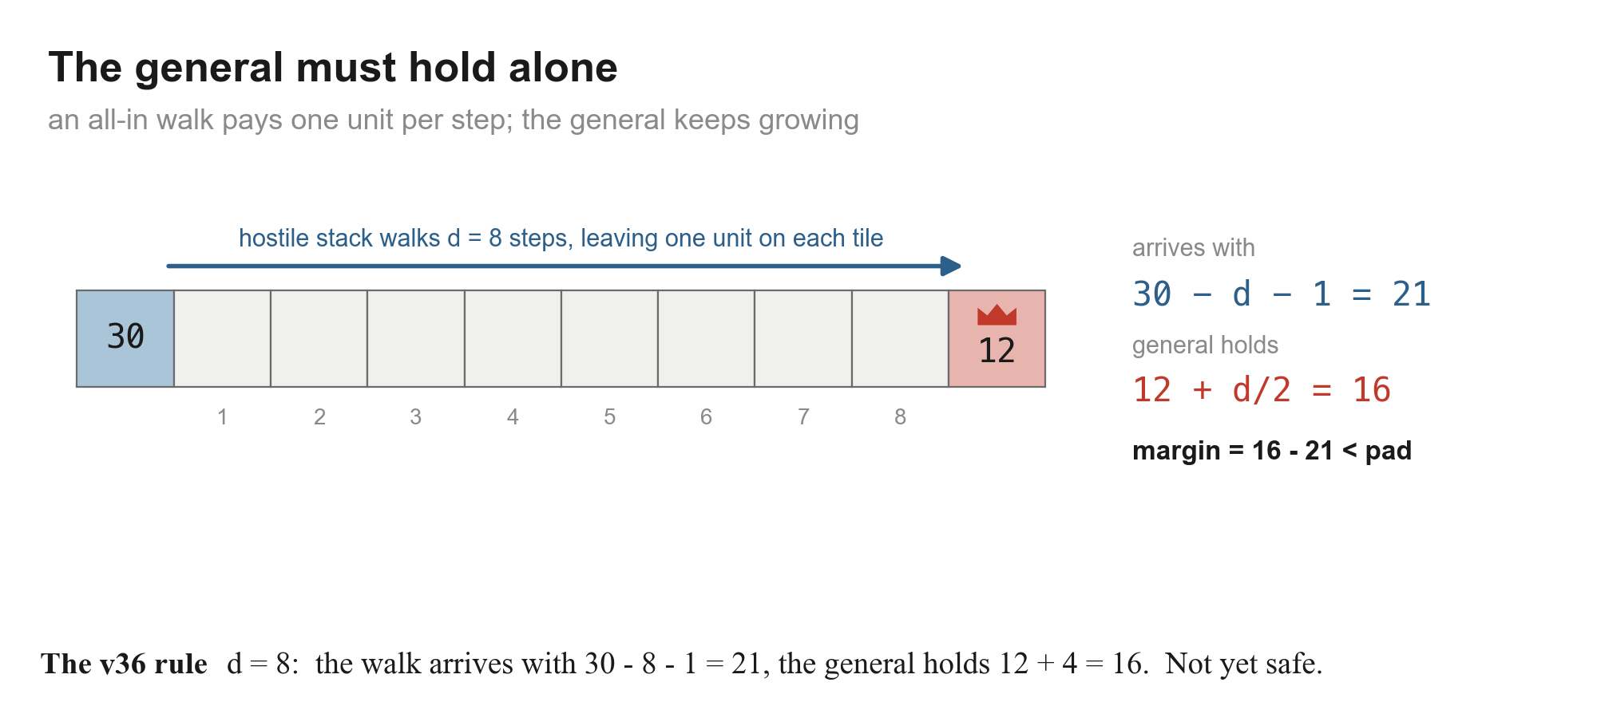
8. REBUILD · v36
One invariant: the general holds alone
20/20
20/20
direct rusher
castle rusher
12/12
16/20
vs v11, the old
final.py
expander (losses
are tiebreaks)
· Moves that do not lower the margin are always allowed, so expansion never freezes
· Any other move must survive exact rollouts of every enemy launch
Our own stacks are not walls, and a stack that might walk away is not a defender: the general must not rely on being refilled.
Search-only AI for Generals.io · DAC-203
15
Notes:
The rule behind every safety check in v46.

Slide 16
8. REBUILD · v37
Then a planner on top: plans, not moves
· ~6 macro plans per decision: expand, hold, take castle, gather home, strike, rush
  - plans with identical rollout outcomes are merged: 6.1 -> 4.6 on average
· Each plan is simulated 24 / 40 / 60 ticks against four opponent scripts
  - rusher, castle rusher, expander, hold - weighted by a Bayesian posterior
· Phases (opening / mid / end) read from the board, not the tick count
· Leaves scored by a 9-feature logistic model, fitted offline like ProbCut's line
  - honest result: no better than land-only in the mid-game (0.372 vs 0.359 log-loss)
· v36 urgent play (capture, verified rush, defence) always runs first
19/20
20/20
expander
(v36: 16/20)
vs v11
12-8
final
vs v36
promoted
2026-11-02
Search-only AI for Generals.io · DAC-203
16
Notes:
The macro idea from v22 returns, now behind the v36 safety layer.

Slide 17
8. REBUILD
Three more tries in this era
FAILED
KEPT
FAILED
v38 kill window
v39 swap-safe defence
v40 ranked planner
Intuition: v37 waits too long to attack.
11-9 vs v37 twice, but seat 0 won 9/10 and seat 1 won 2/10.
Why: against a banking general we can spare ~30 units while theirs holds hundreds. No kill exists without gambling home.
Found by replaying a human win: our general stepped onto an adjacent attacker.
Moves are simultaneous: the stacks passed and the attacker took the empty general.
Never step the general toward an adjacent enemy: 14/60 -> 10/60 losses.
Intuition: learn which plans to search (Barriga 2017, Moraes & Lelis 2018).
CNN trained on the Mac GPU on 8,071 regret-matched positions.
Lost 4-16 to v37: the teacher was noisy and ranker errors compound.
Search-only AI for Generals.io · DAC-203
17
Notes:
One small success, two failures with a clear reason.

Slide 18
9
Losing to people
Every human game is recorded. The bots kept losing them the same way.

Slide 19
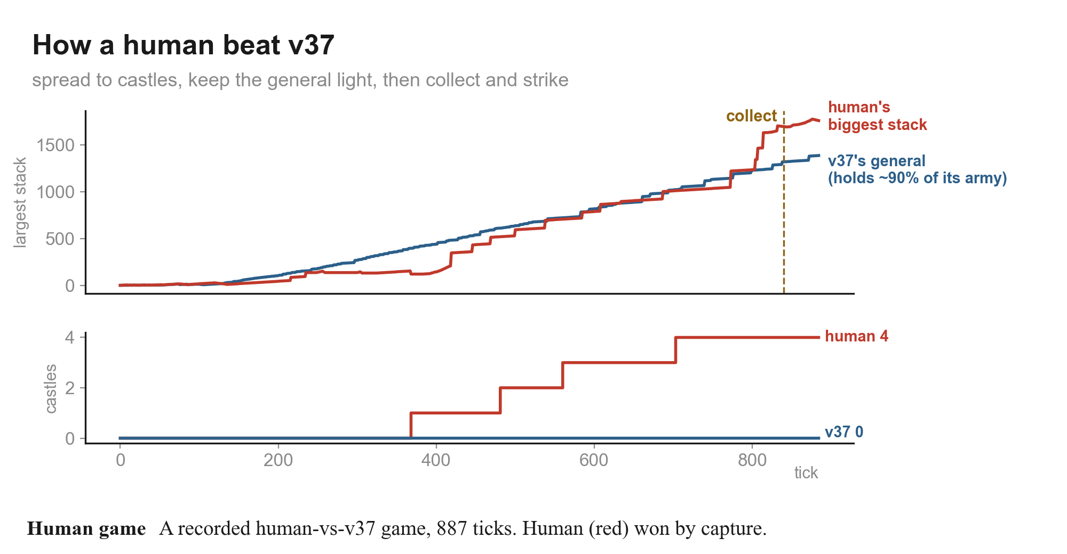
9. LOSING TO PEOPLE
How humans beat v37
· The human pattern
  - spread out, take castles, keep the general light
  - collect everything into one stack, then strike
· v37's blind spot
  - its threat model saw one walking stack at a time
  - many small stacks never looked like a threat until collected
· Recorded record vs v37
  - games over 150 ticks: humans 5, v37 6, 2 unfinished
Search-only AI for Generals.io · DAC-203
19
Notes:
Real data from a recorded game. v37 hoarded in its general and never took a castle.

Slide 20
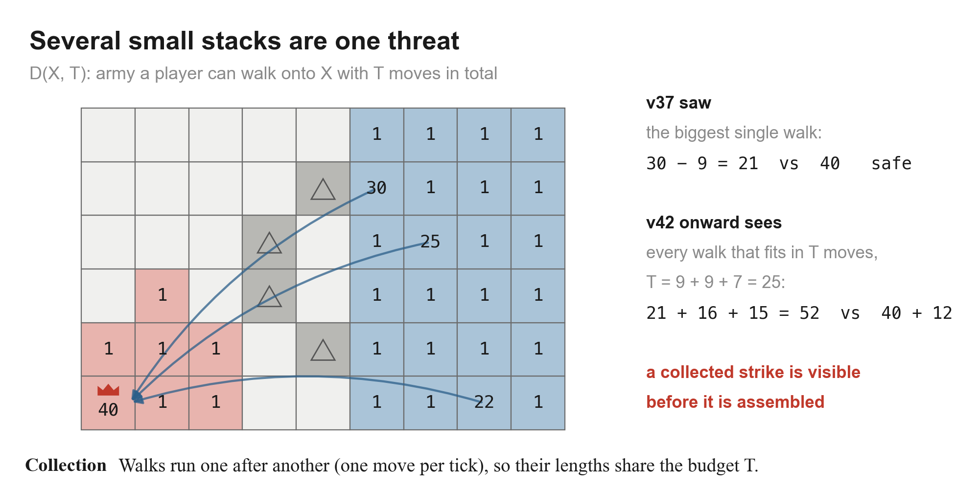
9. LOSING TO PEOPLE · v42
See the collected strike before it is assembled
· D(X, T): army a side can walk onto X when its walks' lengths sum to at most T
  - one move per tick, so walks share the budget
· Safety becomes a race, for every T
  - our general + growth + what we bring home, against what they bring
· Plus a castle layer: castles that pay back, checked past the walk's end
· v42 vs v37: 19-1 on the real harness - promoted
Search-only AI for Generals.io · DAC-203
20
Notes:
The collection race, a simplified prize-collecting Steiner tree as in Human.exe (Straka et al. 2026).

Slide 21
9. LOSING TO PEOPLE · v44
v42 lost to a human anyway: three fixes
What the replay showed | Fix in v44
Two walks home along one corridor both counted the land army on it | Each tile counted once in D(X, T)
The general was drained to 2-15 on castles and a strike | General reserve: hold 0.5 x every hostile walk, now and after 30 / 60 ticks of their growth
The human's general walked out and collected 84 -> 137 | Also hold against the army they can gather in 30 / 60 moves
v42's margin read +10 to +40 until two ticks too late | Counter-strike: when home loses the race, hit their general first if we land sooner
13-7
19-1
82/100
v44 vs v42
v44 vs v37
scripted bots
(v42: 75/100)
Search-only AI for Generals.io · DAC-203
21
Notes:
Game 20261103_154954, 272 ticks. Each fix answers one thing the replay showed.

Slide 22
9. LOSING TO PEOPLE · v45
Answer this opponent, not the average one
· Intuition: castle play is wasted against an opponent who never takes castles
  - and a big reserve is wasted against one who never attacks
· v45: two hand-set gates
  - castle gate open if they hold or mass on castles
  - threat gate open if they attacked or walked their general out
· Result: 10-10 with v44 - the gates were right but too blunt
  - against castle-less v37, skipping castles cost a little (16-4 vs 19-1)
· v46 keeps the gates and decides them from learned beliefs
10-10
16-4
v45 vs v44
v45 vs v37
-> v46
same tree, gates driven by a posterior
and an income race
Search-only AI for Generals.io · DAC-203
22
Notes:
v45 switched modules on what the opponent did. v46 learns it.

Slide 23
10
v46 in depth
The current final.py: five layers, one tick at a time.

Slide 24
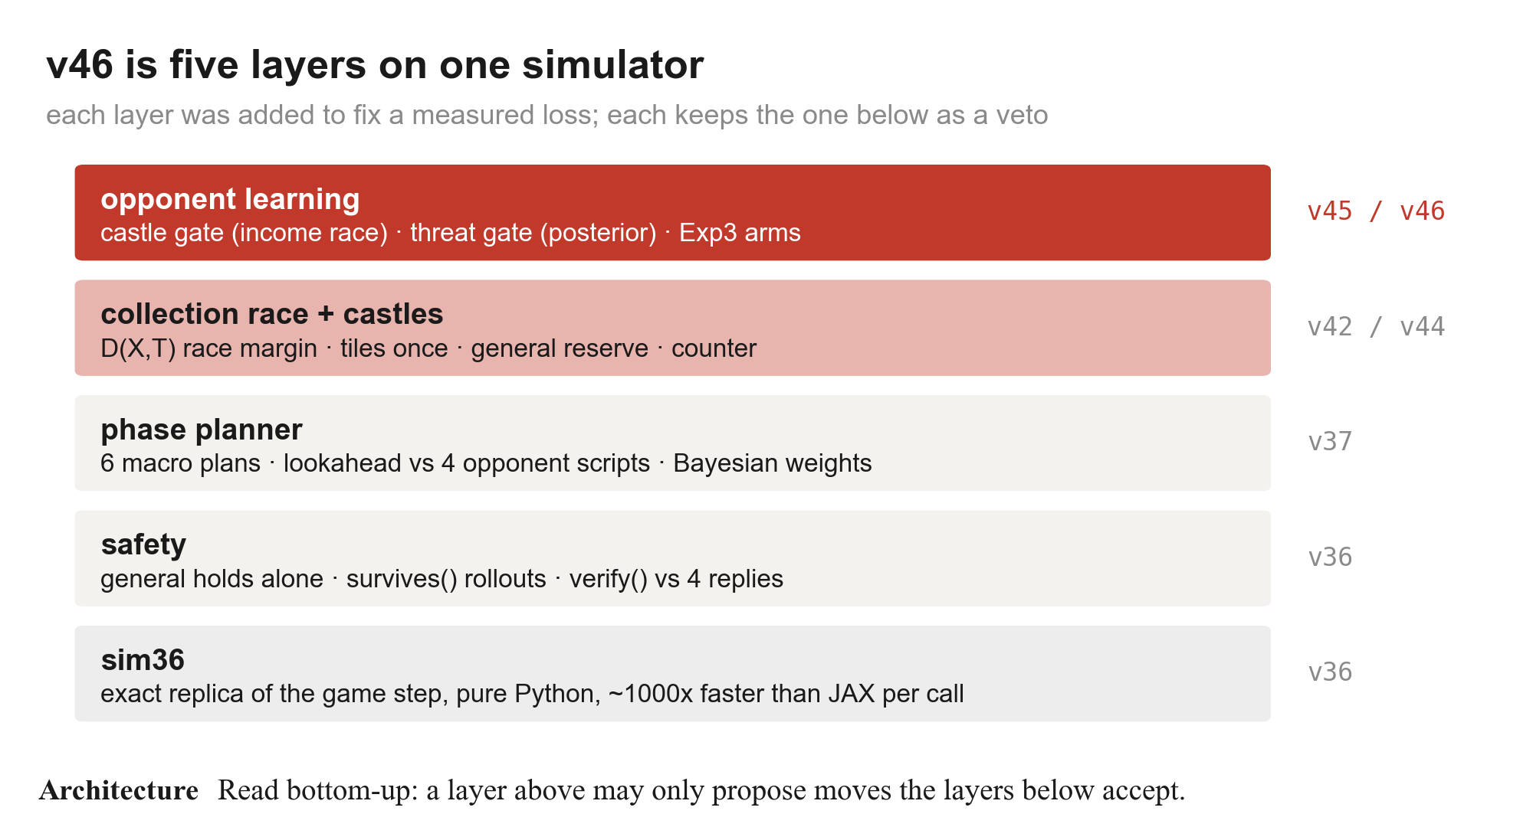
10. v46
Five layers on one simulator
· A layer proposes; the layers below can refuse
  - the opponent model can make v46 greedier, never unsafe
· ~3,100 lines of Python across nine files
  - sim36, core36, core37, v37, v39, v42, v44, v45, v46
· Mean decision ~10 ms in the simulator
  - slowest decision measured: 1.28 s, during rollouts
Search-only AI for Generals.io · DAC-203
24
Notes:
Bottom-up. Each layer was added to fix a measured loss, and each keeps the one below as a veto.

Slide 25
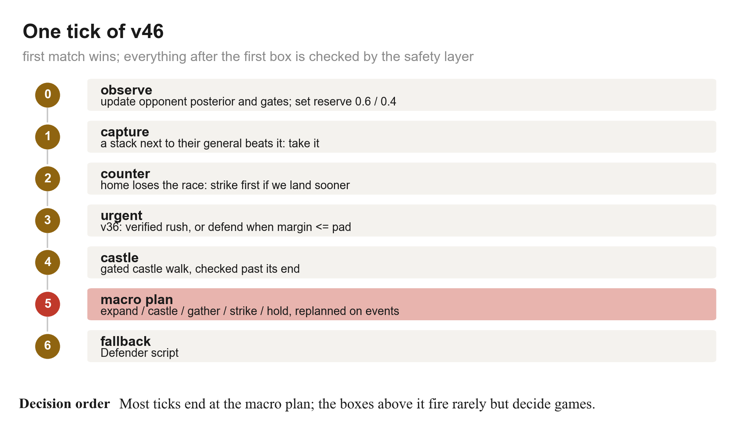
10. v46
One tick, top to bottom
· 0 never moves; it updates beliefs
· 1-3 are rare and decisive
  - capture, counter-strike, verified rush, defence
· 4 is the castle layer, behind the castle gate
· 5 is v37's committed macro plan
  - replanned on events: phase change, a castle changes hands, their general drained
· 6 only if every proposal was vetoed
Search-only AI for Generals.io · DAC-203
25
Notes:
First match wins. Every move after the capture check passes the safety layer.

Slide 26
10. v46 · SAFETY
What the safety layer actually checks
margin
survives()
Race margin > pad
Every launch, played out
min over T of home minus threat. The pad grows with the largest hostile stack (0.08x).
Play the move, then our Defender against every plausible all-in route, judged on the board after the move.
verify()
swap-safe
A plan against four replies
Never step into a swap
Our rush or plan vs Rusher, CastleRusher, Pass and a turtle Econ for d + 4 ticks. Must win all four.
The general never moves toward an adjacent enemy stack; simultaneous moves let them pass.
Search-only AI for Generals.io · DAC-203
26
Notes:
Four checks from v36, used by every layer above.

Slide 27
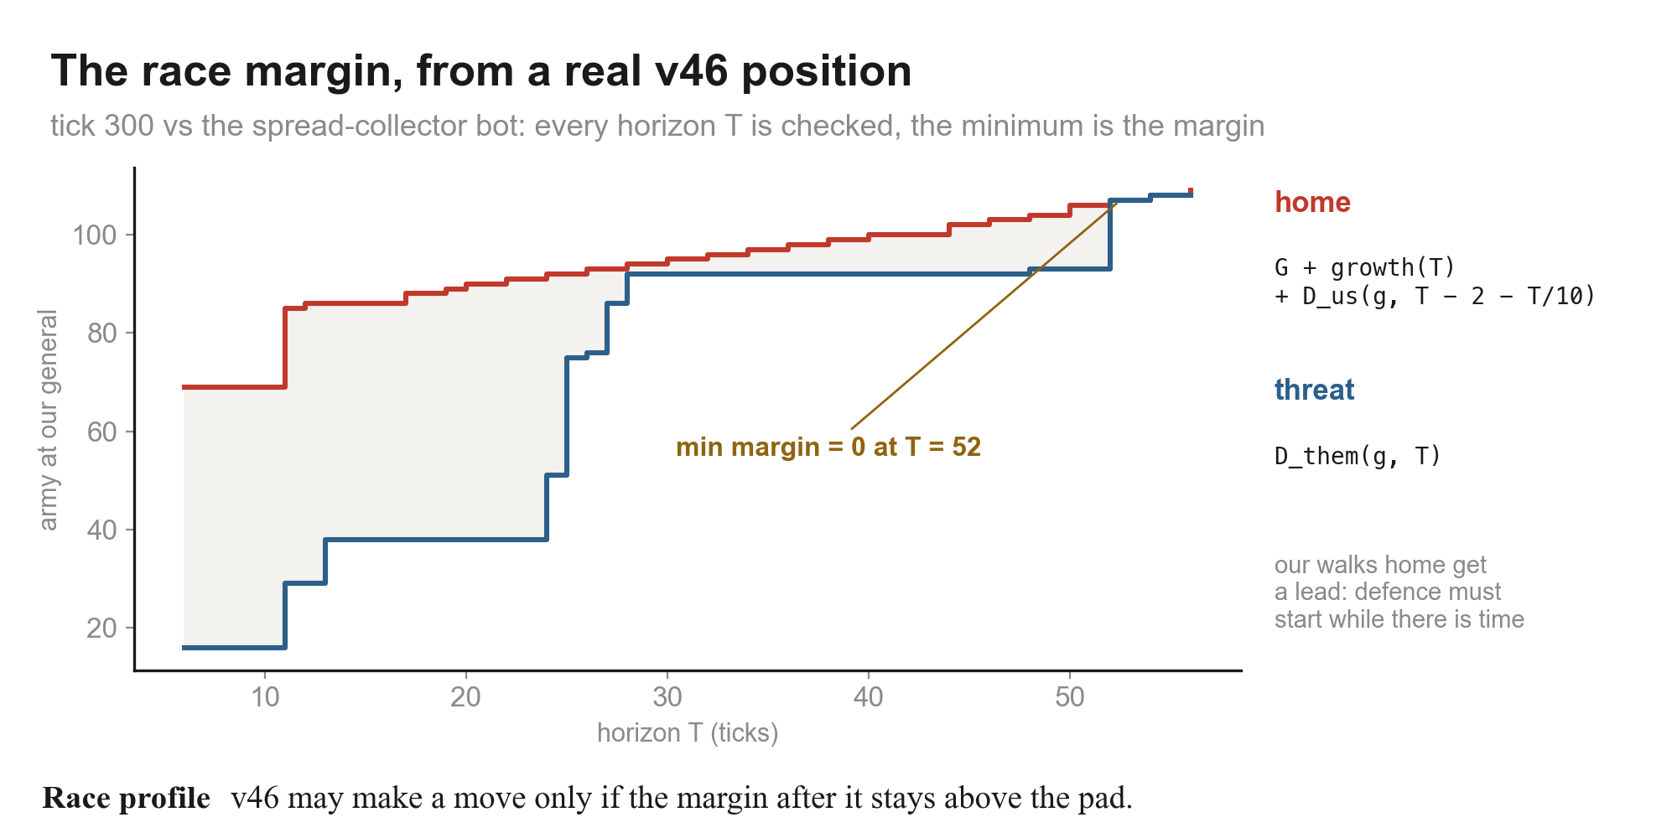
10. v46 · COLLECTION RACE
The race margin, computed from a real position
· Items: each of the top 10 stacks' best walk to our general
  - ours: only through our own land (a walk across theirs can be cut)
  - theirs: our cells cost at most 3 - stacks can step aside
· D(T): biggest walks first, lengths summed <= T, each tile once
· T: every walk length and every pair sum up to 60
· Our walks get a lead of 2 + T/10: defence must start in time
Search-only AI for Generals.io · DAC-203
27
Notes:
This is the number most of v46's decisions are checked against.

Slide 28
10. v46 · RESERVE AND CASTLES
When the general may leave, and which castles to buy
GENERAL RESERVE
CASTLE LAYER
G + growth(H + d) >= R x threat(H)
2 x (garrison + walk) <= ticks left
· for every hostile walk, at H = 0, 30 and 60 ticks from now
  - their walk grows too: producers and land on the way
· and for the army they could gather in H moves
· R = 0.6 if the threat gate is open, 0.4 if shut
· the leaving stack is not counted as coming back
· only castles that pay back before the cap
· sources: half or all-but-one of the general, owned castles, big stacks
· ranked by cost, minus 0.6 per step toward their general, enemy-held first
· safe only if the race margin holds on the board projected past the walk
  - with hostile walks advanced, plus 0.2 x their largest stack
Search-only AI for Generals.io · DAC-203
28
Notes:
The two rules that let v46 take castles without losing its general.

Slide 29
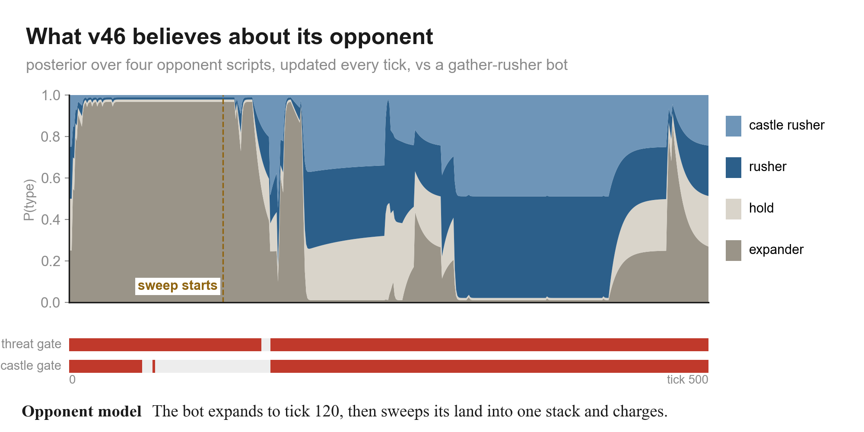
10. v46 · OPPONENT MODEL
Learning the opponent, every tick
· Four scripts each predict the opponent's last move
· Update per tick
  - w <- 0.95 w x (0.8 if consistent else 0.2) / 0.5 + 0.05, then normalise
· Plus observed facts
  - castles held or massed on, attacks near our general, their general walking out
· Here it reads 'expander' until the sweep, then 'rusher'
Search-only AI for Generals.io · DAC-203
29
Notes:
Bayesian opponent typing (Synnaeve & Bessiere 2011; Weber & Mateas 2009).

Slide 30
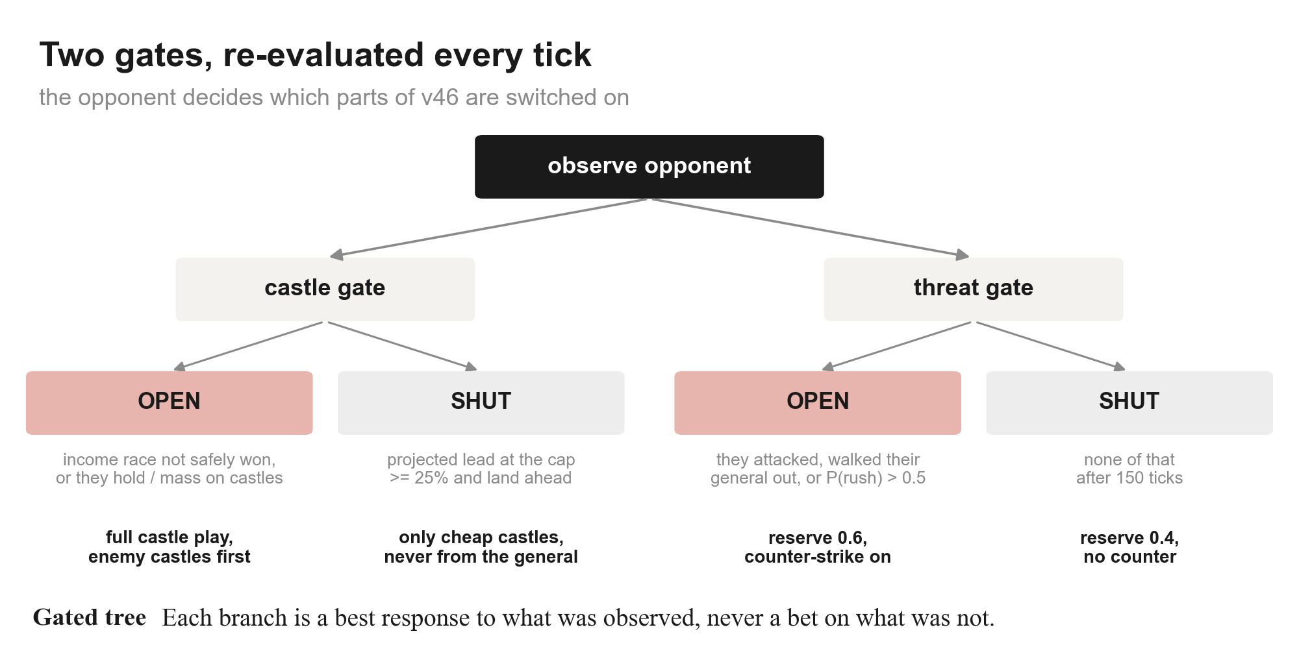
10. v46 · GATES
Two gates decide which parts of v46 run
· Castle gate is an income race (Churchill & Buro 2011)
  - lead = army gap + income gap x ticks left
  - shut once lead > 25% of their army, our income >= theirs and land ahead
· Threat gate opens on observed attacks or P(rusher) + P(castle rusher) > 0.5
· Across games: Exp3 over four parameter arms
  - Auer et al. 2002; only with a memory file, so not tested in matches
Search-only AI for Generals.io · DAC-203
30
Notes:
Safe best response (Ganzfried & Sandholm 2011, 2015): exploit only inside the safety layer.

Slide 31
10. v46
Where v46's moves come from
· Most ticks: the committed macro plan
· Castle share follows the opponent
  - 50% of moves against the castle rusher, 8% against castle-less v37
· Urgent play is 3-7% of ticks
  - that is where captures and defences happen
Search-only AI for Generals.io · DAC-203
31
Notes:
Real counts from four full games (seed 93003). v46 won all four.

Slide 32
10. v46
Results
· 17-3 vs v37, 14-6 vs v42, 11-9 vs v44
  - cap 1000, seeds 93001-93010
· 81/100 vs five scripted bots
  - v44 82, v45 79 on the same games
· Against people, the hardest so far
  - recorded: 1 win, 1 loss for v46
· Promoted to final.py on 2026-11-03
Search-only AI for Generals.io · DAC-203
32
Notes:
Simulator, seats swapped. v46 is level with v44 within noise in these tests; humans find it hardest to beat.

Slide 33
10. v46
The papers behind v46
v42
Superhuman AI for Generals.io (Human.exe section)
collection race: budgeted gather to a point
Straka, Lisy & Schmid · arXiv 2606.23348, 2026
v37
Puppet Search
search over scripts, not raw moves
Barriga, Stanescu & Buro · AIIDE 2015
v46
Bayesian opening prediction / strategy prediction
in-game posterior over opponent types
Synnaeve & Bessiere · AIIDE 2011 / Weber & Mateas · CIG 2009
v46
Safe opponent exploitation
best-respond only inside the safety layer
Ganzfried & Sandholm · AAMAS 2011, TEAC 2015
v46
Build order optimisation
income race decides the castle gate
Churchill & Buro · AIIDE 2011
v46
Exp3 / strategy selection in RTS
cross-game choice of parameter arms
Auer et al. · SIAM J. Comput. 2002 / Tavares et al. · AIIDE 2016
Search-only AI for Generals.io · DAC-203
33
Notes:
Each paper is used for one specific mechanism.

Slide 34
11
What we learned
Forty-six bots, four lessons.

Slide 35
11. WHAT WE LEARNED
Four lessons
1
Measure the right thing
2
Invariants before depth
Swap seats, separate captures from tiebreaks, run caps long enough for captures. Half our early 'gains' were noise.
Twenty versions of deeper or learned search moved nothing. One rule about the general took the rusher from 3/6 to 20/20.
3
People are the test set
4
Learn the opponent, safely
Every big step after v37 came from replaying a game a person won: swap-safe defence, the collection race, the reserve.
v46 changes its castle play and reserve to fit the opponent, but the safety layer still vetoes any move that loses the general.
Search-only AI for Generals.io · DAC-203
35
Notes:
If we started again, these are the four things we would do first.

Slide 36
WHERE IT STANDS
v46 is final.py
Search and rules first: an exact simulator, one invariant, a collection race,
and an opponent model that may only make the bot greedier, never unsafe.
All forty-six bots are kept in models/, failures included.

