Slide 1
DAC-203 · PROJECT NOTES
A Search-Only Agent for
Perfect-Information Generals.io
Real-time strategy on a 23x23 grid. b between 40 and 400. 500 ms per decision.
Five papers, one per chapter of Russell & Norvig 3-6. No learning of any kind.

Slide 2
1
The Game
Rules, production, and the three things that make it hard.

Slide 3
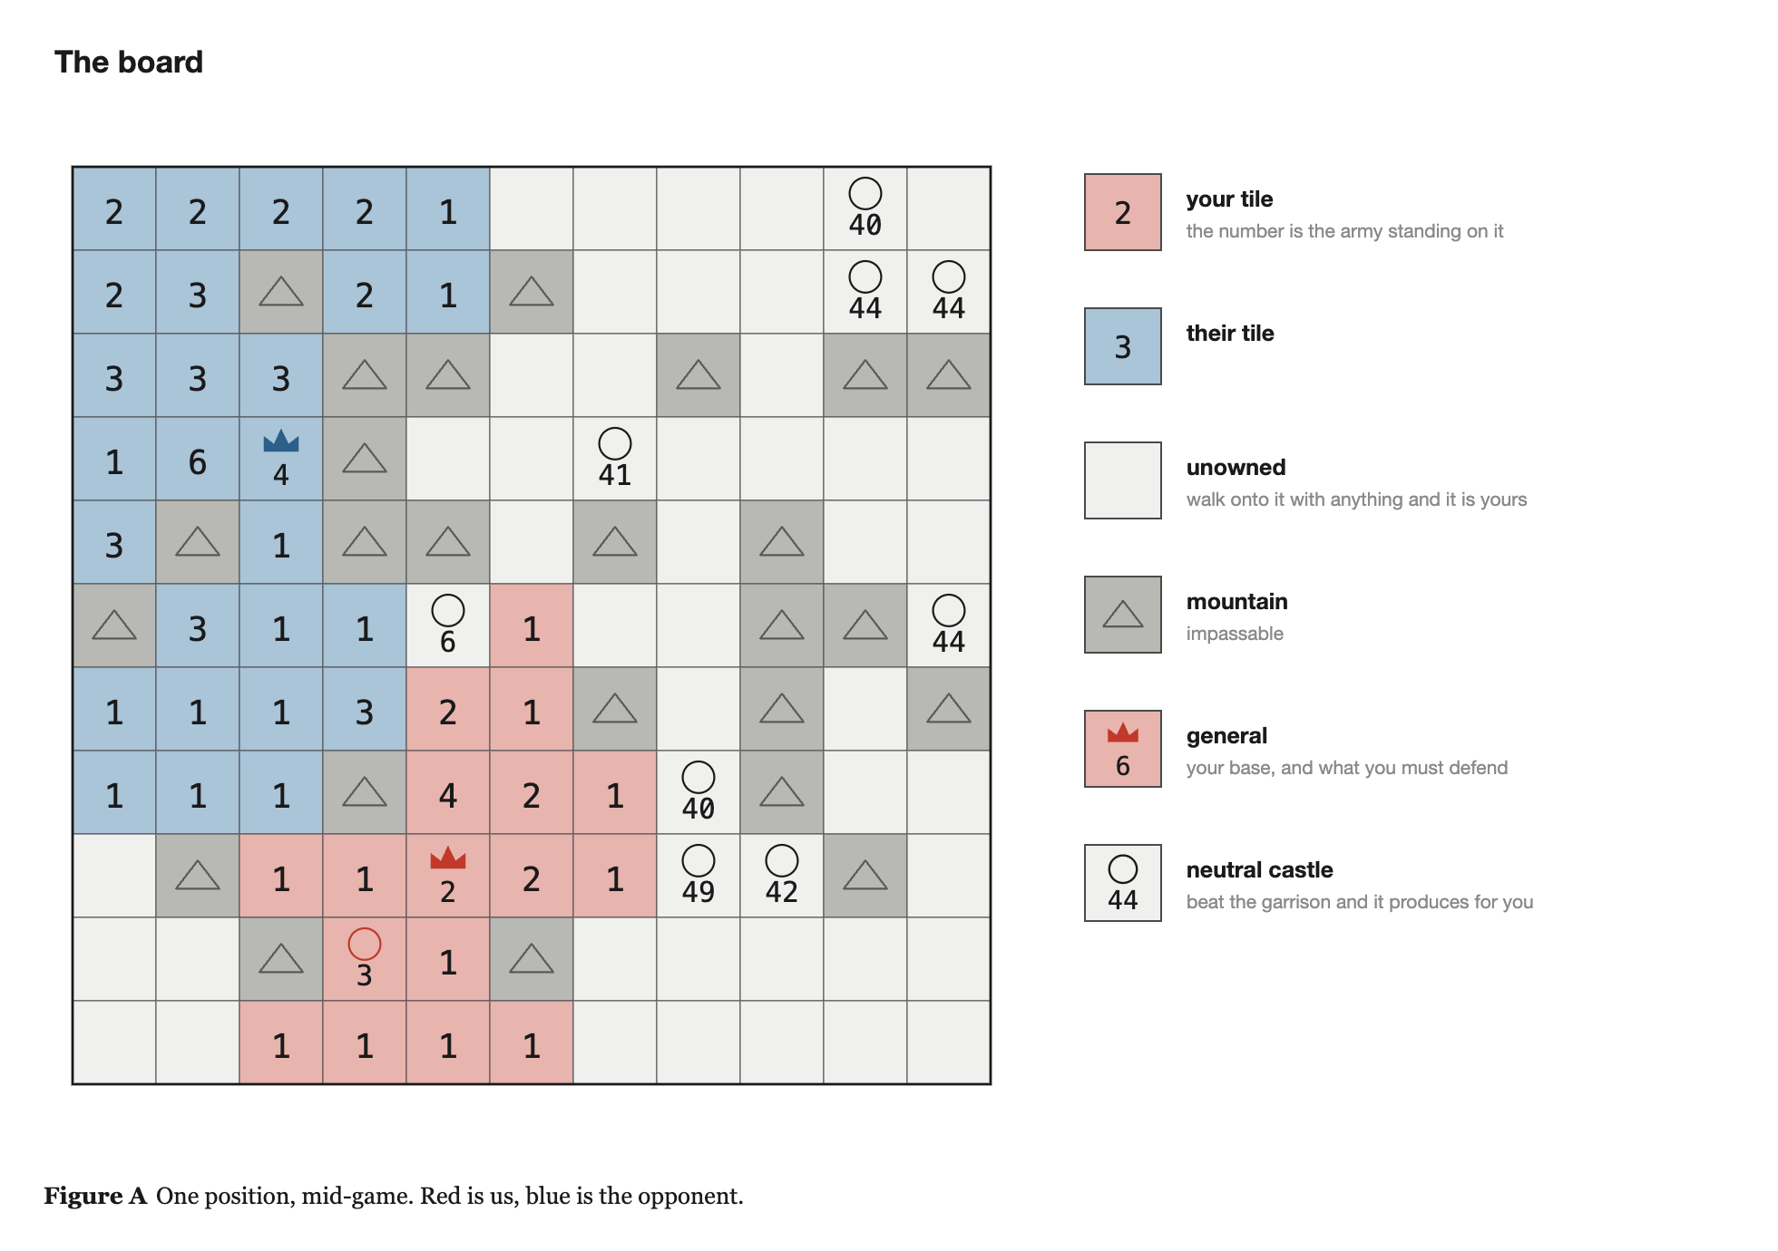
1. THE GAME
The board
· 23 x 23 grid of square tiles
  - plain tiles - anyone may walk on them and own them
  - mountains - impassable, permanent walls
  - castles - produce army for whoever holds them
  - generals - one per player; a base, and the thing you must defend
· Each player starts owning exactly one tile: their general
· Every owned tile carries a number - the army units standing on it
  - mine red, opponent blue, unowned grey
Search-only AI for Generals.io · DAC-203
3

Slide 4
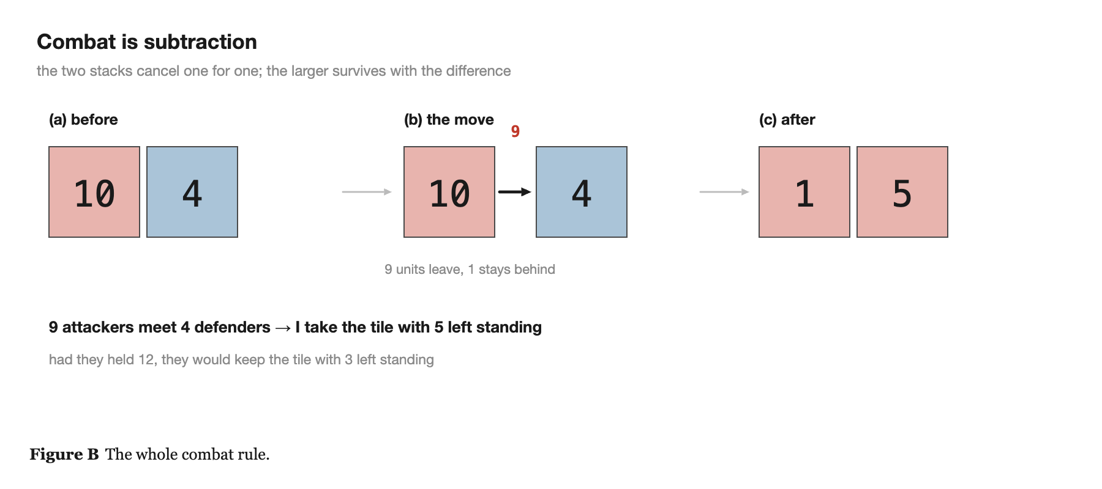
1. THE GAME
Moving and fighting
· One move per tick: pick a tile you own, pick a direction
  - send all but one unit, or exactly half
  - or pass
· That is the entire action set
· Combat is subtraction
· The two stacks cancel one for one; the larger survives with the difference
Ties keep the tile with its previous owner.
Search-only AI for Generals.io · DAC-203
4

Slide 5
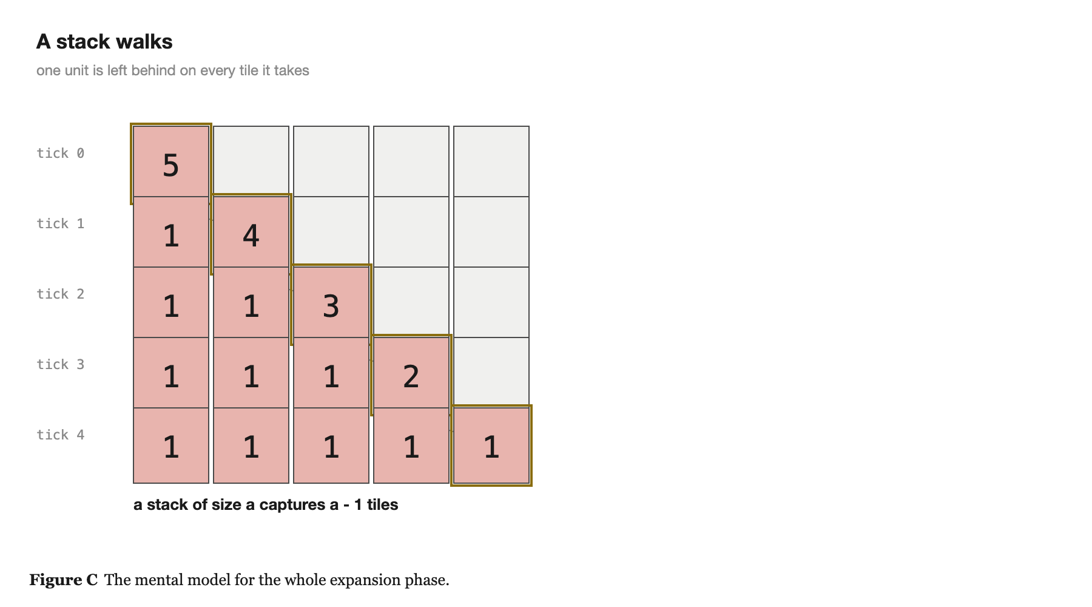
1. THE GAME
A stack of size a captures a - 1 tiles
· Neutral tiles cost almost nothing - walk on with any units at all and it is yours
· One unit is left behind on every tile you leave, so the stack shrinks by one per step
· This is the mental model for the entire expansion phase
Search-only AI for Generals.io · DAC-203
5

Slide 6
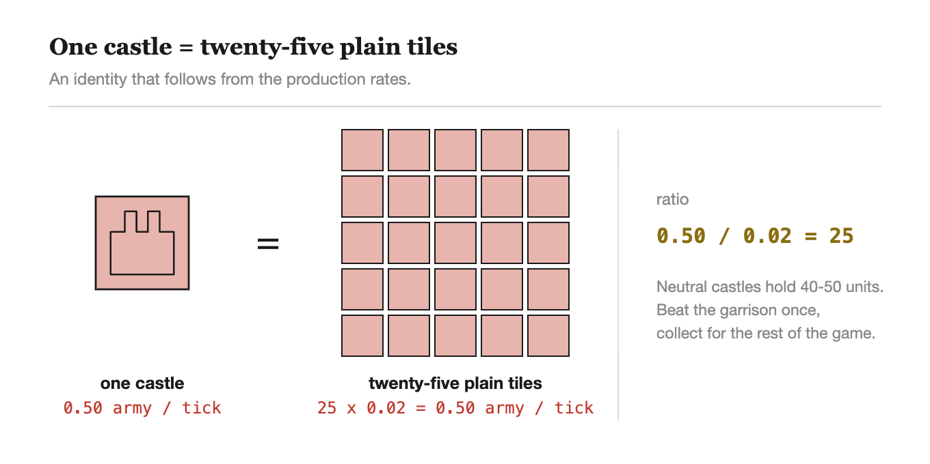
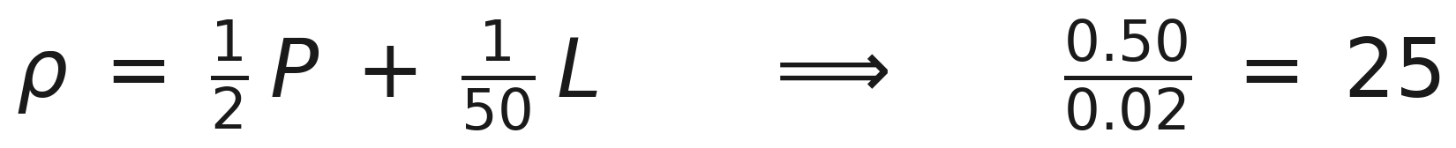
1. THE GAME
Where army comes from
· Your general produces 1 unit every 2 ticks
· Each castle you own produces 1 unit every 2 ticks
· Every tile you own produces 1 unit every 50 ticks
· Neutral castles sit on the map holding 40-50 units - beat the garrison, keep it forever
One castle is worth exactly twenty-five plain tiles. A fact about the rules, not an opinion about strategy.
Search-only AI for Generals.io · DAC-203
6

Slide 7
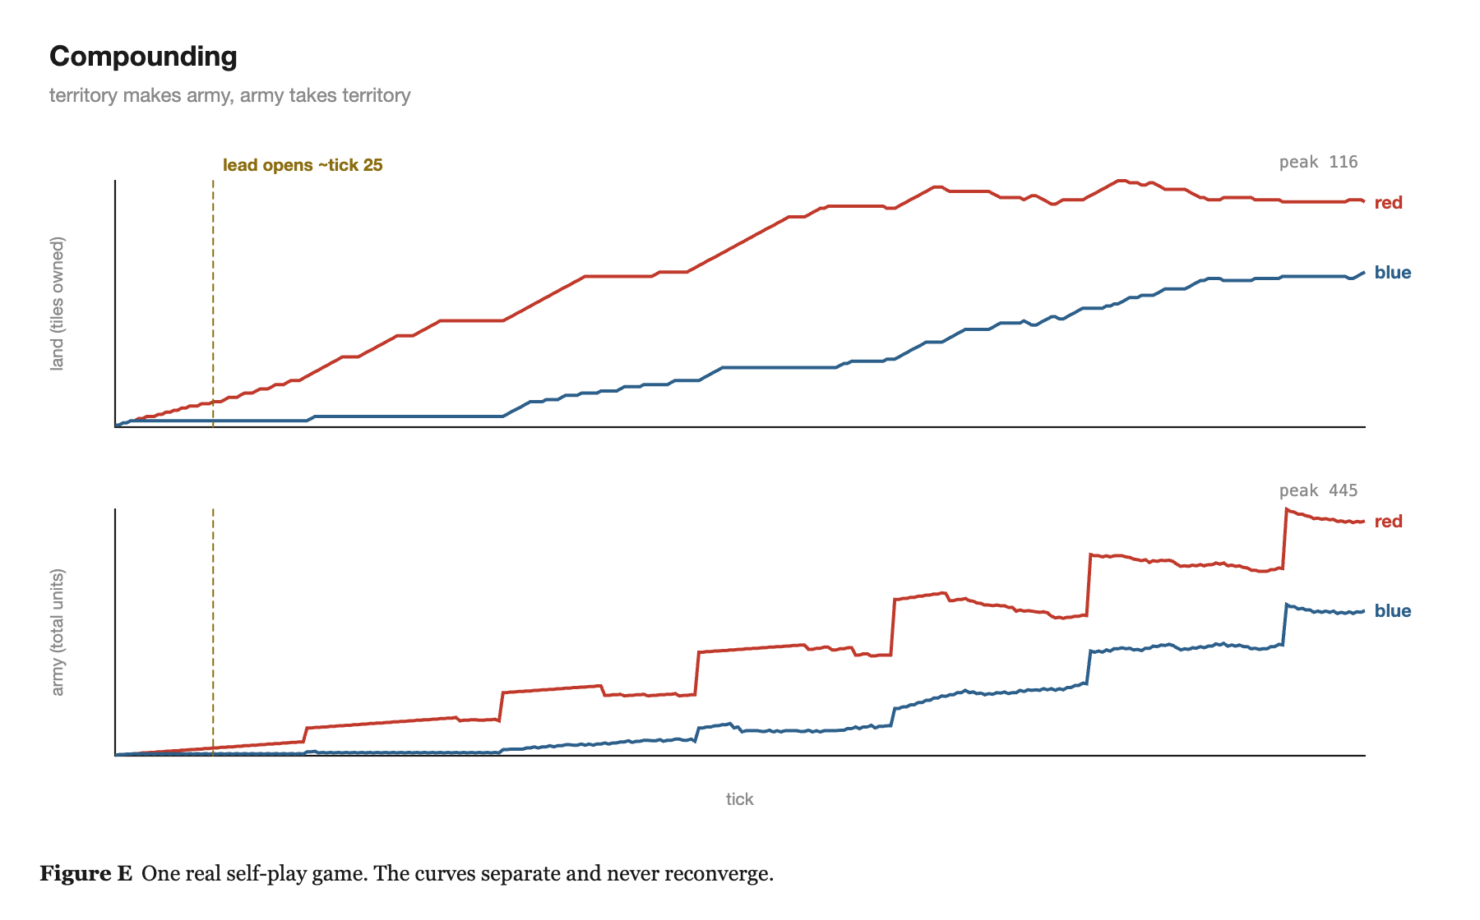
1. THE GAME
Therefore: a compounding game
· Territory produces army
· Army takes territory
· Small early advantages snowball
· Ten tiles ahead at turn 50
  - is usually much further ahead by turn 200
· The curves diverge and never come back together
Search-only AI for Generals.io · DAC-203
7

Slide 8
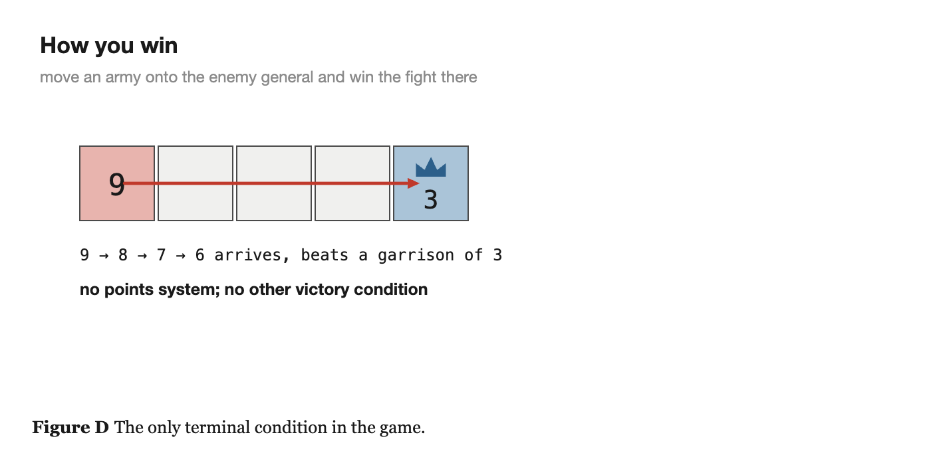
1. THE GAME
How you win
· Move an army onto the enemy general and win the fight there
· That is it
  - no points system
  - no other victory condition
Search-only AI for Generals.io · DAC-203
8

Slide 9
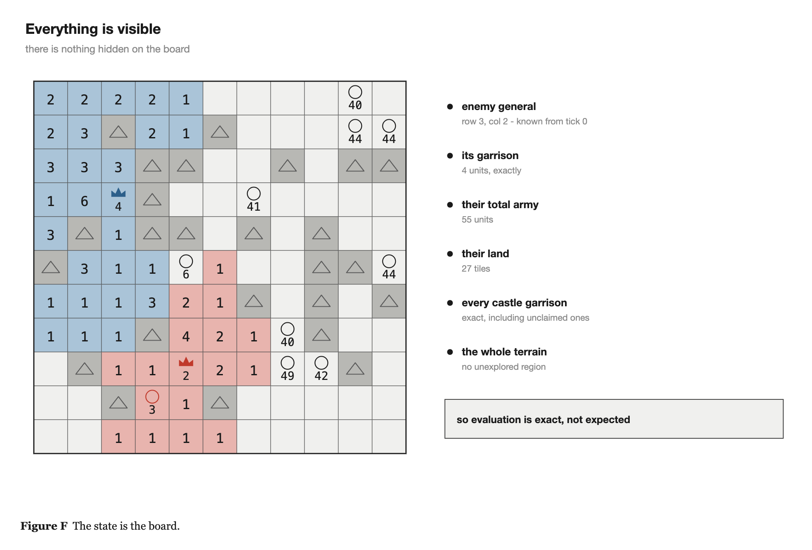
1. THE GAME
Both players see everything
· The board is fully observable - nothing on it is hidden
· This is what makes the algorithms in this course apply at all
· Classical adversarial search assumes you can evaluate the position in front of you. Here you can.
· Evaluation is exact, not expected
· "Can my opponent reach my general within six ticks?" has a definite yes-or-no answer, not a probability
Search-only AI for Generals.io · DAC-203
9

Slide 10
1. THE GAME
What makes it hard
· ONE · Time
  - A real-time strategy game. Both players move together, so tempo is a first-class resource.
· TWO · Branching factor
  - Every owned tile with two or more units has 4 directions x 2 move types. Average b lands between 40 and 400.
· THREE · Sparse, terminal reward
  - You win or lose 500 ticks later. Nothing tells you at tick 137 whether that move was good.
· AND · Simultaneous commitment
  - The one genuine piece of hidden information - and the reason plain minimax is not quite right.
Search-only AI for Generals.io · DAC-203
10

Slide 11
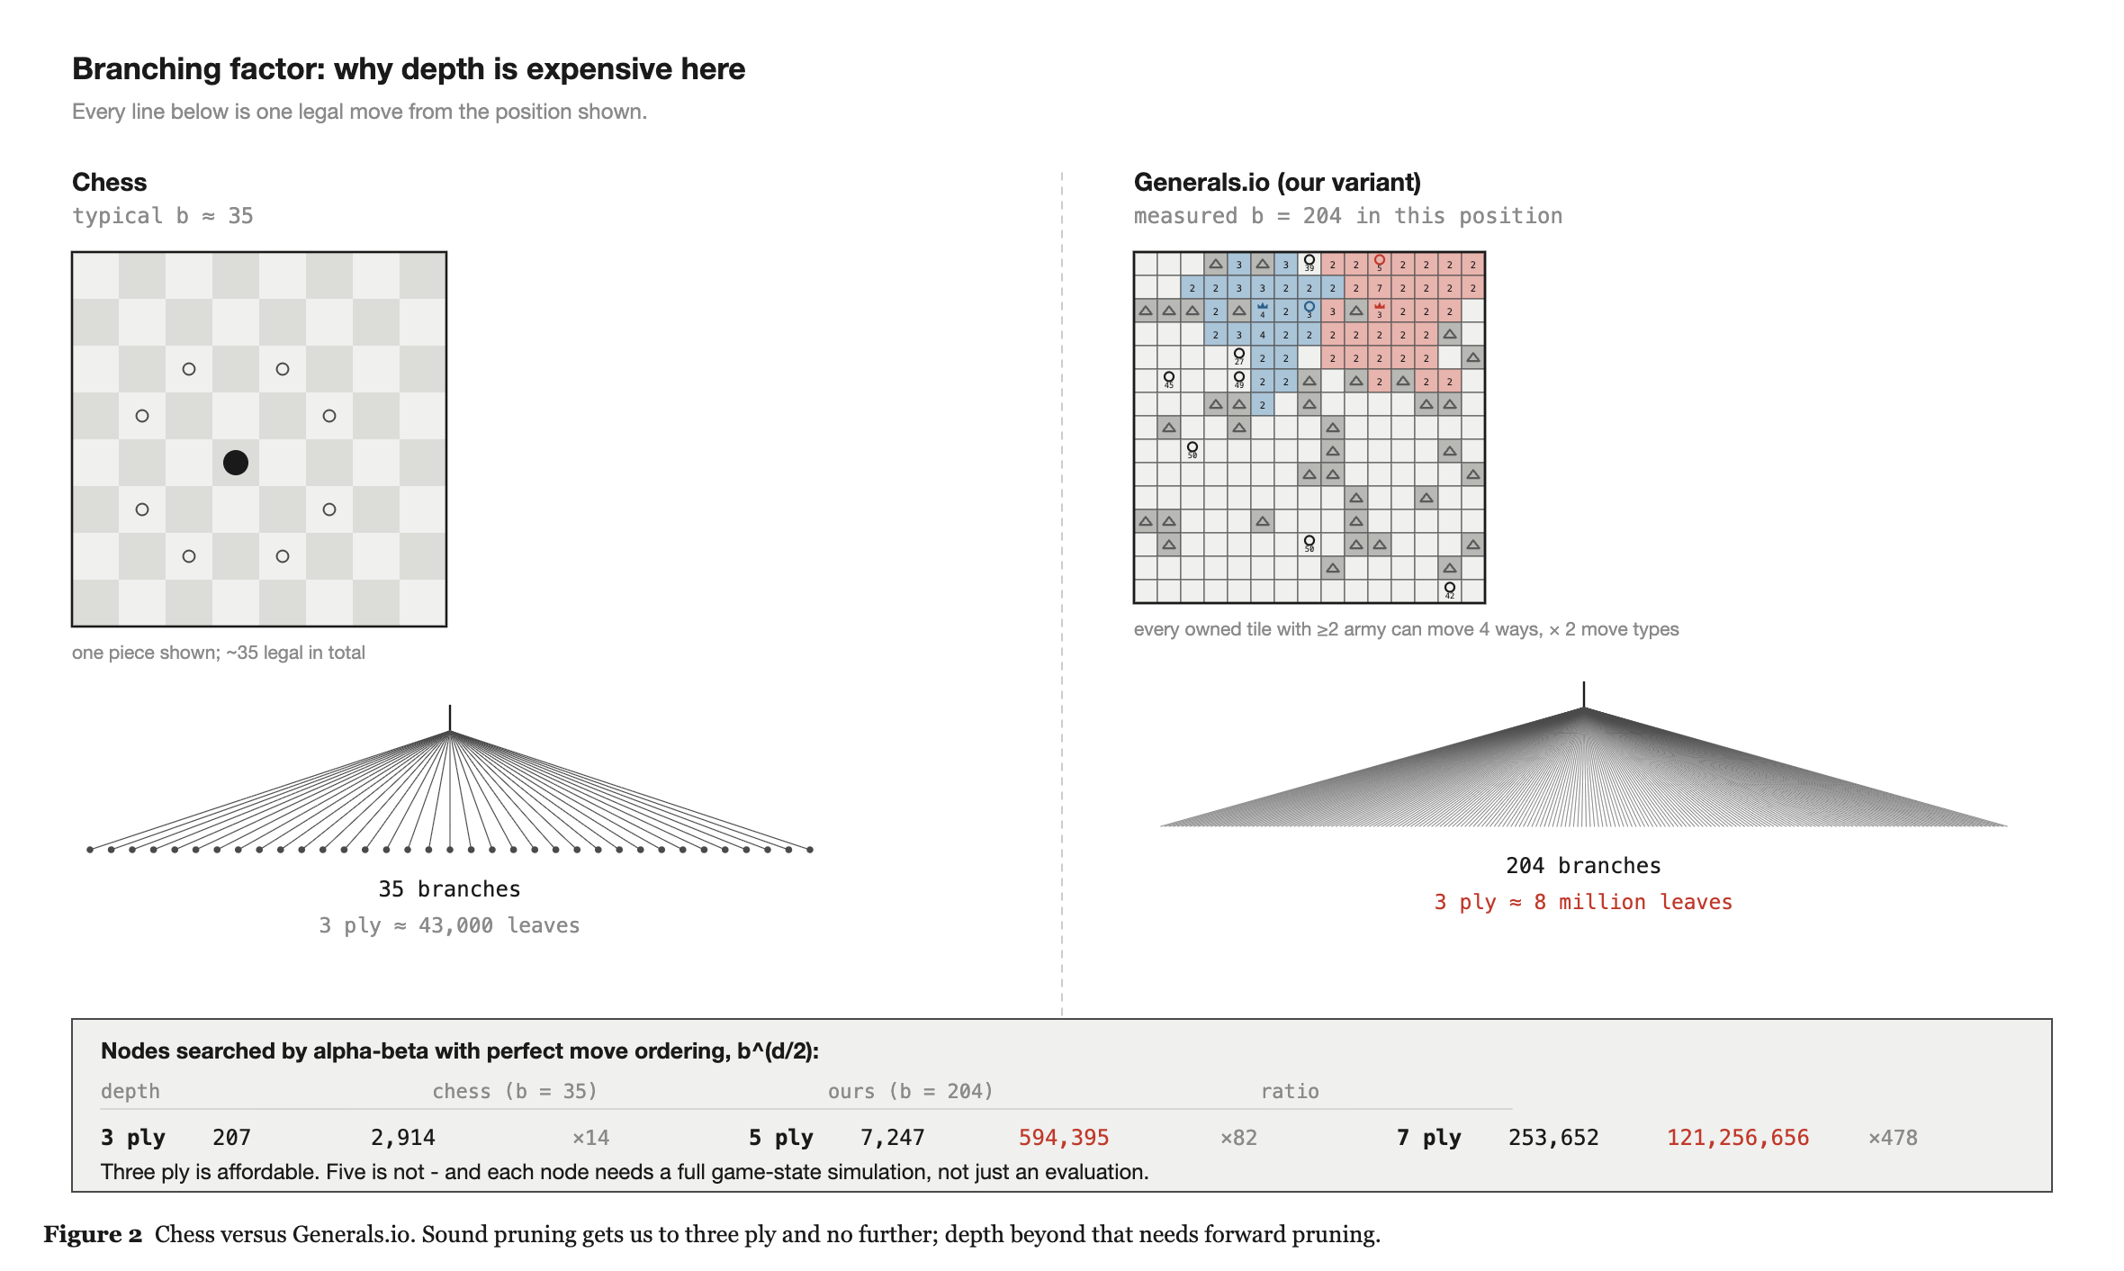
1. THE GAME · HARD #2
Depth is unaffordable
b = 204, measured from a real position. Chess is 35.
Search-only AI for Generals.io · DAC-203
11

Slide 12
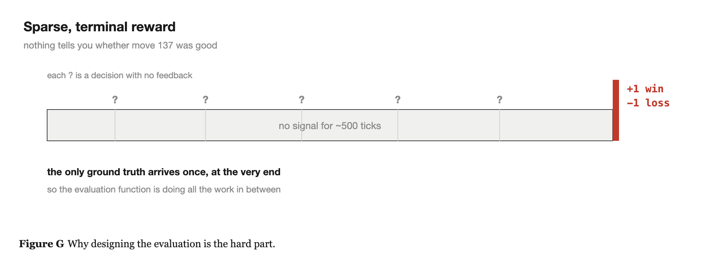
1. THE GAME · HARD #3
The reward is sparse and terminal
· No signal for 500 ticks, then +1 or -1
· So the evaluation function is doing all of the work - it is the hard part, not the search
Search-only AI for Generals.io · DAC-203
12

Slide 13
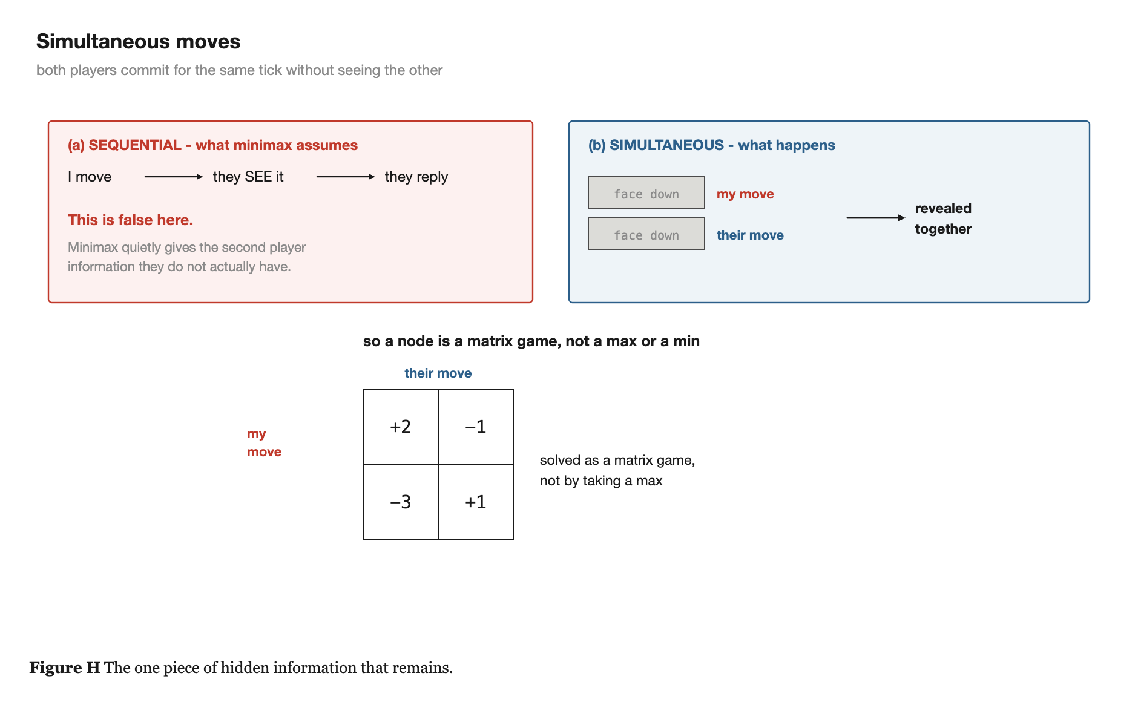
1. THE GAME
Simultaneous moves
· Both players commit their move for the same tick without seeing the other's
· Minimax quietly assumes you move second
  - that you get to see what the opponent did
· A node here is a matrix game, not a max or a min
· Dealing with this properly is an open question in this project
Search-only AI for Generals.io · DAC-203
13

Slide 14
2
Why Search
And why it is not a fallback.

Slide 15
2. WHY SEARCH
Search is a serious approach here
· The constraint: search and CSP only - Russell & Norvig, chapters 3 to 6
  - no reinforcement learning, no neural networks, no machine learning
· The strongest non-learning agent on the public ladder is built entirely out of classical optimisation
  - graph algorithms and dynamic programming - nothing else
  - it was the best bot in the world at this game until an RL agent trained on four H200 GPUs beat it
· So this is not a consolation prize. It is the approach that held the top of the ladder.
Search-only AI for Generals.io · DAC-203
15

Slide 16
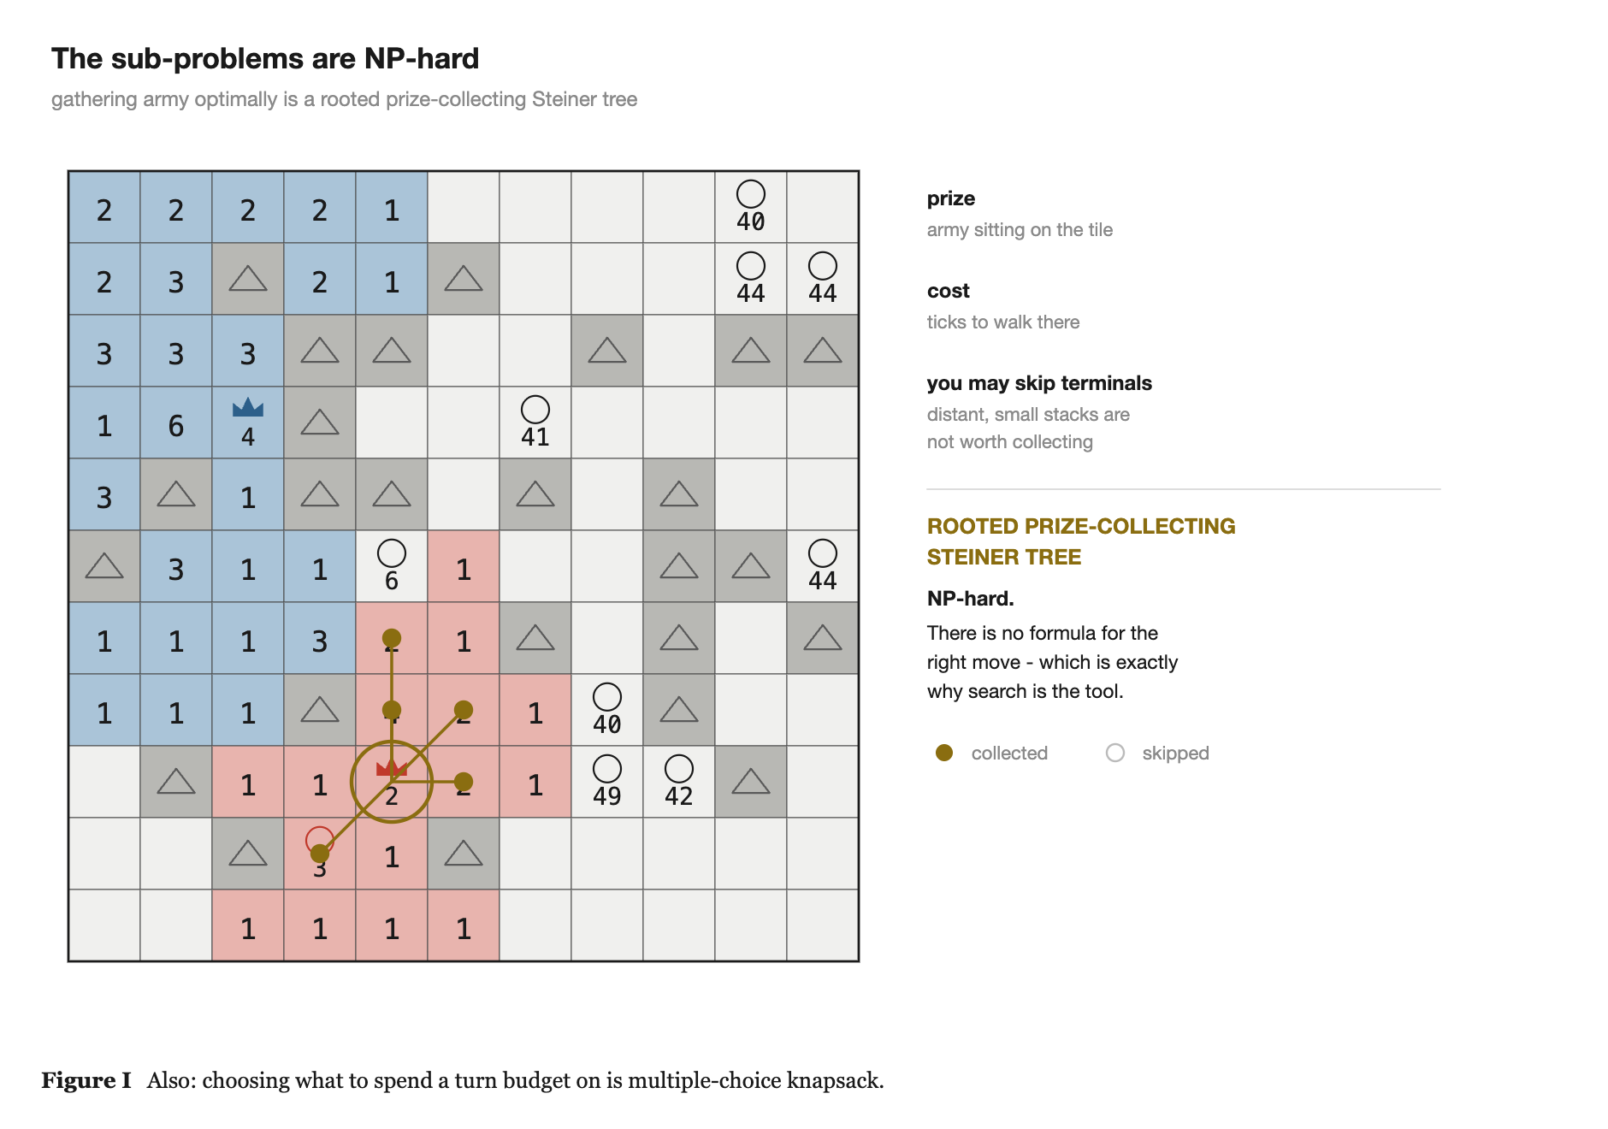
2. WHY SEARCH
The sub-problems are genuinely NP-hard
· Gathering scattered army to one point within a turn budget
  - rooted prize-collecting Steiner tree
· Deciding what to spend a limited number of turns on
  - multiple-choice knapsack
· There is no closed form here
· When a problem has no analytic solution and a combinatorial search space, search is what you use.
Search-only AI for Generals.io · DAC-203
16

Slide 17
3
The Papers
Five papers, one per topic in the course.

Slide 18
3. THE PAPERS
One paper per topic
3.1
ARA*: Anytime A* with Provable Bounds on Sub-Optimality
an answer at every moment
Likhachev, Gordon, Thrun · NIPS 2003
3.2
Real-Time Adaptive A* (RTAA*)
learn more per unit of search
Koenig, Likhachev · AAMAS 2006
3.3
Depression Avoidance in Real-Time Heuristic Search
one bit per state, no scrubbing
Hernandez, Baier · AAAI 2012
3.4
ProbCut: Forward Pruning in Alpha-Beta
prune what is probably irrelevant
Buro
3.5
Metareasoning: deciding how much to think
should I be searching at all?
O'Ceallaigh, Ruml · SoCS 2015 / Russell, Wefald · UAI 1990
Search-only AI for Generals.io · DAC-203
18

Slide 19
3.1 ARA* · LIKHACHEV, GORDON & THRUN, NIPS 2003
A* gives you nothing until it finishes
· If my half second runs out mid-search I have no answer at all
· The tick fires regardless
· Weighted A* is the classical fix
· Inflate the heuristic, and the search becomes greedy and much faster
This comes with a theorem, not a hope:
· A dial between speed and quality - and a guarantee at every setting
Search-only AI for Generals.io · DAC-203
19

Slide 20
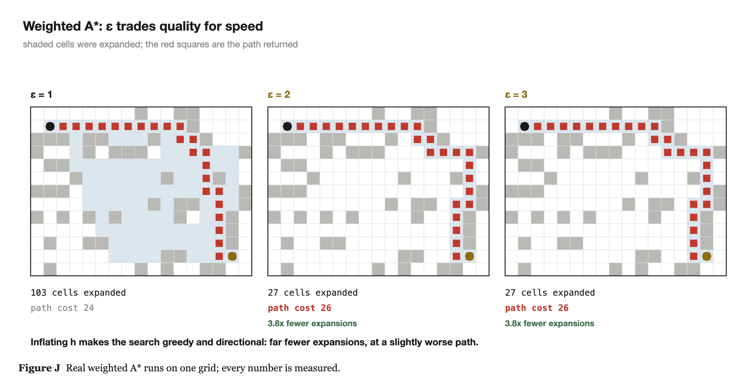
3.1 ARA*
Weighted A* trades quality for speed
Inflating h makes the search directional: 103 expansions at eps = 1 becomes 27 at eps = 3, and the path costs 24 instead of 26.
Search-only AI for Generals.io · DAC-203
20

Slide 21
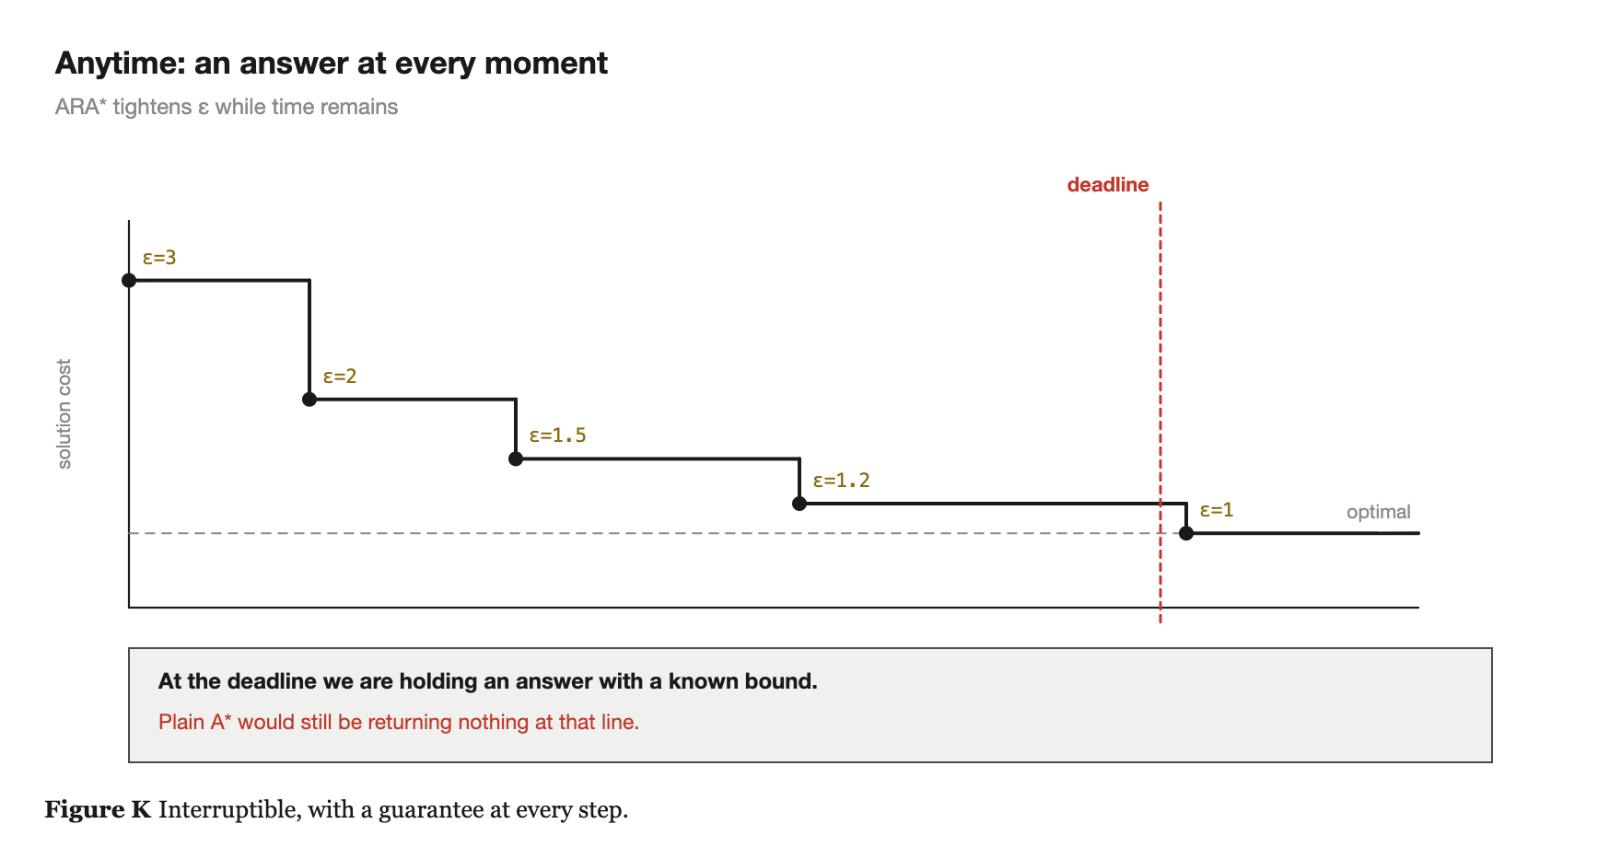
3.1 ARA*
Anytime: run it repeatedly, epsilon decreasing
· Run with eps = 3, then 2, then 1.5, then 1.2
· Each run reuses the previous run's work instead of starting over
· A rough answer almost immediately
· It improves the longer you let it run
· At every moment you know exactly how far from optimal you are
· Plain A* would still be returning nothing at the deadline
Search-only AI for Generals.io · DAC-203
21

Slide 22
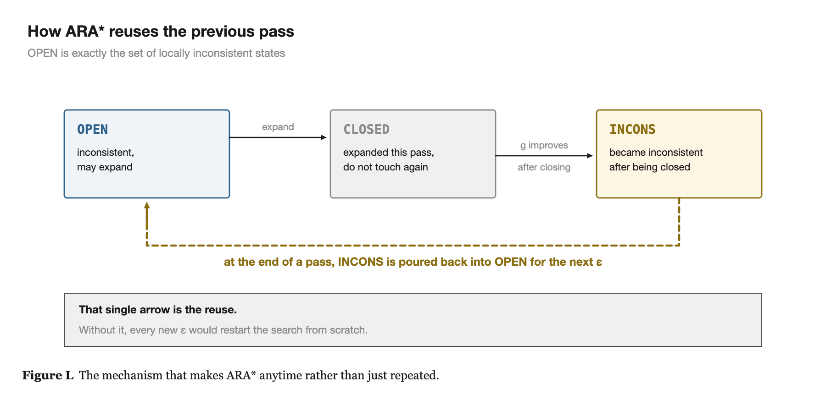
3.1 ARA*
The reuse: a third list
· A state whose g improves after it was closed goes to INCONS, not back to OPEN
· At the end of a pass, all of INCONS is poured back into OPEN for the next eps
  - that last arrow is the reuse
Search-only AI for Generals.io · DAC-203
22

Slide 23
3.2 RTAA* · KOENIG & LIKHACHEV, AAMAS 2006
Acting before you have finished thinking
· The setting: you must act now, you cannot search to the goal, and you will be back in a similar situation next step
· LRTA*, the algorithm in the book
  - keeps a table of heuristic estimates
  - raises the estimate of the state it stands in when neighbours turn out further from the goal than expected
  - over repeated visits the table gets accurate and the agent stops repeating its mistakes
· The weakness: it updates essentially one state per move
  - on a large map the agent physically walks around correcting one number at a time
· RTAA*: bounded-depth A*, then update EVERY state that search expanded - one subtraction each
Search-only AI for Generals.io · DAC-203
23

Slide 24
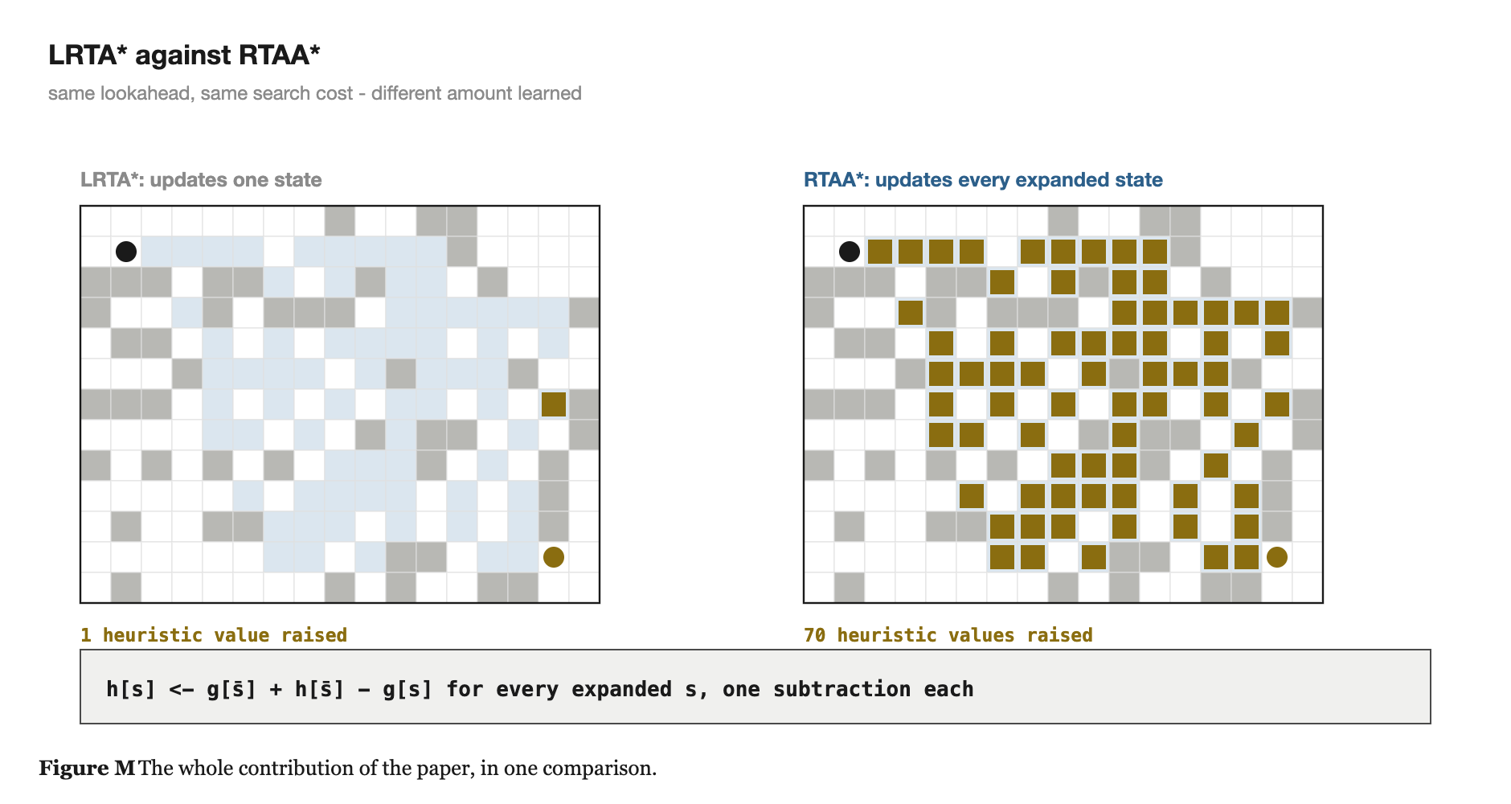
3.2 RTAA*
Same lookahead, vastly more information
Same search region, same cost per move. This single comparison is the whole paper.
Search-only AI for Generals.io · DAC-203
24

Slide 25
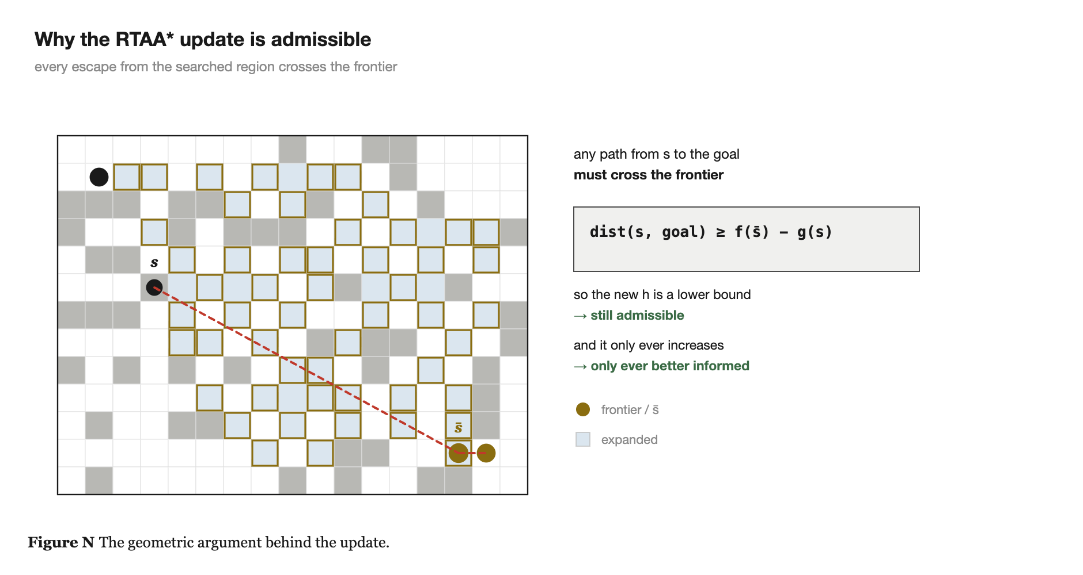
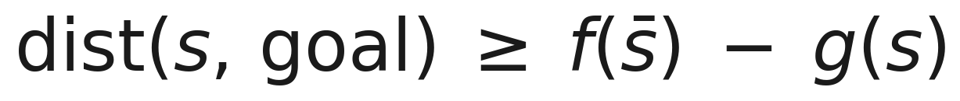

3.2 RTAA*
Why the update is legal
· A* expands in order of increasing f
· So when it stops, the smallest f left on the frontier is a lower bound on the true distance to the goal
· Any path out of the searched region must cross that frontier
· It is a lower bound, so h stays admissible - everything A* guarantees still holds
· The paper also proves the update is monotonically non-decreasing: the table only ever becomes more informed
Search-only AI for Generals.io · DAC-203
25

Slide 26
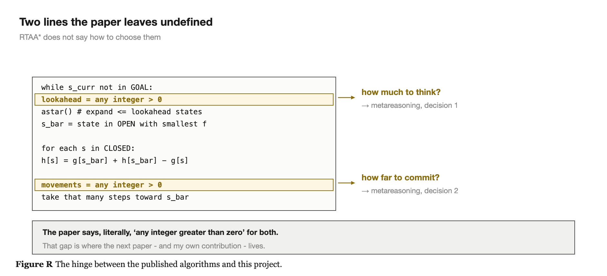
3.2 RTAA*
Two lines the paper leaves undefined
· The paper is honest about the trade-off: LRTA*'s heuristic ends up better informed for the same lookahead - RTAA* is simply so much cheaper per move that it reaches the goal sooner in wall-clock terms
  - which is precisely my situation: I am limited by time, not by number of moves
  - and those two undefined lines are where a later paper lives
Search-only AI for Generals.io · DAC-203
26

Slide 27
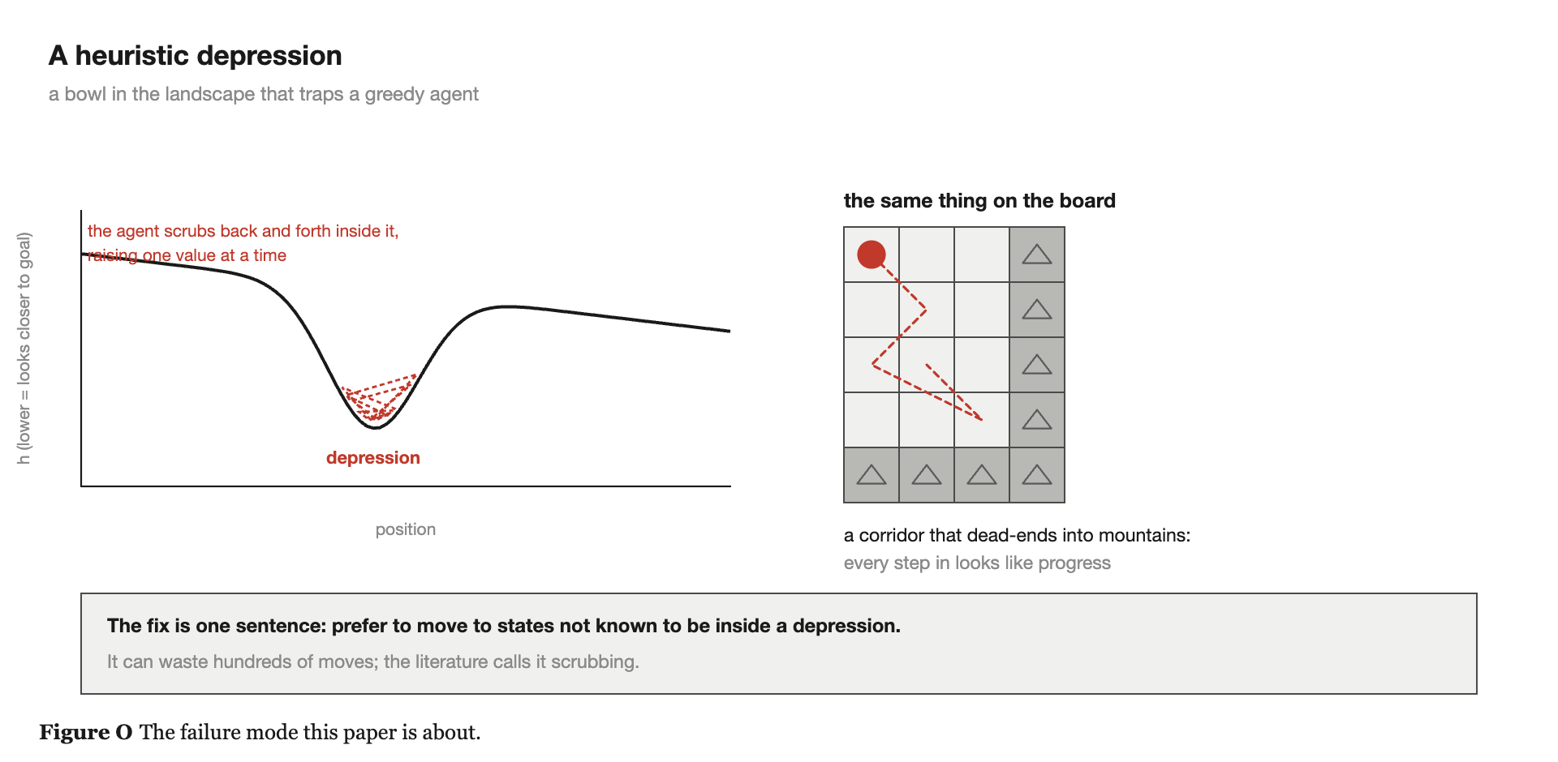
3.3 DEPRESSION AVOIDANCE · HERNANDEZ & BAIER, AAAI 2012
A specific way real-time search fails
· A heuristic depression is a connected region where h badly underestimates true cost, compared with the values on the region's border
· Picture h as a landscape where low means close to the goal. A depression is a bowl.
· A greedy agent rolls in - from outside, everything in the bowl looks close to the goal
· Then it cannot get out: each move raises one state's value slightly
· It wanders the bowl raising values one at a time until the whole thing is filled in
· The literature calls this scrubbing. It can waste hundreds of moves.
Search-only AI for Generals.io · DAC-203
27

Slide 28
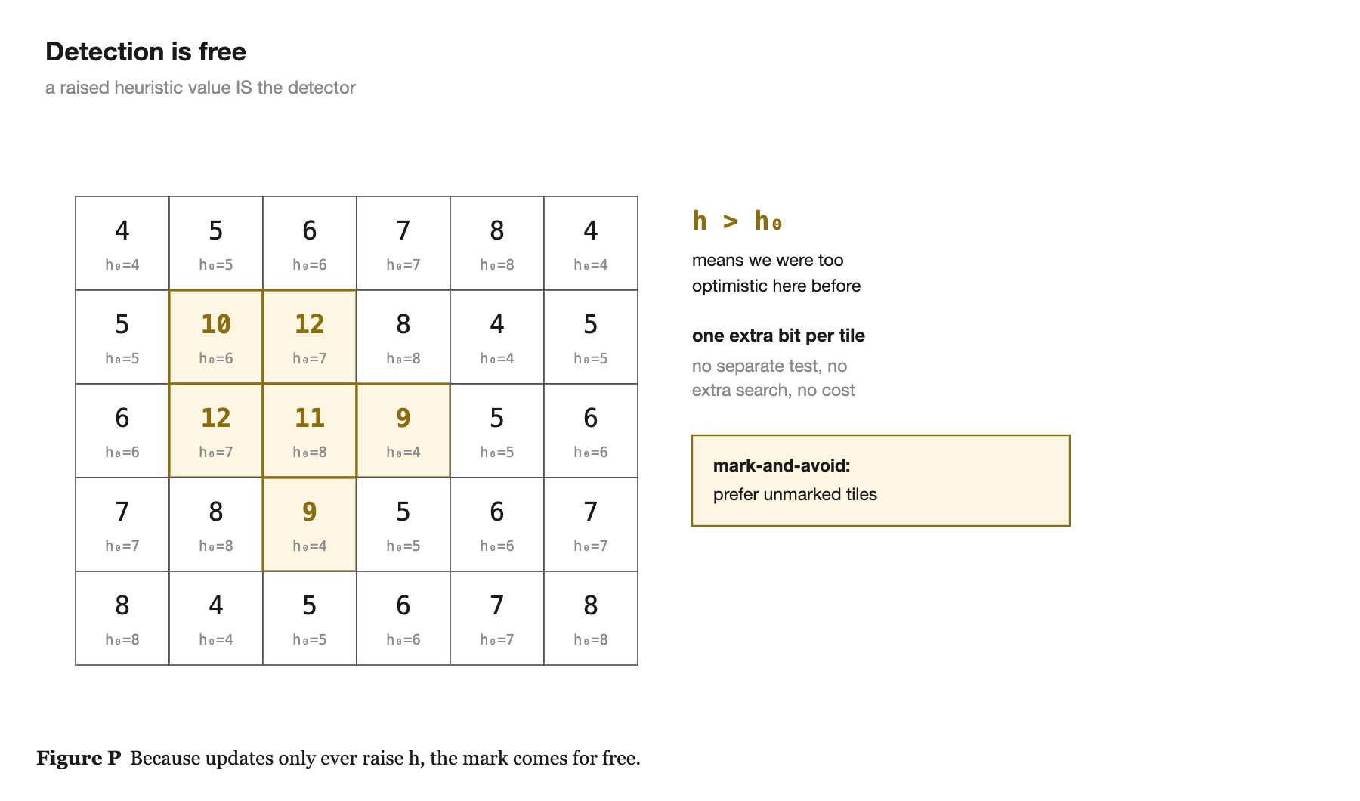
3.3 DEPRESSION AVOIDANCE
The fix is one sentence, and detection is free
· Prefer to move to states that are not known to be inside a depression.
· h starts admissible, and updates only ever raise it
· So the fact that you ever had to raise a state's value means the original estimate there was too optimistic
  - which is the definition of being in a depression
· Cost: one extra bit per state - remember h0, mark the state when h > h0
Search-only AI for Generals.io · DAC-203
28

Slide 29
3.3 DEPRESSION AVOIDANCE
Two ways to use the mark
· MARK-AND-AVOID
  - prefer unmarked states when choosing where to head
  - fall back to marked ones only if everything is marked
· MOVE-TO-BORDER
  - softer: if you are already deep in a depression and every neighbour is marked, aim for the states that look closest to the edge
  - rather than refusing to be in the bowl at all
· There is almost no mathematics in this paper, which I take as a good sign - it is an observation rather than a construction.
Search-only AI for Generals.io · DAC-203
29

Slide 30
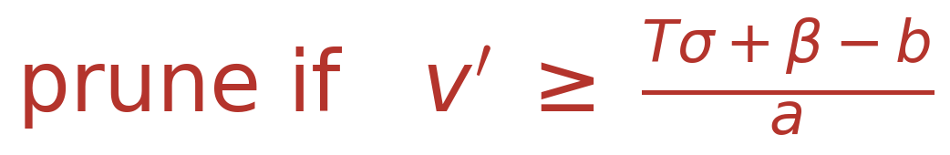
3.4 PROBCUT · BURO
Prune what is probably irrelevant
· Alpha-beta only prunes when it can prove irrelevance - and proof requires searching
  - so depth stays low, and depth is what makes a program strong
· ProbCut: before searching a subtree to full depth, run a much shallower search on it. If the shallow result lands far enough outside the current window, skip the deep search.
· v is the deep value, v' the shallow one - strongly correlated, because a position winning after two ply is usually winning after six
· a, b and sigma are fitted by ordinary least squares over a few thousand positions, offline
  - that is regression, not machine learning in the sense the course excludes
Search-only AI for Generals.io · DAC-203
30

Slide 31
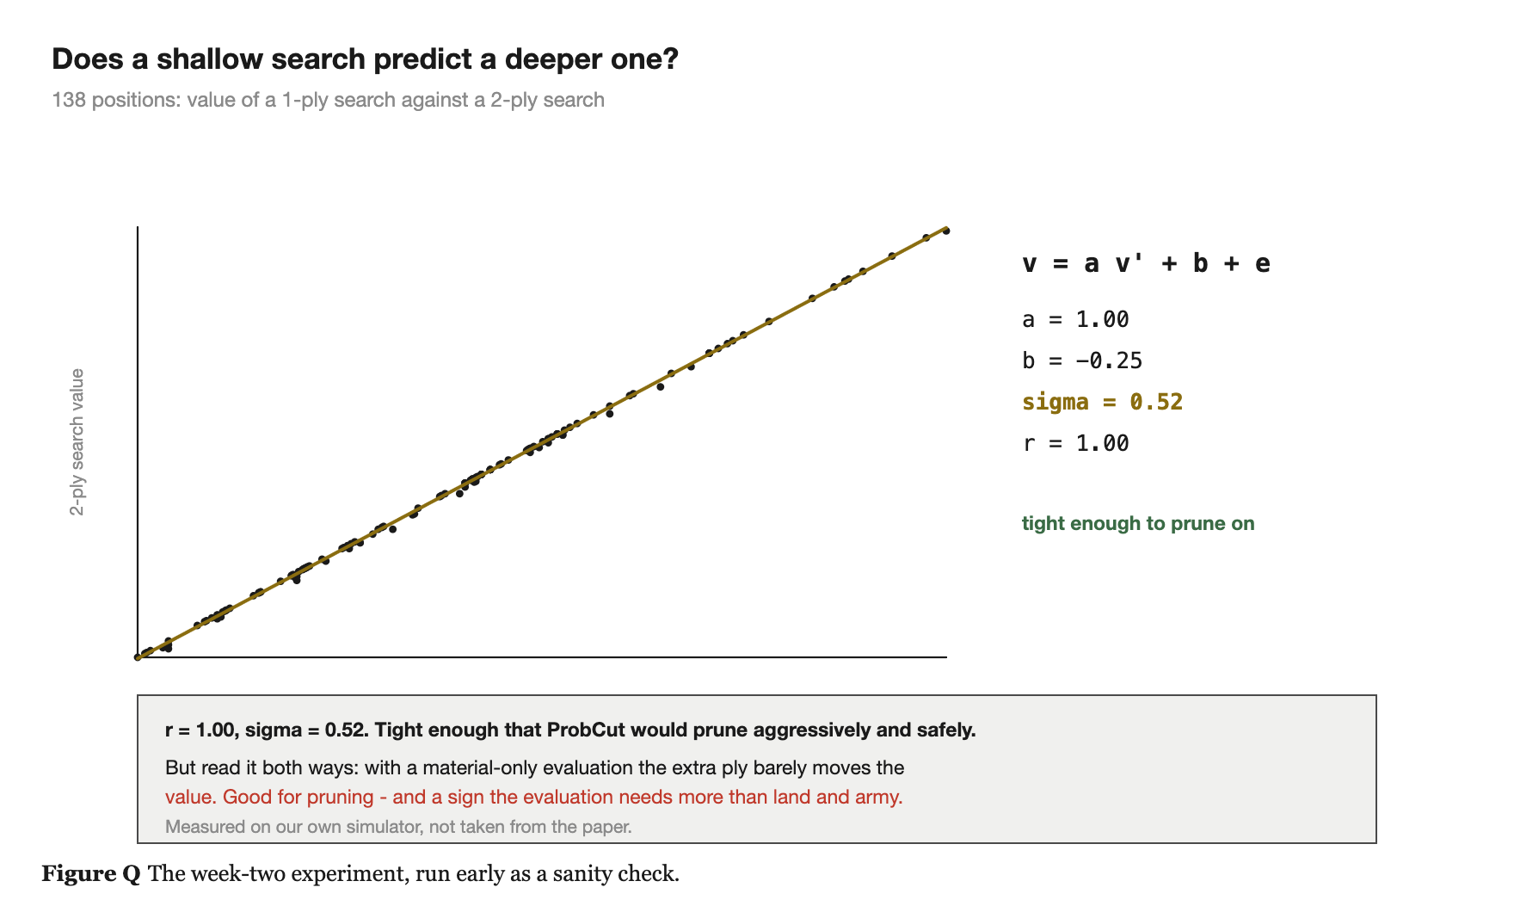
3.4 PROBCUT
Does shallow predict deep in this game?
Measured in our own simulator: 1-ply against 2-ply over 138 self-play positions. Tight enough to prune - and a sign the evaluation needs more than land and army.
Search-only AI for Generals.io · DAC-203
31

Slide 32
3.5 METAREASONING · RUSSELL & WEFALD UAI 1990, O'CEALLAIGH & RUML SOCS 2015
Should I be searching at all right now?
· The four papers above all answer "how do I search well?". This one asks a different question.
· Treat each possible node expansion as an action in its own right:
  - COST - the time it takes
  - BENEFIT - P(this changes which move I finally play) x how much better that move is
· Expand the node with the highest value of computation; stop when the expected benefit drops below the cost
A computation that cannot change your answer has zero value,
no matter how deep it is.
Obvious written down - and almost no game-playing program acts on it. The standard design searches to a fixed depth regardless of whether the decision was ever in doubt.
Search-only AI for Generals.io · DAC-203
32

Slide 33
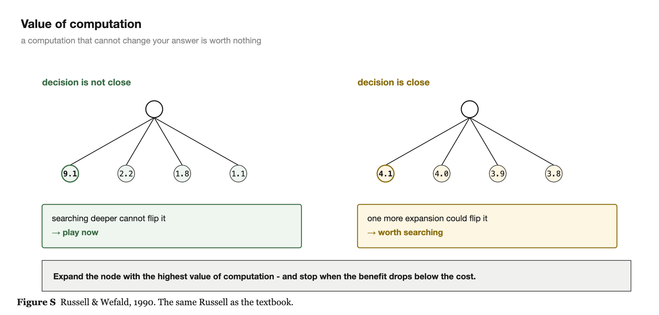
3.5 METAREASONING
Value of computation
Wildly different children: expanding further cannot change the answer. Nearly tied children: one more expansion could flip it.
Search-only AI for Generals.io · DAC-203
33

Slide 34
3.5 METAREASONING
Two decision points - the two undefined lines
· DECISION 1 · the identity action
  - an action that keeps you in the same state while you think longer
  - act now, or stand still and deliberate?
  - standard real-time search never asks - it assumes acting is always right
  - but if the best move is only marginally better than the second best, another round of lookahead might turn up something much better
  - measured in goal achievement time = planning time + execution time
· DECISION 2 · prefix commitment
  - after lookahead you hold a path - how much of it do you execute before replanning?
  - LRTA* commits to exactly one action; later variants commit to the whole path. Neither adapts.
  - one action means replanning constantly, which is expensive
  - the whole path means acting on stale information, which is dangerous
  - the paper chooses dynamically - further when the plan is robust, less when it is fragile
Search-only AI for Generals.io · DAC-203
34

Slide 35
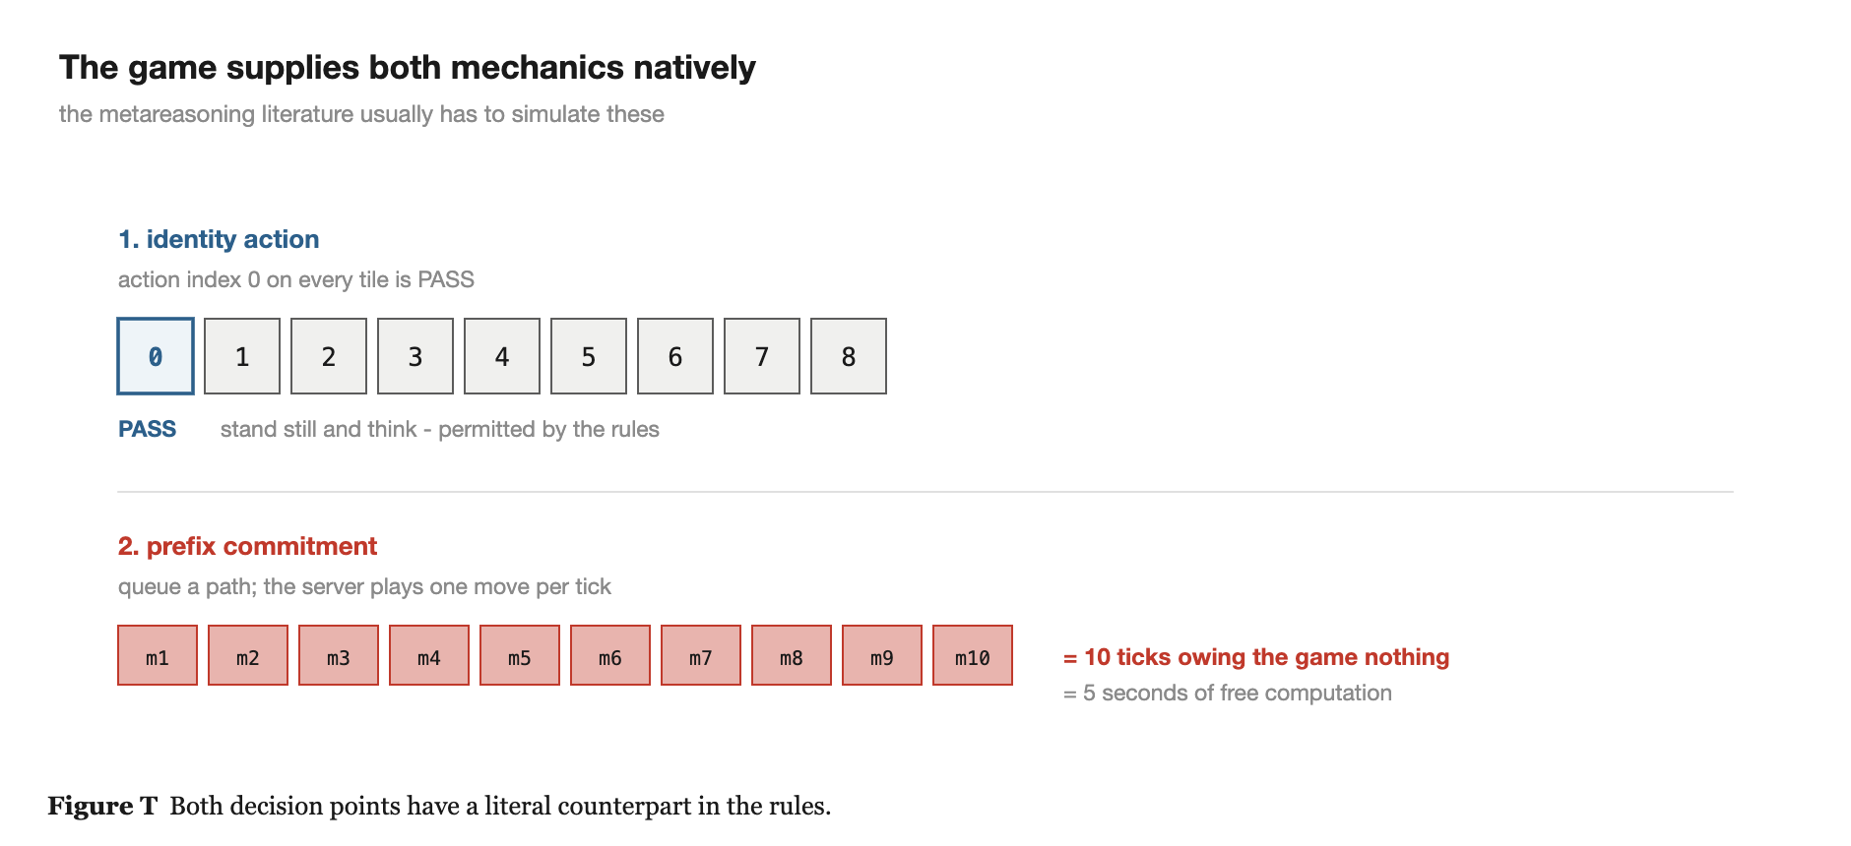
3.5 METAREASONING
Both mechanics come free in this game
· Index 0 on every tile is PASS - the agent can literally stand still and think, and the rules permit it
· The move queue lets you queue a path in advance; the server plays one per tick - prefix commitment, implemented for us
  - this literature usually has to simulate both. That is why I think my own contribution sits here.
Search-only AI for Generals.io · DAC-203
35

Slide 36
5
The Ideas we Want to Test

Slide 37
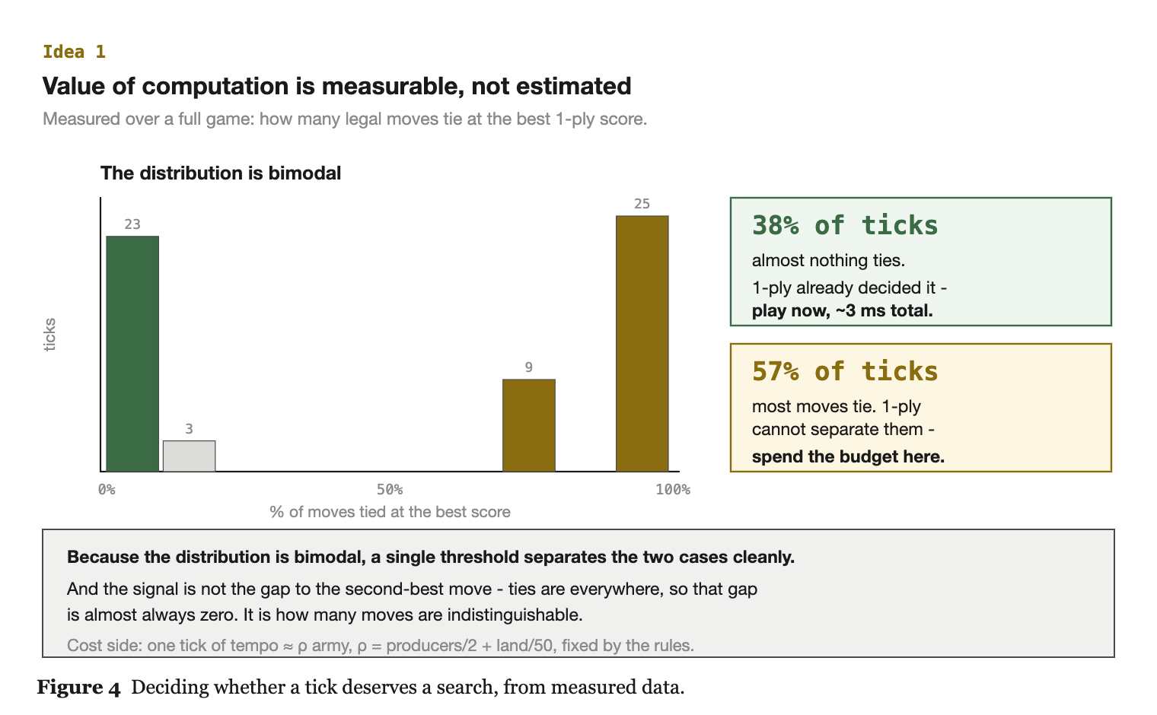
IDEA 1
The value of computation is measurable, not estimated
· Russell & Wefald ask you to weigh a computation's cost against the probability it changes your action
  - the hard part has always been estimating that probability before doing the computation
· Here I do not have to estimate it
  - the batched evaluator gives the full one-ply score distribution in under a millisecond
  - the gap between best and second-best move is a computed proxy for whether more thinking could change the answer
· The cost side is quantifiable too
  - passing costs exactly one tick of tempo
  - the production rate is fixed by the rules, so a tick of thinking is priced in army units
· Both sides of the inequality are computable, which is unusual.
Search-only AI for Generals.io · DAC-203
37

Slide 38
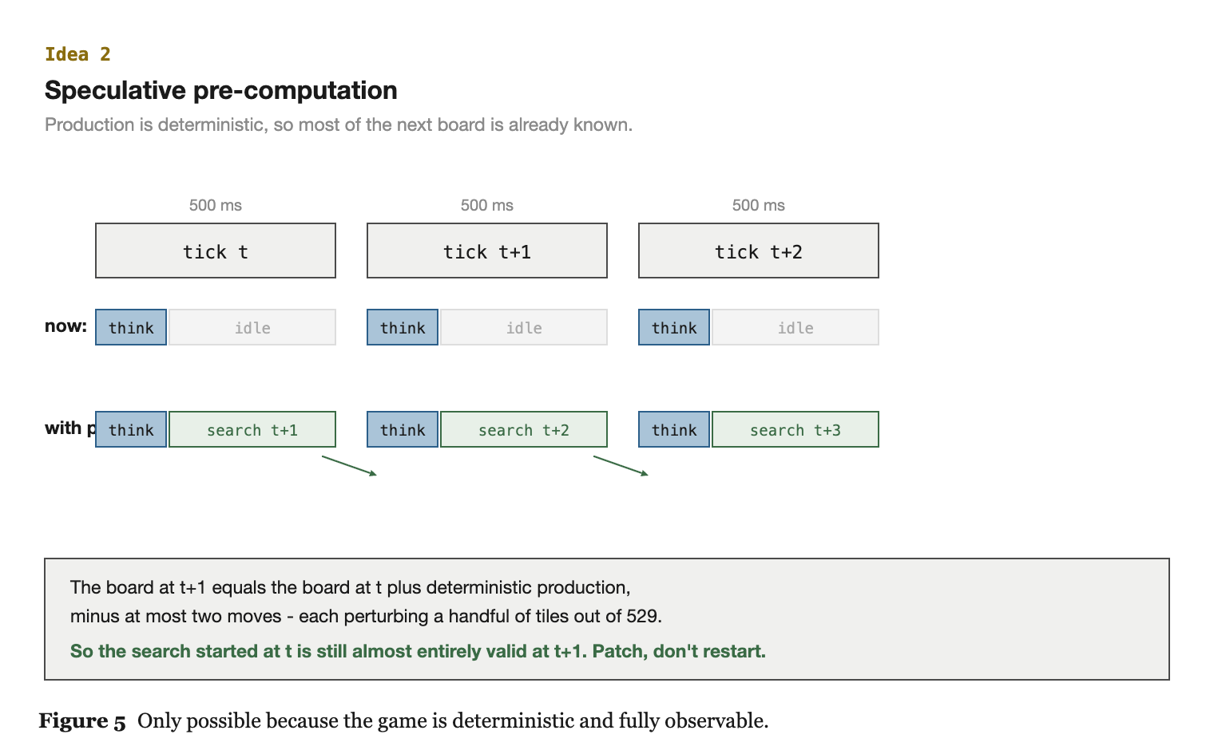
IDEA 2
Speculative pre-computation
· Production is completely deterministic - after the map is generated there is no randomness at all
· So if nobody moved, the board ten ticks from now is exactly computable from the board today
· The only uncertainty about the near future is the handful of moves each side makes - and each move perturbs a tiny region of a 500-tile board
· So start searching next tick's problem during this tick, and patch in the few changed tiles when the real moves arrive
· Done properly this roughly doubles the effective compute budget without making anything faster
· It depends entirely on the game being deterministic and fully observable: I can only extrapolate a board I can actually see
Search-only AI for Generals.io · DAC-203
38

Slide 39
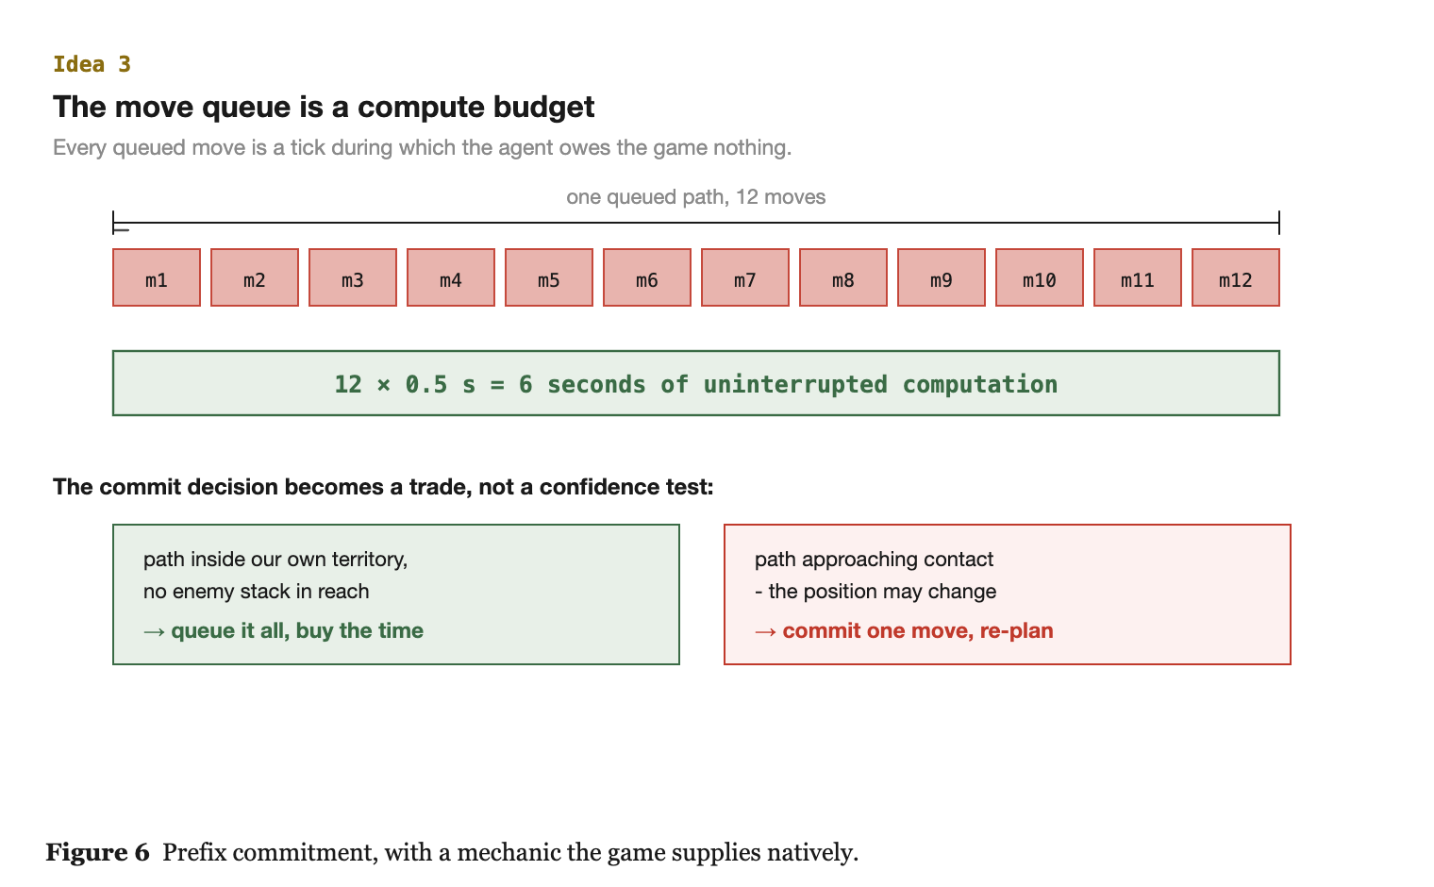
IDEA 3
The move queue is a compute budget
· Normally the queue is treated as a user-interface convenience
· Every move I queue is a tick of thinking time I have bought
  - during a queued move I owe the game no decision
  - queue a twelve-step march home through my own territory and I have bought six seconds of uninterrupted computation
· The commit decision then stops being about confidence and becomes a trade:
  - how much thinking time do I want
  - against how long am I willing to act on stale information
· This is prefix commitment from the metareasoning literature - but with an interpretation those papers do not have, because their domains have no queue.
Search-only AI for Generals.io · DAC-203
39

Slide 40
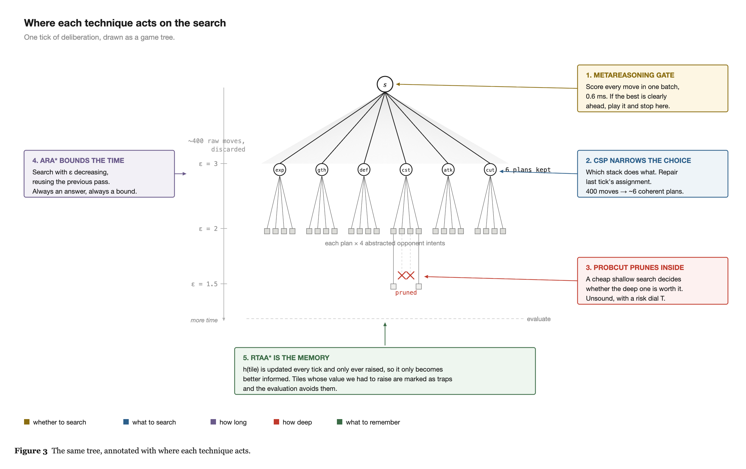
ARCHITECTURE
The backbone
Region decomposition over the tree - the structural backbone the five papers plug into.
Search-only AI for Generals.io · DAC-203
40

