Slide 1
DAC-203 · FIVE-MINUTE VERSION
A Search-Only Agent for
Perfect-Information Generals.io
Five papers, one per chapter of Russell & Norvig 3-6. No learning of any kind.

Slide 2
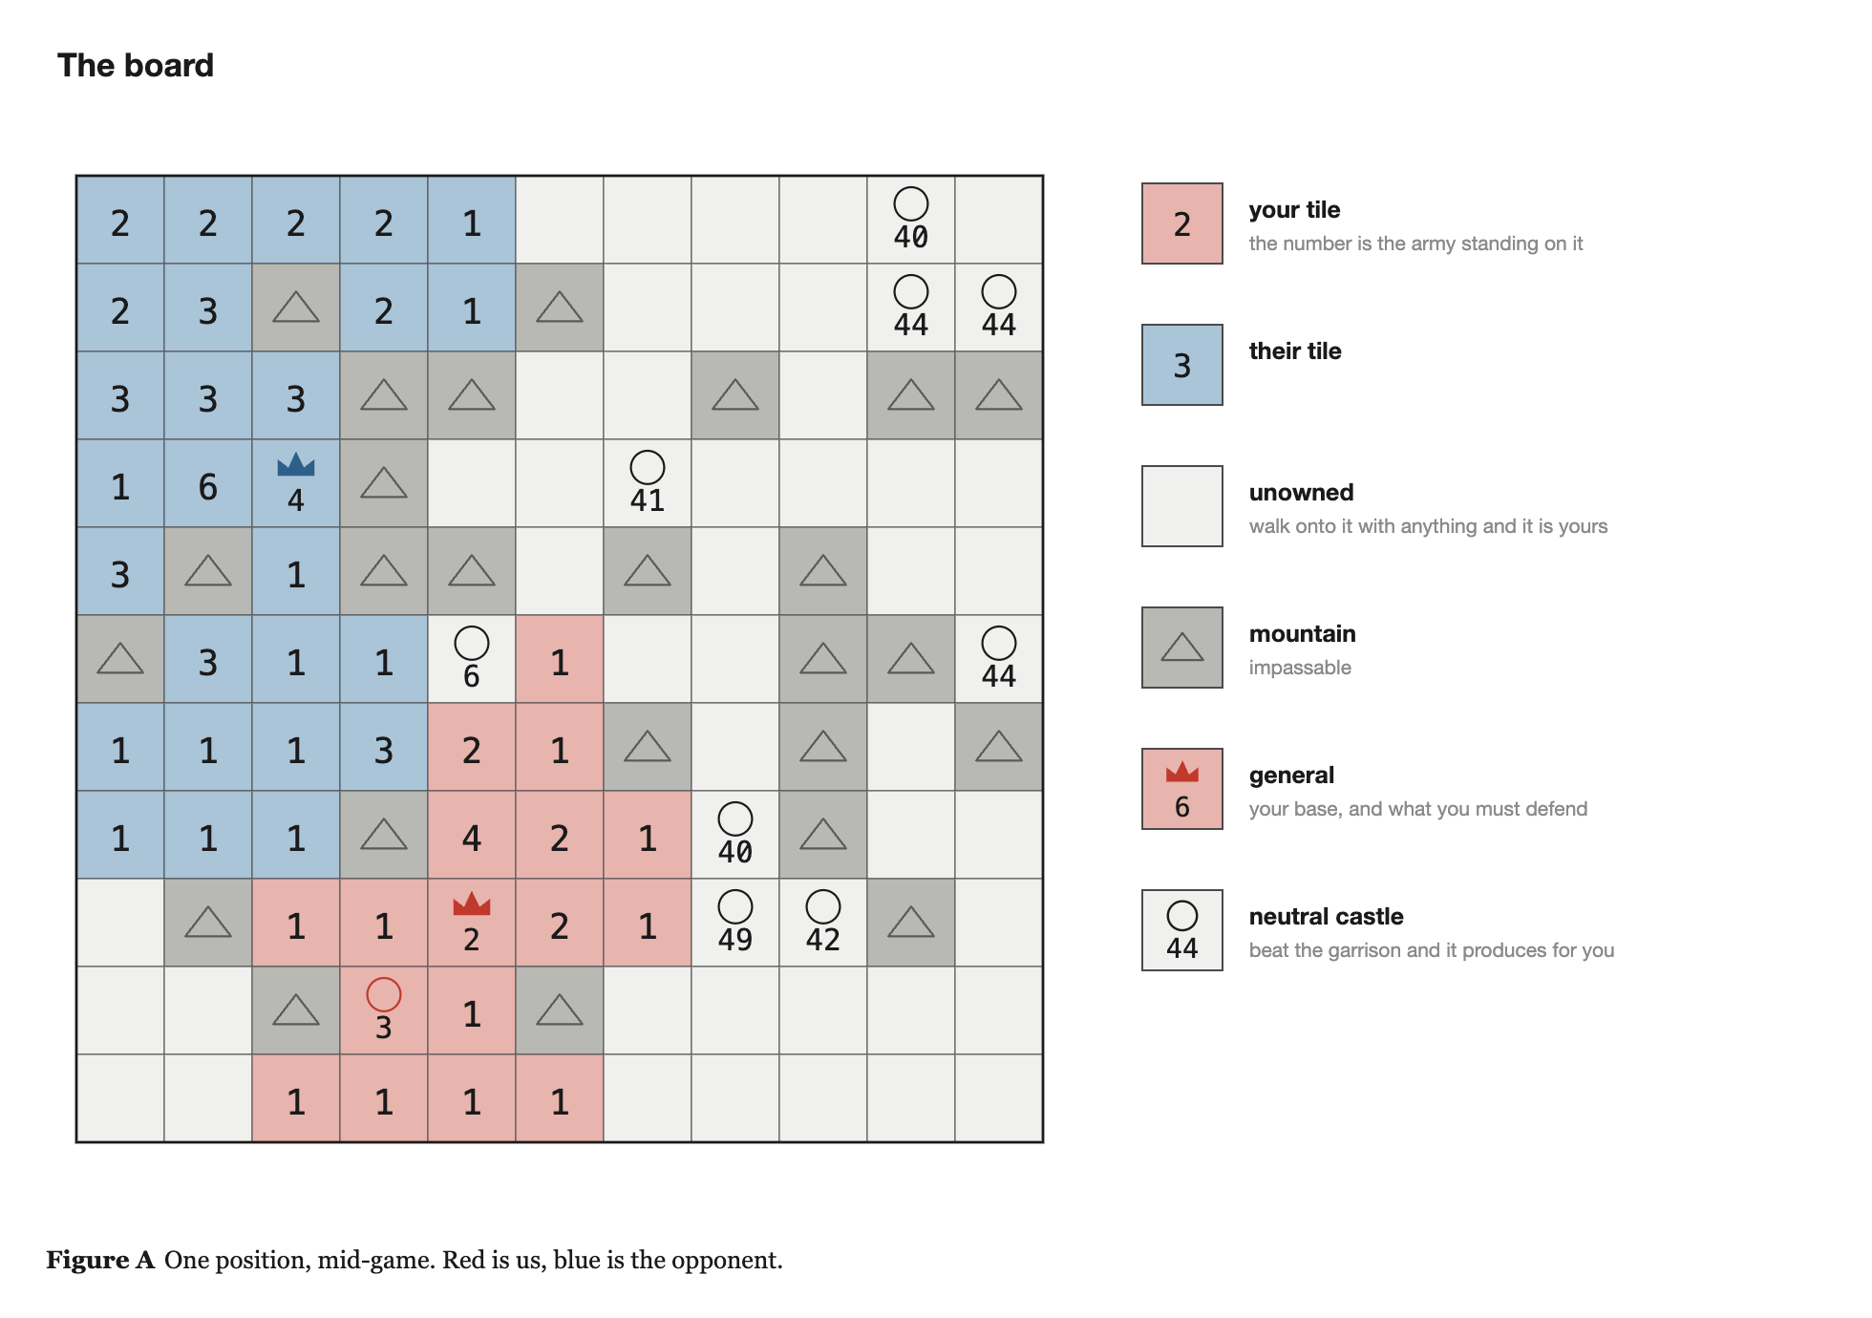
THE GAME
The board, and the whole action set
· A 23 x 23 grid: plain tiles, mountains, castles, one general each
· Every tile I own carries a number - the army standing on it
· One move per tick: a tile, a direction, and all but one unit or half
  - that is the entire action set
· Combat is subtraction - the larger stack survives with the difference
· I win by taking the enemy general. That is the only victory condition.
· And the board is fully observable - which is what makes this course's algorithms apply at all.
Search-only AI for Generals.io · DAC-203
2

Slide 3
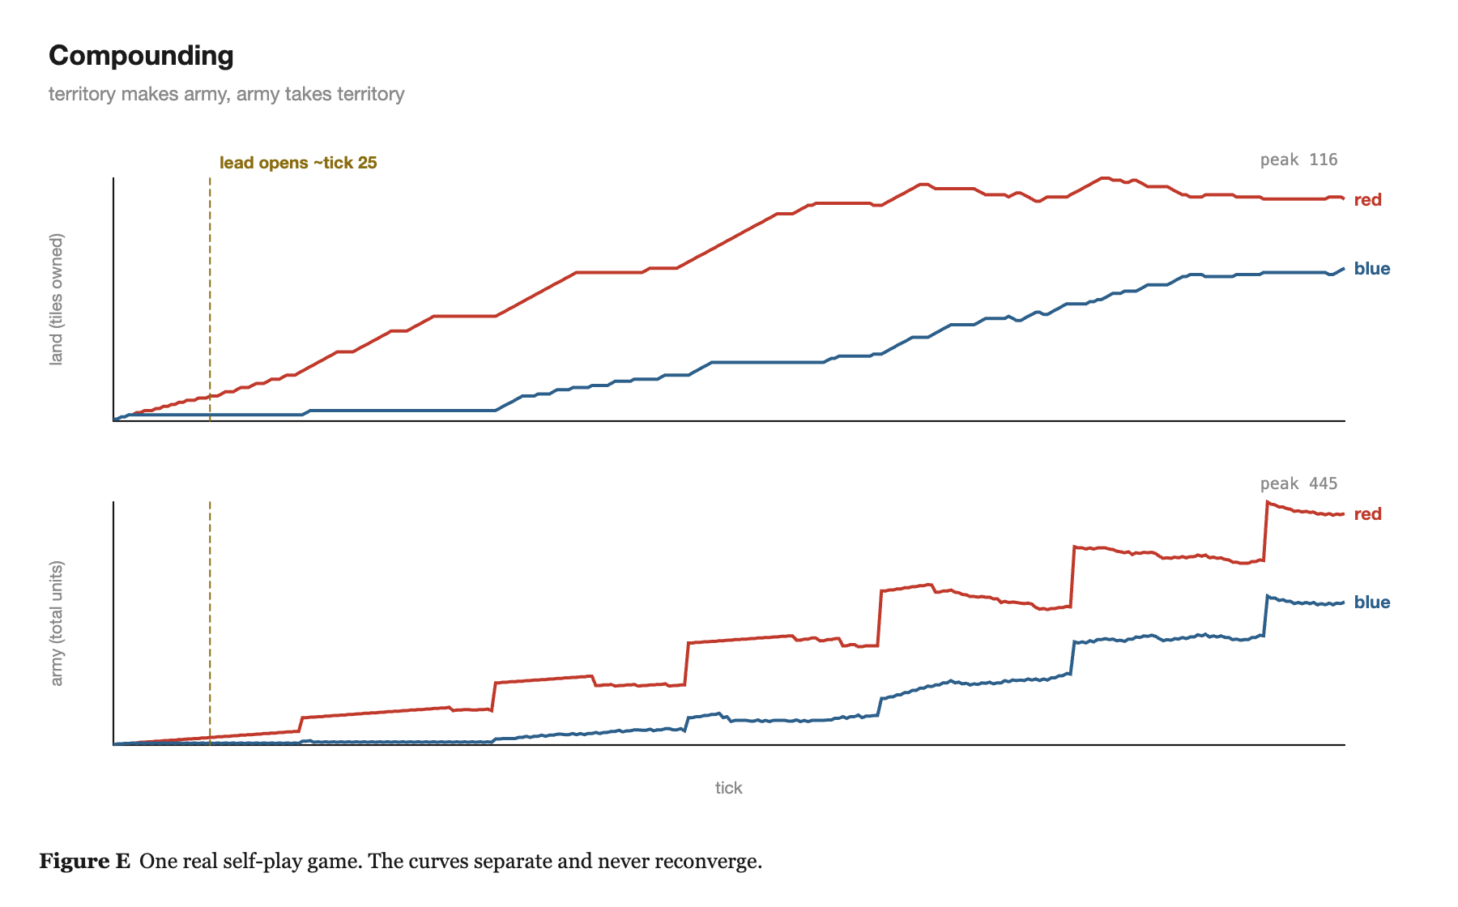
THE GAME
Which means it compounds
· Generals and castles produce one unit every two ticks
· Every tile I own produces one unit every fifty ticks
· So one castle is worth exactly twenty-five plain tiles - a fact about the rules, not an opinion about strategy
· Territory produces army, army takes territory
· Ten tiles ahead at turn fifty is usually much further ahead by turn two hundred
· The curves diverge and never come back together.
Search-only AI for Generals.io · DAC-203
3

Slide 4
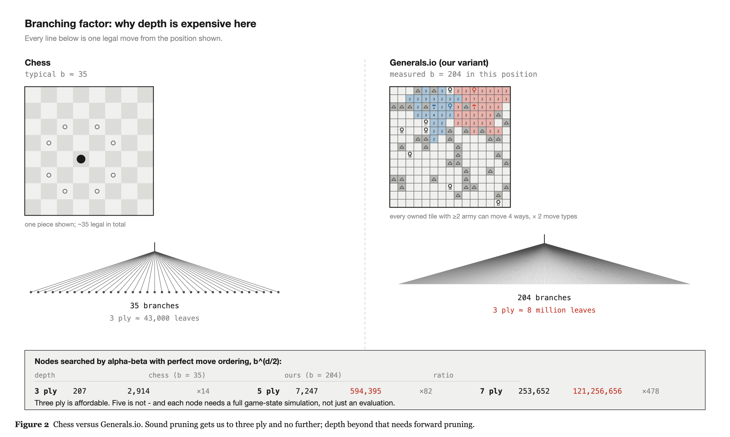
THE GAME
What makes it hard
· It is real time. Both players move together, so tempo is a first-class resource - I get half a second per decision.
· b = 204, measured from a real position. Chess is 35. Depth is unaffordable.
· And the reward is sparse: I win or lose 500 ticks later. Nothing tells me at tick 137 whether that move was good.
Search-only AI for Generals.io · DAC-203
4

Slide 5
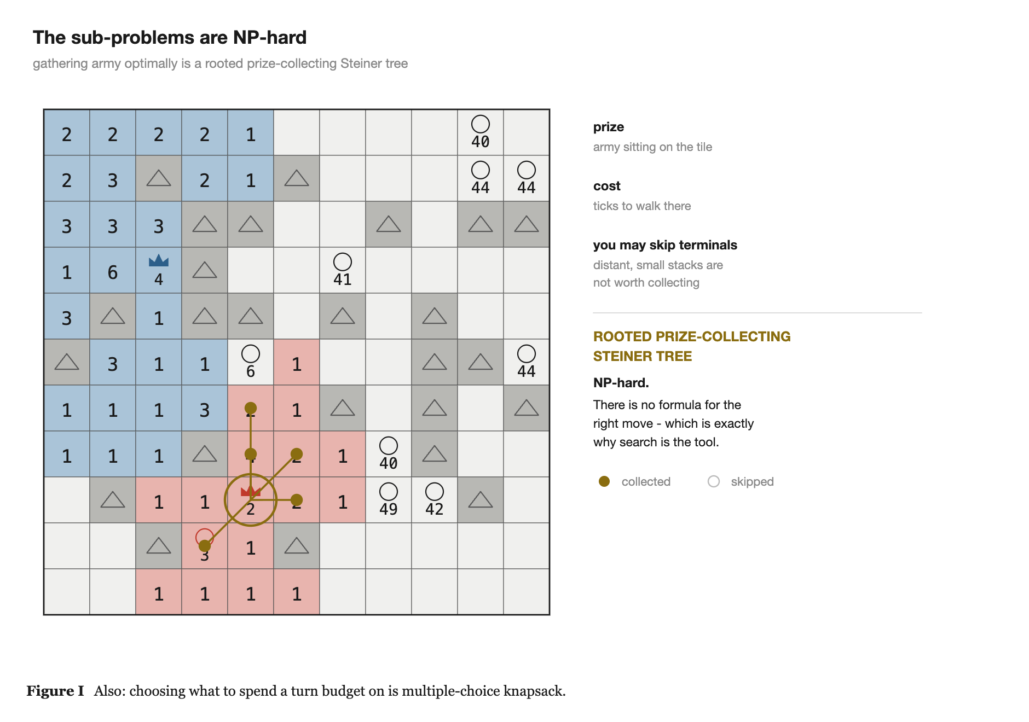
WHY SEARCH
Search is not the fallback here
· Search and CSP only - chapters three to six. No learning of any kind.
· That is not a consolation prize.
  - the strongest non-learning bot on the public ladder is pure classical optimisation
  - it held the top of that ladder until an RL agent on four H200s beat it
· And the sub-problems here are genuinely NP-hard:
  - gathering army - a rooted prize-collecting Steiner tree
  - spending turns - multiple-choice knapsack
· No analytic solution, combinatorial search space. Search is what you use.
Search-only AI for Generals.io · DAC-203
5

Slide 6
THE PAPERS
One paper per topic in the course
3.1
ARA*: Anytime A* with Provable Bounds on Sub-Optimality
an answer at every moment
Likhachev, Gordon, Thrun · NIPS 2003
3.2
Real-Time Adaptive A* (RTAA*)
learn more per unit of search
Koenig, Likhachev · AAMAS 2006
3.3
Depression Avoidance in Real-Time Heuristic Search
one bit per state, no scrubbing
Hernandez, Baier · AAAI 2012
3.4
ProbCut: Forward Pruning in Alpha-Beta
prune what is probably irrelevant
Buro
3.5
Metareasoning: deciding how much to think
should I be searching at all?
O'Ceallaigh, Ruml · SoCS 2015 / Russell, Wefald · UAI 1990
Search-only AI for Generals.io · DAC-203
6

Slide 7
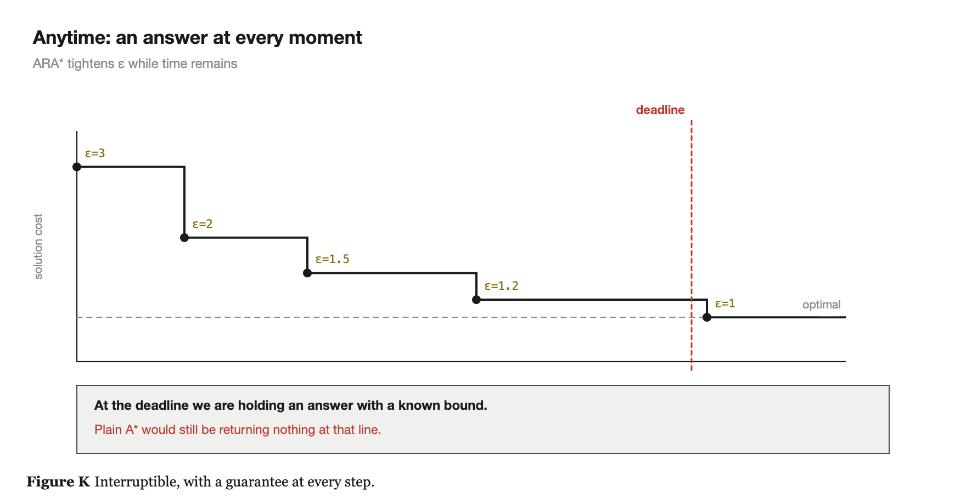
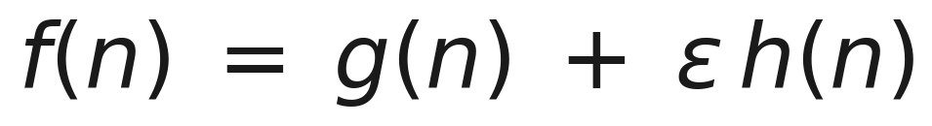
3.1 ARA*
An answer at every moment
· Plain A* gives me nothing until it finishes. If my half second runs out mid-search I have no answer at all, and the tick fires regardless.
· Weighted A* inflates the heuristic - greedier, and much faster
· And it comes with a theorem, not a hope:
· So I run it repeatedly with epsilon decreasing, and each run reuses the previous run's work
  - a rough answer almost immediately, better the longer I let it run, and at every moment I know exactly how far from optimal I am
Search-only AI for Generals.io · DAC-203
7

Slide 8
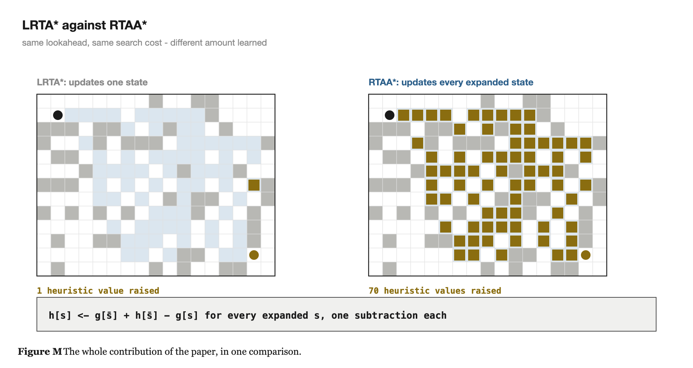

3.2 RTAA* + 3.3 DEPRESSION AVOIDANCE
Learning while I act
· I cannot search to the goal, I must act now, and I will be back in a similar situation next step
· LRTA*, the algorithm in the book, updates essentially one state per move
· RTAA* runs a bounded-depth A* and then updates EVERY state that search expanded - one subtraction each
· Same lookahead, same cost per move, vastly more heuristic learned
· Depression avoidance then costs one extra bit per state: because updates only ever raise h, a raised value IS the detector for a region I should route around.
Search-only AI for Generals.io · DAC-203
8

Slide 9
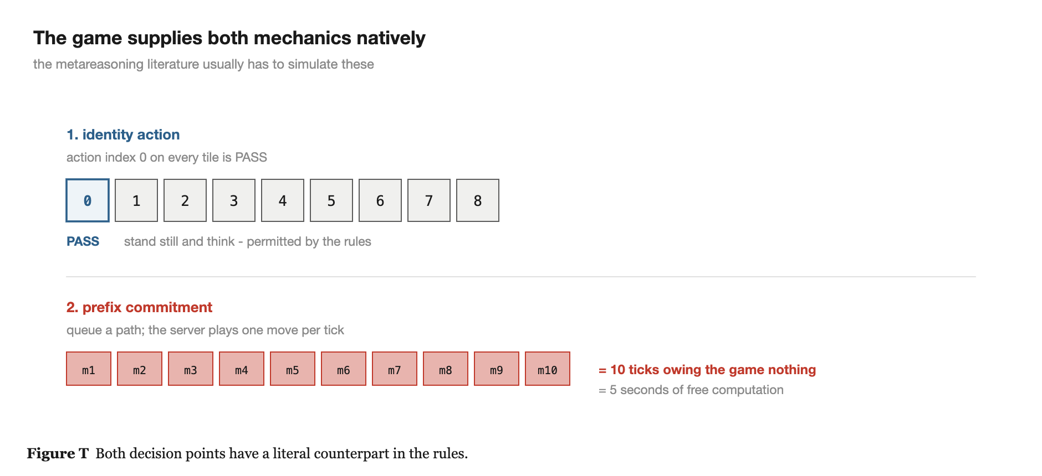
3.5 METAREASONING
Should I be searching at all right now?
· The other four papers ask how to search well. This one asks a different question.
· A computation that cannot change my answer has zero value, no matter how deep it is.
· The 2015 paper names two decisions: act now or think longer, and how far to commit before replanning
  - which are exactly the two lines RTAA* left undefined
· And this game hands me both for free - index 0 is PASS, and the move queue plays one queued move per tick. That is where I think my contribution sits.
Search-only AI for Generals.io · DAC-203
9

Slide 10
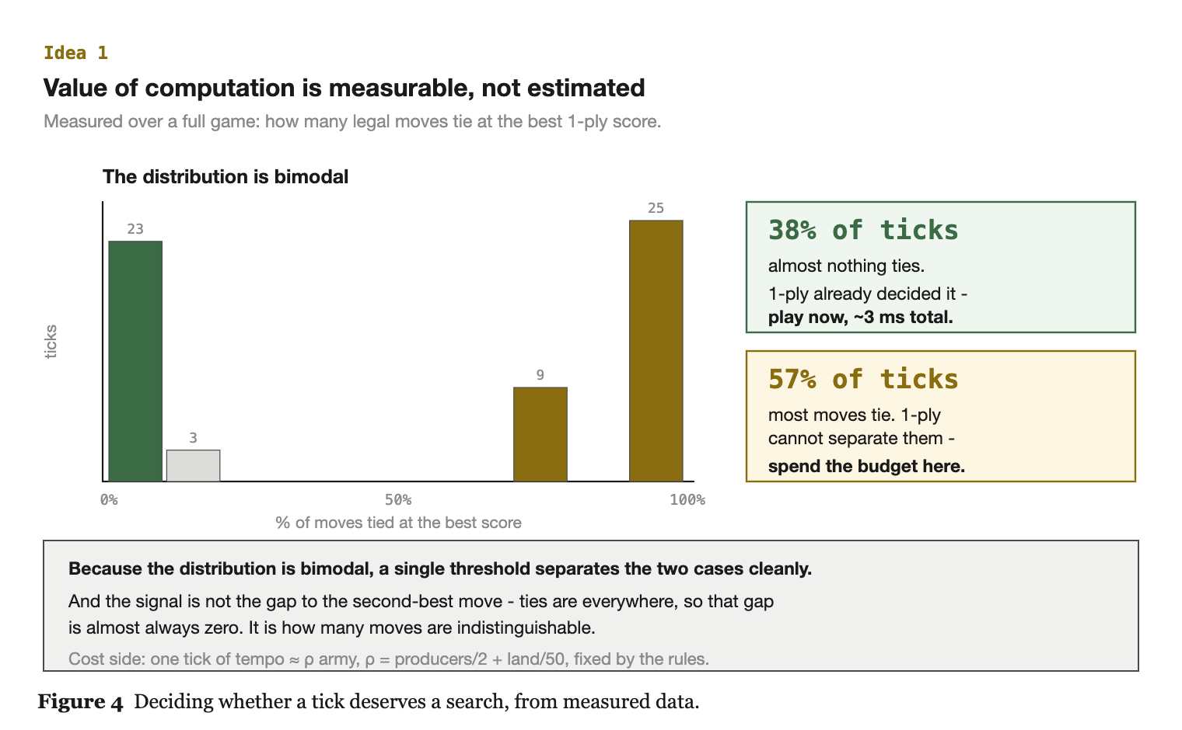
WHAT I WANT TO TEST
Here the value of computation is measurable
· Will this computation change my move? Normally you have to guess.
  - here the evaluator hands me the full one-ply distribution in under a millisecond
· Measured over a full game - how many moves tie at the best one-ply score:
  - 38% of ticks: almost nothing ties. One ply decided it - play now.
  - 57%: most moves tie. One ply cannot separate them - spend the budget here.
· Bimodal, so a single threshold splits the two cases cleanly
· The cost side is priced by the rules too. Both sides of the inequality are computable, which is unusual.
Search-only AI for Generals.io · DAC-203
10

