Slide 1
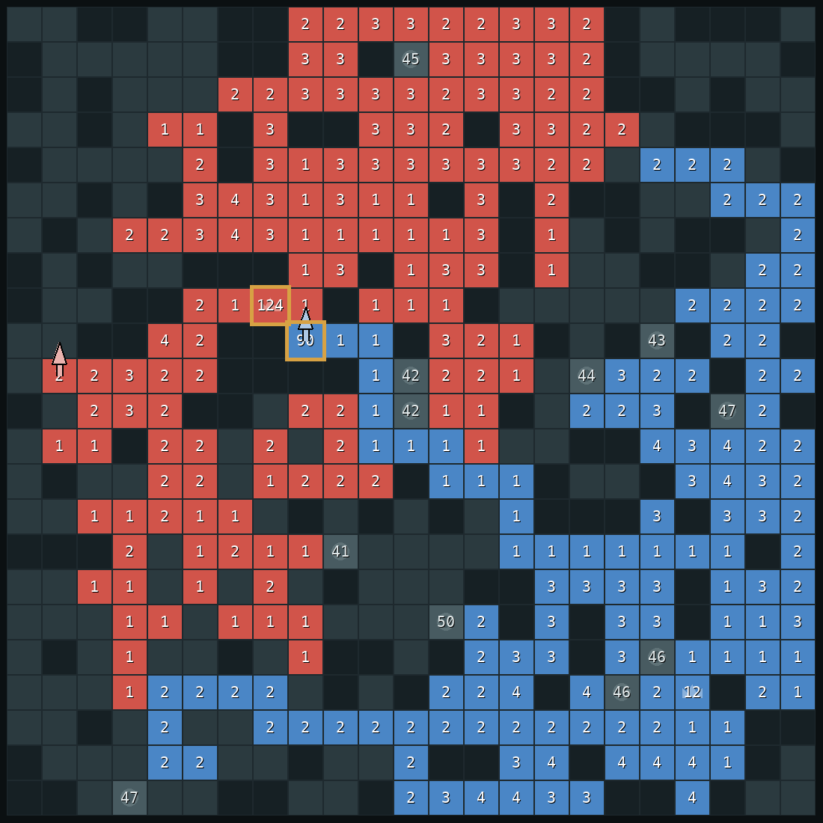
DAC-203 · ARTIFICIAL INTELLIGENCE · IIT ROORKEE
How our bot
plays Generals
v51: collection-aware defence against wait-and-charge attacks.
Right: a real moment from a game. Our bot is red.
Notes:
This talk explains how v51 responds to a specific failure pattern in the modified Generals game: an opponent waits, gathers on productive ground, and then sends a large stack down a short route. The deck follows the evidence from early search experiments to the committed-defence change, then shows one recorded game and the broader match results. The screenshot is from a real game; red is v51. The claim is deliberately scoped to v51 and the tested opponents in this repository.

Slide 2
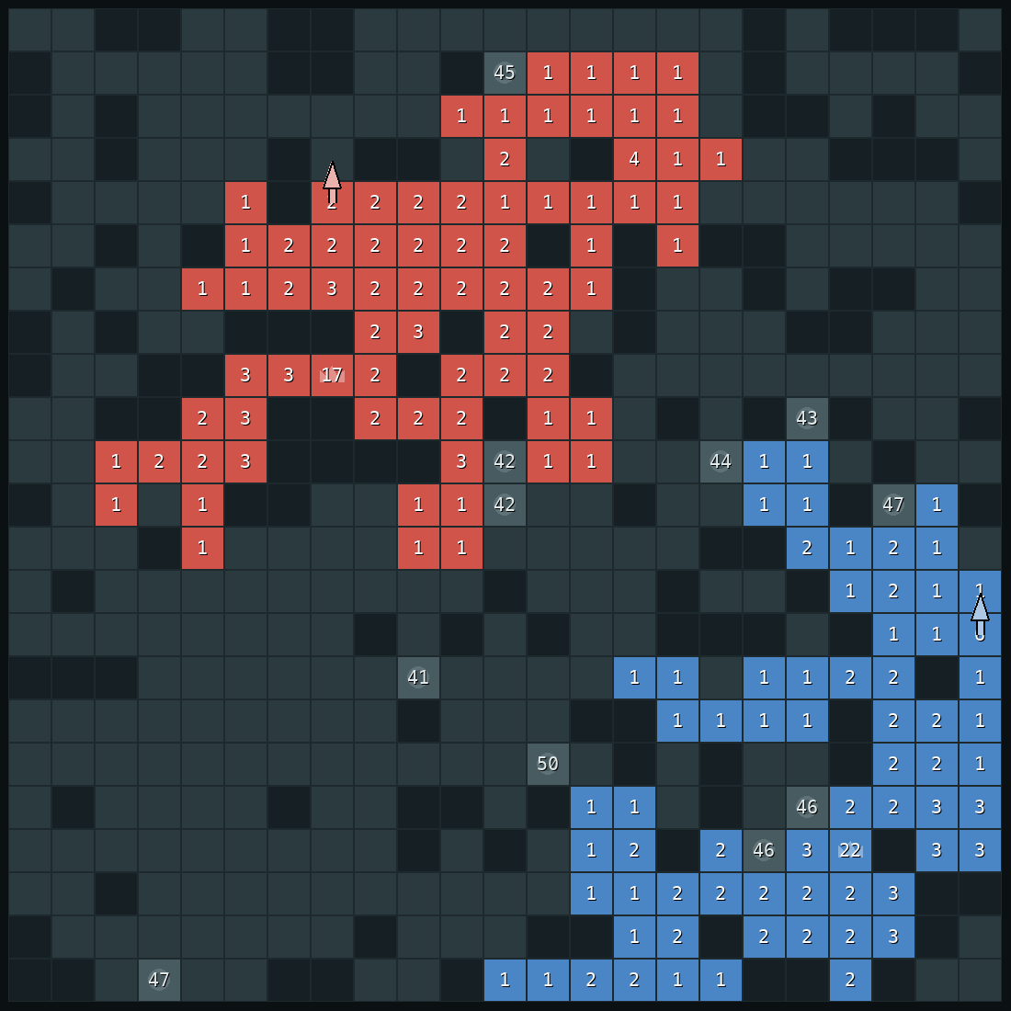
QUICK RECAP
The game in thirty seconds
Numbers are soldiers
Red is our bot, blue is the opponent.
Lose your general, lose the game
The crown marks each player's general.
One move per turn, both at once
Move one stack one square. Fights subtract.
Soldiers grow on their own
Generals and castles fast, land slowly.
2
Notes:
The board is a 23 by 23 grid. The number on a tile is its army, the crown marks a general, and grey squares are mountains. Each side chooses one move at the same time, so neither can react to the other's current move before committing. When armies meet, combat subtracts the smaller army from the larger. Generals and castles grow faster than ordinary owned land. Taking the opposing general ends the game; otherwise the game uses its end condition. These mechanics make time and production part of every attack calculation.

Slide 3


THE KEY IDEA
Walking costs soldiers, waiting earns them
start
8 turns later
30 → 22
12 → 16
A general falls only when its soldiers have left, or when several stacks hit it one after another.
the attacker leaves a soldier on every square
the general grows while it waits
3
Notes:
The picture isolates the key trade-off. A stack that leaves a tile must leave one soldier behind, so a 30-soldier stack walking eight squares arrives with 22 if it fights nothing. Meanwhile a stationary general grows from 12 to 16 over those eight ticks. A full general is therefore difficult to beat with one distant stack. It becomes vulnerable when its army has been moved away, or when several arrivals combine over time. The bot has to predict delivery at a future time, not compare only the largest stacks visible now.

Slide 4
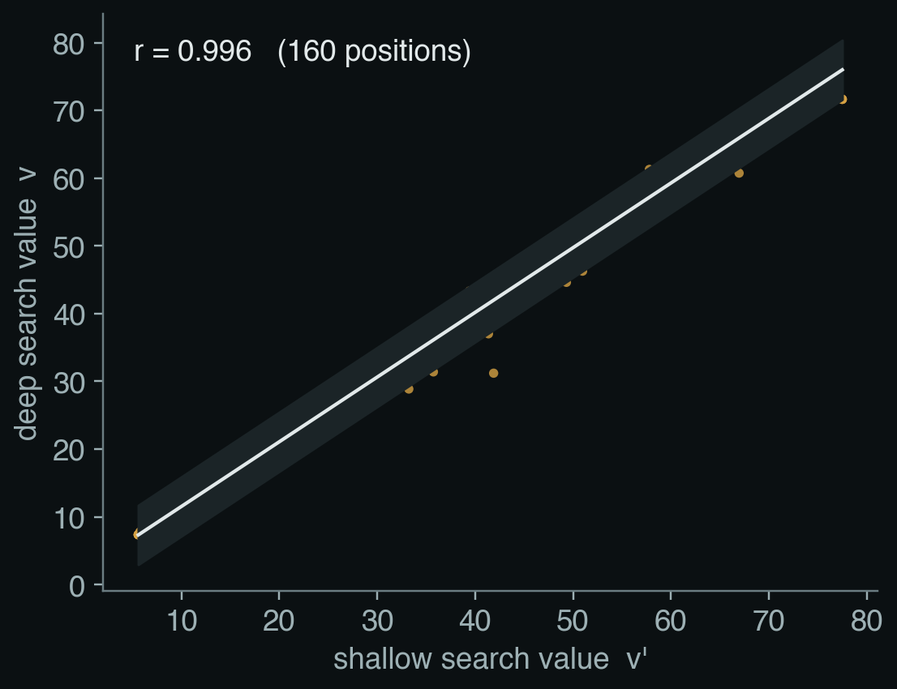
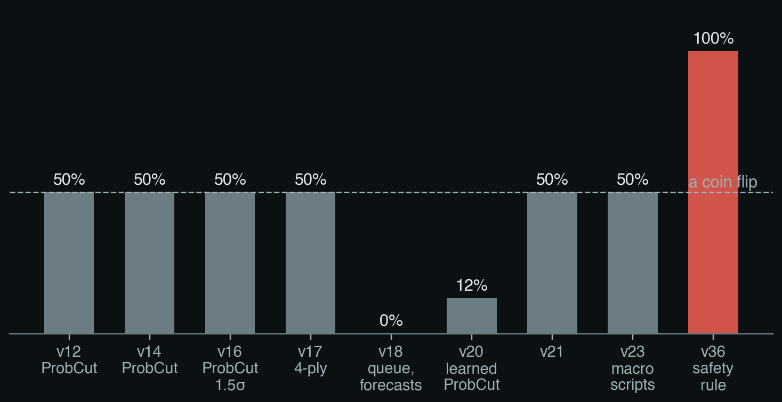
1 · HOW WE GOT HERE
Evidence 1: searching deeper didn't help
Shallow predicts deep almost exactly. 160 positions; v = 0.955 v′ + 1.97, σ = 2.18.
Win rate against v11, our best bot at the time. Search-paper bots (grey) stay at a coin flip or below. v36 (red) is the first bot built on the safety rule.
4
Notes:
This experiment compares a shallow evaluation, written v-prime, with a deeper evaluation, written v. The fitted relation is v approximately a times v-prime plus b plus residual e, with e modelled as a normal random error of standard deviation sigma. In the fit, v is the deep-search score, v-prime is the shallow-search score, a is slope 0.955, b is intercept 1.97, and sigma is 2.18 over 160 saved positions; r = 0.996 is the correlation coefficient. ProbCut's cutoff formula standardizes the predicted deep score against a threshold beta using sigma, then compares it with t, the chosen confidence threshold in standard-deviation units. Here beta is the alpha-beta bound being tested. The close fit meant deeper results seldom changed the ranking. Across tested search variants, match results did not improve enough to address the loss mechanism. This is evidence about these variants and this game setup, not a general result against search. ProbCut source: https://journals.sagepub.com/doi/pdf/10.3233/ICG-1995-18202.

Slide 5
Five papers
ARA*: Anytime A* with Provable Bounds — Likhachev et al., NeurIPS 2003
Real-Time Adaptive A* — Koenig & Likhachev, AAMAS 2006
Depression Avoidance — Hernández et al., JAIR 43 (2012)
ProbCut: Selective Extension of Alpha-Beta — Buro, ICCA J. 1995
Principles of Metareasoning — Russell & Wefald, AI Journal 1991
5
Notes:
This slide is a bibliography only. ARA* is by Likhachev, Gordon, and Thrun (2003); RTAA* is by Koenig and Likhachev (2006); depression avoidance is by Hernández and Baier (2012); ProbCut is by Buro (1995); metareasoning is by Russell and Wefald (1991). The full paper titles and venues appear here. The next slides explain what we measured when we tried the search direction. Sources: Likhachev et al., https://papers.nips.cc/paper_files/paper/2003/hash/ee8fe9093fbbb687bef15a38facc44d2-Abstract.html; Koenig & Likhachev, https://publications.ri.cmu.edu/real-time-adaptive-a; Hernández & Baier, https://doi.org/10.1613/jair.3590; Buro, https://journals.sagepub.com/doi/pdf/10.3233/ICG-1995-18202.

Slide 6
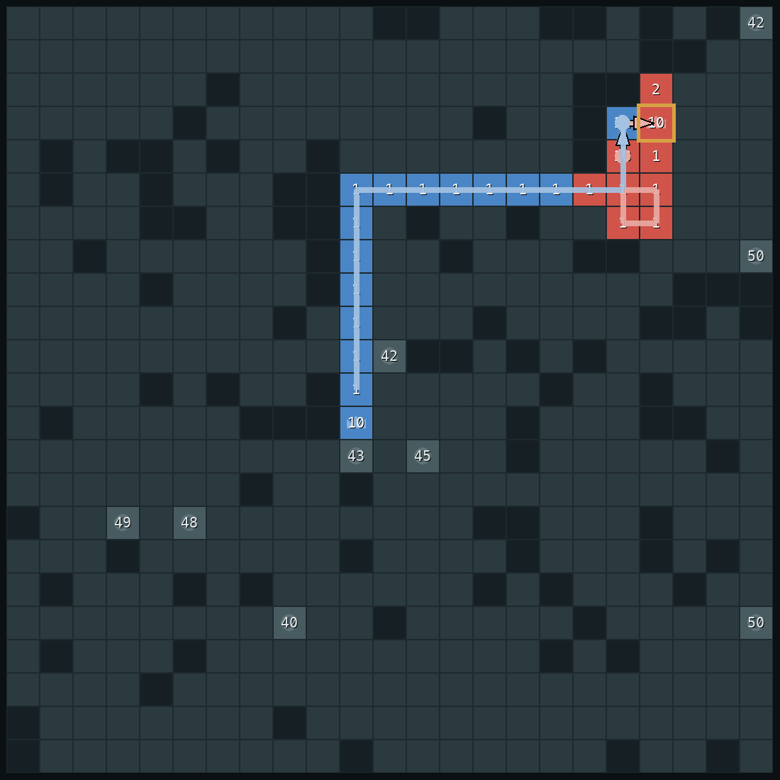
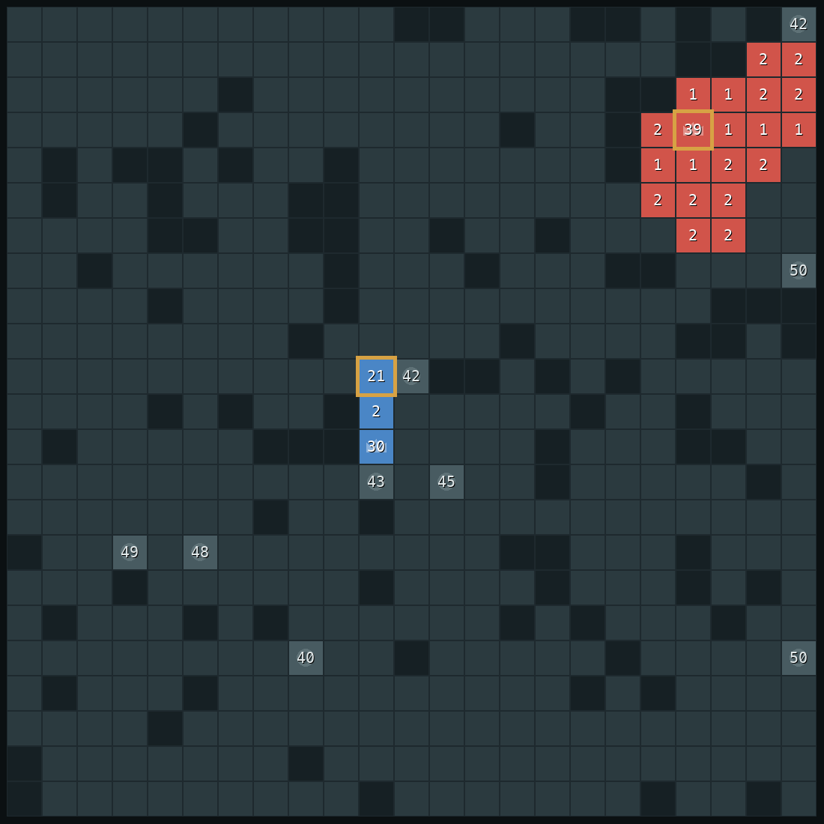
1 · HOW WE GOT HERE
Evidence 2: how the search-era bot actually lost
25 / 60
games v11 lost its general to two simple rush bots
24 / 25
of those games won by v36 on the same maps
turn 99
v11's general falls: 10 soldiers against 21
v11, turn 98. At turn 81 it moved 40 soldiers out of its general. Its stack circles (light red); the rusher walks straight in (light blue).
v36, same map, turn 98. 39 soldiers stay in the general. The rusher's 21 can't break it.
6
Notes:
The first failure was leaving home unprotected. At tick 81 v11 moved 40 soldiers out of its general. Its large stack then circled nearby tiles while the opponent's smaller stack took the direct route. At tick 99 the general held 10 and the attacker arrived with 21. The same map replay shows v36 keeping 39 at home, enough to survive the 21-soldier attack. Across the recorded sets, v11 lost its general in 25 of 60 rush games, and v36 won 24 of those 25 same-map rematches. This motivated a hard safety constraint before any positional optimization.

Slide 7
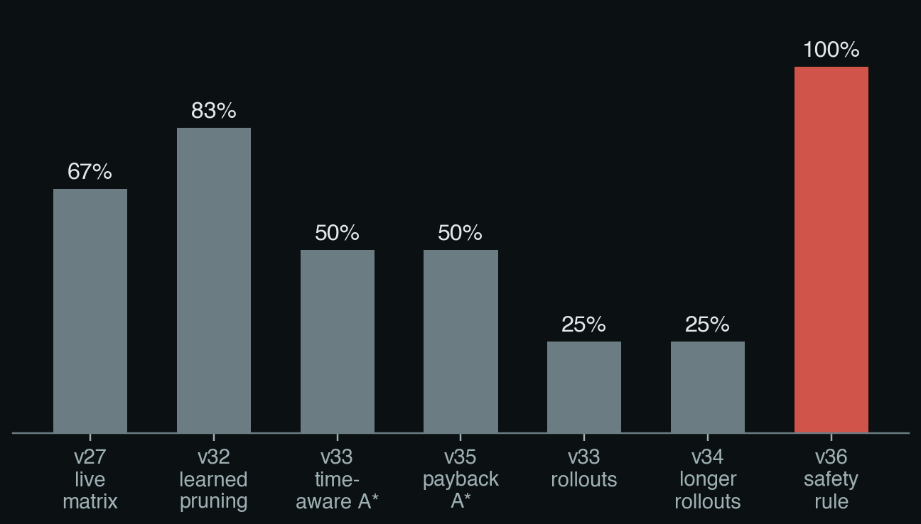
1 · HOW WE GOT HERE
Change 1: a safety rule before anything else (v36)
In words: for every enemy stack, my general must still win if that stack walks in.
v11's move at turn 81, if the general keeps 1:
If it keeps its 40:
Win rate against the direct rusher. Search-era bots (grey) on 4 to 6 game sets; v36 (red) on 20 games.
TERM Constraint before optimisation
First rule out every move that breaks a hard constraint, then choose the best of what is left. Here the constraint is: the general must survive any single enemy walk.
7
Notes:
The displayed inequalities compare the general's remaining army and future growth with an enemy stack's delivered strength. In the invariant, G means our general's current army; growth(d) is its production over d ticks; d_s is the travel time of enemy stack s; x_arrive(s) is that stack's army when it reaches the general. In the v11 example, keeping one means one soldier remains at home and floor(18/2) is the general's growth over 18 ticks. In the v36 example, 40 stay home and the attacker loses one per step along an 18-step route. v36 rejects moves that violate this single-stack survival check. The rule fixed the obvious empty-general rush but did not yet model an opponent collecting multiple stacks.

Slide 8
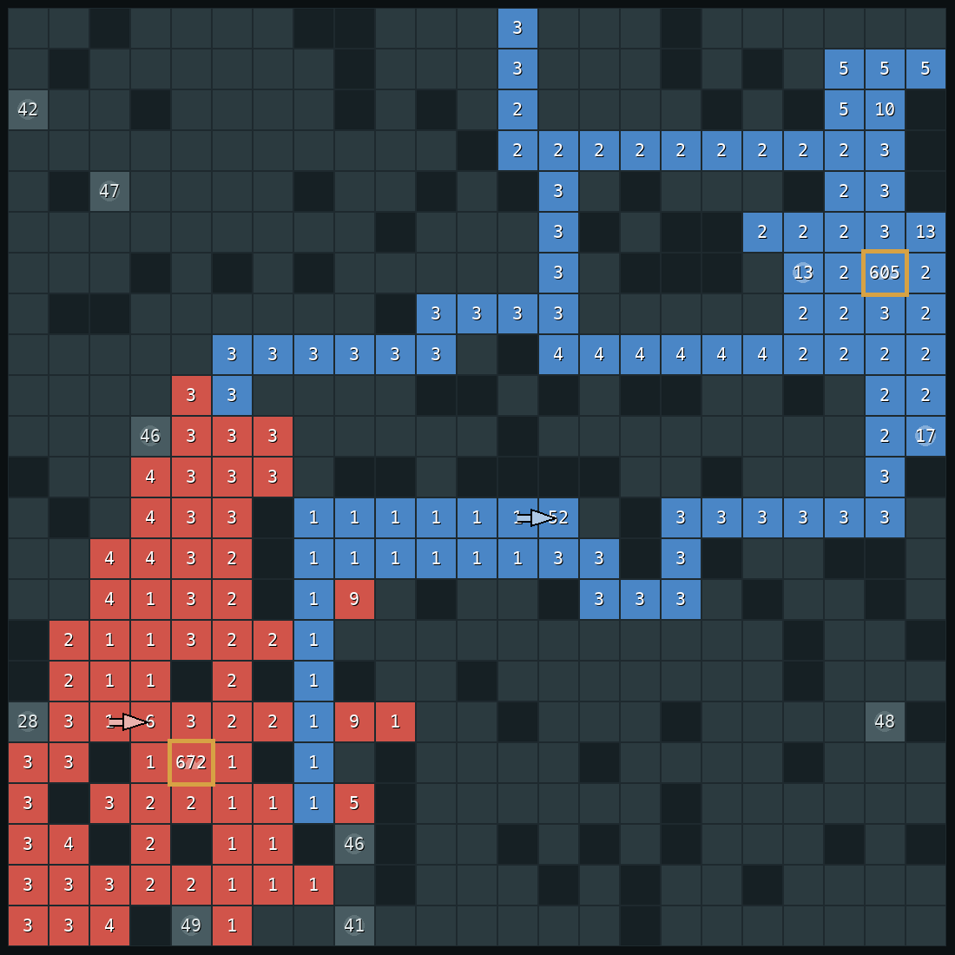
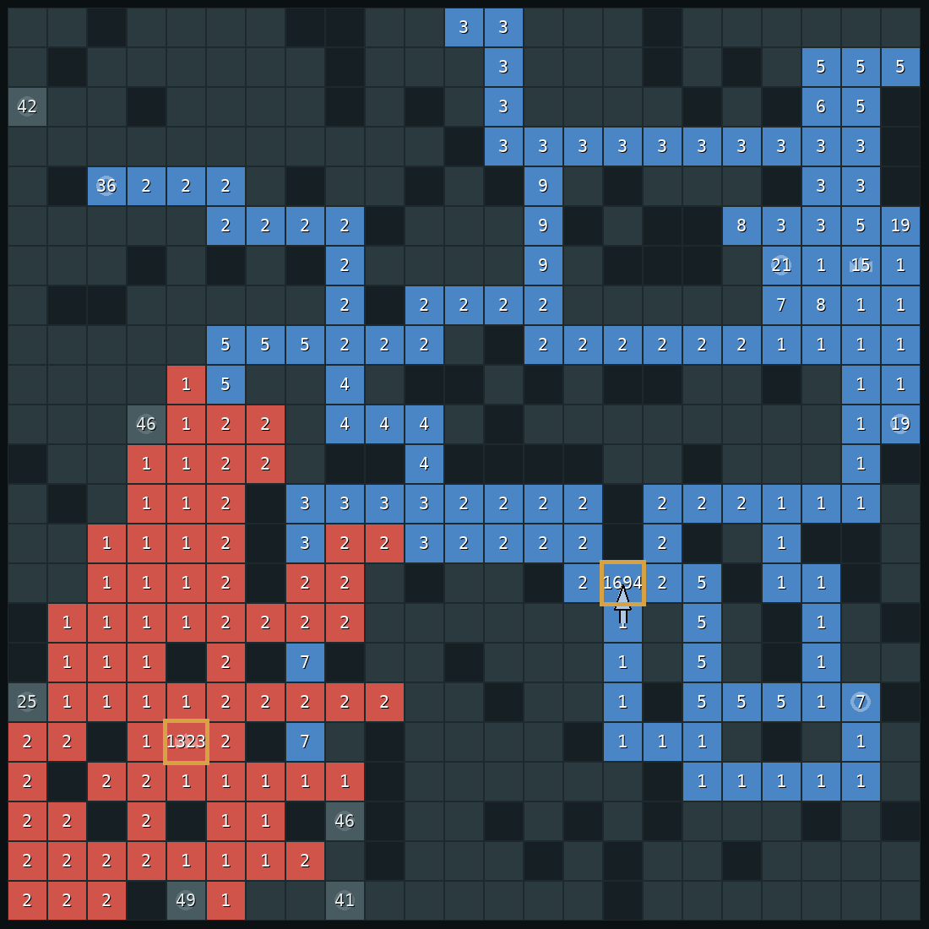
1 · HOW WE GOT HERE
Change 2: people beat it by collecting (v42)
Here the bot is red, the human blue.
No single human stack was bigger than the bot's general, so the old rule said: safe.
But the human held more land and castles 4 to 0, and collected it all into one stack.
New rule: count everything that can be collected in T moves, on both sides.
Turn 520. Human's biggest stack 605, bot's general 672.
Turn 845. Collected: 1,694 against 1,323.
Borrowed from Human.exe (Straka et al. 2026).
Old rule
New rule (idea 2)
8
Notes:
The human replay shows why checking only one stack is insufficient. At tick 520 the human's largest stack is 605 while the bot's general has 672, so the old comparison appears safe. Yet the human has more land and four castles to the bot's zero; after continued collection, the human brings 1,694 soldiers against 1,323 by tick 845. In the old margin, m_old is the worst single-stack safety score, s indexes an enemy stack, d_s is its travel time, and x_s is the stack's strength when evaluated for that route. In the new margin, G is the general army, growth(T) its production over T ticks, D_us(T) the defending army our side can deliver within T ticks, and D_them(T) the enemy army deliverable in the same budget. The minimum over T is the worst projected margin. This is a greedy estimate inspired by Human.exe's collection modelling, not an exact search over every possible route. Human.exe/self-play paper: https://arxiv.org/abs/2606.23348.

Slide 9
2 · HOW V51 DECIDES
What happens every turn
1
2
3
4
5
6
Look
Guess
Check
Decide
Test
Move
read the whole board
what kind of player is the opponent?
is an attack coming?
defend now, or pick a plan
could this move lose the general?
one move, every half second
Two rules never change: a move that fails the test is never played, and when an attack is coming, defence gets every move until it is over.
9
Notes:
Each tick follows the six steps shown. The agent reads the fully visible board, updates its estimate of opponent style, detects whether a large stack is approaching, and chooses immediate defence or a longer-term plan. Before acting, it tests whether the move could expose the general. The actions are simultaneous, and the whole decision loop runs within the game's per-tick allowance. Two controls dominate the rest: unsafe moves are rejected, and a detected committed attack keeps the bot in defence until the threat has passed or the shortfall is resolved.

Slide 10
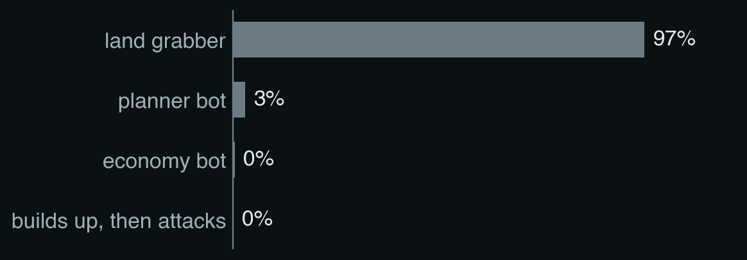
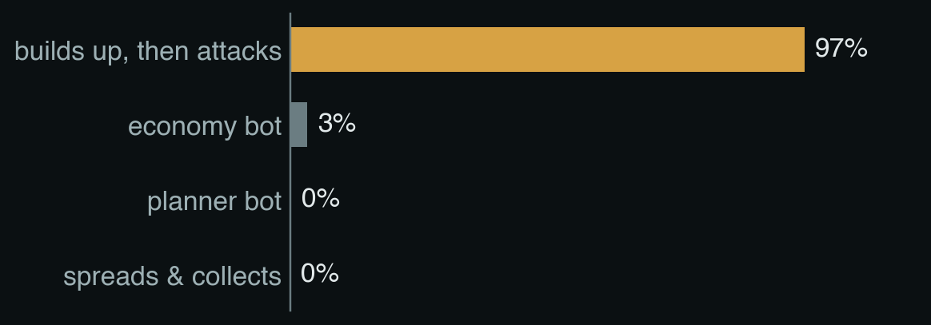
IDEA 1
Guess what kind of player you're facing
FROM THE PAPER Synnaeve & Bessière 2011; Weber & Mateas 2009
The bot can see the whole board, but not the opponent's plan. So it keeps a guess over ten playing styles, like "rushes early" or "builds up, then attacks".
Each turn it measures a few things about the opponent: its land, how much army sits in its general, how big its biggest stack is, and whether that stack is getting closer.
A small neural network turns those measurements into a probability for each style.
turn 205
turn 215, after it pulls everything into one stack
Right about 70% of the time by mid-game on new maps. Random guessing: 10%.
10
Notes:
The classifier estimates one of ten scripted styles from board measurements. The board itself is visible; the uncertainty is the opponent's intent. Features include land, army at the general, largest-stack size, and whether that stack is moving closer. The charts show a delayed gather-rusher: at tick 205 its visible behaviour still resembles a land-grabber; after it empties its general, the later board resembles a build-up-and-attack style. The reported held-out style accuracy is about 70% in the middle game, compared with 10% for ten-way random guessing. That accuracy does not by itself establish a win-rate gain; the head-to-head data later show that removing this classifier did not change the 32–28 record against v46. Sources: Synnaeve & Bessière, https://arxiv.org/abs/1111.3735; Weber & Mateas, https://alumni.soe.ucsc.edu/~bweber/pubs/cig_2009.pdf.

Slide 11
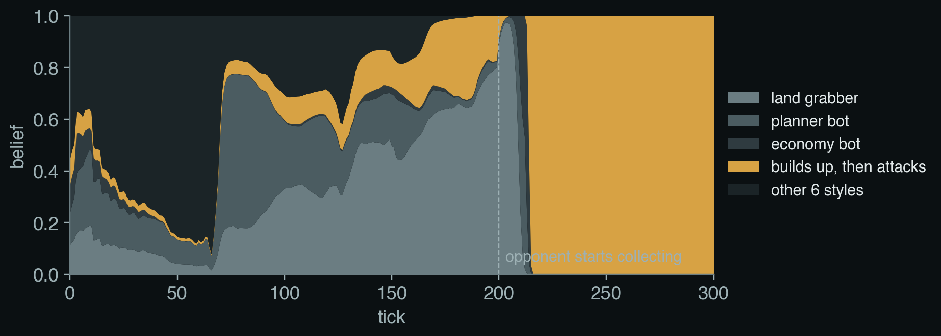
IDEA 1
The guess changes as the game goes on
In words: today's guess = mostly yesterday's guess, nudged toward what today's board suggests.
ℓ(y) how much evidence we have that the opponent plays style y
P(y | x) what the network thinks after seeing today's board x
0.95 old evidence fades slowly, so a change of style is noticed
Until turn 200 the guess is "land grabber", which is correct: before its attack, this opponent only grabs land. At turn 215 the guess flips to "builds up, then attacks".
11
Notes:
A single board can be ambiguous, so the bot smooths evidence over time. In the equation, ell at tick t for style y is the accumulated log evidence for that style; ell at tick t minus one is the previous log evidence; 0.95 is the memory-retention factor; P(y given x_t) is the classifier probability for style y from the current feature vector x_t; and 0.4 is the weight on this new observation. The log operation turns repeated evidence into an additive update. The belief at tick 205 still favours land-grabbing; after the general empties, the next observation shifts the belief toward a gather-and-attack style. This is a lightweight online belief update, not an inference over all possible strategies. Background paper on Bayesian RTS strategy prediction: https://arxiv.org/abs/1111.3735.

Slide 12
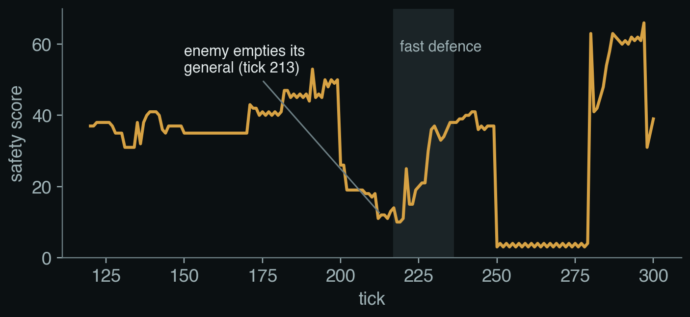
IDEA 2
The safety score during the game
In words: what my side can have at the general, minus what the enemy can bring, at the worst moment.
G soldiers on our general now
growth(T) what the general gains in T turns
D_us, D_them soldiers each side can walk to our general in T turns
lead our stacks must arrive a little early
NP-hard, and so we solved it greedily
Picking the best stacks to walk in a limited number of moves is NP-hard: no fast exact method is known. A greedy algorithm takes the biggest stack first, then the next.
At turn 213 the opponent empties its general into one stack. The score drops from 26 to 12.
12
Notes:
This slide makes the safety signal explicit. G is the current general army; growth(T) is production during T ticks; D_us(T minus lead) is the army our side can deliver with a small timing cushion; D_them(T) is the enemy army that can arrive within T ticks; T is a future move horizon; lead is the number of ticks reserved so defence starts early; and m is the minimum projected safety margin over the tested horizons. A low m means danger. The graph illustrates how the margin falls when the opponent begins collecting. The delivery calculation is a greedy approximation because choosing the best overlapping routes under a move limit is combinatorial. It can trigger a response, but it is not a proof that every enemy schedule has been covered. Human.exe/self-play paper: https://arxiv.org/abs/2606.23348.

Slide 13
IDEA 3
Test every move before making it
1. Try the move on a copy of the board. If the general is still safe, play it.
2. If not, imagine the enemy attacking along each likely route, with our bot defending.
3. If the general falls in any of these imagined games, never play the move.
our move
enemy attack 1
enemy attack 2
enemy attack 3
general safe
general safe
general lost
One loss is enough to throw the move away.
13
Notes:
The diagram shows the safety gate as a reply check. First the bot simulates its proposed move. If the general remains safe, the move can proceed. If the score is close to the danger threshold, the bot considers plausible enemy routes and simulates its own defence against them. If any tested line loses the general, the move is rejected. The left branch shows an attack the general survives; the final branch shows why one losing reply is enough to discard the candidate. This is bounded verification over selected attacks, not a complete minimax search over all simultaneous moves.

Slide 14
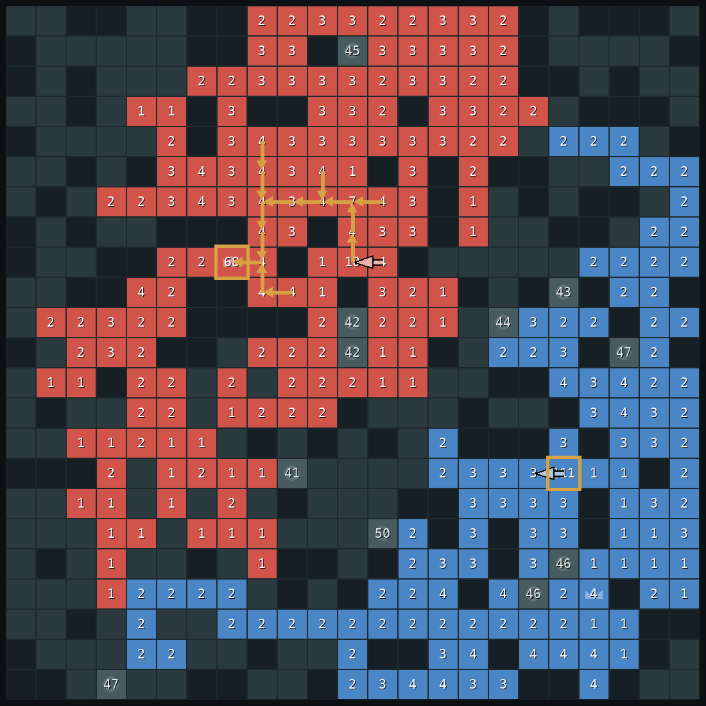
IDEA 4
When an attack is coming, defend fast
FROM THE PAPER Straka, Lisý & Schmid 2026 (Human.exe)
1
Notice
A big enemy stack moved 2+ squares closer in the last 5 turns. Its distance = turns left means we can treat it like as signal to protect
2
Measure
When it arrives, how many soldiers short will the general be?
3
Gather
Use every remaining move to pull soldiers into the general.
Right: the 14-move plan at turn 219 (gold arrows), all ending in the general.
14
Notes:
The fast-defence procedure has three stages. Notice an enemy stack that has made sustained progress toward the general. Measure the shortfall at the expected arrival time: enemy delivery minus the general's expected army, with a margin for uncertainty. If the shortfall is positive, gather. The gold arrows show a plan whose paths all lead into the general. v51 builds a rooted prize-collecting tree: each owned tile offers its army less the one soldier it must leave behind, and each move has a cost. It searches a price per move, greedily adds valuable routes, and executes from outer branches inward. This borrows the collection structure described for Human.exe, adapted to a defensive deadline. Once triggered, the mode is latched so a temporary recovery in the score does not restart expansion while the same stack is still approaching. Human.exe/self-play paper: https://arxiv.org/abs/2606.23348.

Slide 15
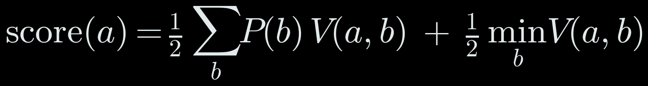
IDEA 5
Pick a plan by imagining the next 40 turns
FROM THE PAPER Barriga, Stanescu & Buro 2015 (Puppet Search)
plan
vs rusher
vs castle
rusher
vs land
grabber
vs waiter
score
In words: half the average (weighted by our guess about the opponent), half the worst case.
keep expanding
0.83
0.83
0.59
0.83
0.59
take castle A
0.88
0.88
0.69
0.88
0.69
take castle B
0.83
0.83
0.69
0.83
0.69
Good against the opponent we expect, never a disaster if we guessed wrong.
take castle C
0.87
0.87
0.69
0.87
0.69
attack now
0.83
0.83
0.59
0.83
0.59
TERM Rollouts · Hurwicz criterion
A rollout plays the game forward in simulation. The Hurwicz criterion scores a choice by mixing its average and its worst case; ours is 50/50.
Real numbers from turn 240: the learned win estimate (section 3) after 40 imagined turns.
15
Notes:
The table compares candidate macro plans against four simplified opponent scripts. A rollout means simulating a plan forward for a fixed horizon. The row scores are win estimates at the end of the rollout, not observed win rates. The Hurwicz formula mixes expected value and worst-case value: alpha is one half, EV is the belief-weighted average score, and MM is the minimum score across opponents. Equivalently, q indexes a candidate plan; m indexes an imagined opponent; p_m is the current probability weight for opponent m; V(q,m) is the learned value after simulating plan q against m; and the minimum term is the worst score. This is inspired by Puppet Search's use of scripts and choice points, but it is a project-specific macro-plan search rather than a full implementation of that paper. Puppet Search paper: https://ojs.aaai.org/index.php/AIIDE/article/view/12779.

Slide 16
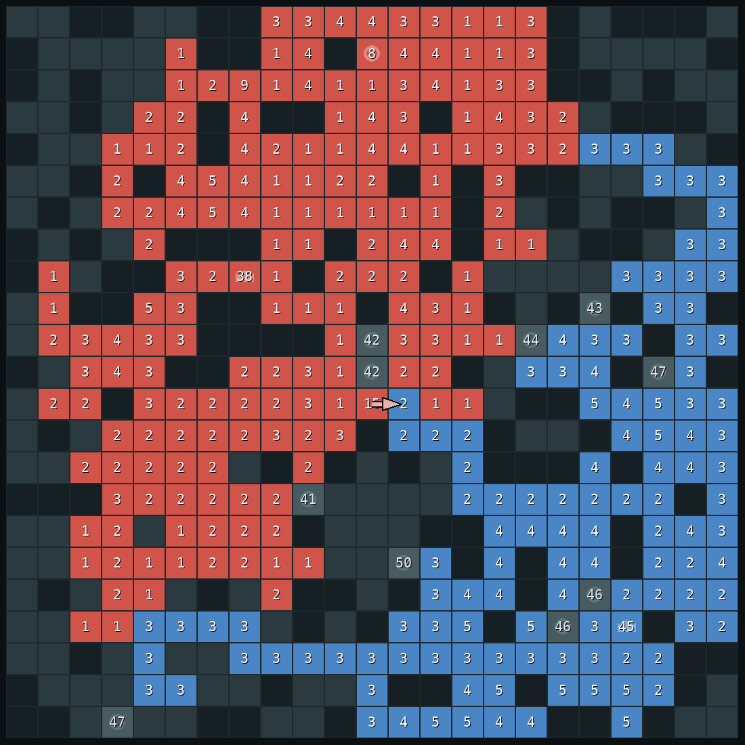
IDEA 6
Castles: only when they pay and home stays safe
FROM THE PAPER Churchill & Buro 2011
Worth it? A castle produces like 25 squares of land. It must pay back its cost before the game ends.
Safe? Fast-forward to when our stack has been spent on the castle. Is the general still safe then?
Needed? If we are already clearly ahead, take only cheap castles.
Right: turn 298, the bot's first castle in this game.
16
Notes:
Castles are treated as investments. They cost a garrison and travel time, but then produce army faster than ordinary land. The bot estimates whether the new production can repay the soldiers committed before the game ends, and checks whether the general remains safe after the trip. Churchill and Buro's StarCraft build-order work motivates thinking in terms of future income and payback; v51 does not use their optimizer. The image shows the first castle taken in the recorded game, after the gather-rusher attack has failed and home defence is no longer urgent. Build-order paper: https://ojs.aaai.org/index.php/AIIDE/article/view/12435.

Slide 17
IDEA 7
Use the guess, but never trust it with the general
FROM THE PAPER Ganzfried & Sandholm 2015
Opponent looks aggressive
keep 60% of each threat at home; counter-attacks allowed
The guess changes what the bot prefers.
It never changes the safety test.
A wrong guess costs some efficiency, never the general.
Opponent looks quiet
keep 40% at home; grab more land
We are not clearly ahead
take castles, enemy castles first
We are clearly ahead
only cheap castles
17
Notes:
The opponent model changes preferences but does not remove the safety gate. When aggressive behaviour is likely, the bot retains a larger home reserve and may allow a counter-attack; when the opponent appears quiet, it can spend more on land and castles. When the bot is behind, it can pursue productive castles; when clearly ahead, it selects cheaper opportunities. Ganzfried and Sandholm's paper studies safe deviations from equilibrium in repeated zero-sum games. v51 borrows the principle of limiting exposure to a mistaken read, but it does not implement that paper's formal algorithm or inherit its guarantee. The reliable protection here comes only from the bot's own threat estimates and tests. Safe exploitation paper: https://www.cs.cmu.edu/~sandholm/safeExploitation.ec12.pdf.

Slide 18
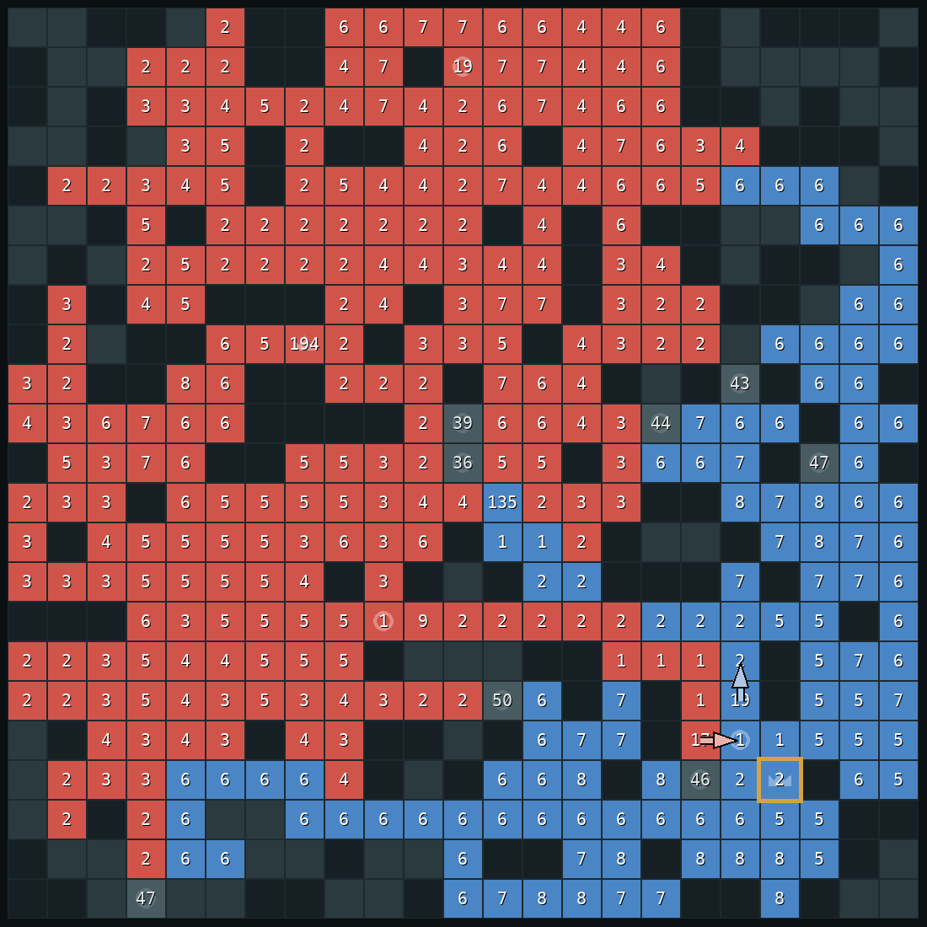
IDEA 8
Attack only when it's sure to work
The bot attacks the enemy general only if:
1 its stack arrives bigger than everything the enemy can have there;
2 our own general stays safe while the stack is away;
3 it wins against four imagined replies.
In practice: when the enemy has emptied its general. Right: turn 405, the enemy general (gold box) has 2 soldiers.
Weakness: against a careful player it attacks late.
18
Notes:
The attack check accounts for the same attrition and production that make defence difficult. The attacking stack loses soldiers along its route and to defenders; the target general grows and may receive reinforcements. The bot also checks whether sending its own stack away would expose its home general. It then tests the attack against several scripted replies before launching. The image shows the late-game example: at tick 405 the opposing general has only two soldiers, so the projected attack can pass its checks; the capture occurs at tick 407. The method is deliberately conservative and can attack late against a careful opponent.

Slide 19
3 · EVERY PART OF V51
The full turn, in order
1
Read the board; update the guess about the opponent
always
2
Can a stack take their general right now?
take it
3
A big stack is coming and the general will be short?
fast defence (idea 4)
4
Update the castle gate and the threat gate (idea 7)
set the reserve R
5
Is our home losing the race?
counter-strike, if it passes the test
6
Urgent: safety score under the pad, or a proven attack?
v36 rules: attack / defend / pull home
7
A castle pays back and stays safe?
castle move (idea 6)
8
Otherwise
the committed plan (idea 5)
Every plan and castle move is tested first (idea 3). If it fails, the next rule is tried; if nothing passes, a simple defender script moves.
19
Notes:
This is the full priority order. Update the opponent belief; take an immediately winning general capture; trigger committed defence when a large stack approaches and the estimated shortfall is positive; update reserve and threat gates; consider a counter-strike only if home is projected to fall and the strike passes its own test; apply urgent safety rules; consider a castle if its payback and safety checks pass; otherwise follow the committed macro plan. Every proposed castle or plan move is tested first. If no candidate survives, the bot uses a simple defensive fallback. This ordering prevents lower-priority economic plans from overriding an urgent home defence.

Slide 20
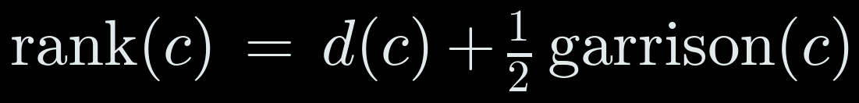
3 · EVERY PART OF V51
The plan menu and the four imagined opponents
OUR PLANS
IMAGINED OPPONENTS
expand
grab free land with stacks that aren't on the general or a castle
rusher
walks its biggest stack at our general
hold
keep soldiers banked on the general and castles; expand with the rest
castle rusher
takes castles, then rushes
take castle ×2–3
one plan per nearby castle, nearest first (formula)
land grabber
only expands
gather home
pull everything into the general; only when the safety score is low
waiter
does nothing
strike
collect on our castle nearest their general, charge when the walk wins
8 plans × 4 opponents = 32 imagined games of 40 turns.
rush
attack now with any stack whose walk already wins
Plans that give identical boards against all four are merged: on average 6.1 plans become 4.6.
Castles are offered in this order:
20
Notes:
The plan menu keeps the rollout branching factor small. Plans include expansion, holding army, taking one of a few nearby castles, gathering home, striking from a forward castle, or rushing when the attack is already favourable. The imagined opponents are a direct rusher, castle rusher, land-grabber, and waiter. Eight candidate plans against four scripts gives at most 32 imagined games before identical outcomes are merged. In the ranking formula, c is a candidate castle, d(c) is its travel distance, and garrison(c) is the neutral army guarding it; lower distance and lower garrison reduce the estimated cost. The ranking is only an ordering heuristic; safety and payback tests still decide whether a plan may be played.

Slide 21
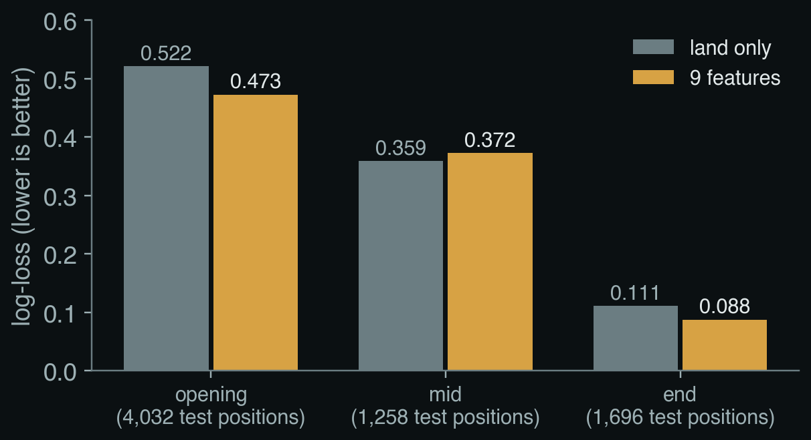
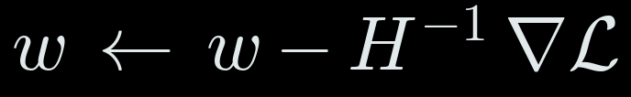
3 · THE LEARNED WIN ESTIMATE
Training it, and how well it predicts
Data: 7 scripted bots play each other on 200 maps; games of 300, 500 or 800 turns.
Every 5 turns: both players' measurements, labelled with who won. Draws dropped.
Split by map: 160 maps train (27,208 positions), 40 maps held out (6,986).
Fitted by Newton's method, one model per phase:
Opening: clearly better than land alone; right 75% of the time (land alone: 71%).
Mid-game: no better than land alone on new maps.
End game: right 98% of the time.
21
Notes:
The learned win estimate scores rollout endpoints. The training data contain scripted games on many maps, with positions labelled by who eventually won. Separate models are trained for opening, middle, and end phases. The slide reports held-out prediction quality: the richer feature model helps in opening and endgame, but is no better than land alone in the middle phase. In Newton's update w is the vector of model weights, H is the Hessian (the matrix of second derivatives of the regularized loss), and the gradient is the vector of first derivatives; the minus sign moves downhill. In the displayed loss, n is the number of training samples, X is the feature matrix, p is the vector of predicted win probabilities, y is the vector of binary outcomes, lambda is the penalty on large weights, I is the identity matrix, and S is the diagonal matrix of logistic variances p_i(1-p_i). The model evaluates short rollouts; it is not a policy that directly chooses moves.

Slide 22
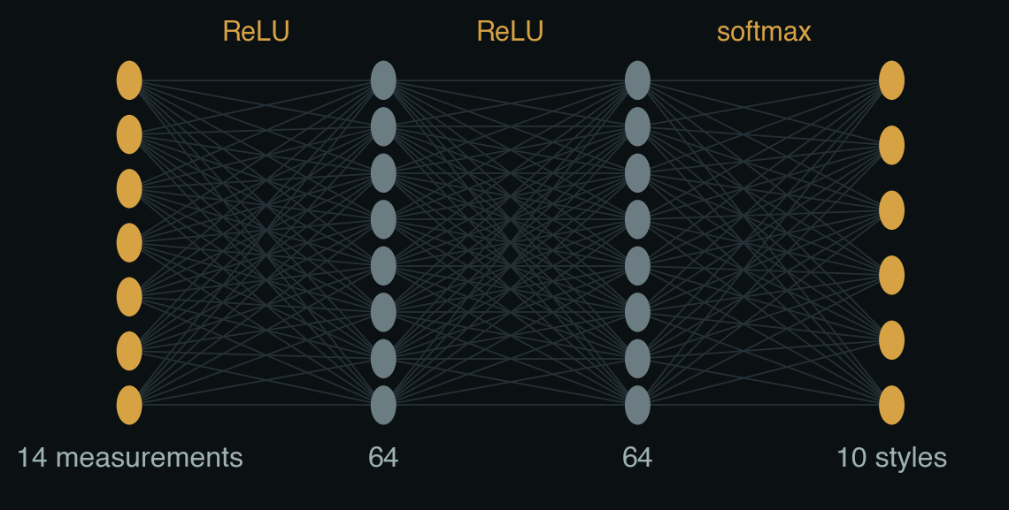
3 · THE STYLE CLASSIFIER
Fourteen measurements in, ten styles out
1
turn number
8
how much closer in 5 turns
2
land
9
land gained in 20 turns
3
total army
10
biggest stack's growth in 5 turns
4
share of army in its general
11
stacks of 5 or more
5
share in its biggest stack
12
times its general was emptied
6
castles held
13
army gained in 20 turns
7
biggest stack's distance to us
14
biggest stack within 10 squares?
All measured on the opponent, from the board alone, and scaled to roughly 0 to 1.
22
Notes:
The network has fourteen input measurements and ten output styles, with two hidden layers of 64 units each. Inputs summarize the opponent's land and army, how much army remains at its general, the largest stack and its distance, recent movement and growth, castles, and evidence of previous general-emptying. In the architecture expression, x is the 14-value input vector; y is an opponent style; P(y given x) is its predicted probability; W1, W2, and W3 are learned weight matrices; b1, b2, and b3 are learned bias vectors. ReLU keeps positive hidden activations and sets negative ones to zero; softmax turns the ten final scores into probabilities. The widths 14, 64, 64, and 10 describe the layers. For normalized input x-hat, mu is the per-feature training mean and sigma is the per-feature training standard deviation. The parameter count is 5,770 learned weights and biases. This is a compact classifier trained on game traces, not a deep reinforcement-learning policy.

Slide 23
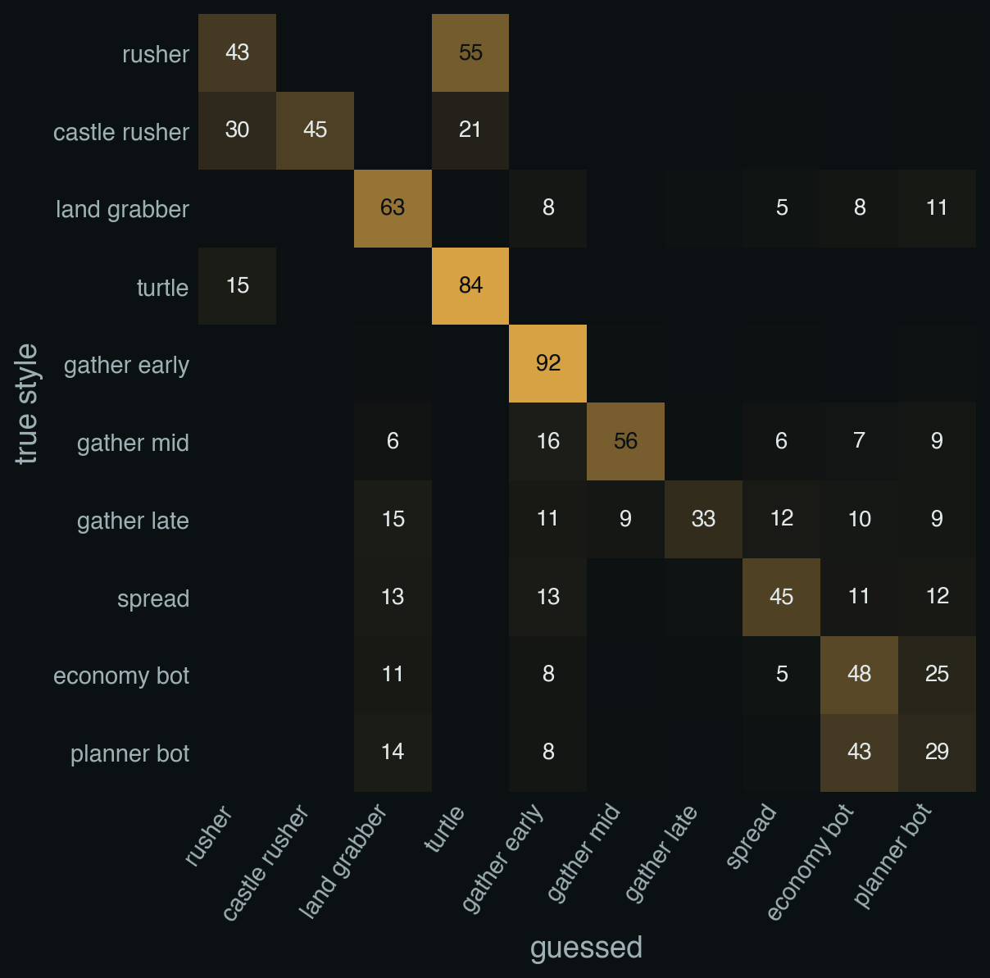
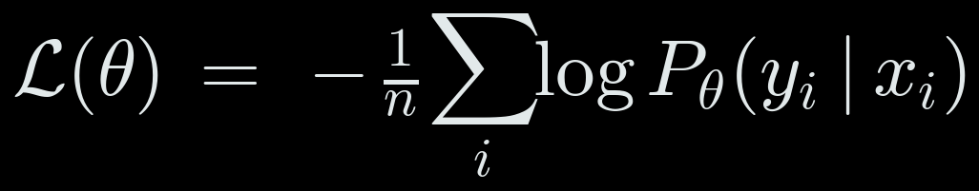
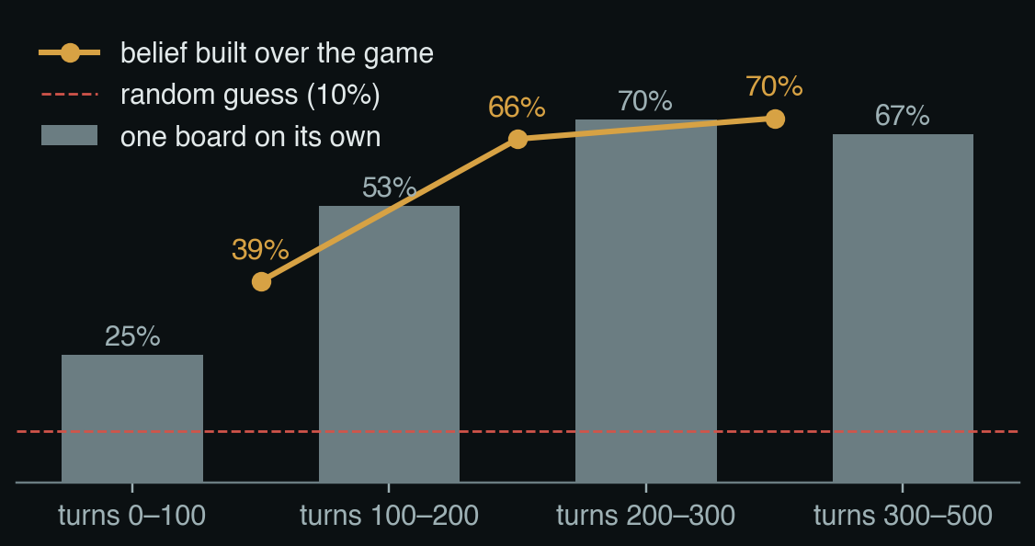
3 · THE STYLE CLASSIFIER
Training it, and where it gets confused
Data: v46 plays each of the 10 styles on 33 maps, both seats, 500 turns. Measurements every 2nd turn.
Split by map: 25 maps train (99,437 rows), 8 unseen maps test (33,318).
Training: Adam, learning rate 0.002, weight decay 0.0001, batches of 512, 60 passes, on the Mac GPU.
Rusher read as turtle (55%): both sit at home until the rusher launches. Economy bot vs planner bot: both map to the same imagined opponent.
23
Notes:
Training uses v46 against ten scripted styles on 33 maps, with both starting seats. Rows are sampled every other tick; the split is by map, with 25 maps for training and eight unseen maps for testing. The reported datasets contain 99,437 training rows and 33,318 held-out rows. The confusion example shows why early prediction is difficult: a rusher that waits at home resembles a turtle until its launch. Economy and planner scripts also look alike, but both map to the same rollout opponent. In the cross-entropy expression, theta denotes all network parameters; N is the number of examples; i indexes examples; y_i is the one-hot true style label; x_i is the feature vector for example i; and P_theta(y_i given x_i) is the predicted probability assigned to its true style. The sum penalizes low probability for the correct style. GPU training made fitting quick, but the classifier did not measurably improve the tested match record.

Slide 24
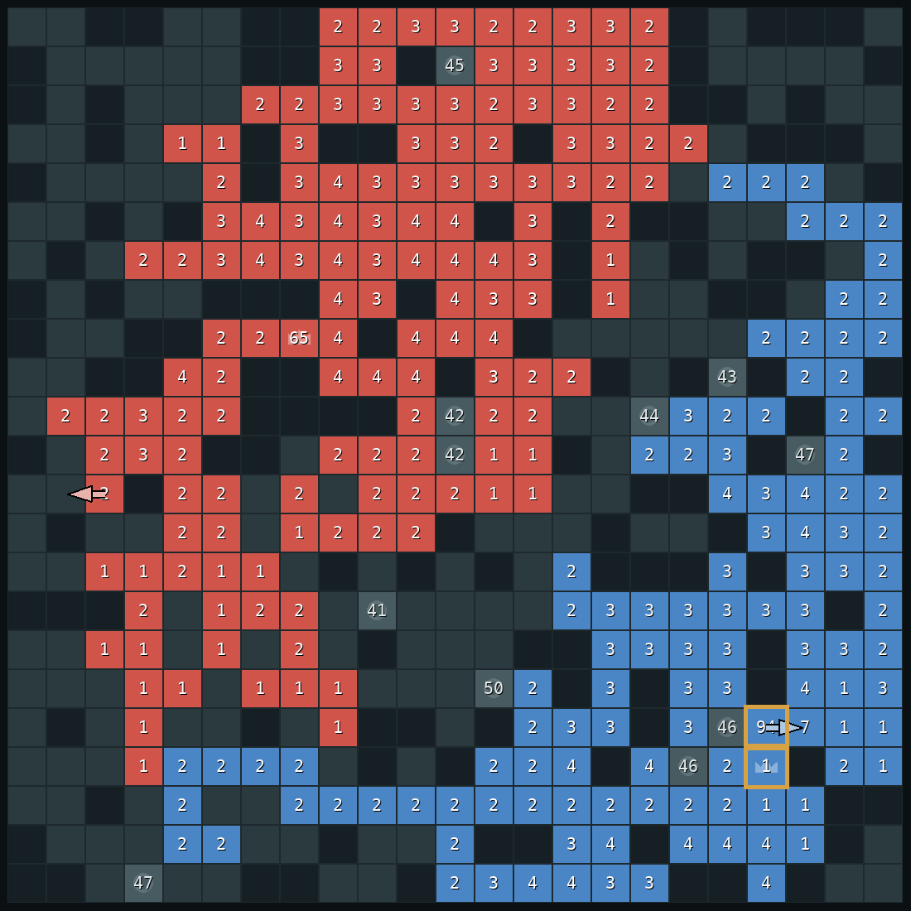
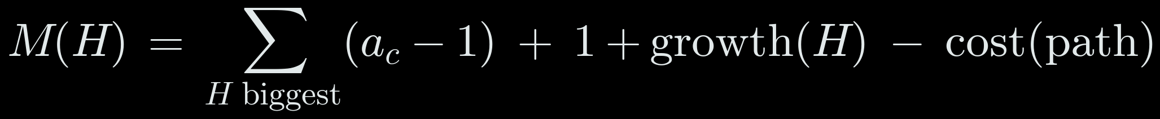
3 · SAFETY DETAILS
The reserve: what the general must keep
From a lost game: a human walked their general 25 squares, collecting 84 → 137. Our safety score read +10 to +40 until two turns too late.
1 · Whatever leaves the general, it keeps a reserve, now and if the enemy waits:
2 · The most the enemy could collect in H moves and walk at us:
R = 0.6 when the threat gate is open, 0.4 when it is shut (idea 7). Each collecting move picks up at most one square, so H moves collect at most the H biggest.
Turn 213 of our game: the enemy empties its general into one stack (gold boxes).
24
Notes:
The reserve rule addresses a failure found in a human game: the general could look safe until too late because the estimate did not account for a patient collection phase. G_keep is the army left on the general after a proposed move; growth is production over the horizon; H is a tested future horizon; d_s is the travel time of stack s; x_s(H) is its projected strength; and R is the required retained fraction, 0.6 when the threat gate is open and 0.4 otherwise. The second expression estimates a mass threat from the H largest collectible stacks: a_c is the army on a candidate tile, one is the soldier left behind, and cost is attrition or movement cost. The turn-213 image shows the opponent gathering before launch. These are conservative guardrails, not an exact adversarial solution.

Slide 25
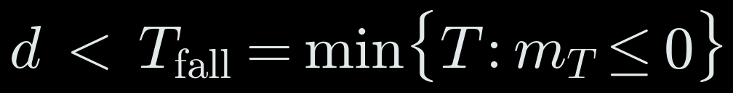
3 · SAFETY DETAILS
Two rules from replays of human wins
Never swap places with an attacker
Counter-strike: when home will fall anyway
If the safety score says our general falls at turn T_fall, launch a stack at their general if it arrives first and wins:
30
25
our general
attacker
Same turn: the general steps out, the attacker steps in. They pass each other, and the attacker lands on a general with 1.
So the general never steps toward an adjacent enemy stack. Another stack hits it, or the general waits and grows.
G′, D′_home: their general, and what they can pull home in time. +3 for safety.
Only with the threat gate open, and only if it passes the four-reply test (idea 3).
25
Notes:
Two edge cases come from replay analysis. First, the general must not step toward an adjacent enemy stack in a simultaneous move: the two can pass, leaving the attacker to land on the general after it moves away. The bot therefore waits or uses another stack to deal with that attacker. Second, if the projected time until our general falls is T_fall, a counter-strike is considered only when our attack arrives sooner and beats the enemy general plus its growth and home reinforcements, with a three-soldier cushion. Here d is our attack travel time, G-prime is the enemy general army, growth(d) is its production, and D-prime_home(d minus one) is enemy reinforcement deliverable before impact. The strike also must pass the attack verification and threat gate.

Slide 26
4
One real game
Our bot (red) against a bot that plays the way people beat our earlier versions: grab land, pull everything into one stack, charge.
Notes:
The replay follows v51 against a delayed gather-rusher. The opponent expands first, then consolidates its army and charges along a short path toward the general. This is the pattern that exposed v46. The next sequence shows the opening, the moment the opponent empties its general, v51's gathering plan, the impact, and the later counterattack. It is one traced match, useful for explaining the mechanism but not a substitute for the multi-game results.

Slide 27
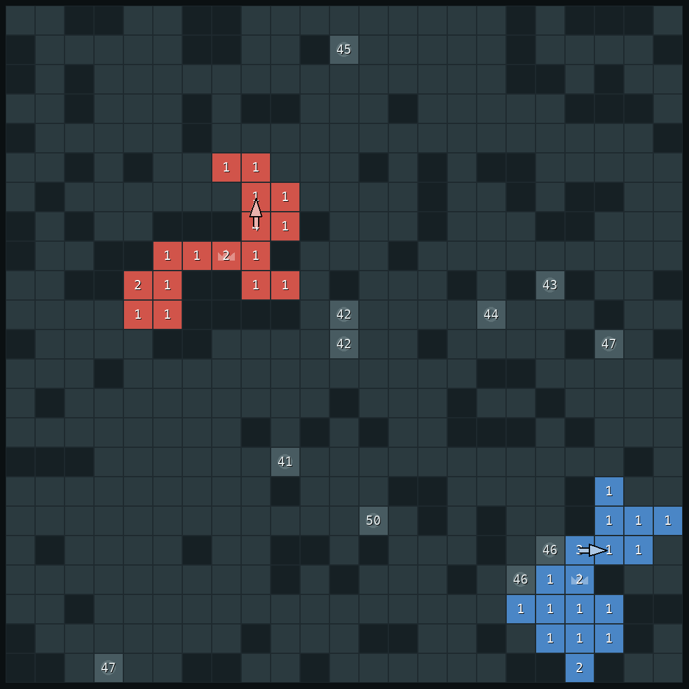
ONE REAL GAME
turn 40
Opening: grab land
Both sides grab one square per move. Nobody is threatening anybody yet, so the bot just expands.
21
21
our soldiers
their soldiers
27
Notes:
At tick 40 both sides are still expanding. The opponent has not assembled an incoming stack, so the defensive detector is quiet and v51 takes ordinary land. The 21 versus 21 army counts show a balanced opening in this game. The point is that committed defence is conditional: it does not mean the bot sits at home from the start. It switches when the board provides evidence of a large stack making progress toward the general.

Slide 28
ONE REAL GAME
turn 213
It empties its general
Its general drops from 93 to 1. A 94-soldier stack appears (gold boxes).
Our safety score drops to 12: an attack is possible soon.
94
12
their big stack
safety score
28
Notes:
At tick 213 the opponent's general empties and a 94-soldier stack appears. The safety estimate drops to 12, showing that future delivery is now a near-term concern even though the stack has not yet reached the general. This is the turning point from ordinary expansion to threat response. The detector uses both stack size and recent distance change, so a large stationary army is not automatically treated as an attack.

Slide 29
ONE REAL GAME
turn 219
Attack confirmed: plan the defence
The stack is 18 squares away and coming closer.
The bot plans 14 moves that pull soldiers into its general (gold arrows). Every move from now on is defence.
111
18
68
attacker
squares away
our general
29
Notes:
At tick 219 the stack is 18 squares away and still approaching. The threat is now confirmed. v51 computes a gathering route with fourteen moves and commits to defence. The gold arrows show the route plan into the general. The measured distance is an approximate arrival time because each player moves once per tick; actual travel can be affected by fighting and route interactions. The latch prevents the planner from abandoning defence after one favourable score update.

Slide 30
ONE REAL GAME
turn 235
Ready
The big stack next to the general steps in. The general now has 124.
The attacker is right next to it with 90.
124
90
our general
attacker
30
Notes:
At tick 235 a nearby stack joins the general. The general now holds 124 soldiers; the attacker has 90 and is two squares away. This is the intended effect of collecting on a schedule: distant soldiers move first and can accumulate before the attack lands. The decision was made before impact, not as a reaction after seeing the opponent's move, which matters because both players act simultaneously.

Slide 31

ONE REAL GAME
turn 237
The attack fails
The attacker hits with 88. The general keeps 38.
Our previous bot lost this exact position: 77 against 82.
38
0
left in our general
attackers left
31
Notes:
At tick 237 the attacker reaches the general with 88 soldiers, and the general retains 38. The preceding bot, v46, lost this same position at 77 against 82. This comparison isolates why a persistent gathering plan matters: the difference is not a deeper tactical line at impact, but having enough army at the target before impact. The example is one seed and should be read alongside the larger match suite.

Slide 32

ONE REAL GAME
turn 407
Our attack, when it's sure
The bot went back to taking castles and pulled ahead.
At turn 405 the enemy general had 2 soldiers. The attack passed all four tests. Captured at 407.
1,099
772
our soldiers
their soldiers
32
Notes:
After surviving, v51 resumes economic play and later attacks when the opponent's general is nearly empty. The image summarizes tick 407, after the enemy general had fallen to two soldiers at tick 405. The attack passed the checks against the tested replies, and the game ended by capture. This shows the full cycle: defend the collection rush, return to expansion, then attack when the target is genuinely weak. Against a careful opponent who keeps its general full, v51 may wait too long for this opening.

Slide 33
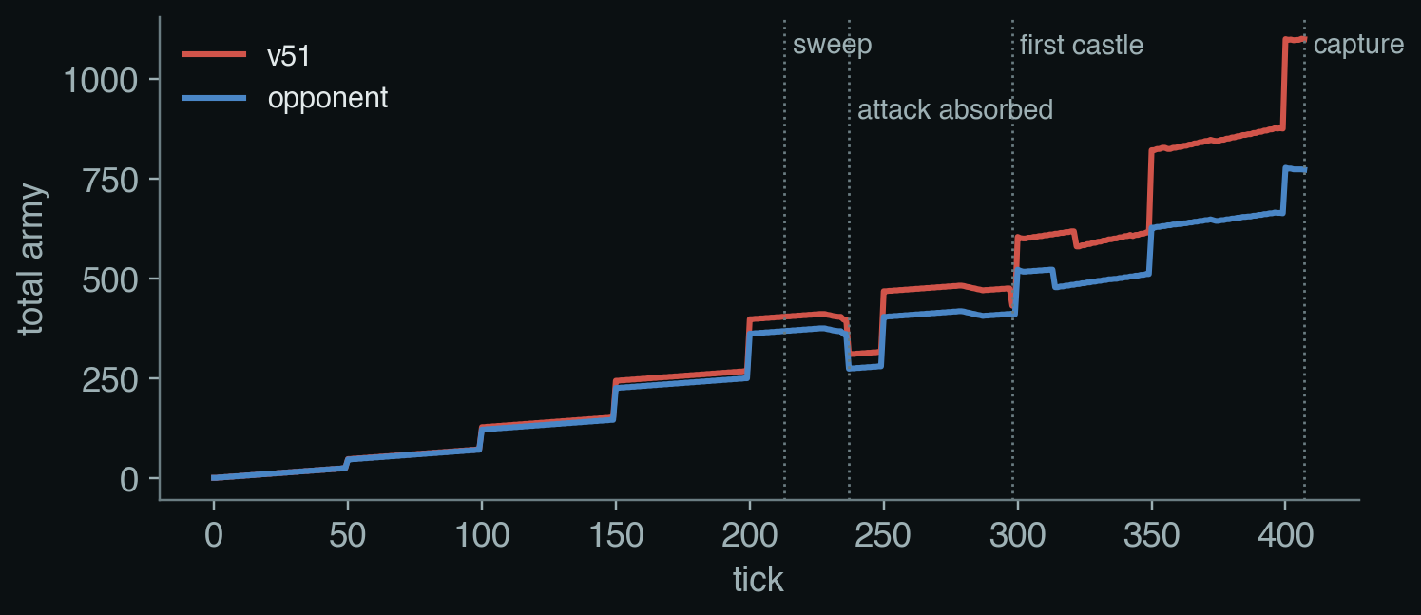
4 · ONE REAL GAME
The whole game in one picture
Until the opponent charges, both armies grow together.
The attack costs both sides; our general survives.
After the first castle, our bot pulls away until the capture.
33
Notes:
The timeline condenses the same game. Early play is expansion; the opponent then gathers; v51 detects the charge and pulls soldiers home; the attack fails; after taking a castle and improving its economy, v51 captures the enemy general. The notes on the individual frames give the exact counts and ticks. The timeline is illustrative rather than statistical; the aggregate table is the proper evidence for performance across games.

Slide 34
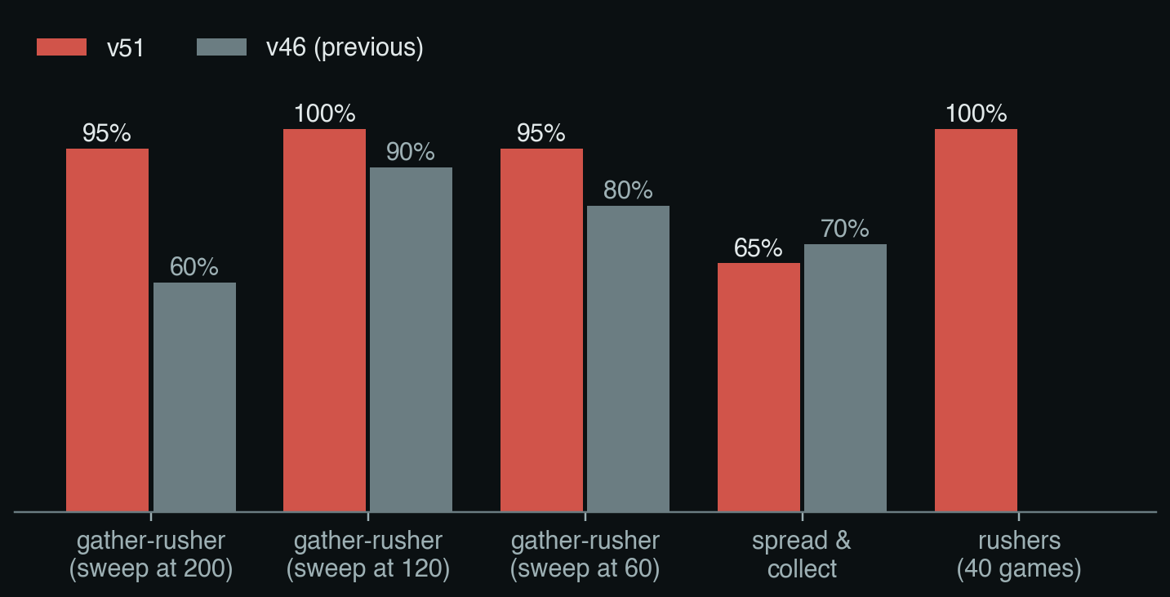
5 · RESULTS
Where v51 is stronger
Bots that collect and charge: the biggest improvement.
Spread-and-castle player: slightly worse.
Against our previous bot: about even, 32–28.
20 games per bar. Grey bars: our previous bot.
34
Notes:
The table compares v51 or its classifier-free fast-defence counterpart with v46. Against delayed gather-rushers, the strongest measured gains are 19 wins out of 20 at a tick-200 start versus 12/20, 20/20 versus 18/20 at tick 120, and 19/20 versus 16/20 at tick 60. It also won all 40 tested games against direct and castle rushers. Against spread-and-collect play, it was slightly worse: 13/20 versus 14/20. In 60 games against v46, v51 went 32–28; v52 without the classifier had the same record. The evidence supports a targeted defence improvement and exposes an opportunity cost against spread collectors; it does not establish universal superiority.

Slide 35
5 · LIVE GAME
Your turn
python play_arena.py then pick Final · champion
What to watch for:
Opening: it grabs land, one square per move.
Send a big stack at its general: it stops and pulls soldiers in.
Keep your general full: it won't attack.
To beat it: spread out and take castles.
35
Notes:
The final prompt invites a live game. The command starts the local arena and the selected entry runs the v51 champion. The audience should watch for three behaviours: it expands early, it gathers home when a large stack approaches, and it usually waits for the enemy general to empty before attacking. Spreading out and taking castles is a different test because it can exploit the defender's time at home. This is the known weakness suggested by the results, not a guaranteed winning strategy against every setup.

Slide 36
REFERENCES
Straka, M., Lisý, V. & Schmid, M. Superhuman AI for Generals.io using self-play reinforcement learning. arXiv 2606.23348, 2026.
Barriga, N., Stanescu, M. & Buro, M. Puppet Search: enhancing scripted behavior by look-ahead search with applications to RTS games. AIIDE 2015.
Synnaeve, G. & Bessière, P. A Bayesian model for opening prediction in RTS games with application to StarCraft. AIIDE 2011.
Weber, B. & Mateas, M. A data mining approach to strategy prediction. CIG 2009.
Ganzfried, S. & Sandholm, T. Safe opponent exploitation. ACM Transactions on Economics and Computation, 2015.
Churchill, D. & Buro, M. Build order optimization in StarCraft. AIIDE 2011.
Started from (section 1): Likhachev, Gordon & Thrun, ARA*, NIPS 2003; Koenig & Likhachev, RTAA*, AAMAS 2006; Hernández & Baier, depression avoidance, AAAI 2012; Buro, ProbCut, ICCA J. 1995; Russell & Wefald, metareasoning, AIJ 1991.
36
Notes:
The references are the research sources discussed throughout the talk. ARA*, RTAA*, depression avoidance, ProbCut, and metareasoning motivated the initial search experiments. The remaining papers inform plan search, opponent prediction, safe exploitation, economic projection, and the collection structure associated with Human.exe. The talk distinguishes those papers' original problem settings from v51's narrower adaptations; in particular, it does not claim to reproduce the full Human.exe or Puppet Search systems. Reference links: https://arxiv.org/abs/2606.23348; https://ojs.aaai.org/index.php/AIIDE/article/view/12779; https://arxiv.org/abs/1111.3735; https://alumni.soe.ucsc.edu/~bweber/pubs/cig_2009.pdf; https://ojs.aaai.org/index.php/AIIDE/article/view/12435; https://www.cs.cmu.edu/~sandholm/safeExploitation.ec12.pdf.

