Slide 1
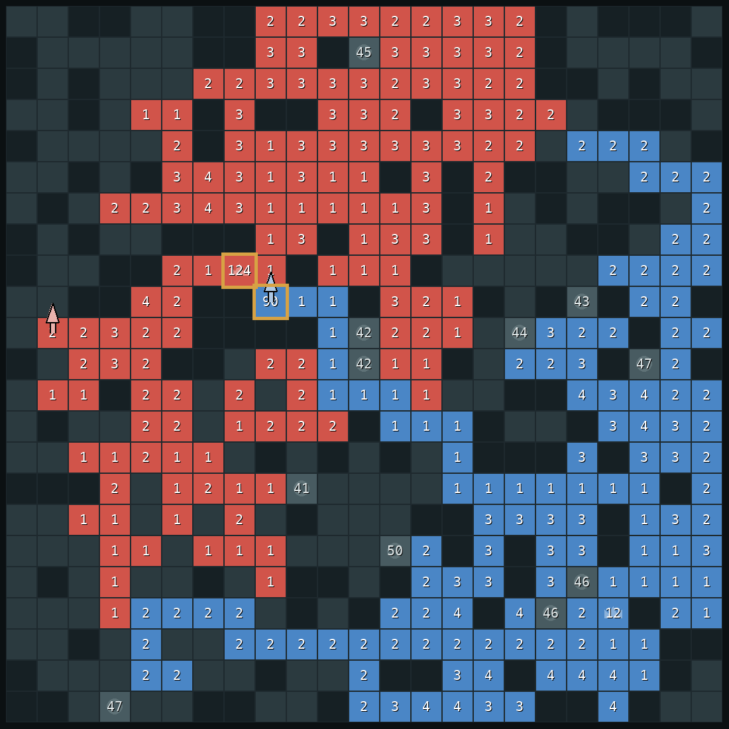
DAC-203 · ARTIFICIAL INTELLIGENCE · IIT ROORKEE
How our bot
plays Generals
v51: a game agent built from the textbook and six research papers.
Right: a real moment from a game. Our bot is red.
Notes:
SAY: Good morning. You've just watched the tutorial and seen the arena, so you already know the game.
In the next fifteen minutes I'll show you how our bot, v51, decides what to do, using one real game it played. Then the professor gets to play it.
The idea of the project was simple: take the methods from the textbook, search, probability, decision making and a bit of learning, and see how good a game player you can build with them.

Slide 2
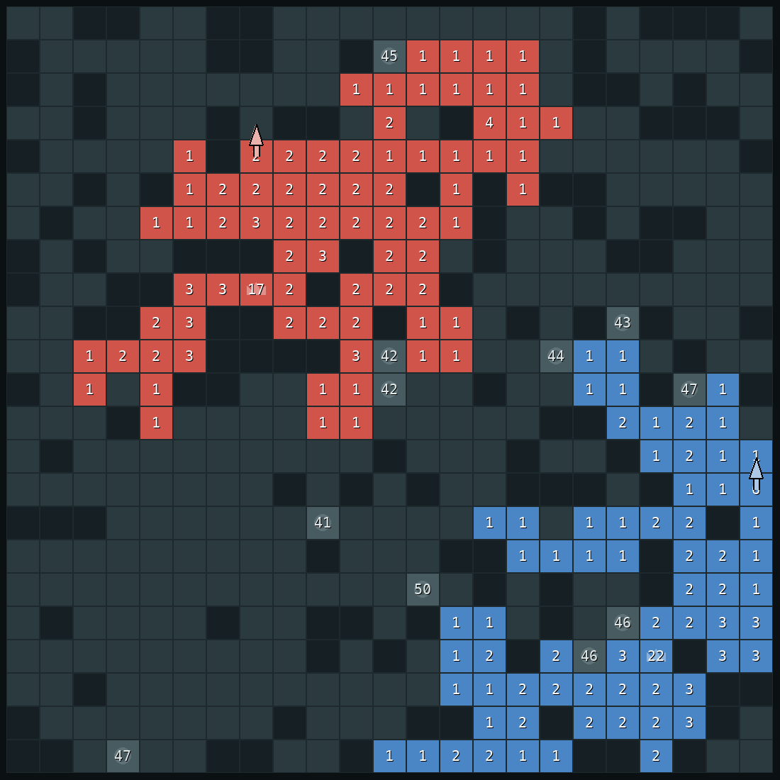
QUICK RECAP
The game in thirty seconds
Numbers are soldiers
Red is our bot, blue is the opponent.
Lose your general, lose the game
The crown marks each player's general.
One move per turn, both at once
Move one stack one square. Fights subtract.
Soldiers grow on their own
Generals and castles fast, land slowly.
2
Notes:
SAY: A quick recap of what you just saw in the tutorial.
Red is our bot, blue is the opponent. The number on a square is how many soldiers stand there. The crown is the general. Lose it and you lose the game.
Each turn you move one stack of soldiers one square. Both players move at the same time, so you never get to react to the other player's move first.
And soldiers grow by themselves. The general and castles grow fast, ordinary land grows slowly. Keep that in mind, because the whole bot is built around it.

Slide 3


THE KEY IDEA
Walking costs soldiers, waiting earns them
start
8 turns later
30 → 22
12 → 16
A general falls only when its soldiers have left, or when several stacks hit it one after another.
the attacker leaves a soldier on every square
the general grows while it waits
3
Notes:
SAY: This slide is the key to everything that follows.
A stack of 30 walks toward a general that has 12. Every square it walks over, it has to leave one soldier behind. So after 8 squares it has 22 left.
Meanwhile the general has been sitting still and growing. It now has 16.
So attacking a general that keeps its soldiers at home usually fails. A general only falls in two situations. One: its owner moved the soldiers away. Two: several stacks arrive one after another, and together they are too much.
Our bot watches for exactly these two things, both in attack and in defence.

Slide 4
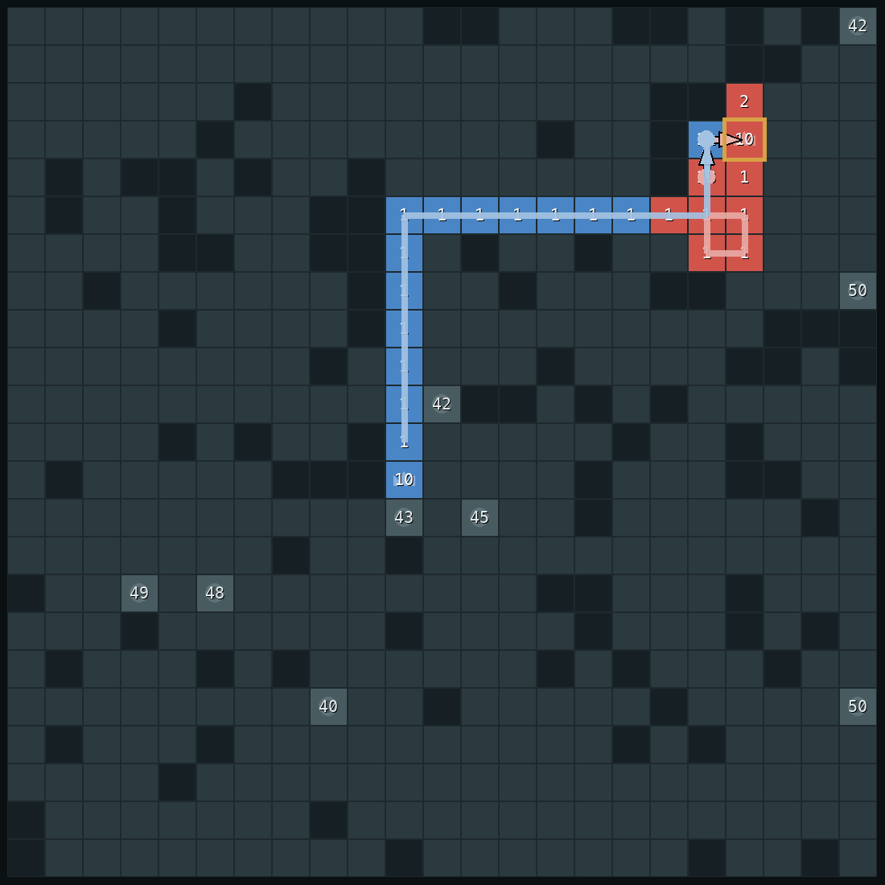
1
How we got here
Fifty versions, three changes of direction. What the five papers from our first two presentations gave us, and the games that made us change course.
Notes:
SAY: Before I explain v51, a few minutes on how we got to it, because v51 is not where we started.
In our first two presentations we picked five search papers and planned to build the bot from them. We built most of them. They worked as designed, and the bot did not get stronger.
I'll show you the evidence for that, then the three moments where real games forced us to change direction. The board on the right is one of those games: our old bot is red, and it is about to lose.

Slide 5
1 · HOW WE GOT HERE
The five papers we started with
Paper
What it is for
What it assumes
ARA*
Likhachev et al. 2003
find a path fast, improve it while time is left
finding the path is the hard part
RTAA*
Koenig & Likhachev 2006
learn better distance estimates while moving
distances are unknown
Depression avoidance
Hernández & Baier 2012
escape dead ends of a wrong estimate
estimates can be wrong
ProbCut
Buro 1995
search deeper by skipping hopeless branches
deeper search wins more
Metareasoning
Russell & Wefald 1991
decide how long to think
thinking time is scarce
All five make search faster or deeper. Our games were lost for another reason: a general left without enough soldiers.
5
Notes:
SAY: Here are the five papers from our first two presentations. For each one: what it is for, what it quietly assumes, and what we found when we measured our game.
ARA* finds a path quickly and improves it while time remains. It assumes finding a path is the hard part. In our game a complete distance map over all 529 squares takes four hundredths of a millisecond.
RTAA* and depression avoidance learn better distance estimates while the agent moves, and escape the dead ends that wrong estimates create. They assume you don't know the distances. Our map is fully visible, so distances are exact from the first turn and there is nothing to learn.
ProbCut lets you search deeper by skipping branches a shallow search already rules out. It assumes deeper search wins more games. I'll show you on the next slide that it didn't.
Metareasoning decides how long to think. It assumes thinking time is scarce. Our final bot uses 10 milliseconds out of 500.
So all five make search faster or deeper. Our games were being lost for a different reason, and none of the five papers looks at it: the general being left without enough soldiers.

Slide 6
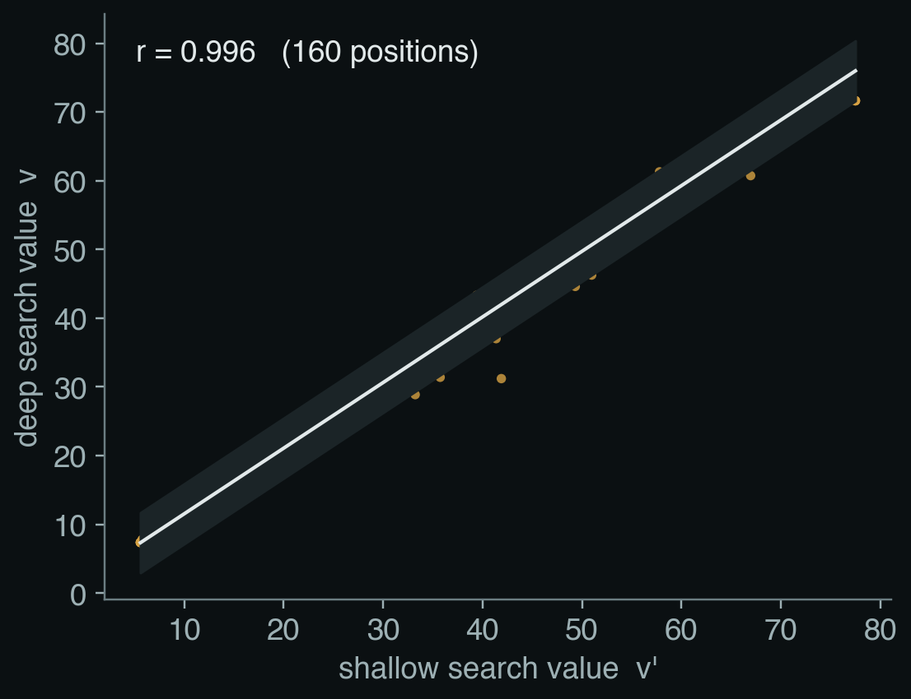
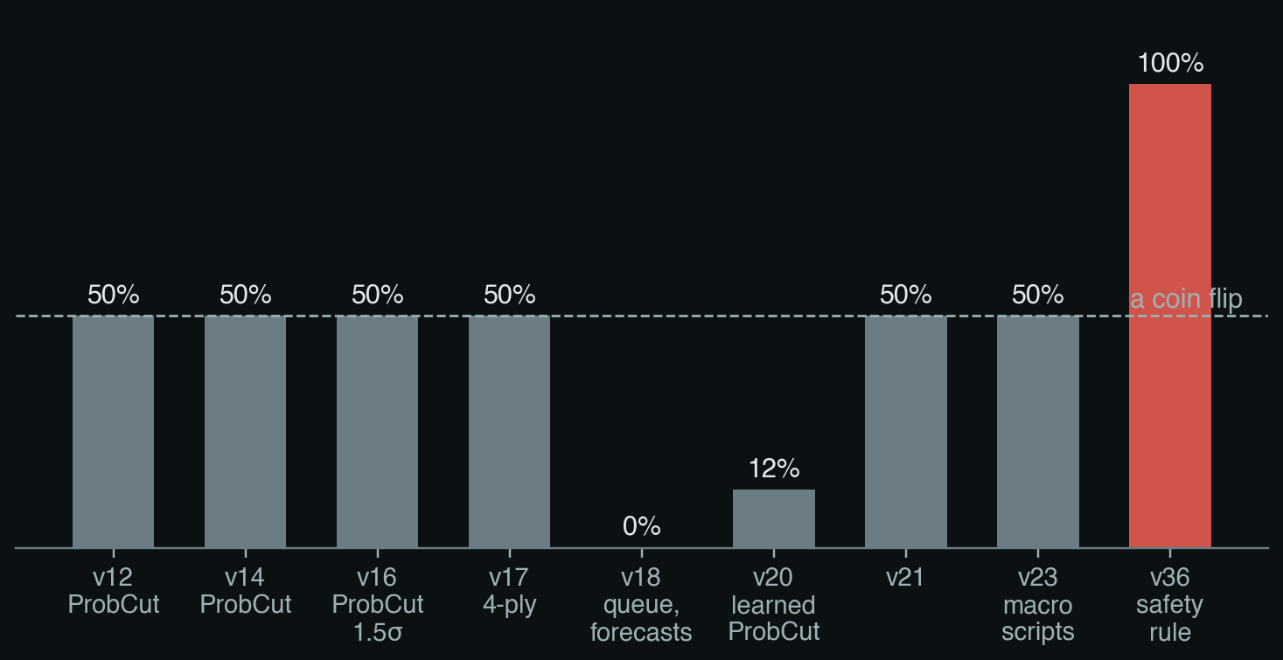
1 · HOW WE GOT HERE
Evidence 1: searching deeper didn't help
Shallow predicts deep almost exactly. 160 positions; v = 0.955 v′ + 1.97, σ = 2.18.
Win rate against v11, our best bot at the time. Search-paper bots (grey) stay at a coin flip or below. v36 (red) is the first bot built on the safety rule.
6
Notes:
SAY: First piece of evidence: ProbCut.
ProbCut's idea is that a shallow search predicts a deep search. The formula at the top: the deep value v is roughly a times the shallow value v-prime plus b, plus some noise. If the prediction is already clearly outside the window you care about, you skip the deep search and spend the time going deeper elsewhere.
We measured this on our game. The scatter on the left is 160 real positions: shallow value against deep value. They sit almost exactly on a line, correlation 0.996.
That sounds like great news for ProbCut. But read it the other way: if the shallow search already tells you the deep answer almost exactly, then searching deeper hardly ever changes your decision.
And that's what the bar chart shows. Every bot we built from these ideas, played against our best bot of that time, v11. ProbCut variants, four-ply search, learned ProbCut: none of them beats a coin flip. The red bar is v36, the first bot built on a different idea, the safety rule. It won every game against v11.

Slide 7
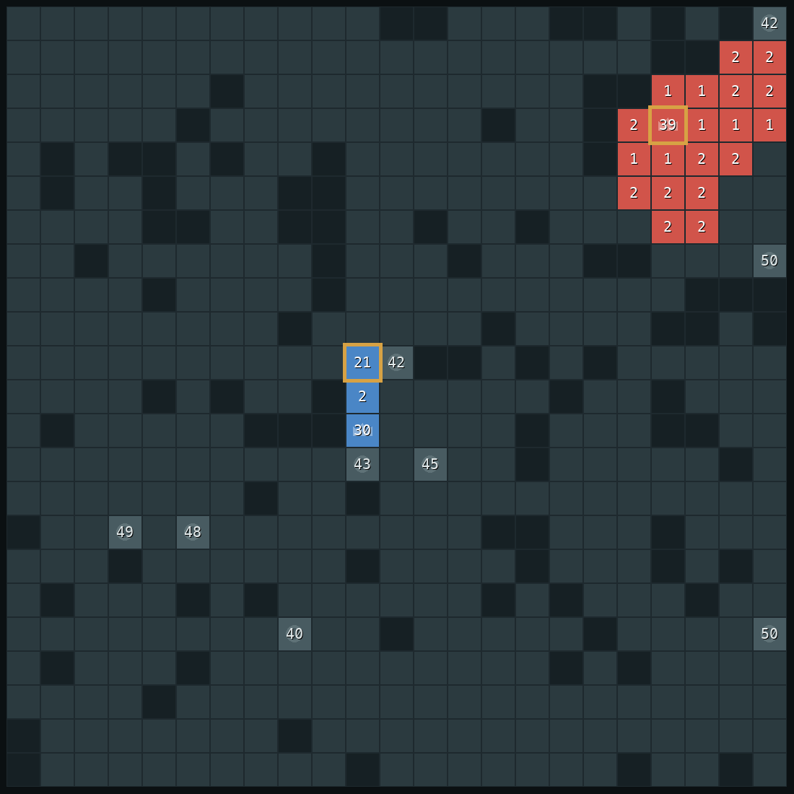
1 · HOW WE GOT HERE
Evidence 2: how the search-era bot actually lost
25 / 60
games v11 lost its general to two simple rush bots
24 / 25
of those games won by v36 on the same maps
turn 99
v11's general falls: 10 soldiers against 21
v11, turn 98. At turn 81 it moved 40 soldiers out of its general. Its stack circles (light red); the rusher walks straight in (light blue).
v36, same map, turn 98. 39 soldiers stay in the general. The rusher's 21 can't break it.
8
Notes:
SAY: Third piece of evidence, and the one that changed our direction: real losses.
We played v11, our best search-era bot, against two simple rush bots on 60 maps. It lost its general in 25 of them.
Here's one, map seed 2. Our bot is red. On the left is turn 98. At turn 81, v11 moved all 40 soldiers out of its general to go expanding. Then, the light red line: for 16 turns that stack circled the same four squares, re-deciding every turn., Meanwhile the rusher, the light blue line walked 17 squares straight to our general, which had grown back to only 10. Captured at turn 99.
On the right, the same map with v36. It never moved the soldiers out of its general: 39 at home. The rusher's stack, 21, has nowhere useful to go. v36 won this game, and 24 of the 25 that v11 lost.
The search wasn't the problem. The problem was that nothing in the bot asked: if I move these soldiers, can my general still be taken?

Slide 8
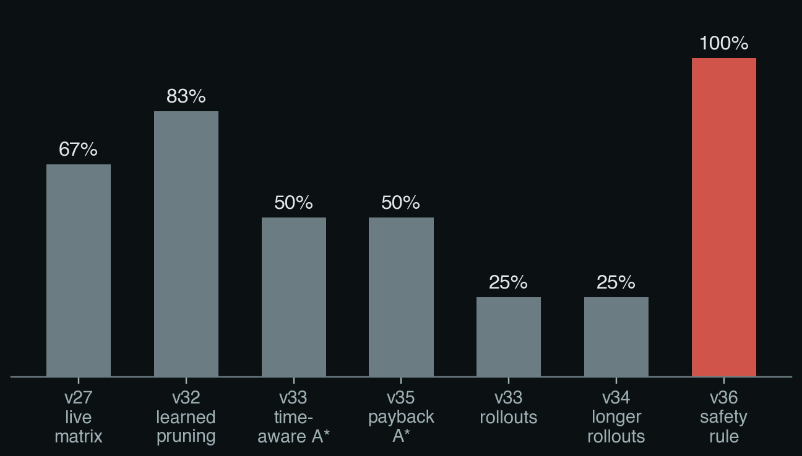
1 · HOW WE GOT HERE
Change 1: a safety rule before anything else (v36)
In words: for every enemy stack, my general must still win if that stack walks in.
v11's move at turn 81, if the general keeps 1:
If it keeps its 40:
Win rate against the direct rusher. Search-era bots (grey) on 4 to 6 game sets; v36 (red) on 20 games.
TERM Constraint before optimisation
First rule out every move that breaks a hard constraint, then choose the best of what is left. Here the constraint is: the general must survive any single enemy walk.
9
Notes:
SAY: So the first change of direction, v36: a safety rule before anything else.
The rule is the first formula. For every enemy stack s: what my general has now, plus what it grows while s walks over, must be more than what s would arrive with.
Apply it to the move v11 made at turn 81. If the general keeps 1 soldier, it has 1 plus 9 growth, 10, when an enemy stack of 42, 18 squares away, could arrive with up to 24. 10 is less than 24: the move is refused. If the general keeps its 40, it has 49 against 24, safe.
Everything else in the bot is allowed only if it keeps this rule. The chart shows the effect: our search-era bots against the direct rusher, small test sets, between 25 and 83 percent. v36: every game, 20 out of 20.
This was the moment we stopped trying to make search deeper and started modelling what actually loses games.
TERM ON THIS SLIDE, CONSTRAINT BEFORE OPTIMISATION: The general principle: rule out the moves that break a hard constraint first, then optimise among the rest.

Slide 9
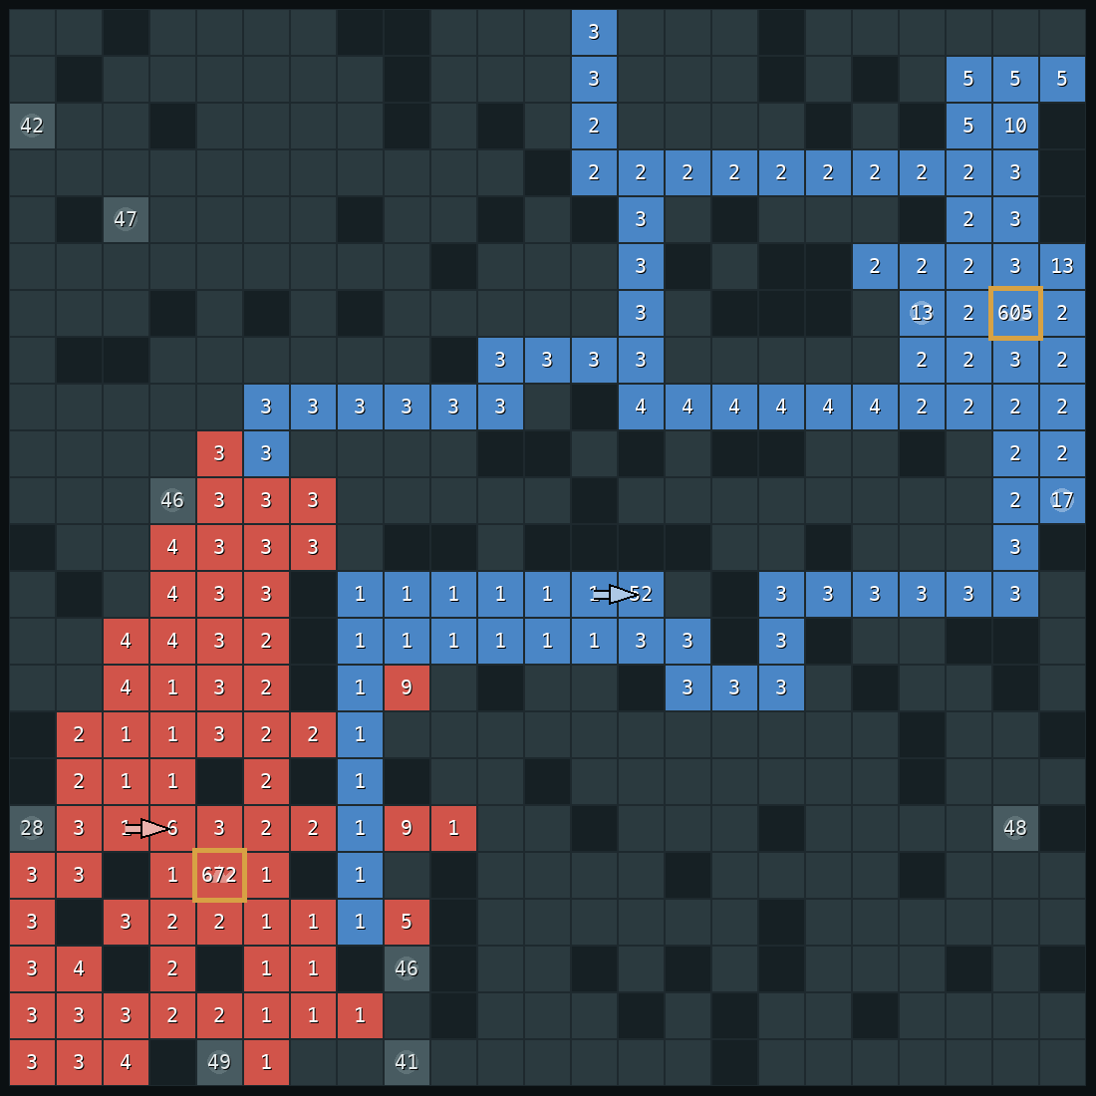
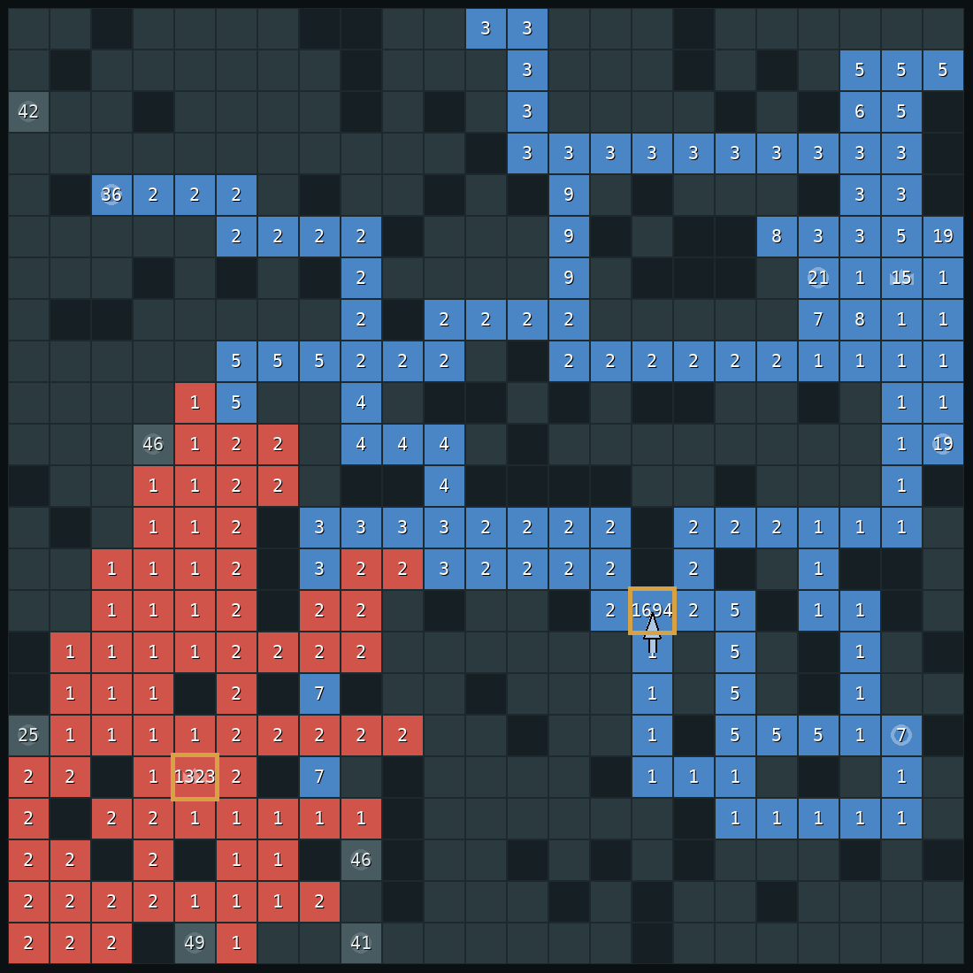
1 · HOW WE GOT HERE
Change 2: people beat it by collecting (v42)
Here the bot is red, the human blue.
No single human stack was bigger than the bot's general, so the old rule said: safe.
But the human held more land and castles 4 to 0, and collected it all into one stack.
New rule: count everything that can be collected in T moves, on both sides.
Turn 520. Human's biggest stack 605, bot's general 672.
Turn 845. Collected: 1,694 against 1,323.
Borrowed from Human.exe (Straka et al. 2026).
Old rule
New rule (idea 2)
10
Notes:
SAY: The second change came from people. After v37 we played against it ourselves, recorded the games, and found a way to beat it.
These are two moments from a real human win. Here the bot is red and the human is blue; the gold boxes are the human's biggest stack and the bot's general.
At turn 520 the human's biggest single stack is 605, smaller than the bot's general at 672. So by the old rule, one stack at a time, the bot felt safe. But the human owned twice the castles and had soldiers spread over much more land. By turn 845 the human has collected everything into one stack of 1,694 against a general of 1,323, and wins.
The old rule, the first formula, looks at one stack at a time. The fix, the second formula, which is the safety score from idea 2: count everything the enemy can collect and bring to my general in T moves, and everything I can bring home, for every T. That's v42, and it's where the Human.exe paper came in.

Slide 10
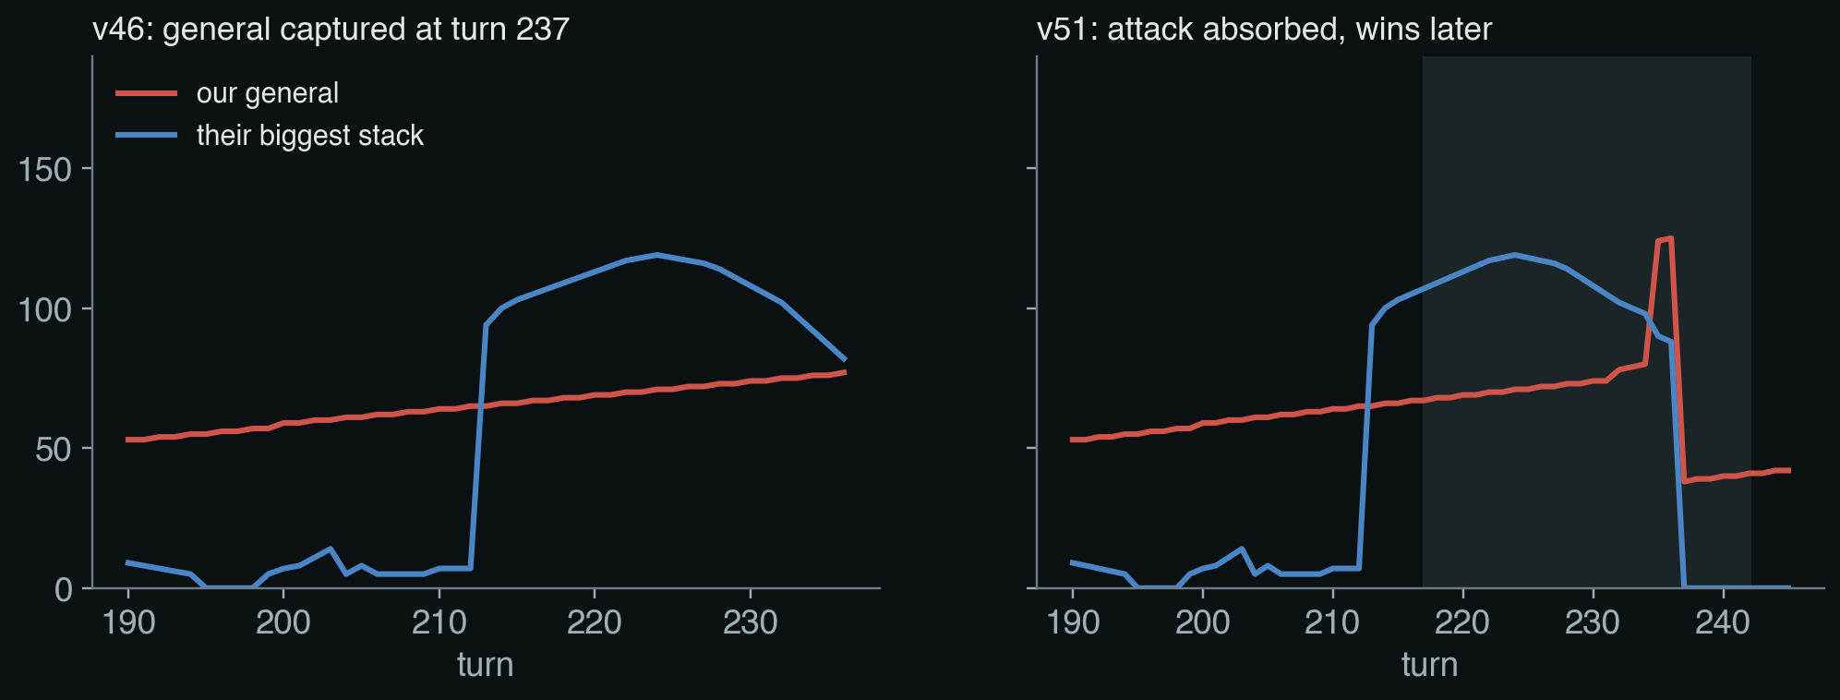
1 · HOW WE GOT HERE
Change 3: defend once, and keep defending (v51)
11
Notes:
SAY: The third change is v51 itself. v46, the version before, still lost to one pattern: build up quietly, then charge with one big stack.
The two charts are the same game, same map, same opponent. Red is our general, blue is the attacker's biggest stack.
On the left, v46. The attacker builds up from turn 200 and charges. v46 noticed the danger, defended for one turn, saw the safety score recover, went back to expanding, and so on. Its general stayed in the 70s and fell at turn 237, 77 against 82. At that moment it had 400 soldiers spread over the board and two stacks only three squares away.
On the right, v51. Once the attack is clearly coming, the grey band, it commits: every move pulls soldiers into the general until the attack is over. The general climbs to 124 and the attack fails.
The formula at the bottom is the whole difference: v46 decided to defend turn by turn; v51 decides once and keeps defending while the attack is coming. That's idea 4, and I'll come back to this exact game later.

Slide 11
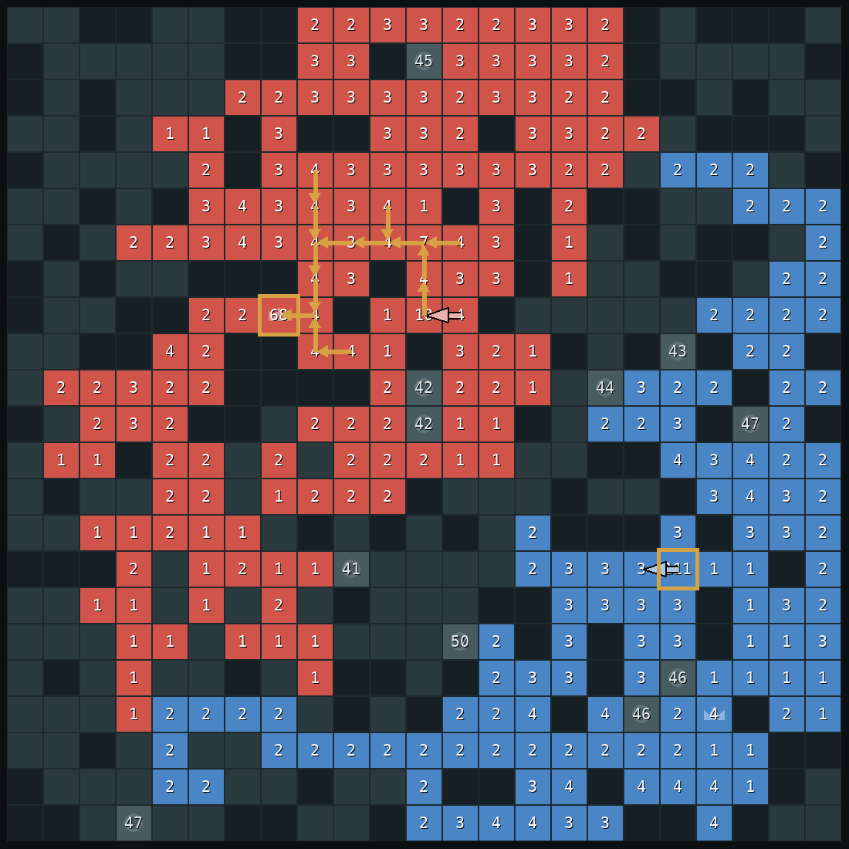
2
How v51 decides a move
Eight ideas. For each: the concept and its paper first, then how v51 uses it.
Notes:
SAY: Now, how does the bot decide what to do each turn? I'll go through eight ideas. For each one I'll say what it does, and where we got it from: the textbook, a research paper, or both.

Slide 12
2 · HOW V51 DECIDES
What happens every turn
1
2
3
4
5
6
Look
Guess
Check
Decide
Test
Move
read the whole board
what kind of player is the opponent?
is an attack coming?
defend now, or pick a plan
could this move lose the general?
one move, every half second
Two rules never change: a move that fails the test is never played, and when an attack is coming, defence gets every move until it is over.
TERM Utility-based agent (AIMA ch. 2)
An agent that picks actions by estimating how good the result will be, instead of following fixed rules.
TERM Simultaneous-move game (AIMA ch. 18)
Both players commit before seeing the other's move, so each turn is closer to rock-paper-scissors than to chess.
14
Notes:
SAY: Every turn, half a second, the bot goes through the same steps.
First it looks at the board. Then it updates its guess about what kind of player it is facing.
Then it asks: is an attack coming at my general? If yes, it drops everything and defends. If not, it picks a plan by imagining how the next forty turns would go.
And whatever move it picks, it tests it first. If the test says the move could lose the general, the move is never played.
The next slides go through these steps one by one.
TERM ON THIS SLIDE, UTILITY-BASED AGENT (AIMA CH. 2): In the book's terms this is a utility-based agent: it doesn't follow fixed if-then rules, it estimates how good each outcome would be and picks the best.
TERM ON THIS SLIDE, SIMULTANEOUS-MOVE GAME (AIMA CH. 18): And it's a simultaneous-move game: both players commit at the same moment, so you can't wait and react. That's why plain chess-style minimax doesn't fit directly.

Slide 13
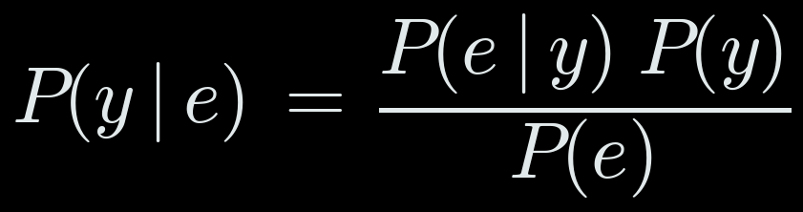
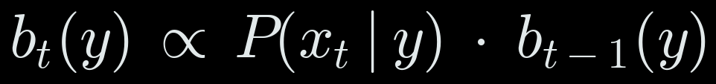
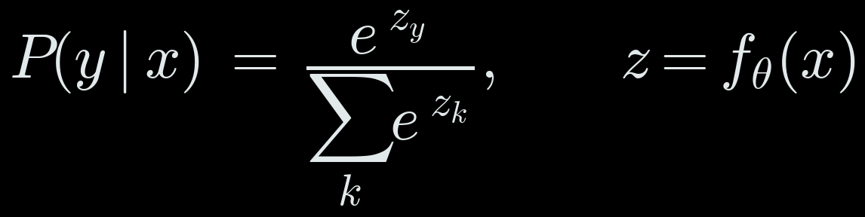
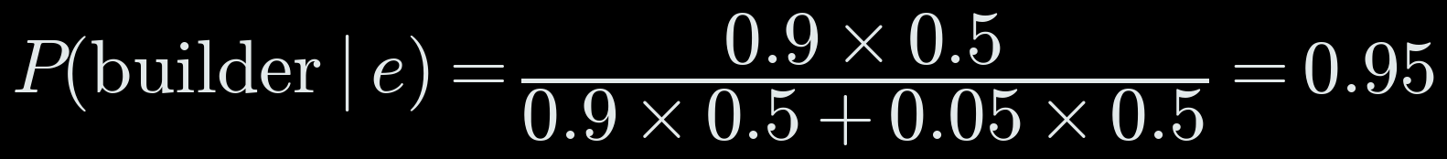
IDEA 1 · THE CONCEPT
Updating a belief with evidence
You hold a probability for each explanation. New evidence raises the explanations that predicted it and lowers the others. That is Bayes' rule.
Do it again every turn, keeping what you believed before, and you get a filter: a belief that follows the game.
Bayes' rule: belief in y after seeing evidence e
Repeated every turn: today's belief from yesterday's
A classifier turns measurements x into probabilities
THE PAPER
Synnaeve & Bessière, AIIDE 2011
Predicted a StarCraft player's opening strategy with a Bayesian model updated from what the player had built so far. Weber & Mateas (CIG 2009) trained classifiers on the same kind of features.
EXAMPLE (illustrative) two styles, 50/50; the general empties: 90% likely for a builder, 5% for a land grabber
15
Notes:
SAY: Before I show how the bot guesses, here's the idea underneath, in its simplest form.
You hold a probability for each explanation. When evidence arrives, the explanations that predicted it go up and the others go down. That's Bayes' rule, the first formula: belief after the evidence equals how well y predicted the evidence, times what we believed before, divided by a normaliser.
Example at the bottom: say we think the opponent is 50/50 a land grabber or a builder. Then its general suddenly empties. A builder does that 90 percent of the time, a land grabber 5 percent. Plug in: 95 percent builder after one observation.
Do that every turn, carrying the old belief forward, and you get a filter, the second formula, from chapter 14.
The third formula is how a classifier, our small neural network, produces those probabilities: it computes a score for each style and the softmax turns the scores into probabilities that add up to one.
The paper: Synnaeve and Bessière predicted StarCraft strategies exactly this way; Weber and Mateas trained classifiers on game features.

Slide 14
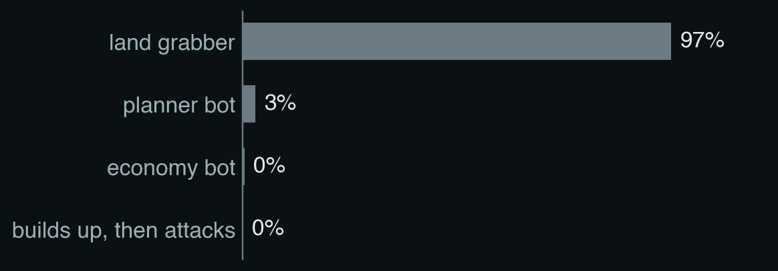
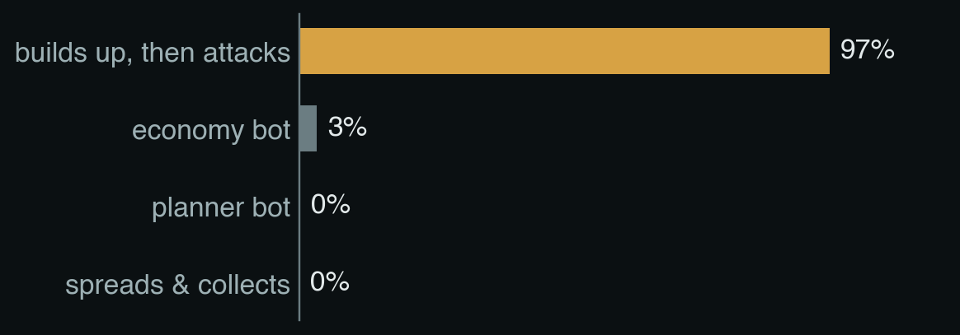
IDEA 1
Guess what kind of player you're facing
FROM THE BOOK updating beliefs with probability
FROM THE PAPER Synnaeve & Bessière 2011; Weber & Mateas 2009
The bot can see the whole board, but not the opponent's plan. So it keeps a guess over ten playing styles, like "rushes early" or "builds up, then attacks".
Each turn it measures a few things about the opponent: its land, how much army sits in its general, how big its biggest stack is, and whether that stack is getting closer.
A small neural network turns those measurements into a probability for each style.
turn 205
turn 215, after it pulls everything into one stack
TERM Classifier (AIMA ch. 19, 21)
A model that sorts an input into one of several categories. Here a small neural network sorts the opponent's stats into 10 styles.
Right about 70% of the time by mid-game on new maps. Random guessing: 10%.
16
Notes:
SAY: Idea one: guess what kind of player you are facing.
The bot can see the whole board, but it can't see the opponent's plan. So it keeps a guess. It knows ten playing styles, for example: rushes early, builds up and then attacks, grabs land and castles.
Every turn it measures a few things about the opponent: how much land it has, how much of its army sits in its general, how big its biggest stack is, and whether that stack is coming closer. A small neural network turns those numbers into a probability for each style.
Look at the two bar charts. At turn 205 the opponent looks like a player that only grabs land. Ten turns later it has pulled everything into one big stack, and the bot now says 97 percent: this player builds up and then attacks.
On new maps it guesses right about 70 percent of the time by the middle of the game. Random guessing would be 10 percent.
TERM ON THIS SLIDE, CLASSIFIER (AIMA CH. 19, 21): The network is a classifier: it takes some numbers and sorts them into one of a fixed set of categories, here ten playing styles. We trained it on games against each style.

Slide 15
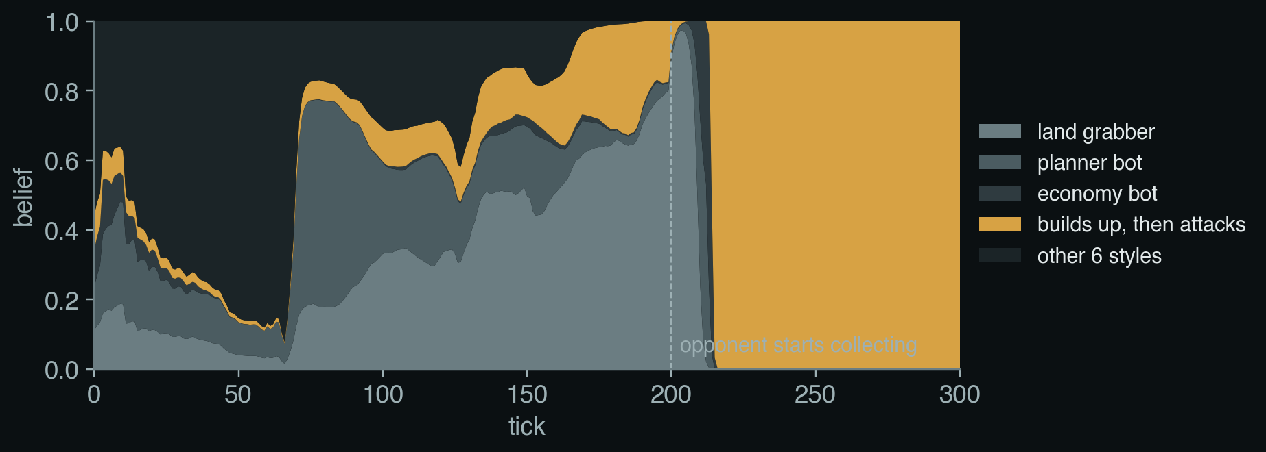
IDEA 1
The guess changes as the game goes on
In words: today's guess = mostly yesterday's guess, nudged toward what today's board suggests.
ℓ(y) how much evidence we have that the opponent plays style y
P(y | x) what the network thinks after seeing today's board x
0.95 old evidence fades slowly, so a change of style is noticed
Until turn 200 the guess is "land grabber", which is correct: before its attack, this opponent only grabs land. At turn 215 the guess flips to "builds up, then attacks".
TERM Bayesian filtering (AIMA ch. 14)
Keep a probability for each possibility and update it with every new observation, using Bayes' rule. Here old evidence also fades slowly.
17
Notes:
SAY: How does the guess change over time? One board on its own is weak evidence, so the bot doesn't throw away what it believed before.
In words: today's guess is mostly yesterday's guess, nudged a little toward what today's board suggests. That's the formula: 0.95 of the old evidence plus a bit of the new.
The 0.95 means old evidence slowly fades, so if the opponent changes style halfway, the bot notices.
In the chart you can see it: the bot thinks "land grabber" until turn 200, which is fair, because until then this opponent really is just grabbing land. The moment it pulls everything together, the guess flips.
This is the "update your belief as evidence arrives" idea from the probability chapters of the book.
TERM ON THIS SLIDE, BAYESIAN FILTERING (AIMA CH. 14): This is Bayesian filtering from chapter 14: you hold a probability for each possibility, and every new observation updates it with Bayes' rule. Ours also forgets slowly, so it can follow an opponent that changes style.

Slide 16
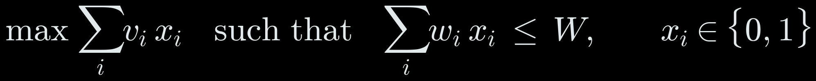
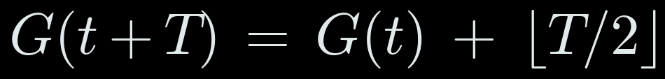
IDEA 2 · THE CONCEPT
Packing the most into a limited budget
You have several items, each with a value and a cost, and a fixed budget. The Knapsack DP problem asks what is the maximum objective we can reach.
Here an item is a stack walking to our general: its value is the soldiers it delivers, its cost is the moves it takes. The budget is the number of turns.
The knapsack problem: take items i to maximise value within budget W
Meanwhile the general grows by one every two turns
THE PAPER
Straka, Lisý & Schmid, 2026 (Human.exe)
Describes Human.exe, the strongest hand-written Generals bot. It decides how to gather its army by solving exactly this kind of budgeted collection problem.
EXAMPLE three enemy stacks bring 21, 16 and 15 in 25 moves; our general has 40
18
Notes:
SAY: Idea two rests on a classic problem: the knapsack. You have items with a value and a cost, and a budget. Which ones do you take?
For us, an item is an enemy stack walking toward our general. Its value is how many soldiers it delivers, its cost is how many moves it takes, and the budget is the number of turns. The first formula says: choose the items, x_i is one if we take item i, to maximise total value without going over the budget.
The second formula is the defender's side: the general gains one soldier every two turns.
Example: three enemy stacks would deliver 21, 16 and 15 soldiers in 25 moves in total, 52. Our general has 40 and grows by 12 in 25 turns, also 52. That's a tie, which means danger.
The knapsack problem is NP-hard: no fast exact method is known. So we use a greedy rule, biggest item first.
The paper: Human.exe, the best hand-written Generals bot, plans its gathering as this kind of budgeted collection problem.

Slide 17

IDEA 2
Is my general safe?
FROM THE BOOK searching for shortest paths
FROM THE PAPER Straka, Lisý & Schmid 2026 (Human.exe)
Every turn the bot compares two numbers:
Threat: how many enemy soldiers could reach my general if the enemy started walking its stacks in now.
Defence: how many my general will have by then, plus what my own stacks can bring home in time.
Defense minus threat is the safety score. Small means danger.
19
Notes:
SAY: Idea two: is my general safe right now?
Remember the danger: several stacks arriving one after another. So every turn the bot asks: if the enemy started walking its stacks at my general right now, how many soldiers could it get there? And how many would my general have by then, counting the stacks I could bring home in time?
The light-blue line on the board is the enemy's route to our general at turn 219. Its big stack has 111 soldiers and is 18 squares away.
The difference between the two numbers is a safety score. When it gets small, the bot knows an attack is possible soon.
We got this from a paper about Human.exe, the strongest hand-written Generals bot. It uses this counting to gather its own army. We use the same counting on the enemy's army, to measure the threat.

Slide 18
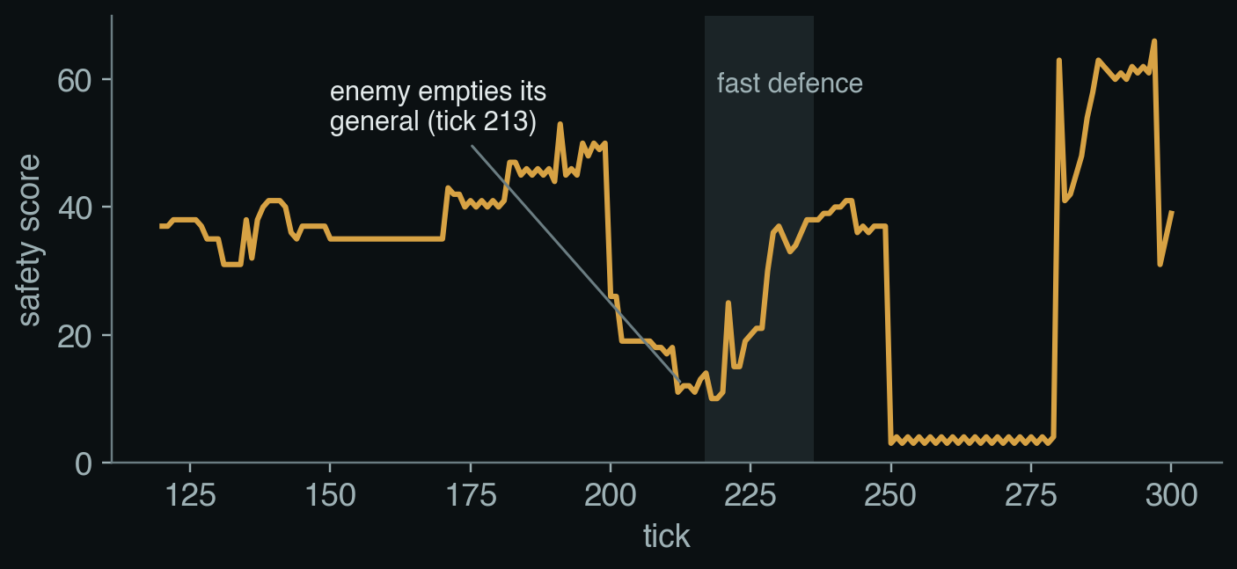
IDEA 2
The safety score during the game
In words: what my side can have at the general, minus what the enemy can bring, at the worst moment.
G soldiers on our general now
growth(T) what the general gains in T turns
D_us, D_them soldiers each side can walk to our general in T turns
lead our stacks must arrive a little early
NP-hard, and so we solved it greedily
Picking the best stacks to walk in a limited number of moves is NP-hard: no fast exact method is known. A greedy algorithm takes the biggest stack first, then the next.
At turn 213 the opponent empties its general into one stack. The score drops from 26 to 12.
20
Notes:
SAY: Here is the same idea written as a formula, and what it looked like during the game.
In words: what my general and my nearby stacks can have there, minus what the enemy can bring, at the worst possible moment. "Worst possible moment" because the bot checks every time window, ten turns, twenty turns and so on, and keeps the worst one.
The chart shows the safety score during the game. It sits around 40, then at turn 213 it falls to 12. That's the moment the opponent emptied its general into one big stack. The grey band is where the bot switches to defending, and the score climbs back up.
TERM ON THIS SLIDE, NP-HARD, SOLVED GREEDILY: Working out exactly how many soldiers can be gathered in T moves is NP-hard, a knapsack-style problem with no known fast exact solution. So we use a greedy algorithm: take the biggest stack first, then the next, until the moves run out. It's fast and close enough.

Slide 19
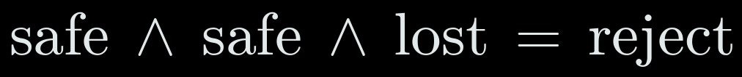
IDEA 3 · THE CONCEPT
Planning against every possible reply
Some problems have two kinds of choice. At an OR point we pick one option, and one good option is enough. At an AND point the world picks, and our plan must work for every option.
A move is safe only if it survives every attack the enemy could make. The tree of choices with these two kinds of point is called an AND-OR tree.
A move is accepted only if the general survives every reply b
Scoring the tree: we take the best at OR points, the worst at AND points
FROM THE BOOK
Russell & Norvig, AIMA chapter 4
Introduces AND-OR trees for planning when the outcome of an action is not under our control: a plan counts only if it works for every outcome.
EXAMPLE three possible enemy attacks; the general survives two of them
21
Notes:
SAY: Idea three comes straight from the textbook, chapter 4.
Some problems have two kinds of choice. At an OR point, we choose, and we only need one option that works. At an AND point, the environment or the opponent chooses, and our plan has to work no matter what it picks.
The first formula is the rule the bot uses: accept a move only if, for all enemy replies b, the general survives.
The second formula is how such a tree is scored: take the best value at our choices, the worst value at the opponent's choices. That's the same idea as minimax in chess, but we only use it as a yes or no safety test.

Slide 20
IDEA 3
Test every move before making it
FROM THE BOOK planning against every possible reply (AND-OR search)
1. Try the move on a copy of the board. If the general is still safe, play it.
2. If not, imagine the enemy attacking along each likely route, with our bot defending.
3. If the general falls in any of these imagined games, never play the move.
our move
enemy attack 1
enemy attack 2
enemy attack 3
TERM AND-OR search (AIMA ch. 4)
A search tree with two kinds of node. At OR nodes we choose one option; at AND nodes every option must work. A move is good only if it survives all enemy attacks.
general safe
general safe
general lost
One loss is enough to throw the move away.
22
Notes:
SAY: Idea three: never make a move that could lose the general.
Before every move, the bot tries it on a copy of the board. If the safety score stays healthy, fine.
If not, it plays the move out in its head. It imagines the enemy attacking along each likely route, with everything it has, and our bot defending. If the general falls in even one of those imagined games, the move is thrown away.
So the bot only needs one bad outcome to reject a move. In the textbook this is called an AND-OR search: we choose our move, but the move has to survive every one of the enemy's options.
TERM ON THIS SLIDE, AND-OR SEARCH (AIMA CH. 4): This is AND-OR search from chapter 4. Our move is an OR node: we just need one good choice. The enemy's possible attacks are an AND node: our move has to survive all of them, not just most.
This is basically like minimax but checking only

Slide 21
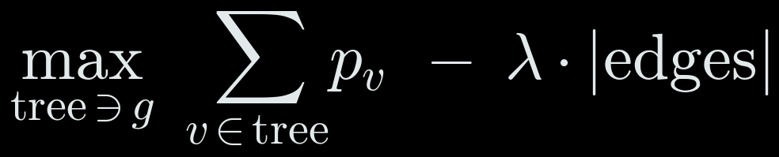
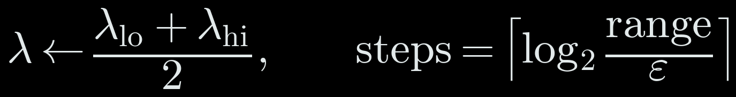
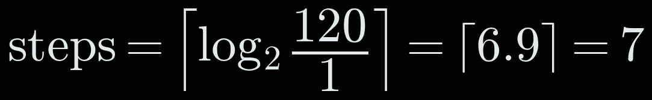
IDEA 4 · THE CONCEPT
Collecting as much as possible with a price on effort
We want a tree of routes, all ending in our general, that collects the most soldiers. Every square on a route costs one move.
Trick: put a price λ on each move. Maximise prize minus price. A high price gives a small, quick tree; a low price gives a big, slow one. Search for the price that makes the tree fit the time left.
Prize-collecting Steiner tree: prize p_v on each square, price λ per move
Binary search on the price: halve the range each time
THE PAPER
Straka, Lisý & Schmid, 2026 (Human.exe)
Human.exe gathers its army with this exact structure, a prize-collecting Steiner tree, and searches for the price per move so the plan fits its turn budget.
EXAMPLE prices between 0 and 120, to within 1
23
Notes:
SAY: Idea four, the fast defence, uses a structure called a prize-collecting Steiner tree. Let me explain it simply.
Imagine every square we own holds a prize, its soldiers. We want a tree of routes, all ending at our general, that collects the most prize. But every square on a route costs a move, and we only have so many turns.
The trick: put a price, lambda, on each move. Then maximise prize minus price times the number of moves. That's the first formula. If the price is high, only stacks very close to the general are worth fetching. If it's low, the tree reaches far away and takes too long.
So we search for the right price with binary search, the second formula: try the middle of the range, see if the tree fits, keep the half that works. Each try halves the range, so seven tries are enough.
The paper: Human.exe gathers its army with exactly this method. We use it the other way round, to defend.

Slide 22
IDEA 4
When an attack is coming, defend fast
FROM THE BOOK turning a goal into a search problem
FROM THE PAPER Straka, Lisý & Schmid 2026 (Human.exe)
1
Notice
A big enemy stack moved 2+ squares closer in the last 5 turns. Its distance = turns left means we can treat it like as signal to protect
2
Measure
When it arrives, how many soldiers short will the general be?
3
Gather
Use every remaining move to pull soldiers into the general.
Right: the 14-move plan at turn 219 (gold arrows), all ending in the general.
24
Notes:
SAY: Idea four is the new part in v51, and it's the reason it beats the strategy that people used against our earlier bots.
When a big enemy stack is clearly coming, the bot stops everything else and defends.
First it notices: a big stack that has moved at least two squares closer in the last few turns. How far away it is tells the bot how many turns it has.
Then it measures: when the attacker arrives, how many soldiers short will the general be?
Then it gathers: it uses every remaining move to pull soldiers into the general itself, not next to it.
The gold arrows on the board are the actual plan it made at turn 219: fourteen moves, all ending in the general.

Slide 23

IDEA 4
Which stacks to pull in, and in what order
In words: collect as many soldiers as possible into the general, using no more moves than the turns left.
a_v − 1 soldiers we can take from square v (one must stay)
λ a price per move. Try prices until the plan fits the time left.
ETA − 2 turns before the attacker arrives, minus a small safety margin
Order: start with the farthest stacks, so soldiers pile up on the way in.
TERM Prize-collecting Steiner tree · binary search
A tree of routes into one point that collects the most prize for its cost (NP-hard). Binary search finds the right price per move by halving the range each try: 7 tries.
Turn 230: three moves of the plan left.
25
Notes:
SAY: How does it decide which stacks to pull in? Think of every square we own as holding a small prize: its soldiers. Every step costs one move. We want the set of routes into the general that collects the biggest prize, using no more moves than we have turns left.
That is a hard problem in general. The trick, which we borrowed from Human.exe, is to put a price on each move. With a high price, the bot only collects stacks close to the general. With a low price, it reaches far, maybe too far to finish in time. It tries prices until the plan just fits the time left.
Then it plays the moves from the far end first, so soldiers pile up on the way in, like a snowball. In the screenshot, three moves of the plan are left.
TERM ON THIS SLIDE, PRIZE-COLLECTING STEINER TREE · BINARY SEARCH: The formal name is a prize-collecting Steiner tree: a tree of routes into one point, the general, that collects the most prize for the cost. It's NP-hard, so we build it greedily for a given price per move, and find the right price with binary search: halve the range each time, seven tries.

Slide 24
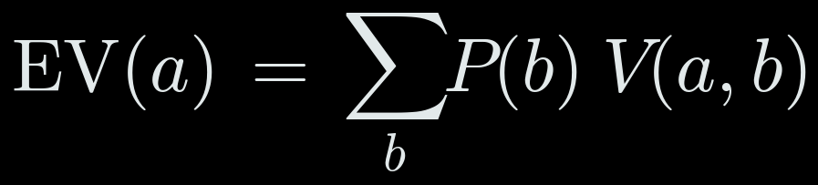
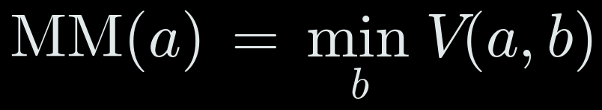
IDEA 5 · THE CONCEPT
Choosing when you don't know the opponent
Too many single moves to search, so search over a few plans instead, each played forward in simulation (a rollout).
Then decide. Average over what we think the opponent is (expected value), or assume the worst (maximin), or mix the two (the Hurwicz criterion).
Expected value: average over opponents, weighted by our belief
Maximin: assume the worst opponent
Hurwicz: a mix of the two; ours is half and half
THE PAPER
Barriga, Stanescu & Buro, AIIDE 2015 (Puppet Search)
Searches over the choices inside a few scripted plans instead of over raw moves, which makes look-ahead affordable in real-time strategy games.
EXAMPLE turn 240 of the game
26
Notes:
SAY: Idea five is about deciding when you don't know who you're up against.
First, you can't search every move, there are tens of thousands. Puppet Search, the paper here, says: search over a few plans instead, and play each one forward in simulation. That forward simulation is called a rollout.
Then you have a table: each plan's chance of winning against each type of opponent. How do you pick?
Expected value, the first formula: average the row, weighted by how likely you think each opponent is.
Maximin, the second: look only at the worst case in each row.
Expected value trusts your guess. Maximin ignores it. The Hurwicz criterion, the third formula, mixes them; we use half and half.
Example from the real game: taking the castle scores 0.70 on average and 0.69 in the worst case, so 0.69. Expanding scores 0.59. The bot takes the castle.

Slide 25
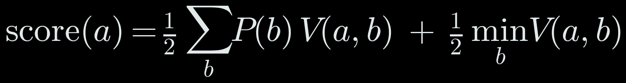
IDEA 5
Pick a plan by imagining the next 40 turns
FROM THE BOOK looking ahead in games; choosing under uncertainty
FROM THE PAPER Barriga, Stanescu & Buro 2015 (Puppet Search)
plan
vs rusher
vs castle
rusher
vs land
grabber
vs waiter
score
In words: half the average (weighted by our guess about the opponent), half the worst case.
keep expanding
0.83
0.83
0.59
0.83
0.59
take castle A
0.88
0.88
0.69
0.88
0.69
take castle B
0.83
0.83
0.69
0.83
0.69
Good against the opponent we expect, never a disaster if we guessed wrong.
take castle C
0.87
0.87
0.69
0.87
0.69
attack now
0.83
0.83
0.59
0.83
0.59
TERM Rollouts · Hurwicz criterion
A rollout plays the game forward in simulation. The Hurwicz criterion scores a choice by mixing its average and its worst case; ours is 50/50.
Real numbers from turn 240: the learned win estimate (section 3) after 40 imagined turns.
27
Notes:
SAY: Idea five: when nothing urgent is happening, how does it choose what to do?
There are tens of thousands of possible moves each turn, far too many to search one by one. So instead the bot chooses between a handful of plans: keep expanding, take one of the nearby castles, attack, and so on.
For each plan, it imagines the next forty turns, four times, against four imagined opponents: one that rushes, one that takes castles first, one that grabs land, and one that waits. At the end it estimates its chance of winning.
This table is real, from turn 240 of the game. Taking a castle scores 0.69, keeping on expanding scores 0.59, so it takes a castle.
How does it combine the four columns? Half the score is the average, weighted by its guess about the opponent from idea one. The other half is the worst case. So it prefers plans that suit the opponent it thinks it faces, but never plans that would be a disaster if the guess is wrong.
The paper here is Puppet Search: search over a few plans instead of over every move.
TERM ON THIS SLIDE, ROLLOUTS · HURWICZ CRITERION: Two terms here. Imagining forty turns ahead is called a rollout: playing the game forward in simulation. And scoring by half average, half worst case is the Hurwicz criterion from decision theory, a middle ground between trusting your guess completely and assuming the worst.

Slide 26
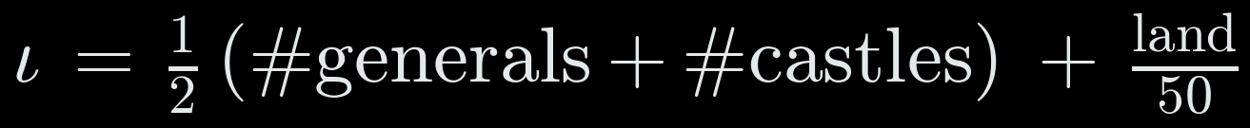
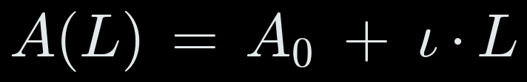
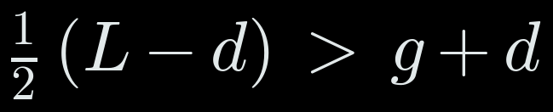
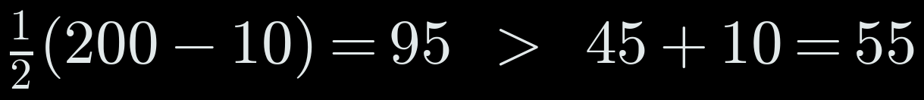
IDEA 6 · THE CONCEPT
Is an investment worth it?
A castle is an investment: you pay soldiers now, and it produces soldiers until the game ends.
Compare what it will produce with what it costs. And to know whether you need it at all, project both players' armies forward at their current income.
Income per turn: generals and castles give ½, each square of land 1/50
Projected army after L more turns
A castle pays if what it produces beats its cost (garrison g plus walk d)
THE PAPER
Churchill & Buro, AIIDE 2011
Planned StarCraft build orders by simulating each player's economy forward in time, to see which investments pay off and when.
EXAMPLE 200 turns left, garrison 45, walk 10
28
Notes:
SAY: Idea six treats a castle as an investment.
You pay soldiers now, the garrison plus the soldiers lost walking there, and the castle produces half a soldier per turn until the game ends.
The first formula is income per turn: generals and castles give a half each, and every square of land gives one fiftieth.
The second projects an army forward: what you have now plus income times the turns left. Comparing both players' projections tells the bot whether it is clearly ahead or not.
The third is the payback rule: half the remaining turns, after the walk, must be more than the cost.
Example: 200 turns left, garrison 45, walk 10. It produces 95, it costs 55. Worth it.
The paper: Churchill and Buro planned StarCraft economies exactly by simulating income forward.

Slide 27
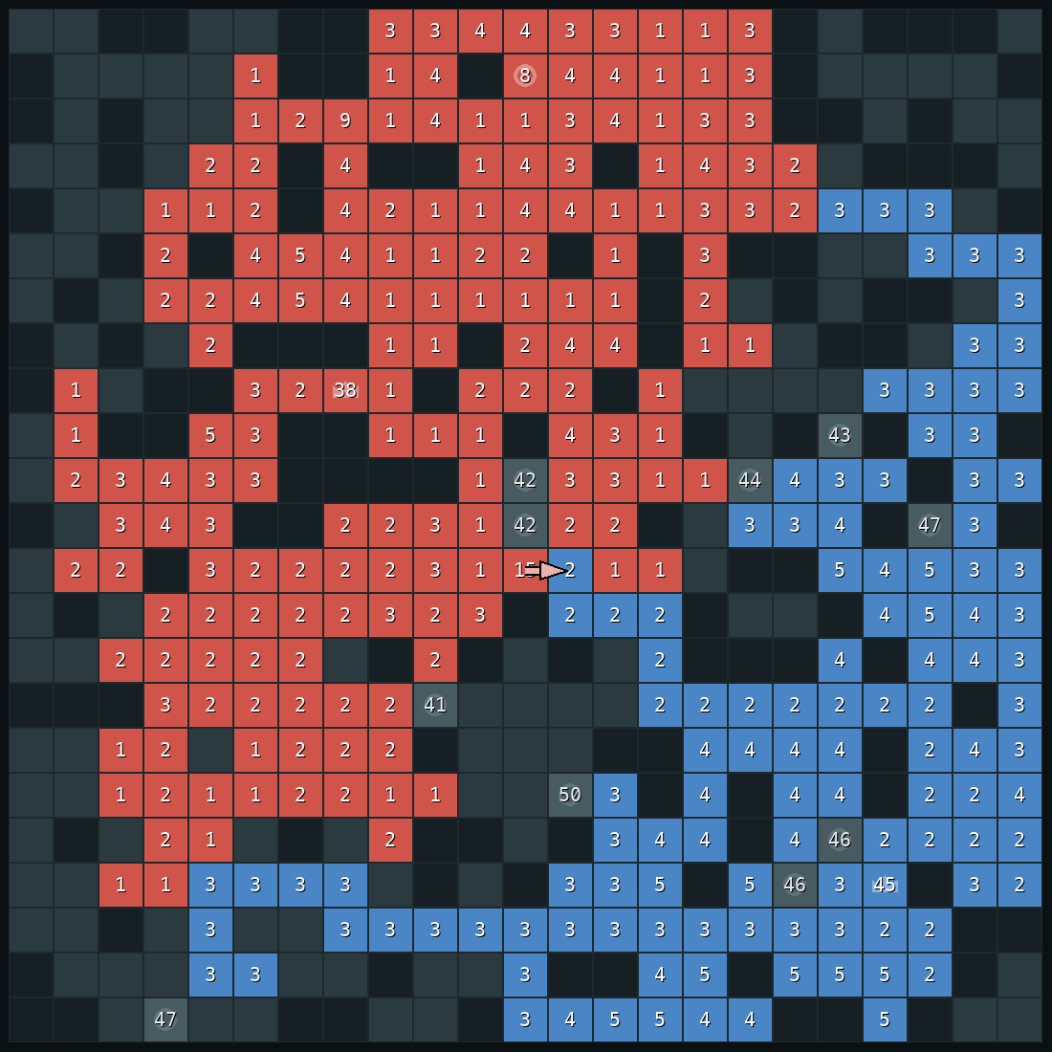
IDEA 6
Castles: only when they pay and home stays safe
FROM THE BOOK weighing costs against expected payoff
FROM THE PAPER Churchill & Buro 2011
Worth it? A castle produces like 25 squares of land. It must pay back its cost before the game ends.
Safe? Fast-forward to when our stack has been spent on the castle. Is the general still safe then?
Needed? If we are already clearly ahead, take only cheap castles.
Right: turn 298, the bot's first castle in this game.
TERM Expected utility (AIMA ch. 16)
The value of a choice is what it is expected to gain minus what it costs, over the time it has to pay off.
29
Notes:
SAY: Idea six: castles. A castle produces as many soldiers as 25 ordinary squares, so castles win long games. But taking one means sending a big stack away, and that leaves home weaker.
So the bot asks three questions. Is it worth it: will the castle pay back what it costs before the game ends? Is it safe: the bot fast-forwards the board to the moment the stack has been spent on the castle, moves the enemy forward too, and checks the general is still safe at that moment. And is it needed: if we are already clearly ahead, cheap castles only.
The last idea comes from a paper on planning the economy in StarCraft: project both players' income forward to the end of the game.
In the screenshot, turn 298, the bot takes its first castle, after it has dealt with the attack.
TERM ON THIS SLIDE, EXPECTED UTILITY (AIMA CH. 16): This is expected utility from chapter 16: a castle is worth taking only if what it's expected to produce before the game ends is more than what it costs.

Slide 28
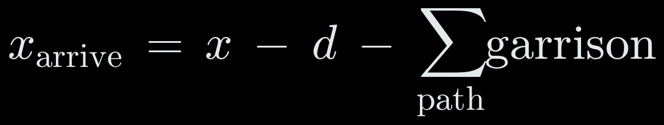
IDEA 8 · THE CONCEPT
The arithmetic of an attack
An attacking stack shrinks on the way: one soldier stays on every square it crosses, and it fights anything in its path.
The defending general keeps growing, and the enemy can bring other stacks home. The attack works only if what arrives beats all of that.
What arrives: the stack, minus one per step, minus what it fights
The attack works only if it beats the general, its growth, and reinforcements
SOURCE
The game's own rules
No paper needed here: these are the movement and production rules of the game, written as inequalities. The attack is then checked with the AND-OR test of idea 3.
EXAMPLE (illustrative) a 60-stack, 10 steps, 5 in the way; general 2, reinforcements 20
32
Notes:
SAY: Idea eight is just arithmetic, the key idea from the beginning written down.
The first formula: what arrives is the stack minus one soldier per step, minus everything it has to fight on the way.
The second: the attack only works if that is more than the general now, plus what it grows during the walk, plus what the enemy could bring home in time.
Example: a stack of 60 walks 10 squares through 5 enemy soldiers and arrives with 45. The enemy general has 2, grows by 5, and the enemy could bring 20 home: 27. 45 beats 27, so the attack can work.
The bot then also plays the attack out against four replies, the AND-OR test from idea three, before it commits.

Slide 29
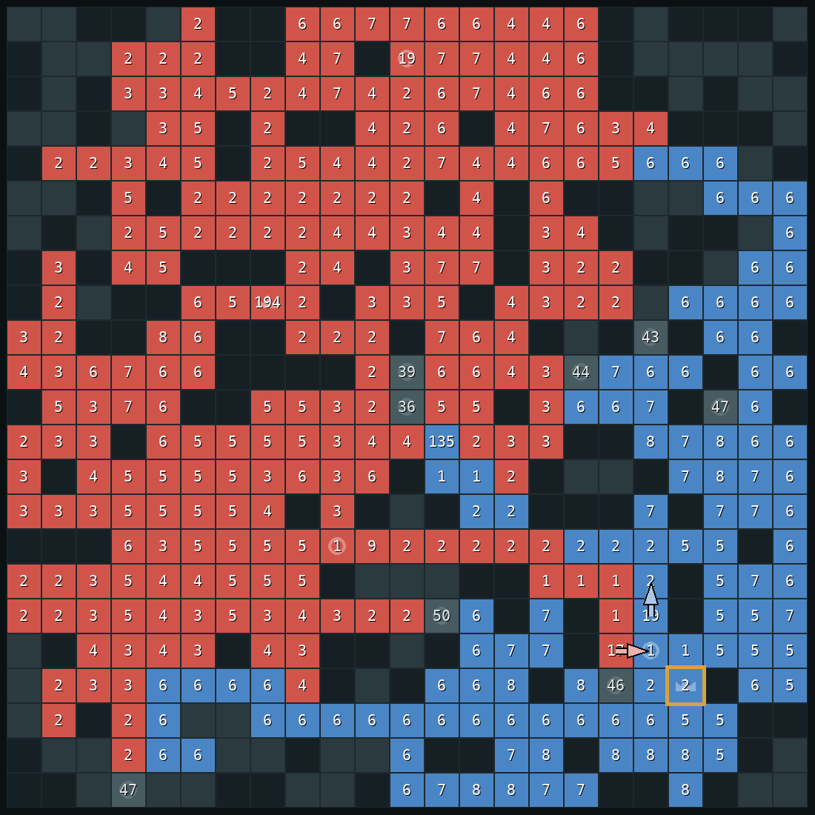
IDEA 8
Attack only when it's sure to work
FROM THE BOOK planning against every possible reply
The bot attacks the enemy general only if:
1 its stack arrives bigger than everything the enemy can have there;
2 our own general stays safe while the stack is away;
3 it wins against four imagined replies.
In practice: when the enemy has emptied its general. Right: turn 405, the enemy general (gold box) has 2 soldiers.
Weakness: against a careful player it attacks late.
33
Notes:
SAY: Idea eight: when does the bot attack?
From the key idea at the start, attacking a full general rarely works. So the bot only attacks when it can prove the attack works.
Three conditions. The stack must arrive bigger than the enemy general, including what the general grows and what the enemy could bring home in time. Our own general must stay safe while the stack is away. And the attack must win in imagined games against four different replies: the enemy rushes us, takes a castle, does nothing, or pulls everything home.
In practice, this happens when the enemy has emptied its general. In this screenshot, turn 405, the enemy general has only two soldiers.
This is also the bot's main weakness: against a careful player who never empties the general, it attacks late or not at all.

Slide 30
2 · HOW V51 DECIDES
Where each idea came from
Paper
What we borrowed
Used in
Straka, Lisý & Schmid 2026
how to count soldiers that can be gathered in time
ideas 2, 4
Barriga, Stanescu & Buro 2015
search over a few plans, not every move
idea 5
Synnaeve & Bessière 2011
keep a probability over the opponent's strategy
idea 1
Weber & Mateas 2009
learn to recognise a strategy from game features
idea 1
Churchill & Buro 2011
plan the economy by projecting income forward
idea 6
From the book: probability and belief updates, planning against replies, game lookahead, decisions under uncertainty, a small neural network.
34
Notes:
SAY: To sum up where the ideas came from.
From the textbook: updating beliefs with probability, planning against every possible reply, looking ahead in games, choosing under uncertainty, and a small neural network.
And six research papers. The two that shape the most behaviour are the Human.exe paper, which gave us the way to count how many soldiers can be gathered in time, used for both the safety score and the fast defence; and Puppet Search, which gave us the idea of searching over a few plans instead of every move.

Slide 31
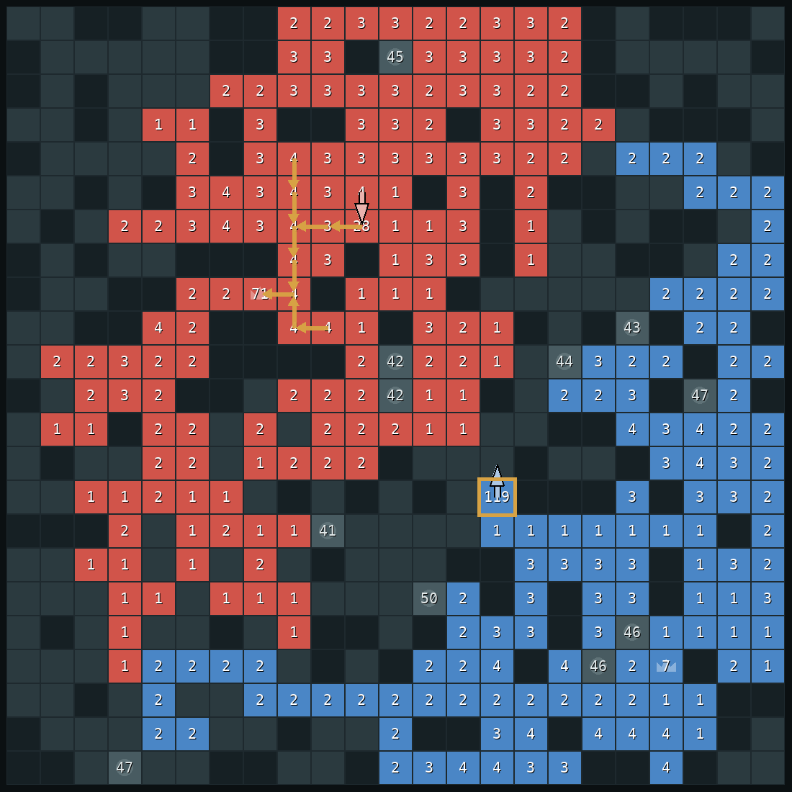
3
Every part of v51
Everything the eight ideas skipped: the order of checks, the simulator, the learned win estimate, the classifier in full, and the small safety rules.
Notes:
SAY: The eight ideas are the core. This section goes through every remaining part of the bot, so that nothing in it is a black box: the exact order of checks each turn, the simulator, the learned model that scores imagined games, the classifier in full, and the small rules that came from specific lost games.

Slide 32
3 · EVERY PART OF V51
The full turn, in order
1
Read the board; update the guess about the opponent
always
2
Can a stack take their general right now?
take it
3
A big stack is coming and the general will be short?
fast defence (idea 4)
4
Is our home losing the race?
counter-strike, if it passes the test
5
A castle pays back and stays safe?
castle move (idea 6)
6
Otherwise
the committed plan (idea 5)
Notes:
SAY: This is the exact order of checks the bot runs every turn. The first check that says yes decides the move.
One: read the board and update the guess about the opponent.
Two: if one of our stacks next to the enemy general can take it, take it. That ends the game, so nothing else matters.
Three: is a big enemy stack coming, and will the general be short when it arrives? Then the fast defence from idea 4 picks the move.
Four: update the two switches from idea 7, the castle gate and the threat gate. The threat gate sets how much the general keeps in reserve.
Five: if our home is losing the race, look for a counter-strike: hitting their general first. Only if it passes the four-reply test.
Six: if things are urgent, the safety score is under the pad or we have a proven attack, the rule list from v36 decides: attack, defend, or pull soldiers home.
Seven: if a castle is worth taking and safe, take it.
Eight: otherwise follow the committed plan from idea 5.
And at the bottom: plan and castle moves are tested first. If a move fails the test, the next rule is tried, and if nothing passes, a simple defender script moves.

Slide 33
3 · EVERY PART OF V51
Phases: how far ahead to look, how long to keep a plan
opening
mid-game
end game
TERM Depth-limited search (AIMA ch. 5)
Look ahead a fixed number of moves, then score the position with an evaluation function instead of playing to the end.
look ahead
24 turns
40 turns
60 turns
keep the plan
6 turns
10 turns
8 turns
castles offered
2 nearest
3 nearest
3 nearest
attack plans
no
yes
yes
End game: few turns left, or one side clearly ahead
Keeping a plan for several turns stops the bot from changing its mind every turn, which is how v11 lost.
Opening: no threat yet and plenty of free land (f free squares, n, n′ owned)
A new plan before K turns are up if:
38
Notes:
SAY: Idea 5 said the bot imagines forty turns ahead. That number actually depends on the phase of the game, and the bot works out the phase from the board, not from the clock.
Opening: nobody threatens anybody and more than 35 percent of the walkable land is still free. That's the second formula. Mid-game: there is contact or a live threat. End game: fewer than 60 turns left, or one side clearly ahead, twice the land plus 20 and twice the army plus 40. That's the first formula.
The table: in the opening it looks 24 turns ahead and keeps a plan for 6 turns; mid-game 40 and 10; end game 60 and 8, or right to the last turn if that's closer, where the game's tiebreak decides the winner exactly.
Keeping a plan for several turns matters: otherwise the bot changes its mind every turn and gets nowhere, which is exactly what we saw v11 do. But some events force a new plan straight away: the phase changes, a castle changes hands, the enemy general drops below half, or the plan is finished. That's the last formula.
In the book this is depth-limited search: look ahead a fixed number of steps, then score the position with an evaluation function, which is the next slides.
TERM ON THIS SLIDE, DEPTH-LIMITED SEARCH (AIMA CH. 5): This is depth-limited search from chapter 5: look a fixed number of moves ahead and score the position there with an evaluation function, since you can't play every line to the end.

Slide 34
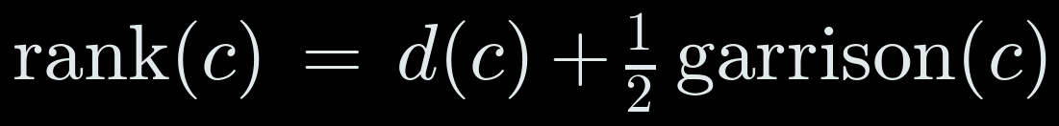
3 · EVERY PART OF V51
The plan menu and the four imagined opponents
OUR PLANS
IMAGINED OPPONENTS
expand
grab free land with stacks that aren't on the general or a castle
rusher
walks its biggest stack at our general
hold
keep soldiers banked on the general and castles; expand with the rest
castle rusher
takes castles, then rushes
take castle ×3
one plan per nearby castle, nearest first (formula)
land grabber
only expands
gather home
pull everything into the general; only when the safety score is low
waiter
does nothing
strike
collect on our castle nearest their general, charge when the walk wins
8 plans × 4 opponents = 32 imagined games of 40 turns.
rush
attack now with any stack whose walk already wins
Plans that give identical boards against all four are merged: on average 6.1 plans become 4.6.
Castles are offered in this order:
TERM Macro actions (AIMA ch. 11)
High-level actions that expand into many single moves, as in hierarchical planning.
39
Notes:
SAY: Which plans does it choose between? Here's the full menu.
Expand: grab neutral land with the stacks that aren't on the general or a castle. Hold: keep soldiers banked on the general and castles, still expanding with the rest. Take castle: one plan for each of the two or three nearest castles, ranked by distance plus half the garrison, the formula. Gather home: pull everything into the general, offered only when the safety score is low. Strike: collect on our castle nearest the enemy general, then charge when the walk wins. Rush: attack with any stack whose walk already wins.
And the four imagined opponents: one that rushes our general, one that takes castles then rushes, one that only grabs land, and one that does nothing.
At most 8 plans times 4 opponents is 32 imagined games of 40 turns each: about 1,300 simulated turns, and it only does this when it picks a new plan.
One trick saves a lot: if two plans lead to exactly the same boards against all four opponents, which happens a lot in the opening where most moves just take one free square, they're merged and scored once. On average 6.1 plans become 4.6.
In the book these are macro actions, high-level actions from the chapter on hierarchical planning: each plan is a small script that expands into single moves.
TERM ON THIS SLIDE, MACRO ACTIONS (AIMA CH. 11): Each plan is what the book calls a high-level or macro action, from hierarchical planning: one choice that expands into many single moves.

Slide 35
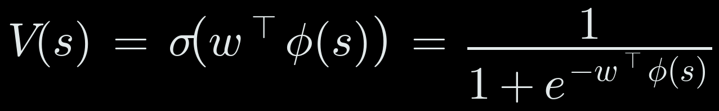
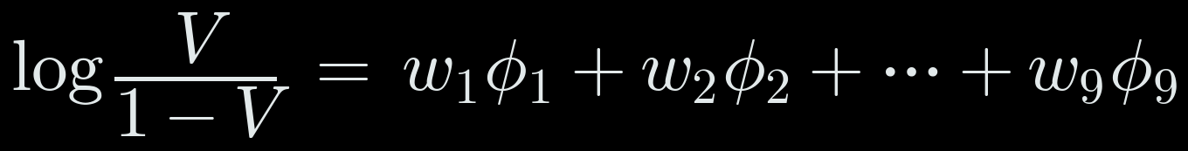
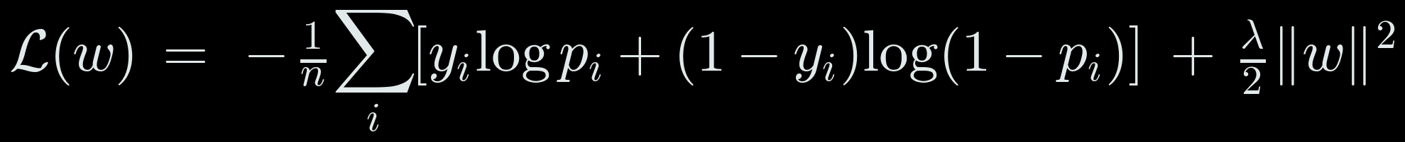
3 · THE LEARNED WIN ESTIMATE · CONCEPT
Turning a board into a chance of winning
At the end of each imagined game the bot needs one number: how likely am I to win from here?
Logistic regression: add up a few measurements, each times a weight, then squash the total into 0 to 1 with the sigmoid. Each weight says how much one unit of a measurement changes the odds.
The win estimate: a weighted sum, squashed by the sigmoid σ
Same thing read as odds: each weight adds to the log-odds
Trained by minimising log-loss (with a small penalty on big weights)
FROM THE BOOK
Russell & Norvig, AIMA ch. 19 and ch. 5
Chapter 19: logistic regression, a linear model with a sigmoid output, fitted by minimising log-loss. Chapter 5: an evaluation function scores positions where the search stops.
EXAMPLE (illustrative) opening: land lead +20, army lead +50, income lead worth +0.5
40
Notes:
SAY: This is the one learned part I haven't explained yet, and it's what gives every imagined game its score.
At the end of each 40-turn imagined game, the bot needs one number: from this board, how likely am I to win? It's not a neural network. It's logistic regression, from chapter 19.
The first formula: take nine measurements of the board, phi, multiply each by a weight, add them up into a score z, and squash z into a probability with the sigmoid, sigma. Big positive score, close to 100 percent; zero, 50 percent.
The second formula is the same model read differently: the log of the odds is just the weighted sum. So each weight tells you how much one unit of that measurement shifts the odds.
The third is how the weights are learned: log-loss. For each training position we know who actually won, y. The loss punishes the model for being confident and wrong. The last term, lambda, discourages huge weights.
Example at the bottom: an opening position where we're 20 squares ahead, 50 soldiers ahead, and ahead on income. The score is 1.29, the sigmoid turns that into 78 percent.
In chapter 5 terms, this is the evaluation function: the score you use where the lookahead stops.

Slide 36
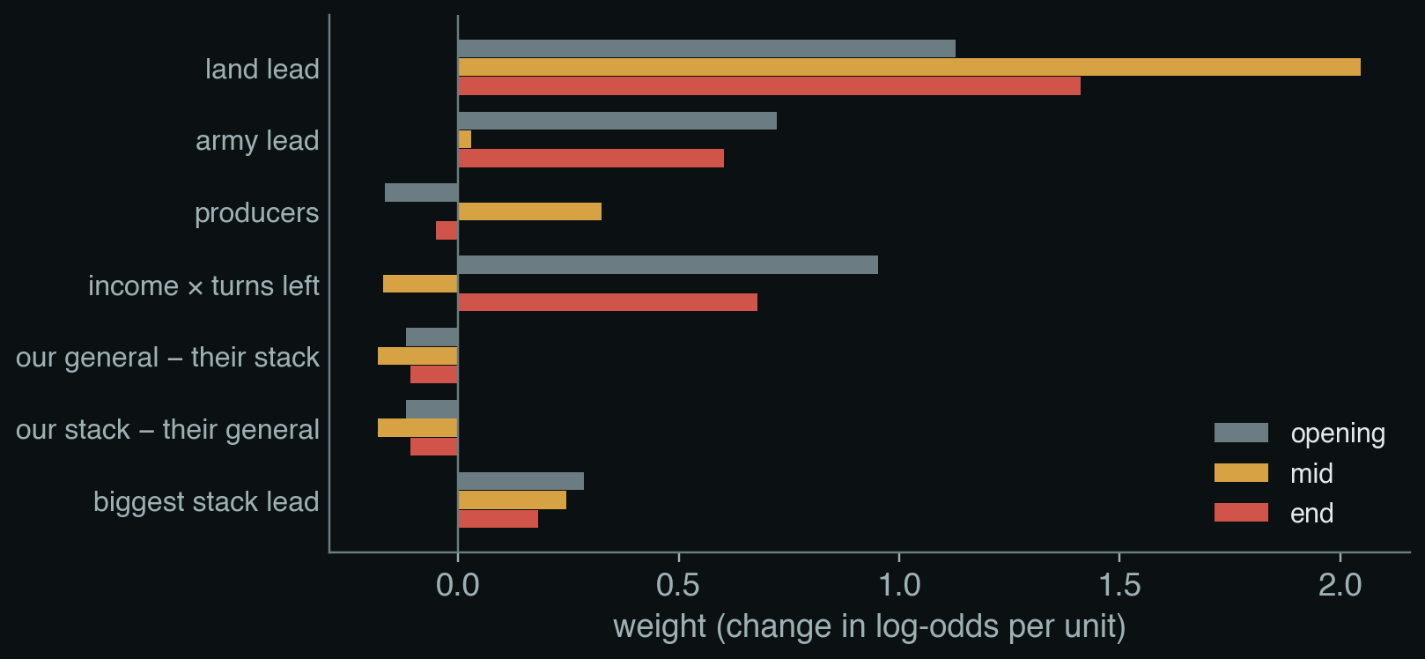
3 · THE LEARNED WIN ESTIMATE
The nine measurements and what the model learned
land
land lead
÷ 50
army
army lead
÷ 100
prod
producers (generals + castles) lead
×1
income
income lead × turns left
÷ 100
defence
our general − their biggest stacks
÷ 50
attack
our biggest stacks − their general
÷ 50
big
biggest stack lead
÷ 50
Opening: income × turns left counts most; early income compounds.
Mid-game: land dominates (weight 2.05).
Constant and turns left: exactly 0. Every position is seen from both sides, so neither side can be favoured.
left
turns left
÷ 500
bias
constant
1
Income = ½ per general or castle + 1 per 50 squares of land, per turn.
41
Notes:
SAY: These are the nine measurements, all differences between us and the opponent, so the model sees the board from our side.
Land lead divided by 50. Army lead divided by 100. Producers, meaning generals plus castles. Income times turns left: income is half a soldier per producer per turn plus one per 50 squares of land, so this is roughly how much extra army our income will have produced by the end. Then three stack comparisons: our general against their biggest stack, which is defence; our biggest stack against their general, attack; and biggest stack against biggest stack. Then turns left, and a constant.
There's a separate set of weights for each phase. The chart shows them. In the opening, income times turns left matters a lot: early income compounds. In the mid-game, land dominates with a weight of 2. In the end game, army counts again, because the game is decided soon.
Two weights are exactly zero: the constant and turns left. That's not a bug. Every training position appears from both players' sides, so the model can't favour either side, and those two measurements are the same for both. For the same reason defence and attack get identical weights: seen from the other side, my defence is your attack.

Slide 37
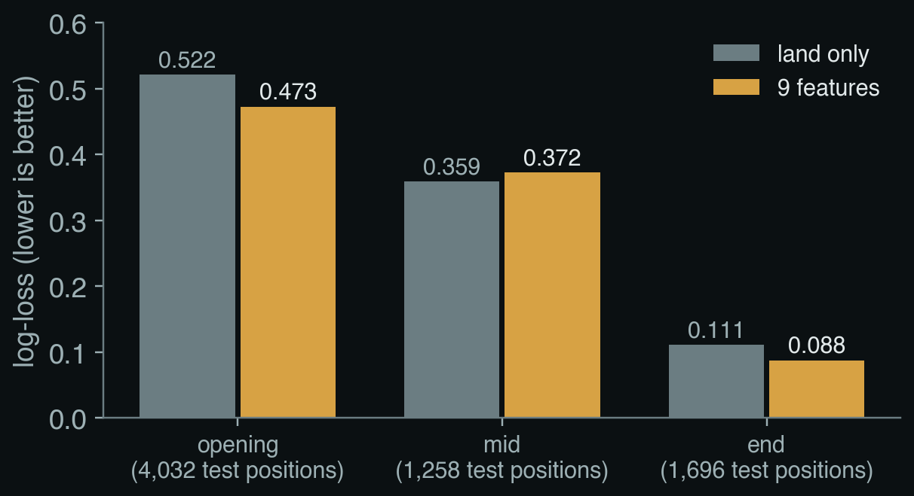
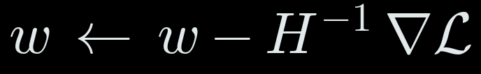
3 · THE LEARNED WIN ESTIMATE
Training it, and how well it predicts
Data: 7 scripted bots play each other on 200 maps; games of 300, 500 or 800 turns.
Every 5 turns: both players' measurements, labelled with who won. Draws dropped.
Split by map: 160 maps train (27,208 positions), 40 maps held out (6,986).
Fitted by Newton's method, one model per phase:
Opening: clearly better than land alone; right 75% of the time (land alone: 71%).
Mid-game: no better than land alone on new maps.
End game: right 98% of the time.
TERM Newton's method (AIMA ch. 4.2)
Uses the curvature H of the loss to jump towards the minimum. Log-loss is convex, so it reaches the one best answer in a few steps. Plain numpy: 9 weights.
42
Notes:
SAY: How was it trained, and how good is it?
The data is self-play: seven simple scripted bots, economy bots with different settings, rushers, a land grabber, a striker, play each other on 200 maps, with games lasting 300, 500 or 800 turns so that "turns left" varies. Every 5 turns we record both players' measurements and, later, who won. Draws are dropped. 160 maps are for training, about 27,000 positions; 40 maps are held out for testing, about 7,000.
The fitting uses Newton's method, the first formula. Instead of taking small downhill steps, it uses the curvature of the loss, the matrix H, the second formula, to jump close to the minimum. For logistic regression the loss is convex, so this converges in a handful of steps to the single best set of weights. This was done in plain numpy; it's nine weights, there was no need for a GPU.
The chart compares it with a simpler model that only uses the land difference. Lower is better. In the opening, the full model is clearly better: 0.473 against 0.522. In the end game, better too. In the mid-game, honestly, no better than land alone: 0.372 against 0.359 on the held-out maps. That fits the weights we just saw, where the mid-game model is mostly land anyway.
So the win estimate is a simple, honest model: right about 75 percent of the time in the opening and 98 percent in the end game.
TERM ON THIS SLIDE, NEWTON'S METHOD (AIMA CH. 4.2): Newton's method is in chapter 4, local search in continuous spaces: use the gradient and the curvature to jump towards the minimum. Because log-loss for logistic regression is convex there is exactly one minimum, and Newton finds it in a few steps.

Slide 38
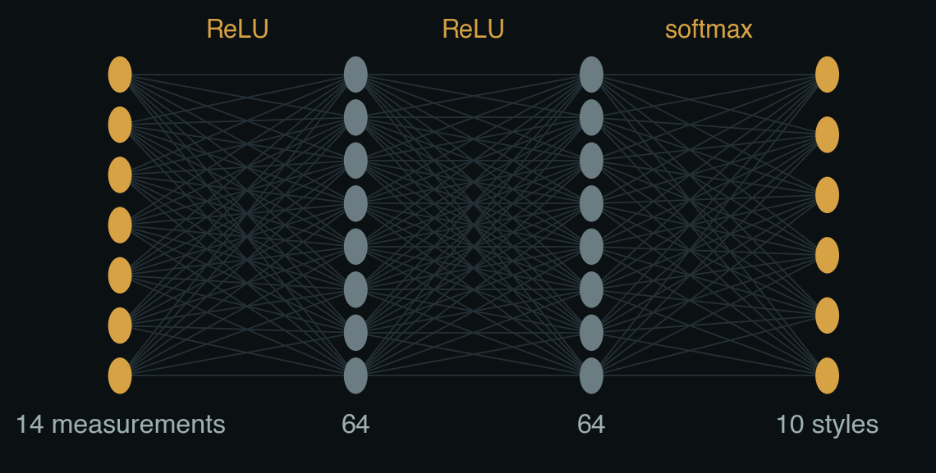
3 · THE STYLE CLASSIFIER
Fourteen measurements in, ten styles out
1
turn number
8
how much closer in 5 turns
2
land
9
land gained in 20 turns
3
total army
10
biggest stack's growth in 5 turns
4
share of army in its general
11
stacks of 5 or more
5
share in its biggest stack
12
times its general was emptied
6
castles held
13
army gained in 20 turns
7
biggest stack's distance to us
14
biggest stack within 10 squares?
All measured on the opponent, from the board alone, and scaled to roughly 0 to 1.
TERM Feed-forward neural network (AIMA ch. 21)
Layers of weighted sums with a simple non-linearity (ReLU) in between; the softmax turns the last layer into probabilities.
44
Notes:
SAY: Now the classifier from idea 1 in full. It's the only neural network in the bot, and it's small.
The input is 14 numbers measured from the board every turn, all about the opponent: the turn number; its land and total army; what share of its army sits in its general, and in its biggest stack; how many castles it holds; how far its biggest stack is from our general, and how much closer it got in the last 5 turns; how much land and army it gained over the last 20 turns; how many stacks of 5 or more it has; how many times it has emptied its general; and whether its biggest stack is within 10 squares of us. Each is divided by a typical size so they're all roughly between 0 and 1.
The network: 14 inputs, two hidden layers of 64 with ReLU, which just sets negatives to zero, and 10 outputs turned into probabilities by the softmax. That's the first formula. Before going in, each input is standardised: minus its average, divided by its spread, from the training data.
It has 5,770 weights in total, the last formula. It runs in plain Python inside the bot, about a millisecond per turn.
TERM ON THIS SLIDE, FEED-FORWARD NEURAL NETWORK (AIMA CH. 21): This is a feed-forward network from chapter 21: each layer is a weighted sum followed by ReLU, which sets negatives to zero; the last layer goes through the softmax so the ten outputs are probabilities that add up to one.

Slide 39
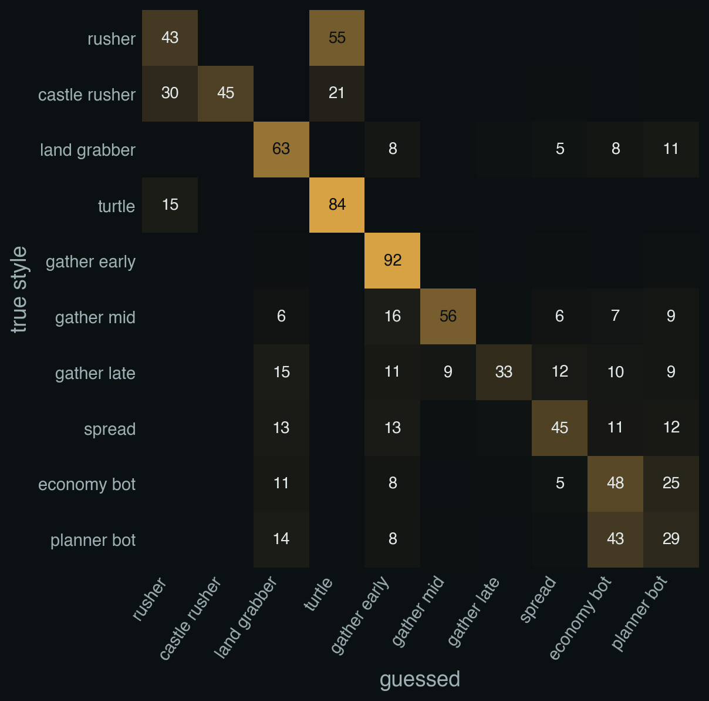
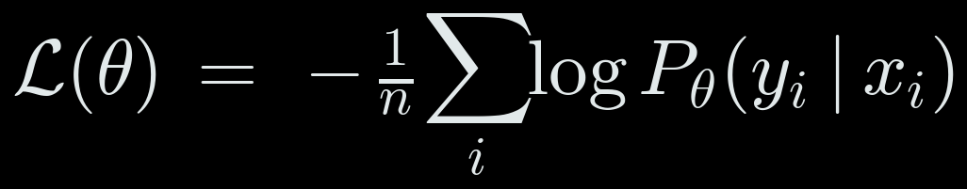
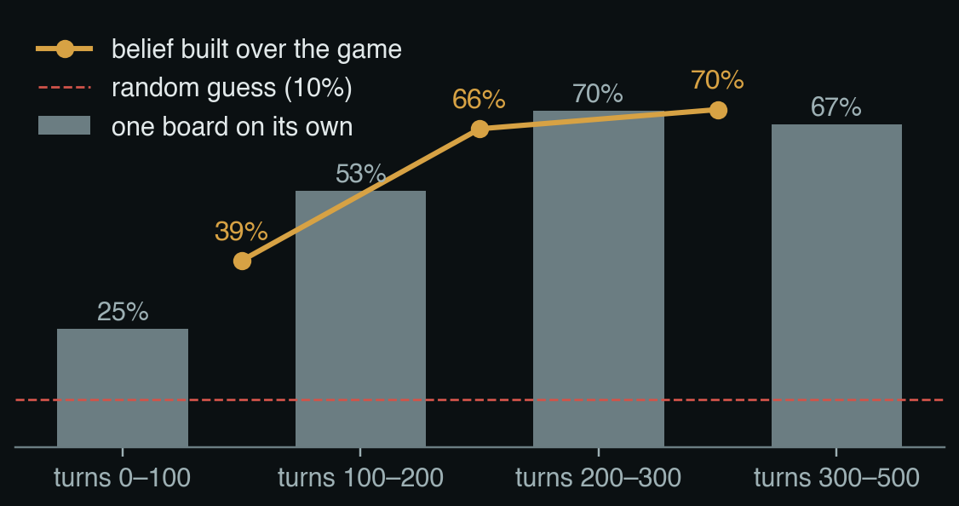
3 · THE STYLE CLASSIFIER
Training it, and where it gets confused
Data: v46 plays each of the 10 styles on 33 maps, both seats, 500 turns. Measurements every 2nd turn.
Split by map: 25 maps train (99,437 rows), 8 unseen maps test (33,318).
Training: Adam, learning rate 0.002, weight decay 0.0001, batches of 512, 60 passes, on the Mac GPU.
Rusher read as turtle (55%): both sit at home until the rusher launches. Economy bot vs planner bot: both map to the same imagined opponent.
45
Notes:
SAY: How it was trained, and how good it is, including where it gets confused.
Data: our previous bot, v46, played each of the ten styles on 33 maps, from both seats, 500 turns each, and we recorded the opponent's 14 measurements every second turn with its true style. 25 maps for training, about 99,000 rows; 8 different maps for testing, about 33,000 rows. So the test is always on maps it has never seen.
Training: the loss is cross-entropy, the formula: minus the log of the probability it gave the right style. We used the Adam optimiser, learning rate 0.002, small weight decay, batches of 512, 60 passes over the data, on the Mac's GPU.
The left chart: from one board on its own, it's right 25 percent of the time in the first 100 turns, because early on everybody just grabs land, rising to about 70 percent. The gold line is the belief built up over the game, the filter from idea 1: 39 percent by turn 100, 66 by turn 200, 70 by turn 300. Random guessing would be 10.
The right chart shows where it's wrong. Rows are the true style, columns the guess. The big mistake: a rusher is often taken for a turtle, 55 percent. That makes sense: a rusher sits at home building up until it launches, and until then it looks exactly like a turtle. The economy bot and the planner bot are also mixed up, but those are our own older bots and they play alike, and both map to the same imagined opponent, so that confusion costs nothing. And a rusher still gets caught: once it actually attacks, the threat gate opens anyway.

Slide 40
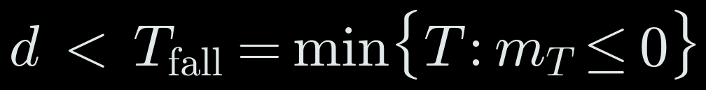
3 · SAFETY DETAILS
Two rules from replays of human wins
Never swap places with an attacker
Counter-strike: when home will fall anyway
If the safety score says our general falls at turn T_fall, launch a stack at their general if it arrives first and wins:
30
25
our general
attacker
Same turn: the general steps out, the attacker steps in. They pass each other, and the attacker lands on a general with 1.
So the general never steps toward an adjacent enemy stack. Another stack hits it, or the general waits and grows.
G′, D′_home: their general, and what they can pull home in time. +3 for safety.
Only with the threat gate open, and only if it passes the four-reply test (idea 3).
48
Notes:
SAY: Two rules found by replaying games that humans won.
Left: never swap places with an attacker. Our general has 30 and an enemy stack of 25 is right next to it. The obvious move is to hit the attacker with the general: 30 beats 25. But moves are simultaneous. If the attacker steps onto our general in the same turn that our general's soldiers step out towards the attacker, the two stacks pass each other. The attacker lands on a general with only one soldier left and takes it. We saw exactly this in replays. So the general never steps toward an adjacent enemy stack; another stack hits it instead, or the general just waits and grows.
Right: the counter-strike. Sometimes home is going to fall: the safety score says the general loses the race at some turn T-fall. Then defending is hopeless, but attacking might not be. If one of our stacks can reach their general before T-fall, the first condition, and arrive bigger than their general plus its growth plus whatever they can pull home in time plus 3, the second condition, the bot launches it, but only if it also passes the four-reply test from idea 3. It's only allowed while the threat gate is open.

Slide 41
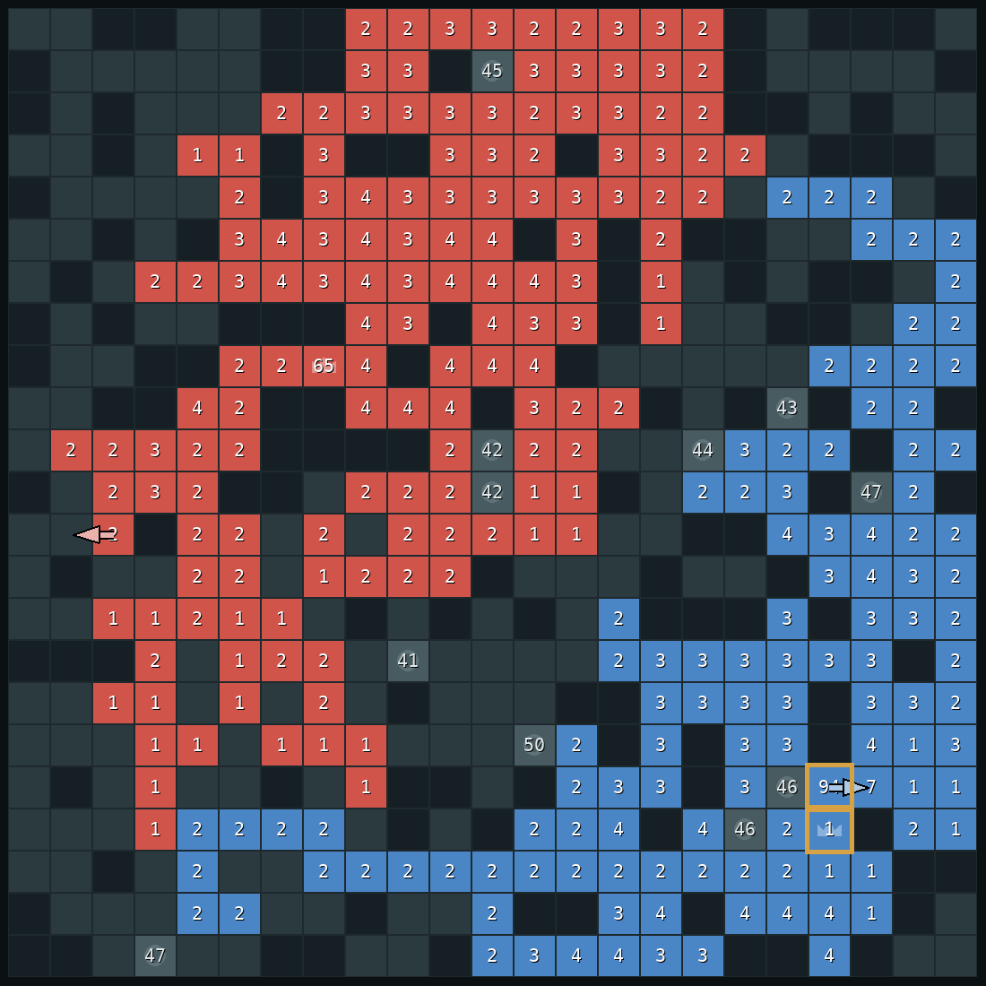
4
One real game
Our bot (red) against a bot that plays the way people beat our earlier versions: grab land, pull everything into one stack, charge.
Notes:
SAY: Now let's watch all of this happen in one real game. The opponent plays the way people beat our earlier bots: it grabs land until turn 200, then pulls its whole army into one stack and charges. Every screenshot is the real board, with what our bot was thinking drawn on top.

Slide 42
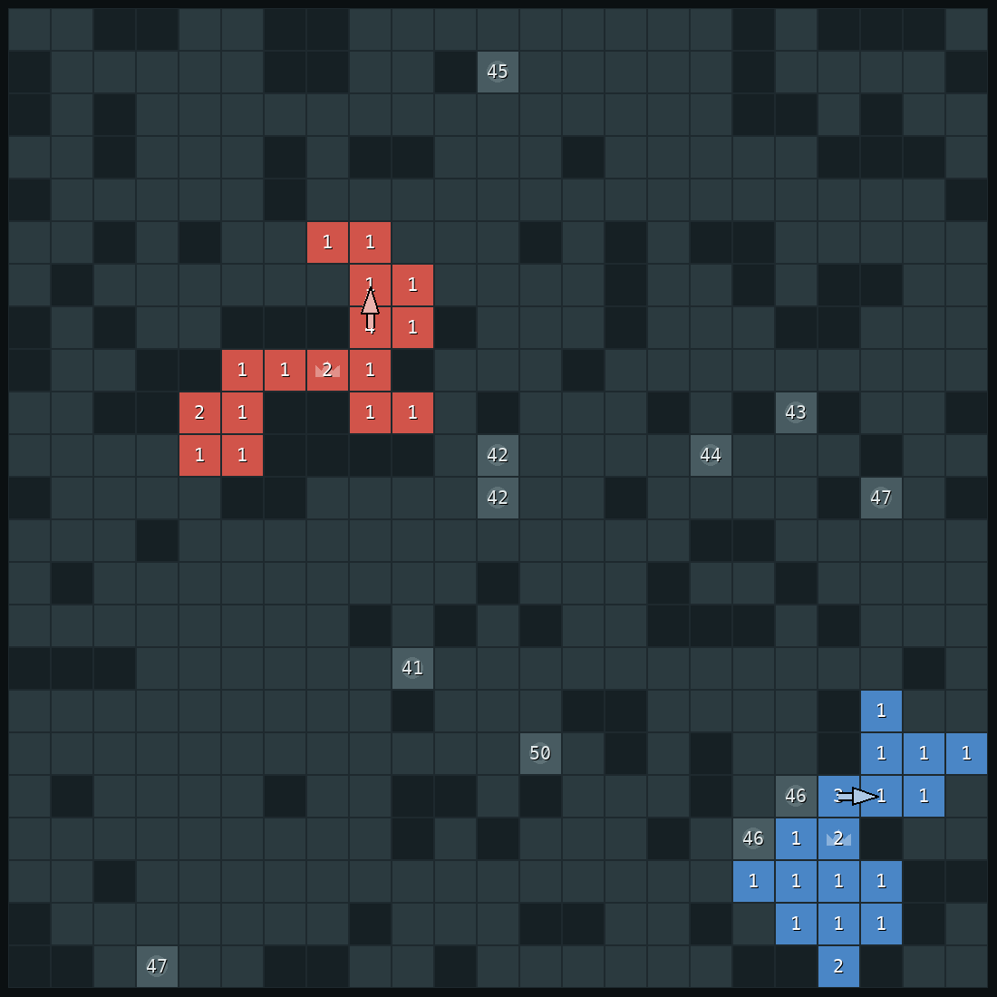
ONE REAL GAME
turn 40
Opening: grab land
Both sides grab one square per move. Nobody is threatening anybody yet, so the bot just expands.
21
21
our soldiers
their soldiers
53
Notes:
SAY: Turn 40. Both sides just grab land, one square per move. There's no threat, so the bot's plan is simply: expand.

Slide 43

ONE REAL GAME
turn 205
The opponent starts collecting
Its general is filling up: it is pulling its soldiers in.
Our bot still thinks it's a land grabber, which so far is true.
61
79
our general
their general
54
Notes:
SAY: Turn 205. The opponent starts pulling its soldiers together; you can see its general growing. Our bot still thinks it's facing a land grabber. That's reasonable: up to now, that's exactly what it was.

Slide 44
ONE REAL GAME
turn 213
It empties its general
Its general drops from 93 to 1. A 94-soldier stack appears (gold boxes).
Our safety score drops to 12: an attack is possible soon.
94
12
their big stack
safety score
55
Notes:
SAY: Turn 213. Here it is: the opponent empties its general, 93 soldiers down to 1, into one big stack of 94. Our safety score drops straight away, from 26 to 12.

Slide 45

ONE REAL GAME
turn 215
The guess changes
Now the board looks like a player that builds up and attacks: 97%.
The bot makes its first defensive move.
103
66
attacker
our general
56
Notes:
SAY: Turn 215. The guess flips: 97 percent "builds up, then attacks". The bot starts defending.

Slide 46
ONE REAL GAME
turn 219
Attack confirmed: plan the defence
The stack is 18 squares away and coming closer.
The bot plans 14 moves that pull soldiers into its general (gold arrows). Every move from now on is defence.
111
18
68
attacker
squares away
our general
57
Notes:
SAY: Turn 219. The stack has moved closer twice in a few turns, so the bot is sure: an attack is coming, 18 squares away. It works out how short the general will be and plans 14 moves, the gold arrows, that pull soldiers into the general. From now on, every single move is defence.

Slide 47
ONE REAL GAME
turn 224
Pulling soldiers in
The farthest stacks move first, so soldiers pile up on the way in.
The attacker shrinks as it walks.
119
13
71
attacker
squares away
our general
58
Notes:
SAY: Turn 224. The gathering is under way, starting from the farthest stacks so they pick up soldiers as they come in. Notice the attacker is shrinking as it walks: the key idea from the start.

Slide 48
ONE REAL GAME
turn 235
Ready
The big stack next to the general steps in. The general now has 124.
The attacker is right next to it with 90.
124
90
our general
attacker
59
Notes:
SAY: Turn 235. The last stack steps into the general. It went from 68 to 124 soldiers in 16 turns. The attacker is right next to it with 90.

Slide 49

ONE REAL GAME
turn 237
The attack fails
The attacker hits with 88. The general keeps 38.
Our previous bot lost this exact position: 77 against 82.
38
0
left in our general
attackers left
60
Notes:
SAY: Turn 237. The attack lands with 88 soldiers, and the general survives with 38. Our previous version, v46, lost this exact position on this exact turn, with 77 soldiers against 82. That's the difference the fast defence makes.

Slide 50

ONE REAL GAME
turn 407
Our attack, when it's sure
The bot went back to taking castles and pulled ahead.
At turn 405 the enemy general had 2 soldiers. The attack passed all four tests. Captured at 407.
1,099
772
our soldiers
their soldiers
61
Notes:
SAY: After that, the bot goes back to its plans, takes castles and pulls ahead. At turn 405 the enemy general has only 2 soldiers. The bot checks that an attack works against all four imagined replies, attacks, and captures the general at turn 407.

Slide 51

4 · ONE REAL GAME
The whole game in one picture
Until the opponent charges, both armies grow together.
The attack costs both sides; our general survives.
After the first castle, our bot pulls away until the capture.
62
Notes:
SAY: The whole game on one chart. The two armies grow together until the opponent collects and charges. The attack costs both sides soldiers, but our general survives. After its first castle, our bot pulls away until it captures the general.

Slide 52
5
Results, then you play
How it does against other bots, and what to try against it.
Notes:
SAY: Finally, the numbers, and then the live game.

Slide 53

5 · RESULTS
Where v51 is stronger
Bots that collect and charge: the biggest improvement.
Spread-and-castle player: slightly worse.
Against our previous bot: about even, 32–28.
20 games per bar. Grey bars: our previous bot.
64
Notes:
SAY: These are simulator games, twenty per bar, with both players taking turns at going first.
The red bars are v51, grey is our previous best bot. The first three groups are bots that collect and charge, the strategy people used to beat our earlier versions. That's where v51 improves the most: from 60 percent to 95 percent against the one that charges at turn 200.
Against a bot that spreads out and takes castles, it's slightly worse, because while it's busy defending, that opponent takes castles.
Head to head against our previous bot, it's about even: 32 wins to 28.
One detail if anyone asks: the defence numbers were measured with the fast defence but without the opponent classifier. The defence code is the same.

Slide 54
5 · LIVE GAME
Your turn
python play_arena.py then pick Final · champion
What to watch for:
Opening: it grabs land, one square per move.
Send a big stack at its general: it stops and pulls soldiers in.
Keep your general full: it won't attack.
To beat it: spread out and take castles.
65
Notes:
SAY: Now it's your turn, professor.
A few things to watch for. In the opening it just grabs land, one square per move.
If you build one big stack and walk it at its general, you'll see it stop expanding and start pulling its soldiers in from the edges. That's idea four.
If you keep your own general full, it won't attack it. It waits for you to empty it.
And if you want to beat it: spread out and take castles. That's where it's weakest.

Slide 55
REFERENCES
Book and papers
Russell, S. & Norvig, P. Artificial Intelligence: A Modern Approach, 4th ed. Pearson, 2020.
Straka, M., Lisý, V. & Schmid, M. Superhuman AI for Generals.io using self-play reinforcement learning. arXiv 2606.23348, 2026.
Barriga, N., Stanescu, M. & Buro, M. Puppet Search: enhancing scripted behavior by look-ahead search with applications to RTS games. AIIDE 2015.
Synnaeve, G. & Bessière, P. A Bayesian model for opening prediction in RTS games with application to StarCraft. AIIDE 2011.
Weber, B. & Mateas, M. A data mining approach to strategy prediction. CIG 2009.
Ganzfried, S. & Sandholm, T. Safe opponent exploitation. ACM Transactions on Economics and Computation, 2015.
Churchill, D. & Buro, M. Build order optimization in StarCraft. AIIDE 2011.
Started from (section 1): Likhachev, Gordon & Thrun, ARA*, NIPS 2003; Koenig & Likhachev, RTAA*, AAMAS 2006; Hernández & Baier, depression avoidance, AAAI 2012; Buro, ProbCut, ICCA J. 1995; Russell & Wefald, metareasoning, AIJ 1991.
66
Notes:
References, for anyone who wants to read further.

