Slide 1

Chronos: Efficient Speculative Parallelism for Accelerators
Maleen Abeydeera, DANIEL SANCHEZ
ASPLOS 2020
Notes:
Hello everyone, I’m Maleen Abeydeera from MIT and I’ll be presenting our work on Chronos: Efficient Speculative Parallelism for Accelerators. This talk is based on our paper at ASPLOS 2020 and this is joint work with my advisor, Prof. Daniel Sanchez.

Slide 2
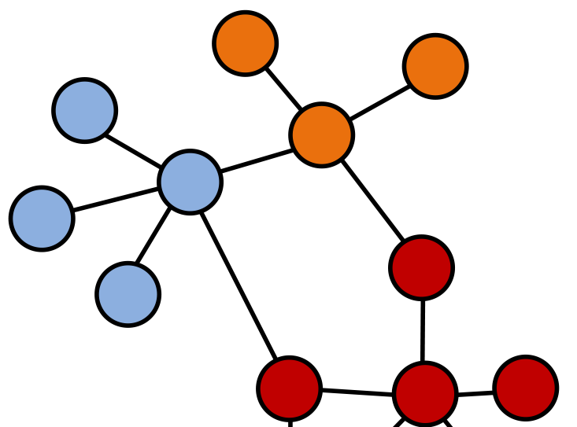
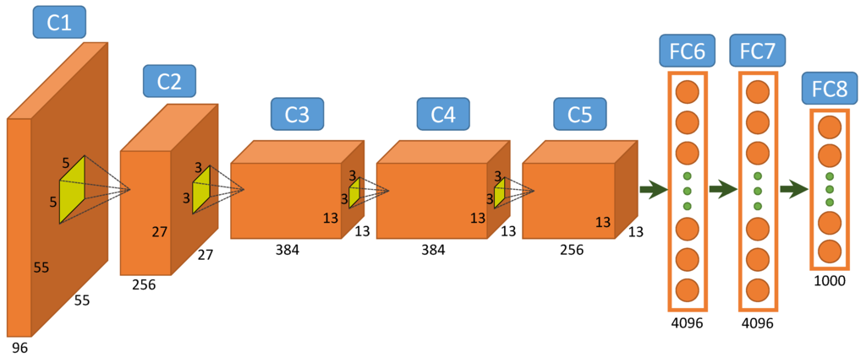
Current hardware accelerators are limited to easy parallelism
Current Accelerators
Target easy parallelism
Tasks and dependences known in advance
Chronos
Targets hard parallelism
Require speculative execution
e.g.: Deep learning, Genomics
e.g.: Graph analytics, simulation, transactional databases
Notes:
We observe that current accelerators have mostly focused on applications with easy parallelism, where tasks and dependences are known in advance and parallelism is easy to extract. These kind of problems are common in domains like deep learning and genomics.
[CLICK] In contrast, Chronos targets application which are hard to parallelizing, where speculative execution is needed to extract parallelism. There kind of applications are present in graph analytics, simulation and transactional databases.

Slide 3
Problem and Insight
Problem
Prior speculation mechanisms (Transactional Memory, Thread Level Speculation) require global conflict detection
Insight
Limit the data that each core can access
Divide work into tiny tasks and send them to data
Coordinate tasks through order constraints
Memory
Transaction 1
Transaction 2
Transaction 1(W, Y)
W
X
Y
Z
Core 1
Core 1
W
W
Order constraints
Core 2
Transaction 2 (Z, W)
Y
Z
Core 2
Shared memory system → coherence protocol Coherence poorly suited for accelerators
Local conflict detection → No coherence needed
Notes:
In order to build Chronos, we had to overcome one significant challenge. Prior speculation mechanisms, such as Transactional Memory require a global conflict detection mechanism.
[CLICK] This is because these systems allow any transaction to run on any core and access any region of memory.
[CLICK] Upon a conflict, the entire system needs to be checked for conflicting tasks
[CLICK] In prior shared memory systems, such global conflict detection is implemented by extending the coherence protocol. However accelerators usually do not have coherence protocols and implementing one would add overheads.
Hence, we rely on a different conflict detection mechanism.
[CLICK] We limit the data that each core can access.
[CLICK] and divide each transaction into tiny tasks, which are then sent near to the data it operates on.
[CLICK] To maintain atomicity of the original transactions, these tiny tasks are sequenced through order constraints
[CLICK] Under this scheme, all conflicts become local and no coherence is needed

Slide 4
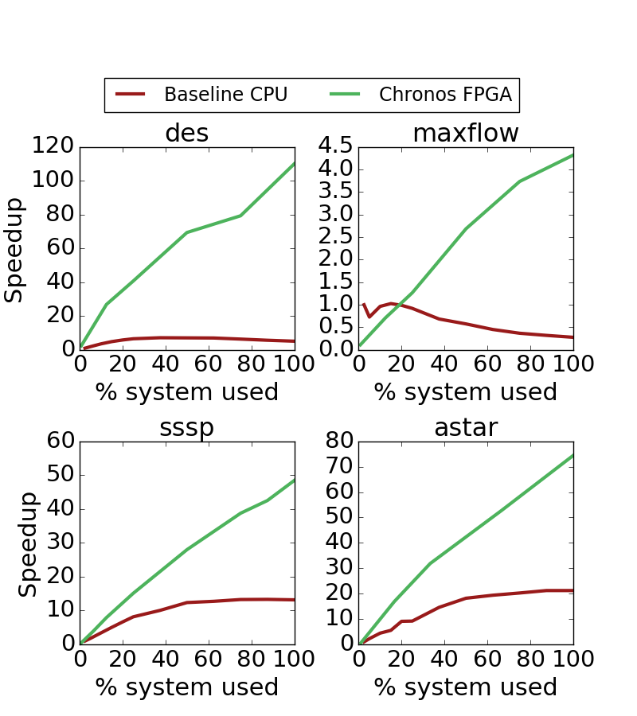
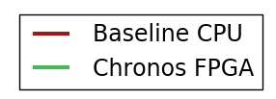
Contributions
SLOT (Spatially Located Ordered Tasks): A new execution model that does not require coherence, but relies on task ordering and spatial task mapping to detect conflicts
Chronos: An implementation of SLOT that provides a common framework for acceleration of applications with speculative parallelism
https://chronos-arch.csail.mit.edu/
Notes:
Using this insight we propose two contributions.
SLOT, or Spatially located ordered tasks is a new execution model that does not require coherence, but relies…
Chronos …
[CLICK] We use Chronos to build accelerators for several hard-to-parallelize applications achieving significant speedups over a 40-threaded Baseline CPU
[CLICK] Chronos is open-source and can be accessed from this URL

Slide 5
Speculative parallelism with single-object tasks
Discrete Event Simulation (DES) for Digital Circuits
2 ns
N2
1
1 ns
NAND
NAND
1
XOR
OR
O1
5 ns
X3
X6
XOR
1 ns
If X6 is being
speculatively executed
0
6 ns
0
OR
1 ns
1
2
3
4
5
6
Time (ns)
Notes:
To illustrate speculative parallelism, we look at des, a discrete event simulator for digital circuits. DES computes the waveform of each wire by tracking when the logic state of a wire toggles. For instance, the OR gate here starts with both inputs at 0 and the output at zero.
[CLICK] If one of the inputs was changed to a 1 after some time, [CLICK] the output of the gate also toggles [CLICK] which propagates to the downstream gate after a certain delay. (Here we assume gates take no time and all delays are pushed on the wires)
[CLICK] We represent a simulation of this circuit by a task diagram, where the toggling of each input to a gate is a separate task. In this diagram, x axis represent time and y axis represent the gate each task operates on. [CLICK] In the beginning task O1, which represents the toggle of one input to the OR gate, [CLICK] creates a new task X6 when executed.
However, X6 is not safe to be executed non-speculatively, because another task could operate on the XOR gate before time 6. [CLICK] To illustrate such a scenario, lets assume that the one of the inputs to the NAND gate changes at 2 ns. [CLICK] This causes a new task at X3. At this point, if the speculative execution of task X6 has already begun, [CLICK] X3 should abort task X6 and re-execute it.

Slide 6
Prior techniques rely on global conflict detection
Why? No restriction on where a task can run
Shared Cache / Directory
N2
Private Cache
Private Cache
O1
X3
X6
O1
X3
N2
X6
Time (ns)
Core 1
Core 2
1
2
3
4
5
6
Relies on coherence protocol to find conflicts
Notes:
Prior systems that performs such speculative execution requires global conflict detection. This is because they allow any task to run at any core.
[CLICK] Lets assume a situation where O1 is run at core 1, X6 at core 2, N2 at core 2 and finally X3 at core 1.
[CLICK] Now, X3 needs to find and abort all tasks which access the same gate but at a higher time, it does so by sending messages throughout the memory system, relying on the coherence protocol to find the other tasks which accessed the same data.

Slide 7
Insight 1: Leveraging spatial task mapping for local conflict detection
Impose restrictions on where a task can run
Shared Cache / Directory
N2
Mapped to Core 1
Private Cache
Private Cache
O1
X3
X6
O1
N2
X3
X6
Mapped to Core 2
Core 1
Core 2
Time (ns)
Conflict detection is local to a core
1
2
3
4
5
6
Notes:
In contrast, we remove the requirement for global conflict detection by mapping same-objects tasks to the same core. For example if the OR and NAND gates are mapped to Core-1 and the XOR gate is mapped to core-2, [CLICK] all accesses as well as conflicts will be local to a core making directory redundant
It may seem like this scheme works if tasks only access a single object. Next, we will look at an example of how we can leverage order to extend this scheme to tasks that access multiple objects.

Slide 8
Insight 2: Leveraging order to ensure atomicity
Banking application:
Each transaction decrements the balance of one account and increments another
Tx. 1:
Transfer W Y
Tx. 2:
Transfer Z W
Tx. 3:
Transfer X Z
Account (object) | Balance
W | $100
X | $1500
Y | $200
Z | $400
0
11
20
1
10
21
Timestamp
Assign a disjoint timestamp range for each coarse transaction
Notes:
Consider a banking application where transactions transfer money between accounts. Each transaction must atomically decrement the balance of one account and increment the balance of another, requiring atomic access to two different objects
[CLICK] We propose to manually divide the large transaction into two fine-grained tasks that access a single object each, with the first task spawning the second. To ensure original order, we give timestamps to each task.
[CLICK] To make sure that different transactions do not interleave, each transaction is assigned a disjoint timestamp range.
This technique generalizes to any arbitrary combination of writes and reads.

Slide 9
Benefits of fine-grained tasks
Memory
Transaction 1
Transaction 2
Core 1
W
X
Y
Z
Transaction 1 (W, Y)
Core 1
W
W
Order constraints
Core 2
Transaction 2 (Z, Y)
Core 2
Y
Z
Brings data to compute
Sends compute to data
✓ Increased data locality
✓ Reduced network traffic
✓ Increased parallelism
✓ Low probability and impact of aborts
✓ Asynchronous communication
Notes:
Such refactoring of an application to use multiple fine-grained tasks also brings in other benefits.
[CLICK] First, instead of bringing data to compute, [CLICK] this scheme sends compute to the data. [CLICK] increasing data locality
[CLICK] Second, this reduces network traffic, since the size of a task is much smaller than the cache line that gets moved around
[CLICK] Third, this scheme also increases parallelism since, multiple smaller tasks can often be executed in parallel
[CLICK] Fourth, the probability and impact of aborts is also reduced. This is because If a conflict were to be found, only the directly conflicting tiny task need to be aborted, not the entire transaction as was the case before.
[CLICK] Finally, in this approach communication is asynchronous because they happen through tasks which are spawned rather than synchronous memory accesses

Slide 10
SLOT (Spatially Located Ordered Tasks)
SLOT programs consist of tasks
Tasks can create children tasks through a simple API:
slot::enqueue( fn_ptr, timestamp, object-id, arguments…);
Timestamp : Specifies order. Tasks appear to execute in timestamp order
Object-id : Specifies dependences. Tasks with same object-id are treated as data-dependent
Tasks with different object-ids can only communicate through arguments
Notes:
Now we are ready to introduce SLOT, which is a programming model that enforces the condition that each task can only single object.
Formally, SLOT programs consists of tasks, where each task can create children tasks through a defined interface.
Creating a new task requires specifying a function pointer, a timestamp, an object id and zero or more additional arguments.
Here, the timestamp specifies the ordering, and the object-id specifies the data dependences, where only tasks with the same object-id are treated as data dependent.
Tasks with different object-ids can only communicate through additional task arguments, since this model does not support shared memory for access for tasks with different object-ids
Transition out: Tasks can be implemented either as software functions or specialized processing engines.

Slide 11
SLOT programming example (in software)
// Simulates an event arriving at a gate
void simToggle(Time time, GateInput input) {
gate = input.gate;
toggledOutput = updateState(gate, input);
if (toggledOutput) {
// create events for connected gates
for (GateInput i : gate.connectedInputs()) {
Time nextTime = time + gate.delay(input, i);
eventQueue.enqueue(nextTime, i);
}
}
}
PriorityQueue<Time, GateInput> eventQueue;
enqueueInitialEvents()
// event loop. Sequentially execute in ts order
while (!eventQueue.empty()){
(time, input) = eventQueue.dequeue();
simToggle(time, input);
}
// Simulates an event arriving at a gate
void simToggle(Time time, GateInput input) {
gate = input.gate;
toggledOutput = updateState(gate, input);
if (toggledOutput) {
// create events for connected gates
for (GateInput i : gate.connectedInputs()) {
Time nextTime = time + gate.delay(input, i);
slot::enqueue(
simToggle, nextTime, i.gateID, i);
}
}
}
enqueueInitialTasks()
slot::run()
2 ns
1
1 ns
1
5 ns
1 ns
0
0
Notes:
[CLICK] Let’s look at how DES could be implemented with software tasks.
We first illustrate a conventional DES implementation and then show the SLOT code.
[CLICK] In DES, the simToggle function simulates an event arriving at a gate.
This function updates the gate’s own state and if the gate’s output was toggled creates new events for downstream gates.
This events are held in a priority queue, which is initialized with the initial events and an event loop sequentially executes these events.
[CLICK] In SLOT, the code is very similar but with two changes,
[CLICK] First, the enqueues to the event queue are replaced with the slot::enqueue function
[CLICK] Second, the priority queue and the manual event loop is encapsulated in the SLOT execution model, requiring only a single slot.run function to invoke it.
A SLOT implementation can chose to run these tasks sequentially, or to run them out-of-order to extract parallelism.

Slide 12
Chronos: An implementation of SLOT
Notes:
Chronos, our implementation of SLOT, does the latter, where tasks are speculatively run out-of-order

Slide 13
Chronos overview
Chronos provides a framework to build accelerators for applications with speculative parallelism
Chronos
Framework
Mem0
Mem1
Mem2
Mem3
Cache (Private, non-coherent)
Memory Traffic Interconnect
…
Application-specific
RTL
…
PE
PE
PE
Tile 0
Tile 1
Tile 2
Tile N
Task Traffic Interconnect
Task Unit
The developer specifies the tasks and how they are implemented
Either software routines on soft cores, or specialized Processing Elements (PE)
Framework takes care of task management and speculative execution
Notes:
Chronos is a framework to build accelerators applications with speculative parallelism
Chronos implements a multi-tiled system, where the tiles are connected through two interconnects for task and memory traffic.
each tile consists of a private cache, that is not kept coherent with those of other tiles, a task unit and processing elements to run the task logic.
To understand how Chronos performs this speculative execution, we begin by understanding the life cycle of a task

Slide 14
Task life cycle
Create
Idle
Dispatch
Running
Finish
Finished
Commit
Abort
Abort
Abort
Parent aborted?
Requeue
Discard
N
Y
Notes:
A Chronos task is created in the IDLE state when a PE enqueues a new task through the slot:enqueue interface. An IDLE task is dispatched to run on a PE in timestamp order, and once it is finished it stays in a finished state until it commits.
[CLICK] A task in any of these states can also be aborted. After the abort, the task can either be discarded or requeued. The decision to discard or requeue depends on why the task aborted in the first place. If it was aborted because its parent task was aborted, the task is discarded, otherwise if the abort was due to a conflict then it requeued.

Slide 15
Chronos internal dataflow
2 ns
Cache
1 ns
2 ns
1
1
1 ns
IDLE (I)
RUNNING (R)
FINISHED (F)
1
1
5 ns
1
6
3
0
Tile A
2
2
2
Mapped to Tile A
Task Queue
Commit Queue
PE
TSB
2
I
2
R
1
I
Task Interconnect
1
R
1
F
6
R
Abort
3
I
6
I
6
6
6
8
I
Tile B
8
Mapped to Tile B
3
Task creation/ dispatch
Speculative state of finished tasks
Abort messages
Cache
Requeue task
Notes:
Now let's look at how a Chronos tile implements this life cycle.
Each Chronos tile consist of a task queue, which stores the status of all tasks, and commit queue stores the speculative state of all running or finished tasks, similar to the RoB of an OoO core. A PE runs the task logic and The Task send buffer (TSB) buffers newly created tasks until they are acknowledged by the destination tile.
We illustrate the operation of these structures through are task graph in the DES example. [CLICK] We assume that this is being in run on a two tiled system, with the mapping shown in this diagram.
*
Now lets also assume that 6 creates another task with timestamp 8 to communicate with the rest of the circuit. Assume this task is also mapped to Tile B
*
Finally, this diagram shows all messages that flows between the components

Slide 16
Versioning and commit protocol
Eager versioning
Commit Protocol (GVT – Global Virtual Time)
Updates speculative values in place
Tile 0
Main Memory / Cache
Tile 1
GVT Arbiter
Core
GVT =
min{LVT₀, .. LVT_{N}}
Tile N
Undo Log
LVT (Earliest unfinished ts in the tile)
Store old values in an undo log
GVT (Earliest unfinished ts in the system)
Key benefits Makes the common case (commits) fast
Makes speculative data available before commit
Key benefits Achieves fast and parallel commits
Notes:
Chronos relies on two mechanisms outlined in prior work for its versioning and commit protocols.
Chronos uses eager versioning which updates speculative values in place but stores the old values in a separate on-chip undo log.
This scheme makes commits fast and allows tasks to use speculatively produced data before the producer commit.
[CLICK]
Chronos uses the GVT protocol to find which tasks can commit. In this protocol, each tile communicates the timestamp of its earliest unfinished task to a global arbiter which responds with the Global virtual time. Each Chronos tile walks its commit queue in the background and commits tasks with a lower timestamp. This scheme is chosen because it achieves fast and parallel commits.

Slide 17

Chronos FPGA implementation
Developed an FPGA implementation of Chronos – up to 16 tiles
Running at 125 MHz
High task throughput – can enqueue, dequeue, execute and commit 8 tasks per cycle on a 16-tile system
16 Tiles
AWS Shell
Notes:
Using these mechanisms, we built an FPGA implementation of Chronos which can fit up to 16 tiles, running at a frequency of 125 Mhz.
Since Chronos tasks are small, it is important that this implementation supports a high task throughput. On a 16-tile system, our implementation can enqueue, dequeue, execute and commit 8 tasks per cycle
This figure shows how a 16-tile Chronos instance is mapped on the FPGA, where different color represent different tiles

Slide 18
Experimental methodology
Four accelerators built using Chronos framework running on AWS FPGAs
Discrete Event Simulation (DES)
Maxflow
Single Source Shortest Paths (SSSP)
Astar Search
Custom PEs per application: 32-way multithreaded PE, single PE/tile
Baseline: Highly optimized software parallel implementations running on a 40-threaded Xeon AWS instance
Platform | AWS Instance | Price ($/hr)
Baseline CPU | M4.10xlarge | 2.00
FPGA | F1.2xlarge | 1.65
Notes:
We evaluate chronos by building accelerators for four challenging applications can running them on the Amazon AWS FPGAs.

Slide 19
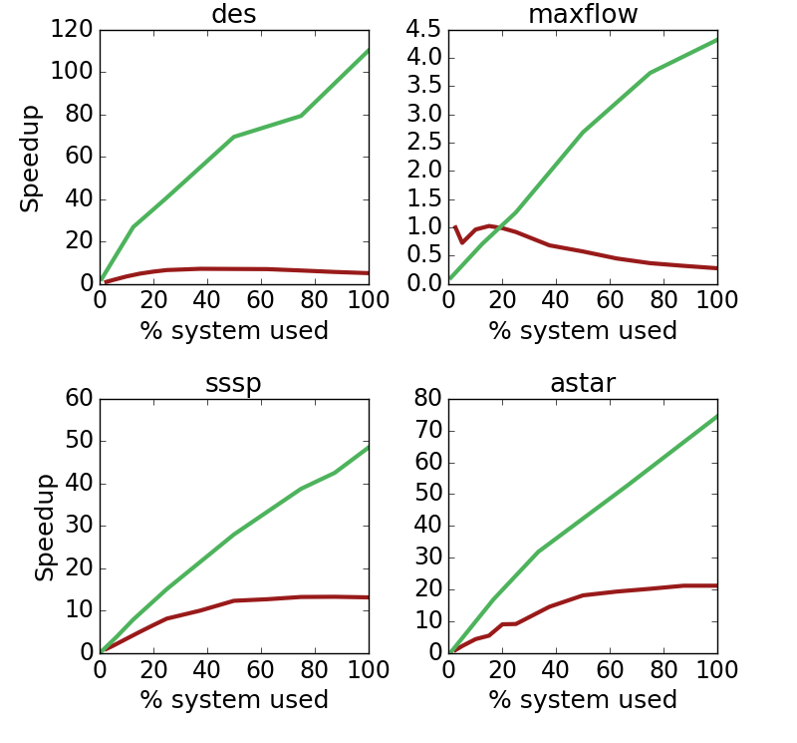
Chronos performance vs. 40-threaded Xeon
App | Concurrent Max. Tasks | FPGA 1t/ CPU 1t | Overall Speedup
des | 256 | 2.45× | 15.3×
maxflow | 192 | 0.11× | 4.3×
sssp | 512 | 0.24× | 3.6×
astar | 192 | 0.58× | 3.5×
15.3x
4.3x
Runs many more tasks in parallel
Specialization helps to run a single task efficiently (narrowing the 19× frequency gap with CPU)
3.6x
3.5x
Notes:
First let's look at performance which shows how Chronos outperforms 40-threaded Xeon baselines significantly
To understand these graphs, we need to understand that this is comparing FPGA and CPU. Because different FPGA systems have different numbers of PEs and tiles, these graphs show results as percentage of system use. In each of these graphs 1x is the performance of single threaded CPUs and red line at 100% corresponds to 40 threads. In the green line, we go from running a single concurrent task at a time to running as many tasks as can be fit on the FPGA.
[CLICK] Compared to the CPU, the FPGA gets 15x for des, 4x for maxflow, 3.6 for sssp and 3.5 for astar.
In all the cases, FPGA outperforms the CPU despite running at 19x slower frequency.
So let's look at why this is faster.
[CLICK] There are two reasons. First, This table shows that we can run a lot of tasks in parallel with the ability to run up to 512 parallel tasks, [CLICK] compared to just 40 on the CPU.
[CLICK] Second, this column shows the performance of the FPGA with a single concurrent task compared to a single threaded CPU variant. [CLICK] Normally we’d expect a slowdown because of the 19x frequency difference but specialization makes it much closer. For DES, it is actually faster because the CPU variant uses a s/w pririty queue while Chronos uses a hardware one.

Slide 20
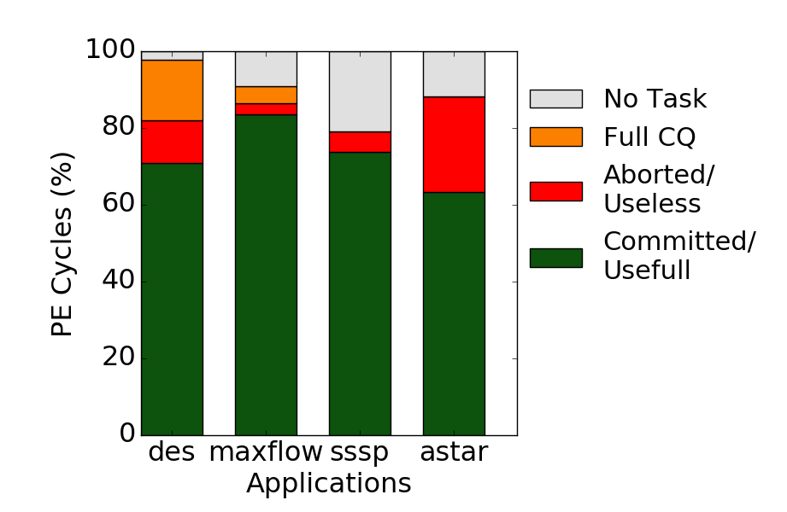
Chronos performance analysis
Observation:
Most work is ultimately useful
(only 11% of cycles result in wasted work)
Breakdown of aggregate PE cycles
Notes:
To illustrate how efficient Chronos is, this diagram shows how each PE spends its cycles. Based on whether they were spent doing work that was ultimate committed and useful, was aborted and wasted, or could not do any work because the CQ was full or no task was available.
This plot shows that only 11% of the cycles are actually wasted and most work is ultimately useful

Slide 21
See the paper for more
Non-speculative applications
Non-rollback applications
Chronos with RISC-V cores
Projected performance on ASIC Chronos
Chronos resource utilization
Notes:
In the paper we show how Chronos performs with traditional non-speculative applications,
and how Chronos can be configured for applications that does not require rollback after task abort.
We also have many more results, including how Chronos performs with RISC-V soft cores as PEs, projected performance with an ASIC implementation and resource utilization on the FPGAs

Slide 22
Conclusion
Prior speculative parallel systems have relied on cache coherence to detect conflicts, precluding their use in accelerators
SLOT (Spatially Located Ordered Tasks): A new execution model that does not require coherence, but relies on task ordering and spatial task mapping to detect conflicts
Chronos: An implementation of SLOT that provides a common framework for acceleration of applications with speculative parallelism
Use Chronos to build FPGA accelerators for four challenging applications providing up to 15x speedup over a multicore baseline
https://chronos-arch.csail.mit.edu/
Notes:
Chronos is available at this link, and we welcome you to check it out and provide feedback.

