Slide 1
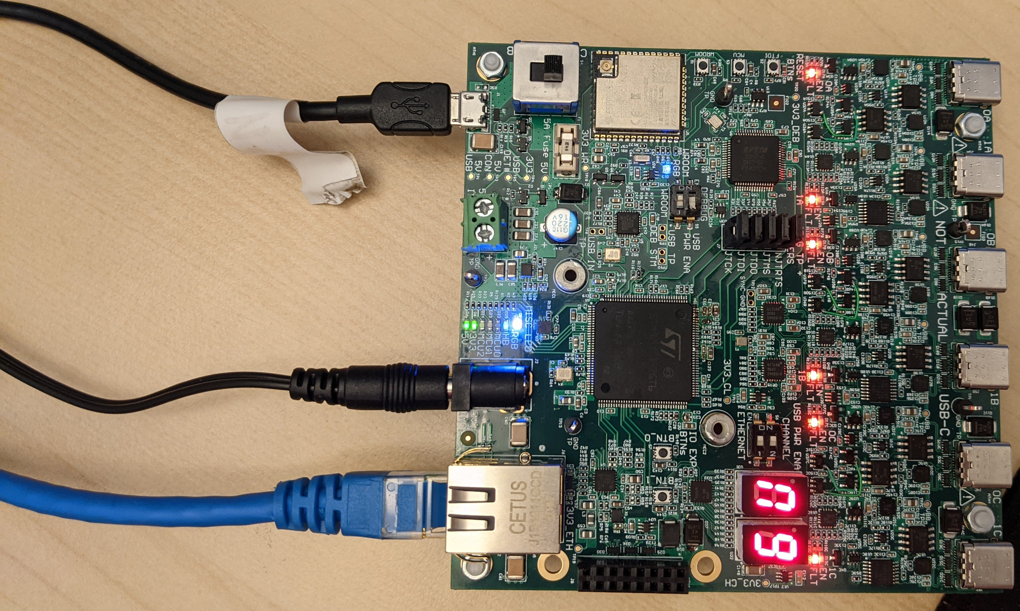
Power switch – “CON” mode
USB – To PC (flash/debug)
Power Supply
Ethernet – To embedded computer

