Slide 1
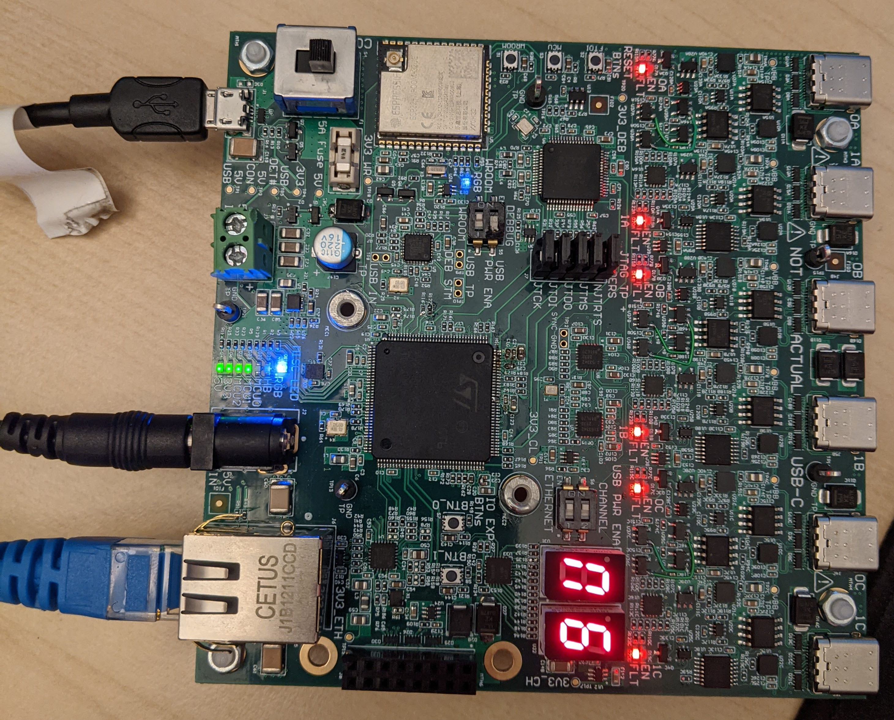
RGB LED -
Blue (Connected)

