Slide 1
Overview
This scan identified unmasked personal data in customer tables, posing a high compliance risk under DPDP. Immediate remediation is required before further data usage.
Final score: 16.68
Quality score: 96.68
Status: Immediate remediation required

Slide 2
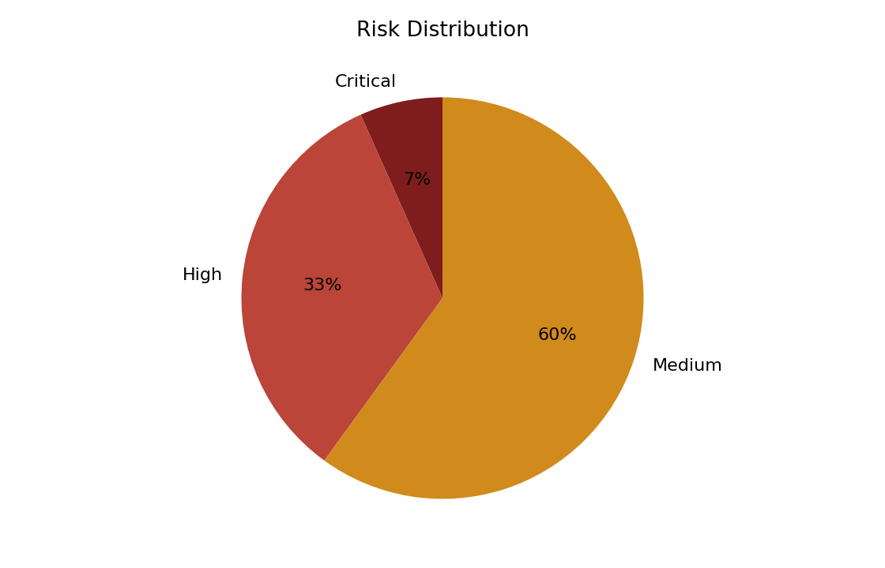
Risk Summary
Apply masking or tokenization to protect sensitive data
customer_email contains invalid email formats
email contains invalid email formats
Increase sample coverage and resolve profiling limitations
amount contains negative values

Slide 3
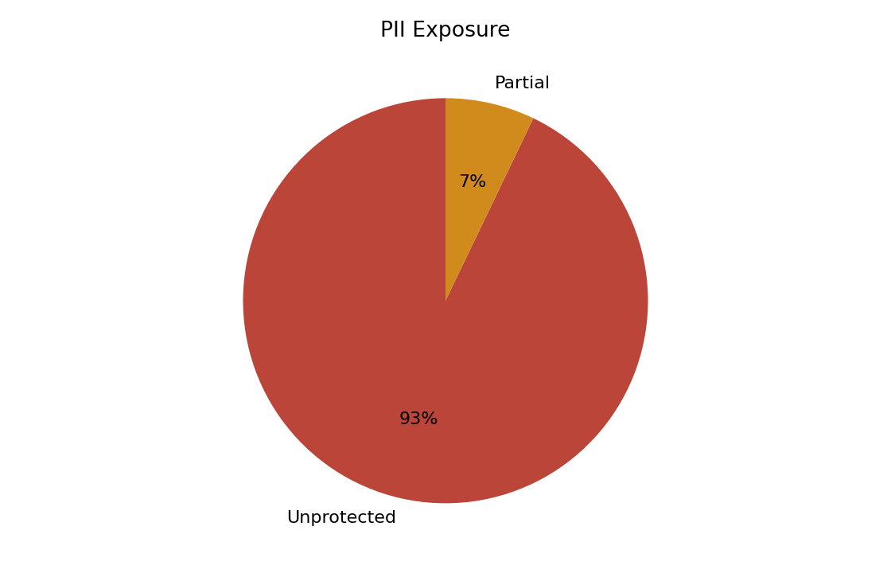
PII Exposure
dpdp_clean.customers.full_name: Unprotected sensitive data
dpdp_clean.customers.email: Unprotected sensitive data
dpdp_masked.communication_preferences.masked_contact: Partially protected sensitive data
dpdp_no_relationships.product_catalog.product_name: Unprotected sensitive data
dpdp_pii_exposure.customer_profiles.full_name: Unprotected sensitive data

Slide 4
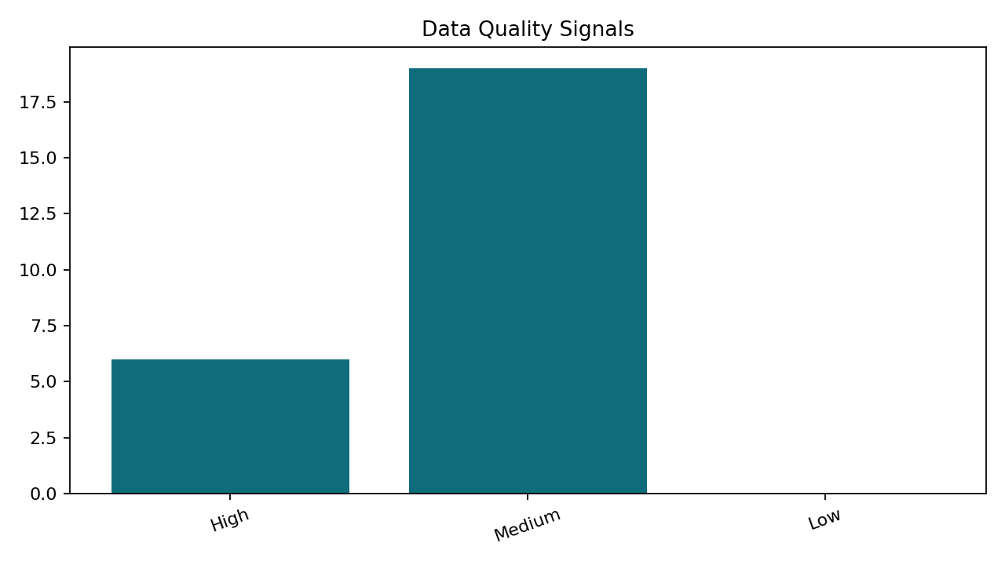
Data Quality
dpdp_clean.customers: Insufficient data for reliable profiling
dpdp_clean.orders: Insufficient data for reliable profiling
dpdp_masked.masked_customers: Insufficient data for reliable profiling
dpdp_masked.communication_preferences: Insufficient data for reliable profiling
dpdp_no_relationships.branch_targets: Insufficient data for reliable profiling

Slide 5
AI Insights
Apply masking or tokenization to protect sensitive data
Increase sample coverage and resolve profiling limitations
6 high-severity RAID risks were identified, indicating elevated governance exposure.
Inferred relationships across 22 column pair(s) suggest shared identifiers that should be validated for lineage and access control.

Slide 6
Recommendations
Apply masking or tokenization to protect sensitive data
Fix invalid formats and add validation rules for the affected dataset.
Deduplicate records and enforce uniqueness rules for the affected dataset.
Review and remediate: amount contains negative values.
Define completeness rules and remediate null-heavy fields in 66.67%.

