Slide 1
Overview
This scan identified unmasked personal data in customer tables, posing a high compliance risk under DPDP. Immediate remediation is required before further data usage.
Final score: 16.68
Quality score: 96.68
Status: Immediate remediation required

Slide 2
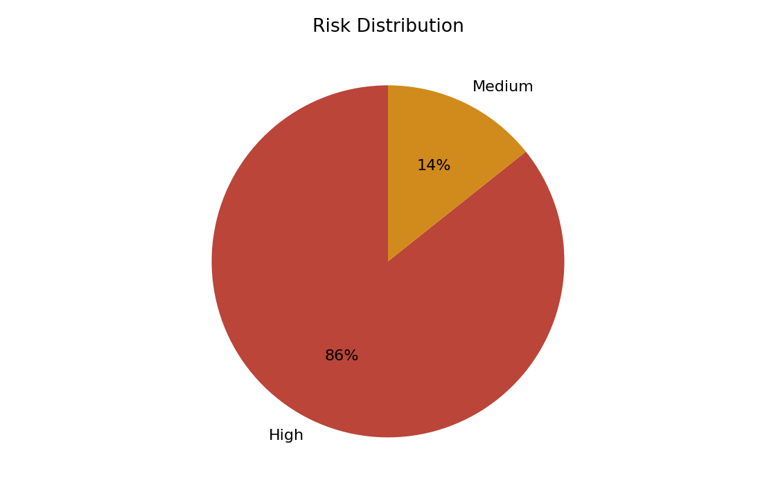
Risk Summary
High severity quality issue in dpdp_poor_quality.customer_imports: city has 66.67% null values
Increase sample coverage and resolve profiling limitations
High severity quality issue in dpdp_poor_quality.customer_imports: email contains invalid email formats
High severity quality issue in dpdp_poor_quality.payment_imports: customer_email contains invalid email formats
High severity quality issue in dpdp_poor_quality.payment_imports: amount contains negative values

Slide 3
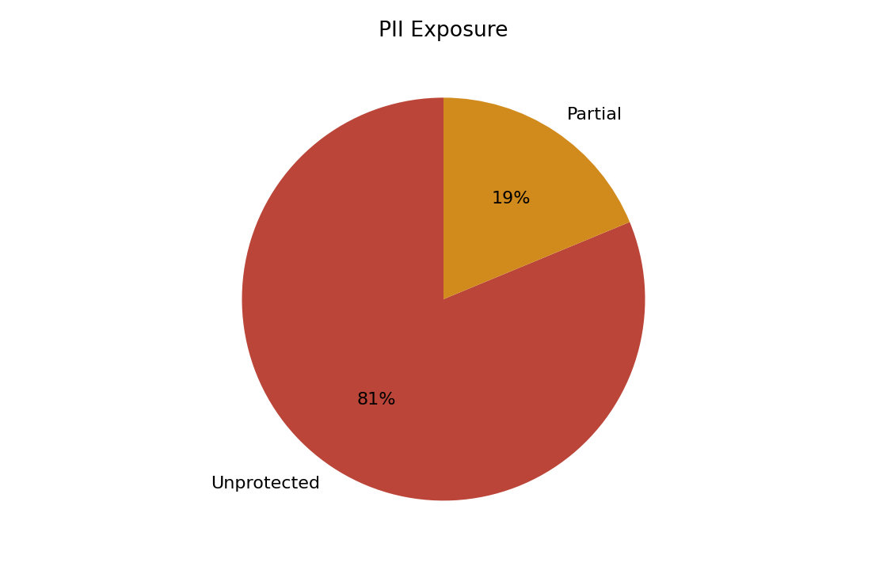
PII Exposure
dpdp_clean.customers.full_name: Unprotected sensitive data
dpdp_clean.customers.email: Unprotected sensitive data
dpdp_masked.masked_customers.masked_email: Partially protected sensitive data
dpdp_masked.masked_customers.masked_phone: Partially protected sensitive data
dpdp_masked.communication_preferences.masked_contact: Partially protected sensitive data

Slide 4
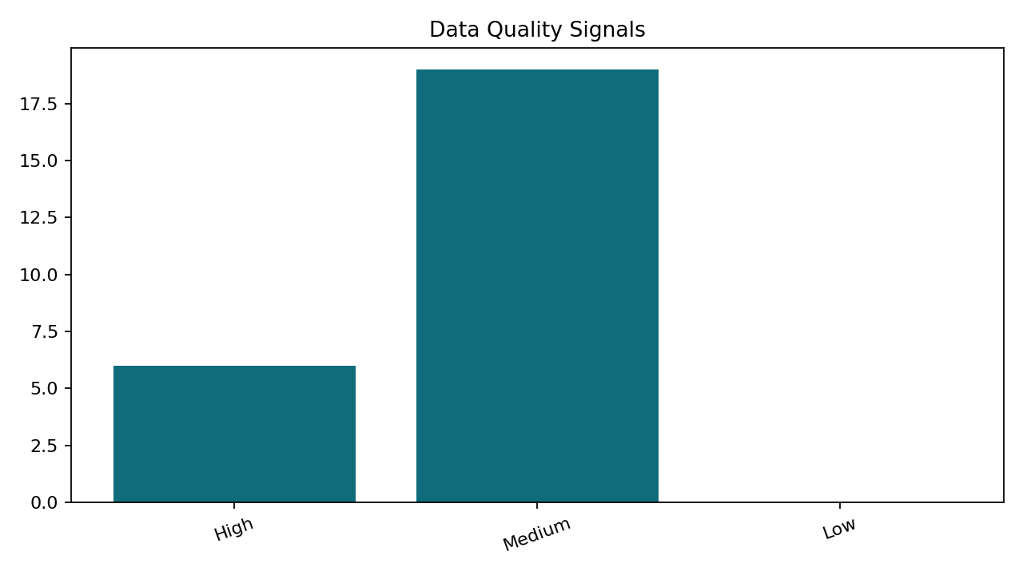
Data Quality
dpdp_clean.customers: Insufficient data for reliable profiling
dpdp_clean.orders: Insufficient data for reliable profiling
dpdp_masked.masked_customers: Insufficient data for reliable profiling
dpdp_masked.communication_preferences: Insufficient data for reliable profiling
dpdp_no_relationships.branch_targets: Insufficient data for reliable profiling

Slide 5
AI Insights
Apply masking or tokenization to protect sensitive data
Increase sample coverage and resolve profiling limitations
19 high-severity RAID risks were identified, indicating elevated governance exposure.
Inferred relationships across 22 column pair(s) suggest shared identifiers that should be validated for lineage and access control.

Slide 6
Recommendations
Increase sample coverage and resolve profiling limitations
Apply masking or tokenization to protect sensitive data
Review completeness rules and upstream capture for dpdp_poor_quality.customer_imports.full_name.
Review completeness rules and upstream capture for dpdp_poor_quality.customer_imports.email.
Review completeness rules and upstream capture for dpdp_poor_quality.customer_imports.phone_number.

