Slide 1
Overview
This scan identified unmasked personal data in customer tables, posing a high compliance risk under DPDP. Immediate remediation is required before further data usage.
Final score: 16.68
Quality score: 96.68
Status: Immediate remediation required

Slide 2
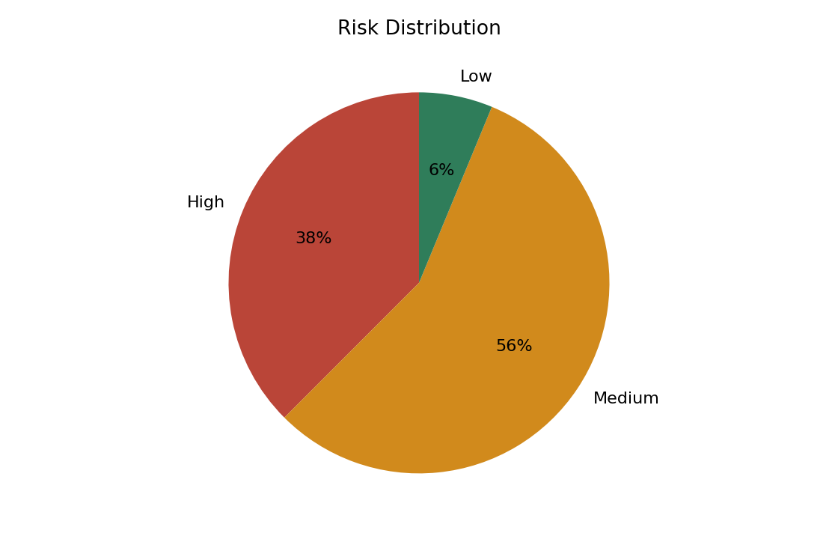
Risk Summary
Apply masking or tokenization to protect sensitive data
Increase sample coverage and resolve profiling limitations
amount contains negative values
city has 66.67% null values
customer_email contains invalid email formats

Slide 3
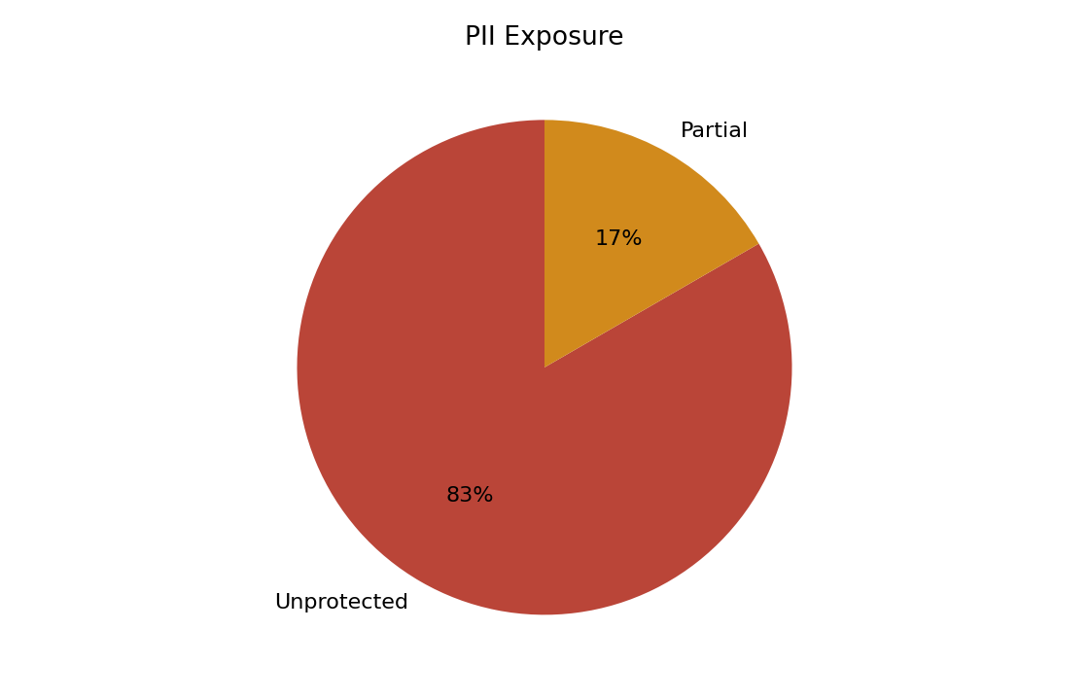
PII Exposure
dpdp_clean.customers.full_name: Unprotected sensitive data
dpdp_clean.customers.email: Unprotected sensitive data
dpdp_masked.masked_customers.masked_email: Partially protected sensitive data
dpdp_masked.masked_customers.masked_phone: Partially protected sensitive data
dpdp_masked.communication_preferences.masked_contact: Partially protected sensitive data

Slide 4
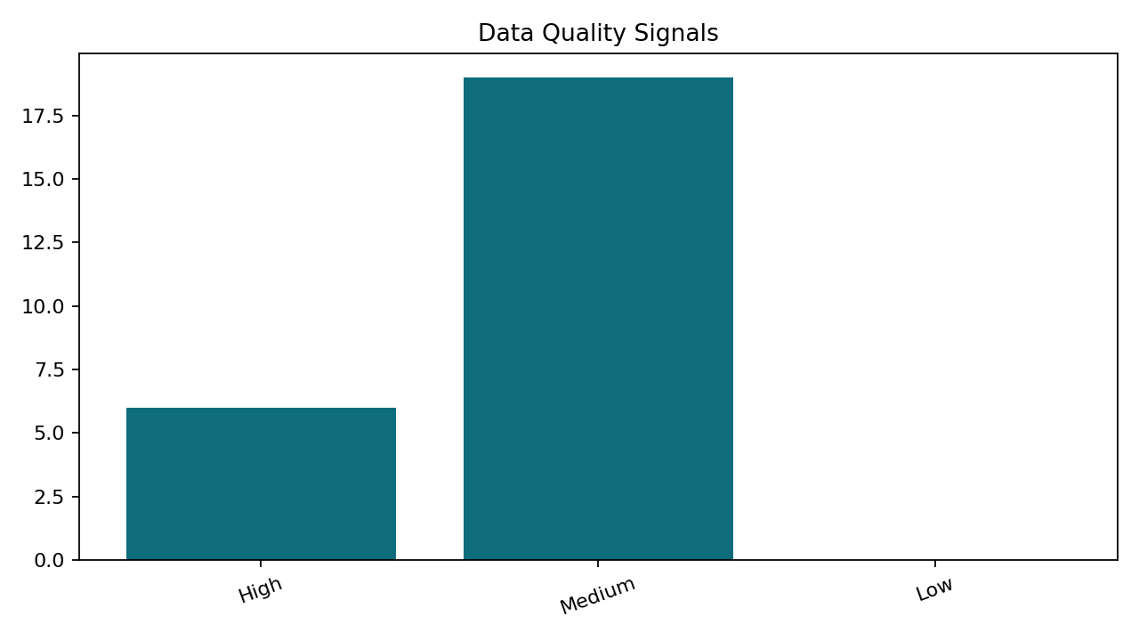
Data Quality
dpdp_clean.customers: Insufficient data for reliable profiling
dpdp_clean.orders: Insufficient data for reliable profiling
dpdp_masked.masked_customers: Insufficient data for reliable profiling
dpdp_masked.communication_preferences: Insufficient data for reliable profiling
dpdp_no_relationships.branch_targets: Insufficient data for reliable profiling

Slide 5
AI Insights
Apply masking or tokenization to protect sensitive data
Increase sample coverage and resolve profiling limitations
8 high-severity RAID risks were identified, indicating elevated governance exposure.
Inferred relationships across 22 column pair(s) suggest shared identifiers that should be validated for lineage and access control.

Slide 6
Recommendations
Apply masking or tokenization to protect sensitive data
Deduplicate records and enforce uniqueness rules for the affected dataset.
Review and remediate: amount contains negative values.
Define completeness rules and remediate null-heavy fields in 66.67%.
Fix invalid formats and add validation rules for the affected dataset.

