Slide 1
Overview
This scan identified unmasked personal data in customer tables, posing a high compliance risk under DPDP. Immediate remediation is required before further data usage.
Final score: 54.0
Quality score: 100.0
Status: Immediate remediation required

Slide 2
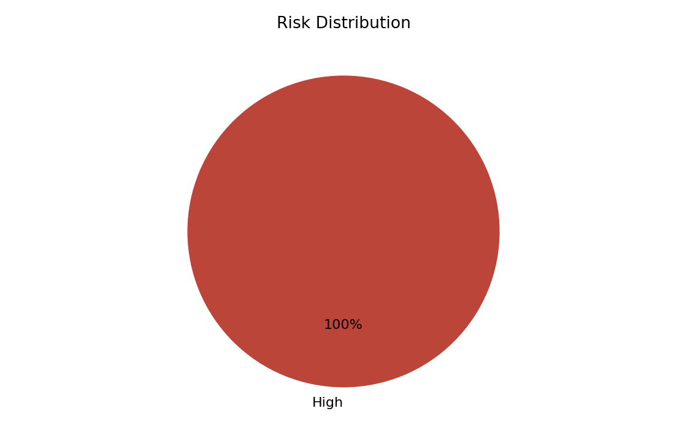
Risk Summary
Apply masking or tokenization to protect sensitive data

Slide 3
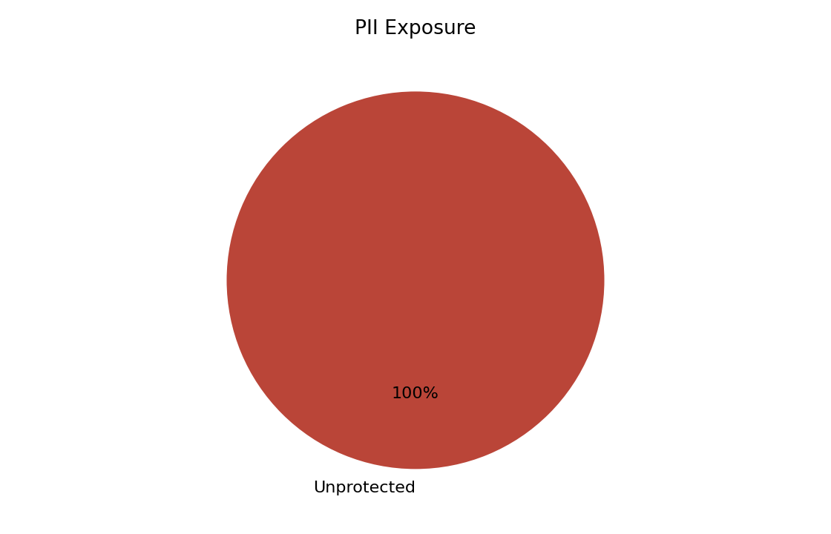
PII Exposure
public.customers.customer_name: Unprotected sensitive data
public.customers.email: Unprotected sensitive data

Slide 4
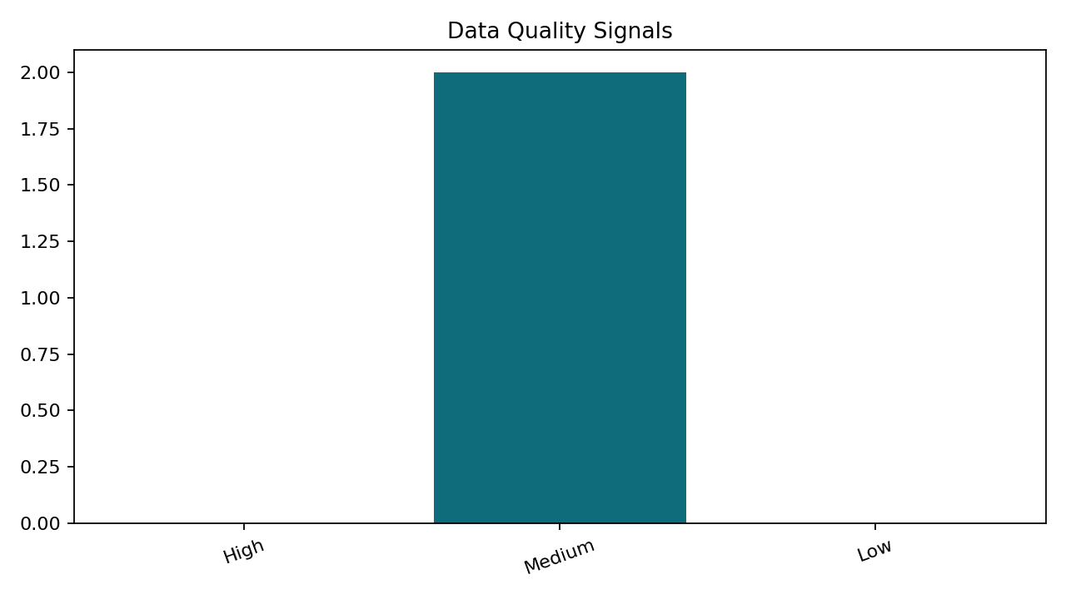
Data Quality
public.customers: Insufficient data for reliable profiling
public.orders: Insufficient data for reliable profiling

Slide 5
AI Insights
Apply masking or tokenization to protect sensitive data
Increase sample coverage and resolve profiling limitations
Inferred relationships across 1 column pair(s) suggest shared identifiers that should be validated for lineage and access control.

Slide 6
Recommendations
Increase sample coverage and resolve profiling limitations
Apply masking or tokenization to protect sensitive data

