Slide 1
Lecture 17 Graph-Based Algorithms
CSE373: Design and Analysis of Algorithms

Slide 2
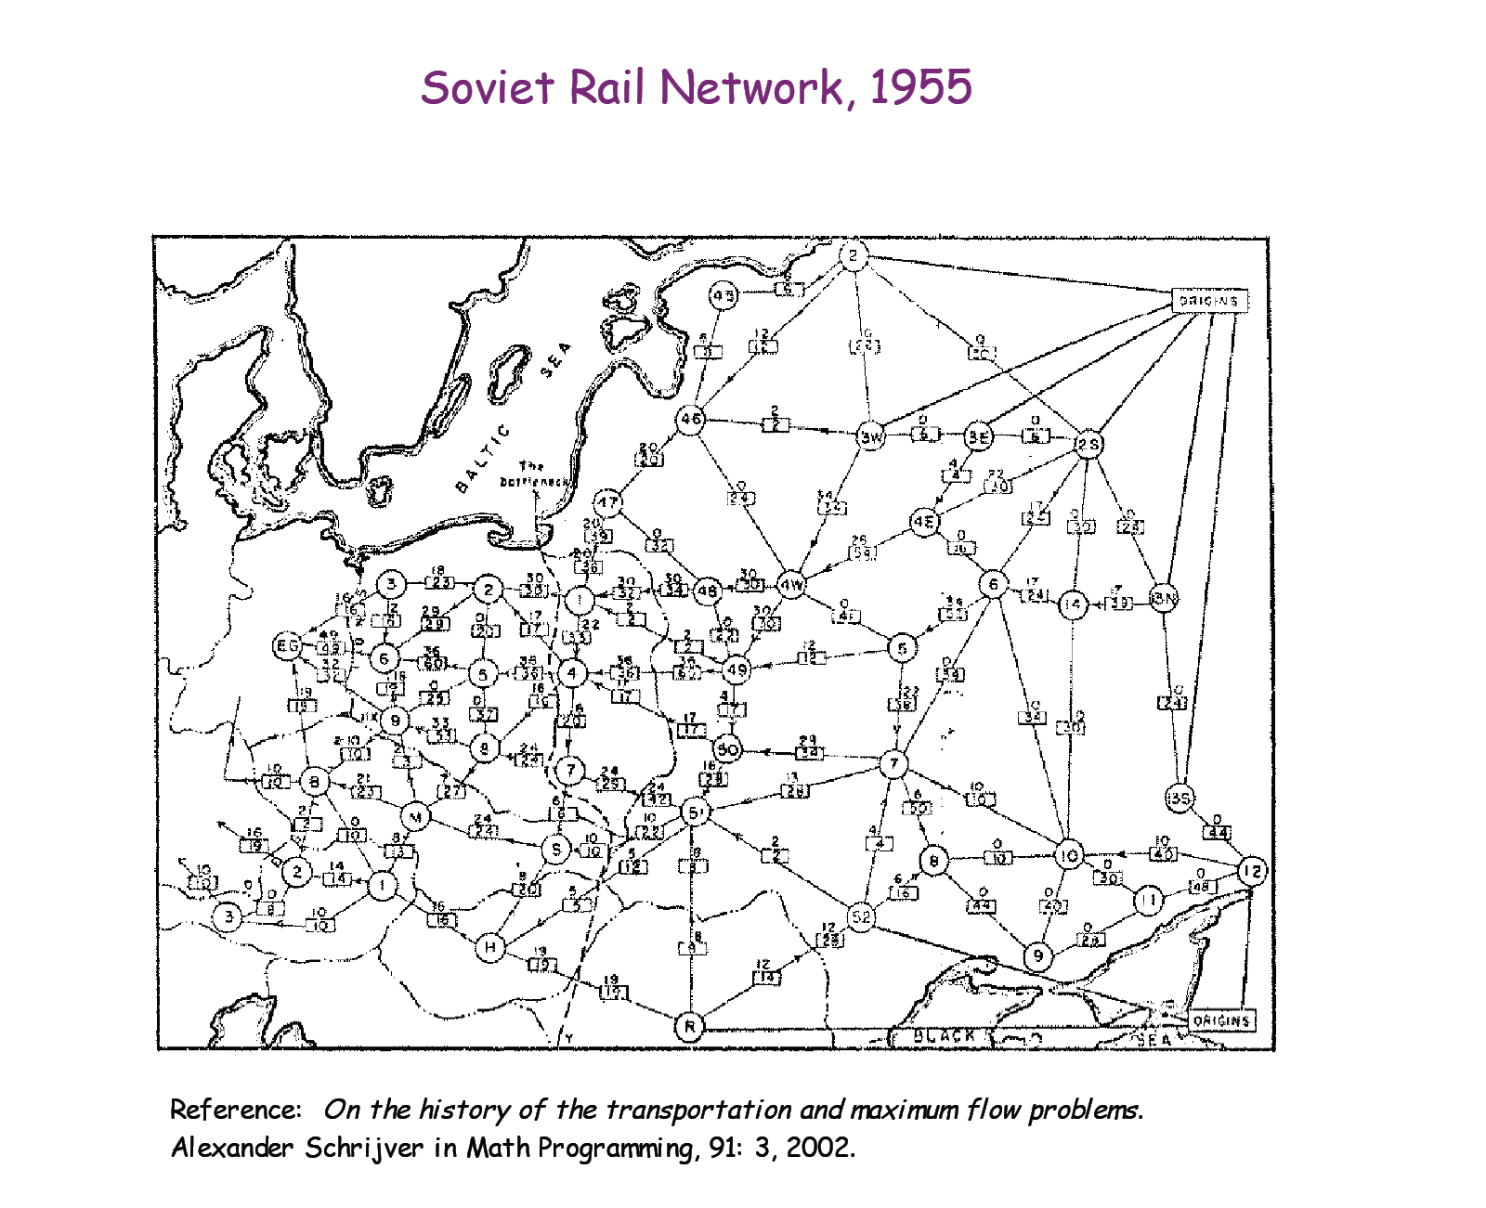
Background
material coursing through a system from a source to a sink

Slide 3
Background
How can we maximize the flow in a network from a source or set of sources to a destination or set of destinations?
The problem reportedly rose to prominence in relation to the rail networks of the Soviet Union, during the 1950's. The US wanted to know how quickly the Soviet Union could get supplies through its rail network to its satellite states in Eastern Europe.
In addition, the US wanted to know which rails it could destroy most easily to cut off the satellite states from the rest of the Soviet Union. It turned out that these two problems were closely related, and that solving the max flow problem also solves the min cut problem of figuring out the cheapest way to cut off the Soviet Union from its satellites.

Slide 4





Flow Networks
A flow network G=(V,E): a directed graph, where each edge (u,v)∈E has a nonnegative capacity c(u,v)>=0. If (u,v)∉E, we assume that c(u,v)=0.
Edges represent pipes that carry flow
Two distinct vertices: a source $s$ and a sink $t$.
12
$$v_{1}$$
$$v_{3}$$
16
20
s
10
9
7
t
4
13
4
$$v_{2}$$
$$v_{4}$$
14

Slide 5

Flow
Given $G=(V,E)$, a flow network with capacity function c, a source $s$ and a sink $t$, a flow in G is a real-valued function $f: V∗V→R$ satisfying the following two properties:
Notes:
Function f also satisfies skew symmetry property: f(u,v)=-f(v,u) for any u,v in V
It implies that f(u,u)=0.
We show only the positive flows in the flow network.

Slide 6





Flow: Example
$$f(v2, v1) = 1, c(v2, v1) = 4.$$
$$f(v1, v2) = −1, c(v1, v2) = 10.$$
$$f(v3, s)+f(v3, v1)+f(v3, v2)+f(v3, v4)+f(v3, t) =$$
$$0+\left(−12\right)+4+(−7)+15=0$$
capacity
12/12
flow
$$v_{1}$$
$$v_{3}$$
capacity
11/16
15/20
s
10
t
1/4
4/9
7/7
8/13
$$v_{2}$$
4/4
$$v_{4}$$
11/14

Slide 7

Value of a Flow
The total flow from source to any other vertices.
The same as the total flow from any vertices to the sink.
The total flow leaving $s$ = the total flow arriving at $t$.

Slide 8

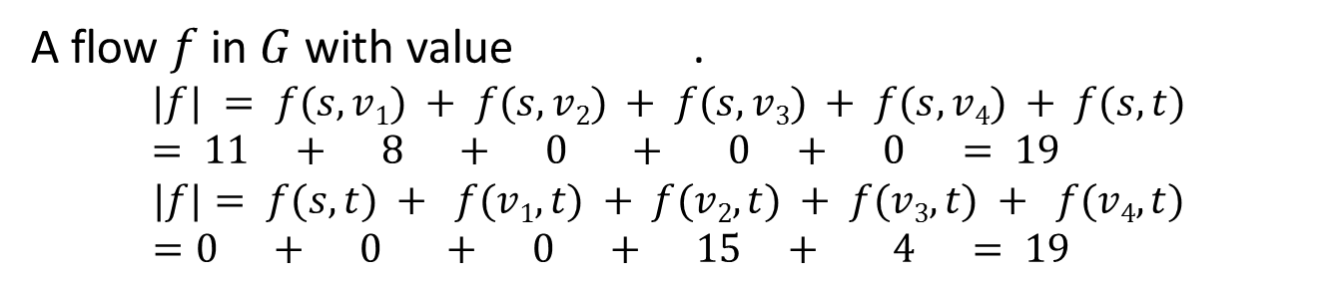



Value of a Flow
12/12
$$v_{1}$$
$$v_{3}$$
11/16
15/20
s
10
t
1/4
4/9
7/7
8/13
$$v_{2}$$
4/4
$$v_{4}$$
11/14
A flow $f$ in $G$ with value .
$$|f| = f(s, v1) + f(s, v2) + f(s, v3) + f(s, v4) + f(s, t) = 11 + 8 + 0 + 0 + 0 = 19$$
$$|f|= f(s, t) + f(v1, t) + f(v2, t) + f(v3, t) + f(v4, t) =0 + 0 + 0 + 15 + 4 = 19$$

Slide 9
The Problem
Use a graph to model material that flows through conduits.
Each edge represents one conduit, and has a capacity, which is an upper bound on the flow rate, in units/time.
Can think of edges as pipes (or, roads) of different sizes (or, widths).
Calculate the max rate that we can ship material from a designated source to a designated sink. That is, calculate the maximum flow.

Slide 10
Multiple Sources Network
We have several sources and several targets. We want to maximize the total flow from all sources to all targets.
We can reduce this problem to ordinary max-flow problem by attaching a supersource to each source and a supersink to each sink as below:

Slide 11
Residual Networks
The residual capacity of an edge (u,v) in a network with a flow f is given by:
The residual network of a graph G induced by a flow f is the graph including only the edges with positive residual capacity, i.e.,
Intuitively a residual network consists of edges that can admit more flow.

Slide 12
Residual Networks
12
4/12
v₁
v₃
v₁
v₃
16
20
4/16
20
s
10
4
7
t
s
7
9
10
4
t
4/9
13
4
13
4/4
v₂
v₄
v₂
v₄
14
4/14
A graph and a flow along the shaded path
Same graph and flow: flow value is shown as flow/cap on each edge of the flow-path
8
12
v₁
v₃
20
4
s
4
4
10
4
t
7
5
13
10
4
v₂
v₄
4
Flow network representation

Slide 13
Augmenting Paths
An augmenting path p is a simple path from s to t on the residual network.
We call the maximum capacity by which we can increase the flow on p the residual capacity of path p.
8
8
12
v₁
v₃
12
20
v₁
v₃
4
20
4
s
4
4
4
10
4
t
s
4
4
7
10
7
t
5
5
13
10
4
13
10
4
v₂
v₄
v₂
v₄
4
Augmenting path
4
Network:
Residual network:

Slide 14
Cuts of Flow Networks

Slide 15

The Net Flow Across a Cut
$$f(S,T) = 12 – 4 + 11 = 19$$

Slide 16
The Net Flow Across a Cut
The net flow across any cut is the same and equal to the flow of the network |f|.

Slide 17

The Capacity of a Cut
$$c(S,T)= 12+ 0 + 14 = 26$$

Slide 18
Bounding the Network Flow
The value of any flow f in a flow network G is bounded from above by the capacity of any cut of G, i.e., |f| ≤ c(S,T) for any cut (S,T) of G.
The capacity of the cut is 26 and flow in the network is 19.

Slide 19
Bounding the Network Flow
The value of any flow f in a flow network G is bounded from above by the capacity of any cut of G, i.e., |f| ≤ c(S,T) for any cut (S,T) of G.
The capacity of the cut is 23.
In this case, the network does have a maximum flow of 23 and this is a minimum cut: set S of edges going from S to T s.t. sum of capacities/weights of edges in S is minimum

Slide 20
Max-Flow Min-Cut Theorem
If f is a flow in a flow network G=(V,E), with source s and sink t, then the following conditions are equivalent:
f is a maximum flow in G.
The residual network G_{f} contains no augmented paths.
|f| = c(S,T) for some cut (S,T) (i.e., max-flow = min-cut).

Slide 21
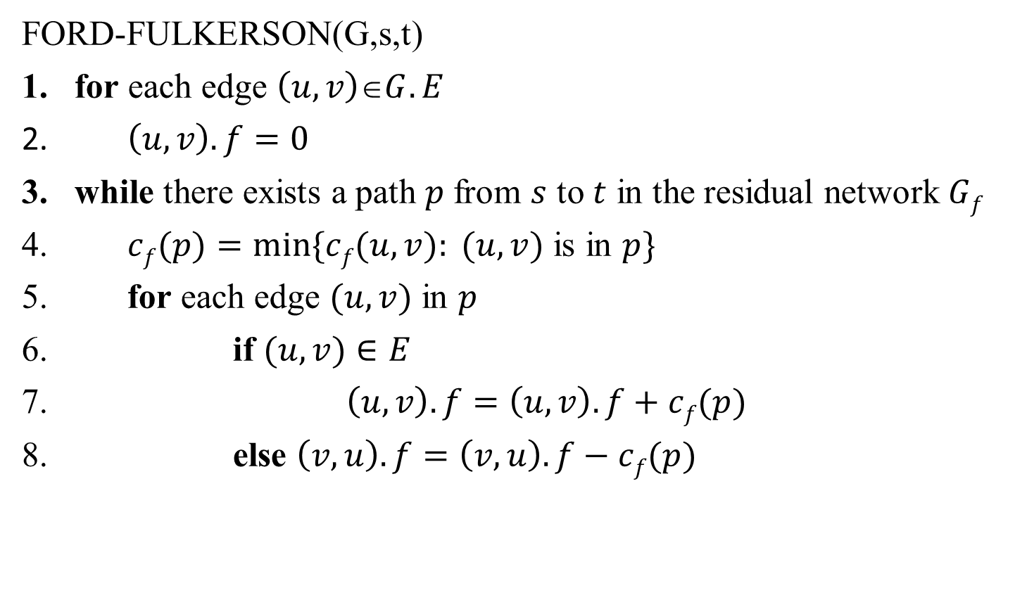
The Basic Ford-Fulkerson Algorithm
FORD-FULKERSON(G,s,t)
for each edge $\left(u,v\right)∈G.E$
$\left(u,v\right).f=0$
while there exists a path $p$ from $s$ to $t$ in the residual network $Gf$
$cf(p)=min⁡\{cf(u,v): (u,v)$ is in $p\}$
for each edge $(u,v)$ in $p$
if $(u,v)∈E$
$\left(u,v\right).f=\left(u,v\right).f+cf(p)$
else $\left(v,u\right).f=\left(v,u\right).f−cf(p)$

Slide 22
Example
Execution of Ford-Fulkerson Method
$$v_{1}$$
$$v_{3}$$
12
16
20
s
9
7
t
10
4
13
4
$$v_{2}$$
14
$$v_{4}$$
Flow: 0

Slide 23
Example
Execution of Ford-Fulkerson Method
$$v_{1}$$
$$v_{3}$$
12
16
20
s
9
7
t
10
4
13
4
$$v_{2}$$
14
$$v_{4}$$
Flow: 0

Slide 24
Example
Execution of Ford-Fulkerson Method
4
$$v_{1}$$
$$v_{3}$$
4
8
12
20
s
5
7
t
10
4
4
13
4
$$v_{2}$$
10
$$v_{4}$$
4
Flow: 0+4

Slide 25
Example
Execution of Ford-Fulkerson Method
4
$$v_{1}$$
$$v_{3}$$
4
8
12
20
s
5
7
t
10
4
4
13
4
$$v_{2}$$
10
$$v_{4}$$
4
Flow: 0+4

Slide 26
Example
Execution of Ford-Fulkerson Method
4
$$v_{1}$$
$$v_{3}$$
11
8
7
5
13
s
5
7
t
3
11
4
13
4
$$v_{2}$$
3
$$v_{4}$$
11
Flow: 0+4+7

Slide 27
Example
Execution of Ford-Fulkerson Method
4
$$v_{1}$$
$$v_{3}$$
11
8
7
5
13
s
5
7
t
3
11
4
13
4
$$v_{2}$$
3
$$v_{4}$$
11
Flow: 0+4+7

Slide 28
Example
Execution of Ford-Fulkerson Method
12
$$v_{1}$$
$$v_{3}$$
11
15
5
5
s
5
7
t
11
3
4
5
4
8
$$v_{2}$$
3
$$v_{4}$$
11
Flow: 0+4+7+8

Slide 29
Example
Execution of Ford-Fulkerson Method
12
$$v_{1}$$
$$v_{3}$$
11
15
5
5
s
5
7
t
11
3
4
5
4
8
$$v_{2}$$
3
$$v_{4}$$
11
Flow: 0+4+7+8

Slide 30
Example
Execution of Ford-Fulkerson Method
12
$$v_{1}$$
$$v_{3}$$
11
19
5
1
s
9
7
t
11
3
1
4
12
$$v_{2}$$
3
$$v_{4}$$
11
Flow: 0+4+7+8+4=23 (no more augmenting path)

Slide 31
Analysis
FORD-FULKERSON(G,s,t)
for each edge $\left(u,v\right)∈G.E$
$\left(u,v\right).f=0$
while there exists a path $p$ from $s$ to $t$ in the residual network $Gf$
$cf(p)=min⁡\{cf(u,v): (u,v)$ is in $p\}$
for each edge $(u,v)$ in $p$
if $(u,v)∈E$
$\left(u,v\right).f=\left(u,v\right).f+cf(p)$
else $\left(v,u\right).f=\left(v,u\right).f−cf(p)$
O(E)
?
O(E)

Slide 32
Analysis
If capacities are all integer, then each augmenting path raises |f| by ≥ 1.
If max flow is f*, then need ≤ |f*| iterations → time is O(E|f*|).
Note that this running time is not polynomial in input size. It depends on |f*|, which is not a function of |V| or |E|.
If capacities are rational, can scale them to integers.
If irrational, FORD-FULKERSON might never terminate!

