Slide 1
CSE-301
Combinatorial Optimization
Asymptotic Notation

Slide 2
Analyzing Algorithms
Predict the amount of resources required:
  memory: how much space is needed?
  computational time: how fast the algorithm runs?
FACT: running time grows with the size of the input
Input size (number of elements in the input)
  Size of an array, polynomial degree, # of elements in a matrix, # of bits in the binary representation of the input, vertices and edges in a graph
Def: Running time = the number of primitive operations (steps) executed before termination
  Arithmetic operations (+, -, *), data movement, control, decision making (if, while), comparison

Slide 3
Algorithm Analysis: Example
Alg.: MIN (a[1], …, a[n])
  m ← a[1];
  for i ← 2 to n
  if a[i] < m
  then m ← a[i];
Running time:
  the number of primitive operations (steps) executed before termination
  T(n) =1 [first step] + (n) [for loop] + (n-1) [if condition] +
  (n-1) [the assignment in then] = 3n - 1
Order (rate) of growth:
  The leading term of the formula
  Expresses the asymptotic behavior of the algorithm

Slide 4
Typical Running Time Functions
1 (constant running time):
  Instructions are executed once or a few times
logN (logarithmic)
  A big problem is solved by cutting the original problem in smaller sizes, by a constant fraction at each step
N (linear)
  A small amount of processing is done on each input element
N logN
  A problem is solved by dividing it into smaller problems, solving them independently and combining the solution

Slide 5
Typical Running Time Functions
N² (quadratic)
  Typical for algorithms that process all pairs of data items (double nested loops)
N³ (cubic)
  Processing of triples of data (triple nested loops)
N^{K} (polynomial)
2^{N} (exponential)
  Few exponential algorithms are appropriate for practical use

Slide 6
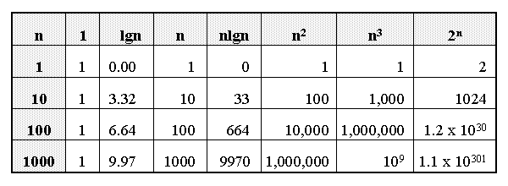
Growth of Functions

Slide 7
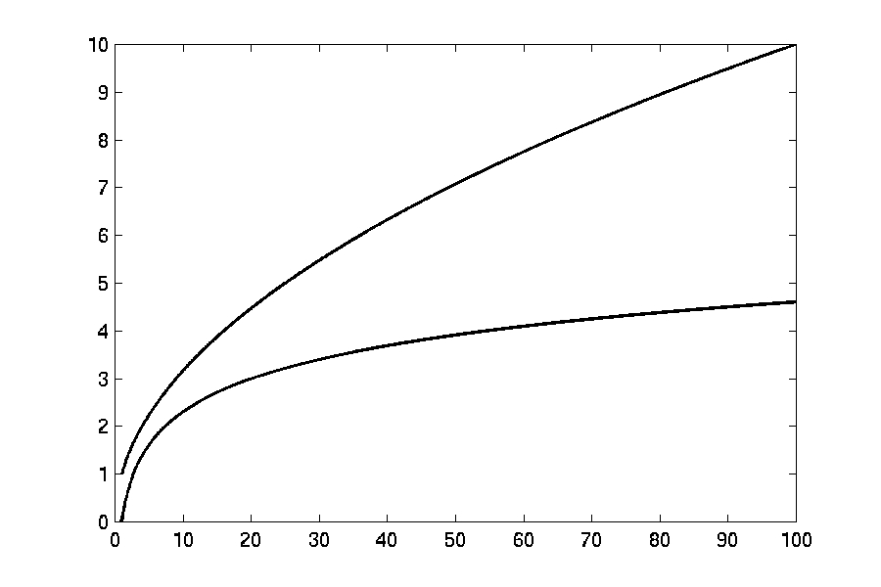

Complexity Graphs
log(n)

Slide 8
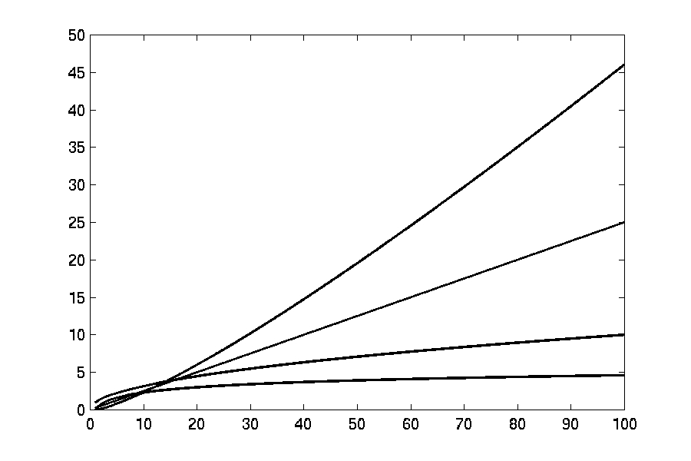
Complexity Graphs
n log(n)
n
log(n)

Slide 9
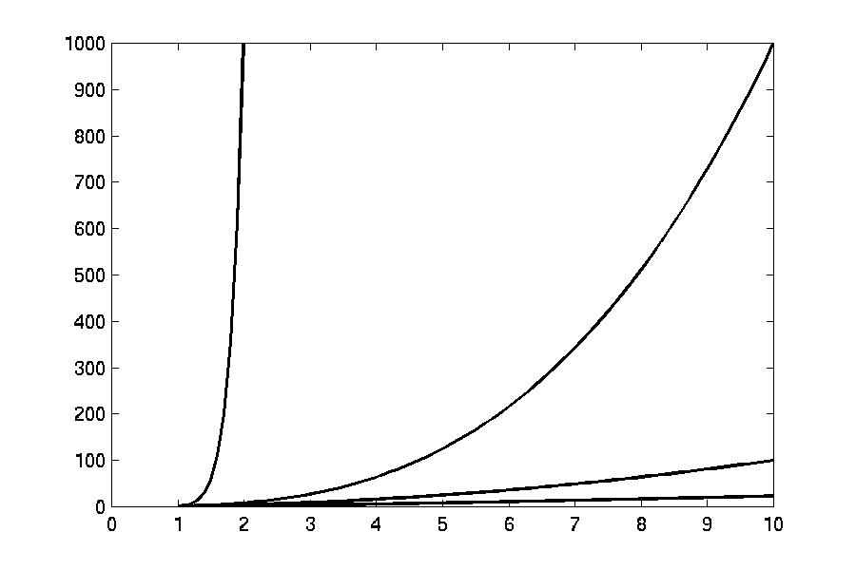
Complexity Graphs
n¹⁰
n³
n²
n log(n)

Slide 10
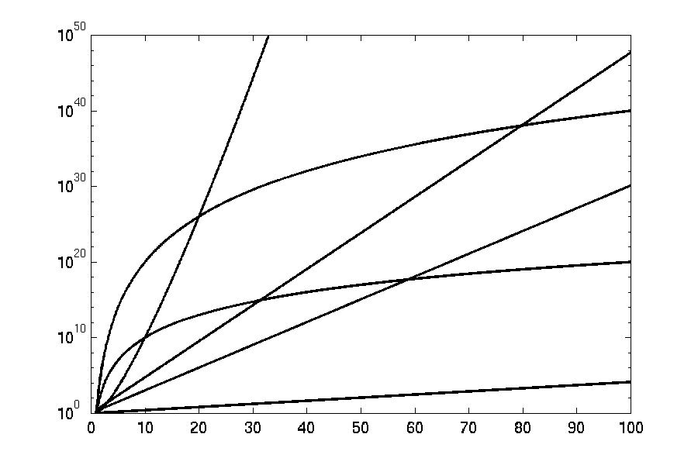
Complexity Graphs (log scale)
3^{n}
n^{n}
n²⁰
2^{n}
n¹⁰
1.1^{n}

Slide 11
Algorithm Complexity
Worst Case Complexity:
  the function defined by the maximum number of steps taken on any instance of size n
Best Case Complexity:
  the function defined by the minimum number of steps taken on any instance of size n
Average Case Complexity:
  the function defined by the average number of steps taken on any instance of size n

Slide 12
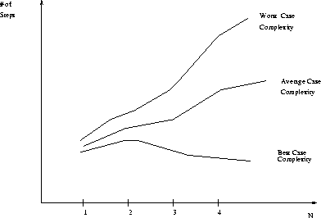
Best, Worst, and Average Case Complexity
Number of steps
Worst Case Complexity
Average Case Complexity
Best Case Complexity
N
(input size)

Slide 13
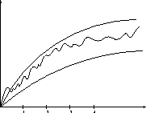
Doing the Analysis
It’s hard to estimate the running time exactly
  Best case depends on the input
  Average case is difficult to compute
  So we usually focus on worst case analysis
    Easier to compute
    Usually close to the actual running time
Strategy: find a function (an equation) that, for large n, is an upper bound to the actual function (actual number of steps, memory usage, etc.)
Upper bound
Actual function
Lower bound

Slide 14
Motivation for Asymptotic Analysis
An exact computation of worst-case running time can be difficult
  Function may have many terms:
    4n² - 3n log n + 17.5 n - 43 n^{⅔} + 75
An exact computation of worst-case running time is unnecessary
  Remember that we are already approximating running time by using RAM model

Slide 15
Classifying functions by their
Asymptotic Growth Rates (1/2)
asymptotic growth rate, asymptotic order, or
order of functions
  Comparing and classifying functions that ignores
    constant factors and
    small inputs.
The Sets big oh O(g), big theta Θ(g), big omega Ω(g)

Slide 16
Classifying functions by their
Asymptotic Growth Rates (2/2)
O(g(n)), Big-Oh of g of n, the Asymptotic Upper Bound;
Θ(g(n)), Theta of g of n, the Asymptotic Tight Bound; and
Ω(g(n)), Omega of g of n, the Asymptotic Lower Bound.

Slide 17
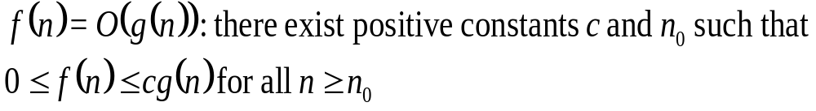
Big-O
What does it mean?
  If f(n) = O(n²), then:
    f(n) can be larger than n² sometimes, but…
    We can choose some constant c and some value n₀ such that for every value of n larger than n₀ : f(n) < cn²
    That is, for values larger than n₀, f(n) is never more than a constant multiplier greater than n²
    Or, in other words, f(n) does not grow more than a constant factor faster than n².

Slide 18
Visualization of O(g(n))
cg(n)
f(n)
n₀

Slide 19
Examples
  2n² = O(n³):
  n² = O(n²):
  1000n²+1000n = O(n²):
  n = O(n²):
2n² ≤ cn³ ⇒ 2 ≤ cn ⇒ c = 1 and n₀= 2
n² ≤ cn² ⇒ c ≥ 1 ⇒ c = 1 and n₀= 1
1000n²+1000n ≤ cn² ≤ cn²+ 1000n ⇒ c=1001 and n₀ = 1
n ≤ cn² ⇒ cn ≥ 1 ⇒ c = 1 and n₀= 1

Slide 20
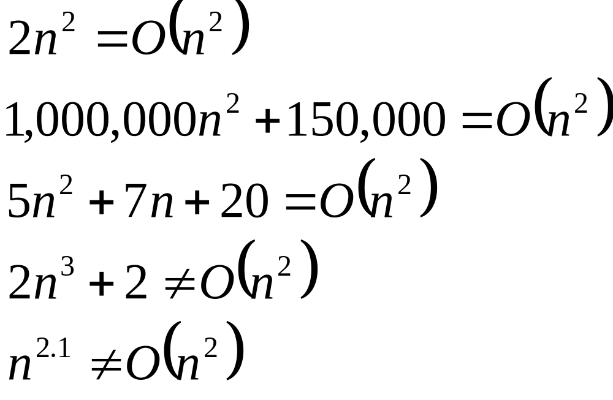
Big-O

Slide 21
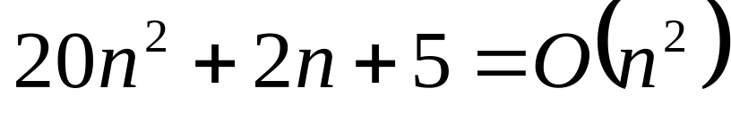
More Big-O
Prove that:
Let c = 21 and n₀ = 4
21n² > 20n² + 2n + 5 for all n > 4
n² > 2n + 5 for all n > 4
TRUE

Slide 22
Tight bounds
We generally want the tightest bound we can find.
While it is true that n² + 7n is in O(n³), it is more interesting to say that it is in O(n²)

Slide 23
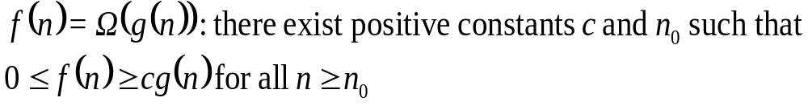
Big Omega – Notation
Ω() – A lower bound
  n² = Ω(n)
  Let c = 1, n₀ = 2
  For all n ≥ 2, n² > 1 × n

Slide 24
Visualization of Ω(g(n))
f(n)
cg(n)
n₀

Slide 25
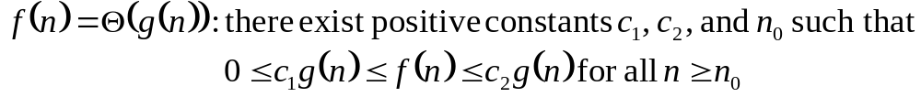
Θ-notation
Big-O is not a tight upper bound. In other words n = O(n²)
Θ provides a tight bound
In other words,

Slide 26
Visualization of Θ(g(n))
c₂g(n)
f(n)
c₁g(n)
n₀

Slide 27
A Few More Examples
n = O(n²) ≠ Θ(n²)
200n² = O(n²) = Θ(n²)
n^{2.5} ≠ O(n²) ≠ Θ(n²)

Slide 28
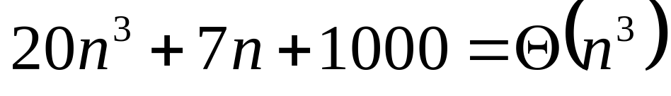
Example 2
Prove that:
Let c = 21 and n₀ = 10
21n³ > 20n³ + 7n + 1000 for all n > 10
n³ > 7n + 5 for all n > 10
TRUE, but we also need…
Let c = 20 and n₀ = 1
20n³ < 20n³ + 7n + 1000 for all n ≥ 1
TRUE

Slide 29
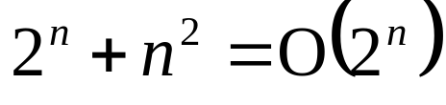
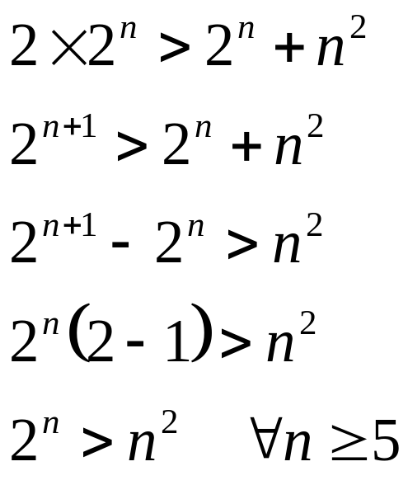
Example 3
Show that
Let c = 2 and n₀ = 5
✓

Slide 30
Asymptotic Notations - Examples
Θ notation
  n²/2 – n/2
  (6n³ + 1)lgn/(n + 1)
  n vs. n²
Ω notation
  n³ vs. n²
  n vs. logn
  n vs. n²
= Θ(n²)
= Θ(n²lgn)
n ≠ Θ(n²)
O notation
  2n² vs. n³
  n² vs. n²
  n³ vs. nlogn
n³ = Ω(n²)
2n² = O(n³)
n = Ω(logn)
n² = O(n²)
n ≠ Ω(n²)
n³ ≠ O(nlgn)

Slide 31
Asymptotic Notations - Examples
For each of the following pairs of functions, either f(n) is O(g(n)), f(n) is Ω(g(n)), or f(n) = Θ(g(n)). Determine which relationship is correct.
  f(n) = log n²; g(n) = log n + 5
  f(n) = n; g(n) = log n²
  f(n) = log log n; g(n) = log n
  f(n) = n; g(n) = log² n
  f(n) = n log n + n; g(n) = log n
  f(n) = 10; g(n) = log 10
  f(n) = 2^{n}; g(n) = 10n²
  f(n) = 2^{n}; g(n) = 3^{n}
f(n) = Θ (g(n))
f(n) = Ω(g(n))
f(n) = O(g(n))
f(n) = Ω(g(n))
f(n) = Ω(g(n))
f(n) = Θ(g(n))
f(n) = Ω(g(n))
f(n) = O(g(n))

Slide 32
Simplifying Assumptions
1. If f(n) = O(g(n)) and g(n) = O(h(n)), then f(n) = O(h(n))
2. If f(n) = O(kg(n)) for any k > 0, then f(n) = O(g(n))
3. If f₁(n) = O(g₁(n)) and f₂(n) = O(g₂(n)),
then f₁(n) + f₂(n) = O(max (g₁(n), g₂(n)))
4. If f₁(n) = O(g₁(n)) and f₂(n) = O(g₂(n)),
then f₁(n) * f₂(n) = O(g₁(n) * g₂(n))

Slide 33
Example
Code:
a = b;
Complexity:
Notes:
constant

Slide 34
Example
Code:
sum = 0;
for (i=1; i <=n; i++)
sum += n;
Complexity:
Notes:
linear

Slide 35
Example
Code:
sum = 0;
for (j=1; j<=n; j++)
for (i=1; i<=j; i++)
sum++;
for (k=0; k<n; k++)
A[k] = k;
Complexity:
Notes:
N squared == 1 + 2 + … + N

Slide 36
Example
Code:
sum1 = 0;
for (i=1; i<=n; i++)
for (j=1; j<=n; j++)
sum1++;
Complexity:
Notes:
Obviousy n squared

Slide 37
Example
Code:
sum2 = 0;
for (i=1; i<=n; i++)
for (j=1; j<=i; j++)
sum2++;
Complexity:

Slide 38
Example
Code:
sum1 = 0;
for (k=1; k<=n; k*=2)
for (j=1; j<=n; j++)
sum1++;
Complexity:
Notes:
outer loop O(lg N), inner loop (N) == O (N lg N) by product rule

Slide 39
Example
Code:
sum2 = 0;
for (k=1; k<=n; k*=2)
for (j=1; j<=k; j++)
sum2++;
Complexity:
Notes:
outer O (lg N) inner = sum of powers of 2 which is linear since
The sum of powers of 2 dividing into N is 2N so its O (N lg N) by product rule

Slide 40
Recurrences
Def.: Recurrence = an equation or inequality that describes a function in terms of its value on smaller inputs, and one or more base cases
E.g.: T(n) = T(n-1) + n
Useful for analyzing recurrent algorithms
Methods for solving recurrences
  Substitution method
  Recursion tree method
  Master method
  Iteration method

