Slide 1
CSE 301
Combinatorial Optimization
Lecture 2
Recurrence

Slide 2
Today’s Topic
Recurrence
  Substitution Method
  Recursive Method
  Master Method
  Akra-bazzi method
  Solving homogeneous equation
  Solving non-homogeneous equation

Slide 3
Recurrence Relations
A recurrence relation is the recursive part of a recursive definition of either a number sequence or integer function.

Slide 4
Recursively Defined Sequences
Fibonacci sequence:
  {f_{n} } = 0,1,1,2,3,5,8,13,21,34,55,…
  Recursive definition for {f_{n} }:
  INITIALIZE: f₀ = 0, f₁ = 1
  RECURSE: f_{n} = f_{n-1}+f_{n-2} for n > 1.
  The recurrence relation is the recursive part
  f_{n} = f_{n-1}+f_{n-2}.Thus a recurrence relation for a sequence consists of an equation that expresses each term in terms of lower terms.

Slide 5
Substitution method
The most general method:
Guess the form of the solution.
Verify by induction.
Solve for constants.
Example: T(n) = 4T(n/2) + n
[Assume that T(1) = Θ(1).]
Guess O(n³) .
Assume that T(k) ≤ ck³ for k < n .
Prove T(n) ≤ cn³ by induction.

Slide 6
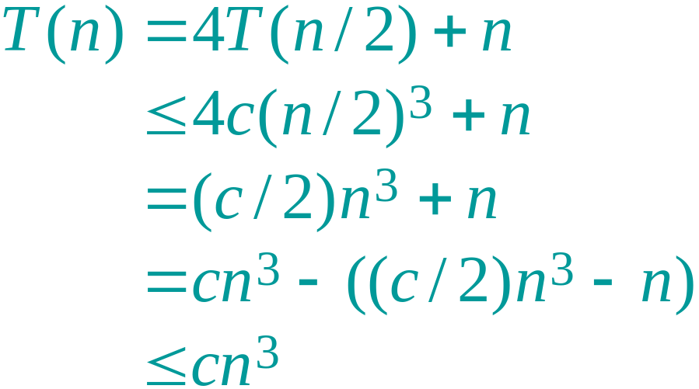
Example of substitution
desired – residual
desired
whenever (c/2)n³ – n ≥ 0, for example, if c ≥ 2 and n ≥ 1.
residual

Slide 7
Example (continued)
We must also handle the initial conditions, that is, ground the induction with base cases.
Base: T(n) = Θ(1) for all n < n₀, where n₀ is a suitable constant.
For 1 ≤ n < n₀, we have “Θ(1)” ≤ cn³, if we pick c big enough.
This bound is not tight!

Slide 8
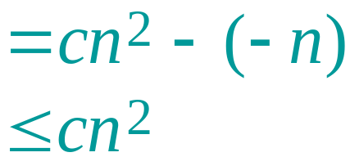
A tighter upper bound?
We shall prove that T(n) = O(n²).
Assume that T(k) ≤ ck² for k < n:
T
(
n
)
=
4
T
(
n
/
2
)
+
n
≤
4
cn
2
+
n
=
O
(
n²
)
[ desired – residual ]
for no choice of c > 0. Lose!

Slide 9
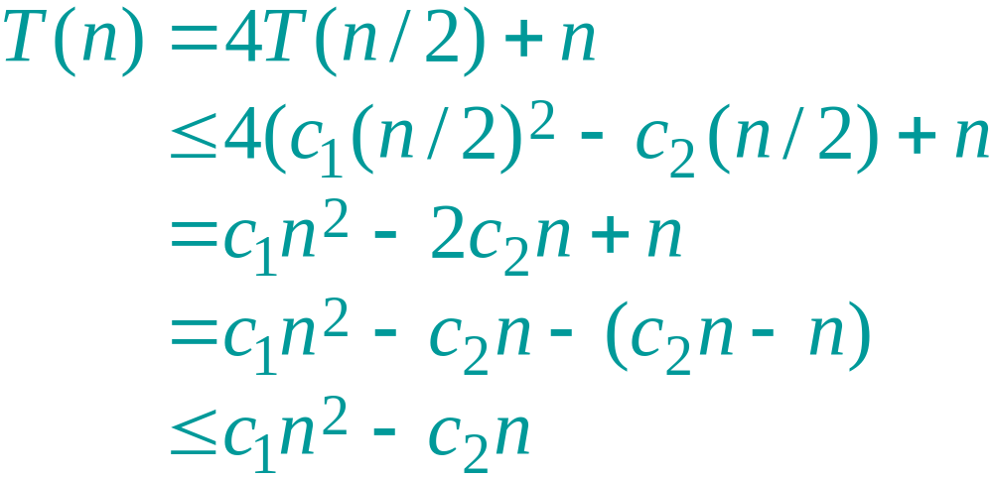
A tighter upper bound!
IDEA: Strengthen the inductive hypothesis.
Subtract a low-order term.
Inductive hypothesis: T(k) ≤ c₁k² – c₂k for k < n.
if c₂ > 1.
Pick c₁ big enough to handle the initial conditions.

Slide 10
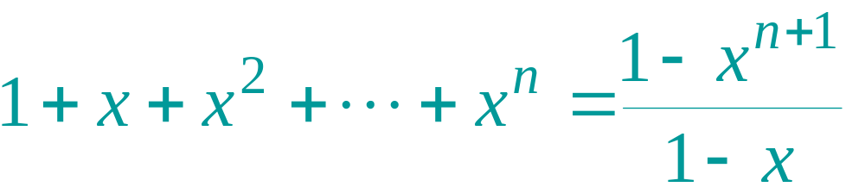
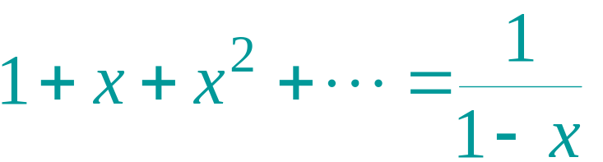
Appendix: geometric series
for x ≠ 1
for |x| < 1

Slide 11
Evaluate recursive equation using Recursion Tree
Evaluate: T(n) = T(n/2) + T(n/2) + n
  Work copy: T(k) = T(k/2) + T(k/2) + k
  For k=n/2, T(n/2) = T(n/4) + T(n/4) + (n/2)
[size|cost]

Slide 12
Recursion-tree method
A recursion tree models the costs (time) of a recursive execution of an algorithm.
The recursion tree method is good for generating guesses for the substitution method.
The recursion-tree method can be unreliable.
The recursion-tree method promotes intuition, however.

Slide 13
Recursion Tree e.g.
To evaluate the total cost of the recursion tree
  sum all the non-recursive costs of all nodes
  = Sum (rowSum(cost of all nodes at the same depth))
Determine the maximum depth of the recursion tree:
  For our example, at tree depth d
  the size parameter is n/(2^{d})
  the size parameter converging to base case, i.e. case 1
  such that, n/(2^{d}) = 1,
  d = lg(n)
  The rowSum for each row is n
Therefore, the total cost, T(n) = n lg(n)

Slide 14
Example of recursion tree
Solve T(n) = T(n/4) + T(n/2) + n²:

Slide 15
Example of recursion tree
Solve T(n) = T(n/4) + T(n/2) + n²:
T(n)

Slide 16
Example of recursion tree
Solve T(n) = T(n/4) + T(n/2) + n²:
n²
T(n/4)
T(n/2)

Slide 17
Example of recursion tree
Solve T(n) = T(n/4) + T(n/2) + n²:
n²
(n/4)²
(n/2)²
T(n/16)
T(n/8)
T(n/8)
T(n/4)

Slide 18
Example of recursion tree
Solve T(n) = T(n/4) + T(n/2) + n²:
n²
(n/4)²
(n/2)²
(n/16)²
(n/8)²
(n/8)²
(n/4)²
…
Θ(1)

Slide 19

Example of recursion tree
Solve T(n) = T(n/4) + T(n/2) + n²:
n²
(n/4)²
(n/2)²
(n/16)²
(n/8)²
(n/8)²
(n/4)²
…
Θ(1)

Slide 20
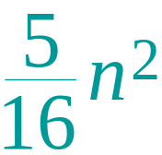
Example of recursion tree
Solve T(n) = T(n/4) + T(n/2) + n²:
n²
(n/4)²
(n/2)²
(n/16)²
(n/8)²
(n/8)²
(n/4)²
…
Θ(1)

Slide 21
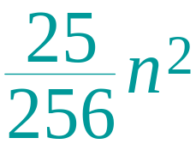
Example of recursion tree
Solve T(n) = T(n/4) + T(n/2) + n²:
n²
(n/4)²
(n/2)²
(n/16)²
(n/8)²
(n/8)²
(n/4)²
…
…
Θ(1)

Slide 22
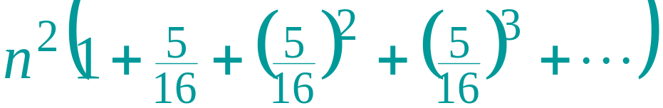
Example of recursion tree
Solve T(n) = T(n/4) + T(n/2) + n²:
n²
(n/4)²
(n/2)²
(n/16)²
(n/8)²
(n/8)²
(n/4)²
…
…
Θ(1)
Total =
= Θ(n²)
geometric series

Slide 23
The divide-and-conquer design paradigm
Divide the problem (instance) into subproblems.
Conquer the subproblems by solving them recursively.
Combine subproblem solutions.

Slide 24
Example: merge sort
Divide: Trivial.
Conquer: Recursively sort 2 subarrays.
Combine: Linear-time merge.
T(n) = 2 T(n/2) + O(n)
# subproblems
work dividing and combining
subproblem size

Slide 25
The master method
The master method applies to recurrences of the form
T(n) = a T(n/b) + f (n) ,
where a ≥ 1, b > 1, and f is asymptotically positive.

Slide 26
Three common cases
Compare f (n) with n^{logba}:
f (n) = O(n^{logba – ε}) for some constant ε > 0.
  f (n) grows polynomially slower than n^{logba} (by an n^{ε} factor).
Solution: T(n) = Θ(n^{logba}) .
f (n) = Θ(n^{logba}).
  f (n) and n^{logba} grow at similar rates.
  Solution: T(n) = Θ(n^{logba} lg n) .

Slide 27
Three common cases (cont.)
Compare f (n) with n^{logba}:
f (n) = Ω(n^{logba + ε}) for some constant ε > 0.
  f (n) grows polynomially faster than n^{logba} (by an n^{ε} factor),
and f (n) satisfies the regularity condition that a f (n/b) ≤ c f (n) for some constant c < 1.
Solution: T(n) = Θ( f (n) ) .

Slide 28

Examples
Ex. T(n) = 4T(n/2) + n
a = 4, b = 2 ⇒ n^{logba} = n²; f (n) = n.
CASE 1: f (n) = O(n^{2 – ε}) for ε = 1.
∴ T(n) = Θ(n²).
Ex. T(n) = 4T(n/2) + n²
a = 4, b = 2 ⇒ n^{logba} = n²; f (n) = n².
CASE 2: f (n) = Θ(n²).
∴ T(n) = Θ(n²lg n).

Slide 29
Examples
Ex. T(n) = 4T(n/2) + n³
a = 4, b = 2 ⇒ n^{logba} = n²; f (n) = n³.
CASE 3: f (n) = Ω(n^{2 + ε}) for ε = 1
and 4(cn/2)³ ≤ cn³ (reg. cond.) for c = 1/2.
∴ T(n) = Θ(n³).
Ex. T(n) = 4T(n/2) + n²/lg n
a = 4, b = 2 ⇒ n^{logba} = n²; f (n) = n²/lg n.
Master method does not apply. In particular, for every constant ε > 0, we have n^{ε} = ω(lg n).

Slide 30
General method (Akra-Bazzi)
The Master method is fairly powerful and results in a closed form solution for divide-and-conquer recurrences with a special form.
Akra and Bazzi discovered a far more general solution to divide-and-conquer recurrences.

Slide 31
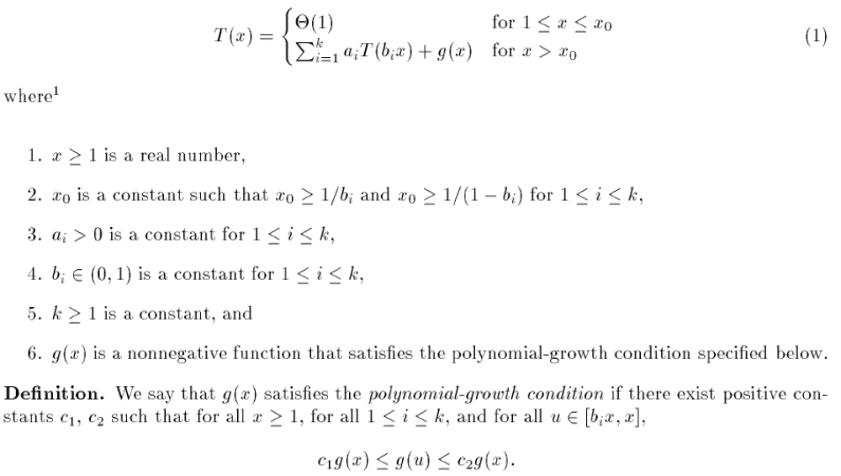
The Akra-Bazzi Method

Slide 32
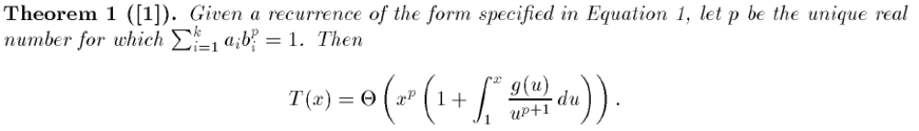
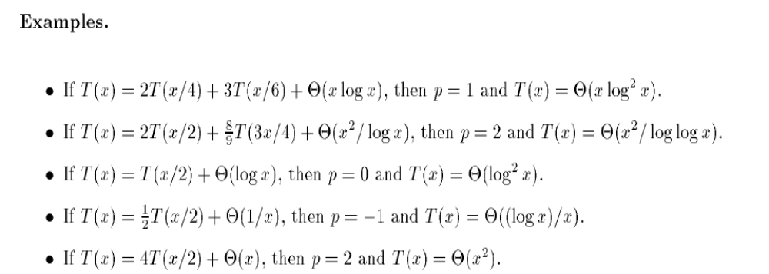
The Akra-Bazzi Solution

Slide 33
Idea of master theorem
Recursion tree:
f (n)
f (n)
a
f (n/b)
f (n/b)
…
f (n/b)
a f (n/b)
n=bh
h = log_{b}n
a
f (n/b²)
f (n/b²)
…
f (n/b²)
a² f (n/b²)
…
…
#leaves = a^{h}
= a^{logbn}
= n^{logba}
n^{logba}Τ (1)
Τ (1)

Slide 34
Idea of master theorem
Recursion tree:
f (n)
f (n)
a
f (n/b)
f (n/b)
…
f (n/b)
a f (n/b)
a
h = log_{b}n
f (n/b²)
f (n/b²)
…
f (n/b²)
a² f (n/b²)
…
…
CASE 1: The weight increases geometrically from the root to the leaves. The leaves hold a constant fraction of the total weight.
n^{logba}Τ (1)
Τ (1)
Θ(n^{logba})

Slide 35
Idea of master theorem
Recursion tree:
f (n)
f (n)
a
f (n/b)
f (n/b)
…
f (n/b)
a f (n/b)
a
h = log_{b}n
f (n/b²)
f (n/b²)
…
f (n/b²)
a² f (n/b²)
…
…
CASE 2: (k = 0) The weight is approximately the same on each of the log_{b}n levels.
n^{logba}Τ (1)
Τ (1)
Θ(n^{logba}lg n)

Slide 36
Idea of master theorem
Recursion tree:
f (n)
f (n)
a
f (n/b)
f (n/b)
…
f (n/b)
a f (n/b)
a
h = log_{b}n
f (n/b²)
f (n/b²)
…
f (n/b²)
a² f (n/b²)
…
…
CASE 3: The weight decreases geometrically from the root to the leaves. The root holds a constant fraction of the total weight.
n^{logba}Τ (1)
Τ (1)
Θ( f (n))

Slide 37
Recurrence Relations for Counting
Often it is very hard to come up with a closed formula for counting a particular set, but coming up with recurrence relation easier.
Question:
  Find a recurrence relation for the number of bit strings of length n which contain the string 00.

Slide 38
Recurrence Relations for Counting
A: a_{n}= #(length n bit strings containing 00):
If the first n-1 letters contain 00 then so does the string of length n. As last bit is free to choose get contribution of 2a_{n-1}
Else, string must be of the form u00 with u a string of length n-2 not containing 00 and not ending in 0 (why not?). But the number of strings of length n-3 which don’t contain 00 is the total number of strings minus the number that do. Thus get contribution of 2^{n-3}-a_{n-3}
Solution: a_{n} = 2a_{n-1} + 2^{n-3} - a_{n-3}
Q: What are the initial conditions:
Notes:
Answer to “why not”: Then would be back to case I since first n-1 letters would then contain 00.

Slide 39
Recurrence Relations for Counting
A: Need to give enough initial conditions to avoid ensure well-definedness. The smallest n for which length is well defined is n=0. Thus the smallest n for which a_{n} = 2a_{n-1} + 2^{n-3} - a_{n-3} makes sense is n=3. Thus need to give a₀, a₁ and a₂ explicitly.
a₀ = a₁ = 0 (strings to short to contain 00)
a₂ = 1 (must be 00).
Note: example 6 on p. 313 gives the simpler recursion relation b_{n} = b_{n-1} + b_{n-2} for strings which do not contain two consecutive 0’s.
Notes:
a₃ = 2 + 1 – 0 = 3 (000,100,001)
Simpler recursion comes from fact that

Slide 40
Solving Recurrence Relations
We will learn how to give closed solutions to certain kinds of recurrence relations. Unfortunately, most recurrence relations cannot be solved analytically.
However, recurrence relations can all be solved quickly by using dynamic programming.

Slide 41
Numerical Solutions
Dynamic Programming
Recursion + Lookup Table = Dynamic Programming
Consider a recurrence relation of the form:
a_{n} = f (a₀,a₁,…,a_{n-2},a_{n-1})
Then can always solve the recurrence relation for first n values by using following pseudocode:
integer-array a(integers n, a₀)
table₀ = a₀
for(i = 1 to n)
table_{i} = f(table₀,table₁,…,table_{i-1})
return table
Notes:
This pseudocode assumes that there is only one initial condition a₀

Slide 42
Dynamic Program for String Example
Solve a_{n} = 2a_{n-1} + 2^{n-3} - a_{n-3} up to n=7.
Pseudocode becomes:
integer-array a(integer n)
table₀ = table₁ = 0
table₂ = 1
for(i = 3 to n)
table_{i} = 2^{i-3}-table_{i-3}+2*table_{i-1}
return table

Slide 43
Dynamic Program for String Example
Solve a_{n} = 2a_{n-1} + 2^{n-3} - a_{n-3} up to n=7:
i | 2^{i-3}-a_{i-3}+2a_{i-1} = a_{i}
0 | 0
1 | 0
2 | 1
3
4
5
6
7

Slide 44
Dynamic Program for String Example
Solve a_{n} = 2a_{n-1} + 2^{n-3} - a_{n-3} up to n=7:
i | 2^{i-3}-a_{i-3}+2a_{i-1} = a_{i}
0 | 0
1 | 0
2 | 1
3 | 1-0+2·1 = 3
4
5
6
7

Slide 45
Dynamic Program for String Example
Solve a_{n} = 2a_{n-1} + 2^{n-3} - a_{n-3} up to n=7:
i | 2^{i-3}-a_{i-3}+2a_{i-1} = a_{i}
0 | 0
1 | 0
2 | 1
3 | 1-0+2·1 = 3
4 | 2-0+2·3 = 8
5
6
7

Slide 46
Dynamic Program for String Example
Solve a_{n} = 2a_{n-1} + 2^{n-3} - a_{n-3} up to n=7:
i | 2^{i-3}-a_{i-3}+2a_{i-1} = a_{i}
0 | 0
1 | 0
2 | 1
3 | 1-0+2·1 = 3
4 | 2-0+2·3 = 8
5 | 4-1+2·8 = 19
6
7

Slide 47
Dynamic Program for String Example
Solve a_{n} = 2a_{n-1} + 2^{n-3} - a_{n-3} up to n=7:
i | 2^{i-3}-a_{i-3}+2a_{i-1} = a_{i}
0 | 0
1 | 0
2 | 1
3 | 1-0+2·1 = 3
4 | 2-0+2·3 = 8
5 | 4-1+2·8 = 19
6 | 8-3+2·19 = 43
7

Slide 48
Dynamic Program for String Example
Solve a_{n} = 2a_{n-1} + 2^{n-3} - a_{n-3} up to n=7:
i | 2^{i-3}-a_{i-3}+2a_{i-1} = a_{i}
0 | 0
1 | 0
2 | 1
3 | 1-0+2·1 = 3
4 | 2-0+2·3 = 8
5 | 4-1+2·8 = 19
6 | 8-3+2·19 = 43
7 | 16-8+2·43 = 94

Slide 49
Closed Solutions by Telescoping
Plug recurrence into itself repeatedly for smaller and smaller values of n.
See the pattern and then give closed formula in terms of initial conditions.
Plug values into initial conditions getting final formula.
Telescoping also called back-substitution

Slide 50
Telescope Example
Find a closed solution to a_{n} = 2a_{n-1}, a₀= 3:
a_{n}=2a_{n-1}

Slide 51
Telescope Example
Find a closed solution to a_{n} = 2a_{n-1}, a₀= 3:
a_{n}=2a_{n-1}
=2²a_{n-2}

Slide 52
Telescope Example
Find a closed solution to a_{n} = 2a_{n-1}, a₀= 3:
a_{n}=2a_{n-1}
=2²a_{n-2}
=2³a_{n-3}

Slide 53
Telescope Example
Find a closed solution to a_{n} = 2a_{n-1}, a₀= 3:
a_{n}=2a_{n-1}
=2²a_{n-2}
=2³a_{n-3}
=…

Slide 54
Telescope Example
Find a closed solution to a_{n} = 2a_{n-1}, a₀= 3:
a_{n}=2a_{n-1}
=2²a_{n-2}
=2³a_{n-3}
=…
=2^{i}a_{n-i}

Slide 55
Telescope Example
Find a closed solution to a_{n} = 2a_{n-1}, a₀= 3:
a_{n}=2a_{n-1}
=2²a_{n-2}
=2³a_{n-3}
=…
=2^{i}a_{n-i}
=…

Slide 56
Telescope Example
Find a closed solution to a_{n} = 2a_{n-1}, a₀= 3:
a_{n}=2a_{n-1}
=2²a_{n-2}
=2³a_{n-3}
=…
=2^{i}a_{n-i}
=…
=2^{n}a₀

Slide 57
Telescope Example
Find a closed solution to a_{n} = 2a_{n-1}, a₀= 3:
Plug in a₀= 3 for final answer:
a_{n} = 3·2^{n}
a_{n}=2a_{n-1}
=2²a_{n-2}
=2³a_{n-3}
=…
=2^{i}a_{n-i}
=…
=2^{n}a₀

Slide 58
Blackboard Exercise for 5.1
5.1.21: Give a recurrence relation for the number of ways to climb n stairs if the climber can take one or two stairs at a time.

Slide 59
Linear Recurrences
The only case for which telescoping works with a high probability is when the recurrence gives the next value in terms of a single previous value. But…
There is a class of recurrence relations which can be solved analytically in general. These are called linear recurrences and include the Fibonacci recurrence.
Begin by showing how to solve Fibonacci:

Slide 60
Solving Fibonacci
Recipe solution has 3 basic steps:
Assume solution of the form a_{n} = r ^{n}
Find all possible r’s that seem to make this work. Call these¹ r₁ and r₂. Modify assumed solution to general solution a_{n} = Ar₁^{n} +Br₂^{n} where A,B are constants.
Use initial conditions to find A,B and obtain specific solution.
Notes:
¹In general there may be more then 2 solutions if recurrence is in terms of more than 2 previous terms. In this case would need to generalize to r₁, r₂ , … , r_{k}

Slide 61
Solving Fibonacci
Assume exponential solution of the form a_{n} = r ^{n} :
Plug this into a_{n} = a_{n-1} + a_{n-2} :
r ^{n} = r ^{n-1} + r ^{n-2}
Notice that all three terms have a common r ^{n-2} factor, so divide this out:
r ^{n} /r ^{n-2} = (r ^{n-1}+r ^{n-2} )/r ^{n-2} ➔ r ² = r + 1
This equation is called the characteristic equation of the recurrence relation.

Slide 62
Solving Fibonacci
Find all possible r’s that solve characteristic
r ² = r + 1
Call these r₁ and r₂.¹ General solution is a_{n} = Ar₁^{n} +Br₂^{n} where A,B are constants.
Quadratic formula² gives:
r = (1 ± √5)/2
So r₁ = (1+√5)/2, r₂ = (1-√5)/2
General solution:
a_{n} = A [(1+√5)/2]^{n} +B [(1-√5)/2]^{n}
Notes:
¹In general there may be more then 2 solutions if recurrence is in terms of more than 2 previous terms. In this case would need to generalize to r₁, r₂ , … , r_{k}
²Recall the quadratic formula: ax² + bx + c = 0 is solved by setting x = [b ± √(b²-4ac)] / 2a

Slide 63
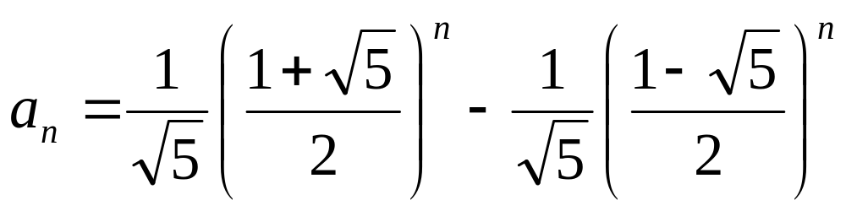
Solving Fibonacci
Use initial conditions a₀ = 0, a₁ = 1 to find A,B and obtain specific solution.
0=a₀ = A [(1+√5)/2]⁰ +B [(1-√5)/2]⁰ = A +B
1=a₁ = A [(1+√5)/2]¹ +B [(1-√5)/2]¹ = A(1+√5)/2 +B (1-√5)/2 = (A+B )/2 + (A-B )√5/2
First equation give B = -A. Plug into 2nd:
1 = 0 +2A√5/2 so A = 1/√5, B = -1/√5
Final answer:
(CHECK IT!)

Slide 64
Linear Recurrences with Constant Coefficients
Previous method generalizes to solving “linear recurrence relations with constant coefficients”:
DEF: A recurrence relation is said to be linear if a_{n} is a linear combination of the previous terms plus a function of n. I.e. no squares, cubes or other complicated function of the previous a_{i} can occur. If in addition all the coefficients are constants then the recurrence relation is said to have constant coefficients.

Slide 65
Linear Recurrences with Constant Coefficients
Q: Which of the following are linear with constant coefficients?
a_{n} = 2a_{n-1}
a_{n} = 2a_{n-1} + 2^{n-3} - a_{n-3}
a_{n} = a_{n-1}²

Slide 66
Linear Recurrences with Constant Coefficients
A:
a_{n} = 2a_{n-1}: YES
a_{n} = 2a_{n-1} + 2^{n-3} - a_{n-3}: YES
a_{n} = a_{n-1}²: NO. Squaring is not a linear operation. Similarly a_{n} = a_{n-1}a_{n-2} and a_{n} = cos(a_{n-2}) are non-linear.

Slide 67
Homogeneous Linear Recurrences
To solve such recurrences we must first know how to solve an easier type of recurrence relation:
DEF: A linear recurrence relation is said to be homogeneous if it is a linear combination of the previous terms of the recurrence without an additional function of n.
Q: Which of the following are homogeneous?
a_{n} = 2a_{n-1}
a_{n} = 2a_{n-1} + 2^{n-3} - a_{n-3}

Slide 68
Linear Recurrences with Constant Coefficients
A:
a_{n} = 2a_{n-1}: YES
a_{n} = 2a_{n-1} + 2^{n-3} - a_{n-3}: No. There’s an extra term f (n) = 2^{n-3}

Slide 69
Homogeneous Linear Recurrences with Const. Coeff.’s
The 3-step process used for the Fibonacci recurrence works well for general homogeneous linear recurrence relations with constant coefficients. There are a few instances where some modification is necessary.

Slide 70
Homogeneous
-Complications
Repeating roots in characteristic equation. Repeating roots imply that don’t learn anything new from second root, so may not have enough information to solve formula with given initial conditions. We’ll see how to deal with this on next slide.
Non-real number roots in characteristic equation. If the sequence has periodic behavior, may get complex roots (for example a_{n} = -a_{n-2})¹. We won’t worry about this case (in principle, same method works as before, except use complex arithmetic).
Notes:
¹The characteristic equation of a_{n} = -a_{n-2} is r ²+1 = 0 which gives r = i,-i where i is the square root of -1. Nominally, this means that the general solutions has the form:
a_{n} = Ai ^{n} +B(-i )^{n}
which is seemingly a non-real number

Slide 71
Complication: Repeating Roots
EG: Solve a_{n} = 2a_{n-1}-a_{n-2} , a₀ = 1, a₁ = 2
Find characteristic equation by plugging in a_{n} = r ^{n}:
r ² - 2r +1 = 0
Since r ² - 2r +1 = (r -1)² the root r = 1 repeats.
If we tried to solve by using general solution
a_{n} = Ar₁^{n}+Br₂^{n} = A1^{n}+B1^{n} = A+B
which forces a_{n} to be a constant function (→←).
SOLUTION: Multiply second solution by n so general solution looks like:
a_{n} = Ar₁^{n}+Bnr₁^{n}
Notes:
If had more repeating roots, would multiply each new solution by another n. So if r₁ is repeated four times general solution would look like:
a_{n} = Ar₁^{n}+Bnr₁^{n} +Cn²r₁^{n} +Dn³r₁^{n}

Slide 72
Complication: Repeating Roots
Solve a_{n} = 2a_{n-1}-a_{n-2}, a₀ = 1, a₁ = 2
General solution: a_{n} = A1^{n}+Bn1^{n} = A+Bn
Plug into initial conditions
1 = a₀ = A+B·0·1⁰= A
2 = a₀ = A·1¹+B·1·1¹= A+B
Plugging first equation A = 1 into second:
2 = 1+B implies B = 1.
Final answer: a_{n} = 1+n
(CHECK IT!)

Slide 73
The Nonhomogeneous Case
Consider the Tower of Hanoi recurrence (see Rosen p. 311-313) a_{n} = 2a_{n-1}+1.
Could solve using telescoping. Instead let’s solve it methodically. Rewrite:
a_{n} - 2a_{n-1} = 1
Solve with the RHS set to 0, i.e. solve the homogeneous case.
Add a particular solution to get general solution. I.e. use rule:
General
Nonhomogeneous
General
homogeneous
Particular
Nonhomogeneous
=
+

Slide 74
The Nonhomogeneous Case
a_{n} - 2a_{n-1} = 1
Solve with the RHS set to 0, i.e. solve
a_{n} - 2a_{n-1} = 0
Characteristic equation: r - 2 = 0
so unique root is r = 2. General solution to homogeneous equation is
a_{n} = A·2^{n}

Slide 75
The Nonhomogeneous Case
Add a particular solution to get general solution for a_{n} - 2a_{n-1} = 1. Use rule:
There are little tricks for guessing particular nonhomogeneous solutions. For example, when the RHS is constant, the guess should also be a constant.¹
So guess a particular solution of the form b_{n}=C.
Plug into the original recursion:
1 = b_{n} – 2b_{n-1} = C – 2C = -C. Therefore C = -1.
General solution: a_{n} = A·2^{n} -1.
General
Nonhomogeneous
General
homogeneous
Particular
Nonhomogeneous
=
+
Notes:
¹If the non-homogeneous part of the equation is a polynomial P (n) of degree k, then you should guess a particular solution of the form:
A_{k} n ^{k} + A_{k-1} n ^{k-1} + A_{k-2} n ^{k-2} + … + A₁ n + A₀
Where the A_{i} are constants that are determined by plugging into the recurrence relation. If instead, the inhomogeneous part is P (n)·s ^{n} [polynomial·exponential] and s is not a root of the characteristic equation, the guess should be modified to:
[A_{k} n ^{k} + A_{k-1} n ^{k-1} + A_{k-2} n ^{k-2} + … + A₁ n + A₀] ·s ^{n}
Finally, if the inhomogeneous part is P (n)·s ^{n} s a root of the characteristic equation which is repeated m times [m=1 means the root occurs but is not repeating], the guess should be modified to:
[A_{k} n ^{k} + A_{k-1} n ^{k-1} + A_{k-2} n ^{k-2} + … + A₁ n + A₀] ·s ^{n} n ^{m}

Slide 76
The Nonhomogeneous Case
Finally, use initial conditions to get closed solution. In the case of the Towers of Hanoi recursion, initial condition is:
a₁ = 1
Using general solution a_{n} = A·2^{n} -1 we get:
1 = a₁ = A·2¹ -1 = 2A –1.
Therefore, 2 = 2A, so A = 1.
Final answer: a_{n} = 2^{n} -1

Slide 77
More Complicated
EG: Find the general solution to recurrence from the bit strings example: a_{n} = 2a_{n-1} + 2^{n-3} - a_{n-3}
Rewrite as a_{n} - 2a_{n-1} + a_{n-3} = 2^{n-3} and solve homogeneous part:
Characteristic equation: r ³ - 2r +1 = 0.
Guess root r = ±1 as integer roots divide.
r = 1 works, so divide out by (r -1) to get
r ³ - 2r +1 = (r -1)(r ² +r -1).

Slide 78
More Complicated
r ³ - 2r +1 = (r -1)(r ² +r -1).
Quadratic formula on r ² +r -1:
r = (-1 ± √5)/2
So r₁ = 1, r₂ = (-1+√5)/2, r₃ = (-1-√5)/2
General homogeneous solution:
a_{n} = A + B [(-1+√5)/2]^{n} +C [(-1-√5)/2]^{n}

Slide 79
More Complicated
Nonhomogeneous particular solution to a_{n} - 2a_{n-1} + a_{n-3} = 2^{n-3}
Guess the form b_{n} = k 2^{n}. Plug guess in:
k 2^{n} - 2k 2^{n-1} + k 2^{n-3} = 2^{n-3}
Simplifies to: k =1.
So particular solution is b_{n} = 2^{n}
Final answer:
a_{n}=A + B [(-1+√5)/2]^{n} + C [(-1-√5)/2]^{n} + 2^{n}
General
Nonhomogeneous
General
homogeneous
Particular
Nonhomogeneous
=
+

