Slide 1
Assemulation
Presented by:
Swarna Islam
Roll: 60913
Supervised By:
Dr. Zerina Begum

Slide 2
Goal of This Project
Help new learners to get a better view of how things interacts behind the execution

Slide 3
Main features of the Project
01
02
03
04
Bug Report
Pseudo Instruction Translation
Around 21 unique types of programming bugs will be identified and reported
Actual instruction implementation
Stack memory simulation
State of registers after each execution
Particularly helpful to understand recursive calling
A rare feature that many MIPS simulator doesn’t provide

Slide 4
About the Project
Input the file path
Enter file path:
>>
Tokenization
/…../sourceCode.asm
Preprocessing
1. Prior bug detection
2. Pseudocode translation
Processing

Slide 5
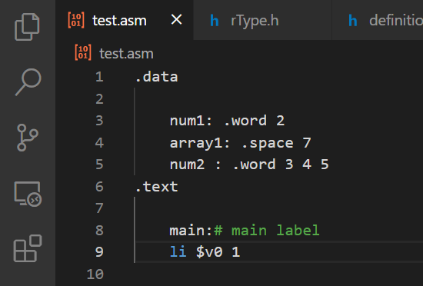
Pseudocode translation

Slide 6
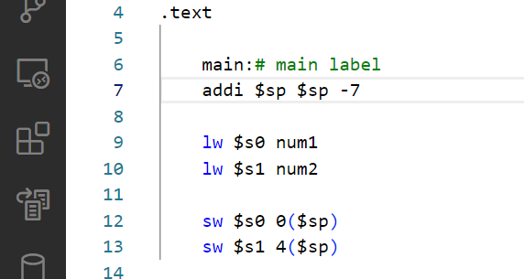

Error Handling

Slide 7
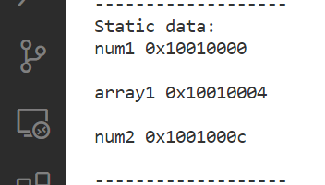
Word alignment

Slide 8
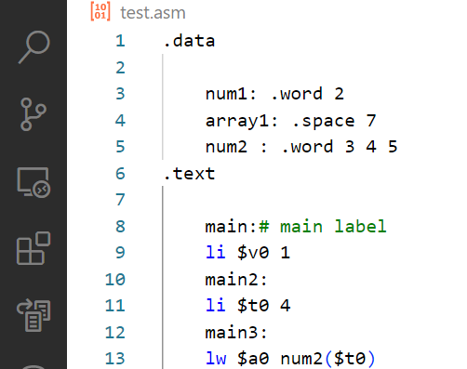
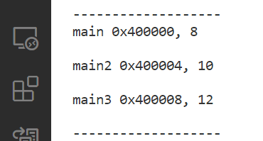
Address mapped by labels

Slide 9
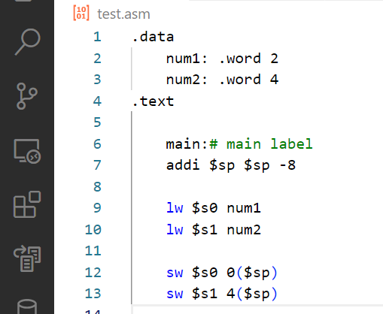

Stack Memory

Slide 10
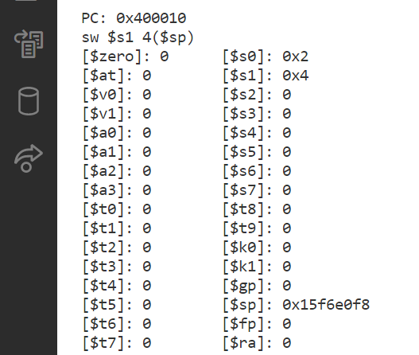
Registers

Slide 11

Key Algorithms
…………………
Hash code:
3672
Address: 0x400000
Line:
6
…………………
…………………

Slide 12
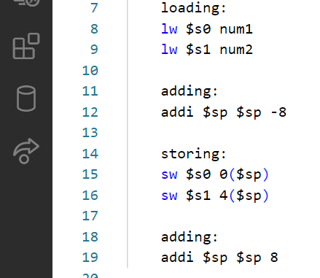
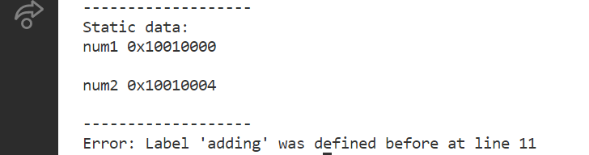
Key Algorithms
Binary search tree to detect multiple declaration of the same instance.

Slide 13
A Modular View of this Project
01
02
03
04
05
06
Memory
Operator
Definition
Loading from/storing into memory, getting label and storing their address
Executing instruction based on the instruction that the program counter is directing at
Defining valid keywords, registers and so on
Debugger
Preprocess
Spliter
Displaying the error message
Checking validation of number, label, keywords, translate, initialize etc.
Tokenizing each instruction

Slide 14
Background Study
Hash table
Collision handling
Polynomial rolling function
Binary Search tree
MIPS instruction architecture
Error handling
Overflow trap
Careful study of multiple translations of a pseudo instruction depending on different criteria
And so on

Slide 15
Reference
https://docs.google.com/spreadsheets/d/1JRXJVL7L14vqd4ceUcXpPOk-jf_rGmi9_11C2GTmlE8/edit?usp=sharing
https://eng.libretexts.org/Bookshelves/Computer_Science/Programming_Languages/Introduction_To_MIPS_Assembly_Language_Programming_(Kann)
https://cseweb.ucsd.edu/classes/fa12/cse141/project/pseudo.html

Slide 16
THANKS
GitHub Link of the project: https://github.com/SwarnaIslam/SPL1
Please keep this lide for attribution

