Slide 1
ASSEMULATION
An Assembly Simulator
Swarna Islam
0111101010100011………

Slide 2
MOTIVATION OF THE PROJECT

Slide 3

Faces challenges to understand what is happening behind the screen
li $v0, 1
la $a0, address
syscall

Slide 4

HOW THIS PROJECT WILL HELP
To get a better view of the inner workings
To get a better view of the inner workings
What is wrong with an instruction
How recursive calling is working

Slide 5
Features of This Project

Slide 6


Features of this project
State of registers and memory after executing each instruction
Bug detection
equivalent real MIPS instructions of pseudo instructions

Slide 7
WHAT THE PROJECT IS CAPABLE OF DOING SO FAR

Slide 8
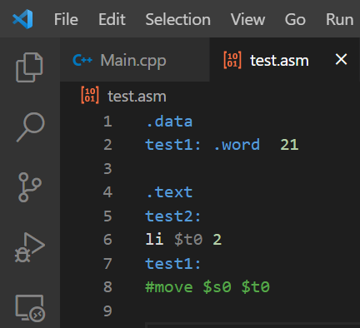
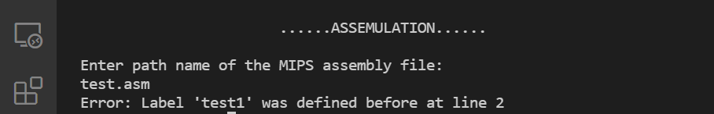
Detect multiple instances of same label

Slide 9
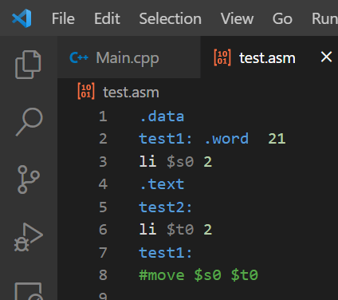
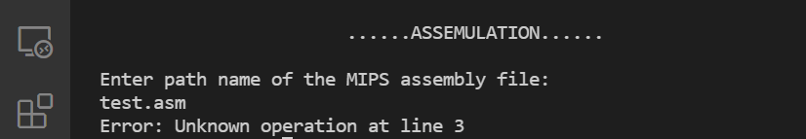
Invalid operation in a section

Slide 10
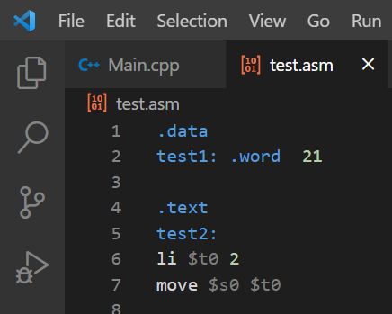
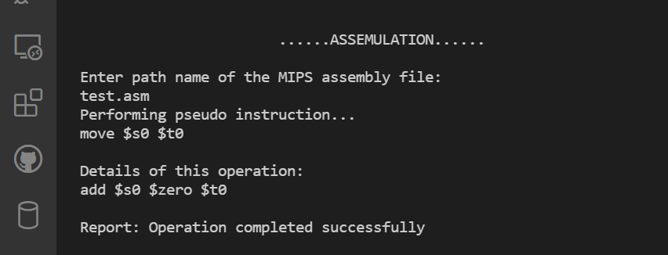
Explanation of certain pseudo instruction

Slide 11
01
02
03
04
05
Detect invalid directive
Detect invalid operation in the text section
Missing of either data or text section
Invalid format detection of labels
Token validation

Slide 12
A Modular View of this Project
01
02
03
04
05
06
Memory
Operator
Definition
Loading from/storing into memory, getting label and storing their address
Executing instruction based on the instruction that the program counter is directing at
Defining valid keywords, registers and so on
Debugger
Format
Spliter
Displaying the error message
Checking validation of number, label, keywords etc.
Tokenizing each instruction

Slide 13
CHALLENGES

Slide 14
LEXICAL ANALYSIS
Tokenization of the given MIPS Assembly program
SYNTACTICAL ANALYSIS
Able to detect about 15 types of error so far
DETAILS ABOUT THE OPERATORS
Executing instruction and set the state of registers and memory
MIPS ARCHITECTURE IN-DEPTH

Slide 15
Things to implement
Simulating the state of registers and memory
Including more operations of MIPS

Slide 16
THANKS
GitHub Link of the project: https://github.com/SwarnaIslam/SPL1
Please keep this lide for attribution

