Slide 1
The Queue

Slide 2
Queues
Queue: a collection whose elements are added at one end (the rear or tail of the queue) and removed from the other end (the front or head of the queue)
A queue is a FIFO (first in, first out) data structure
Any waiting line is a queue:
The check-out line at a grocery store
The cars at a stop light
An assembly line

Slide 3
Conceptual View of a Queue
Adding an element
Front of queue
New element is added to the rear of the queue

Slide 4
Conceptual View of a Queue
Removing an element
New front element of queue
Element is removed from the front of the queue

Slide 5
Uses of Queues in Computing
For any kind of problem involving FIFO data
Printer queue (e.g. printer in MC 235)
Keyboard input buffer
GUI event queue (click on buttons, menu items)

Slide 6
Uses of Queues in Computing
In simulation studies, where the goal is to reduce waiting times:
Optimize the flow of traffic at a traffic light
Determine number of cashiers to have on duty at a grocery store at different times of day
Other examples?
Notes:
Ticket counter simulation

Slide 7
Queue Operations
enqueue : add an element to the tail(rear end) of a queue
dequeue : remove an element from the head(front) of a queue
first : examine the element at the head of the queue (“peek”)
Other useful operations (e.g. is the queue empty)
It is not legal to access the elements in the middle of the queue!

Slide 8
Operations on a Queue
Operation | Description
dequeue | Removes an element from the front of the queue
enqueue | Adds an element to the rear of the queue
first | Examines the element at the front of the queue
isEmpty | Determines whether the queue is empty
size | Determines the number of elements in the queue

Slide 9
Just as stacks can be implemented as arrays or linked lists, so with queues.

Slide 10
Queue (Linear Queue)
It is a linear data structure consisting of list of items.
In queue, data elements are added at one end, called the rear and removed from another end, called the front of the list.
Two basic operations are associated with queue:
1. “Insert” operation is used to insert an element into a queue.
2. “Delete” operation is used to delete an element from a queue.
FIFO list
Example:
Queue: AAA, BBB, CCC, DDD, EEE
7
6
EEE
5
1
2
3
4
5
6
7
DDD
4
AAA
BBB
CCC
DDD
EEE
CCC
3
BBB
2
Front
Rear
AAA
1
Rear
Front

Slide 11
Algorithms for Insert and Delete Operations in Linear Queue
For Insert Operation
Insert-Queue(Queue, Rear, Front, N, Item)
Here, Queue is the place where to store data. Rear represents the location in which the data element is to be inserted and Front represents the location from which the data element is to be removed. Here N is the maximum size of the Queue and finally, Item is the new item to be added.
1. If Rear = N then Print: Overflow and Return. /*…Queue already filled..*/
2. Set Rear := Rear +1
3. Set Queue[Rear] := Item
4. Return.

Slide 12
For Delete Operation
Delete-Queue(Queue, Front, Rear, Item)
Here, Queue is the place where data are stored. Rear represents the location in which the data element is to be inserted and Front represents the location from which the data element is to be removed. Front element is assigned to Item.
1. If Front = N+1 then Print: Underflow and Return. /*…Queue Empty
2. Set Item := Queue[Front]
3. Set Front := Front + 1
4. Return.

Slide 13
Example: Consider the following queue (linear queue).
Rear = 4 and Front = 1 and N = 7
10
50
30
40
1
2
3
4
5
6
7
(1) Insert 20. Now Rear = 5 and Front = 1
10
50
30
40
20
1
2
3
4
5
6
7
(2) Delete Front Element. Now Rear = 5 and Front = 2
50
30
40
20
1
2
3
4
5
6
7
(3) Delete Front Element. Now Rear = 5 and Front = 3
30
40
20
1
2
3
4
5
6
7
(4) Insert 60. Now Rear = 6 and Front = 3
30
40
20
60
1
2
3
4
5
6
7

Slide 14
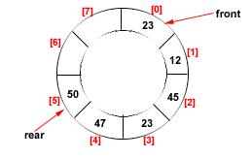
Drawback of Linear Queue
Once the queue is full, even though few elements from the front are deleted and
some occupied space is relieved, it is not possible to add anymore new elements,
as the rear has already reached the Queue’s rear most position.
Circular Queue
This queue is not linear but circular.
Its structure can be like the following figure:
In circular queue, once the Queue is full the
"First" element of the Queue becomes the
"Rear" most element, if and only if the "Front"
has moved forward. otherwise it will again be
a "Queue overflow" state.
Figure: Circular Queue having
Rear = 5 and Front = 0

Slide 15
Algorithms for Insert and Delete Operations in Circular Queue
For Insert Operation
Insert-Circular-Q(CQueue, Rear, Front, N, Item)
Here, CQueue is a circular queue where to store data. Rear represents the location in which the data element is to be inserted and Front represents the location from which the data element is to be removed. Here N is the maximum size of CQueue and finally, Item is the new item to be added. Initailly Rear = 0 and Front = 0.
1. If Front = 0 and Rear = 0 then Set Front := 1 and go to step 4.
2. If Front =1 and Rear = N or Front = Rear + 1
then Print: “Circular Queue Overflow” and Return.
3. If Rear = N then Set Rear := 1 and go to step 5.
4. Set Rear := Rear + 1
5. Set CQueue [Rear] := Item.
6. Return

Slide 16
For Delete Operation
Delete-Circular-Q(CQueue, Front, Rear, Item)
Here, CQueue is the place where data are stored. Rear represents the location in which the data element is to be inserted and Front represents the location from which the data element is to be removed. Front element is assigned to Item. Initially, Front = 1.
1. If Front = 0 then
Print: “Circular Queue Underflow” and Return. /*..Delete without Insertion
2. Set Item := CQueue [Front]
3. If Front = N then Set Front = 1 and Return.
4. If Front = Rear then Set Front = 0 and Rear = 0 and Return.
5. Set Front := Front + 1
6. Return.

Slide 17
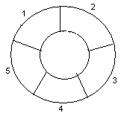
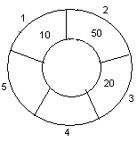
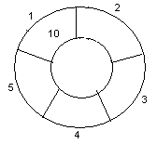
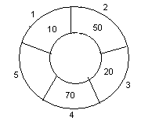
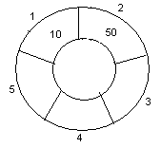
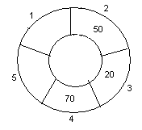
Example: Consider the following circular queue with N = 5.
1. Initially, Rear = 0, Front = 0.
4. Insert 20, Rear = 3, Front = 0.
Front
Rear
2. Insert 10, Rear = 1, Front = 1.
5. Insert 70, Rear = 4, Front = 1.
Rear
Front
Front
Rear
3. Insert 50, Rear = 2, Front = 1.
6. Delete front, Rear = 4, Front = 2.
Front
Rear
Front
Rear

Slide 18
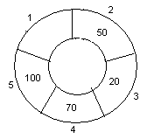
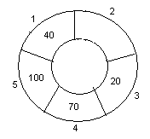
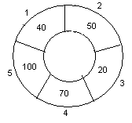
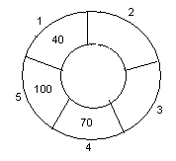
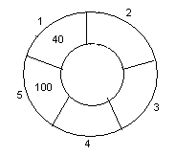
7. Insert 100, Rear = 5, Front = 2.
10. Delete front, Rear = 1, Front = 3.
Front
Rear
Front
Rear
8. Insert 40, Rear = 1, Front = 2.
11. Delete front, Rear = 1, Front = 4.
Rear
Rear
Front
Front
9. Insert 140, Rear = 1, Front = 2.
As Front = Rear + 1, so Queue overflow.
12. Delete front, Rear = 1, Front = 5.
Rear
Rear
Front
Front

Slide 19
while inserting an element rear=(rear+1) mod (size -1)
while deleting an element
front=(front+1) mod (size-1)
Overflow?
front=(rear+1) mod (size-1)
Empty?
front=rear

