Slide 1
Cloud Computing
Principle and Paradigms

Slide 2
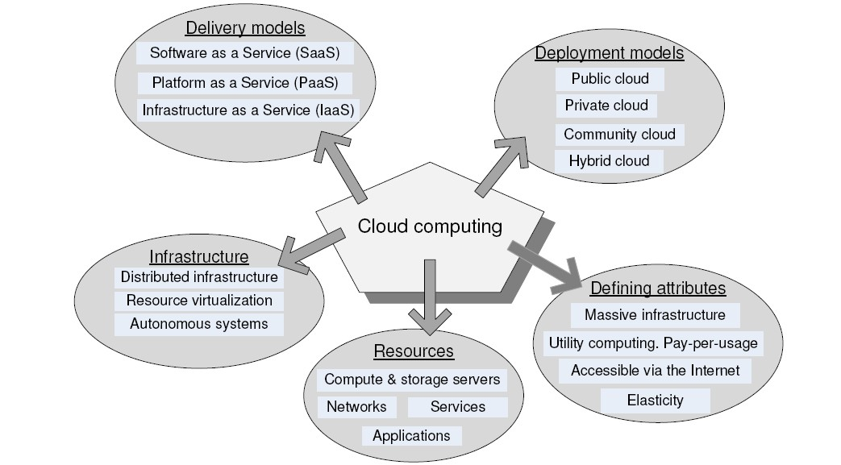
Cloud Computing: In a Glance

Slide 3
Introduction to Cloud Computing
Electric Power
Virtualize
means delivering useful functions while hiding how their internals
work
Cluster, grid, cloud
access to large amounts of computing power in a fully virtualized manner, by aggregating resources and offering a single system view
Delivering Computing as a utility
On-demand
Pay-as-you-go
Service provider (Amazon, Google)
Computing infrastructure (Cloud)
Access from anywhere
As a service

Slide 4
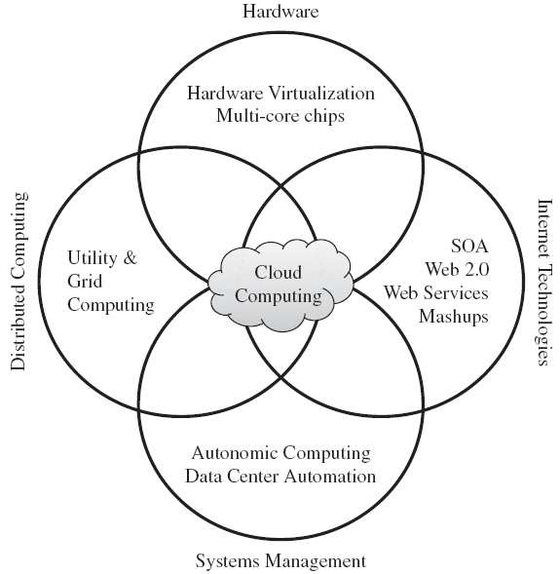
Roots of Cloud Computing

Slide 5
Internet Technologies
Web Service
applications running on different messaging product platforms
enabling information from one application to be made available to others
enabling internal applications to be made available over the Internet
SOA
address requirements of loosely coupled, standards-based, and
protocol-independent distributed computing
WS ,HTTP, XML
Common mechanism for delivering service
applications is a collection of services that together perform complex
business logic
Building block in IaaS
User authentication, payroll management, calender

Slide 6
Distributed Computing
Grid Computing
aggregation of distributed resources
transparently access
Problems
QoS, Lack of performance
Availability, Virtualization
Utility Computing
assign a “utility” value to users
QoS constraints (deadline, importance, satisfaction)

Slide 7
Virtualization
Virtualization is a technique, which allows to share single physical instance of an application or resource among multiple organizations or tenants (customers)..
Virtualization is a proved technology that makes it possible to run multiple operating system and applications on the same server at same time.
Virtualization is the process of creating a logical(virtual) version of a server operating system, a storage device, or network services.
The technology that work behind virtualization is known as a virtual machine monitor(VM), or virtual manager which separates compute environments from the actual physical infrastructure.

Slide 8
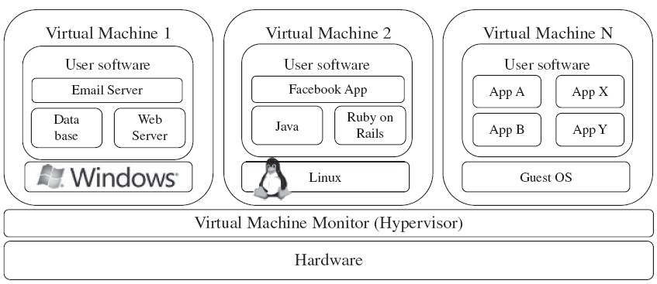
Virtualization

Slide 9
Concept behind the virtualization
Creation of a virtual machine over existing operating system and hardware.
Host machine: The machine on which the virtual machine is created.
Guest machine: virtual machines referred as a guest machine.
Hypervisor: Hypervisor is a firmware or low-level program that acts as a Virtual Machine Manager.

Slide 10
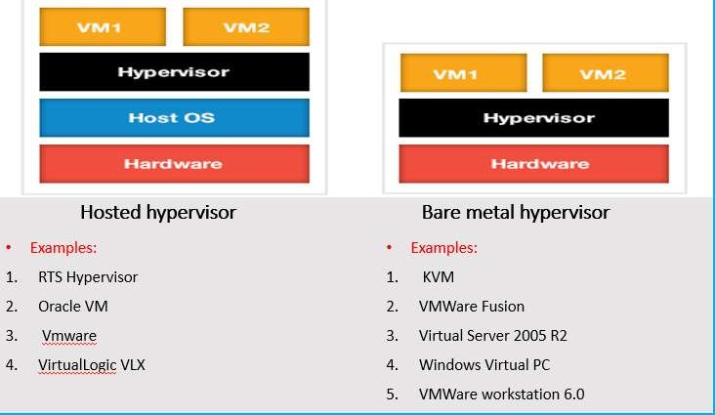
Architecture of Virtualization

Slide 11
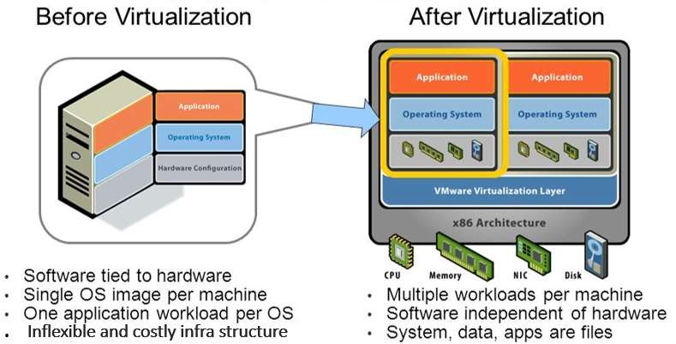

Slide 12
Types of Virtualization
Hardware Virtualization.
Operating system Virtualization.
Server Virtualization.
Storage Virtualization.

Slide 13
1. Hardware Virtualization
When the virtual machine software or virtual machine manager (VMM) is directly installed on the hardware system is known as hardware virtualization.
The main job of hypervisor is to control and monitoring the processor, memory and other
hardware resources.
Usage:
Hardware virtualization is mainly done for the server platforms, because controlling virtual machines is much easier than controlling a physical server.

Slide 14
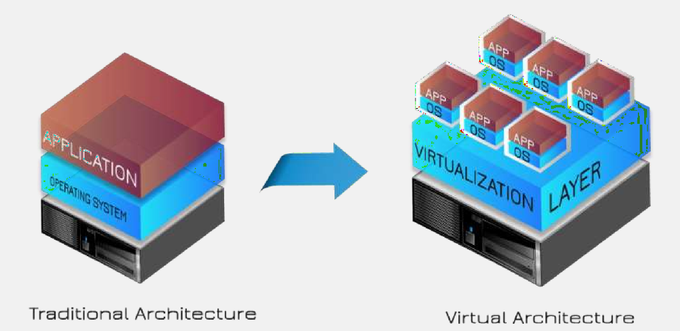

Slide 15
2.Operating System Virtualization
When the virtual machine software or virtual machine manager (VMM) is installed on the Host operating system instead of directly on the hardware system is known as operating system virtualization.
Usage:
Operating System Virtualization is mainly used for testing the applications on different platforms of OS.

Slide 16
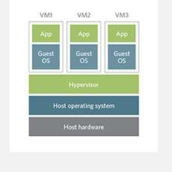
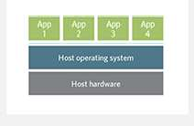
Traditional Operating system
Architecture
Virtual Operating system
Architecture

Slide 17
3.Server Virtualization:
When the virtual machine software or virtual machine manager (VMM) is directly installed on the Server system is known as server virtualization.
Usage:
Server virtualization is done because a single physical server can be divided into multiple servers on the demand basis and for balancing the load.

Slide 18
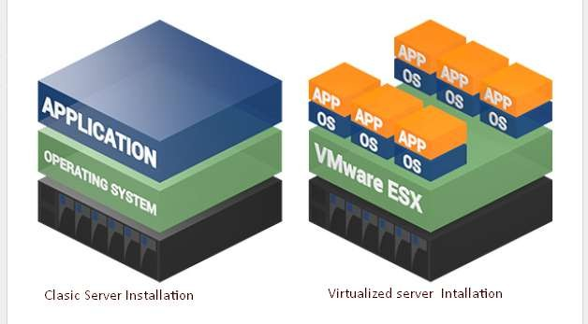

Slide 19
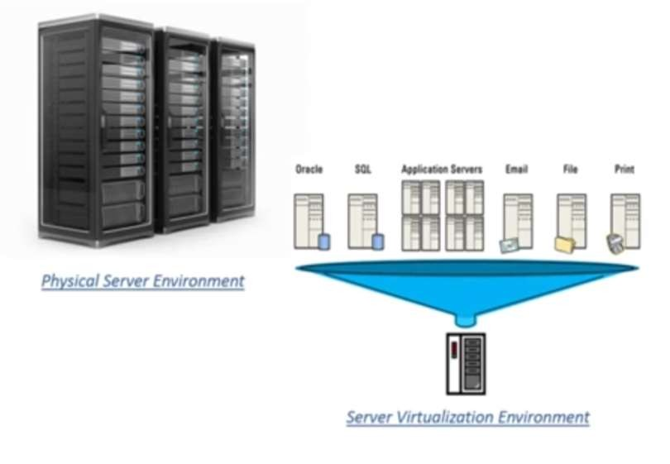

Slide 20
4.Storage Virtualization
Storage virtualization is the process of grouping the physical storage from multiple network storage devices so that it looks like a single storage device.
Storage virtualization is also implemented by using software applications.
Usage:
Storage virtualization is mainly done for back-up and recovery purposes.

Slide 21
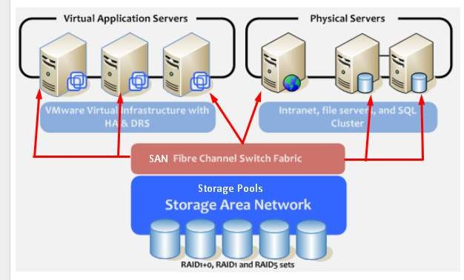

Slide 22
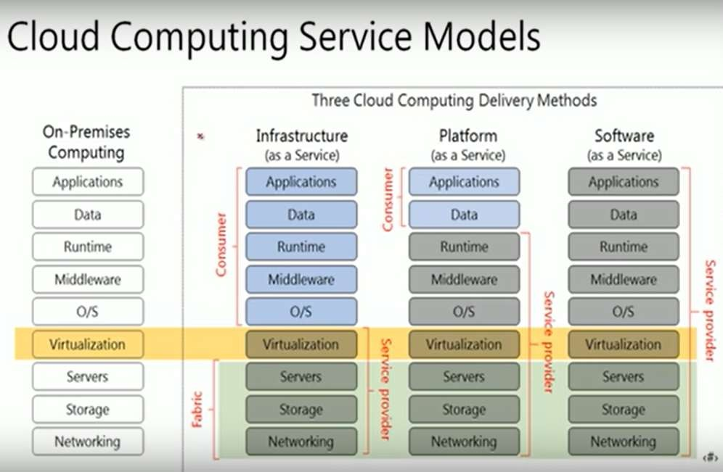
Cloud vs Virtualization
Virtualization can exist without the cloud but cloud computing cannot exist without virtualization.

Slide 23
Advantages of Virtualization
Reduced Costs.
Efficient hardware Utilization.
Virtualization leads to better resource Utilization and increase performance
Testing for software development.
Increase Availability
Save energy
Shifting all your Local Infrastructure to Cloud in a day
Possibility to Divide Services
Running application not supported by the host.

Slide 24
Disadvantages of Virtualization
Extra Costs.
Software Licensing.

Slide 25
Autonomic Computing
Improve systems by decreasing human involvement in their operation.
Manage themselves, with high-level guidance from humans
Properties
Self-Configuration
Automatic configuration of components.
Self-Healing
Automatic discovery, and correction of faults.
Self-Optimization
Automatic monitoring and control of resources to ensure the optimal functioning with respect to the defined requirements.
Self-Protection
Proactive identification and protection from arbitrary attacks.
IBM reference Model
MAPE-K

Slide 26
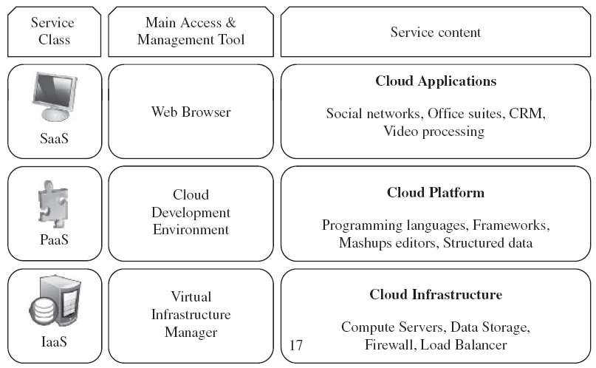
Layers and Types of Cloud

Slide 27
IAAS
Offering virtualized resources on demand
computation, storage, communication
Bottom layer of cloud systems
Example
Amazon EC2
Offering VM
Software stack

Slide 28
PAAS
make a cloud easily programmable
offers an environment
developers create and deploy applications
do not necessarily need to know how many processors or how much memory that applications will be using
offered building blocks
Google AppEngine
Python, java
Building block
Mail service, instance messaging service, image manipulation service

Slide 29
SAAS
Applications reside on the top of the cloud stack
accessed by end users through Web portal
From locale to on-line software with same functionally
Example
Salseforce.com
CRM

Slide 30
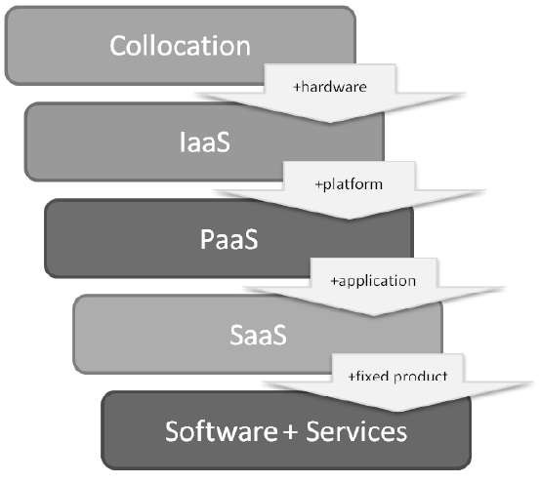
Delivery Models

Slide 31
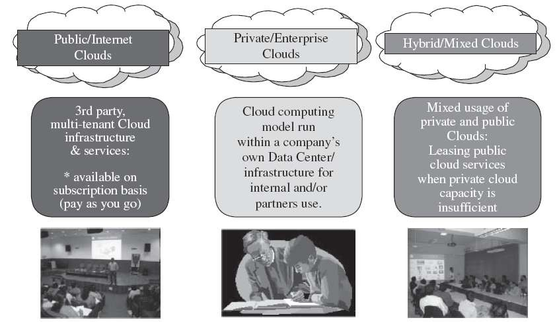
Deployment Models

Slide 32
Deployment Models
Public cloud
cloud made available in a pay-as-you-go manner to the general
public
Private cloud
internal data center of a business or other organization, not made available to the general public
restructuring an existing infrastructure
adding virtualization and cloud-like interfaces
Community cloud
shared by several organizations and supports community that has shared concerns
hybrid cloud
Takes shape when a private cloud is supplemented with computing capacity from public clouds

Slide 33
Desired Features of Cloud
self-service
per-usage metered and billed
elastic
customizable.

Slide 34
Cloud Infrastructure Management
Management is a challenge
VIM
The software toolkit responsible for rapidly and dynamically provision resources to applications
Cloud operation system
Cloud toolkit vs. virtual infrastructure manager
Availability and management users
Features
basic and advanced features that are usually available in VIMs
Case Studies
The most popular VI managers available

Slide 35
Features
Virtualization Support
Self-Service, On-Demand Resource Provisioning
Multiple Backend Hypervisors
Storage Virtualization
SAN
Interface to Public Clouds
Virtual Networking
Dynamic Resource Allocation
Green computing
Virtual Clusters
Reservation and Negotiation Mechanism
Advance reservation and best-effort request
High Availability and Data Recovery
FailOver Mechanism, redundancy, backup

Slide 36
Case Studies
Apache VCL
AppLogic
Grid Operating System
Citrix Essentials
Enomaly ECP
..
OpenPEX
..
..
..
VMWare vSphere and vCloud

Slide 37
IAAS Providers
features
geographic presence
To improve availability and responsiveness, Availability Zones
user interfaces and access the system
GUI, CLI, WS
Advance reservation of capacity
Amazon, long period
Automatic scaling and load balancing
Service Level Agreement
Availability and performance guarantee, QoS
Hypervisor and operation system choice

Slide 38
PAAS Providers
Features
Programming Models, Languages, and Frameworks
MapReduce, WebService, Workflow, computational task
Persistence Options
Record state and recover, relational DB, distributed storage
Case studies
Aneka
.NET, amazon EC2, threads
AppEngine
python-java, Google
Microsoft Azure
.NET, Microsoft
Force.com
Apex, own dc
Heroku
Ruby, automatic scaling

Slide 39
Challenges and Risks
Security, privacy and trust
Third party services
Countries laws
Data lock-in and standardization
Portable user data
Availability, Fault tolerance, disaster Recovery
SLA
Resource Management and Energy efficiency
Migration
Performance

