Slide 1
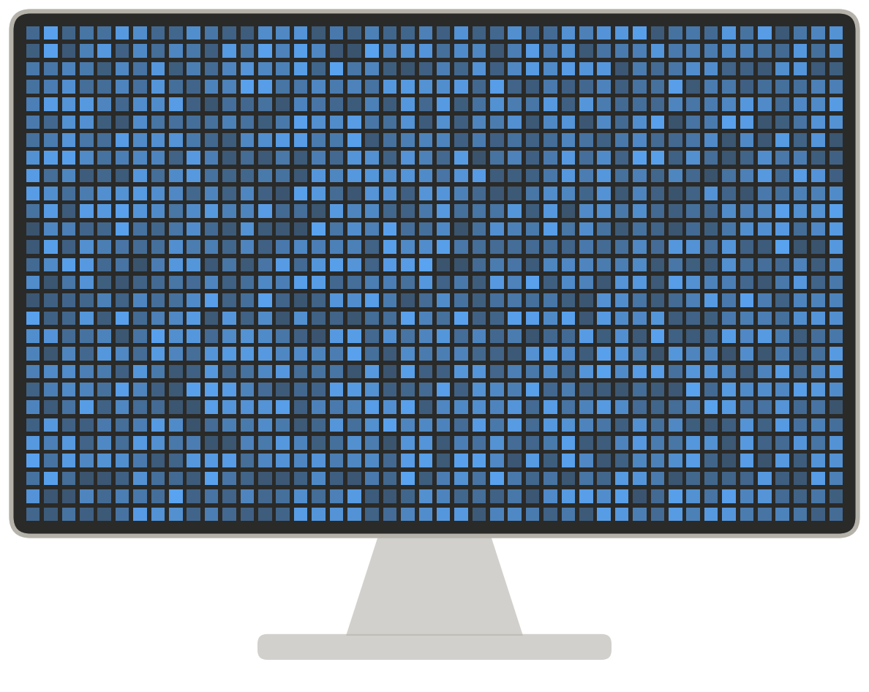
Saving the
Tokens
Your agent pays again for everything it already sent.
Find the big thing. Stop sending it.
Shyamji Tiwari
Applied Scientist, Amazon
IEEE AgenticAI Summit 2026 · Bangalore
Views are my own.

Slide 2


HANDS UP
EXAMPLE MODEL
Which is the bigger part of the bill?
A 20-turn session with an AI agent that reads your screen
A
B
or
The screenshots
The system prompt
a new one every turn (~1,200 tokens)
the same instructions every turn (400 tokens)
Agent = an AI that reads your screen and acts. Turn = one message to it, and its reply. Token = the unit you are billed in.
Saving the Tokens · Shyamji Tiwari

Slide 3
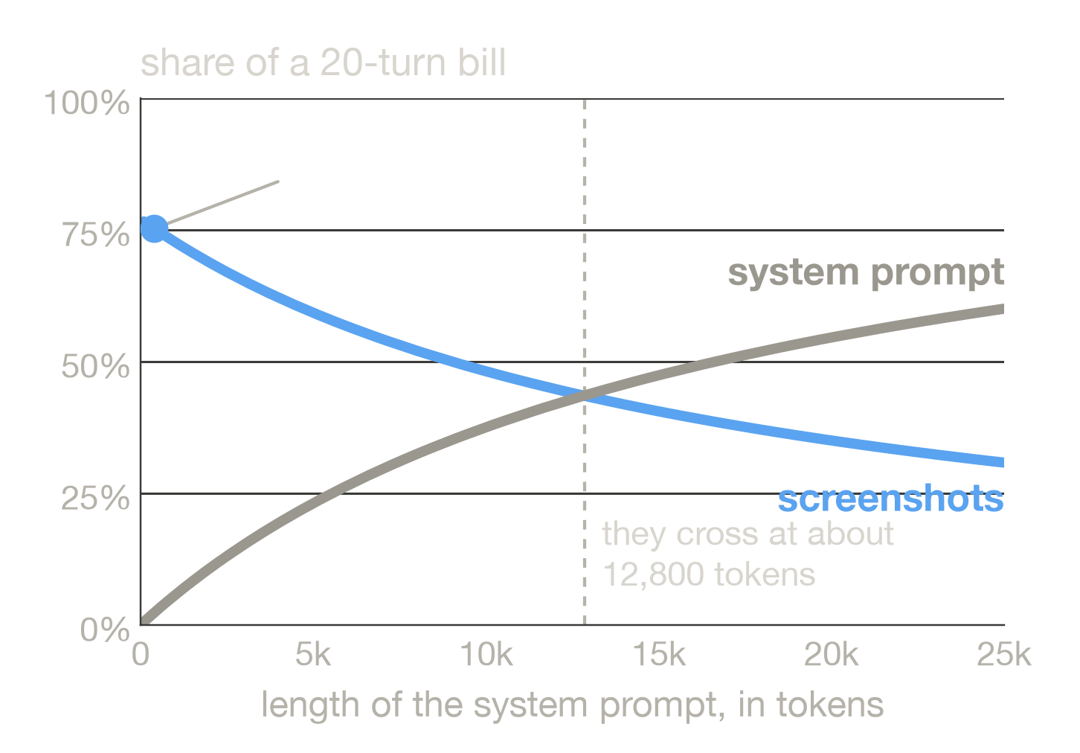
THE ANSWER: A
EXAMPLE MODEL
75%
of the bill is
the screenshots.
System prompt (400 tokens): 2.3%
A new screenshot every turn, and each one is sent again.
A long prompt can win: it never grows, but per turn it can cost more than one screenshot. Break-even prompt is about 610 × (turns + 1) tokens: 6,700 at 10 turns, 12,800 at 20, 25,000 at 40.
An example agent, not a measurement. 20 turns. Each turn: 8 s of speech (256 tokens, Gemini's published 32 a second), one 1,222-token screenshot (modelled), a 120-token reply. 400-token prompt, no caching. Change a setting and the percentages move.
Saving the Tokens · Shyamji Tiwari
numbers come from a model you can run and edit: ex3_budget.py

Slide 4

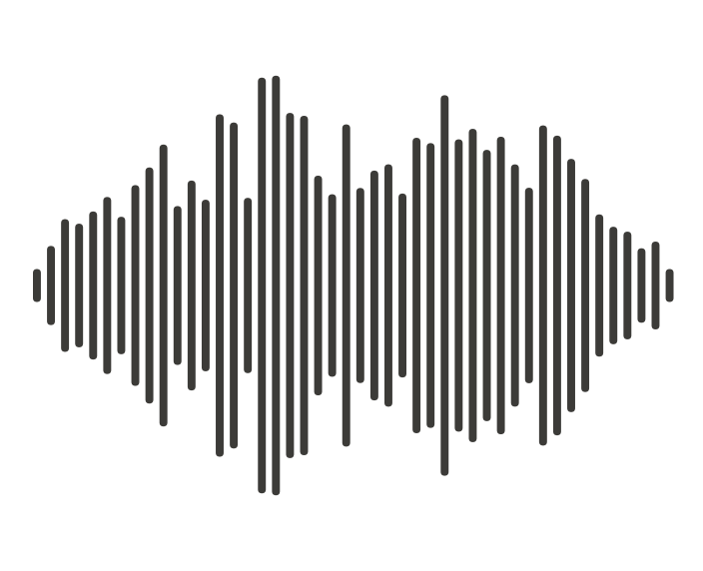
GROUND RULES
A token is the unit of the bill
You pay for everything going in, not just what comes out.
≈ 750
1,105–2,691
256
tokens · one 1920×1080 screenshot
tokens · a dense page of text
tokens · 8 seconds of speech
rule of thumb: 1 token is about 4 characters, a page about 3,000
published rules of OpenAI and Claude (next slides)
Gemini: 32 tokens a second, published (others differ)
Saving the Tokens · Shyamji Tiwari

Slide 5
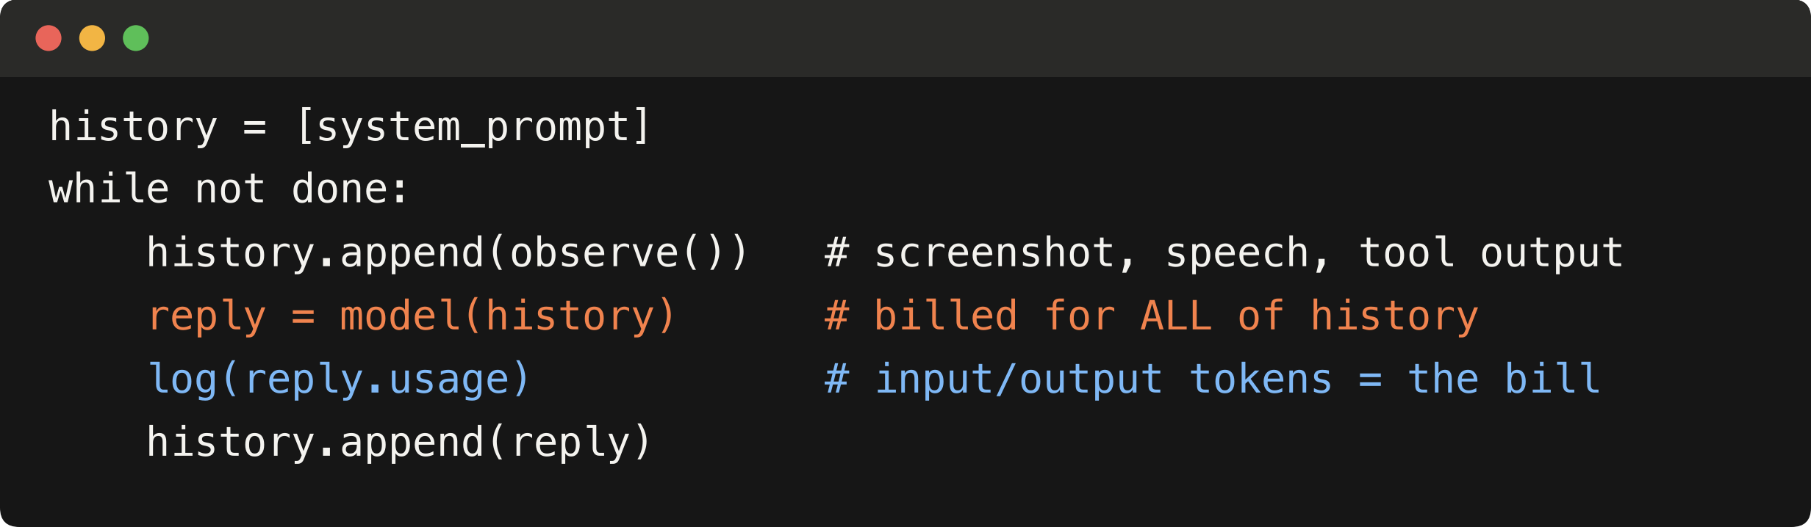
GROUND RULES
Every call sends the whole history again
Pseudo-code of most agents. The usage field is where the bill is read.
Orange = what you pay for again. Blue = where you read what it cost.
Orange is full price unless you cache it (slide 14). The model can only read so many tokens per call: that limit is the context window.
Saving the Tokens · Shyamji Tiwari

Slide 6
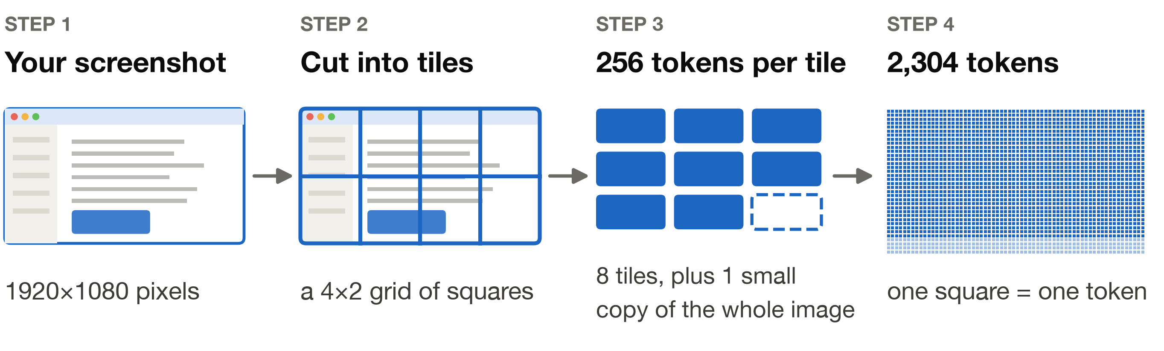
HOW IT WORKS
EXAMPLE MODEL
How a picture becomes tokens
A modelled tiler (InternVL-style). Real vendors work differently: slide 8.
9 tiles × 256 tokens = 2,304 tokens
Saving the Tokens · Shyamji Tiwari

Slide 7
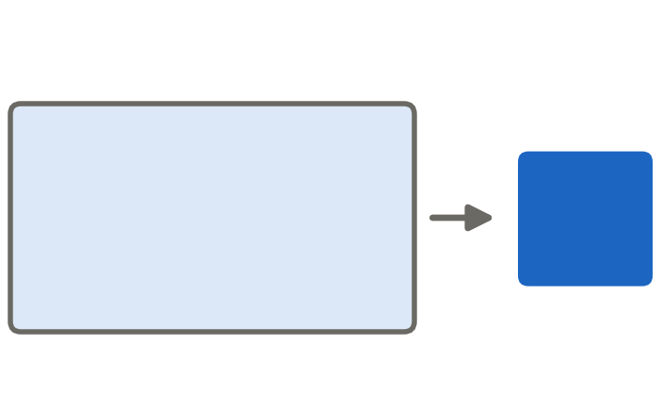
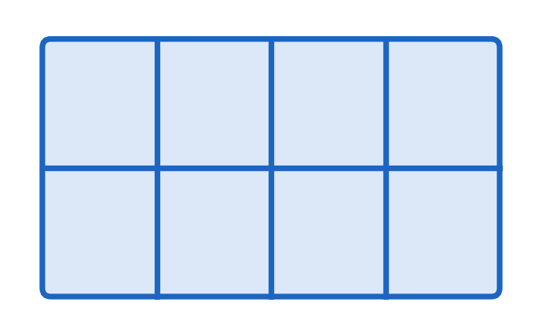
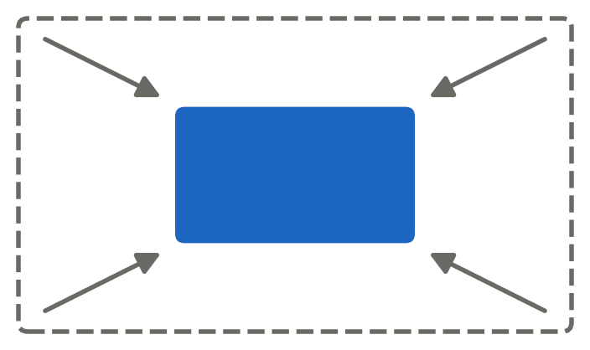
HOW IT WORKS
EXAMPLE MODEL
Three ways a model can turn a picture into tokens
Three modelled strategies, all priced on the same 1920×1080 screenshot
Squash it
Cut into tiles
Shrink to a budget
Same cost, any size
Cost follows the shape
The cap is a setting
576
2,304
1,222
tokens
tokens
tokens
Saving the Tokens · Shyamji Tiwari
the example agent uses “shrink to a budget”, capped at 1,280

Slide 8
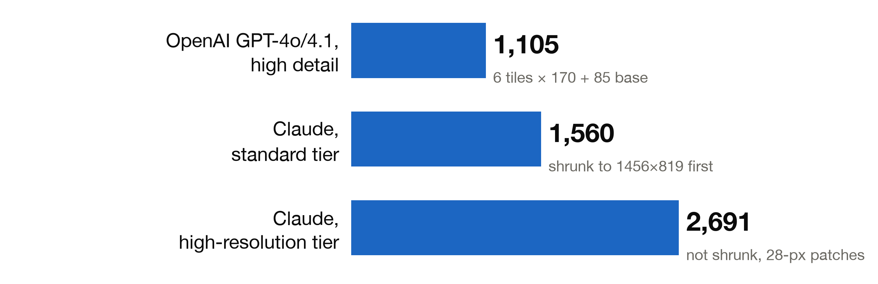
HOW IT WORKS
PUBLISHED RULE
Real products price it differently
A 1920×1080 screenshot, priced by each vendor's published rule
Claude standard: a 4K screen costs the same 1,560. The cap sets the bill.
Claude 4.7+ is the high-res tier: an upgrade can move it from 1,560 to 2,691.
Saving the Tokens · Shyamji Tiwari
published rules, checked 2026-10-29 · vendors change them, re-check before quoting

Slide 9
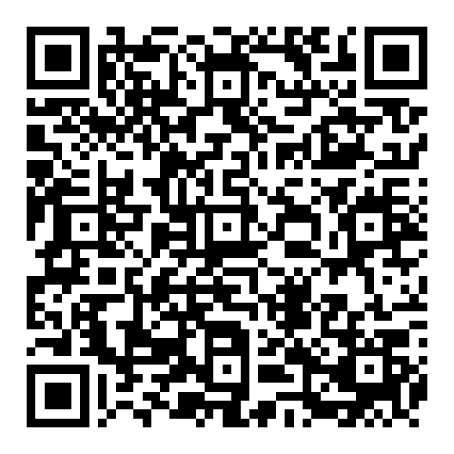
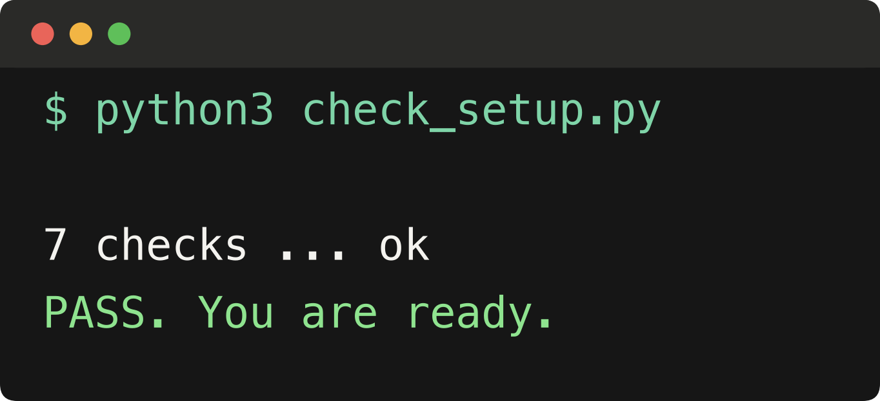
MEASURE IT
Open the notebook. Run two cells.
1 Press Play on
Run this first
2 Press Play on
Check the setup
3 Look for PASS
Scan: opens in Colab
Google account + wifi
Have Python? Use a terminal. works offline
Get the folder: github.com/ieee-ai/agentic-ai-26
1 Mac: ⌘-Space, type Terminal.
Windows: Start, type PowerShell.
2 cd, a space, drag the folder in, Enter.
Windows: py, not python3
Nothing to install. No API key.
No Google account? Pair with a neighbour.
Saving the Tokens · Shyamji Tiwari

Slide 10
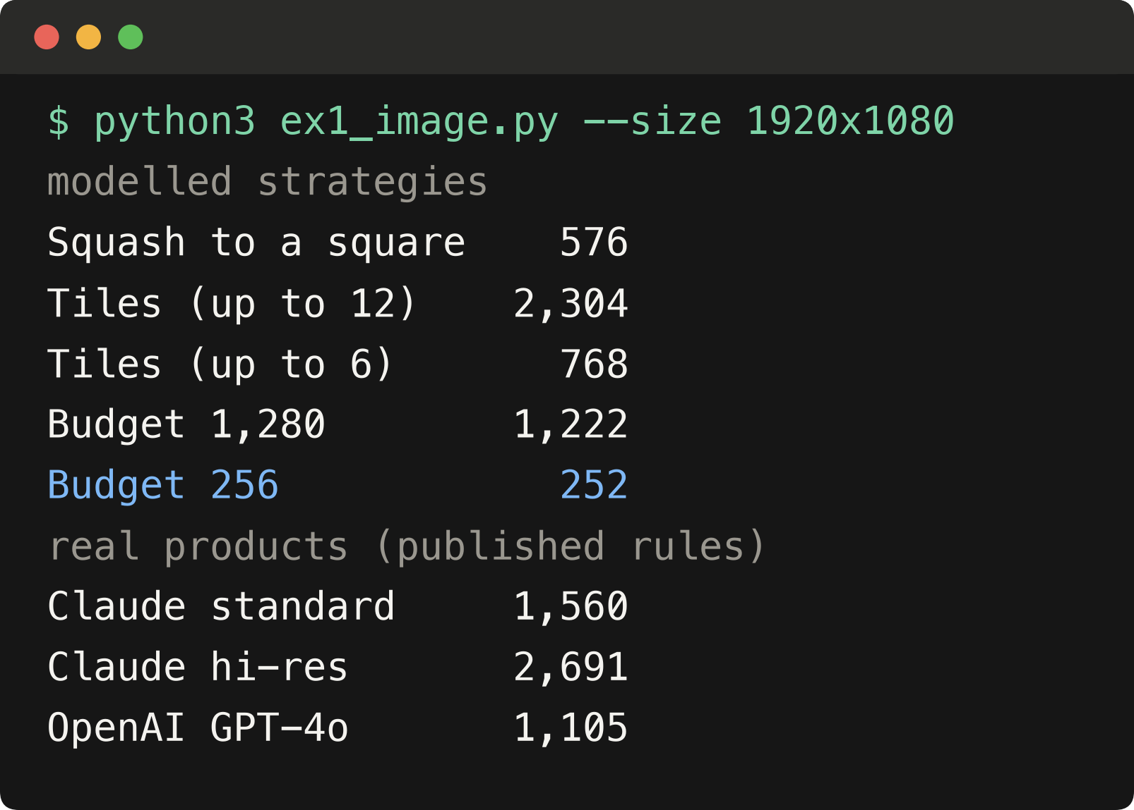
EXERCISE 1
What does one image cost?
TRY IT · notebook section 2
1 Your own screen size
Mac: menu > About This Mac. Windows: Settings > Display.
2 Which is cheapest?
3 Double the width
4 Try 3840x2160
Same picture: 1,105 to 2,691 tokens on real products.
The modelled strategies span 252 to 2,304 (252 is a 588×336 view).
Saving the Tokens · Shyamji Tiwari

Slide 11
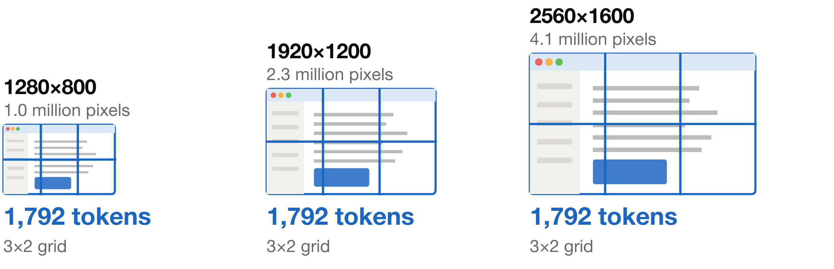
MEASURE IT
EXAMPLE MODEL
Four times the pixels. Same bill.
In the modelled “cut into tiles” strategy
A tiler prices the shape of your image, not its size.
Real rules on the same two screens: OpenAI 1,105 and 1,105, Claude standard 1,334 and 1,550, Claude hi-res 1,334 and 4,698. Measure at the sizes you ship.
Saving the Tokens · Shyamji Tiwari

Slide 12
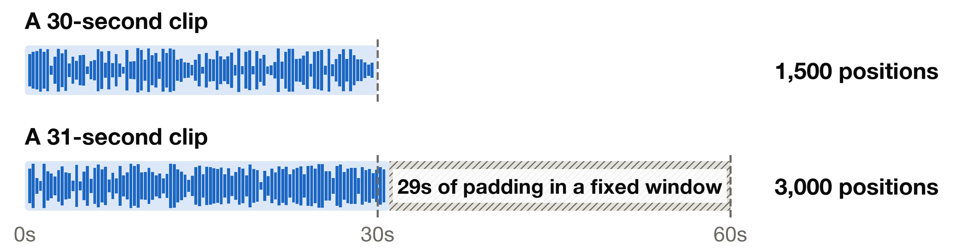
EXERCISE 2 · DEMO
EXAMPLE MODEL
Check whether your audio is padded
A Whisper-style encoder works in 30-second windows. Does your product bill for that?
33 tokens
Send the words, not the sound.
8 seconds as text: 8× fewer tokens than speech at Gemini's 32 a second (up to 45× against a padded window). Speech recognition is not priced.
Saving the Tokens · Shyamji Tiwari
window encoder: modelled · 32 tokens a second: Gemini, published

Slide 13
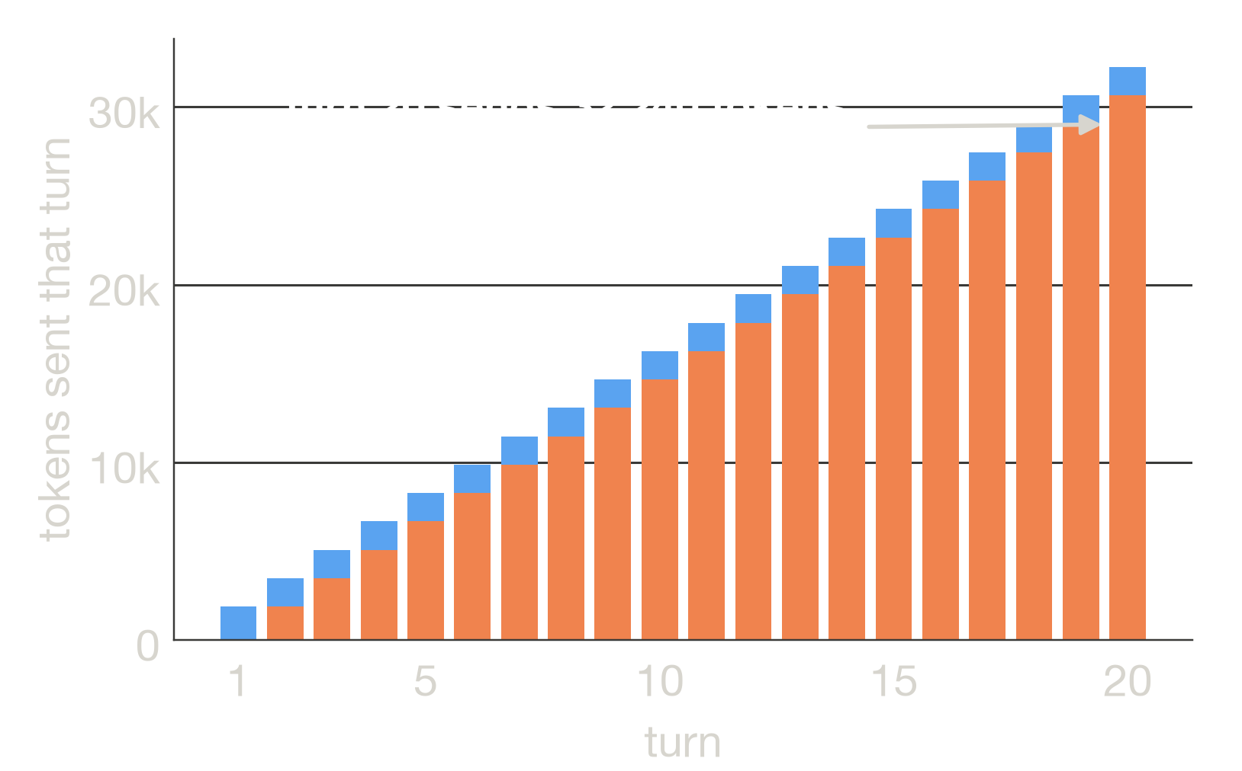
FIX IT
EXAMPLE MODEL
Every turn re-sends the whole conversation
91%
of the input tokens were sent before
(20 turns, no caching)
New content 32,240
Sent again 308,940
Input in total 341,180
Two things grow. The bill: double the turns, about 4× the tokens. And the request itself: this agent reaches the 128,000-token context window at turn 80. max_tokens only caps one reply.
Saving the Tokens · Shyamji Tiwari
input tokens only (output is priced separately)

Slide 14
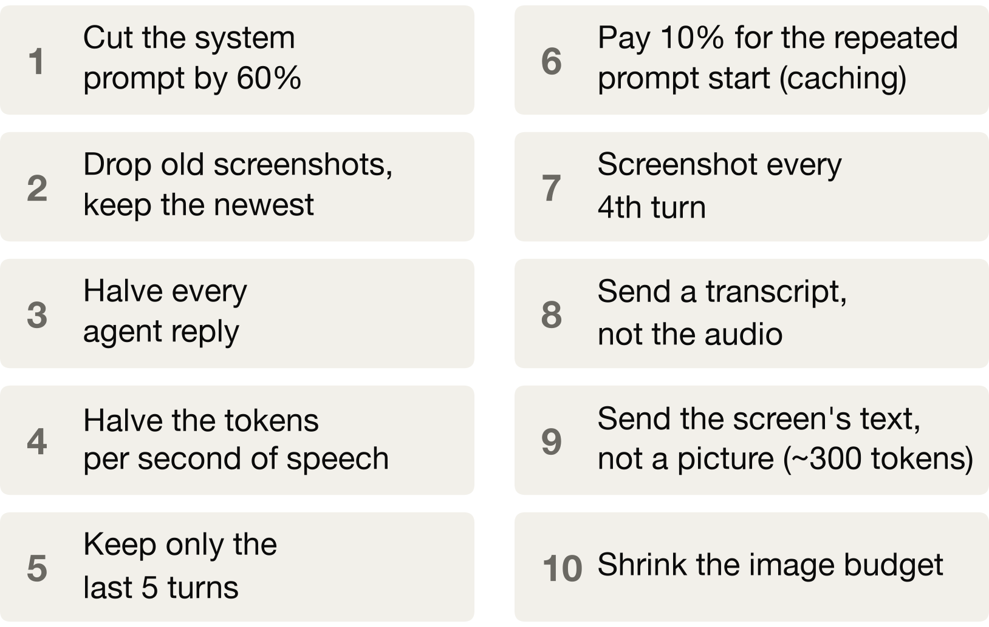
EXERCISE 3
EXAMPLE MODEL
Ten ways to cut the bill. Which wins?
For a voice agent that watches the screen, 20 turns
ON PAPER, NOW
Most?
Least?
90 seconds. Then run:
Play “Reveal”
Prefix caching: the provider remembers the start of your prompt and charges about 10% to read it again.
Saving the Tokens · Shyamji Tiwari

Slide 15
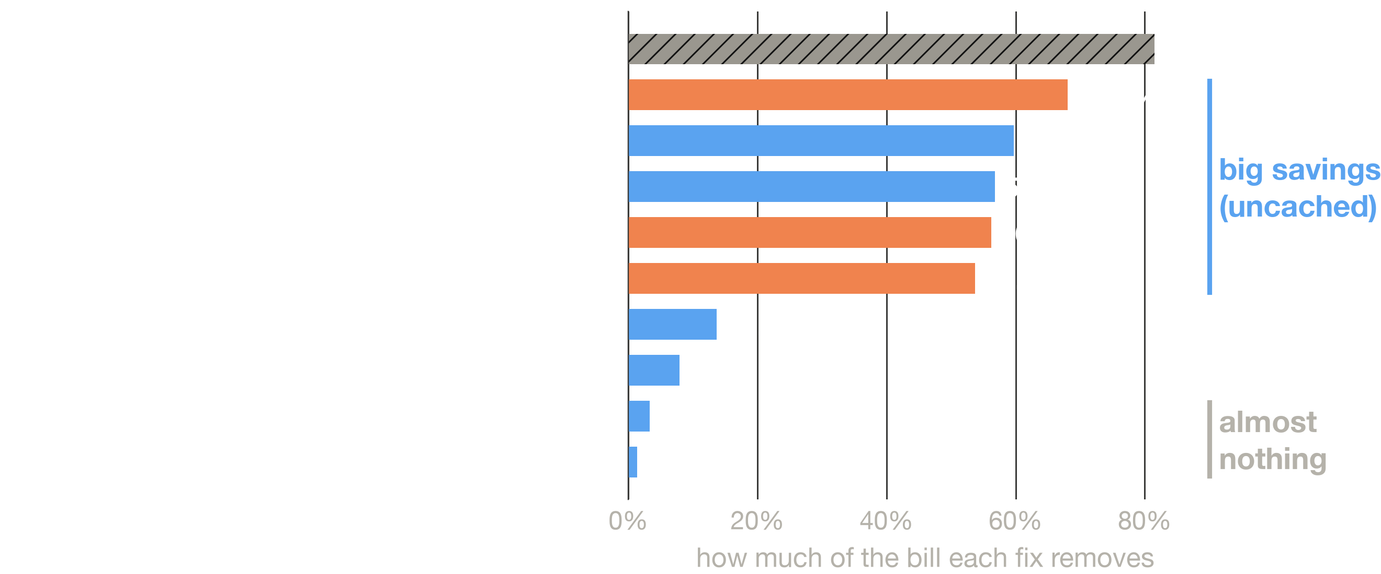
EXERCISE 3 · THE ANSWER
EXAMPLE MODEL
Ranked by what it saves, in our example agent
400-token prompt, 20 turns, uncached; ranked by tokens saved, not by what survives your task. At 4,000 tokens the prompt fix saves 12%.
Make it smaller
Send it again less
Cheaper per send (caching)
slide 18: when it changes

Slide 16
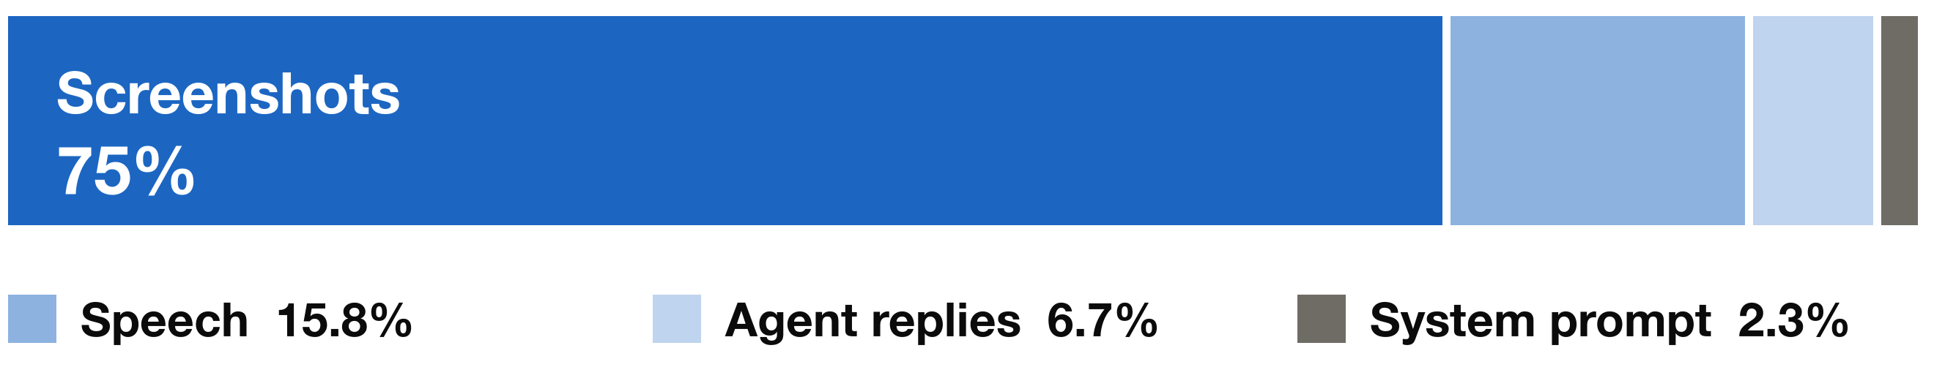
FIX IT
EXAMPLE MODEL
Your bill is a multiplication
how big each thing is × how many times you send it × what each send costs
Shrinking acts on the first, pruning (dropping old items) on the second, caching on the third.
Share of the input tokens, one 20-turn session. The ranking you just saw follows these shares.
About $1.02 a session and about $307,000 a month at 10,000 sessions a day, 30 days. Assumed $3.00 per million input tokens.
Saving the Tokens · Shyamji Tiwari
Simulated 20-turn session · illustrative settings · input tokens only

Slide 17
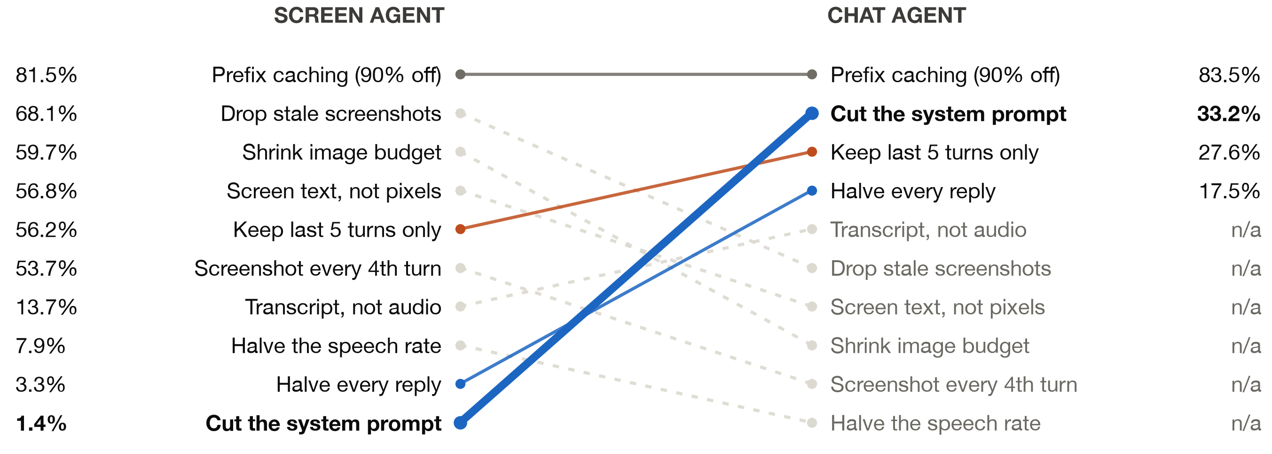
EXERCISE 3 · TWIST
EXAMPLE MODEL
No pictures: now the prompt is the big item
Chat agent bill: prompt 55%, replies 35%, messages 10%. Six of the ten fixes do not apply.
Control: the screen agent with the same 6,000-token prompt ranks the prompt fix only 6 of 9 design fixes (16%). It takes the pictures being gone, not just a long prompt.
Press Play on “Two agents side by side”
terminal: python3 ex3_budget.py --agent both
Saving the Tokens · Shyamji Tiwari
Simulated 20-turn session · illustrative settings · input tokens only

Slide 18
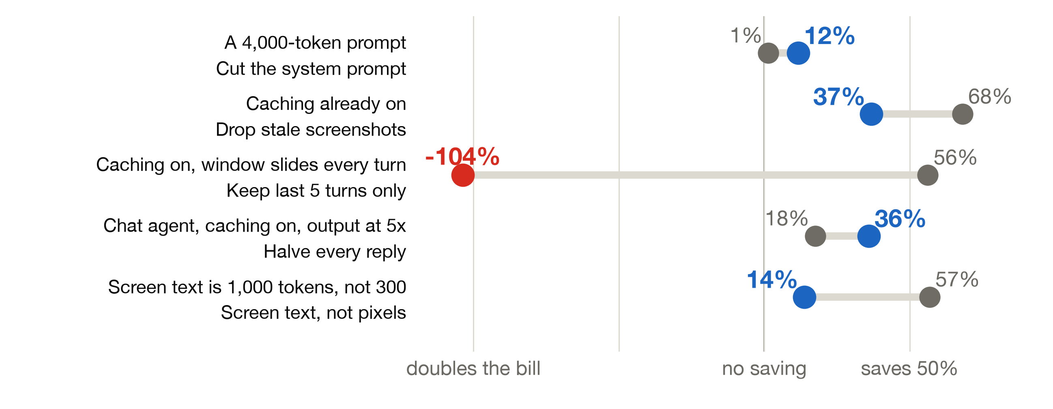
HONESTY
EXAMPLE MODEL
That ranking is not a law
Change one assumption of the agent and a fix moves a long way
Not modelled: tool results and schemas · cache write fees and expiry · output tokens in the bill · accuracy
Saving the Tokens · Shyamji Tiwari

Slide 19
TAKE THIS WITH YOU
Four things that are easy to get wrong
2.0×
turn 80
Caching + pruning is worse than caching
Caching buys money, not room
128,630 vs 63,133 tokens. Sliding the window every turn changes the start of the prompt, so the cache misses. Prune in batches.
The 128,000-token window fills at turn 80 with or without caching. Only dropping content moves it: turn 337 with old screenshots dropped.
1,105 to 4,784
1.4% to 33.2%
Resolution is a choice, not a fact
The same fix, two agents
One 4K screenshot: 1,105 on OpenAI's rule, 1,560 on Claude standard, 4,784 on Claude high-resolution. Measure at the size you ship.
Cutting the system prompt on a screen agent, then on a chat agent. The shape of your bill picks the fix.
Saving the Tokens · Shyamji Tiwari
cards 1, 2, 4: example agent · card 3: published rules, checked 2026-10-29

Slide 20

TAKE THIS WITH YOU
Four questions to ask your own agent
1
What share of my input is cache reads?
Thank you
Shyamji Tiwari
Applied Scientist, Amazon
github.com/ieee-ai/agentic-ai-26
/Saving-the-Tokens
From the usage field. Near zero means you pay full price for every repeat.
2
What changes at the start of my prompt?
A timestamp, a reordered tool list, a dropped message: it voids the cache from that point.
3
At what turn does my window fill?
Tokens per call plus growth per turn, against the window. Caching will not move it.
4
Which item is the biggest share of my bill?
Run bill_report.py on a log. Then pick the lever: size, sends, or price.
slides, notebook, scripts
Saving the Tokens · Shyamji Tiwari

